Slide 1





MassHealth Managed Care Basics for Doula Providers
Executive Office of Health & Human Services

Slide 2

Overview of MassHealth Plans
Most, but not all, pregnant and postpartum MassHealth members have one of the following MassHealth managed care plans where they can get coordinated, high-quality care from a network of primary care, behavioral health, and specialist providers:
  Accountable care organizations (ACOs)
    Accountable Care Partnership Plans
    Primary Care ACO Plans
  Managed care organizations (MCOs)
  One Care (this is for members who are dual-eligible for Medicaid and Medicare, usually due to disability status)
  Primary care clinician (PCC) plan
Members who have certain MassHealth managed care plans may have access to extra supports and services such as free infant car seats, childbirth education classes, housing and nutrition supports, and care management. Members should contact their health plan for more information.
MassHealth doula providers can serve any MassHealth member in any of these managed care plans, as well as members with fee-for-service (not managed care) coverage. MassHealth doula providers are considered “fee-for-service” providers because they are paid directly by MassHealth outside of the managed care plans.
More information about MassHealth health plans: https://www.masshealthchoices.com/

Slide 3
Full List of MassHealth Health Plan Options (as of 1/1/26)
Accountable Care Partnership Plans (ACPP)
Fallon Health - Atrius Health Care Collaborative
Berkshire Fallon Health Collaborative
Fallon 365 Care
BeHealthy Partnership Plan
WellSense Beth Israel Lahey Health (BILH) Performance Network ACO
WellSense Community Alliance
WellSense Boston Children's ACO
East Boston Neighborhood health WellSense Alliance
WellSense Mercy Alliance
WellSense Signature Alliance
WellSense Southcoast Alliance
WellSense Care Alliance
Mass General Brigham Health Plan with Mass General Brigham ACO
Tufts Health Together with Cambridge Health Alliance (CHA)
Tufts Health Together with UMass Memorial Health
One Care Plans
Commonwealth Care Alliance One Care
Tufts Health One Care
UnitedHealthcare Connected
Mass General Brigham One Care
Molina One Care
Managed Care Organizations (MCO)
WellSense Essential MCO
Primary Care ACO Plans (PCACO)
Community Care Cooperative (C3)
Revere Health Choice
Primary Care Clinician PCC Plan

Slide 4

ACO, MCO and PCC Plan: Care Coordination
Accountable care organizations (ACOs) and managed care organizations (MCOs) provide baseline care coordination supports for all members. Baseline care coordination supports include but are not limited to:
  Assigning members to a Primary Care Provider, if a member has not already selected one
  Ensuring members are screened for physical health, behavioral health, Long-Term Services and Supports (LTSS) needs, and Health-Related Social Needs
  Ensuring members receive appropriate services and referrals to address their care needs
  Ensuring the providers follow-up on tests, treatments, and services in a systematic and timely manner
  Coordinating with service providers, community services organizations, and state agencies to improve integration of enrollee’s care
Members in the primary care clinician (PCC) plan often get care coordination services through their primary heath care provider. High-risk members may also be eligible for care management services.

Slide 5
ACOs/MCOs: Enhanced Care Coordination
A member’s ACO or MCO may be able to connect certain enrollees such as high-risk perinatal members with enhanced care coordination services, including:
ACO/MCO Care Management
  ACO/MCO Care Management programs provide personalized support to members through coordinated services and resources including: comprehensive assessments and care plans, supporting transitions of care, coordinating with other state agencies, and coordinating support to address health-related social needs

Slide 6
ACOs: Health-Related Social Needs
A member’s ACO may be able to connect high-risk perinatal members with services that address health-related social needs such as housing and nutrition supports, including:
Health-Related Social Needs (HRSN)
  Health-Related Social Needs (HRSN) Services: MassHealth members enrolled in ACOs may be able to get help with food and housing needs through MassHealth Health Related Social Needs (HRSN) Services. Each ACO offers two or more of the HRSN Services listed in the materials linked. Members are encouraged to reach out to their ACO directly to learn more about what HRSN Services their ACO offers and if they are available to the member.
More information about MassHealth HRSN can be found here:
https://www.mass.gov/info-details/masshealth-members-who-need-assistance-with-food-or-housing

Slide 7
One Care: Overview
Some pregnant and postpartum members with a disability may be in an integrated care plan called One Care.
One Care is a comprehensive health plan for individuals ages 21-64 at the time of enrollment who are dually eligible for both MassHealth and Medicare. All members receive comprehensive whole person-centered care coordination that promotes the individual’s goals and needs, including the following: comprehensive assessments and individualized care plans, supporting transitions of care, coordinating with other state agencies, and coordinating support to address social determinants of health needs.
Members are eligible for:
  Comprehensive Care Coordination
  Medicare: All Part A, Part B, and Part D
  MassHealth State Plan Services, which includes LTSS
  Behavioral Health Diversionary Services
  Additional Community-based Services
  Independent LTSS care coordination support from a Long Term Supports Coordinator (LTS-C)
Members are not eligible for:
  HRSN Services (as they may already be included within the One Care plan)
  For more information about One Care plans, visit: https://www.mass.gov/info-details/one-care-plans

Slide 8
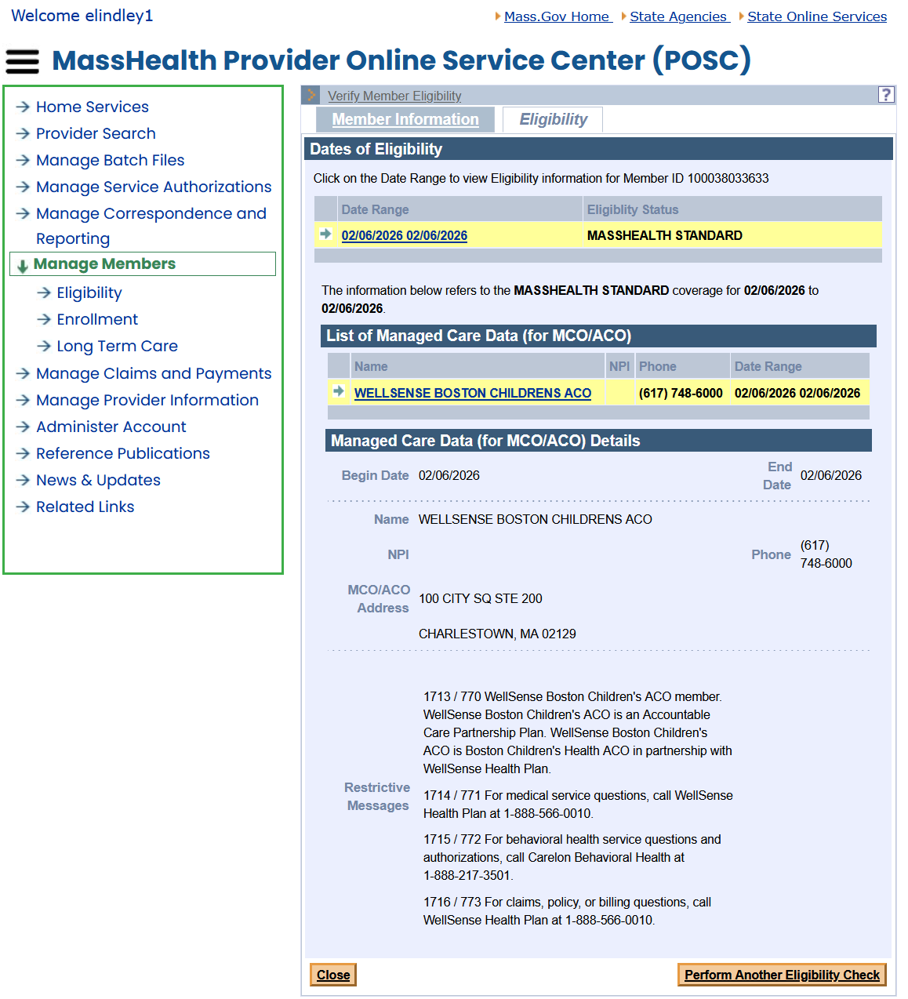
Managed Care Data in the Eligibility Verification System (EVS)
The List of Managed Care Data panel indicates if the member is enrolled in an MCO, ACO, ICO (One Care), or PCC plan
Select the name listed to display the Managed Care Data panel
The Managed Care Data panel provides the contact information, DBA address, telephone number for the Health Plan (if MCO or ACO) or the site (if PCC)

Slide 9
Importance of Managed Care Plans & Care Coordination
MassHealth values the important role doulas play in supporting members during pregnancy, labor and delivery, and the postpartum period. However, we recognize that members may have complex needs that go beyond what doula services can address.
Care coordination among providers helps ensure that members receive an appropriate spectrum of care. We encourage you to engage with MassHealth managed care plans to help connect members with the appropriate resources and services.
  MassHealth has shared with enrolled MassHealth doulas a list of contacts for each managed care plan and will send any updates to those contacts via email.
Managed care plans have access to information about members enrolled in their plan who have received doula support from a MassHealth doula provider, including member information, services received, and the first and last name of the rendering doula provider.
  To support care coordination, plan representatives may contact you based on the information available in the MassHealth Provider Directory.
  By collaborating with these plans, you can help ensure members are connected with appropriate supports for their needs.

Slide 10
Helpful Resources
Full list of MassHealth ACOs and MCOs
One Care Plans
MassHealth Choices
MassHealth Doula Resource Guide
Providers caring for pregnant and postpartum MassHealth members | Mass.gov
Questions? Please contact the MassHealth Provider Team:
Phone: (800) 841-2900
Email: provider@masshealthquestions.com

