Slide 1
MassHealth Member Webinar: Upcoming Federal Changes
FOR DISCUSSION ONLY. SUBJECT TO CHANGE BASED ON CMS GUIDANCE AND FURTHER ANALYSIS
Executive Office of Health and Human Services
April 2026

Slide 2
Today We Will Discuss:
FOR DISCUSSION ONLY. SUBJECT TO CHANGE BASED ON CMS GUIDANCE AND FURTHER ANALYSIS
1
Changes coming to MassHealth
2
More Information About Work and Education Requirements
3
How You Can Prepare
4
Frequently Asked Questions
5
Wrap-Up and Discussion

Slide 3
Changes Coming to MassHealth

Slide 4
Background
FOR DISCUSSION ONLY. SUBJECT TO CHANGE BASED ON CMS GUIDANCE AND FURTHER ANALYSIS
What is the One Big Beautiful Bill Act?
In July 2025, the One Big Beautiful Bill Act (known as OB3, OBBBA, or H.R.1) was signed into law.
This law includes major changes to Medicaid (which, in Massachusetts, is MassHealth).
OB3 also made large changes to Health Connector coverage, SNAP, Medicare, and more.
MassHealth is legally required to follow federal law. We have to implement changes from OB3.
When do the new rules begin?
The new rules do not happen right away.
The biggest changes affecting MassHealth members don’t start until Fall 2026.
How will MassHealth members be affected?
The new federal rules will only affect certain members. Some members will not see any changes. The largest changes will be for some adults ages 19 to 64 and certain immigrants.
MassHealth still needs more information from the federal government. Until we get this information, we will have answers to some questions. We expect to get this information this summer.
We will keep members updated. We will begin communicating with affected members this summer.

Slide 5
MassHealth’s Priorities
FOR DISCUSSION ONLY. SUBJECT TO CHANGE BASED ON CMS GUIDANCE AND FURTHER ANALYSIS
Making sure eligible members keep their health coverage
We are working to keep as many members covered as possible, using data we already have, clear and simple communication, and community partnerships.
Working closely with partners in your community
We are meeting with partners – including health plans, doctors, and community groups – to reach members like you. We will work together to help you understand the changes and how to prepare.
Supporting our members and…
Following federal laws and rules
MassHealth must follow federal law, including OB3. However, there are many open questions. We will get answers over the summer, when the federal government gives us more information.

Slide 6
What Are the Biggest Changes from OB3?
FOR DISCUSSION ONLY. SUBJECT TO CHANGE BASED ON CMS GUIDANCE AND FURTHER ANALYSIS
October 2026
Coverage Changes for Certain Immigrants
January 2027
“Retroactive Coverage” is Shortened
Shortened to 1 month for some adults; 2 months for everyone else
Future Changes to MassHealth
Because of OB3
January 2027
Renewals Every 6 Months
For some adults, age 19 to 64
January 2027
Work and Education Requirements
For some adults, age 19 to 64 (with several exemptions)
October
2028
Cost Sharing
For some adults, age 19 to 64, with income above 100% FPL
Note: These are not the only changes happening because of OB3, but they are the biggest changes affecting members.​

Slide 7
Coverage Changes for Certain Immigrants
FOR DISCUSSION ONLY. SUBJECT TO CHANGE BASED ON CMS GUIDANCE AND FURTHER ANALYSIS
When does this happen? | October 1, 2026
Who do we think is affected, based on current information? | This affects some members who the federal government says are “Qualified Alien Immigrants” today. This includes about 2,500 members who are: Refugees Asylees Parolees Certain victims of abuse and trafficking
What is the change? | These members may lose MassHealth Standard because the federal government will stop paying for part of their care. For the ~2,500 members who are affected: Adults age 65 or older will move to MassHealth Family Assistance* Disabled adults ages 19 through 64 will move to MassHealth Family Assistance* Adults who are not disabled, ages 19 through 64 will move to emergency coverage (MassHealth Limited and Health Safety Net) Children, pregnant members and members who are postpartum will continue to get full coverage through MassHealth Standard.
*Family Assistance does not cover Long Term Services and Supports (such as nursing home care) or non-emergency medical transportation

Slide 8
Retroactive Coverage is Shortened
4
FOR DISCUSSION ONLY. SUBJECT TO CHANGE BASED ON CMS GUIDANCE AND FURTHER ANALYSIS
When does this happen? | January 1, 2027
Who do we think is affected, based on current information? | All members
What is the change? | Today, members can qualify for up to three months of “retroactive coverage.” Retroactive coverage is when MassHealth starts your benefits before the date you applied and were found eligible. Members can get retroactive coverage if they were eligible during that time and had qualifying medical expenses. Starting in January 2027, retroactive coverage will be shortened to: One month for most non-disabled adults, ages 19 to 64, with no children Two months for everyone else

Slide 9
Renewals Every 6 Months
FOR DISCUSSION ONLY. SUBJECT TO CHANGE BASED ON CMS GUIDANCE AND FURTHER ANALYSIS
When does this happen? | January 1, 2027
Who do we think is affected, based on current information? | Adults who are not disabled, ages 19 to 64, who are: Not Pregnant or postpartum (that is, you've been pregnant in the last 12 months, no matter how the pregnancy ended); Not the parent or caretaker of a child or disabled adult; and Not a member of a Federally Recognized Tribe.
What is the change? | These members will need to renew their MassHealth eligibility every six months. Currently, members only need to renew their eligibility once a year.

Slide 10
Work and Education Requirements
FOR DISCUSSION ONLY. SUBJECT TO CHANGE BASED ON CMS GUIDANCE AND FURTHER ANALYSIS
When does this happen? | January 1, 2027
Who do we think is affected, based on current information? | Certain adults who are not disabled, ages 19 to 64. However, members do not have to meet this requirement if: Pregnant or postpartum (that is, you've been pregnant in the last 12 months, no matter how the pregnancy ended); They are a parent, guardian or caretaker of a child under age 14 or someone with a disability; They have a “serious or complex” medical condition; They have a substance use disorder; or They are meeting work requirements through TAFDC (cash benefits), or subject to work requirements through SNAP (food stamps).
What is the change? | Affected members will need to do one of the following activities to keep their MassHealth coverage: Work or volunteer 80 or more hours per month; Participate in a work program for 80 or more hours per month; Be enrolled in an educational program at least half-time; Do a combination of the above activities for 80 or more hours per month; or Earn at least $580 per month

Slide 11
More Information About Work and Education Requirements

Slide 12
If I’m Subject to Work and Education Requirements, What Will Happen?
FOR DISCUSSION ONLY. SUBJECT TO CHANGE BASED ON CMS GUIDANCE AND FURTHER ANALYSIS
Step 1
At your renewal, we will check if you are exempt from work and education requirements.
Based on the information we already have, we will automatically check to see:
  If you are under age 19, or age 65+
  If you have a disability
  If you are the parent / guardian of a child under age 14
  If you are pregnant or postpartum
  If you meet another exemption
If we can confirm that you meet one of these situations, you will be exempt. If you are exempt, it means you don’t need to meet work and education requirements.
If we can confirm you are exempt:
X
If we can’t confirm you are exempt:
  You will not need to do anything to meet work and education requirements. You do still need to reply to your renewal.
  Continue to Step 2 

Slide 13
If I’m Subject to Work and Education Requirements, What Will Happen?
FOR DISCUSSION ONLY. SUBJECT TO CHANGE BASED ON CMS GUIDANCE AND FURTHER ANALYSIS
Step 2
We will check to see if you are meeting work and education requirements.
If we can’t confirm you are exempt, we will check our system to see:
  If your income is at least $580 per month
  If you are working at least 80 hours per month
If we can confirm you meet work and education requirements:
X
If we can’t confirm you meet work and education requirements:
  You will not need to do anything else to prove you meet work and education requirements. You do still need to reply to your renewal.
  Continue to Step 3 

Slide 14
If I’m Subject to Work and Education Requirements, What Will Happen?
FOR DISCUSSION ONLY. SUBJECT TO CHANGE BASED ON CMS GUIDANCE AND FURTHER ANALYSIS
Step 3
We will send you a notice in the mail.
If you receive a notice, you will have 30 days to reply. You must prove that:
  You are exempt from work and education requirements;
  OR
  You are meeting work and education requirements
If you prove that you are exempt or are meeting work and education requirements, MassHealth will process your renewal. We will send you a new notice to tell what coverage you qualify for.
If you don’t reply or don’t meet the rules, you may lose your coverage.
If we can confirm you are exempt or meet work and education requirements:
X
If we can’t confirm you are exempt or meet work and education requirements:
  You are done. MassHealth will process your renewal and tell you if you are eligible for coverage.
  You may lose your coverage.

Slide 15

STEPS
FOR DISCUSSION ONLY. SUBJECT TO CHANGE BASED ON CMS GUIDANCE AND FURTHER ANALYSIS
Scenario 1: A Mother of a Young Child Applies for MassHealth
1
I apply for MassHealth online. In my application, I say that I have a child who is 5 years old.
MassHealth Action: MassHealth reviews my application:
Since I said I have a dependent child (under 14 years old) on the application, I am exempt from work and education requirements.
I am otherwise eligible for MassHealth.
2
I receive a notice confirming I am now on MassHealth.
LIFE STAGE | Adult
AGE | 25
HOUSEHOLD | Single 1 Child (5 y/o) Not Disabled
INCOME | $370 per Month
EMPLOYMENT | Works 40 Hours per Month
ACTION | New Application

Slide 16

FOR DISCUSSION ONLY. SUBJECT TO CHANGE BASED ON CMS GUIDANCE AND FURTHER ANALYSIS
Scenario 2: A Student Renews their MassHealth Coverage
STEPS
1
I receive my MassHealth renewal form in a blue envelope.
I report that I am a student enrolled in a higher education program.
2
I complete my renewal online.
MassHealth Action: MassHealth reviews my renewal form:
I report that I am a full-time student, but do not provide any related documentation.
I am otherwise eligible for MassHealth.
LIFE STAGE | Student
AGE | 22
HOUSEHOLD | Single No Children Not Disabled
INCOME | $0 per Month
EMPLOYMENT | Full-Time Student
ACTION | Renewal
I receive a “request for information” for work and education requirements from MassHealth. This means I need to respond with the required documentation within 30 days.
I send MassHealth documentation of my enrollment in full-time higher education.
3
MassHealth Action: MassHealth reviews my response:
Since my enrollment in higher education has been confirmed, I meet work and education requirements.
4
I receive a notice confirming my MassHealth coverage is renewed.

Slide 17

FOR DISCUSSION ONLY. SUBJECT TO CHANGE BASED ON CMS GUIDANCE AND FURTHER ANALYSIS
Scenario 3: A Working Adult Renews their MassHealth Coverage
STEPS
1
I receive my MassHealth renewal form in a blue envelope.
2
I complete my renewal online. I report that I do 38 hours of work and volunteering per month.
MassHealth Action: MassHealth reviews my renewal form:
I am otherwise eligible for MassHealth.
As I do not report any information that makes me exempt, I am not exempt from work and education requirements.
As my income is below $580 and I did not report work activity, I am not meeting work and education requirements.
LIFE STAGE | Adult
AGE | 50
HOUSEHOLD | Single No Children Not Disabled
INCOME | $293 per Month
EMPLOYMENT | (1) Works 18h per Month; (2) volunteers for 20h per Month
ACTION | Renewal
MassHealth determines I am no longer eligible for MassHealth, since I am not meeting work and education requirement rules.
3
I receive a notice confirming my coverage is ending. I have the right to appeal, if I disagree with MassHealth’s decision.

Slide 18

FOR DISCUSSION ONLY. SUBJECT TO CHANGE BASED ON CMS GUIDANCE AND FURTHER ANALYSIS
Scenario 4: An Adult With a New Disability Renews Their MassHealth Coverage
STEPS
1
I receive my MassHealth renewal form in a blue envelope.
2
I complete my renewal online.
MassHealth Action: MassHealth reviews my renewal form:
I report a new disability that makes me exempt, which must be verified before exemption can be granted.
I am otherwise eligible for MassHealth.
LIFE STAGE | Adult
AGE | 30
HOUSEHOLD | Single No Children Newly Disabled
INCOME | $250 per Month
EMPLOYMENT | Works 25 Hours per Month
ACTION | Renewal
3
I receive a “request for information” for disability verification from MassHealth.
I send MassHealth documentation of my disability.
MassHealth Action: MassHealth reviews my response:
Since my disability has been confirmed, I am exempt from work and education requirements.
4
I receive a notice confirming my MassHealth coverage is renewed.

Slide 19
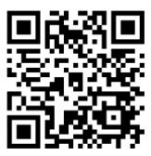
How Will I Know if I Am Affected by Work and Education Requirements?
FOR DISCUSSION ONLY. SUBJECT TO CHANGE BASED ON CMS GUIDANCE AND FURTHER ANALYSIS
MassHealth is working hard to make sure all members understand the upcoming changes.
If we think you are affected by work and education requirements, MassHealth will reach out to you this Summer.
We will send you a notice in the mail. We will also send you a text, an email, and a phone call. ​
We are working with organizations in your community to help share information.
This includes doctors, community groups, churches, health plans, and other partners across the state.
We have a website where members can learn more about federal changes.
We will also post information to social media and other locations, so you hear about updates and know to look for important notices.
Visit MassHealth’s OB3 member website for more information:
Mass.gov/MassHealthMemberChanges

Slide 20
How You Can Prepare

Slide 21
What Do I Need to Do? How Can I Prepare?
MassHealth members should take these actions to keep getting the best coverage available:
Make sure we have your current information.
Tell us if you move, get a new number, are pregnant, or have another change that could affect your coverage.
Continue to get care, refill prescriptions, and go to your appointments.
You will hear directly from MassHealth before anything changes about your coverage.
Always read and reply to letters or messages from MassHealth.
Create a MyServices account to see eligibility notices, and be on the lookout for more information this Summer.
If you have questions or need help, contact us!
Call us at (800) 841-2900, TDD/TTY: 711, visit a MassHealth Enrollment Center, or find an assister near you.

Slide 22
How to Report a Change to MassHealth
Report a Change Online
Option 1
Go to MAHealthConnector.org
Members 64 years old and younger can make changes to their MassHealth account online using mahealthconnector.org
Option 2
Use Adobe Sign
Fill out the MassHealth Report a Change Form
and submit directly online using the free Adobe Sign tool
IMPORTANT: make sure MassHealth has your current information! This includes your current phone number, address, email, pregnancy status, household size, and disability status. If we can’t reach you, you could miss notices and lose your coverage. Use this link to learn more about reporting a change.
Notes:
JARRED
members that indicate on the application or when they talk to us that they are homeless, have to include a residential or mailing address on their file. Folks may want to encourage the members that they work with that are experiencing homelessness to put an address where they can consistently get mail such as a friend, family member, case manager, etc.

Slide 23
How to Report a Change to MassHealth (continued)
Report a Change via Mail, Fax, or In-Person
Option 3
Walk into a MEC
Walk into one of our seven MassHealth Enrollment Centers located across the Commonwealth.
Open Monday-Friday,
8:45am-5pm
Option 4
Mail an Update
To report a change by mail, print out the form at MassHealth Member forms and mail it to:
Commonwealth of Massachusetts
Health Insurance Processing Center
PO Box 4405
Taunton, MA 02780
Option 5
Call Us or Send a Fax
To report a change by phone, call us at (800) 841-2900 (TTY: 711), or send a fax to 857-323-8300.
If sending a fax, be sure to include the name of the head of household (HOH), the HOH’s date of birth, the HOH’s MassHealth ID, and a description of the change(s).
IMPORTANT: make sure MassHealth has your current information! This includes your current phone number, address, email, pregnancy status, household size, disability status, etc. If we can’t reach you, you could miss notices and lose your coverage. Use this link to learn more about reporting a change.
Notes:
JARRED
members that indicate on the application or when they talk to us that they are homeless, have to include a residential or mailing address on their file. Folks may want to encourage the members that they work with that are experiencing homelessness to put an address where they can consistently get mail such as a friend, family member, case manager, etc.

Slide 24

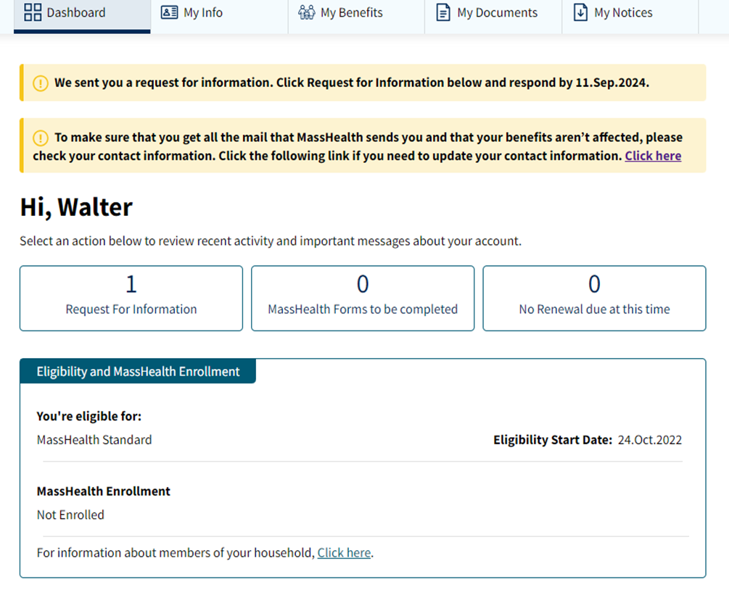
Sign up for MyServices
MyServices is MassHealth’s easy-to-use mobile app and website for all members. Visit MyServices.mass.gov to sign up!
In MyServices, members can:
  See copies of eligibility notices and get alerts about important events and actions they need to take
  See their current benefit from MassHealth or the Massachusetts Health Connector
  See their current health plan enrollment, including the name of their health plan and the date their plan started
  Review the contact information MassHealth has on file (such as name, address, and phone number)
  Check the status of Requests for Information (RFIs), including whether any response they submitted has been processed
  View and print a copy of their MassHealth ID card
MyServices helps members see important information, like copies of notices and information about their coverage.
Sign up at MyServices.mass.gov
Notes:
JARRED Note that in Myservices, members can see their coverage type and their next renewal date

Slide 25
Wrap-Up and Discussion

Slide 26
What to Remember About Today’s Presentation
FOR DISCUSSION ONLY. SUBJECT TO CHANGE BASED ON CMS GUIDANCE AND FURTHER ANALYSIS
1
  Federal law is requiring MassHealth to change some of its rules.
  These changes are not happening right away, and they are not all starting at the same time. The first changes start in October 2026.
2
3
  The changes only affect certain people. They mostly affect non-disabled adults age 19-64, who are not pregnant and not parents/caretakers of young kids.
4
  MassHealth will contact you this summer if we think you are affected by work and education requirements.
5
  Update your contact information today! If MassHealth doesn’t have your current address, you could miss important mail and lose your coverage.
6
  Visit Mass.gov/MassHealthMemberChanges to learn more about OB3 and stay up-to-date.

