Slide 1
MassHealth Payment Policy Advisory Board and Medical Care Advisory Committee
Executive Office of Health & Human Services
December 11, 2017
Phase I Provider Deck –Version 11/8/2017 (F)

Slide 2
Agenda
Overview of MassHealth Payment and Care Delivery Innovation (PCDI)
MassHealth Plan Options for 2018
Member Enrollment and Assignment
Provider Information and Training
Community Partners
Objectives
Overview of Community Partners
Behavioral Health Community Partners
LTSS Community Partners
ACO/MCO – CP Relationships
Contracted Community Partners

Slide 3
MassHealth Payment and Care Delivery Innovation (PCDI)
The Executive Office of Health and Human Services (EOHHS) is committed to a sustainable, robust MassHealth program for its 1.8 million members
EOHHS is making changes to MassHealth for managed care-eligible members – introducing ACOs and Community Partners (CPs) to emphasize care coordination and member-centric care
ACOs have groups of primary care providers (PCPs) and other providers who work together to improve member care coordination and better meet overall health care needs
Community Partners (CPs) are community-based experts who will provide care coordination services to and connect members with available behavioral health and LTSS services. CPs will be available to certain members with high needs as determined by MassHealth or the ACO/MCO. Providers make referrals for consideration.
Phase I Provider Deck –Version 11/8/2017
Notes:
ACOs:
Have an enhanced role for primary care,
Are rewarded for value – better cost and outcomes – not volume
Have a major and unique focus on better integrating our members’ physical, behavioral health (BH), and long term services and supports (LTSS) needs, as well as building linkages to social services

Slide 4
Agenda
Overview of MassHealth Payment and Care Delivery Innovation (PCDI)
MassHealth Plan Options for 2018
Member Enrollment and Assignment
Provider Information and Training
Community Partners
Objectives
Overview of Community Partners
Behavioral Health Community Partners
LTSS Community Partners
ACO/MCO – CP Relationships
Contracted Community Partners

Slide 5
MassHealth Health Plan Options for 2018
Accountable Care Partnership Plans (Model A) | Accountable Care Partnership Plans Collaborations
Be Healthy Partnership | Baystate Health Care Alliance with Health New England
Berkshire Fallon Health Collaborative | Health Collaborative of the Berkshires with Fallon Community Health Plan
BMC HealthNet Plan Signature Alliance | Signature Healthcare Corporation with Boston Medical Center HealthNet Plan
BMC HealthNet Plan Community Alliance | Boston Accountable Care Organization with Boston Medical Center HealthNet Plan
BMC HealthNet Plan Mercy Alliance | Mercy Health Accountable Care Organization with Boston Medical Center HealthNet Plan
BMC HealthNet Plan Southcoast Alliance | Southcoast Health Network with Boston Medical Center HealthNet Plan
Fallon 365 Care | Reliant Medical Group with Fallon Community Health Plan
My Care Family | Merrimack Valley ACO with Neighborhood Health Plan
Tufts Health Together with Atrius Health | Atrius Health with Tufts Health Public Plans
Tufts Health Together with BIDCO | Beth Israel Deaconess Care Organization with Tufts Health Public Plans
Tufts Health Together with Boston Children's ACO | Children’s Hospital Integrated Care Organization with Tufts Health Public Plans
Tufts Health Together with CHA | Cambridge Health Alliance with Tufts Health Public Plans
Wellforce Care Plan | Wellforce with Fallon Community Health Plan
Primary Care ACO Plans (Model B)
Community Care Cooperative (C3)
Partners HealthCare Choice
Steward Health Choice
MCOs
Boston Medical Center Health Plan (BMCHP)
Tufts Public Plans (Tufts)
MCO-Administered ACO (Model C)
Lahey Clinical Performance Network (Participating with Boston Medical Center HealthNet Plan and Tufts Health Public Plans)
PCC Plan
Primary care Providers in the PCC Plan network
Phase I Provider Deck –Version 11/8/2017

Slide 6
Defining Health Plan Options for 2018
Types of ACOs
Accountable Care Partnership Plans (Model A): A network of PCPs who have exclusively partnered with a single MCO to use the MCO’s provider network to provide integrated and coordinated care for members.
Primary Care ACOs (Model B): A network of PCPs who contract directly with MassHealth, using MassHealth’s provider network, to provide integrated and coordinated care for members. Members who enroll in a Primary Care ACO receive behavioral health services through the Massachusetts Health Behavioral Partnership (MBHP).
MCO-Administered ACOs (Model C): A network of PCPs who may contract with one or multiple MCOs, and use the MCO provider networks to provide integrated and coordinated care for members. MCO-Administered ACOs are not presented as an enrollment option for members because they will be attributed through their relevant MCO.
Phase I Provider Deck – Version 11/8/2017

Slide 7
Defining Health Plan Options for 2018
MCOs
MCOs are health plans run by insurance companies that provide care through their own provider network that includes PCPs, specialists, behavioral health providers, and hospitals. Care coordinators are employed by the MCO
Primary Care Clinician (PCC) Plan
The Primary Care Clinician (PCC) Plan is statewide plan run by MassHealth that uses the MassHealth provider network. Behavioral health services for the PCC Plan are provided by Massachusetts Behavioral Health Partnership (MBHP). Members must choose a PCC in order to enroll in a PCC Plan.
Phase I Provider Deck – Version 11/8/2017

Slide 8
Agenda
Overview of MassHealth Payment and Care Delivery Innovation (PCDI)
MassHealth Plan Options for 2018
Member Enrollment and Assignment
Provider Information and Training
Community Partners
Objectives
Overview of Community Partners
Behavioral Health Community Partners
LTSS Community Partners
ACO/MCO – CP Relationships
Contracted Community Partners

Slide 9
Important Member-Choice Dates
Below are important dates for current managed care eligible members.
For new managed care eligible members, after March 1, 2018 plan selection is the first 90 days after enrollment in an ACO/MCO, and fixed enrollment is for the remaining 275 days of the year.
All members have a new plan selection period every year.
Members can choose and enroll in a new health plan for March 1, 2018.
Plan Selection Period. Members can change health plans for any reason.
11/13/17
12/22/17
3/1/18
6/1/18
Start of Plan Selection Period
Start of Fixed Enrollment Period
Members receive letters
Members will follow their PCP into a new ACO will enroll in a new health plan.
Members enrolled in an ACO or MCO can only change their health plans for certain reasons.
Phase I Provider Deck – Version 11/8/2017

Slide 10
Member Notices Overview
Notice # | Letter ID: | PCP Movement | Member Movement (From → To) | Special Assignment | Logic | Message
#1 | MassHealth A (green) | PCP joins Model A | PCC Plan → Model A Pilot → Model A MCO → Model A | Special Assignment 1 | Member follows PCP to Model A | Your current PCP has joined a Partnership Plan ACO. You will be enrolled in this ACO and continue receiving care from your PCP. Please contact MassHealth if you would like to make a different choice.
#2 | MassHealth B (green) | PCP joins Model B | PCC Plan → Model B Pilot → Model B MCO → Model B | Special Assignment 2 | Member follows PCP to Model B | Your current PCP has joined a Primary Care ACO. You will be enrolled in this ACO and continue receiving care from your PCP. Please contact MassHealth if you would like to make a different choice.
#3 | MassHealth C (green) | PCP joins Model C (in an MCO) | PCC Plan → MCO Pilot → MCO MCO Leaves → MCO | Special Assignment 3 | Member is enrolled in an MCO, and MCO is informed of PCP affiliation | Your current PCP has joined an MCO. You will be enrolled in this MCO and continue receiving care from your PCP. Please contact MassHealth if you would like to make a different choice.
#4 | MassHealth AE (green) | MCO is no longer available & PCP does not join an ACO | MCO → Auto-assignment | Auto-Assignment | Use auto-assignment algorithm to place member | Your MCO is leaving MassHealth or has left your service area. You will automatically be enrolled in a new health plan beginning on 3/1. Please contact MassHealth if you would like to make a different choice.
#5 | MassHealth PSP (green) | Other PCP movements | Member stays in current enrollment | No Enrollment Change | Member is assigned a new PCP if needed | Your Plan Selection Period is beginning on 3/1. New plan options are available. Please contact MassHealth if you would like to change plans.
Phase I Provider Deck – Version 11/8/2017

Slide 11
Member Experience: Notices
Example:
The member’s current PCP has joined a Partnership Plan ACO.
The member will be enrolled in a Partnership Plan ACO and continue receiving care from their PCP.
Phase I Provider Deck – Version 11/8/2017
Notes:
TP: side by side visual of the notices, looks are similar for those going into ACOs

Slide 12
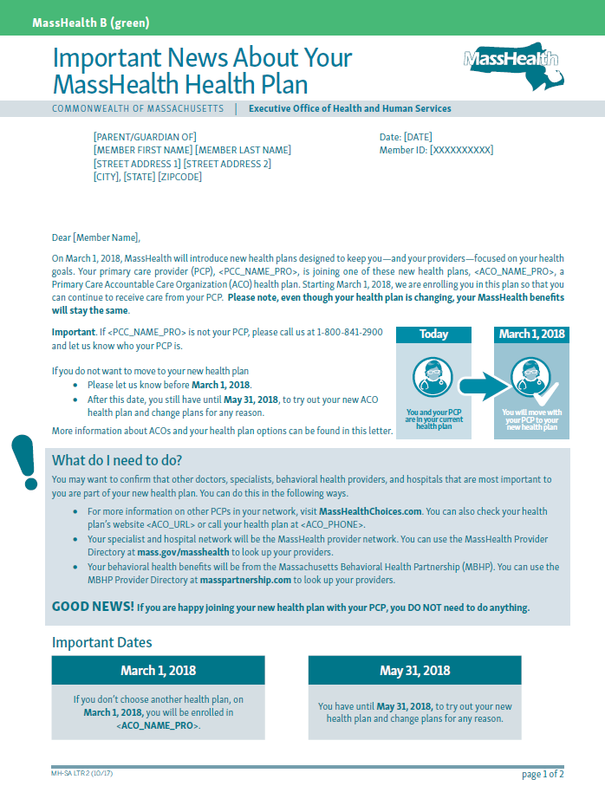
Member Experience: Notices
Example:
The member’s current PCP has joined a Primary Care ACO.
The member will be enrolled in a Primary Care ACO and continue receiving care from their PCP.
Phase I Provider Deck – Version 11/8/2017

Slide 13
Member Experience: Notices
Example:
The member’s current PCP has joined an MCO.
The member will be enrolled in the MCO the PCP has joined and continue receiving care from their PCP.
Phase I Provider Deck – Version 11/8/2017

Slide 14
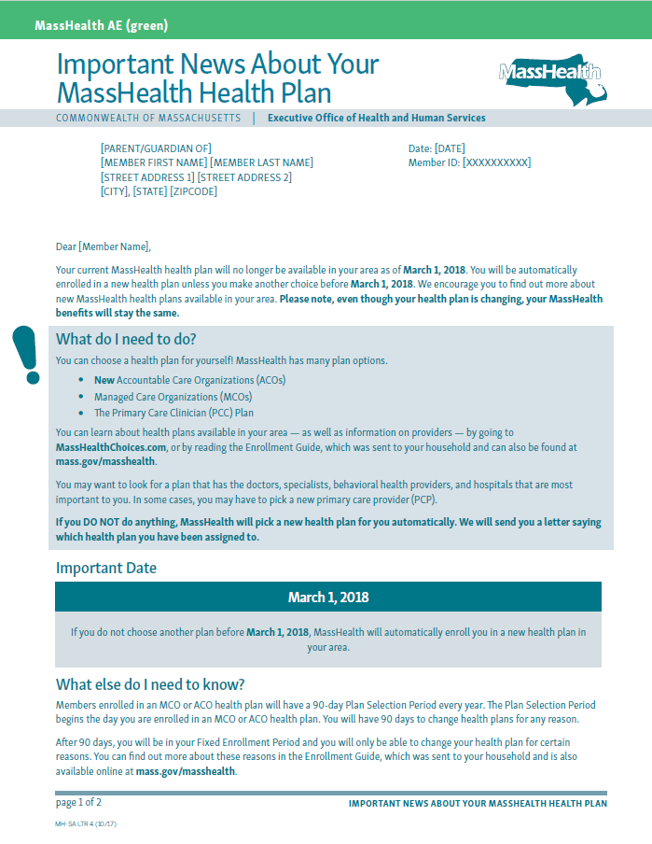
Member Experience: Notices
Example:
The member’s MCO is leaving MassHealth or has left the member’s service area. The member’s PCP has not joined an ACO.
The member will automatically be enrolled in a new health plan beginning on 3/1/2018.
Phase I Provider Deck – Version 11/8/2017
Notes:
TP: from last slide vs those who will receive a letter letting them know their current health plan is sun-setting or will no longer be available as of 3/1/2018.

Slide 15
Member Experience: Notices
Example:
The member’s PCP has not joined an ACO and the member is currently enrolled in an MCO that will continue after 3/1/17.
The member does not need to change plans.
The member’s Plan Selection Period is beginning on 3/1/2018.
The member has an opportunity to review and select current or new plan options.
Phase I Provider Deck – Version 11/8/2017
Notes:
TP : Sample PSP notice to members who will not be “directly impacted”

Slide 16
Agenda
Overview of MassHealth Payment and Care Delivery Innovation (PCDI)
MassHealth Plan Options for 2018
Member Enrollment and Assignment
Provider Information and Training
Community Partners
Objectives
Overview of Community Partners
Behavioral Health Community Partners
LTSS Community Partners
ACO/MCO – CP Relationships
Contracted Community Partners

Slide 17
MassHealth Customer Service
The MassHealth Customer Service Center is making changes to deliver and
maintain the best possible customer experience throughout the PCDI implementation
Members are encouraged to use the new MassHealth Choices online tool and enhanced online enrollment form
The robust technology platform is prepared for increased call volume
The number of Customer Service Representatives (CSR) available to assist Members is increasing by 80% during periods of anticipated high volume
Provider Customer Service is enhanced
In person trainings, webinars and on site visits
Enhancements to EVS
Dedicated Provider CSRs to support PCDI, billing and enrollment questions
Phase I Provider Deck – Version 11/8/2017

Slide 18
Member Resources: Information and Training
MassHealth Choices
MassHealth website with access to information on plan choices, explanations of the ACO model, the importance of selecting a PCP, and links to provider directories and the online enrollment form
www.masshealthchoices.com
Member mailings and Fact Sheets
Member mailings and Fact Sheets will be issued around key events (Special Assignment, ACOs, PCPs,)
Webinars for Assisters
Webinar series will be hosted by the MassHealth Customer Service Center (CSC) to train member assisters on a variety of topics
We will provide additional information on how to access these trainings
MassHealth Customer Service Center
Increased CSC staff to support enrollment activity, incoming calls, and member questions
Phase I Provider Deck – Version 11/8/2017
Notes:
To support the goals of MassHealth Restructuring, MassHealth is focused on strategies that bring awareness of PCDI activity and delivery system change to the provider community.
Providers will need information about how and when MassHealth restructuring will impact them, including network contracting choices, payments and accountability, and administrative changes, as well as changes for members
MassHealth will develop messaging tailored for specific provider groups
MassHealth will use a variety of communication strategies and methods to share information with providers

Slide 19
Provider Resources: Information and Training
MassHealth website
MassHealth website with access to information, notices, and tools relevant to providers
www.mass.gov/masshealth-for-providers
Provider bulletins and Fact Sheets
Provider bulletins and Fact Sheets will be issued around key events (i.e. Special Assignment, CP go-live, Provider Directory launch, etc.)
Webinars
Webinar series will be hosted by the MassHealth Customer Service Center (CSC) to train providers on a variety of topics
www.masshealthtraining.com (Note: a valid PID/SL is required to access these resources)
MassHealth Innovations
MassHealth page describing innovations in delivery system and payment models, patient engagement, and the use of data to monitor and improve performance
www.mass.gov/hhs/masshealth-innovations
Phase I Provider Deck – Version 11/8/2017
Notes:
To support the goals of MassHealth Restructuring, MassHealth is focused on strategies that bring awareness of PCDI activity and delivery system change to the provider community.
Providers will need information about how and when MassHealth restructuring will impact them, including network contracting choices, payments and accountability, and administrative changes, as well as changes for members
MassHealth will develop messaging tailored for specific provider groups
MassHealth will use a variety of communication strategies and methods to share information with providers

Slide 20
Upcoming PCDI Provider Events and Trainings
Phase I Provider Deck – Version 11/8/2017

Slide 21
Agenda
Overview of MassHealth Payment and Care Delivery Innovation (PCDI)
MassHealth Plan Options for 2018
Member Enrollment and Assignment
Provider Information and Training
Community Partners Objectives and Overview
Behavioral Health Community Partners
LTSS Community Partners
ACO/MCO – CP Relationships
Contracted Community Partners

Slide 22
Objectives for Community Partners (CP) Program
Support members with high BH needs, complex LTSS needs and their families to help them navigate the complex systems of BH and LTSS in Massachusetts.
Improve member experience, continuity and quality of care by holistically engaging members with high BH needs (SMI, SED, and SUD¹) and complex LTSS needs.
Create opportunity for ACOs and MCOs to leverage the expertise and capabilities of existing community-based organizations serving populations with BH and LTSS needs.
Invest in the continued development of BH and LTSS infrastructure (e.g. technology, information systems) that is sustainable over time.
Improve collaboration across ACOs, MCOs, CPs, community organizations addressing the social determinants of health, and BH, LTSS, and health care delivery systems in order to break down existing silos and deliver integrated care.
Support values of Community First, SAMHSA recovery principles, independent living, and promote cultural competence.
1 SMI = Serious Mental Illness; SED = Serious Emotional Disturbance; SUD = Substance Use Disorder

Slide 23
Overview: Community Partners Program
Community Partners (CPs) are procured, contracted, and managed by MassHealth.
There are two types of Community Partners:
Behavioral Health Community Partner (BH CP) | Long-Term Services and Supports Community Partner (LTSS CP
Responsible for care management and coordination for populations with significant BH needs | Provide LTSS care coordination and navigation to populations with complex LTSS needs

Slide 24
Agenda
Overview of MassHealth Payment and Care Delivery Innovation (PCDI)
MassHealth Plan Options for 2018
Member Enrollment and Assignment
Provider Information and Training
Community Partners Objectives and Overview
Behavioral Health Community Partners
LTSS Community Partners
ACO/MCO – CP Relationships
Contracted Community Partners

Slide 25
Behavioral Health Community Partners (BH CP): how it helps MassHealth adult members and family members navigate and coordinate care
Behavioral Health Community Partner (BH CP)
What the BH CP is doing:
Eligible member
Actively outreach and engage individual/ families
Assess needs, provide options and refer to services
Coordinate with individual and providers to develop and maintain a care plan
Help navigate medical, behavioral health, disability, social services
MassHealth plan (Accountable Care Organization or Managed Care Organization)
DMH services or other state agencies (as applicable)
Social services/ other supports (as applicable)
PCP
Medical
Specialists
Prescriptions
DMH Programs (e.g. ACCS, Clubhouses, Case Management)
Social service agencies (food/ housing subsidies, social supports)
Behavioral health clinicians
Addiction treatment providers
DDS services
Long term
services/ supports
Other specialists
Other providers
MRC services
MassHealth contracts with Accountable Care Organizations (ACOs) and Managed Care Organizations (MCOs) to help manage care. ACOs and MCOs are required to work with BH CPs
Notes:
Talking point – BH CP functions include:
Outreach and engagement;
Comprehensive assessment and person-centered treatment planning;
Care Coordination & Care Management, including across
Medical
Behavioral Health
Long Term Services and Supports;
Care Transitions;
Medication Reconciliation;
Health and Wellness Coaching; and
Connection to Social Services and Community Resources, including Flexible Services

Slide 26
Behavioral Health Community Partners (BH CP): who is eligible and how MassHealth adult members are enrolled in a BH CP
Who is eligible for BH CP?
MassHealth members are eligible for BH CP services if they are:
Enrolled in an Accountable Care Organization (ACO) or managed care plan (MCO)
Among ~35,000 of the most complex MassHealth members with serious mental illness (e.g., schizophrenia) and/or addiction treatment needs
MassHealth identifies members who are eligible for BH CP using a claims-based analysis; ACOs, MCOs and providers may identify additional members as potentially eligible
Members who are identified as eligible for both BH CP and LTSS CP services will receive all CP services from the BH CP
Members can ask their ACO or MCO if they are eligible for BH CP supports.
In addition, all MassHealth members who are in DMH’s ACCS program are eligible for BH CP services, unless they are enrolled in One Care or SCO*
Members will continue to receive supports from a BH CP even after they are no longer in need of ACCS services and have transitioned to other services
How are eligible members enrolled in a BH CP?
Eligible members will be assigned to a BH CP in the member’s area
Members have the right to request a different BH CP in their area or may opt out of the program at any time
Once a member is identified as eligible for BH CP, the member’s ACO or MCO will have 30 days to ensure they are enrolled in a BH CP, unless the member opts out
* DMH ACCS clients who have MassHealth and Medicare and who enroll in a One Care or SCO plan receive similar enhanced care coordination and supports through One Care or SCO instead of a BH CP

Slide 27
Agenda
Overview of MassHealth Payment and Care Delivery Innovation (PCDI)
MassHealth Plan Options for 2018
Member Enrollment and Assignment
Provider Information and Training
Community Partners Objectives and Overview
Behavioral Health Community Partners
LTSS Community Partners
ACO/MCO – CP Relationships
Contracted Community Partners

Slide 28
LTSS Community Partners (LTSS CP): how they help MassHealth members coordinate across the continuum of care
LTSS Community Partner (LTSS CP)
What the LTSS CP is doing*:
Outreach and engagement of members
Identifying members’ unmet needs and providing informed choice of services and providers
Developing and maintaining a LTSS care plan
Coordinating LTSS and social services
Participating on ACO/MCO Care Team to integrate LTSS with other care
Coordinating and collaborating with other state agencies and providers providing services to members
Eligible member
MassHealth plan (Accountable Care Organization or Managed Care Organization)
MassHealth LTSS (as applicable)
Social services/ other supports (as applicable)
Coordinate and Collaborate with Other State Agencies Providing Services (as applicable)
Non-ACO/MCO Covered
State Plan LTSS
Social service agencies (food/ housing/tenancy supports, social supports)
PCP
EOEA
DMH
Other ACO/MCO
Covered Services (e.g.
DME, Home Health)
DDS
DPH
HCBS Waiver
Services**
MRC
DYS
MCDHH
MCB
MassHealth contracts with Accountable Care Organizations (ACOs) and Managed Care Organizations (MCOs) to help manage care. ACOs and MCOs are required to work with LTSS CPs.
*CP enrollees have a diversity of needs. Some will have services and some level of care coordination in place while others will have unmet needs and no care coordination supports. The CP payment rate allows for this diversity in level of need across enrollees and level of effort required to ensure care is coordinated and integrated.
**HCBS Waiver services are not ACO/MCO Covered Services. LTSS CP may supplement but will not duplicate the functions of a HCBS Waiver case manager.
Notes:
Talking Points – LTSS CP core functions include:
Outreach and engagement;
LTSS Care Planning including Choice Counseling;
Care Team Participation;
LTSS Care Coordination;
Support for Transitions of Care;
Health and Wellness Coaching; and
Connection to Social Services and Community Resources, including Flexible Services

Slide 29
LTSS Community Partners (LTSS CP): who is eligible and how MassHealth members are enrolled in a LTSS CP
MassHealth members are eligible for LTSS CP supports if they are:
Ages 3 or older
Enrolled in an Accountable Care Organization (ACO) or Managed Care Organization (MCO)
Among ~20,000 - 24,000 of the managed care eligible MassHealth members with the most complex LTSS needs
Either identified by MassHealth as having complex LTSS needs through a claims-based analysis* or referred (e.g. self-referral or by provider) for LTSS CP Supports to the ACO or MCO for approval
Who is eligible for LTSS CP Supports?
How are eligible members enrolled in a LTSS CP?
Eligible members will be assigned to a LTSS CP
Members have the right to request a different LTSS CP in their area or may opt out of the LTSS CP program at any time
Once a member is identified as eligible for a LTSS CP, the member’s ACO or MCO will have 30 days to ensure they are enrolled in a LTSS CP, unless the member opts out
*Comprehensive care coordination is provided by some MassHealth programs, such as HCBS Waivers, Community Case Management and the Children’s Behavioral Health Initiative. Members in these programs will not be pre-identified by MassHealth to receive LTSS CP Supports. However, members in these programs could be referred for LTSS CP Supports if there is a need for additional coordination and integration.

Slide 30
Agenda
Overview of MassHealth Payment and Care Delivery Innovation (PCDI)
MassHealth Plan Options for 2018
Member Enrollment and Assignment
Provider Information and Training
Community Partners
Objectives
Overview of Community Partners
Behavioral Health Community Partners
LTSS Community Partners
ACO/MCO – CP Relationships
Contracted Community Partners

Slide 31
Evolution of the ACO/MCO – CP relationship over time
Level 3:
Sustainability plan to support continued relationships and for advanced business partnerships
Level 2:
ACO/MCO-CP Agreements and Documented Processes
Examples of potential domains:
Shared savings
Bundled payments
Joint ACO/MCO-CP interventions to improve care delivery and quality of care for defined population
IT/EHR integration
Level 1:
ACO/MCO-MH contract requirements
CP-MH contract requirements
Domains:
Enrollee assignment and engagement
Outreach
Administration of care management and care coordination
Transitions of care
Authorization of services
Data sharing and IT systems
Conflict resolution
Other requirements specified by EOHHS (e.g. contract management, termination, incidence reporting)
Examples:
Continued management process and conflict resolution processes to address concerns or disagreements
Joint processes for data exchange, event notifications
Roles and responsibilities
ACO or MCO contract main domains:
Care coordination and management
Comprehensive assessment and care planning
CP partnership requirement
CP Contract main domains:
Outreach
Comprehensive assessment (BH CP)
Care planning and care coordination
Examples:
ACOs must complete Care Needs Screening to identify enrollee needs
ACOs must complete Comprehensive assessment for LTSS CP eligible enrollees
- ACO/MCO - CP Agreements to be executed May 2018
- Policy development to be complete by Dec 2018; ACO/MCO-CP Agreement to include sustainability plan starting in Contract Year 2

Slide 32
Agenda
Overview of MassHealth Payment and Care Delivery Innovation (PCDI)
MassHealth Plan Options for 2018
Member Enrollment and Assignment
Provider Information and Training
Community Partners
Objectives
Overview of Community Partners
Behavioral Health Community Partners
LTSS Community Partners
ACO/MCO – CP Relationships
Contracted Community Partners

Slide 33
The following is a list of the entities that have been contracted as MassHealth Behavioral Health Community Partners (1/2)

Slide 34
The following is a list of the entities that have been contracted as MassHealth Behavioral Health Community Partners (2/2)

Slide 35
The following is a list of the entities that have been contracted* as MassHealth Long-Term Services and Supports Community Partners
*Greater Lynn Senior Services, Inc., d.b.a North Region LTSS Partnership has also been selected for contracting to be a LTSS CP in the Northern Region

