Slide 1
MassHealth Payment Policy Advisory Board and Medical Care Advisory Committee
Executive Office of Health & Human Services
September 6, 2019
FOR POLICY DEVELOPMENT PURPOSES ONLY

Slide 2
Agenda
Welcome and Introductions
MassHealth ACO updates
MassHealth Drug Pricing: New Reforms
Discussion

Slide 3
MassHealth ACO restructuring: a summary
MassHealth’s ACO program is the most significant restructuring of MassHealth since the 1990s, a multi-year effort focused on reshaping and improving how health care is delivered for MassHealth members
The ACO restructuring addresses 4 key goals identified through 2+ years of stakeholder engagement:
Materially improves member experience
Strengthens relationship between members and primary care providers (PCPs)
Measures and pays providers based on quality, cost and member experience
Integrates behavioral health (BH), long-term supports and services (LTSS), and social services with physical health care
Meaningful progress has been made towards these goals in 2018, with17 ACOs and 27 Community Partners (CPs) now contracted across the Commonwealth
Implementation to-date has met or exceeded expectations
Over 850,000 MassHealth members are enrolled in one of 17 MassHealth ACOs, which launched March 1, 2018
CPs launched in July 2018, with the goal of providing high-touch support and care management for individuals with complex needs
March 2018 – June 2018, ACOs were enrolling members and MassHealth was focused on providing continuity of care for members. The ACO program is now 8 months old. We will release data on Year 1 member experience, quality, and cost at the end of 2019.

Slide 4
What are Accountable Care Organizations (ACOs)
ACOs are provider-led organizations that are rewarded for better health outcomes, lower cost, and improved member experience
August of 2017, MassHealth contracted with 17 ACOs who are responsible for achieving these results through strong, team-based care coordination and integration of behavioral and physical health care
MassHealth members have a specific primary care provider and access to robust networks of specialty providers (e.g., hospitals, specialists, behavioral health providers) that participate in their plan
ACOs are financially accountable for specific quality measures within six quality domains:
Providing preventive care
Managing chronic diseases like diabetes and heart failure
Screening for behavioral health conditions and initiating appropriate treatment for mental health, addictions, and co-occurring disorders
Ensuring appropriate follow-up care after a medical or behavioral health hospitalization
Maintaining members with disabilities living in the community rather than in nursing facilities
Reducing preventable emergency department visits and hospitalizations
Part of ACOs’ quality score will be based on member experience surveys conducted by Massachusetts Health Quality Partners, an independent, objective, third party – survey work started first quarter of 2019

Slide 5
What are Community Partners (launched July 2018)
MassHealth is providing wrap-around behavioral health (BH) and long-term services and supports (LTSS) as part of the ACO program through the Community Partners (CP) program
MassHealth has contracted with 27 community-based CPs across the Commonwealth to provide high touch, specialty wrap-around support and care coordination for members with complex behavioral and long-term care needs.
18 BH CPs will coordinate care for MassHealth members with serious mental illness, substance use disorders, or co-occurring disorders
9 LTSS CPs will coordinate long-term services and supports for MassHealth members with disabilities
~45,000 members have been identified with complex needs (e.g., high behavioral health needs, frequent Emergency Department visits, housing instability/homelessness)
CPs are paid to engage these members and then work with the healthcare system to coordinate and improve their care

Slide 6
ACO expectations and progress to-date – Year One (1 of 2)
Expectations
Key progress and learnings to-date
Beginning March 2018, transition 800-850,000 members into ACOs
MassHealth ensures continuity of care for members during transition to ACO. Members able to change plans and physicians up until May 2018
ACOs achieve team-based care coordination and integration of behavioral and physical health care
Over 850,000 members enrolled. All ACOs financially accountable for cost, quality, and member experience.
Health care paid for based on value, not volume
Transitioning members into ACOs went as planned due to the significant, dedicated focus on continuity of care (ACOs agreed not just to 30 days but extended to 90 days)
ACO enrollments have remained steady
ACOs invested $350M in team-based, integrated care, e.g.:
Health IT to improve data and reduce redundancies/ inefficiencies in care
Different staffing models (e.g., co-locating psychiatrists and social workers in primary care)
Initiatives to address nutrition and housing (e.g. funding emergency groceries for members)
Still significant progress to make – changing decades-long patterns of front-line care is hard
We have learned this requires more timely data and operational flexibility from MassHealth

Slide 7
ACO expectations and progress to-date – Year One (2 of 2)
Expectations
Key progress and learnings to-date
Members have a specific primary care provider and access to robust specialty networks
Innovative Community Partners (CPs) program to support care coordination for members with complex behavioral and long-term care needs
All ACO members have an assigned PCP. Significant efforts to improve the accuracy of PCP assignments to strengthen relationships
Not all members are successfully engaged in primary care. Certain members require additional supports or specialized outreach (see below)
Significant progress identifying and engaging this population, e.g.:
~45,000 members identified based on data
Contracted with 27 CPs with community-based expertise engaging these members
Hundreds of community workers have successfully reached over 10,000 of these members to-date
This work is challenging but important
Reaching these members takes time – MassHealth lacks accurate contact information for ~half this population
Achieving vision of full ACO-CP integration requires further culture change: ACOs may overlook BH and social factors; CPs may lack sufficient clinical and operational capabilities (e.g. IT systems)

Slide 8
MassHealth ACO restructuring: four areas of focus for 2019
A
Execute day-to-day oversight of ACOs
B
Improve data and operational supports for ACOs and providers
C
Integrate and strengthen team-based care, including for those with addiction and mental illness
D
Engage and improve care for members with complex clinical & social needs

Slide 9
Detail on 2019 areas of focus (1 of 3)
A
Execute substantial day-to-day operational work required to manage and oversee the ACO program, including:
Oversight and compliance of how ACOs execute responsibilities for member, provider and administrative functions
Customer service and member support (e.g., continuity of care, ACO enrollments, exceptions processes, clinical escalations)
Meet federal/ CMS requirements
Manage 2020 adjustments to ACO participation (e.g. adds/drops of provider sites within an ACO) with continued focus on smooth, seamless member transitions
Execute day-to-day oversight of ACOs
B
Improve data and operational supports for ACOs and providers
Continue to build MassHealth data capabilities required to:
Provide additional data feeds that help Primary Care ACOs more quickly understand their performance and historical population
Strengthen MassHealth’s ability to monitor ongoing ACO performance and identify clinical improvement opportunities
Address operational pain points for participating providers and ACOs
Many are longstanding sources of administrative complexity that get in the way of providers improving care for members (e.g., credentialing)
Examples include: newborn enrollment, cumbersome data transactions for member enrollment, inconsistent payment policies across ACOs
Additional operational flexibility for Model B ACOs by relaxing and coordinating certain utilization management/ authorization processes
Refine actuarial and pricing elements: make technical/ pricing refinements based on ongoing discussions with ACOs (e.g., risk adjustment)

Slide 10
Detail on 2019 areas of focus (2 of 3)
C
Integrate and strengthen team-based care, including for those with addiction and mental illness
Reshape how health care is delivered, including:
Continued investment in new models of care: ACOs will invest $250M in new models of care that are member-centric, team-based, data driven and outcomes-oriented
Member experience: First time member survey underway - used to hold ACOs accountable (survey scores impact ACO payments)
Workforce: continue roll-out of investments for student loan repayments for clinicians, new MD residency programs in safety net providers
Payment model & provider engagement: Work with ACOs to identify ways to help individual primary care and specialty practices get off the fee-for-service treadmill
Payer-provider integration: Continue to strengthen integration and increase efficiencies between payer and provider entities Model A ACOs
Expanded addiction treatment: continue roll out of the 1115 waiver expansion (expecting 125+ additional capacity for residential recovery that care for individuals dually diagnosed with addictions and mental illness)
Strengthen ambulatory/ outpatient behavioral health treatment:
An improved ambulatory system is necessary for the ACO and Community Partners care model to be fully effective
Improve efficiency and capacity of ambulatory BH treatment services including in primary care, urgent care, and crisis care to ensure accessible, evidence-based care for individuals with mental illness and/or addiction

Slide 11
Detail on 2019 areas of focus (3 of 3)
D
Engage and improve care for members with complex clinical & social needs
Ensure ACOs are focused on improving care and meeting unmet needs for members with disabilities, BH needs, and social complexity
Find and manage care for individuals with high complexity (~45,000 members identified) through CPs and ACOs
Address growing pains in Community Partners: support ACOs, CPs, PCPs and BH providers to better operationalize the elements of a multi-disciplinary care team (e.g. refinements to the payment model)
Identify and address health-related social needs: implement ACO screener for unmet social needs; stand up Flexible Services program which allows ACOs to help with housing and nutrition supports

Slide 12
MassHealth ACO Enrollment as of July 2019
Plan Type | ACO/MCO | Total Enrollment
ACO | BMC Accountable Care | 115,072
 | Mercy / BMC HealthNet | 27,989
 | Signature / BMC HealthNet | 17,699
 | Southcoast / BMC HealthNet | 16,493
 | Berkshire / Fallon Health | 15,949
 | Fallon / Reliant | 31,319
 | Wellforce Care Plan | 50,673
 | BeHealthy Partnership | 38,163
 | My Care Family (Merrimack Valley / AHP) | 32,505
 | Atrius / Tufts | 31,441
 | Boston Children’s ACO / Tufts | 96,768
 | Beth Israel Deaconess Care Org / Tufts | 36,713
 | Cambridge Health Alliance / Tufts | 28,559
 | Community Care Cooperative (C3) | 123,374
 | Partners Healthcare Choice | 106,721
 | Steward Health Choice | 121,733
Total |  | ~900,000*
* Includes ~11K Lahey ACO members

Slide 13
ACO / MCO major provider affiliates
MCO partner | Model A ACO: | Providers:
Health New England | BeHealthy Partnership | Baystate Medical Center Caring Health Center Mason Square Brightwood High Street CHC
AllWays Health Partners | My Care Family (Merrimack Valley / AHP) | Greater Lawrence Family Health Center Lawrence General Hospital
Fallon | Berkshire / Fallon Health | Berkshire Medical Center Fairview Medical Community Health Programs (CHP CHC, CHP Neighborhood Health Center, CHP North Adams, etc.)
 | Fallon / Reliant | Reliant Medical Group Southboro Medical Group
 | Wellforce Care Plan | Tufts Medical Center Circle Health Hallmark Health Lowell General Hospital MG Lowell CHC
BMCHP | BMC Accountable Care | Boston Medical Center Codman Square DotHouse Manet Greater New Bedford CHC SSTAR
 | Mercy / BMC HealthNet | Mercy Medical Group + Medical Center Riverbend Medical Group
 | Southcoast / BMC HealthNet | Southcoast Physicians Group Affiliated hospitals: Charlton Memorial, St. Luke’s, Tobey
 | Signature / BMC HealthNet | Signature Brockton Hospital Signature Medical Group
Tufts | Atrius / Tufts | Havard Vanguard Medical Associates Dedham Medical Associates Plymouth Medical Group
 | Boston Children’s ACO / Tufts | Boston Children's Hospital Pediatric Physicians Organization at BCH (statewide)
 | Beth Israel Deaconess Care Org / Tufts | Beth Israel Deaconess Medical Center South Cove CHC Bowdoin Street CHC
 | Cambridge Health Alliance / Tufts | Cambridge Health Alliance Broadway Care Center Malden Family Medical Center Revere Care Center Cambridge Family Health Cambridge Pediatrics
Model B & C ACO: | Providers:
Community Care Cooperative (C3) | Brockton Neighborhood Health Center Community Health Center of Cape Cod Community Health Connections Charles River Community Health Community Health Center of Franklin County The Dimock Center East Boston Neighborhood Health Center Edward M. Kennedy Community Health Center Family Health Center of Worcester Fenway Health Hilltown Community Health Center Holyoke Health, Lynn Community Health Center NEW Health – North End Waterfront Health North Shore Community Health Springfield Health Services for the Homeless Upham’s Corner Health Center
Steward Health Choice | St. Elizabeth’s Medical Center Steward Carney Hospital Holy Family Hospital Good Samaritan Medical Center New England Sinai Morton Hospital St. Anne’s Cape Cod Healthcare Harbor Health Harvard Street NHC Highland Pediatrics Prima Care Pediatric Association of Greater Salem Steward Medical Group (SMG Core + Hawthorn)
Partners Healthcare Choice | Mass General Hospital Brigham and Women’s Cooley-Dickenson Mass Eye and Ear North Shore Medical Center Newton-Wellesley Spaulding Rehabilitation Network Martha’s Vineyard Hospital Nantucket Cottage Hospital Penntucket Medical
Lahey | Lahey Medical Center Lahey Clinic Lahey Health Primary Care Winchester Hospital Family Medicine Associates

Slide 14
MassHealth Restructuring: 2018 Milestones
This implementation process follows over a year and a half of intensive stakeholder engagement and work groups that informed the development of the ACO and CP programs.
DSRIP investments in community-based workforce launch
DSRIP Technical Assistance (TA) Program launch
March 2018
July 2018
Oct 2018
March-June 2018
Sept 2018
Plan Selection
& Continuity of Care Period
for members
CPs launch for members with BH/LTSS needs
Flexible Services Protocol (for nutrition and housing supports) approved
ACO/MCOs
launch
Notes:
Anything else to add to this one?

Slide 15
MassHealth Restructuring: Anticipated 2019 Milestones
Improve CP program design and operationalization, with stakeholder engagement
Implement operational improvements identified by ACOs
CMS submission of proposed CP policy and payment model changes
Flexible Services Programs go live
First installment of Y2 DSRIP funding released
Jan 2019
April 2019
June 2019
Dec 2019
Jan 2019 onwards
Feb 2019
April 2019 onwards
Q3 2019
Jan 2020
Flexible Services and BH system improvements stakeholder engagement meetings
Member experience surveys launch (results available Q4)
Release updated, more timely data feeds for ACOs
ACOs submit Flexible Services programs for approval
Initial read out of Y1 performance on quality, cost, member experience
Notes:
Anything else to add to this one?

Slide 16
MassHealth Drug Pricing: New Reforms

Slide 17
MassHealth Rx Spending Has Nearly Doubled Over 5 Years
MassHealth pharmacy spend
$ Millions
1,900
MassHealth Pharmacy Spend
1,500
Statewide Healthcare
3.6% Growth Benchmark
1,100
Notes:
________________________________________________________________________________________________________________________________________________________________________________________________________________________________________________________________________

Slide 18
Pharmacy Spend is Growing Faster Than Other Categories of MassHealth Spending
Average PMPM (per member per month) Spend growth FY16-FY17
10.8%
-0.4%
Rx
Other
Notes:
________________________________________________________________________________________________________________________________________________________________________________________________________________________________________________________________________

Slide 19
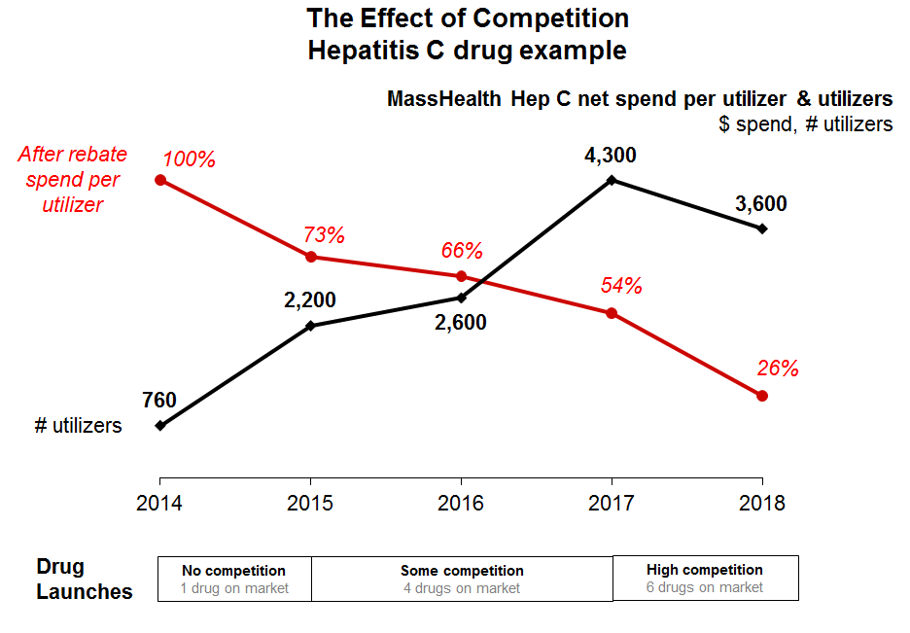
Extensive Work to Bring Pharmacy Growth Under Control
Increasing transparency and enforcing limits on spread pricing for pharmacy benefit managers (PBMs)
All Managed Care Entities required to disclose PBM spread pricing
Projected to save the Commonwealth $10M in FY20 and $20M in subsequent years
In recent years, MassHealth has maximized supplemental rebates using all available negotiation tools

Slide 20
FY20 Budget: New Drug Pricing Reform
The FY20 budget authorizes MassHealth to directly negotiate with drug manufacturers
The reforms were proposed by The Baker-Polito Administration, and enacted by the Legislature
The reforms establish accountability and transparency of drug prices and incorporate drug manufacturers into public processes that exist for other MassHealth health care providers and payors
Access to needed medications, including new to market drugs, will not be impacted by the new negotiation process

Slide 21
MassHealth Pharmacy Reforms: Overview of Process
Identify highest cost drugs and engage drug manufacturers in direct negotiations with the goal of entering into supplemental rebate agreements
Includes value-based agreements
Step 1: MassHealth direct negotiations
If no agreement is reached, MassHealth may publically identify a proposed value for the drug and hold a public comment period and/or hearing on that value.
MassHealth may amend the proposed target based on public input and comments from the manufacturer
MassHealth will seek a supplemental rebate from the manufacturer consistent with the publically determined target value
Step 2: MassHealth public process
If no agreement is reached, MassHealth may refer the manufacturer to the HPC for review – consistent with existing frameworks to hold providers and health plans.
The HPC may require the manufacturer and other relevant parties to disclose additional information
After reviewing all information, the HPC must issue a determination as to whether the drug is reasonably priced
The manufacturer may be subject to penalties if it does not comply with the HPC’s requests
Step 3: Health Policy Commission Accountability Process

Slide 22
Next Steps
Effective August 1st, direct negotiations with select drug manufacturers has commenced
If an agreement is not reached, the public processes to determine a target value of a drug, hold a public hearing, and refer to the Health Policy Commission (HPC) require new MassHealth regulations
MassHealth anticipates $70M in savings to the Commonwealth through these reforms in FY20
The Baker-Polito Administration will continue to explore opportunities to lower pharmacy costs

