Slide 1
MassHealth Demonstration to Integrate Care for Dual Eligibles
One Care: MassHealth plus Medicare
MassHealth Updates to the Implementation Council
July 25, 2014,1:00 PM – 3:00 PM
One Ashburton Place, 21st Floor
Boston, MA

Slide 2
Agenda for MassHealth Updates
Enrollment
Auto-Assignment
Upcoming Member Mailings
LTS Coordinator Training
Contract Management and Monitoring
Community Outreach
Provider Outreach
2
2
2
2
2
2

Slide 3
Total Enrollment
Effective July 1, total number of enrollees: 18,836
7,828 self-selection enrollments
5,531 round 3 auto-assignment
2,320 round 2 auto-assignment
3,157 round 1 auto-assignment
Total Enrollment by Rating Category
F1 | 22
C3B | 142
C3A | 2,628
C2B | 731
C2A | 3,633
C1 | 11,677
Unavailable* | 3
Total | 18,836
Total Enrollment by Plan
Commonwealth Care Alliance (CCA) | 9,714
Fallon Total Care (FTC) | 7,551
Network Health | 1,571
Total | 18,836
3
*Rating categories for three enrollments were unavailable at the time of this report.

Slide 4
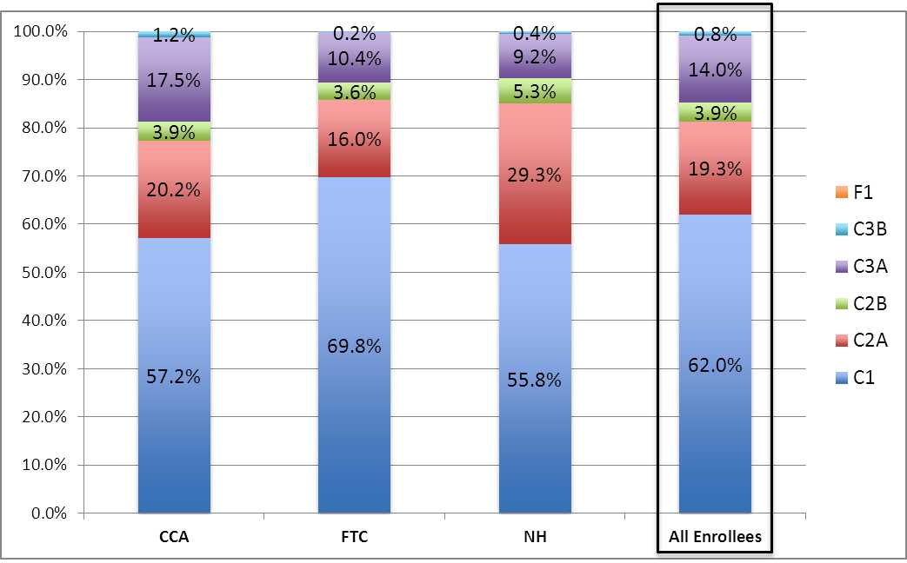
Rating Category Enrollment by Plan
Rating category enrollment distribution fluctuates month-to-month with new enrollments driving most of the changes. Additionally, as plans complete assessments for new enrollees, some individuals move to a different rating category.
4
4
4
4
4
4
F1 < 1% of enrollments in each plan

Slide 5
Enrollments via Auto-Assignment Round 3
Who was Included | Assignment Approach | Key Dates
9,314 individuals from across the target population, including those with higher levels of LTSS and behavioral health need (i.e., C1, C2 and C3 rating categories) | In addition to primary care, MassHealth used data on where individuals accessed LTSS and behavioral health services to match individuals to a One Care plan | April 28: 60-day notices mailed May 29: 30-day notices mailed July 1: Coverage effective
Of those 9,314 individuals who were included in auto-assignment:
59% stayed with their assigned plan for July 1
4% decided to enroll in assigned plan for an earlier effective date
2% switched plans
24% opted out of One Care
10% were cancelled for various reasons (e.g. no longer eligible, or notices came back undeliverable)
Notes:
April/round 2
Of those 6,485 individuals:
53% stayed with their assigned plan for April 1
5% decided to enroll in assigned plan for an earlier effective date
3% switched plans
30% opted out of One Care
10% were cancelled for various reasons (e.g. no longer eligible, or notices came back undeliverable)
January/ round 1
Of those 6,886 individuals:
61% stayed with their assigned plan for Jan. 1
6% decided to enroll in assigned plan for an earlier effective date
2% switched plans
25% opted out of One Care
7% were cancelled for various reasons (e.g. no longer eligible, or notices came back undeliverable)

Slide 6
Auto-Assignment (cont’d)
MassHealth will not do auto-assignments for October 2014
MassHealth is considering auto-assigning members to Network Health for coverage beginning November 1, 2014
Network Health did not take any auto-assigned enrollments in round two (April 1, 2014 coverage effective date)
MassHealth has been working closely with Network Health and is comfortable with the plan’s capacity to accept auto-assigned enrollments for November 1, 2014
MassHealth and CMS continue to work closely with all of the plans to understand their capacity to accept potential auto-enrollments in 2015
6

Slide 7
Upcoming Member Mailings
LTS Coordinator member document
MassHealth is readying materials to be mailed to all current enrollees (enrolled as of 8/1/14) by the end of July
MassHealth will make final electronic version of member document available to One Care plans, CBOs, the OCO, state agencies, and others
MassHealth will also make the document available on the One Care website for people to refer to when making enrollment decisions. People will be able to download or order the document from the website.
One Care Ombudsman
MassHealth is preparing to mail a notice and OCO brochure to all current enrollees (enrolled as of 8/1/14) informing them of the OCO services
MassHealth is targeting the end of July/early August to mail this to enrollees
7

Slide 8
LTS Coordinator Training
MassHealth and UMass Medical School are currently developing a training webinar in response to stakeholders’ request for a uniform, consistent training curriculum for the LTS Coordinator role in One Care
Stakeholders have provided input on webinar content; will provide continued consultation as the webinar takes shape
MassHealth requested additional feedback on examples of LTS Coordinators and Care Coordinators working on a care team and suggestions of LTS Coordinators who could talk about their role
The webinar will be recorded and posted to the One Care learning website
There is interest in developing additional trainings and alternative formats to meet the needs of different audiences
MassHealth is also working with the One Care plans to understand:
their experience from the referral process
challenges related to CBO/agency capacity to accept LTS Coordinator referrals
8

Slide 9
Contract Management/Monitoring Activities
Quality Monitoring and Outcomes Measurement
The first quality work group meeting will be Aug. 13, 2014 from 3-5
The work group will assist MassHealth with review of quality and outcome measures
Plan Monitoring
Accelerated monitoring for July auto-assignment (as for previous passive enrollment periods)
weekly calls, monitoring claims volume, authorization requests, and call center trends
MassHealth to convene a follow-up meeting at the end of July to continue discussions about privacy concerns with Department of Mental Health (DMH), Department of Public Health (DPH), Mental Health Legal Advisors, Implementation Council members and One Care plans

Slide 10
Community Outreach
MassHealth continues to plan and participate in conferences and meetings across the state to reach key One Care audiences. Here is a schedule of upcoming events:
MassHealth is planning additional events at Pine Street Inn, Rosie's Place and other organizations
Date | Session/Conference/Event | Location
8/21/14 | National Alliance on Mental Illness Greater Boston Consumer Advocacy/Affiliate Network (NAMI GB CAN) | Boston
8/6/14 | MassMATCH & Easter Seals Assistive Technology Expo (Exhibit Table) | Holyoke
8/17/14 | 1199 SEIU Health Fair (Exhibit Table) | Dorchester
9/5-9/7/14 | Abilities Expo (Exhibit Table) | Boston
9/17/14 | The Arc of Opportunity (AM and PM discussion) | Fitchburg
9/18/14 | Living Longer: Aging with Intellectual Disability Conference (Hosted by Bridgewell) (Exhibit Table) | Framingham
9/30/14 | Shared Living & Adult Family Care Conference | Worcester

Slide 11
Community Outreach
Video Vignettes
MORE advertising has interviewed five One Care enrollees and captured their stories on video
MassHealth plans to share the video vignettes at the next One Care Open Meeting: Friday, Aug. 22, 1-3pm, Transportation Building
The vignettes will be used to share member experiences with One Care
11

Slide 12
Provider Outreach
MORE advertising has developed full- and half-page One Care ads for placement in six provider journals.
New England Journal of Medicine (NEJM)
Journal of the American Medical Association (JAMA)
American Family Physicians
Journal of Family Practice
MA Psychiatric Society Newsletter
Behavioral Magazine
Ads will run in September, October, November and December 2014
MORE will distribute One Care messaging to provider associations to include in newsletters, bulletins, and updates to their members and networks

Slide 13
Visit us at www.mass.gov/masshealth/onecare
Email us at OneCare@state.ma.us

