Slide 1
MassHealth Demonstration to Integrate Care for Dual Eligibles
One Care: MassHealth plus Medicare
Implementation Council Meeting – MassHealth Update
March 28, 2014, 1:00 PM – 3:00 PM
One Ashburton Place, 21st Floor
Boston, MA

Slide 2
MassHealth and Implementation Council Planning Meeting
MassHealth and Implementation Council chairs held a joint planning meeting on March 19, 2014
Topics discussed included:
2014 IC priorities
MassHealth’s planning timeline to maximize impact of IC input on decision processes
IC 2013 Annual Report
IC 2014 Work Plan
2

Slide 3
Total Enrollment
Effective March 1, total number of enrollees: 9,722
Total Enrollment by Plan
Commonwealth Care Alliance (CCA) | 6,371
Fallon Total Care (FTC) | 2,549
Network Health | 802
Total | 9,722
Total number of opt-outs as of March 1: 17,701
Details regarding enrollment as of March 1 are posted in the Monthly Enrollment Report on the One Care website
April enrollment numbers expected in 2-3 weeks (will include Round 2 auto-enrollments)
3

Slide 4
Round Two Auto-Assignment
Number of people auto-assigned | Assignment Approach | Key Dates
Approx. 6,400 | Includes individuals from across the target population (rating categories C1, C2, C3) In addition to primary care, MassHealth used data on where individuals accessed LTSS and behavioral health services to match individuals to a One Care plan MassHealth worked closely with the One Care plans throughout the assignment process to understand their capacity to accept additional auto-assignment enrollments, and to maximize matches with their provider networks | January 24-27: 60-day notices mailed to enrollees February 21: 30-day reminder notices mailed to enrollees April 1: Coverage begins

Slide 5
Round Three Auto-Assignment
MassHealth and the One Care plans have begun discussions about round three auto-assignment, which will take effect July 1, 2014
At 3/19/14 planning meeting with Implementation Council representatives, MassHealth requested input regarding auto-assignment Round 3 by the end of March for consideration during the planning process
60-day notices will be mailed by April 28
30-day reminder notices will be mailed by May 28
5

Slide 6
LTS Coordinator
From continuing discussions with stakeholders and the Implementation Council, MassHealth is:
Refining a one-page description of the LTS Coordinator and the option for members to have one on their Care Team
Draft incorporates language and feedback from LTS providers, community organizations, Implementation Council members, One Care plans, and EOHHS agencies
MassHealth anticipates finalizing the document for One Care plans to use by the end of April
MassHealth will develop a webinar on the LTS Coordinator role for providers, plans, LTS coordinators, community-based organizations, and others on the LTS Coordinator’s role in One Care
MassHealth will continue work with stakeholders to finalize the LTS Coordinator role document, develop key concepts for the webinar, and understand data around how the role is being implemented
Initial data is expected April/May
6

Slide 7
Mailing to Additional Members
In September 2013, MassHealth sent a One Care Enrollment Package to approximately 82,000 members and their guardians
From March 26-31, MassHealth is mailing another One Care Enrollment Package to 12,965 members and guardians:
Individuals who have become eligible for One Care since the September mail file was created
Others who appear eligible in MassHealth data, but were not mailed to in September
Enrollment packet is posted on the One Care website
MassHealth requests Implementation Council members’ participation in alerting their networks of this mailing
7

Slide 8
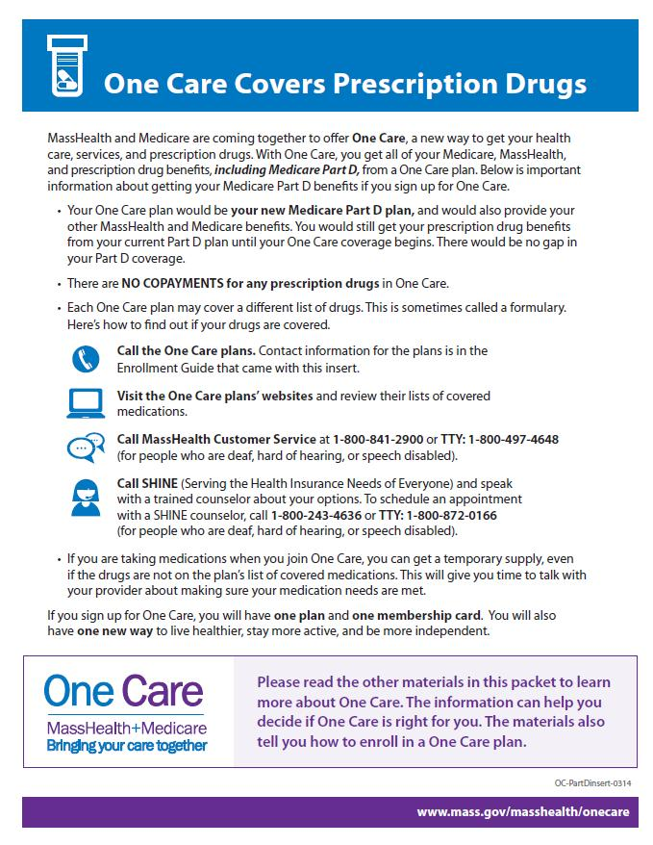
Mailing to Additional Members (cont’d)
The March 2014 mailing included a new “One Care Covers Prescription Drugs” insert with important information about Medicare Part D benefits in One Care
MassHealth developed the insert in response to feedback from members, advocates, and stakeholders about Medicare Part D coverage in One Care
When members enroll in One Care, the One Care plan becomes their new Medicare Part D plan

Slide 9
Provider Engagement Strategy Update
Multi-prong strategy to continue to raise awareness of One Care among providers and to increase provider participation in One Care:
Targeted Provider Awareness Campaign, Late Spring 2014
Direct mail
Publicizing in trade and advocacy communication materials
Print advertising in trade publications
Participation and promotion at key meetings and conferences
Provider Learning Conference, June 2014
Conference theme: Behavioral Health Integration and Primary Care
MassHealth will present case studies and highlight examples of best practices in integrating delivery of care across medical, behavioral health, and long-term services and supports
9

Slide 10
Visit us at www.mass.gov/masshealth/onecare
Email us at OneCare@state.ma.us

