Slide 1

One Care:
Implementation Council Meeting
Executive Office of Health & Human Services
MassHealth Demonstration
to Integrate Care for Dual Eligibles
October 10, 2017, 10:00 AM – 12:00 PM
AARP Office
One Beacon St., Suite 2301
Boston, MA

Slide 2
One Care Rating Category Definitions
F1 – Facility-based Care. Individuals identified as having a long-term facility stay of more than 90 days
C3 – Community Tier 3 – High Community Need. Individuals who have a daily skilled need; two or more Activities of Daily Living (ADL) limitations AND three days of skilled nursing need; and individuals with 4 or more ADL limitations
  In CY2014, C3 split into two subsets:
    C3B: for C3 individuals with certain diagnoses (e.g., quadriplegia, ALS, Muscular Dystrophy and Respirator dependence) leading to costs considerably above the average for current C3
    C3A: for remaining C3 individuals
C2 – Community Tier 2 – Community High Behavioral Health. Individuals who have a chronic and ongoing Behavioral Health diagnosis that indicates a high level of service need
  - In CY2014, C2 split into two subsets
    C2B: for C2 individuals with co-occurring diagnoses of substance abuse and serious mental illness
    C2A: for remaining C2 individuals
C1 – Community Tier 1 Community Other. Individuals in the community who do not meet F1, C2 or C3 criteria

Slide 3
Total Enrollment
Effective September 1, 2017, total number of enrollees: 17,573
Total Enrollment by Plan
Commonwealth Care Alliance (CCA) | 14,430
Tufts Health Plan | 3,143
Total | 17,573
Total Enrollment by Rating Category
F1 | 83
C3B | 202
C3A | 6,953
C2B | 1,103
C2A | 5,451
C1 | 3,770
unavailable | 11
Total | 17,573
7,311 individuals enrolled in One Care during 2017.
Of the 17,573 enrolled in One Care in September 2017, 5,444 individuals had enrolled during 2017.
As these data points are snapshots for 2017, some of these individuals may have been enrolled in One Care before.
*The rating categories for 11 enrollments were unavailable at the time of this report.

Slide 4
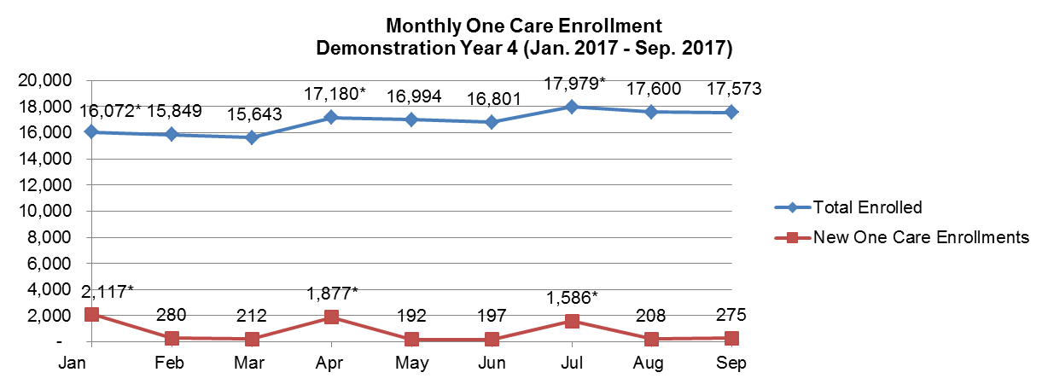
Enrollment Over Time: Demonstration Year 4
*Auto-assignment effective dates (Round 8: 1/1/2017; Round 9: 4/1/2017; Round 10: 7/1/2017).
Note: Data in the graph reflect current month information about enrollments. Monthly data may vary slightly from the previous reports due to enrollment status changes that have occurred since previous reports were issued.

Slide 5
New Monthly Enrollments Over Time, By Plan:
Demonstration Year 4
2017 | Jan* | Feb | Mar | Apr* | May | Jun | Jul* | Aug | Sep
New Monthly Enrollments | 2,117 | 280 | 212 | 1,877 | 192 | 197 | 1,586 | 208 | 275
*Auto-assignment effective dates (Round 8: 1/1/2017; Round 9: 4/1/2017; Round 10: 7/1/2017).
Note: Data in the graph reflect current month information about enrollments. Monthly data may vary slightly from the previous reports due to enrollment status changes that have occurred since previous reports were issued.

Slide 6
Recent Disenrollment Snapshot
  For people who enrolled between October 2016 and June 2017, 17.9% disenrolled within the first 3 months
  For people who enrolled between October 2016 and June 2017, 11.1% disenrolled sometime after 3 months
  70.2% of individuals from these enrollment cohorts were still enrolled or had re-enrolled in September 2017

Slide 7
Opt-Outs: Demonstration Year 4
*Auto-assignment effective dates (Round 8: 1/1/2017; Round 9: 4/1/2017; Round 10: 7/1/2017).
Note: Data in the graph reflect current month information about enrollments. Monthly data may vary slightly from the previous reports due to enrollment status changes that have occurred since previous reports were issued.

Slide 8
Most Opt-Outs Requested in Demonstration Year 1

Slide 9
One Care Updates
  Online enrollment:
    Members can now enroll in One Care online
    To enroll, visit the One Care website at www.mass.gov/one-care and click on “I’m ready to enroll in One Care!”
  Update on MassHealth Redeterminations

Slide 10
Visit us at: www.mass.gov/one-care
Email us at: OneCare@state.ma.us

