Slide 1
MassHealth Demonstration to Integrate Care for Dual Eligibles
One Care: MassHealth plus Medicare
Implementation Council Meeting
October 16, 2015 1:30 PM – 3:30 PM
250 Washington St.
Public Health Conference Room, 2nd Floor
Boston, MA

Slide 2
Agenda for Today
Fallon Total Care (FTC) Closure Wrap-Up
LTS Coordinator Discussions with Tufts and CBOs
Moving Forward - Enhanced Outreach
Early Successes from One Care Plans
One Care Enrollee Assessment and LTS Coordinator Referral Quarterly Reports
2
2
Notes:
Include update on shared learning? UMMS to do?

Slide 3
FTC Closure Wrap-Up
FTC member transition breakdown (note that exact numbers may change):
~ 610 members transitioned from FTC into another One Care plan for effective enrollment dates between August 1 and November 1.
~ 4,700 members transitioned back into Fee For Service.
We have shared the direct contact information for our One Care contract management team with the customer service center, Implementation Council, SHINE, the OCO, and other stakeholders to escalate any access to care issues that may arise for former FTC members
On October 1, we sent another targeted mailing to identified high-risk individuals with behavioral health needs to let them know about the availability of DMH services as a resource through this process.
MassHealth is working with UMMS to consider how to track and evaluate the experiences of FTC members as they transition to different coverage, and post-transition perspectives on One Care.
MassHealth has also asked CMS’ evaluator to consider how to capture the experience of FTC members in the One Care evaluation
3
3
3
3
3

Slide 4
LTS Coordinator Discussions with Tufts and CBOs
MassHealth continues discussions with Tufts Health Plan and their contracted Community-Based Organizations (CBOs) about the provision of the Long-Term Supports (LTS) Coordinators in Tufts Health Plan
Tufts and the CBOs have been working to strengthen their relationships and to improve communications
By the end of October, Tufts has committed to:
Resolving any outstanding billing and payment issues with the CBOs
Working with the CBOs to finalize contract amendments
MassHealth will reconvene a joint meeting in mid-November with Tufts and the CBOs to discuss progress

Slide 5
Moving Forward – Enhanced Outreach
We need to maintain integrated care options in light of losses felt from FTC’s withdrawal from One Care
Includes up to 500 additional enrollments with Tufts in Worcester County
Tufts wants to expand its footprint in Suffolk County
Will help to offset the market challenges of adding up to 500 Worcester County new enrollees so quickly
Enhanced outreach approach, including passive enrollment of 750 members into Tufts in Suffolk County for January 2016
MassHealth will be partnering with Tufts on a new enhanced outreach strategy:
Targeting local communities with large numbers of members selected for passive enrollment
Goal is to reduce the percent of members who opt out

Slide 6
Community-Based Outreach Events
MassHealth will be working with Tufts Health Plan to host at least three community-based events in targeted communities between November 9th and December 19th, 2015
Using members’ zip codes, MassHealth has identified four target communities in Suffolk county with a significant number of members selected for passive enrollment:
Chelsea/Revere
Dorchester
Roxbury
Downtown Boston
These events will give members the opportunity to learn more about One Care and Tufts Health Plan and the ability to ask questions face-to-face prior to enrollment
The events will include a presentation by Tufts Health Plan, and incentives for member attendance, such as door prizes or a raffle
We are also reaching out to consumers, such as Tufts’ Consumer Advisory Board, to help plan the events and to ensure that peers (currently enrolled One Care members) can be present to answer members’ questions
We welcome assistance and attendance from Implementation Council members with this new enhanced outreach approach

Slide 7
Additional Enhanced Outreach Efforts
MassHealth’s outreach efforts will also involve the following:
Considering targeted outreach to providers that serve large numbers of selected members
Finding existing community events (for both consumers and providers) happening in Suffolk county over the next two months where we can bring information about One Care to members
Identifying additional community spaces (e.g., libraries and pharmacies) for One Care posters or other materials about One Care
We would like input and assistance from the Implementation Council on these strategies:
Staffing and publicizing events
Suggestions for additional community events (for both consumers and providers) in Suffolk county in November and December
Identifying spaces in communities where we could place One Care materials and information
Additional ideas you have about outreach

Slide 8
One Care is Showing Early Signs of Success
CCA Inpatient utilization after 12 mos.¹
Admits/1,000 member months
CCA ED utilization after 12 mos. ¹
Visits/1,000 member months
(6.4%)
(7.5%)
Note: plans make significant upfront investments in care coordination and other services but observe impact over 12-18 month period. Given rolling enrollment, many One Care members have been in the program < 12 months
Other measures of impact:
82% of enrollees satisfied with One Care, only 6% dissatisfied²
CCA’s One Care Spring 2015 CAHPS (member experience survey) scores used for Medicare Advantage Star Ratings beat those of their mature integrated elder D-SNP³
Nurse/care coordinators finding significant levels of “under-care”
Significant advocate and enrollee buy-in; many anecdotes of lives improved

Slide 9
One Care Is Increasing Access to Community-based LTSS; FFS Underestimates Needs
One Care enrollees get more LTSS* than in FFS^{1,5}
Historical FFS utilization underestimates needs:
CCA’s PMPM costs increased by 1.3% for members already receiving LTSS; for members without LTSS in FFS, PMPMs increased by 23.6%¹
25.5% of CCA’s enrollees had their MassHealth rating category increased post-assessment⁴
Tufts connected 68% of enrollees to resources such as fuel assistance, financial assistance, or improved housing⁵
14% in FFS
*Differences between plans’ LTSS increases are not adjusted for enrollment mix or member care planning preferences

Slide 10
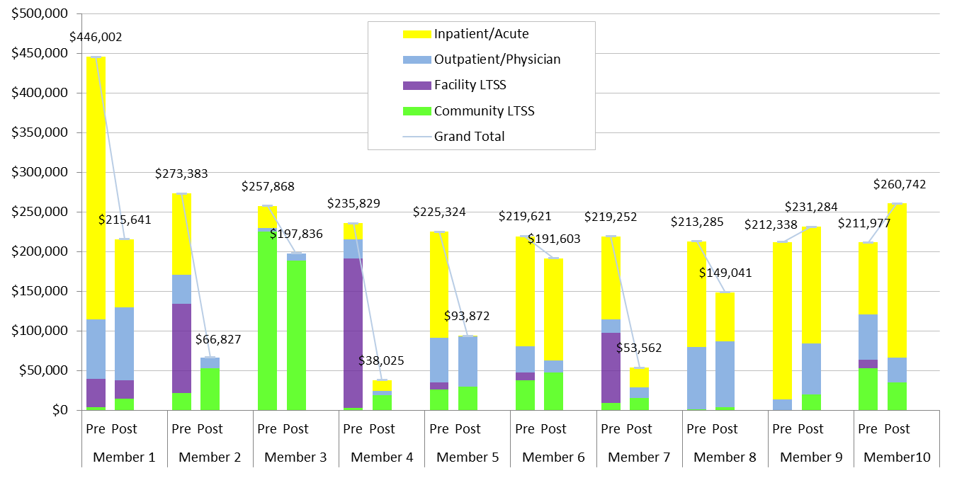
One Care Has Had Significant Impact On Highest Utilizers
CCA’s cost (12 mos. pre- and post-enrollment) for 10 highest spend members¹
Cost reductions due to decreased inpatient/acute and skilled nursing facility utilization
Investments in care management, primary care, and community-based LTSS to achieve reductions
8 of 10 highest cost members had reduced cost
For all 10, average cost reduction of -38%

Slide 11
Insights From Experience To Date …
Significant pent-up demand and unmet needs for new members
Upfront investments (care coordination, increased medical, BH and LTSS care) required, but savings take 12-18 months to realize
Claims history is significantly underestimating the population’s functional limitations, behavioral health conditions, and other needs
Investments in care management are critical to success of model – key to making person-level connections
Expanded services are diverting enrollees from more acute and expensive care (ex. Crisis Stabilization Units)
CCA building own Crisis Stabilization Units – up-front cost with long-term savings

Slide 12
Early Successes from One Care Plans- Endnotes
¹ Charts based on data from “Early Review of One Care Performance.” Commonwealth Care Alliance. August 14, 2015. Data based on analysis of 4,559 individuals continuously enrolled for 12+ months through December 2014 preceded by 12+ months continuously eligible for MassHealth and Medicare. Part D claims excluded from analysis due to limitations on data availability. Medicare claims may be incomplete.
² The One Care Early Indicators Project, “Findings from the One Care Member Experience Survey (2014),” May 2015. Available at http://www.mass.gov/eohhs/docs/masshealth/onecare/eip-survey-2-report.pdf
³ Medicare Advantage and Prescription Drug Plan CAHPS for 2015 conducted in Spring 2015, as reported in “Early Review of One Care Performance.” Commonwealth Care Alliance. August 14, 2015.
⁴ “Early Review of One Care Performance.” Commonwealth Care Alliance. August 14, 2015.
⁵ Information provided by Tufts Health Plan – Network Health, August 24, 2015.

Slide 13
Enrollee Assessment and LTS Coordinator Referral Quarterly Report: January - March 2015
The One Care enrollee assessment and LTS Coordinator (LTS-C) referral report for individuals who enrolled in One Care on January 1, February 1, and March 1, of 2015 is now available.
MassHealth will post the report on the One Care website at: www.mass.gov/masshealth/onecare, in the “One Care News and Community” section.
This quarter included the highest assessment completion rates by the plans to date, and an increase both in the number of members with an identified need for LTSS, and the number of members being offered an LTS-C.
13
13
13
13
13

Slide 14
Visit us at www.mass.gov/masshealth/onecare
Email us at OneCare@state.ma.us

