Slide 1
MassHealth Demonstration to Integrate Care for Dual Eligibles
One Care: MassHealth plus Medicare
MassHealth Updates to the Implementation Council
September 12, 2014,1:00 PM – 3:00 PM
One Ashburton Place, 21st Floor
Boston, MA

Slide 2
Agenda for MassHealth Updates
Enrollment Update
LTS Coordinator Training
Encounter Data
Contract Management and Monitoring
2
2
2
2
2
2

Slide 3
Total Enrollment
Effective September 1, total number of enrollees: 17,739
Total Enrollment by Plan
Commonwealth Care Alliance (CCA) | 9,864 (55.6%)
Fallon Total Care (FTC) | 6,415 (36.2%)
Network Health | 1,460 (8.2%)
Total | 17,739
Total Enrollment by Rating Category
F1 | 27
C3B | 142
C3A | 2,852
C2B | 764
C2A | 3,724
C1 | 10,223
Unavailable* | 7
Total | 17,739
3
*The rating category for seven enrollments was unavailable at the time of this report.

Slide 4
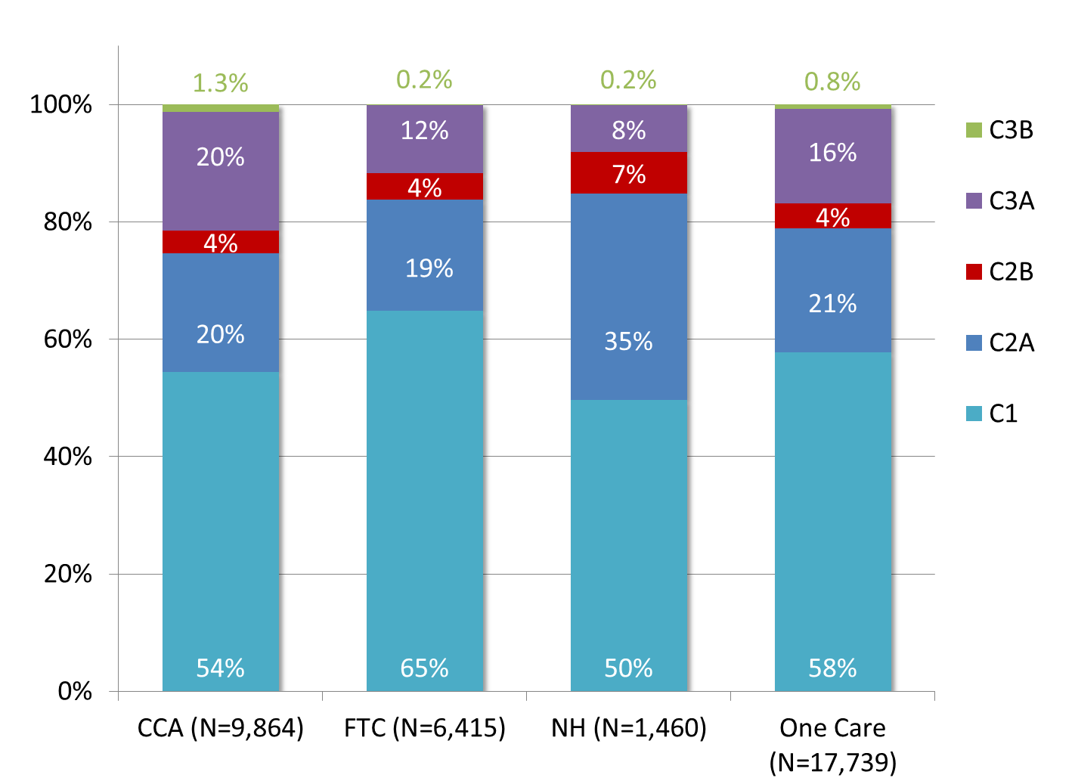
Rating Category Enrollment by Plan (As of September 1, 2014)
4
4
4
4
4
4
F1 < 1% of enrollments in each plan

Slide 5
Round Four Auto-Assignment
MassHealth auto-assigned 1,332 people to Tufts Health Plan – Network Health for coverage beginning November 1, 2014
MassHealth mailed 60-day auto-assignment notices and a Part D insert to those people on Thur., Aug. 28
MassHealth will mail 30-day reminder notices at the end of September 2014
Individuals can choose to enroll before November 1, opt out, or enroll in a different One Care plan
5

Slide 6
LTS Coordinator Training Webinar
The LTS Coordinator: Role and Benefits for One Care Enrollees
Thursday, September 18, 2014
Noon - 1pm
During this webinar, we will discuss:
making referrals to Independent Living and Long-Term Services (LTS) and Supports Coordinators;
ways to explain this role to One Care enrollees; and
the benefits of engaging LTS Coordinators on care teams.
6

Slide 7
Encounter Data
What are encounter data?
Records of services delivered to Medicaid beneficiaries enrolled in managed care
Typically come from billed claims that providers submit to managed care plans
We can use ad hoc inquiries and/or standardized reports to understand the data
Encounter data can be used to
Provide plan-level information about member service utilization
Measure and monitor quality, utilization, finance and compliance with contractual requirements
Monitor which providers are delivering services to One Care members
Inform the capitation rate-setting process
Perform risk-adjustment to account for differences in member health status across plans
http://www.medicaid.gov/Medicaid-CHIP-Program-Information/By-Topics/Data-and-Systems/Downloads/Medicaid-Encounter-Data-toolkit.pdf

Slide 8
Encounter Data
How will MassHealth use encounter data for One Care?
Encounter data reporting can help us understand the unique features of One Care, and how enrollees are using services
We are reviewing other product lines (e.g., MCOs and SCOs) to learn from how they are using and reporting encounter data
Encounter data can help us see how people use services in One Care compared to fee-for-service
E.g.: PCA utilization, hospital admissions, behavioral health diversionary service utilization vs. inpatient psych; dental visit frequency
We invite MassHealth Implementation Council input on specific areas we should focus on in One Care encounter data analysis and reports
Timing: The One Care plans will report encounter data on a monthly basis. We expect the data to be ready sometime next year.

Slide 9
Contract Management/Monitoring
Quality Monitoring and Outcomes Measurement
The first Implementation Council Quality Subgroup meeting was held on Aug. 13, 2014. The group reviewed
Types of measures plans are required to report
Timelines for submission of measures
The group provided feedback on administration of the Mental Health Recovery Measure (MHRM) survey and cover letter. This survey is slated to be administered by UMASS Office of Survey Research (OSR) later this year.
The group continues to provide feedback on messaging to encourage survey participation, including increasing awareness of the survey’s objectives
The next meeting is scheduled for Oct 22, 2014 from 2-4 pm

Slide 10
Contract Management/Monitoring (cont’d)
Plan Contract Management – Behavioral Health Privacy
MassHealth held the second Behavioral Health Privacy meeting on 9/11/14. Attendees included
Department of Mental Health (DMH)
Department of Public Health (DPH)
Mental Health Legal Advisors
Implementation Council members
One Care plans
Topics of discussion
Review of One Care plans Readiness Review documents
Improving Behavioral Health through integrated care
Provider roles and responsibilities
Member rights and management of PHI (focus on BH diagnosis)

Slide 11
Visit us at www.mass.gov/masshealth/onecare
Email us at OneCare@state.ma.us

