Slide 1
MassHire/Adult Education
WIOA Partner Cross-Training
October 5, 2020
10:00 am – 11:30 am am

Slide 2
Today’s webinar will be recorded.
Please use the chat box to introduce yourself.
You can listen through speakers or use the dial-in option listed with the webinar link.
You can use the chat box or “raise hand” feature to ask a question.
Please remember to mute your computers and phones to minimize background noise.

Slide 3
Presenters and Overview
Presenters:
Sacha Stadhard, Manager, Special Grants and Youth Policy MassHire DCS
Rosemary Alexander, Director of Training, MassHire DCS
Derek Kalchbrenner, Education Specialist, Department of Elementary and Secondary Education
Overview:
Programs, Services, and Eligibility Criteria for Career Center and Adult Education services
Local Area Referral Process
Identifying Shared Customers
Data Entry into MOSES

Slide 4
MassHire /Adult Education Systems Overview
MassHire Workforce Development System
16 Workforce Development Areas
16 Workforce Development Boards
29 One Stop Career Centers
25 comprehensive
4 Affiliated
Adult Education System: Adult and Community Learning Services
86 Adult Education Programs
Community Adult Learning Centers, Family Literacy, Workplace Education
11 Transition to Community College programs
19 agencies providing outstationing services in all 16 local workforce areas

Slide 5
Program Eligibility
MassHire Workforce Development System
Universal Access to basic Career Center services
Special Programs – Exceptions & Special criteria
Adult Education
are at least 16 years of age;
are not enrolled or required to be enrolled in secondary school under state law; and
do not have a secondary school diploma or its recognized equivalent and have not achieved an equivalent level of education; or are basic skills deficient; or are English language learners.

Slide 6
IMPACT OF COVID-19
MassHire
Virtual Customer Flow
Virtual Services
Electronic Documentation
Use of Zoom, WebEx, and other virtual platforms
Email, text,
Flexibility of service delivery depending on need
Accommodations
Adult Education
Starting in September 2020, programs have the option of offering in-person, hybrid, or remote instruction
Programs are accepting referrals and enrolling students in classes
GED and HiSET testing is being done remotely

Slide 7
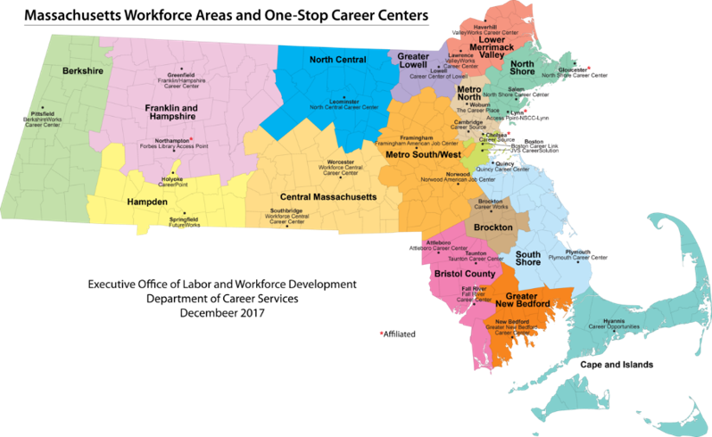
Workforce System MAP
Department
MassHire Department of Career Services
16 Workforce Development Areas​
16 Workforce Development Boards​
29 One Stop Career Centers ​
25 comprehensive (OSCCs) – 4 Affiliated (OSCCs)​

Slide 8
Mass Workforce Required Partners
MassHire Department of Career Services
Lead Operator

Slide 9
Overview of MassHire Career Center Services
One Stop Career Centers provide services to individual customers based on individual needs
No required sequence of services
Required partner services that must be provided through the career center delivery system:
Basic Career Services
Individualized Career Services
Follow-up Services
Business Services

Slide 10
Overview MassHire Career Center Services Special Programs
WIOA-Funded Training (Title I)
Training Opportunities Program (TOP) - Section 30
Veteran Services
Customers with Disabilities (DEI)
Youth (16 – 24)
Migrant and Seasonal Farmworkers (MFSW) & Agricultural Employees

Slide 11
Overview MassHire Career Center Services Special Programs
Work Opportunity Tax Credit (WOTC)
Trade Programs (Foreign Competition)
National Dislocated Worker Grants (NDWG)
Department of Unemployment Assistance (DUA)
ReEmployment Services and Eligibility Assessment (RESEA)
Multilingual Services
Coordinates translation & interpretation services for multiple languages, including American Sign Language (ASL)
https://www.mass.gov/orgs/office-of-multilingual-services

Slide 12
WIOA – Eligibility Requirements
United States citizen or authorized to work in U.S. (Permanent resident card).
Males must be registered with Selective Service if born after 1960. (NOTE) Registering with selective service to receive a status letter may take 4-6 weeks.
Income Eligible
- Family income must meet eligibility guidelines
as determined by Department of Labor
Able to justify that training will enhance current skills. This should include:
Current resume,
Proof of job search; including print-outs of actual jobs applied for via internet and indication from employers that the resume was received.

Slide 13
Shared Customer
A shared customer is a student who is enrolled in more than one core partner program at any time during a fiscal year (i.e., a student who is co-enrolled and a student who is sequentially enrolled).
In order to be a shared customer, a student must meet the eligibility criteria of partner agencies.
Example: Someone enrolled in an ESOL program and receiving Career Center services (e.g. workshop, resume development, etc.) IS a shared customer
Someone who is receiving Career Center services and is on a wait list for an Adult Education program is NOT a shared customer
** Career Center staff must contact the local Adult Education representative and confirm that the customer is enrolled in a funded Adult Education program.
WIOA Joint Partner Communication 01.2018: WIOA Partner Shared Customer

Slide 14
Shared Customers – Statewide Summary
Source – Massachusetts One Stop Employment System (MOSES) Data Base – as September 14,. 2020

Slide 15
fiFIX

Slide 16
Process to Identify the Shared Customer
To determine whether or not it is appropriate to check the Apply box in MOSES of a partner program to indicate a shared customer, staff must confirm locally that the customer meets Partners’ enrollment criteria and is receiving services from that agency.
For example, in order to be considered enrolled as a student in Adult Education programs, an individual must have received 12 or more hours of service of adult education programming. Only when this information is confirmed should the Apply box on the Basic Screen for Adult Education be checked.
Process example: MCC Adult Education point of contact (career center staff) contacts the local Adult Education representative (outstationing coordinator) and once a month, the outstationing coordinator provides thier MCC point person with:
the names of MCC customers referred to AE agencies
the names of AE students referred to the MCC
Data matching process under development!

Slide 17
Examples of Shared Customers
Examples of shared customers who enroll in more than one core partner program include but are not limited to:
AE/ESOL students enrolled by MCC and receiving career center services leading to employment
AE/ESOL students ages 16-24 and enrolled in Title I out-of-school youth programs
AE/ESOL students who exit AE services and then enrolls in a WIOA funded training program within the reporting year is considered a shared customer.

Slide 18
Feedback on Process to Identify Shared Customers
Does everyone know who their MH and Adult Ed point of contacts are?
What has been the impact of COVID-19 on service delivery?
What additional information would be helpful to assist with this process to identify shared customers?

Slide 19
THANK YOU!
Presenter Contact:
Sacha Stadhard
Sacha.stadhard@detma.org
MassHire Department of Career Services
Rosemary Alexander
Rosemary.Alexander@DETMA.ORG
MassHire Department of Career Services
Derek Kalchbrenner
Derek.Kalchbrenner@mass.gov
Department of Elementary and Secondary Education

