Slide 1

WIOA PERFORMANCE TRAINING
https://www.mass.gov/masshire-career-centers
July 15, 2021
  MassHire Programs & Services are funded in full by US Department of Labor (USDOL) Employment and Training Administration grants.
  (Additional details furnished upon request.)

Slide 2
Today’s webinar will be recorded.
Please use the chat box to introduce yourself.
You can listen through speakers or use the dial-in option listed with the webinar link.
You can use the chat box or “raise hand” feature to ask a question.
Please remember to mute your computers and phones to minimize background noise.

Slide 3
WIOA Performance Indicators
Performance Topics:
  Brief Background on Federal Reporting
  WIOA Performance Indicators
  MOSES Data Entry Impact
  Review Performance Scenarios
  Blue/Bold Services Discussion
    Notes, Exits, and the 90 Day Clock
Note: This session will be recorded.

Slide 4
  Quarterly Federal Reporting
Each calendar quarter, the PIRL (Participant Information Record Layout) report is submitted to the USDOL.
The PIRL contains both active participants as well as those that have exited up to 2 ½ years ago!
Once submitted, the data in the PIRL are used to calculate our federal performance for the quarter.
PIRL
USDOL
Wage Data
MOSES Data

Slide 5
WIOA Performance Indicators
Performance Measure | FY2021 Cohort [Exit*] Range
Adult/DW: Employment in the 2nd Quarter After Exit Youth: Employment, or Education/Training in the 2nd Quarter After Exit | July 2019 - June 2020
Adult/DW: Employment in the 4th Quarter After Exit Youth: Employment, or Education/Training in the 4th Quarter After Exit | Jan 2019 - Dec 2019
Median Wages 2nd Quarter After Exit | July 2019 - June 2020
Credential Attainment | Jan 2019 - Dec 2019
Measurable Skill Gain *[Participants] | July 2020 - June 2021
Effectiveness in Serving Employers | Jan 2019 – Dec 2019

Slide 6
WIOA Performance Indicators
Exit Quarter - Represents the calendar quarter in which the date of exit is recorded for the participant.
2019 |  |  | 2019 |  |  | 2019 |  |  | 2019
JAN | FEB | MAR | APR | MAY | JUN | JUL | AUG | SEP | OCT | NOV | DEC
Exit Quarter
1st Qtr After Exit
2nd Qtr After Exit
2020 |  |  | 2020 |  |  | 2020 |  |  | 2020
JAN | FEB | MAR | APR | MAY | JUN | JUL | AUG | SEP | OCT | NOV | DEC
3rd Qtr After Exit
4th Qtr After Exit

Slide 7
WIOA Performance Indicators
Employment 2nd Quarter After Exit
In Employment during the 2nd Quarter After Exit:
  The percentage of participants who are employed during the second quarter after their exit.
For Youth: In Employment, Education, or Training during the 2nd Quarter After Exit:
  The percentage of participants who are employed, or in education, or in advanced training during the second quarter after their exit.
Employment:
UI wage records
(see TEGL 26-16 for adding wages when no wage record found; e.g someone who is in federal employment)
Education or Training (Youth only):
Retention Services on the General tab of MOSES

Slide 8
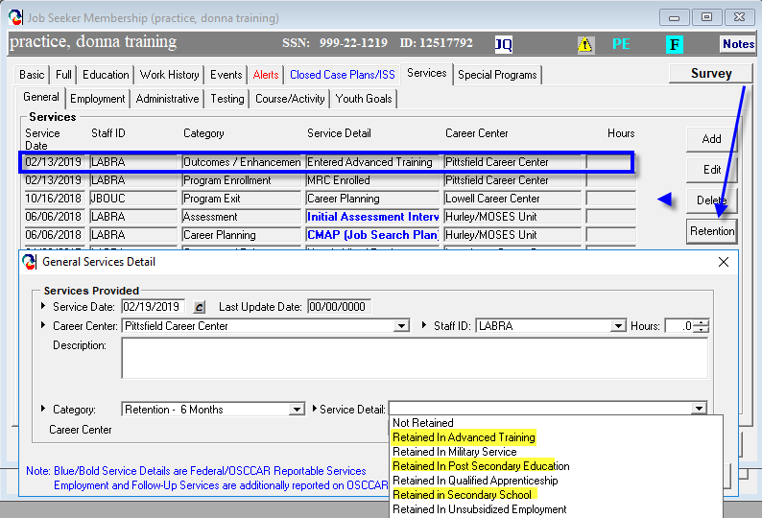
Retention Services in MOSES
Retention Services (Month 6/2nd Quarter After Exit)

Slide 9
Employment 2nd Quarter After Exit
Scenario
Nancy is a WIOA dislocated worker who was laid off from her job at a medical supply company and is working with a career counselor on her specific interests. The counselor is aware of a training in mechatronics and after discussing the details with her, enrolls Nancy in the program.
Nancy exits the training program and WIOA Dislocated Worker program in January 2019 and gets a job immediately. In August 2019, Nancy moves to another state, buts finds a new job and continues working.
Is Nancy a positive outcome in the Employment Rate 2nd Quarter After Exit?

Slide 10
WIOA Performance Indicators
Employment 4th Quarter After Exit
In Employment during the 4th Quarter After Exit:
  The percentage of participants who are employed during the fourth quarter after their exit.
For Youth: In Employment, Education, or Training during the 4th Quarter After Exit:
  The percentage of participants who are employed, or in education, or in advanced training during the fourth quarter after their exit.
Employment:
UI wage records
(see TEGL 26-16 for adding wages when no wage record found; e.g someone who is in federal employment)
Education or Training (Youth only):
Retention Services on the General tab of MOSES

Slide 11
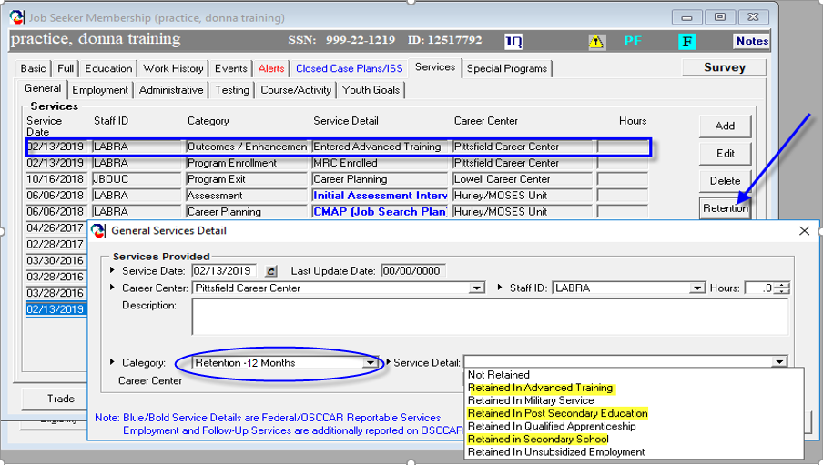
Retention Services in MOSES
Retention Services (Month 12/4th Quarter After Exit)

Slide 12
Employment 4th Quarter After Exit
Scenario
Sara is an OSY participant, participating in mentoring and internship. After completing her internship, the employer hires her full time and she also exits the WIOA Youth program.
She remains employed through her 2nd and 3rd quarter after exit, but loses her job in the first month of her 4th quarter after exit.
Is Sara a positive outcome in the Employment/Education Rate 2nd Quarter After Exit?
Is Sara a positive outcome in the Employment/Education Rate 4th Quarter After Exit?

Slide 13
WIOA Performance Indicators
Median Wages 2nd Quarter After Exit:
  The median wage of those exiters employed in the 2nd quarter after exit.
  Employment:
  UI Wage records
  The difference between median and average:
  The average of {5, 6, 7, 9, 28} = 11
  The median of {5, 6, 7, 9, 28} = 7

Slide 14
WIOA Performance Indicators
Recognized Post-Secondary Credential
  Section 3(52) of WIOA defines “recognized postsecondary credential” as a credential consisting of an industry-recognized certificate or certification, a certificate of completion of an apprenticeship, a license recognized by the State involved or Federal Government, or an associate or baccalaureate degree*.
* Note that a graduate degree is not included in the definition although allowable for Trade program participants, but never is a positive outcome in performance.

Slide 15
WIOA Performance Indicators
  Credential Attainment measure:
  Number of participants who exited during the reporting period that were in an education or training program (excluding OJT and Customized Training) and who obtained a recognized postsecondary credential during the program or within one year after exit;
  plus the number of participants who exited that were in a secondary education program and who obtained a secondary education diploma or its equivalent during the program or within one year after exit AND who were also employed or enrolled in an education or training program leading to a recognized postsecondary credential within one year after exit.
Notes:
*education or training means all ISY and any one in occ skills or ged prep, etc.

Slide 16
Types of Post Secondary Credentials
Credential Attainment
Industry-recognized certification
  e.g. Microsoft Certified IT Professional (MCITP), National Institute for Automotive Service Excellence certification
Apprenticeship certification
  e.g. from Massachusetts Division of Apprentice Standards
License issued by a State or Federal government
  e.g. State licensed asbestos inspector, Federal Aviation Administration aviation mechanic license
Associate or bachelor’s degree
  BUT, not a graduate degree!
Notes:
The credential attainment measure is written from WIOA perspective, not TAA. They aren’t doing advanced degrees under WIOA so they didn’t think to include it. That does not mean you shouldn’t approve them under Trade.

Slide 17
Secondary School Diplomas/Equivalents
Credential Attainment
For those attaining a high school equivalency or diploma:
Only included as a positive outcome, if within one year after exit, the participant is:
  Employed
    OR
  Enrolled in education or training leading to a postsecondary credential

Slide 18
WIOA Performance Indicators
Credential Attainment MOSES Tracking Steps:
  Recognized Post Secondary
  Add the Attainment Service on the General tab of MOSES. Done!
  High School Diploma/Equivalency
  Add the Attainment Service on the General tab of MOSES
  Add Retention Service on the General tab of MOSES if in Advanced Training or Post Secondary Education
  UI Wage record

Slide 19
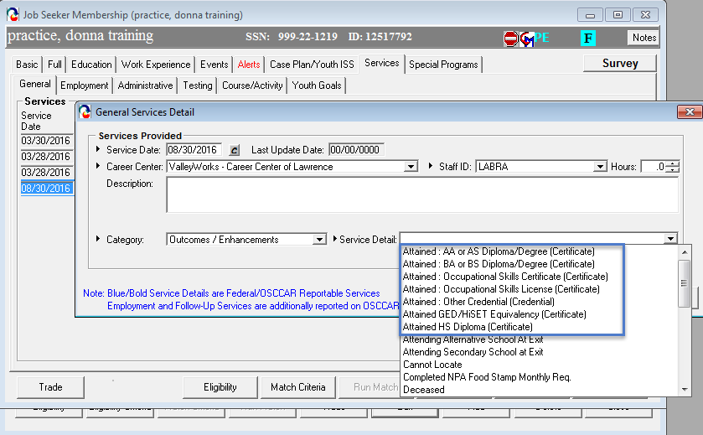
WIOA Performance Indicators
Credential Attainment – Step 1

Slide 20
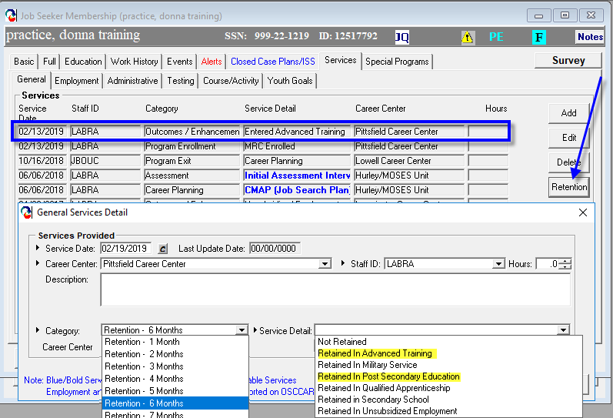
WIOA Performance Indicators
Credential Attainment – Step 2 (for those only achieving hs equivalency)
Retention Services – any month (1 – 12):

Slide 21
Credential Attainment
Scenario
Julia is a WIOA ISY attending high school. She graduates from high school, earns her diploma, and exits the WIOA Youth program shortly thereafter. In her 2nd quarter after exit, she is attending community college. By her 4th quarter after exit, she is no longer in community college, nor is she employed.
Is Julia included in the credential attainment rate?
Is Julia a positive outcome in the Credential Attainment rate?

Slide 22
WIOA Performance Indicators
  Measurable Skill Gain (MSG) Indicator:
  The measurable skill gains indicator measures the percentage of program participants who, during a program year, are in an education or training and who are achieving progress, defined as documented gains in academic, technical, or occupational skills leading towards a credential or employment.
  MSG is not an exiter based performance indicator.

Slide 23
WIOA Performance Indicators
Who is in the Measurable Skill Gains measure?
  All In School Youth are included!
  Adults/Dislocated Workers who are in any occupational skills training, including OJT, or in any secondary school programs (ABE/GED).
  Out of School Youth who are in any occupational skills training, not including OJT, or in any secondary education programs (ABE/GED), or YouthBuild or Job Corps.

Slide 24
WIOA Performance Indicators
Measurable Skill Gain
MSG Rules:
At least one measurable skill gain must be accomplished for each program year that a participant is enrolled in an education or training component.
A skill gain may count if attained after exit if still within the program year.

Slide 25
WIOA Performance Indicators
Measurable Skill Gains
There are five (5) types of gains;
Educational Functioning Level Gain:
  Compare pre-test and post test to see gain in educational functioning level based on standard National Reporting System (NRS) tests like TABE, CASAS, MAPT.
Diploma or Recognized Equivalent:
  HS diploma or state recognized equivalent (GED/HiSET)
Transcript or Report Card:
  The report card should demonstrate satisfactory achievement in all classes by the participant in secondary education for one semester.
  A post secondary transcript showing achievement with sufficient credit hours; 12+ hours per semester for full time, or 12+ hours over two semesters during a 12-month period for part time students.

Slide 26
WIOA Performance Indicators
Measurable Skill Gains
Training Milestones:
  The gain is documented by a satisfactory or better progress report from an employer or trainer. Some examples are:
    Completion of OJT or apprenticeship program or steps to complete either.
    Milestones for mastery of job skills
    Increased pay from improved skills or performance
Skills Progression (based on exams):
  Some examples are:
    Passing a ServSafe exam on way to a culinary certification
    Passing a CPR exam on way to a CNA certification
    Any industry recognized credential

Slide 27
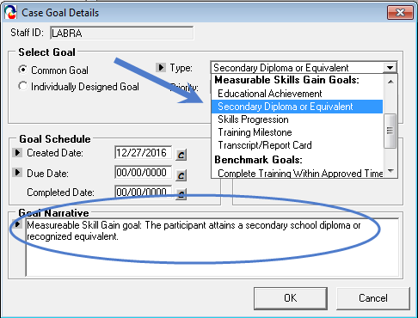
WIOA Performance Indicators
Tracking Measurable Skill Gains
On the Career Planning tab:

Slide 28
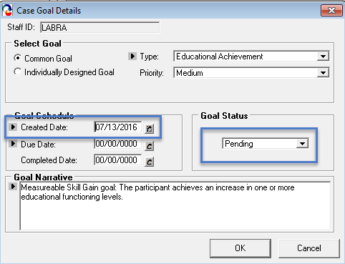
WIOA Performance Indicators
WIOA Performance Indicators
Tracking Measurable Skill Gains
On the Career Planning tab:

Slide 29
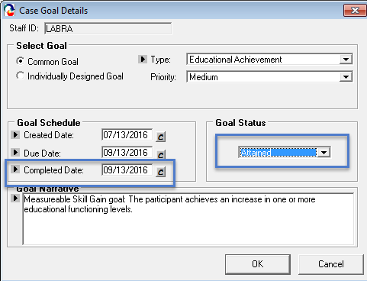
WIOA Performance Indicators
WIOA Performance Indicators
Tracking Measurable Skill Gains
On the Career Planning tab:

Slide 30
WIOA Performance Indicators
Measurable Skill Gains
DON’T FORGET:
  When entering a Secondary Diploma/Equivalency MSG, you must add the High School diploma/equivalency attainment service on the General tab of MOSES!!!!
  When entering an Educational Achievement MSG, you must add the pre and post test scores to the Testing tab of MOSES!!!

Slide 31
Measurable Skill Gain
Scenario
Danny is a WIOA Adult participant who entered into an OJT with a local software developer on January 15, 2020. He completed the training on May 7, 2020 at which time he became a full time employee.
Is Danny included in the Measurable Skill Gains indicator for FY2020 (July 2019 – June 2020)?
Is Danny a positive outcome in the Measurable Skill Gain measure?

Slide 32
Staff Assisted (Blue/Bold) Services, Notes, Exits, and the 90 Day Clock

Slide 33
Definition of WIOA Exit
20 CFR § 677.150(c)
An exit occurs when a participant has not received a [staff-assisted (blue/bold)] service for 90 consecutive days and no future services are planned. The exit date becomes the last day that the participant receives services.

Slide 34
Participation/Exit Timeline/Continuum
Participation Start Date: July 7 Exit Date: September 7
<< Participation >>
<< Follow-Up Services >>>>>>>>
90 Day Clock is always counting
Exit Determined
Blue/Bold Services
Exit Date
Jul 7
Sept 7
Dec 7

Slide 35
Staff Assisted Services (Blue/Bold)
Staff assisted services trigger and/or extend participation in the program (i.e. any blue/bold service resets the 90 day clock to zero (0))
Staff assisted services provide some benefit to a customer and take substantial staff time.
Services like assessment or career planning or counseling are examples of staff assisted services.
Services like emailing a customer or leaving a phone message are examples of services that are not staff-assisted services.
All services entered should be accompanied by clear notes!!!

Slide 36
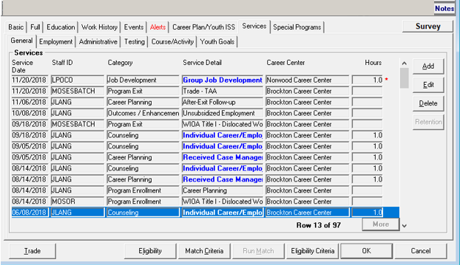
Adding Staff Assisted (Blue/Bold) Services

Slide 37
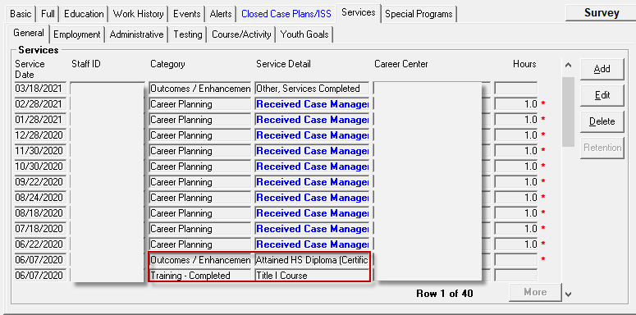
Incorrect Use of Blue/Bold Services!!

Slide 38
Exclusions from Performance
Must be identified and documented* by the end of the 3rd quarter after exit:
  Institutionalized
  Health/Medical Care
  Deceased
  Reservist Called to Active Duty
  Youth Mandated to Relocation Program/Foster Care
* New USDOL/ETA data integrity tool!
- FMO staff will be focusing on exclusionary exits

Slide 39
Key MOSES Data Entry Points
Performance Measure | Tracking Point
In Employment or Education or Training in the 2nd Quarter After Exit | Employment Tab/General Services Tab Follow-up Month 6 (Q2), (or all months as they occur) Retention Month 6 (Q2), (or all months as they occur)
In Employment or Education or Training in the 4th Quarter After Exit | Employment Tab/General Services Tab Follow-up Month 12 (Q4), (or all months as they occur) Retention Month 12 (Q4), (or all months as they occur)
Credential Attainment | General Services tab Attainment services Plus for secondary credential, employment follow up and/or retention (any quarters)
Measureable Skill Gain | Case Management tab goals (plus any attainments, test scores, etc.)

Slide 40
Resources
  Workforce Innovation and Opportunity Act: Department of Labor Only – Final Rule
  https://www.gpo.gov/fdsys/pkg/FR-2016-08-19/pdf/2016-15975.pdf
  Department of Labor TEGL 10-16 Change 1 Performance Accountability
  https://wdr.doleta.gov/directives/corr_doc.cfm?DOCN=3255
Department of Labor TEGL 26-16 Supplemental Wage Information
  https://wdr.doleta.gov/directives/corr_doc.cfm?DOCN=5002
Department of Labor TEN 25-19 Post Secondary Credentials
  https://wdr.doleta.gov/directives/corr_doc.cfm?docn=5953
Performance Review Tool Report
  WIOA reports | Mass.gov

