Slide 1
Adult and Dislocated Worker Program
December 12, 2019

Slide 2
TOPICS
Importance of WIOA
Eligibility Criteria for Adults and Dislocated Workers
Source Documentation
Career Services/ Training
Career Planning
Coordination with WIOA Partner Programs
Shared Customers

Slide 3
Importance of the Workforce Innovation and Opportunity Act
WIOA focuses on serving individuals with barriers to employment and seeks to ensure these individuals receive access to quality of services.
Services provided to eligible individuals under the WIOA Title I Adult and Dislocated Worker Program lead to pathways for economic self-sufficiency.

Slide 4
WIOA Adult Eligibility/Priority of Service
Citizenship or work authorized, AND Selective Service Compliance AND 18 or older
Populations Given Priority of Service for Individualized and Training Services
Covered persons (Veterans and eligible spouses)
Public assistance
Other low income
Basic skills deficient
The Local Board and the Governor may establish a process that also gives priority to other individuals eligible to receive such services, provided that it is consistent with priority of service for Veterans. (§680.600(c)) *
*VETERANS PRIORITY OF SERVICE - Mass Workforce issuance 100 DCS 15.100
Veterans under WIOA sec. 3(63)(A) and 38 U.S.C. 101 receive priority of service in all Department of Labor-funded training programs under 38 U.S.C. 4215 and described in 20 CFR 1010. A Veteran must still meet each program’s eligibility criteria to receive services under the respective employment and training program.

Slide 5
WIOA Adult Eligibility/Priority of Service
Priority Ordering (for individualized and training services)
First, to veterans and eligible spouses who are also included in the groups given statutory priority for WIOA adult formula funds.
Second, to non-covered persons (that is, individuals who are not veterans or eligible spouses) who are included in the groups given priority for WIOA adult formula funds.
Third, to veterans and eligible spouses who are not included in WIOA’s priority groups.
Fourth, priority populations established by the Local Workforce Development Board
Last, to non-covered persons outside the groups given priority under WIOA

Slide 6
WIOA Dislocated Worker Eligibility
Citizenship or work authorized, and Selective Service Compliance
One or more of the following four (4) conditions:
Employment Status of Received Notice of Layoff OR Layoff Status of Terminated/Laid Off AND
UI Claimant (Active/Expired/Exhausted) OR Workforce Attachment = “Yes” AND is unlikely to return to a previous industry or occupation
Employment Status of Received Notice of Layoff OR Layoff Status of Terminated/Laid Off
AND Work History record with a Layoff ID
Displaced Homemaker
4. Layoff Status of Unemployed, Previously Self Employed

Slide 7
WIOA Dislocated Worker Eligibility Definitions
DISPLACED HOMEMAKER (WIOA sec. 3(16)) – an individual who has been providing unpaid services to family members in the home and who –
(A) (i) has been depending on the income of another family member but is no longer supported by that income; or
(ii) is the dependent spouse of a member of the Armed Forced on active duty and whose family income is significantly reduced because of a deployment, or call to active duty, or service connected death or disability, AND
(B) Is unemployed or underemployed and is experiencing difficulty in obtaining or upgrading employment
ATTACHMENT TO THE WORKFORCE (WIOA sec. 3(15))
- an individual who has been employed for a duration sufficient to demonstrate, to the appropriate entity at a one-stop center referred to in section 121(e), attachment to the workforce, but is not eligible for unemployment compensation due to insufficient earnings or having performed services for an employer that were not covered under a State unemployment compensation law…

Slide 8
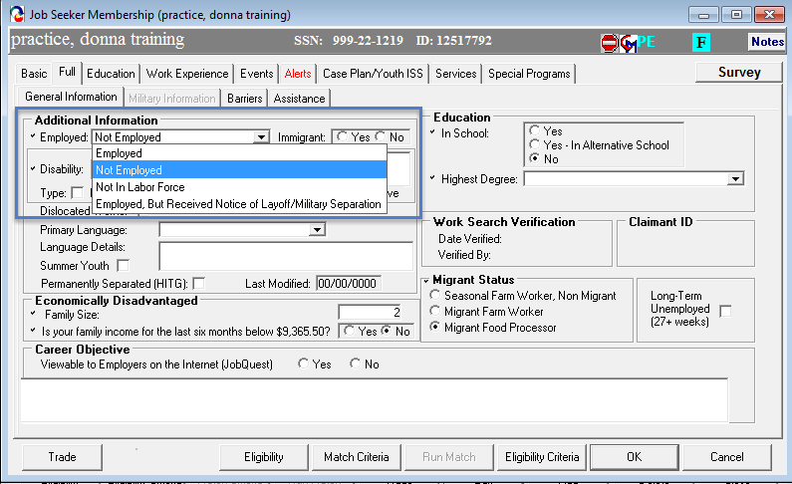
WIOA Dislocated Worker Eligibility
Employment Status

Slide 9
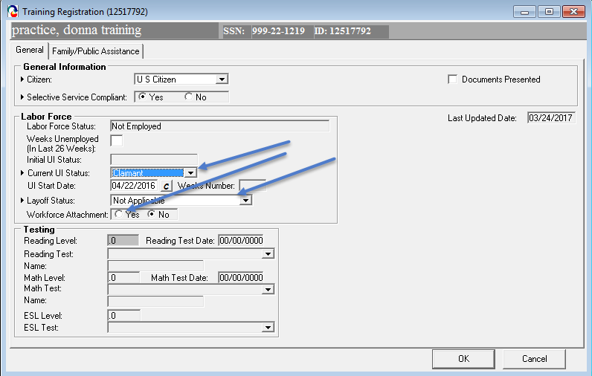
WIOA Dislocated Worker Eligibility
UI Claimant Status, Layoff Status, Workforce Attachment

Slide 10
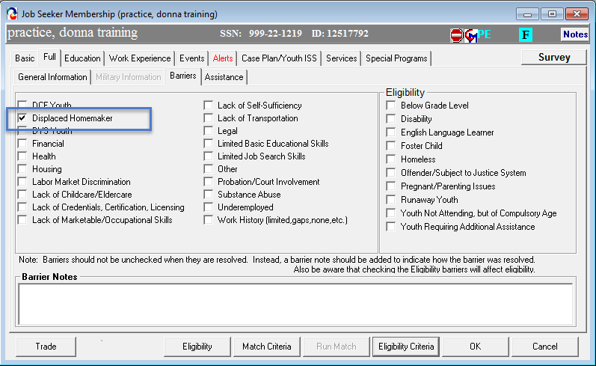
WIOA Dislocated Worker Eligibility
Displaced Homemaker

Slide 11
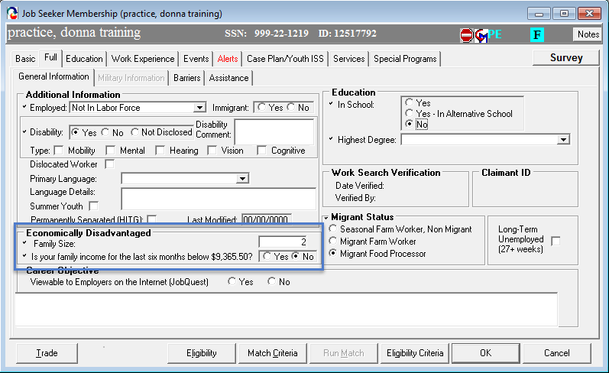
Income Stuff
Self Attestation Question on Full Tab

Slide 12
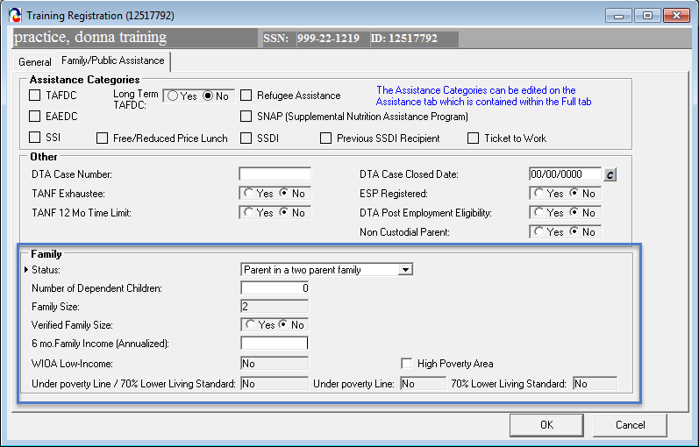
Income Stuff
Verifying Income

Slide 13
Source Documentation
Documentation is necessary to support Adult and Dislocated Worker eligibility and priority of service.
Staff must verify and confirm that individuals are eligible to participate in Adult and Dislocated Worker program services through an examination of documents.
Documentation may be stored electronically, however documentation must be available to program monitors, fiscal monitors, and auditors. (Security protocols to safeguard personal information must be in place.)
Local areas must retain records for a period of at least three (3) years after the submittal of the final closeout expenditure report for that funding period.
100 DCS 18.101.4 Eligibility Requirements for WIOA Title I Adult and Dislocated Worker
13

Slide 14
Three Types of Career Services
**Under WIOA there is no longer a sequence of services**
Basic Career Services: Universally accessible and made available to all individuals seeking employment and training.
Services include:
Eligibility Determination
Initial Skills Assessment
Labor Exchange Services
Information on Programs and Services
Program Referrals
Basic services must be made available in at least one comprehensive Career Center per local area.
Basic Career Services may be provided by Adult and Dislocated Worker staff and Employment Services staff.

Slide 15
Three Types of Career Services continued…
Individualized Career Services: Made available to participants after staff determine that such services are required to retain or obtain employment consistent with applicable statutory priorities.
Services Include:
Specialized Assessment
Development of Individualized Employment Plan
Jointly developed by the participant and career planner
On-going strategy to identify:
Employment goals
Achievement objectives
Appropriate combination of services for the participant to achieve the employment goals
Counseling
Work Experiences (including transitional jobs)
Transitional Jobs: time limited and wage-paid work experiences up to 100 percent subsidized.
Must be combined with career and supportive services
Established work history, demonstrates success in the workplace and develops skills
Local Boards may use 10% of funds to support transitional jobs
Individualized Career Services may be provided by Adult and Dislocated Worker staff and Employment Services staff.

Slide 16
Training Services
Training may be provided whether or not the individual has received basic or individualized career services first.
Exception – When career services are not provided before training, career center staff and partner program staff must adhere to the Local Board’s policy that provides justification of the circumstances in which to provide services without first providing career services.
Case file must contain a determination of the need for training services.
Training can be justified through the use an interview, evaluation, assessment, or career planning.
The following tools can be used to justify training (the list below is not intended to be limiting):
Work Keys Placement Quiz or Exam
MassCIS
TORQ
Academic Assessment Tool
Staff must adhere to the local area policy on eligibility for training

Slide 17
Training Services continued…
Individual Training Account (ITA)
Training provided by an Eligible Training Provider (ETP)
Participants must have access to the Eligible Training Provider List (ETPL)
* The ETPL is accessible to all local OSCCs and customers through Job Quest
Types of Training Services that may be provided Include but are not limited to:
Occupational Skills Training
OJT Training
Incumbent Worker Training
Workplace training with related instruction
Training programs operated by the private sector
Skill upgrade and training
Entrepreneurial Skills Training
Job readiness training
Adult education and literacy activities
Customized Training

Slide 18
Training Services continued…
Under certain circumstances a training contract may be used to provide training. This type of training is referred to as a “training exception” or “contract exception”
One of five circumstance need to apply and the process for using a contract exception must be described in the local plan:
OJT
Insufficient Number of ETPs
Training Program that has Demonstrated Effectiveness
Training Provided by an Institution of Higher Education
Pay for Performance Contracts
The Local Board must fulfil the consumer choice requirements in 20 CFR 680.340
Local WDBs may determine that providing training through a combination of ITAs and contracts is the most effective approach to placing participants in programs such as Registered Apprenticeship programs and other similar types of training.

Slide 19
Three Types of Career Services continued……
Follow-Up Services: Provided for 12 months after the first day participants are placed in unsubsidized employment. Local area policies must define appropriate follow-up services.
Services Include:
Providing individuals counseling about the workplace
Career planning and counseling
Information about additional educational opportunities
Referral to support services available in the community and peer support groups
Case management administrative follow-up
Follow up services for case planning are not to be construed as follow up services required for performance reporting.
100 DCS 08.102: WIOA Title I Follow Up Services Policy:
http://www.mass.gov/massworkforce/docs/issuances/wioa-policy/08-102.pdf

Slide 20
Tracking Follow-Up Services in MOSES
Follow-up variants for tracking;
Required 12 Month Follow-up
Overarching, required by law
After Exit Follow-up Services
Specific services delivered after exit (e.g. Counseling)
Retention Services
Extremely Important for federal performance
Employment Follow-up Services
Possibly extremely important for federal performance

Slide 21
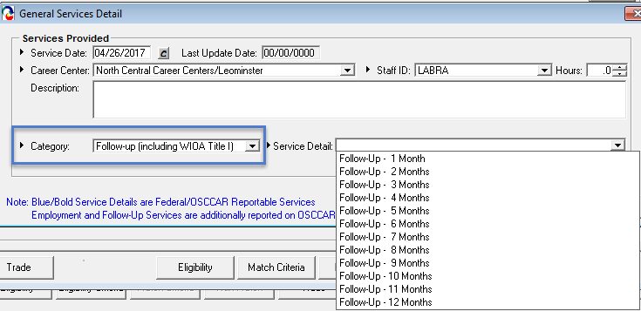
Types of Follow Up Services Entry
Required 12 Month Follow Up

Slide 22
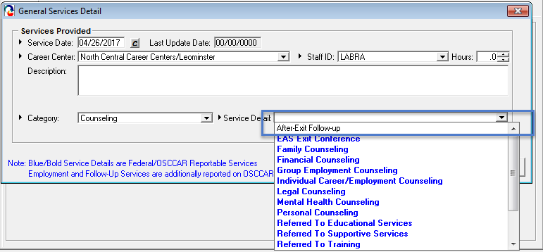
Types of Follow Up Services Entry
After Exit Follow Up Services
(Use the After Exit Follow-up service detail so that a new participation cycle is not created)

Slide 23
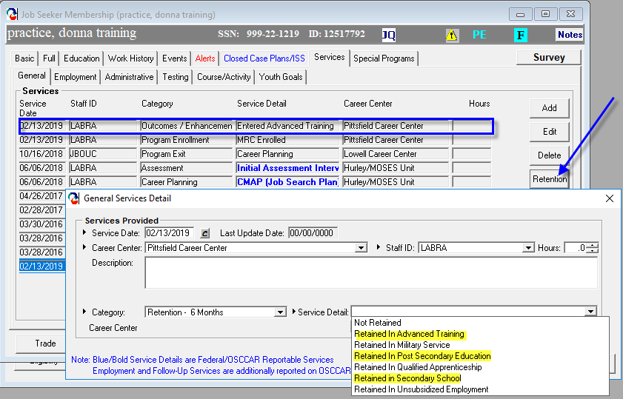
Types of Follow Up Services Entry
Retention Services (Month 1 – 12)

Slide 24
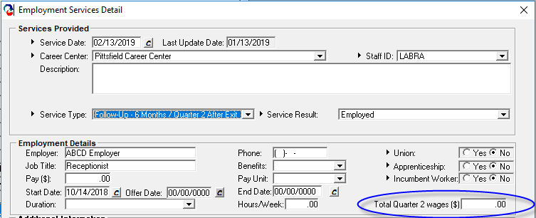
Types of Follow Up Services Entry
Employment Follow Up Services

Slide 25
Supportive Services and Needs Related Payments
Supportive Services
Available to Adults and Dislocated Workers participating in Title I career services or training activities.
Enables the individual to participate in career services or training activities.
Needs Related Payments
Designed to provide participants with financial assistance to participate in training services
Participants must be enrolled in a training program in order to receive needs-related payments
100 DCS 08.106: Supportive Services and Needs-Related Payments for Title I Adults and Dislocated Worker Youth Policy
http://www.mass.gov/massworkforce/docs/issuances/wioa-policy/08-106.pdf

Slide 26
Career Planning Requirements
All customers enrolled in WIOA Title I Adult and DW program receiving individualized career services will have an Individualized Employment Plan also known as the Career Action Plan (CAP).
The CAP is an individualized career service consisting of connected activities, jointly developed by the participant and career center staff.
The CAP is an ongoing strategy used to identify:
Employment Goals
Achievement Objectives
Appropriate Combination of Services
The CAP must be monitored by staff to ensure effectiveness.
Career Planning must be documented in the Career Plan in MOSES
MassWorkforce Issuance 100 DCS 08.112.10: Career Planning for Workforce Innovation and Opportunity Act (WIOA) Job Seeker Customers

Slide 27
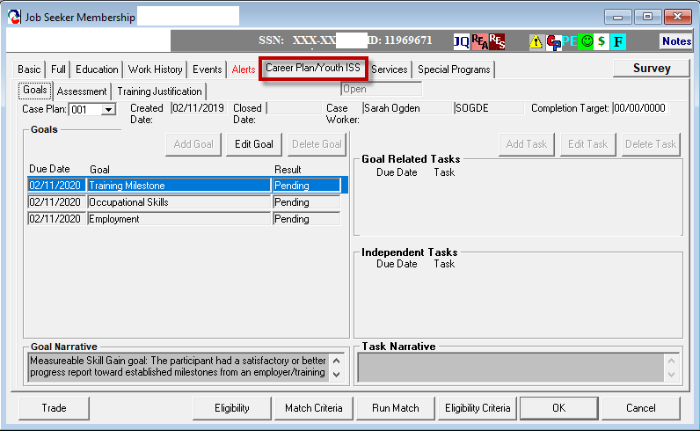
Career Plan in MOSES

Slide 28
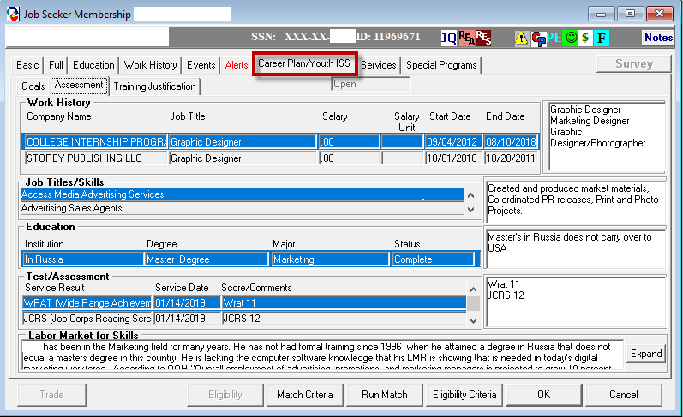
Career Plan in MOSES

Slide 29
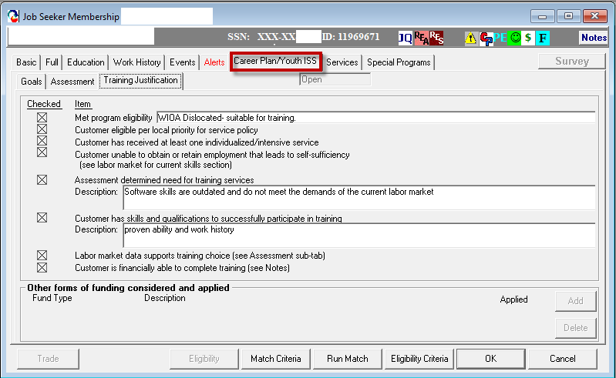
Career Plan in MOSES

Slide 30
Coordination with WIOA Partner Programs
Partner Program | Population | Services
WIOA Title I Youth Program (Youth Service Providers) | ISY and OSY 14 -24 | Comprehensive assessments, career planning, support services, alternative education, work-based learning experiences, and occupational skills training.
WIOA Title II Adult Education and Family Literacy (Adult Education Providers) | Adults 16 and older not currently enrolled, or required to be enrolled in high school. | Assist adults to become literate and obtain the knowledge and skills necessary for employment and economic self-sufficiency.
Vocation Rehabilitation Title IV (Mass Rehabilitation Commission and Mass Commission for the Blind) | Individuals must have a physical or mental impairment that is a substantial impediment to employment. | Preparation for placement in competitive integrated employment.
Senior Community Employment Service Program Title V (Older Workers) | Individuals age 55 an older | Provides opportunities for community services and work-based training for older workers.
TANF and SNAP (Department of Transitional Assistance) | Low-income individuals and families. | Assists low-income individuals and families meet their basic needs, improve their quality of life.

Slide 31
Shared Customers
Key reform of WIOA is strategic alignment of workforce partners to serve individuals that have a variety of needs.
Job Seekers and Youth that are eligible to receive service from more than one WIOA Partner Program are considered shared customers (this also includes businesses.)
Shared customers benefit from services and resources delivered across multiple WIOA Partner Programs.
Shared customers must be tracked in MOSES
Co-location of Partner staff in the career centers will lead to increased number of shared customers
Joint Partner Policy Commination: 01.2018 – WIOA Partner Shared Customer

Slide 32
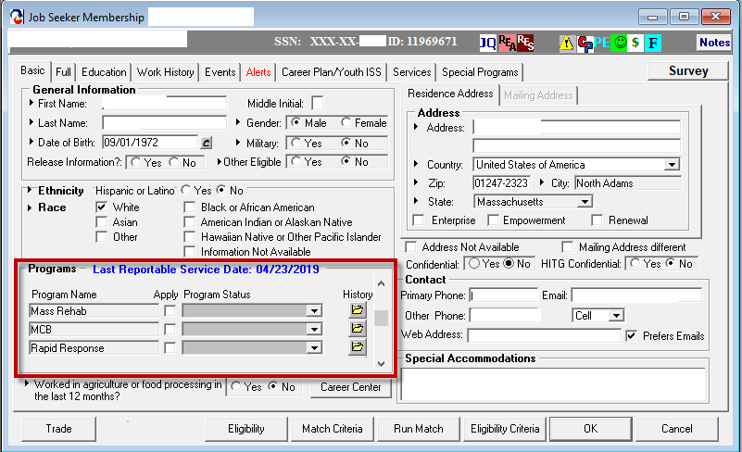
Documenting the Shared Customer in MOSES

Slide 33
Co-Enrollment
Youth Program Service Elements
Adult Program ITA
Co-enrollment for Alignment of Services
Example
Individual receives support and wrap around services through enrollment in the Youth Program
Occupational Skills Training supported through the Adult Program
Individuals aged 18-24 may be eligible for both the WIOA Youth and Adult programs and can be co-enrolled in the two programs.

Slide 34
Program Coordination
Adult Education
Adult Program ITA
Integrated Education and Training
Example
Individual enrolled in English Language Proficiency classes
Enrolled in CDL course supported through the Adult Program
WIOA allows Title I and Title II to coordinate in the development of career pathways and co-enrollment so that participants receive the full spectrum of services for their education and employment needs.

Slide 35
Blending and Braiding Resources
Using resources from multiple sources to meet the needs of a job seeker
Example 1:
Individual receives skill training funded by WIOA
Job accommodations paid for by MRC
Example 2:
Individual from a disability program uses Career Center services
Disability program provides post-placement support (job coaching)
Example 3:
Combining revenue from Ticket to Work with workforce development funding/resources
MassHire
MRC or MCB
Service Alignment

Slide 36
Resources
Workforce Innovation and Opportunity Act
https://www.congress.gov/bill/113th-congress/house-bill/803/text
Workforce Innovation and Opportunity Act: Department of Labor Only – Final Rule
https://www.gpo.gov/fdsys/pkg/FR-2016-08-19/pdf/2016-15975.pdf
Department of Labor TEGL 10-16, Change 1 Performance Accountability
https://wdr.doleta.gov/directives/corr_doc.cfm?DOCN=8226
Department of Labor TEGL 19-16 Guidance on the Adult and Dislocated Worker Program
https://wdr.doleta.gov/directives/corr_doc.cfm?docn=3851
Workforce GPS – Workforce Systems Strategy Website
https://www.workforcegps.org/
https://ion.workforcegps.org/
Career One Stop – American Job Centers
https://www.careeronestop.org/site/american-job-center.aspx

