Slide 1

A Tool to Find and Download GIS Data
Aleda Freeman– Web Mapping Services Manager Massachusetts Bureau of Geographic Information (MassGIS)
Executive Office of Technology Services and Security (EOTSS)
Notes:
Hi everyone, my name is Aleda Freeman, and I work at MassGIS. GIS stands for Geographic Information System, which is digital mapping. MassGIS is with the Executive Office of Technology Services and Security which is one of the branches of the Commonwealth of MA state government. MassGIS has been around for over 35 years! Our Director Cy Smith is with us today as well to help answer any questions you might have.

Slide 2
MassMapper & MassGIS Data
Presentation Topics
1
About MassGIS
2
MassGIS Data
3
MassMapper Demo
4
MassGIS Data Hub Demo
5
Questions?
Notes:
Today I’d like to tell you a little about MassGIS, about the data we publish and some tools to access that data, particularly the MassMapper application and the MassGIS Data Hub. We’ll have time for questions as well. Cy Smith our Director is here with you today also.

Slide 3
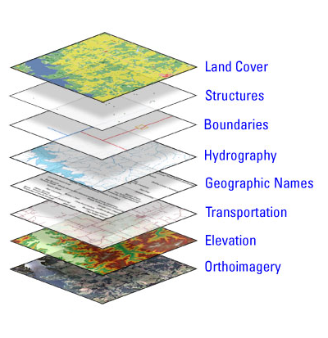
MassMapper & MassGIS Data
GIS Layers
MassGIS
parcels, addresses, aerial photos
MA Dept. of Transportation
streets, ports, exits
MA Dept. of Conservation & Recreation
parks, trails, wildlife
MA Dept. of Education
schools, districts
MA Dept. of Environmental Protection
wetlands, landfills, wells
Notes:
Kinds of data
The MassGIS data catalog includes a wide variety of data. Some data is created by MassGIS staff and other data is collected from state agencies. By compiling and publishing data MassGIS functions as a central clearinghouse. This helps users of GIS data as they no longer have to contact multiple state agencies to get what they need to create their map or do their analysis – since projects usually require a set of layers.

Slide 4
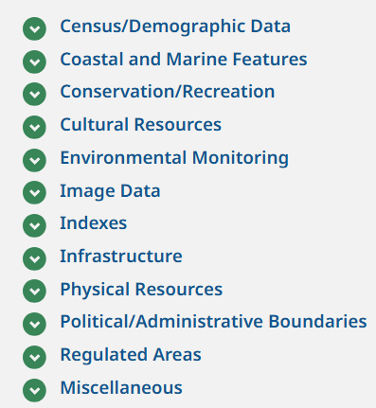
MassMapper & MassGIS Data
GIS Layers
Categories
Examples
population, environmental justice
shellfish, eelgrass, hurricane surge
openspace, wildlife, boating, trails
historic districts and buildings
water quality monitoring
aerial photos, elevation
latitude/longitude grids, aerial photo grids
roads, trains, buildings, dams, schools
land use, soils, wetlands, aquifers
towns, counties, legislative districts
landfills, flood zones, wellheads
https://www.mass.gov/info-details/massgis-data-layers
Notes:
MassGIS Data Categories
One way to find and download data is to go to the main MassGIS data catalog page on our web site. On that page you’ll see the categories on the left hand side. We’ve used these categories for many years to help organize our large amount of data. You can see some examples on the right of each. Infrastructure for example is for things that are built such as roads or buildings. Physical Resources are for things that are part of the land such as soils or wetlands.

Slide 5
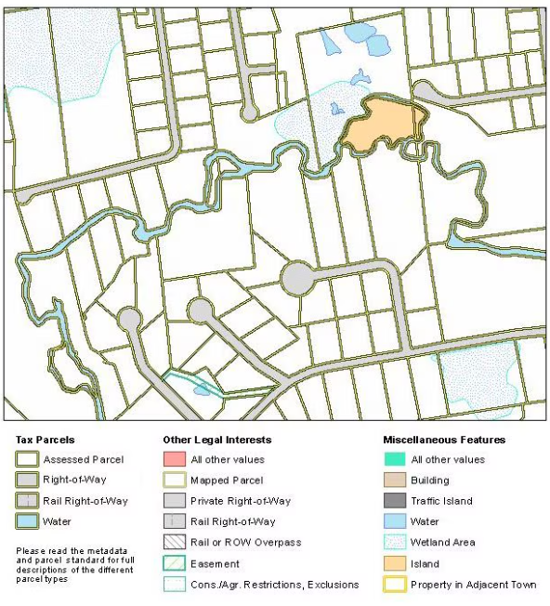
MassMapper & MassGIS Data
Statewide Property Tax Parcels
Notes:
I’d like to tell you a little more about one of our most popular datalayers which is Property Tax Parcels. Many years ago, MassGIS created a standard for editing parcel data and got the 351 municipalities in MA to adopt the standard. The standard ensures that the parcel polygons don’t have gaps or overlaps geospatially and have appropriate standardized data values. We publish a set of QA tools that check the data and as a result we collect updated data every year that can be viewed seamlessly across the state, enabling regional or statewide analysis.

Slide 6
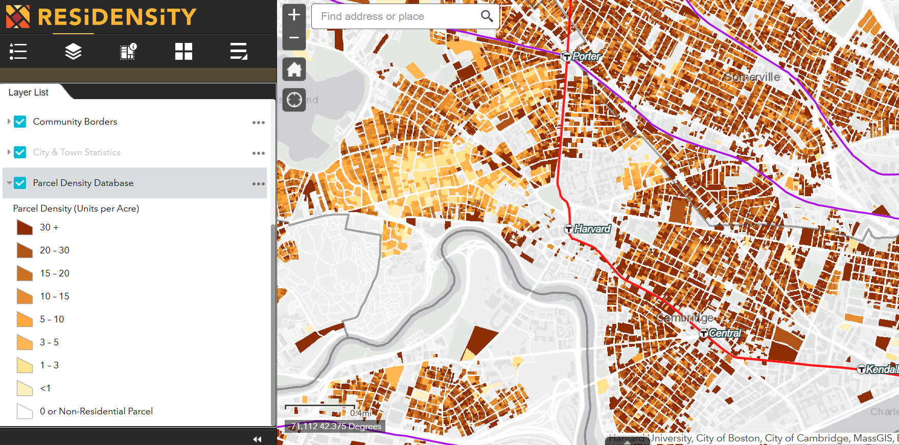
MassMapper & MassGIS Data
Projects using parcel data
MHP Residensity https://residensity.mhp.net/
Notes:
The availability of statewide parcel data enables interesting analytical projects – one is the Mass Housing Partnership Residensity application which allows users to interactively explore housing density. This slide shows the map centered on Harvard and you can see the color ramp where darker brown indicates more units per acre. The red line and the commuter rail is also shown, and it seems there is a clustering of more housing units closer to transit.

Slide 7
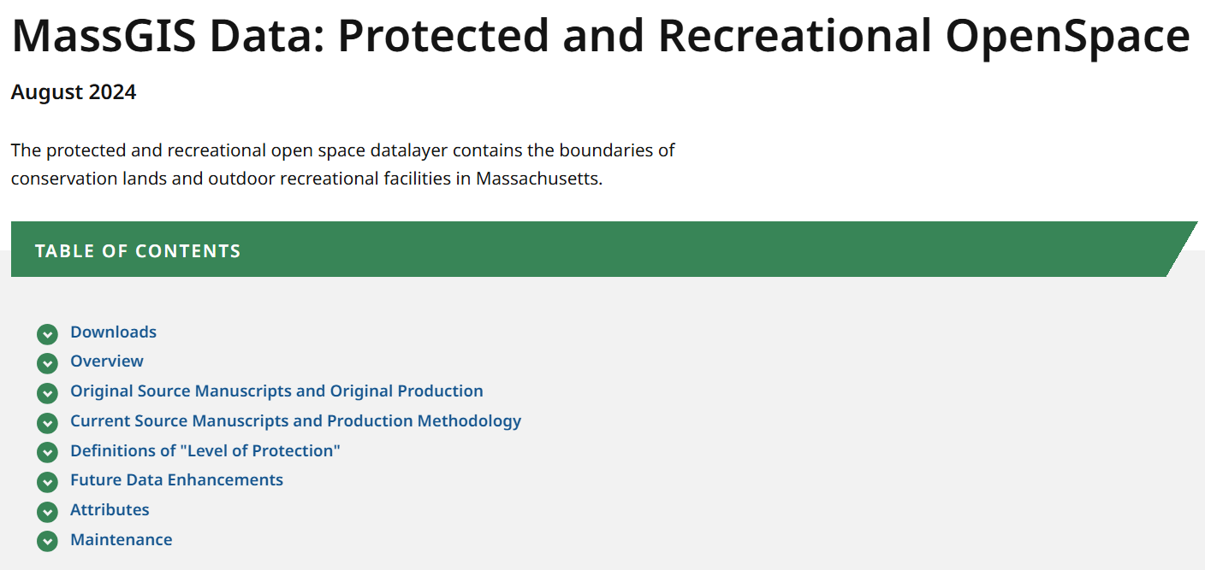
MassMapper & MassGIS Data
Metadata
Notes:
So, if you’re thinking about using some MassGIS data for your project, how do you find out more about a specific datalayer? One way is to look at the datalayer’s metadata web page on MassGIS’ web site. Each datalayer has extensive information about how the datalayer was created, who created it, how it is maintained, how often it is updated. Here we’re looking at the top of the Protected and Recreational OpenSpace datalayer which includes state and local parks and other open lands such as playing fields, golf courses and protected agricultural land.

Slide 8
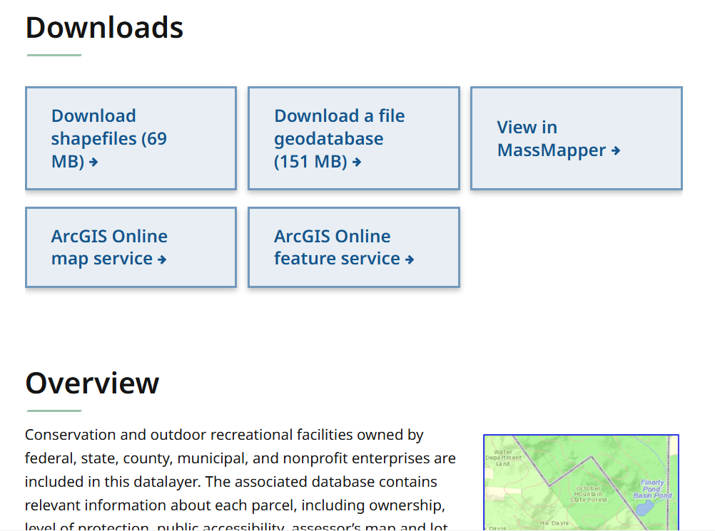
MassMapper & MassGIS Data
Metadata
Notes:
There’s a section on downloading the data in various formats, viewing it in an application such as MassMapper or using it as a streaming web map service. All the MassGIS data layers are available as ESRI vendor and open source streaming APIs.

Slide 9
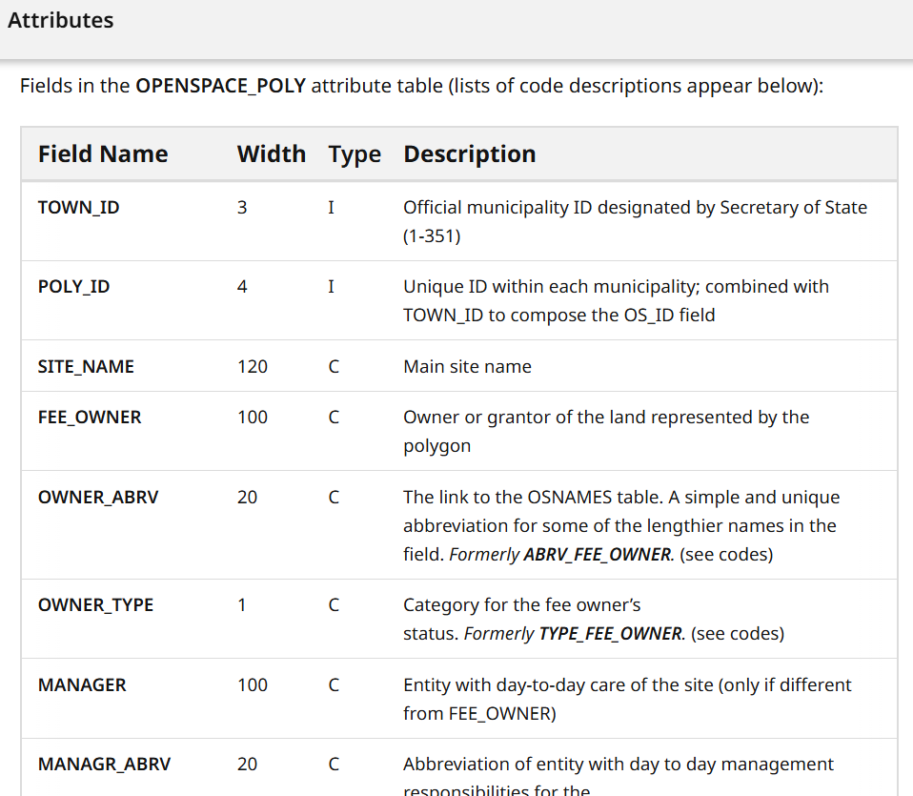
MassMapper & MassGIS Data
Metadata
Notes:
Each datalayer consists of points, lines or polygons that display on the map but also contain a row of tabular information with various attributes. Scrolling down on the datalayer metdata page is an important explanation of the tabular information including what the fields are about and what the codes or values represent. This will help you decode what the values mean and let you make colorful maps. For example, openspace has many attributes that describe the site’s name, ownership, management, type, acres, deed information and more.

Slide 10
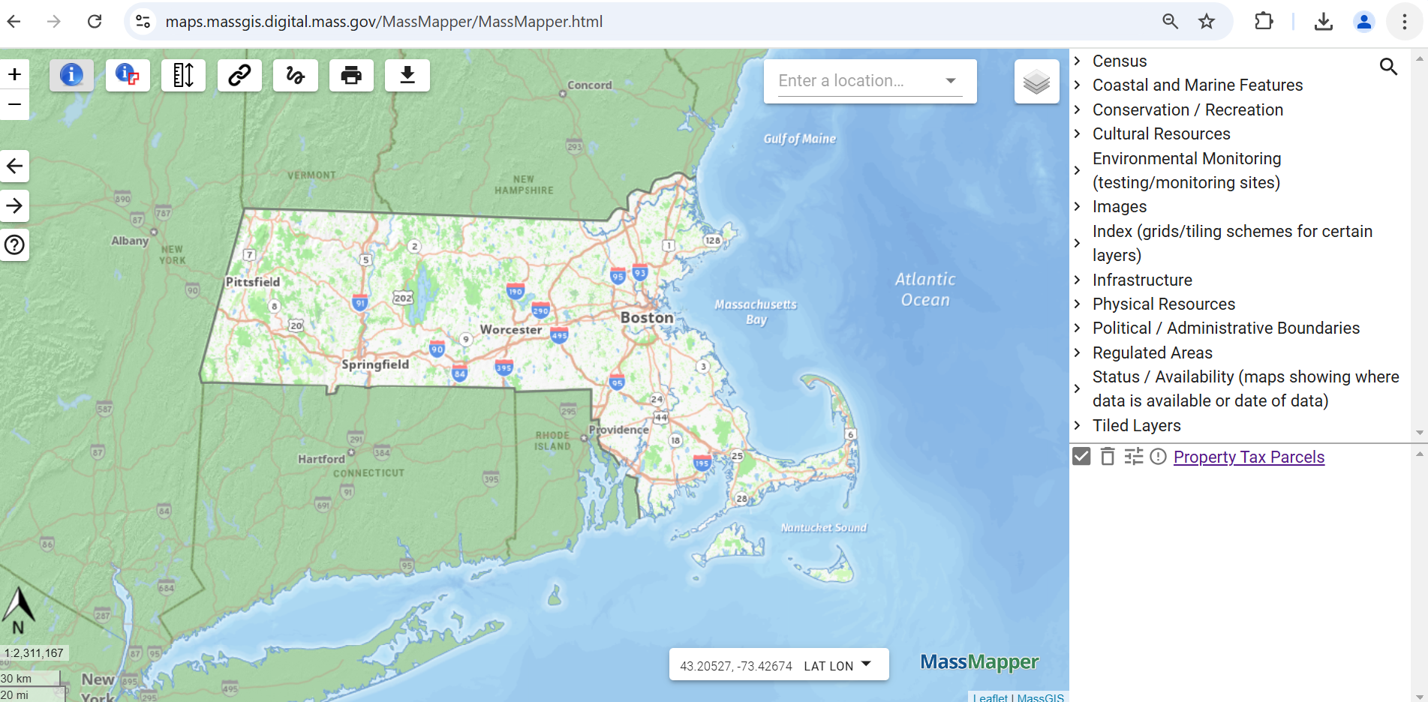
MassMapper & MassGIS Data
MassMapper Interface
Notes:
While the list of datalayers on the MassGIS website is helpful, since there are several hundred layers hosted by MassGIS, we’ve created an application called MassMapper to help people more easily find and preview data to see if they want to download a piece. According to our logs, MassMapper is launched about 2,500 times a day. I hope to give you a quick demo of MassMapper now to show how you can explore map data. Note: MassMapper works in all major web browser types such as Chrome, Edge and Safari. It works well on a computer or tablet but is a bit too large for a phone. Pointing out the sections of the user interface, the main section is the large map panel in the middle, In the upper right is a menu of layer choices which can be opened into subfolders. In the bottom right is a legend area that will show data symbology. In the upper left are tools for navigating the map, and querying and downloading data. In the lower right we have a coordinate display that will show you the coordinates of your mouse, with some different coordinate choices. Note that if you hover your mouse over any button or item you’ll get more information about it.

Slide 11
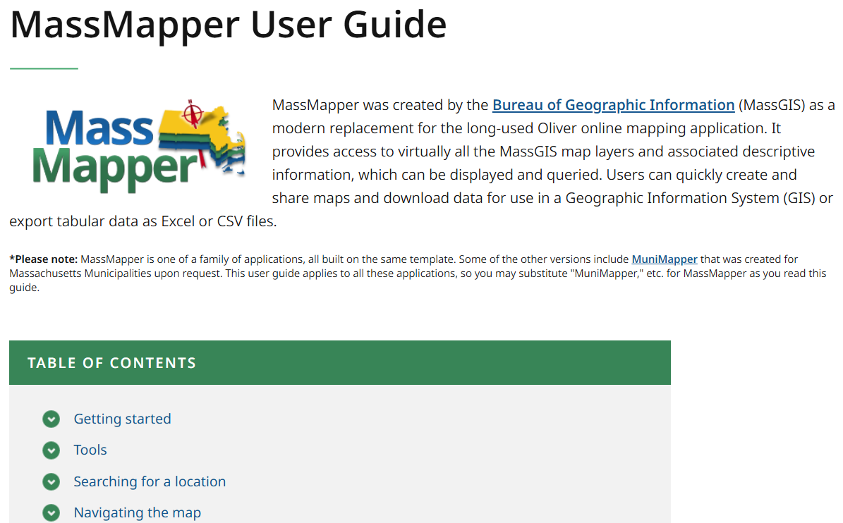

MassMapper & MassGIS Data
MassMapper – Custom MassGIS Basemap
https://maps.massgis.digital.mass.gov/MassMapper/MassMapperUserGuide.htm
Notes:
Before I go any further I also want to mention that there is a help button which looks like a question mark on the left side of the map which will bring you to a web page that goes into detail about all the MassMapper functions.

Slide 12
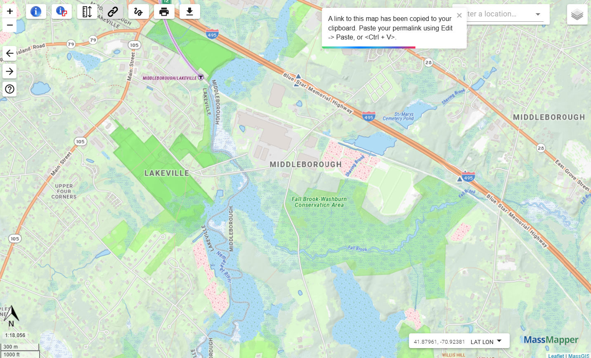
MassMapper & MassGIS Data
MassMapper – Custom MassGIS Basemap
Notes:
I think adding GIS datalayers together is kind of like making a pizza. When you launch MassMapper you won’t see a blank screen - we give you the bottom layer automatically – the crust, which is a baked in-house by our cartographer Michael Trust to give you a detailed basemap. This basemap includes many datalayers such as roads, parks and lakes which are updated frequently. However, the basemap is just a visual aid - it can’t be queried – if you want to query these types of items you’ll add them from the menu.

Slide 13
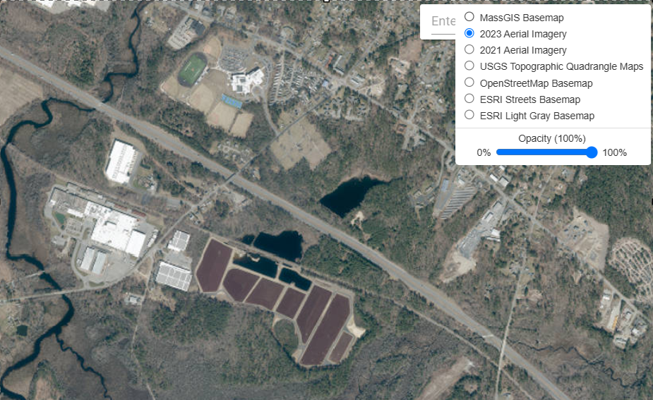
MassMapper & MassGIS Data
MassMapper – Other Basemaps
Notes:
The default basemap can be changed to other basemap options such as an aerial photo from spring of 2023 by using the button in the upper right that looks like a stack of layers. The opacity can also be changed for each basemap by using the slider tool.

Slide 14
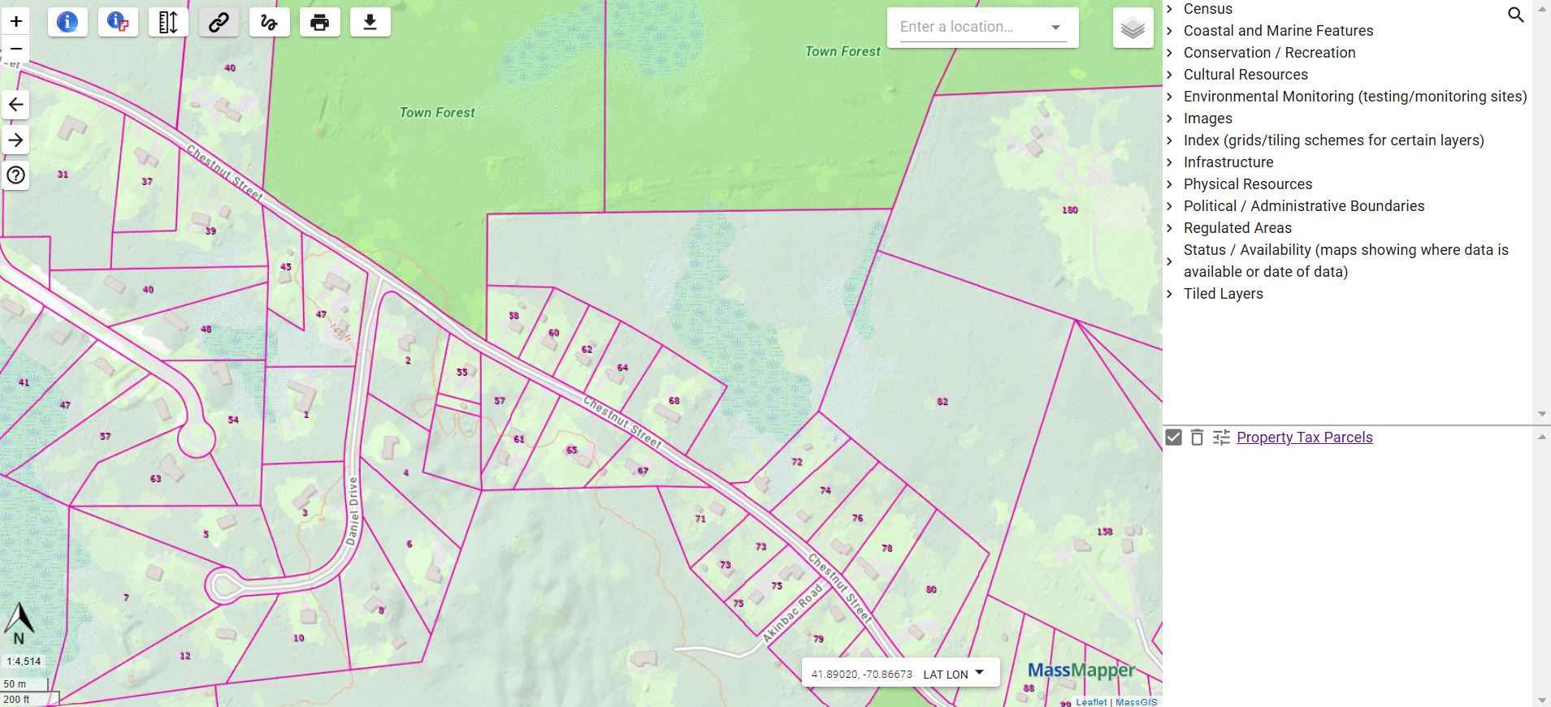
MassMapper & MassGIS Data
MassMapper – Base Layers
Notes:
Continuing with the pizza analogy, the other thing MassMapper gives you by default is cheese. Because it is such a popular datalayer, MassMapper automatically adds Property Tax Parcels. If you don’t want the parcels in your map you can easily undraw then by turning off the check mark or deleting layer by clicking the trash can icon.

Slide 15
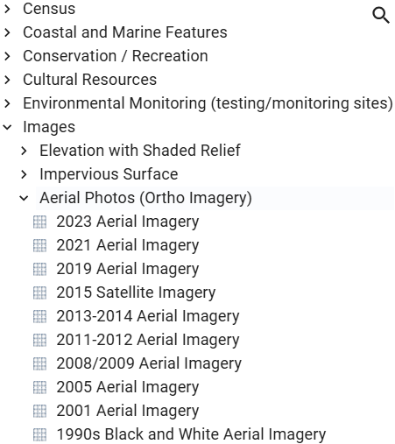
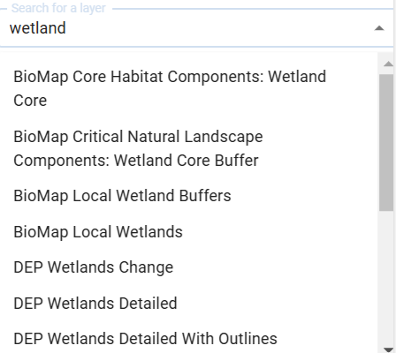
MassMapper & MassGIS Data
MassMapper – Searching for Layers
Notes:
Given those 2 default layers after that it is up to you to decide what type of pizza you want to make. You can add data from the menu we provide in the upper right, by exploring the MassGIS categories previously mentioned. Since there is so much data, there’s also a search option which will display a list of matches by text string. For example, I can type wetland into the box and as I start typing a list of matching layers appears, which I can choose from.

Slide 16
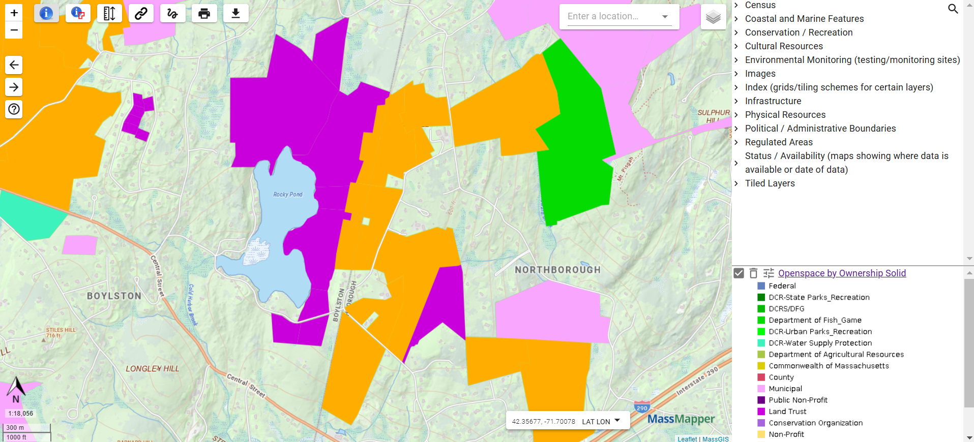
MassMapper & MassGIS Data
MassMapper Adding Data
Notes:
So, we can use MassMapper to view and query some datasets to decide whether we want to download them. For example, we can add OpenSpace data symbolized by ownership type. OpenSpace areas have different types of ownership such as state parks or municipal parks or tracts owned by land trusts. If we want to pull back up the metadata page, that link is available right in the legend. MassMapper allows some data exploration - if we want more detailed information on ownership, we can use the identify tool. That is the blue circle with an white letter “I” inside, and is enabled by default. That dark large dark purple polygon adjacent to the lake looks in the legend to be a land trust area, we can just click once on that to see the row of information in the table.

Slide 17
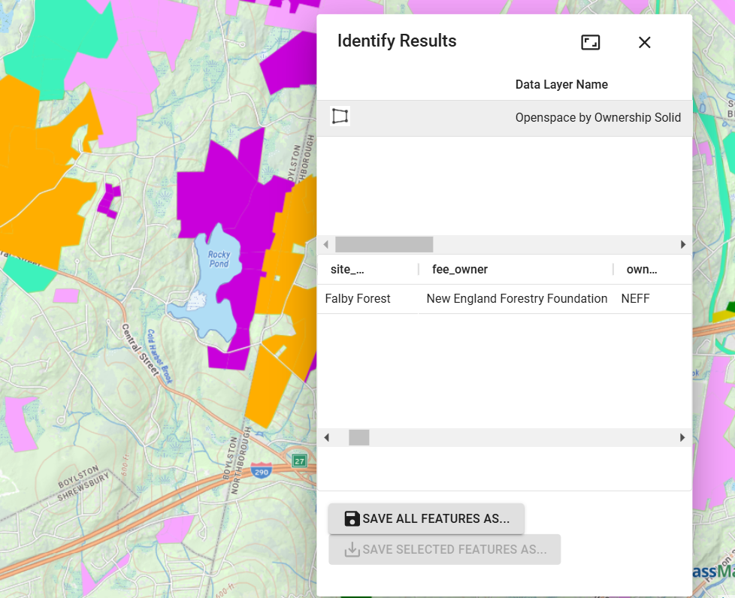
MassMapper & MassGIS Data
MassMapper Identify
Notes:
Then, looking at the tabular info we can compare to the metadata page to get an understanding of what the fields mean. One named fee_owner is pretty straight-forward and the owner is the New England Forestry Foundation.

Slide 18
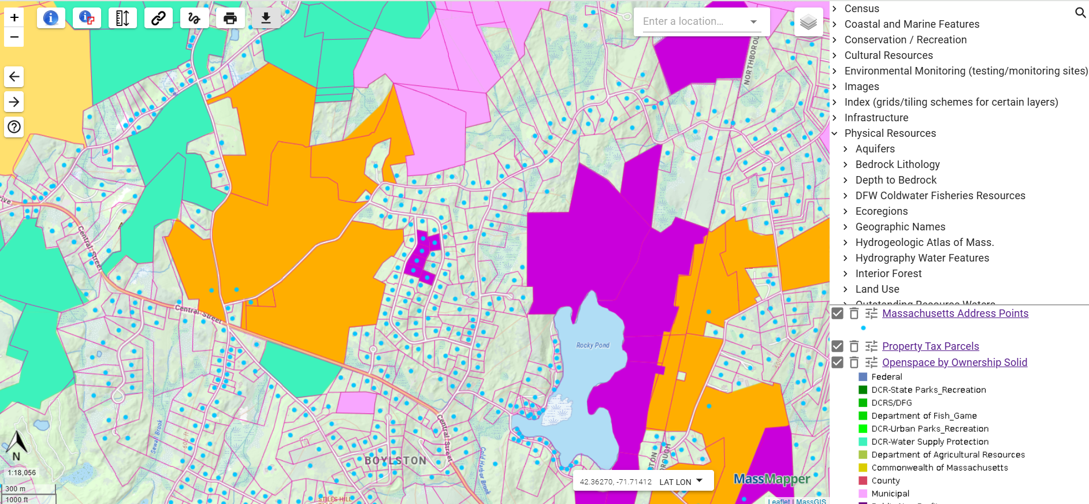
MassMapper & MassGIS Data
MassMapper Layers
Notes:
We can add more datalayers to my map – under Infrastructure I can add Massachusetts Address Points. This is a very up to date datalayer that MassGIS works on for the State 911 Department that is also useful for a lot of other projects. Now, if we decided we have enough and we want to download what we see in this window for use in a GIS project we can click the download button. The download button on the toolbar has an icon of a downward pointing arrow.

Slide 19
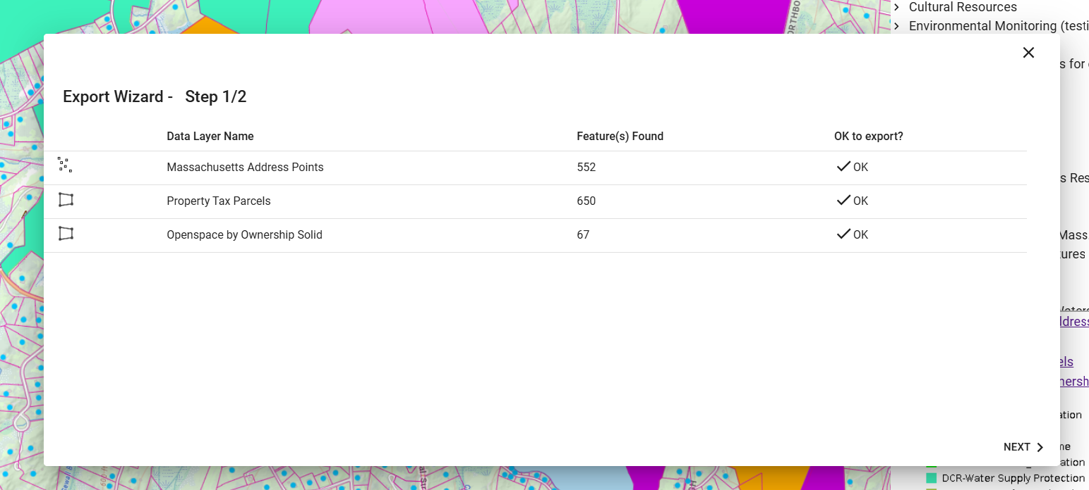
MassMapper & MassGIS Data
MassMapper Download Features
Notes:
We first get some information about how many features will be included in each of the datalayers we have on our map. The download will include all the features in our rectangular view.

Slide 20
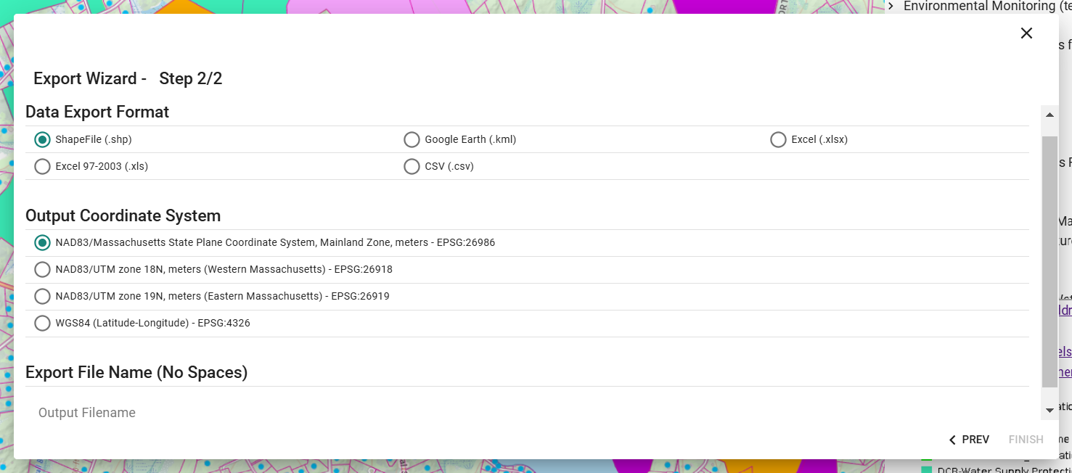
MassMapper & MassGIS Data
MassMapper Download Formats
Notes:
We can choose between 2 geographic output formats currently - ESRI shapefile or Google KML, and 3 tabular formats – 2 versions of Excel and CSV which is Comma Separate Values text file. We plan to offer more options in the near future. If we choose one of the two spatial formats there are several coordinate system options. MassGIS’ standard is State Plane meters which is the default. The data will be downloaded as one consolidated .zip file. Looking into the .zip file we can see a folder for each layer and inside, the components of the shapefile.

Slide 21
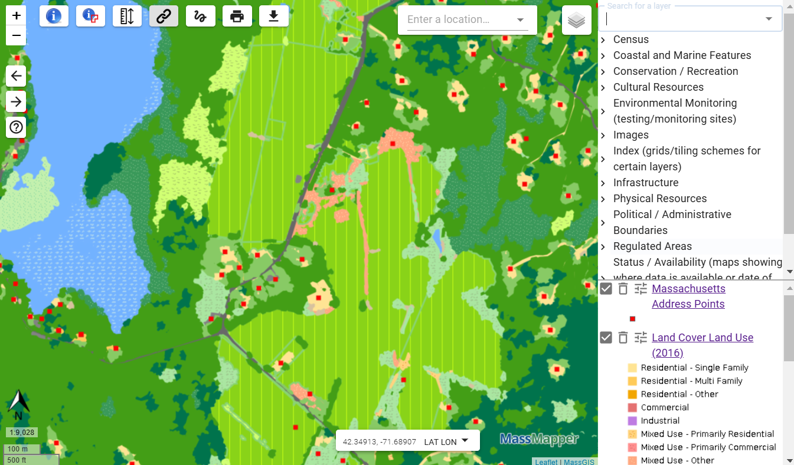
MassMapper & MassGIS Data
MassMapper Symbology
Notes:
Other than downloading data, I’d like to show you a few more of MassMapper’s features. As you’re exploring the data it is possible to tweak the display by changing the drawing order of the layers by dragging them up and down. For example, if I was to add Land Use – and this datalayer is so dense that we’re give an indication by an exclamation mark and a note that we need to zoom in more to see it – it would cover up other layers. We can drag the address points back on top of the Land Use. Then, if we think these address points are difficult to see because of the color palette of Land Use, we can change the color of the address points. It is also possible to change the level of transparency of the layers. We might want to make the landuse more transparent to see more of the basemap underneath.

Slide 22
MassMapper & MassGIS Data
MassMapper Permalink
https://maps.massgis.digital.mass.gov/MassMapper/MassMapper.html?bl=MassGIS%20Basemap__100&l=massgis:MAD.MAD_ADDRESS_POINTS_GC__MAD.MAD_ADDRESS_POINTS_GC::Default__ON__100,massgis:GISDATA.LANDCOVER_LANDUSE_POLY__GISDATA.LANDCOVER_LANDUSE_POLY::Default__ON__48&b=-71.69435262680055,42.33802290730078,-71.66688680648805,42.35039340633491
Notes:
If we decide we’d like to save our map to work on later or send it to someone else we can use the Permalink button which looks like a paperclip. The Permalink button creates a URL of the map containing info about which basemap and its opacity, the datalayers you’ve added and their opacities, and the geographic area you’ve zoomed into. This can be used to make a favorite or bookmark in your web browser or you can paste it into an email to send to someone or paste into a document as a link.

Slide 23
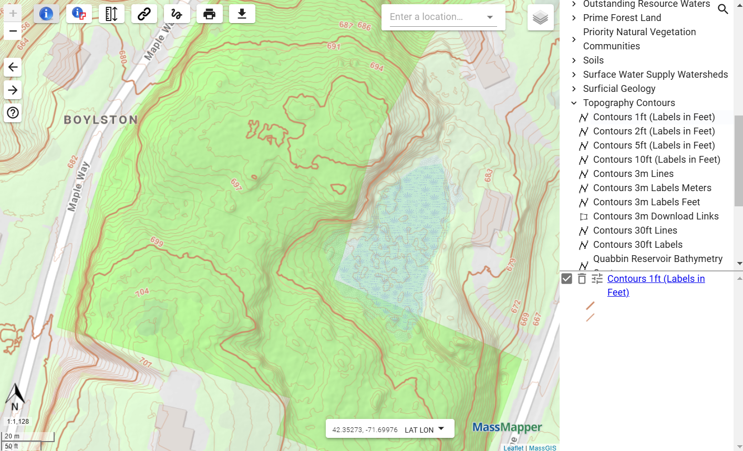
MassMapper & MassGIS Data
MassMapper Contours
Notes:
Another datalayer that MassGIS has to offer is very detailed elevation information. These 1 ft contour intervals come from Lidar terrain data. Lidar stands for light detection and ranging and is a technology that uses light pulses to collect three-dimensional information. Lidar data is often collected from an airplane using a laser system pointed at the ground. This dense elevation information can be used to model flooding potential for example.

Slide 24
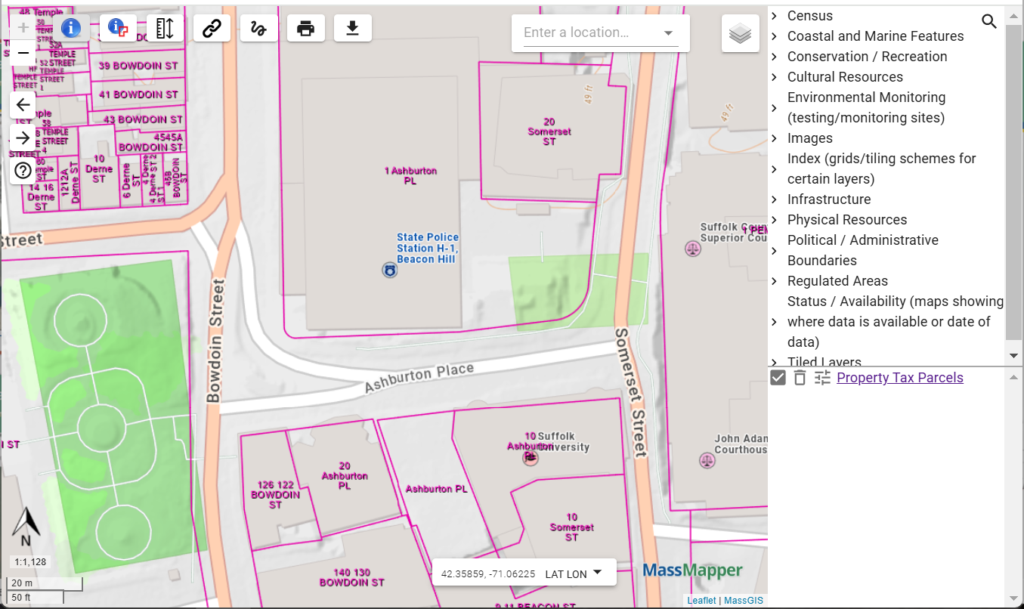
MassMapper & MassGIS Data
MassMapper Address or Place of Interest Search
Notes:
In order to more easily zoom to a particular place in MA, MassMapper offers a flexible geographic search box. This search box take locate addresses, places of interest such as museums, schools, or parks, or latitude and longitude.

Slide 25
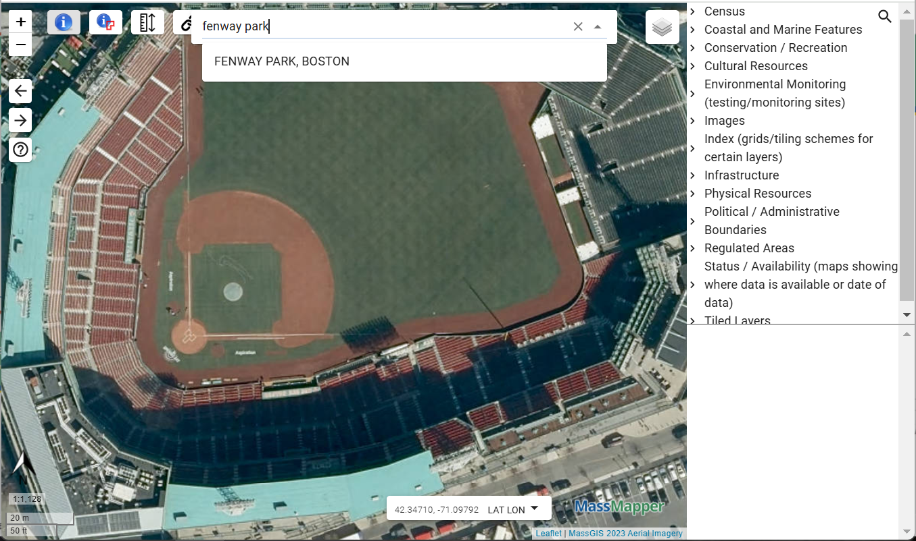
MassMapper & MassGIS Data
MassMapper Address or Place of Interest Search
Notes:
One example of a place of interest is fenway park. When I type it into the box and hit return it will give me back what it thinks is a match. If I click that choice MassMapper will zoom in close. If we turn off some layers and look at the 2023 aerial photo can see the level of detail.

Slide 26
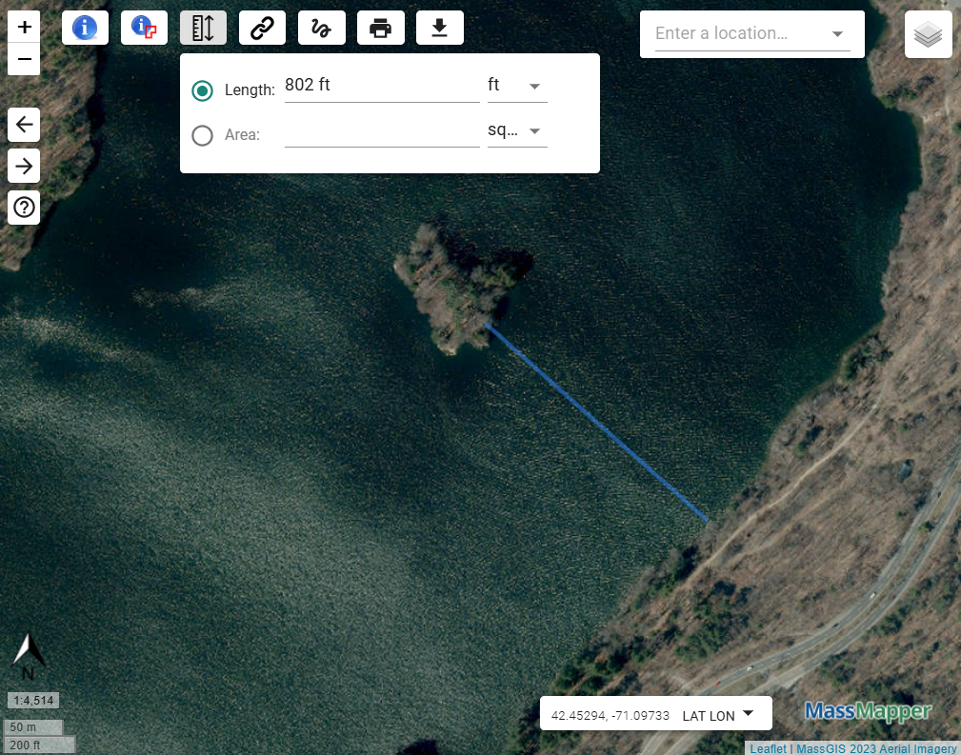
MassMapper & MassGIS Data
MassMapper Measure Tool
Notes:
MassMapper can also measure lines and areas in various units. The units can be set during or after the measurement. I might want to measure how far it is from this island to the shore.

Slide 27
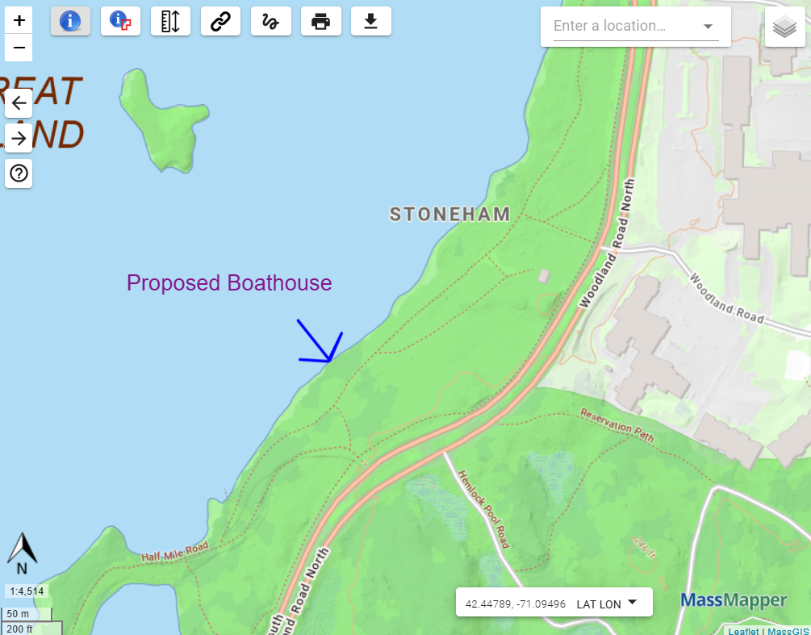
MassMapper & MassGIS Data
MassMapper Drawing Tools
Notes:
MassMapper has some simple drawing tools for lines and text. In this example I can put a note about the location of a proposed boathouse.

Slide 28
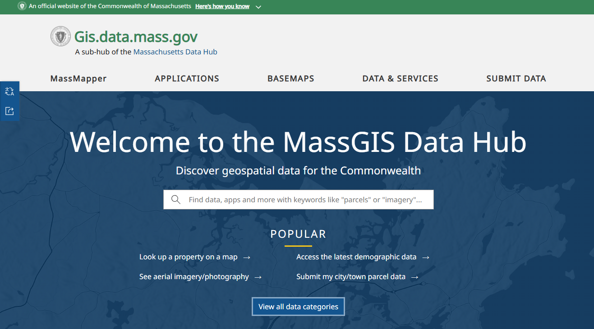
MassMapper & MassGIS Data
MassGIS Data Hub
https://gis.data.mass.gov/
Notes:
If you can’t find what you’re looking for for your project in MassMapper we have another option new for you to try. MassGIS recently set up something called the MassGIS Data Hub. It includes all the MassGIS datalayers and applications but also all the other MA state agency, municipal and nonprofit datalayers and applications that we could find. It’s a large catalog currently containing approximately 2,500 items. There are multiple ways of searching it – one is a simple Google type input box.

Slide 29
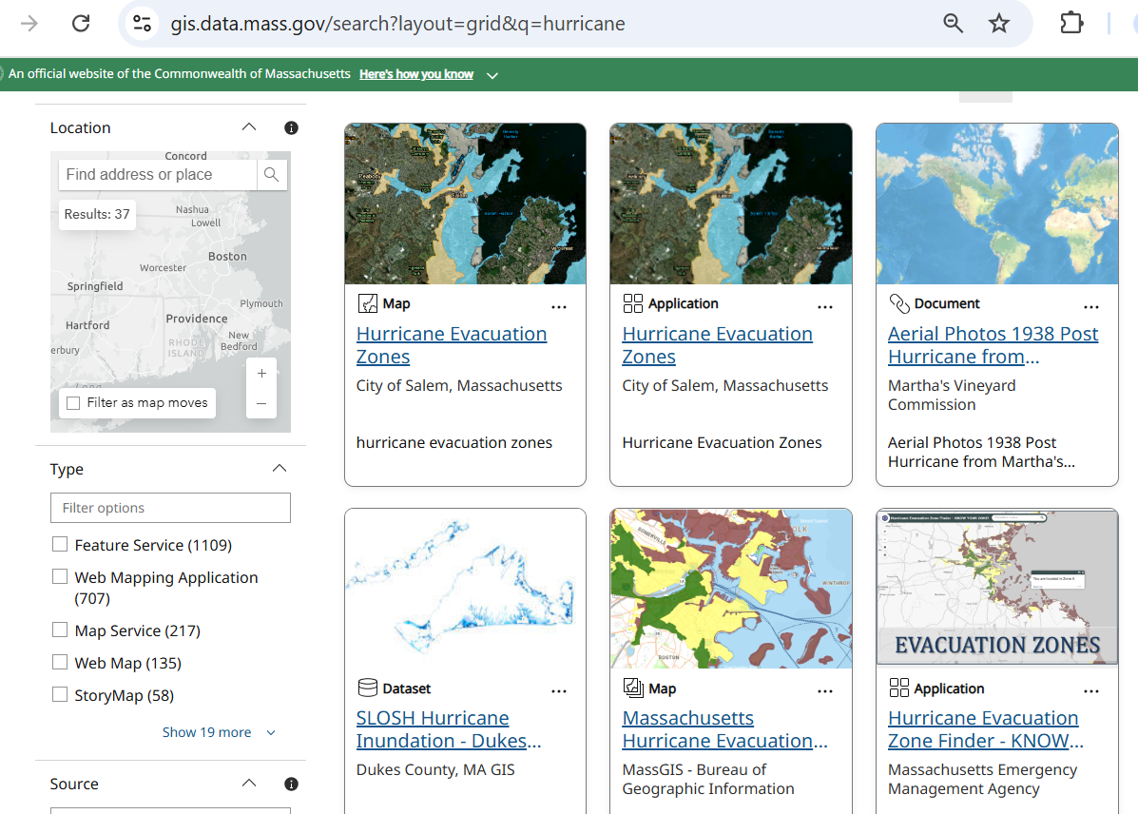
MassMapper & MassGIS Data
MassGIS Data Hub
Notes:
If I put in the word hurricane I see some items from various organizations. You can see the results a list or grid. Each result details the author.

Slide 30
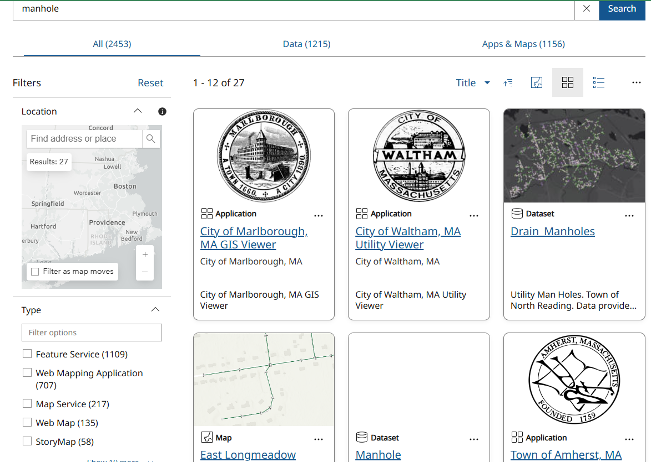
MassMapper & MassGIS Data
MassGIS Data Hub
Notes:
There is a lot of interesting data from municipalities. MassGIS does not have certain layers such as zoning, stormwater or wastewater statewide yet, however those can be easily found with the Data Hub. You can see if I put in stormwater and choose the town of Canton’s data viewer that we can see things such as culverts, manholes and other utility features.

Slide 31
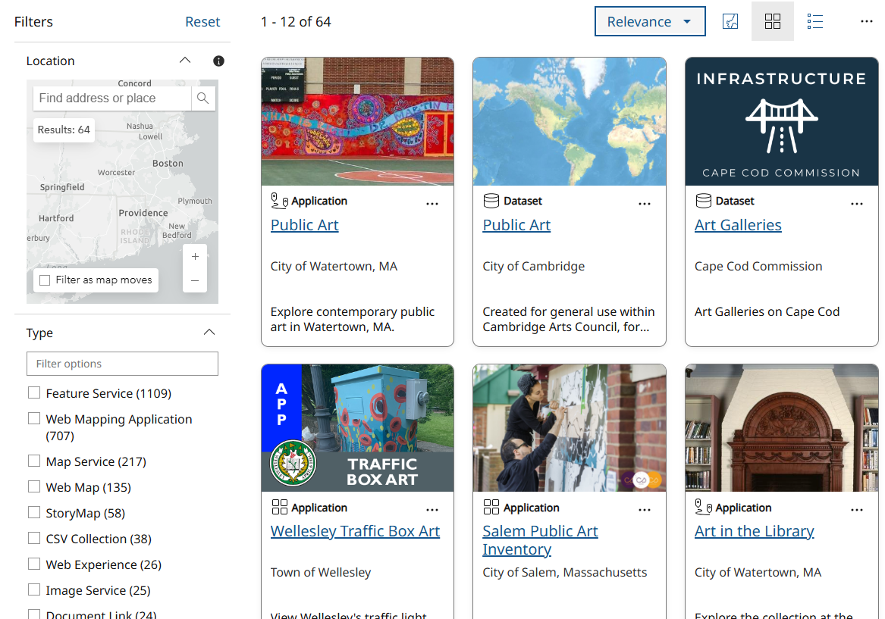
MassMapper & MassGIS Data
MassGIS Data Hub
Notes:
There’s a lot to explore, for example entering art will return the map data some entities have done on their community’s murals, galleries or traffic boxes.

Slide 32
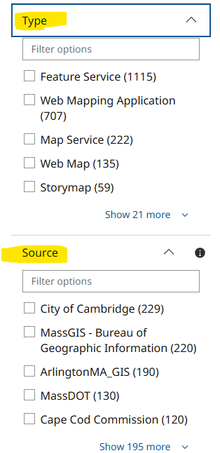
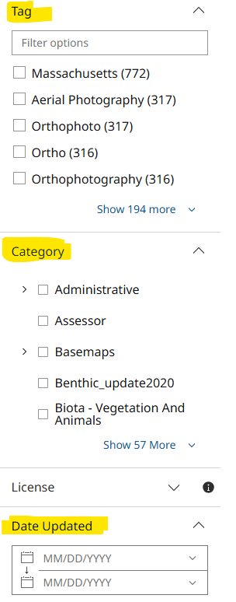
MassMapper & MassGIS Data
MassGIS Data Hub
Notes:
In addition to searching by tag values, on the left-hand side there are other ways to filter the items in the Hub. It is possible to search by type of item – a Feature Service for example will be downloadable data while a Web Mapping Application will be an interactive tool. It’s possible to search by Source – this can be a city, town, state agency or regional entity. It’s also possible to focus on data updated within a particular date range.

Slide 33

MassMapper & MassGIS Data
aleda.freeman@mass.gov
or
massgismail@mass.gov
Questions?
Notes:
At this point I’ll stop the live demo and return to my last slide.
If anyone has questions about anything MassGIS please feel free to email massgismail@mass.gov – this email account is checked daily and a staff member will get back to you. We are happy to take feedback about MassMapper or the Data Hub – we are planning to make some enhancements soon. At this point, are there any questions Cy or I can answer about MassGIS?
Questions about MassGIS data and services?

