Slide 1
Massachusetts MOLST to POLST Transition

Slide 2
MOLST to POLST Transition

Slide 3
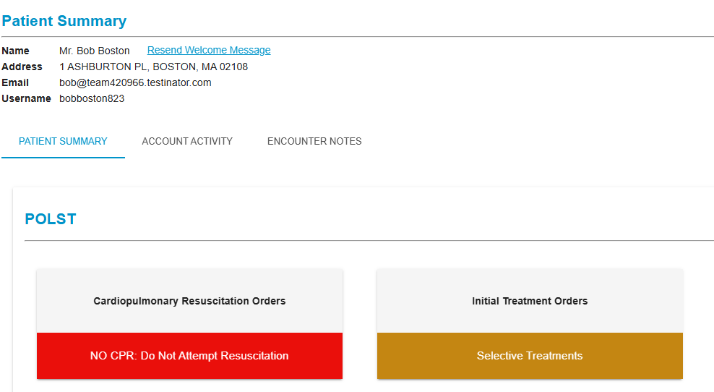
MOLST to POLST Transition
Effective April 6, 2027:
The MOLST form will no longer be used to document patient treatment preferences
All medical orders for life-sustaining treatment will be created on the electronic POLST form in the ePOLST Registry
POLST forms created in the ePOLST Registry will be accessible across all care settings
Existing MOLST and DNR/Comfort Care forms will remain valid and will continue to be honored by EMS
Partial view, Massachusetts ePOLST Registry

Slide 4
ePOLST System Map
Stakeholders Inputting Data
Stakeholders Consuming Data
Automatic Validation
EMS
Healthcare Team
Cloud Based ePOLST Registry
Patient/ health care agent
Patient/ health care agent
Healthcare Providers
Provider Organization System Interoperability
EHR/ePCR

Slide 5
Why Transition from MOLST to POLST
MOLST
POLST + ePOLST Registry
Paper form allows for conflicting, incompatible, or invalid orders
Built-in registry logic ensures forms are completed correctly and orders are valid
Integrity
Access
Orders may be hard to locate at critical moments
Accessible to care providers in all care settings, including EMS
Orders focus on yes/no to procedures, not goals of care conversation
Orders organized around goals of care thus easier for patients to understand
Trust
Trust
CE and CME approved education supports healthcare providers
Process
Lack of standard processes and training for providers
Process

Slide 6

Impact of Serious Illness Conversations and POLST
Greater alignment between documented preferences and care delivered
  Shared understanding of values, goals, and prognosis
  Orders more likely aligned with what patient wants
Reduced unwanted high-intensity care
  Fewer ICU admissions and hospitalizations
  Earlier and more hospice and palliative care use
Quality of life
  No increase in anxiety, depression, or emotional distress
  Improved caregiver bereavement outcomes

Slide 7




Who is involved?
Executive Office of Aging & Independence (EOAI) in partnership with:
State agencies: Massachusetts Department of Public Health, Office of Emergency Management Services, and Executive Office of Health and Human Services
Healthcare partners: Acute/non-acute hospitals, skilled nursing and long-term care facilities, hospice, home health, and EMS agencies, and industry and subject matter experts
MyDirectives: ePOLST Registry vendor

Slide 8
Statewide Implementation

Slide 9
Timeline
March-June 2026
Go-live kickoff
July-September 2026
Site Administrator access
Final consumer materials
Publish Regulations and guidance
ePOLST Registry Statewide Go-live
(end MOLST creation)
EHR interoperability testing
End-to-End testing
September-December 2026
Evaluation of End-to-End testing
Update workflows
EMS Integration testing
April 6, 2027
January-March 2027
Provider technical and clinical training
User account registration
Call Center Go-Live
April 2027 and onward
Data collection and evaluation
Refinement and improvement

Slide 10




Key workstreams
IT/EHR: Developing the technical bridge between the EHR and the ePOLST Registry
Clinical Operations: Updating Advance Care Planning (ACP), goals of care, and code status workflows and policies to reflect the transition to POLST
Mission & Quality: Aligning POLST with organizational goals and metrics, supporting implementation, and sharing success stories.
Education & Engagement: Supporting providers and staff to take virtual training, adapting communication materials for patients and families

Slide 11
How will my organization be supported by MassPOLST?
ePOLST Registry
Education
Virtual training for providers and staff (CE and CME approved)
Design, development, implementation
Training
Patient engagement materials
EMS protocol updates and training
Implementation Resources
MassPOLST Website
Technical support
Regulations and guidance
Call Center
Licensing

Slide 12

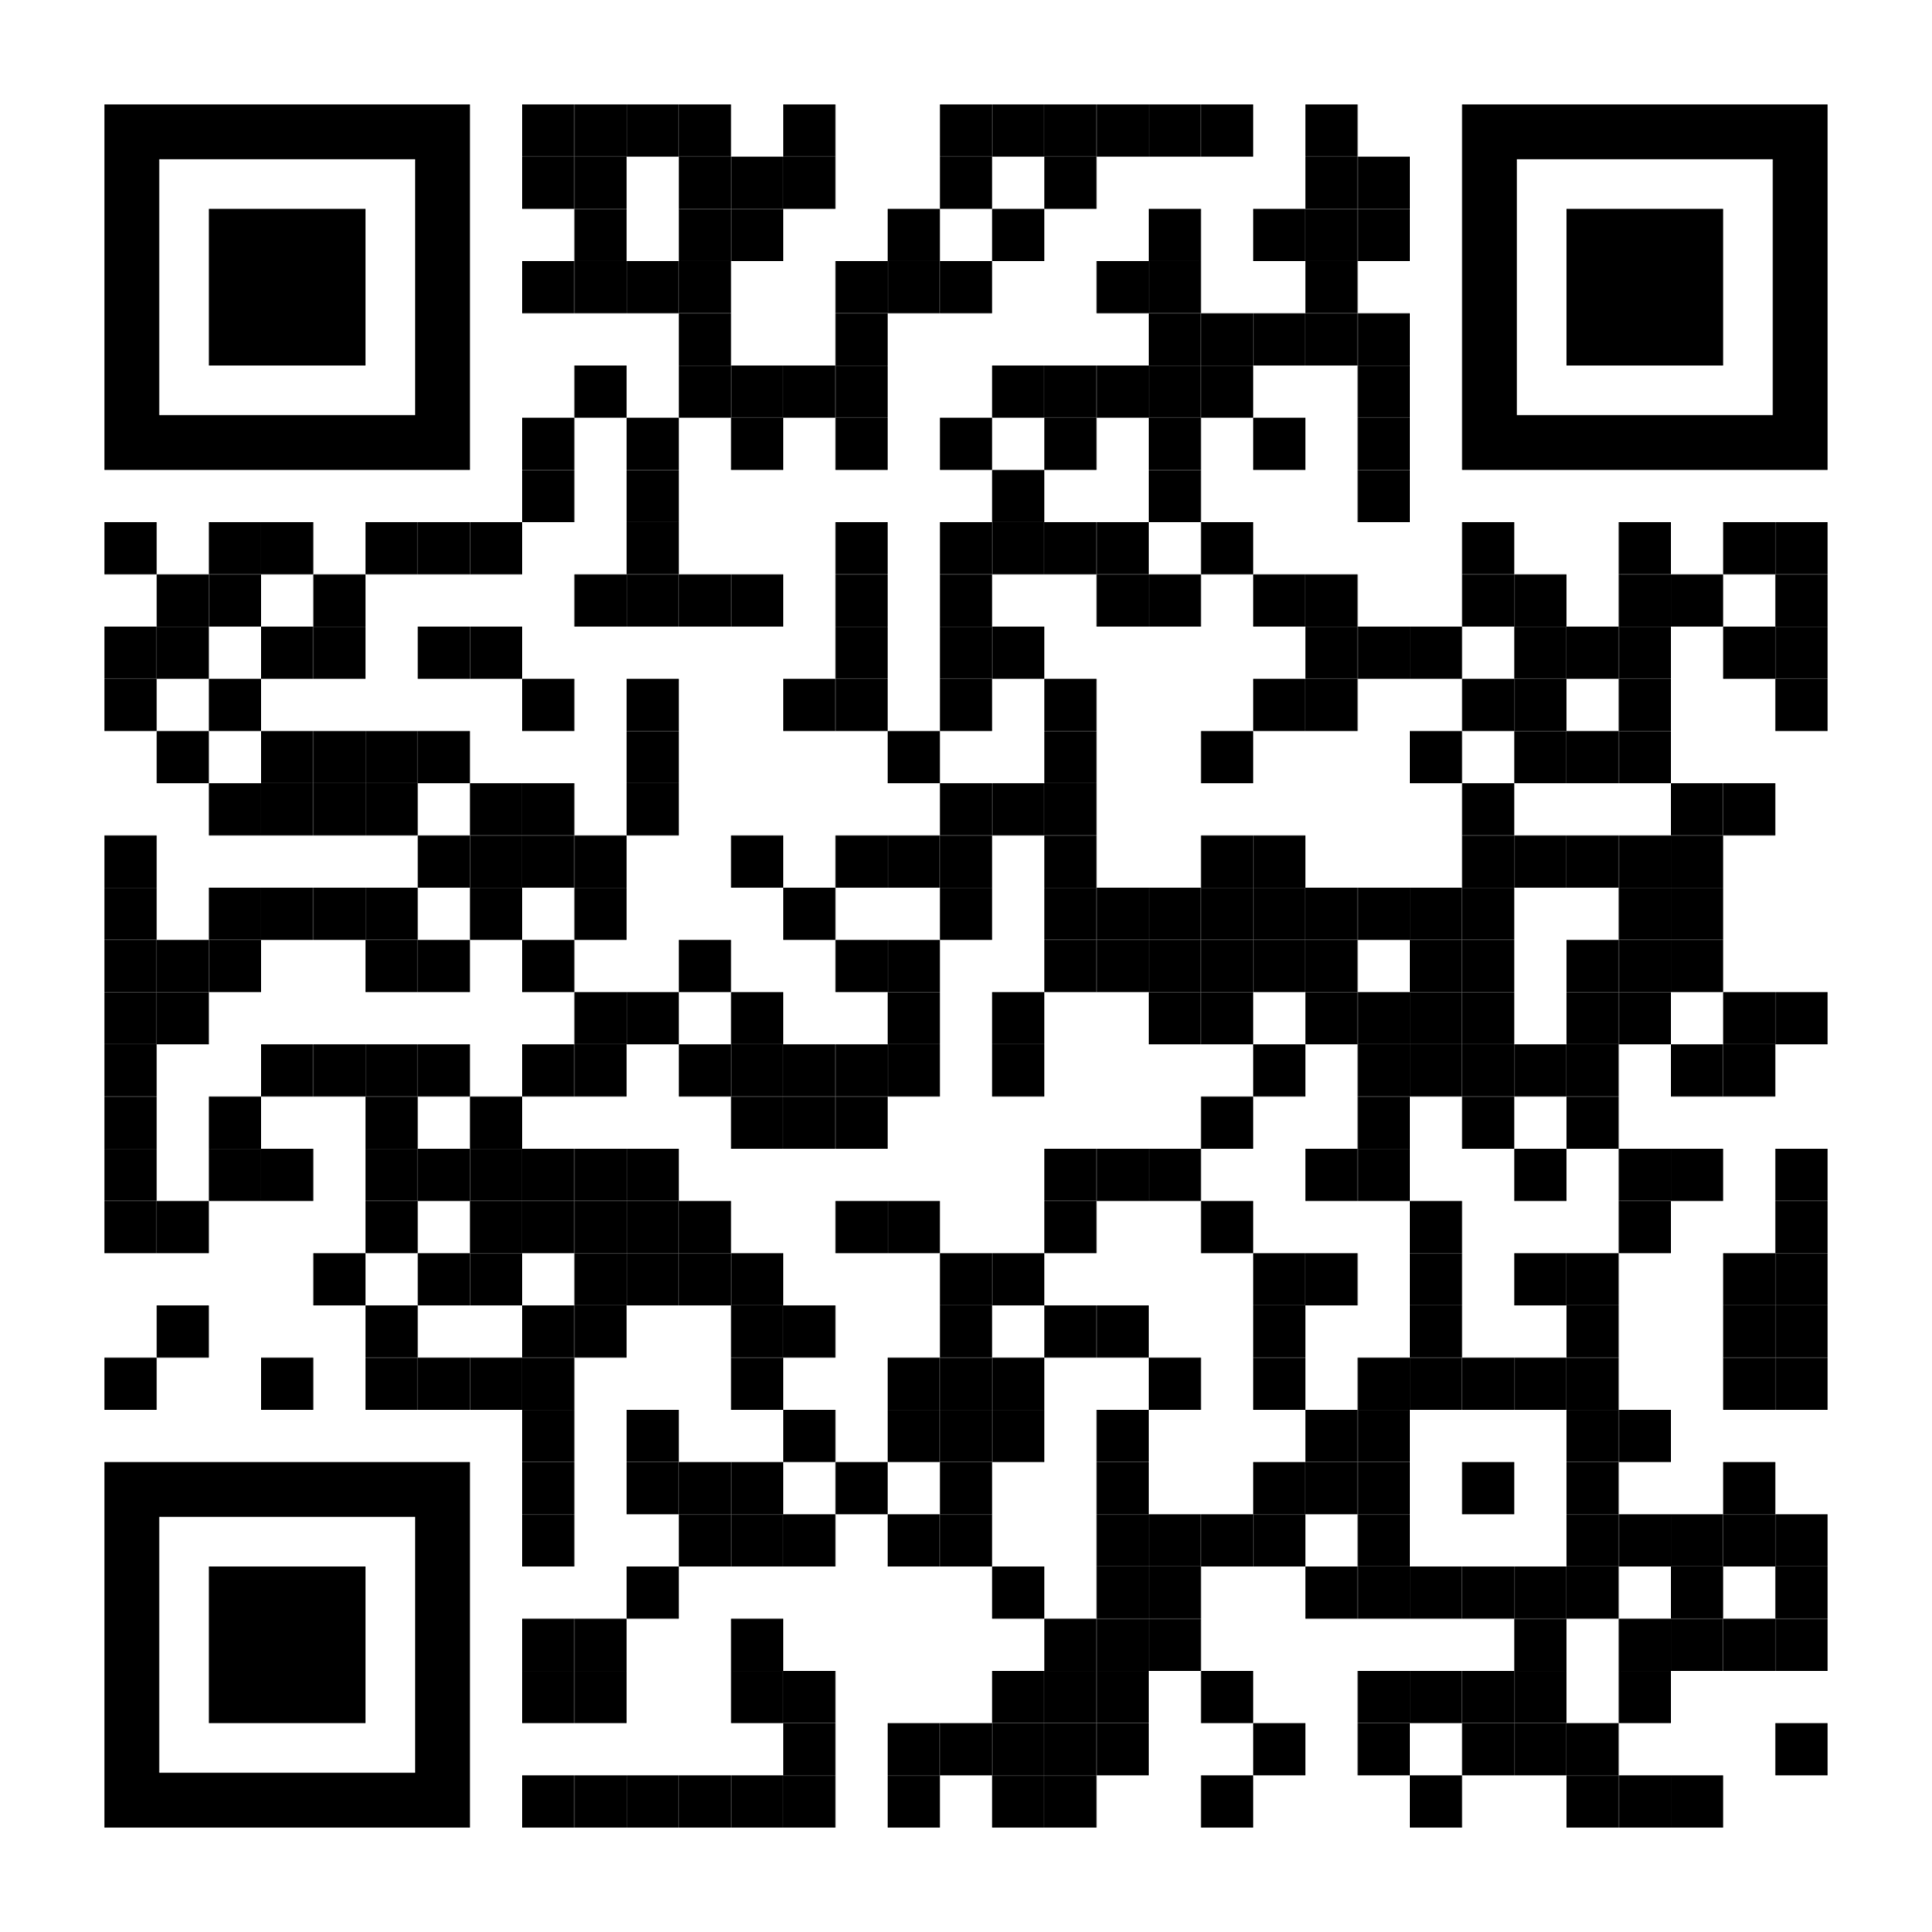
What should our organization do next?
Establish implementation team
Determine how your EHR will interact with the ePOLST Registry
Attend MassPOLST Sessions
Signup for MassPOLST Communications
Visit POLST website for additional information and helpful resources

Slide 13
Mass.gov/MassPOLST

