Slide 1
MassWorks Guidance Webinar
Community One Stop for Growth

Slide 2
Road Map
What is the Community One Stop for Growth?
MassWorks Overview
Where does MassWorks Fit in the One Stop?
Important Program Parameters
How to Be Competitive
Examples of Successful Applications
Completing the Full Application
Key Dates and Opportunities to Get Guidance

Slide 3
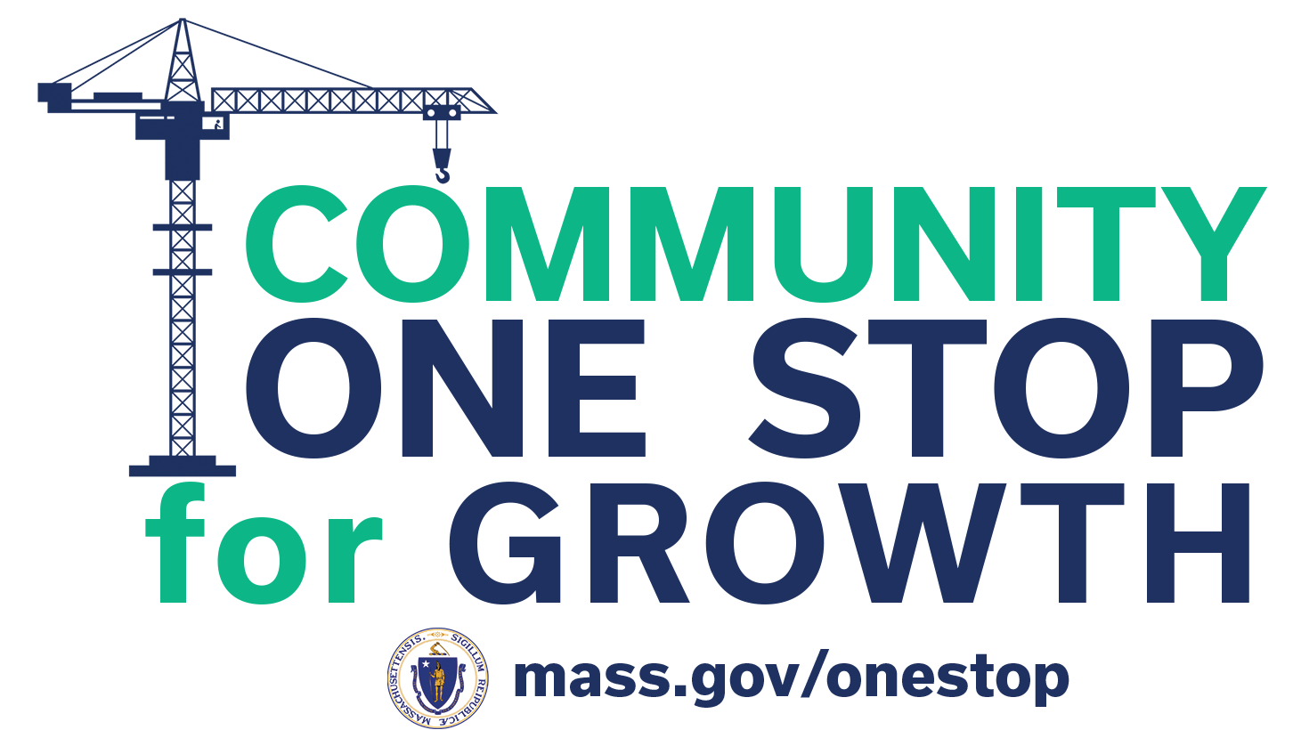
What is the Community One Stop for Growth?
The Community One Stop for Growth is the main driver of economic development in the Commonwealth.
The One Stop is a single application portal and collaborative review process designed to streamline the experience for the applicant and better coordinate economic development programs and staff on engagement and grant making.
Executive Office of Economic Development | MassDevelopment Finance Agency | Executive Office of Housing and Livable Communities
MassWorks Infrastructure Program Rural Development Fund Urban Agenda Grant Program Massachusetts Downtown Initiative | Underutilized Properties Program Site Readiness Program Collaborative Workspaces Program Brownfields Redevelopment Fund Real Estate Services Technical Assistance | HousingWorks Infrastructure Program Housing Choice Grant Program Community Planning Grants Program

Slide 4
MassWorks Overview
Program Staff | Juan R. Vega, Assistant Secretary for Communities & Programs Marc Horne, Senior Director for Communities & Programs
What is the Purpose of the Program? | To provide Infrastructure grants to municipalities and other public instrumentalities. Purpose: To assist municipalities to advance projects that support job creation and expansion, housing development and rehabilitation, community development projects, and small-town transportation projects Type of Work: Design, construction, building, land acquisition, rehabilitation, repair and other improvements to publicly-owned infrastructure. Type of Infrastructure: Sewers, utility extensions, streets, roads, curb-cuts, parking, water treatment systems, telecommunications systems, transit improvements, public parks and spaces within urban renewal districts and pedestrian and bicycle ways.
Who is Eligible? | Any Massachusetts city or town, acting by and through its municipal officers or by and through an agency designated by such municipal officers to act on their behalf, or any local public entity, may apply to the program for a grant in a specified amount to fund a public infrastructure project. Two or more municipalities may apply jointly, with one municipality or public entity acting as fiscal agent.

Slide 5
Where Does MassWorks Fit in the One Stop?
Preparing for Growth |  |  | Catalyzing Specific Projects
Community Activation & Placemaking | Planning & Zoning | Site Preparation | Building | Infrastructure
Technical Assistance for Downtowns Downtown Design Consultant Services Downtown Mobility/Parking Consultant Services Downtown Wayfinding/Branding Consultant Services Economics of Downtown Consultant Services Pedestrian Orientation/Placemaking Consultant Services Small Business Support/E-commerce Consultant Services Forming a Downtown Management District Equitable Workforce and Business Development Programming Entrepreneurship and Small Business Development Workforce Development and Training Initiatives Community Organizing and Leadership Development | Community Plan Master Plan Neighborhood Plan Downtown Plan Urban Renewal Plan Housing Production Plan Regional Plan Corridor Plan Zoning Revision Zoning Revision to Comply with Section 3A of MGL c.40A Comprehensive Zoning Review & Revision Planning for Housing Housing Feasibility Plan Housing Site Master Plan Housing Infrastructure Plan Housing Site Design Plan District Redevelopment Technical Assistance Planning for Growth in a Commercial/Industrial District | Brownfield Site Clean Up Brownfields Site Assessment Brownfields Remediation Site Improvements to Unlock Development Site Readiness Pre-Construction Site Readiness Construction Municipal Surplus Property Disposition Municipal Surplus Property Disposition Study | Underutilized Property Rehabilitation Underutilized Property Pre-Construction Underutilized Property Construction Creating Collaborative Workspace Collaborative Workspace Feasibility Study Collaborative Workspace Fit-Out or Equipment Community Lead Housing Production Support Housing Production Support Housing Rehabilitation Support Housing Preservation | Public Infrastructure to Support Housing Growth (Residential Only) Pre-construction - Design / Engineering Documents Only Construction Public Infrastructure to Support Mixed-Use and Commercial/Industrial Growth Pre-construction - Design / Engineering Documents Only Construction Small Town Road Improvements to Enhance Public Safety (STRAP) Construction of Road Improvements to Enhance Public Safety

Slide 6
Important Project Parameters
Project Budget | Typical Grant range Infrastructure: $1,000,000 - $5,000,000 Maximum Grant Size Small Town Road Improvement: $1,000,000 Typical Grant range Pre-Development: $100,000 - $500,000
Project Timeline Requirements | Three full fiscal years: MassWorks grants will run for a maximum of 3 full fiscal years following the successful execution of a contract. Contract executed by June 2024 will expire in June 2027.
Eligible Use of Funds | Infrastructure Pre-Development: Design Documents Only Infrastructure Construction: Roadway Streetscape Improvements, Bridge/Culvert Repair or Replacement, Water/Sewer Infrastructure, Public Utility Project (Gas, Electric, etc Small Town Road Improvement: Roadways and Streetscape Only
Ineligible Use of Funds | Vertical Construction: Parking Garages, Building, Cell Towers, etc… Private Development Costs: Project items not attributable to the private developer outside the public right of way Admin and Overhead: No grant management fee can be charged to the grant from the grantee

Slide 7
How To Be Competitive
Key application information:
Readiness to proceed immediately following an award: Design and Permitting are advanced
A high level of local support: Local matching funds and municipal CEO letter
Measurable outcomes in private investment: Demonstrable growth local job growth and/or housing development
Particularly important application questions:
Budget and Local Match – 2.7, 2.8, 2.9
Private Development Outputs – 2.20
Design Status – 5.12
Permitting Status - 5.13
Measurable Outcomes of the Public Infrastructure – 5.14
Private Development Impacts: 5.23, 5.24, 5.25
Required application attachments:
Engineer’s cost estimate for construction. For Pre-Dev, a quote from a qualified designer
An aerial view map showing the limits of work of the public project site in relation to the limits of work of the private project site. For STRAP and Pre-Dev, only the project location is needed.
A support letter from the municipal CEO
A copy of the project's output report from the Commonwealth’s online RMAT Climate Resilience Design Standards Tool
A letter from the private development proponent confirming the project details
Small Town Road Improvements images of the road, particularly focused on the areas that create public safety hazards

Slide 8
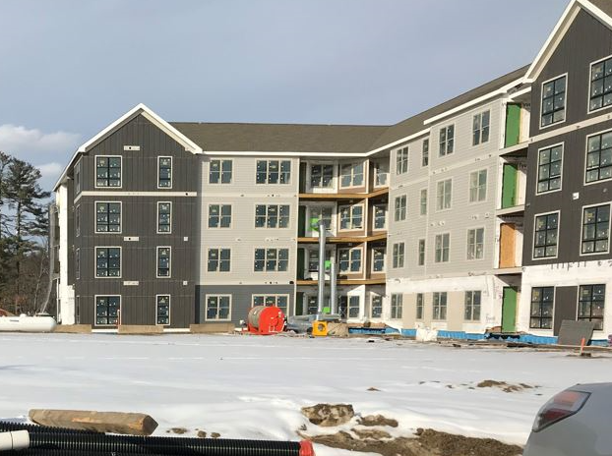
Successful Application Example #1
Applicant: | Town of Wayland
Project Description: | Infrastructure. The project provided a sewer extension to a 218-unit housing development, 55 of which qualify as affordable. In addition, the infrastructure upgrade provide a source for the Town to discharge treated effluent from the wastewater treatment plant. This will allow the Town to maximize additional development in currently under-utilized areas of the wastewater service area
What Made the Project Successful: | Strong Local Match of Funds at more than 50% - $2.2M in MWIP and $1.2M in Local Funds Public Project was advanced in design, more than 25% Documented support from the municipal CEO Public Infrastructure investment was crucial in allowing the Private project to proceed Private project investment was substantial, adding 218 units of new housing in a Town of just over. In 2020 there were just under 5,000 housing in Wayland, providing a nearly 5% increase.
Insert Image of Project Site/Area

Slide 9
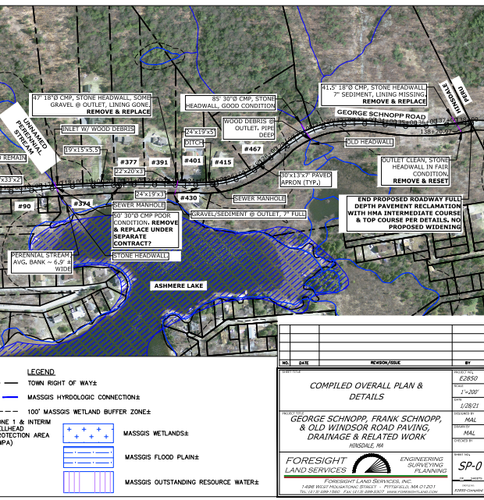
Successful Application Example #2
Applicant: | Town of Hinsdale
Project Description: | Small Town Road Improvement. Reconstruction of 1.3 Miles of Schnopp Roads Restoration Project, running through Hinsdale from the Town Dalton to the Town of Peru. This grant allowed Hinsdale to complete a full depth reclamation within the same roadway footprint (approx. 22-foot-wide), and repair substantial drainage issues.
What Made the Project Successful: | Clear detailed Engineer’s Cost Estimate and Budget Advanced Design, more than 30% Local Match Contribution of nearly 10% Permits Secured at the time of application Excellent documentation of public safety concerns, including pictures of existing conditions, and pavement condition rating documentation.
Insert Image of Project Site/Area

Slide 10
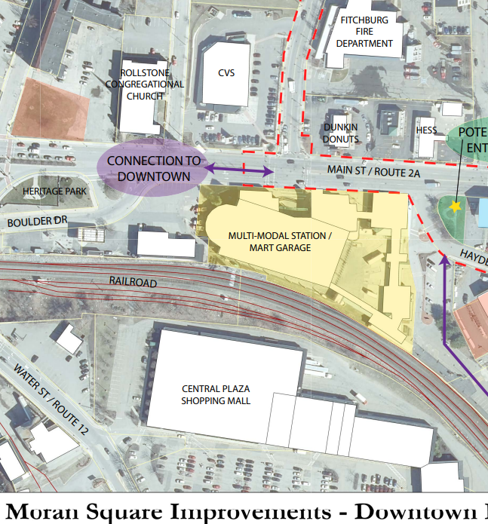
Successful Application Example #3
Applicant: | City of Fitchburg
Project Description: | Pre-Development. Design development of infrastructure and streetscape of the Moran Square area to support recent and anticipated housing and economic growth. Funding is being used to advance initial plans into final design and permitting. The anticipated outcome of the pre-dev work will be a fully permitted project with a biddable plan and spec package.
What Made the Project Successful: | Design Project which results in a biddable design package in support of specific growth. $450,000 grant amount is supported with $125,000 local match of funds Plan is in an existing Urban Renewal area and current Transformative Development Initiative District Anticipates infrastructure improvements in an area where 4 proposed housing development are location
Insert Image of Project Site/Area

Slide 11
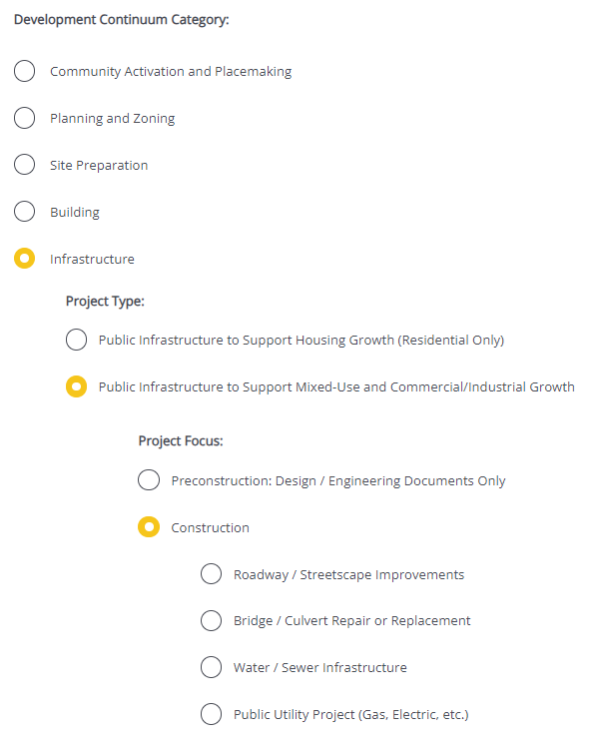
Completing the Full Application
Key Question: In Section 2 of the Full Application, applicants are asked to indicate the Project Category. To be reviewed by MassWorks, applicants should make the following selections in question 2.4:
For more information on completing the Full Application, visit www.mass.gov/onestop to view One Stop Webinar 2: Application Guidance
Development Continuum: | Infrastructure
Project Type: | Public Infrastructure to Support Mixed-Use and/or Commercial/Industrial Growth
Project Focus: | Pre-Construction, Construction, Small Town Road Improvements
Update Image for Each Program

Slide 12
FY25 Round Timeline
JAN
Jan.
Full Application and Expression of Interest Open (January) – The Full Application is the official form for submitting all funding requests. Applicants may now begin to work on applications in the IGX system, however applications will only be accepted during the submission period.
One Stop Guidance Phase (January – May) – A series of webinars will be hosted be both the One Stop Team and staff from each program within the One Stop. In addition, office hours will be hosted to answer applicant questions. Visit www.mass.gov/onestop for the full schedule of webinars and office hours.
Full Application Submission Period (May-June) – Applicants may submit their Full Application(s) beginning May 6, 2024. All applications must be submitted by the Full Application deadline of 11:59 p.m. on Wednesday, June 5.
Review and Evaluation (July – August) – All complete and eligible Full Applications submitted by the deadline will be reviewed and evaluated by the corresponding program managers at each state agency. The One Stop team will also conduct joint application reviews across agencies. Based on the program’s criteria, each program will prepare its list of applications recommended for funding, to be further reviewed and approved by agency and Secretariat leadership.
Notification of Grant Decisions (September) – Once final recommendation have been approved, applicants will be notified of grant decisions in writing, and announcement events will be scheduled.
Sept.

Slide 13
Opportunities for Guidance
Visit www.mass.gov/onestop for more information on:
Expression of Interest
Complete an Expression of Interest form to see if your project(s) is eligible for funding through the One Stop and get tips for preparing your application
One Stop and Program Webinars
Recordings of all One Stop webinars are now available on the One Stop website
Office Hours
One Stop General Guidance Office Hours – One Stop staff will hold office hours to discuss general One Stop process and technology questions
Program Office Hours – Staff from each program will hold an office hour to answer applicant questions related to the program
MassWorks’s office hours will be held on April 16th at 11am

