Slide 1
One Care: May 2019 Enrollment Report
Executive Office of Health & Human Services
MassHealth Demonstration to Integrate Care for Dual Eligibles

Slide 2
Monthly Enrollment Report
MassHealth issues monthly reports on One Care enrollment activity
Reports are issued near the end of the month
Reports are intended to provide general information to stakeholders

Slide 3
One Care Rating Category Definitions
F1 – Facility-based Care. Individuals identified as having a long-term facility stay of more than 90 days
C3 – Community Tier 3 – High Community Need. Individuals who have a daily skilled need; two or more Activities of Daily Living (ADL) limitations AND three days of skilled nursing need; and individuals with 4 or more ADL limitations
In CY2014, C3 split into two subsets:
C3B: for C3 individuals with certain diagnoses (e.g., quadriplegia, ALS, Muscular Dystrophy and Respirator dependence) leading to costs considerably above the average for current C3
C3A: for remaining C3 individuals
C2 – Community Tier 2 – Community High Behavioral Health. Individuals who have a chronic and ongoing Behavioral Health diagnosis that indicates a high level of service need
- In CY2014, C2 split into two subsets
C2B: for C2 individuals with co-occurring diagnoses of substance abuse and serious mental illness
C2A: for remaining C2 individuals
C1 – Community Tier 1 Community Other. Individuals in the community who do not meet F1, C2 or C3 criteria

Slide 4
Total Enrollment
Effective May 1, 2019, total number of enrollees: 24,210
Total Enrollment by Plan
Commonwealth Care Alliance (CCA) | 21,472
Tufts Health Plan | 2,738
Total | 24,210
Total Enrollment by Rating Category
F1 | 164
C3B | 273
C3A | 11,307
C2B | 1,217
C2A | 7,080
C1 | 4,158
Unavailable* | 11
Total | 24,210
*The rating categories for 11 enrollments were unavailable at the time of this report.

Slide 5
Enrollment Penetration by County
County | Enrolled | Eligible | % Eligible Enrolled
Bristol | 76 | 14,865 | 0.5%
Essex | 2,684 | 14,657 | 18.3%
Franklin | 190 | 2,117 | 9.0%
Hampden | 6,047 | 15,697 | 38.5%
Hampshire | 333 | 2,769 | 12.0%
Middlesex | 3,728 | 17,337 | 21.5%
Norfolk | 1,286 | 7,489 | 17.2%
Plymouth | 1,361 | 7,292 | 18.7%
Suffolk | 4,665 | 14,257 | 32.7%
Worcester | 3,840 | 16,036 | 23.9%
Total | 24,210 | 112,516 | 21.5%

Slide 6
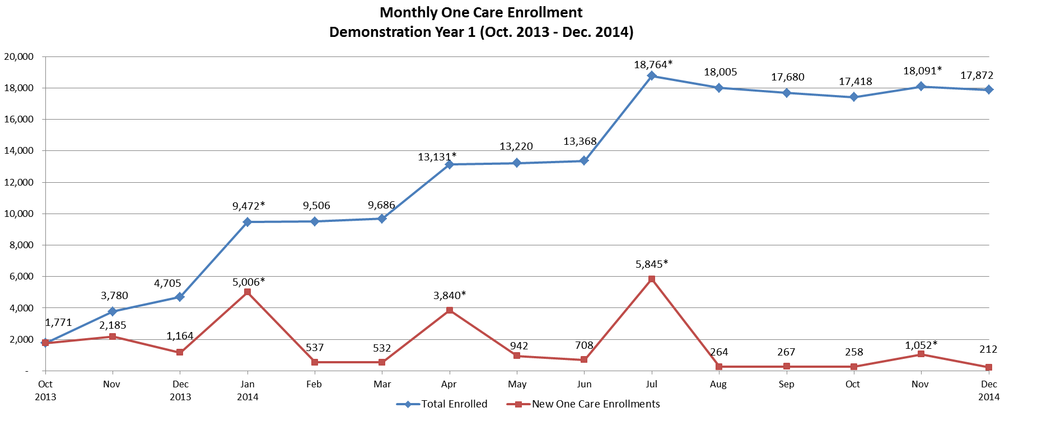
Enrollment Over Time: Demonstration Year 1
*Auto-assignment effective dates (Round 1: 1/1/2014, Round 2: 4/1/ 2014, Round 3: 7/1/2014, Round 4: 11/1/2014). Round 4 consisted only of auto-assignments to Tufts Health Plan.
Note: Data in the graph reflect current month information about enrollments. Monthly data may vary slightly from the previous reports due to enrollment status changes that have occurred since previous reports were issued.

Slide 7
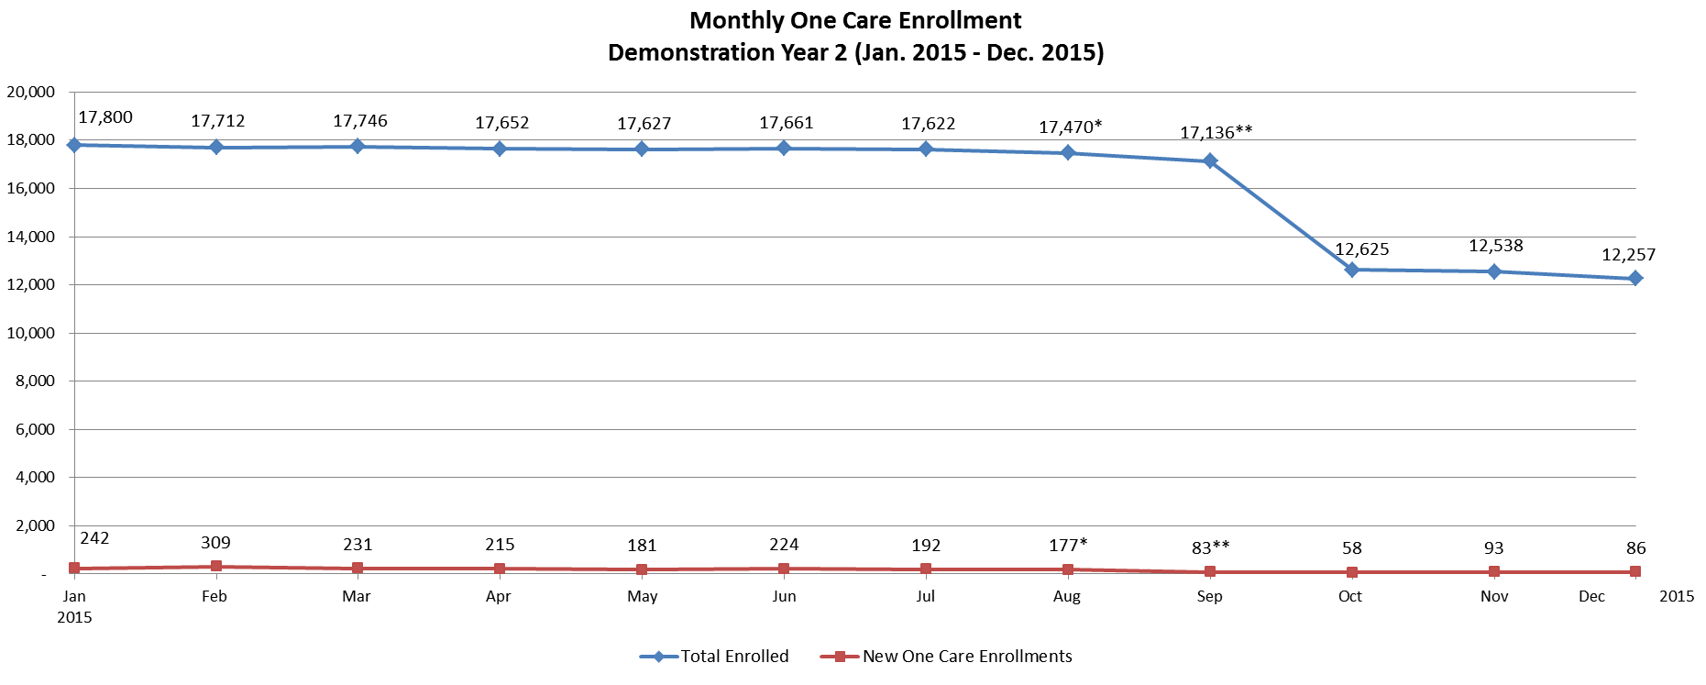
Enrollment Over Time: Demonstration Year 2
*On August 7, 2015, CCA temporarily stopped accepting new One Care enrollments. Members previously enrolled with CCA for One Care were able to re-enroll.
**Fallon Total Care ended its participation in One Care as of September 30, 2015.
Note: Data in the graph reflect current month information about enrollments. Monthly data may vary slightly from the previous reports due to enrollment status changes that have occurred since previous reports were issued.

Slide 8
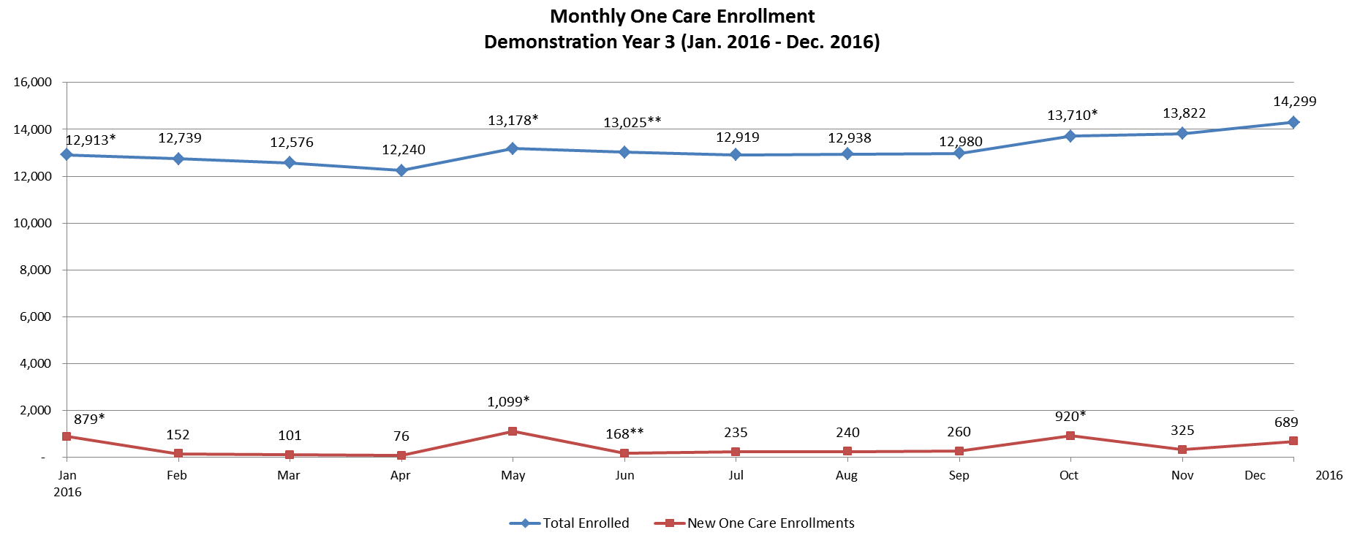
Enrollment Over Time: Demonstration Year 3
*Auto-assignment effective dates (Round 5: 1/1/2016; Round 6: 5/1/2016; Round 7: 10/1/2016). Rounds 5 and 6 consisted only of auto-assignments to Tufts Health Plan; Round 7 consisted only of auto-assignments to CCA.
**CCA accepted limited enrollments for January 1 and May 1 in 2016, and in May fully reopened to new enrollments for June 1, 2016 and later dates.
Note: Data in the graph reflect current month information about enrollments. Monthly data may vary slightly from the previous reports due to enrollment status changes that have occurred since previous reports were issued.

Slide 9
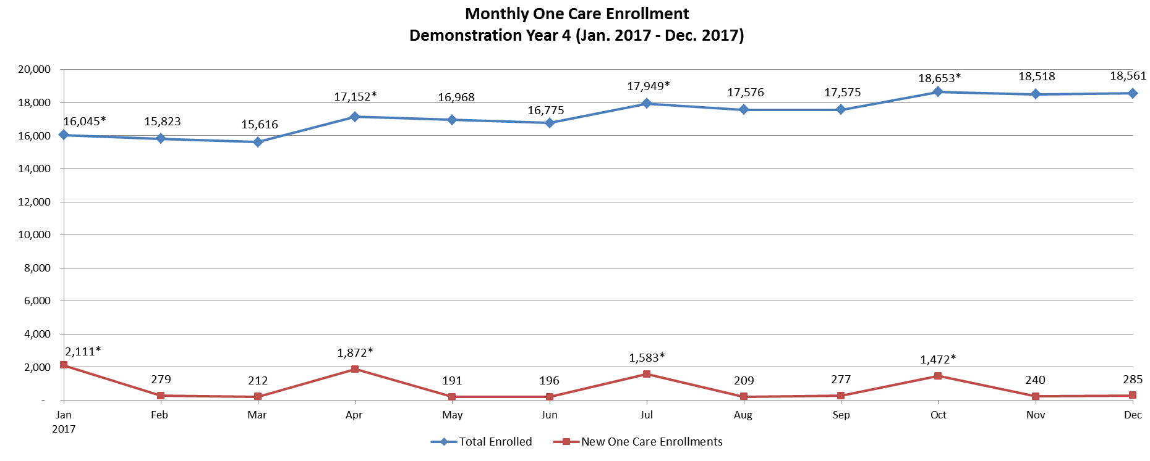
Enrollment Over Time: Demonstration Year 4
*Auto-assignment effective dates (Round 8: 1/1/2017; Round 9: 4/1/2017; Round 10: 7/1/2017; Round 11: 10/1/2017). Round 11 consisted only of auto-assignments to CCA.
Note: Data in the graph reflect current month information about enrollments. Monthly data may vary slightly from the previous reports due to enrollment status changes that have occurred since previous reports were issued.

Slide 10
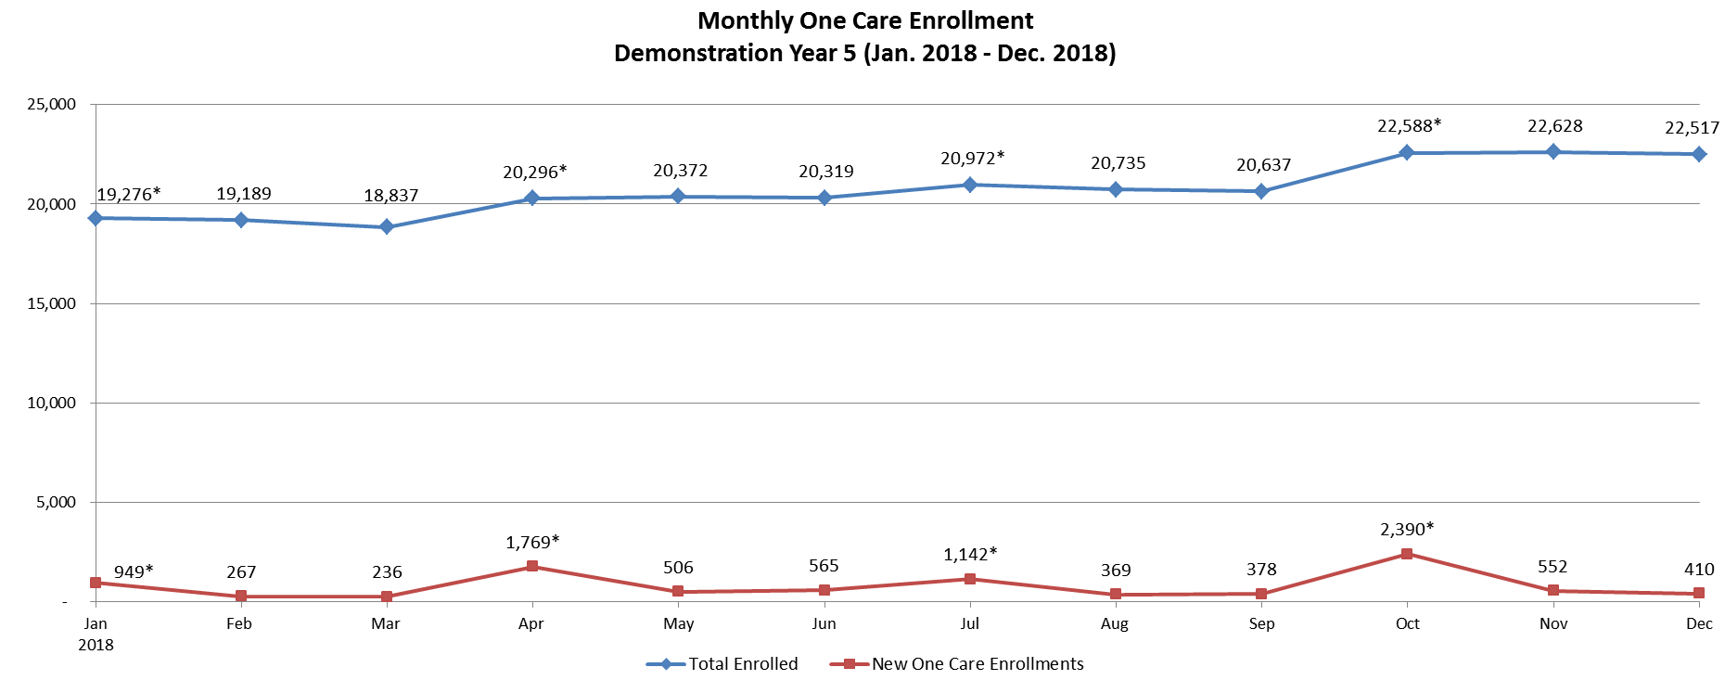
Enrollment Over Time: Demonstration Year 5
*Auto-assignment effective date (Round 12: 1/1/2018; Round 13: 4/1/2018; Round 14: 7/1/2018; Round 15: 10/1/2018). Rounds 12, 13, and 14 consisted only of auto-assignments to CCA.
Note: Data in the graph reflect current month information about enrollments. Monthly data may vary slightly from the previous reports due to enrollment status changes that have occurred since previous reports were issued.

Slide 11
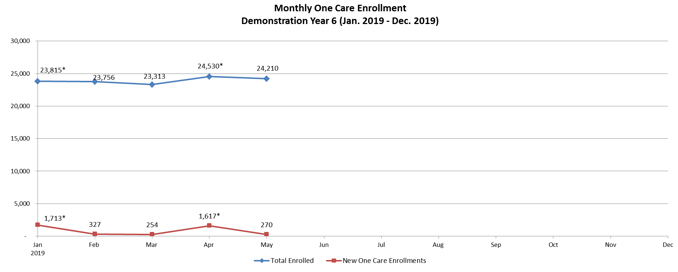
Enrollment Over Time: Demonstration Year 6
*Auto-assignment effective date (Round 16: 1/1/2019; Round 17: 4/1/2019). Rounds 16 and 17 consisted only of auto-assignments to CCA.
Note: Data in the graph reflect current month information about enrollments. Monthly data may vary slightly from the previous reports due to enrollment status changes that have occurred since previous reports were issued.

Slide 12
Opt-Outs
Total number of opt-outs as of May 1: 38,119
Will be excluded from any future auto-enrollment
If eligible, can choose to enroll by self-selection at any time
Total opt-out number includes individuals who may be ineligible
Of the 112,516 individuals who are eligible for One Care, 33.9% have chosen to opt out
Total Opt-Outs by County
Bristol | 129
Essex | 3,494
Franklin | 517
Hampden | 7,308
Hampshire | 1,560
Middlesex | 5,561
Norfolk | 1,978
Plymouth | 1,748
Suffolk | 6,674
Worcester | 8,910
Non-Demo Counties | 240
Total | 38,119

Slide 13
VISIT US ONLINE www.mass.gov/one-care
EMAIL US OneCare@state.ma.us

