Slide 1
Massachusetts Federal Funds Partnership
-This meeting will be recorded. ​
-Please mute yourself after arrival.
-Please submit your questions via the chat function.
-Questions will be answered during Q&A.
May 2026 Meeting

Slide 2
Agenda
FFIO Updates
Q&A
Open Funding Opportunities
Distance Learning and Telemedicine Grant Program – USDA
Flood Mitigation Assistance - MEMA

Slide 3
FFIO Updates

Slide 4
Federal Updates
DHS Funding & Reconciliation
FY2027 Annual Budget
Surface Transportation Bill
Congress has been unable to pass a bill to fully fund the Department of Homeland Security for FY2026. Recently they have pursued an approach that will leverage the reconciliation process:
Update: Last week, the Senate Homeland Security and Governmental Affairs Committee passed a reconciliation bill to fund Immigration and Customs Enforcement and Customs and Border Protection for FY2026. The House must adopt the same budget resolution for the reconciliation process to move forward.
On April 3, the White House released the FY2027 President’s Budget. The next step in the annual budget process is for Congressional Subcommittees to develop their own appropriations bills.
It is unclear if Congress will be able to pass all appropriations bills ahead of September 30 when current funding expires.
Surface transportation funding authorized by the Bipartisan Infrastructure Law (BIL) expires at the conclusion of Federal FY2026 (September 30).
Update: On Friday, May 22, the House Transportation and Infrastructure Committee approved its version of a bill, titled the BUILD America 250 Act. The Senate is expected to release its version of a bill in the coming months.

Slide 5
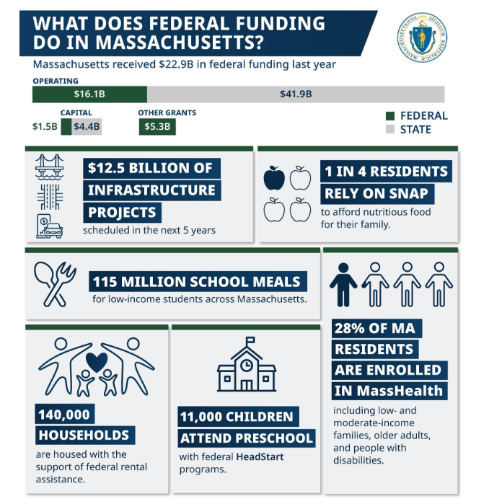
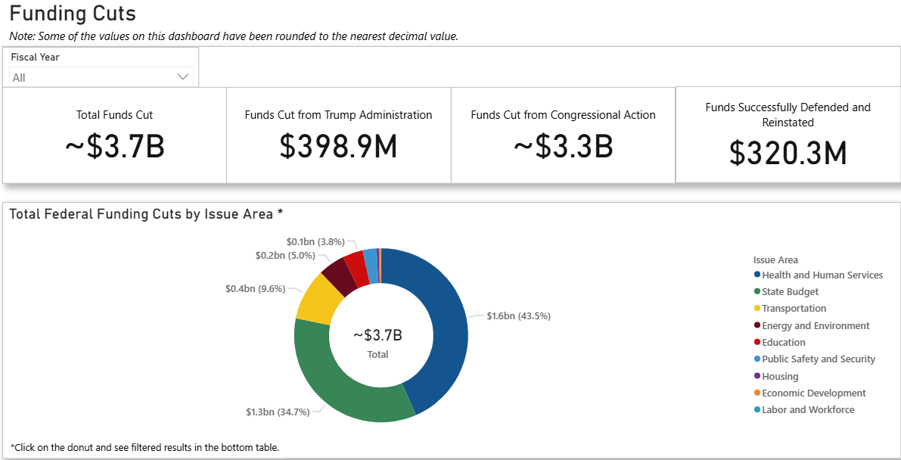
Mass.gov/FedImpact
Massachusetts is Tracking and Communicating the Impact of Federal Funding Cuts
Website updated weekly on federal funding impacts

Slide 6
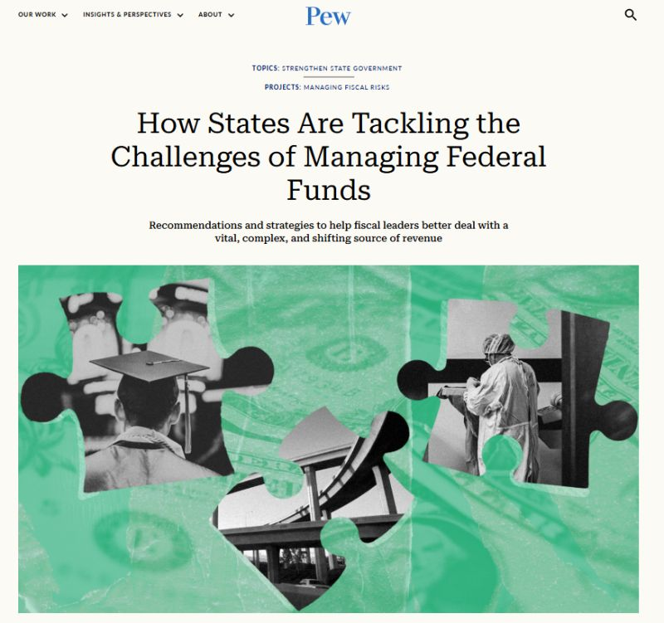
Strategic Approach to Evolving Federal Landscape
This month, Pew Research Center published a report which details how FFIO and the Massachusetts Executive Office for Administration and Finance have worked to respond to a rapidly changing federal funding environment.
The report highlights the Healey-Driscoll Administration's work to deliver key information on federal funds to communities quickly and transparently, improve coordination across state agencies, and expand resources to support project advancement as the federal landscape evolves.

Slide 7

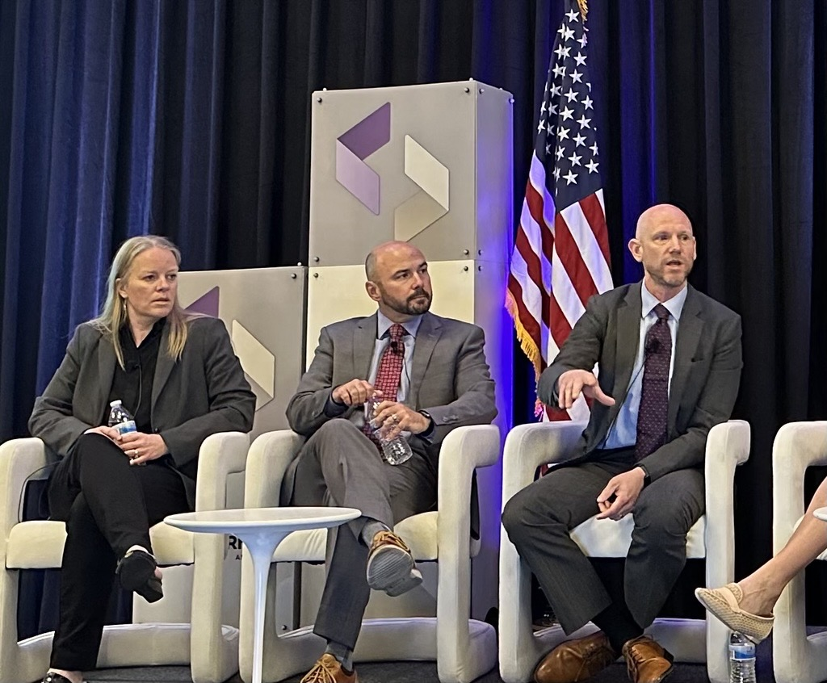
NGA Infrastructure/Broadband Workshops
Last week, FFIO Director, Quentin Palfrey attended the National Governor’s Association Infrastructure Coordinator’s Workshop in Washington D.C.
The workshop focused on solutions to counter headwinds from the upcoming expiration of the Infrastructure Investment and Jobs Act (IIJA) as well as inflation in the cost of construction. Of note was the surface transportation reauthorization process which will provide a successor to the IIJA.
Additionally, in April, members from Massachusetts joined state broadband leaders from across the country in Alexandria Virginia to discuss the latest updates in federal broadband programming.
At the event, FFIO Director Quentin Palfrey joined a panel to discuss MA’s approach to BEAD “Nondeployment” (how BEAD funding can be used for purposes other than broadband deployment) amidst the NTIA’s anticipated release of updated guidance around use of remaining funds.

Slide 8
Get in touch with FFIO
Find more information on Federal Funds Partnership meetings, video recordings, grant lists, and other resources on the FFIO website.
Follow FFIO on LinkedIn to see the latest updates from our office.
Contact the FFIO email inbox (FedFundsInfra@mass.gov) for questions about federal grant opportunities!

Slide 9
Open Funding Opportunities

Slide 10
Recently Opened Federal Grants
Grant Name | Eligibility | Max Award | Deadline
Assistance to Firefighters | Fire departments and other emergency medical services agencies | N/A | 6/22/26
Staffing for Adequate Fire & Emergency Response (SAFER) | Fire departments and volunteer firefighter interest organizations | N/A | 6/22/26
Fire Prevention and Safety (FP&S) Grant Program: | Fire departments and non-profit organizations, academic and other research-oriented institutions | $1.5 million | 6/22/26
Distance Learning and Telemedicine Grant Program | State and local governments, businesses, nonprofits, school districts, higher education, tribes, and more | $750k | 6/30/26
*See FFIO’s monthly newsletter for the more open grants relevant to municipalities and tribes. To sign up, email fedfundsinfra@mass.gov

Slide 11
Recently Opened Federal Grants
Grant Name | Eligibility | Max Award | Deadline
Rural Business Development Program | State and local governments, tribes, nonprofits, public higher education, etc. | No max award listed. | 6/30/26
Rural Capacity Building for Community Development and Affordable Housing Grants | Nonprofits | $3.5M | 7/6/26
Flood Mitigation Assistance | States, tribal governments, and local communities/special district governments |  | MEMA SOI Deadline: 5/29/26 Subapplication Deadline: 7/7/26
*See FFIO’s monthly newsletter for the more open grants relevant to municipalities and tribes. To sign up, email fedfundsinfra@mass.gov. See grants.gov for full list of open federal grant opportunities.

Slide 12
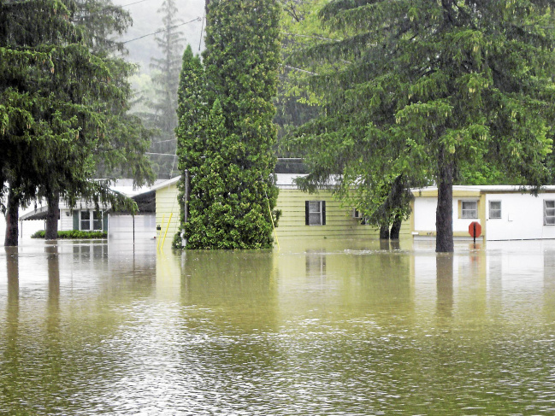
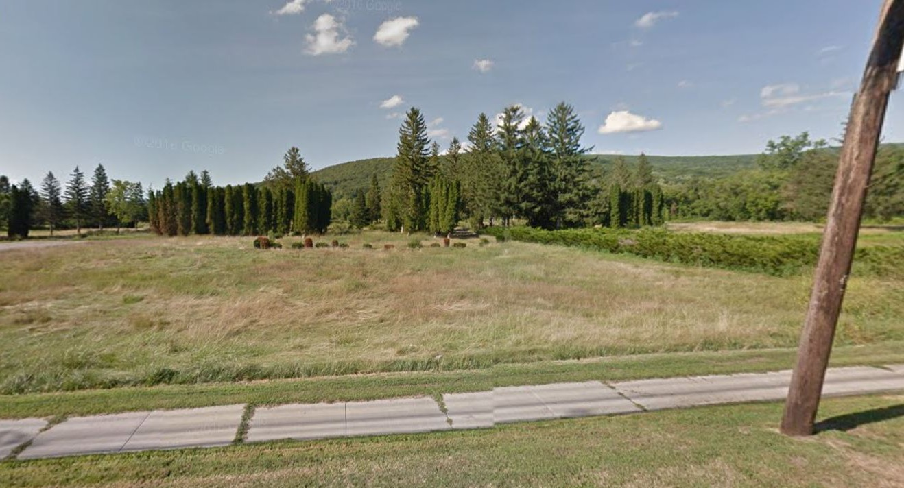
FEMA Hazard Mitigation Assistance
Flood Mitigation Assistance (FMA)
Massachusetts Emergency Management Agency
May 2026

Slide 13
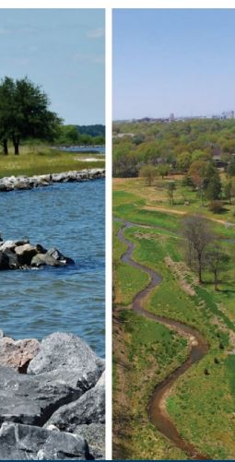
What is Hazard Mitigation?
Providing increased level of protection that will reduce or eliminate risk
Adapting to natural hazards
Protecting people, structures and infrastructure from future hazards
Maintaining consistency with resiliency and sustainability principles
Minimizing the costs of disaster response and recovery
Saving lives and money!

Slide 14
Flood Mitigation Assistance (FMA)
Funding for projects that reduce or eliminate risk of flood damage to buildings that are insured under the National Flood Insurance Program (NFIP)
Community must participate in NFIP
Nationwide Competitive Review Process
Announced by an Annual Notice of Funding Opportunity (NOFO)
Statement of Interest due May 29, 2026
Subapplications due to MEMA July 7, 2026

Slide 15
FY24 (Amendment)
Flood Mitigation Assistance (FMA)
Flood mitigation funding for states, tribal governments, and local communities/special district governments
Establishes an annual national competitive award announced by an Annual Notice of Funding Opportunity (NOFO)
  $600 Million available nationwide
  Projects can be up to 36 months
  Project funding limits
    $50 Million (Federal Share) for construction projects
    $900,000 scoping projects
    $300,000 additional C&CB activities
      (partnership development, enhance local floodplain management, SRL/RL strategy , SD procedures, CRS, etc)
    $25,000 local mitigation plans

Slide 16
Eligible Activities
(project types)
Mitigation Projects
 | Property Acquisition
 | Structure Elevation
 | Mitigation Reconstruction
 | Flood Risk Reduction Measures
 | Stabilization
 | Floodproofing
 | Retrofitting
 | Aquifer Recharge, Storage and Recovery
 | Innovative Mitigation Projects
Capability and Capacity Building Projects
 | New Hazard Mitigation Plans
 | Hazard Mitigation Plan Updates
 | Planning Related Activities
 | Project Scoping / Advance Assistance
 | Financial Technical Assistance
 | Partnerships
 | Innovative Capability and Capacity Building

Slide 17
HMA Project Requirements
Mitigate a Natural Hazard
Demonstrates an increase in Level of Protection (LOP)
Regulatory Design Construction
Feasible to Implement
Cost Effective
Must comply with Environmental and Historic Preservation (EHP)

Slide 18
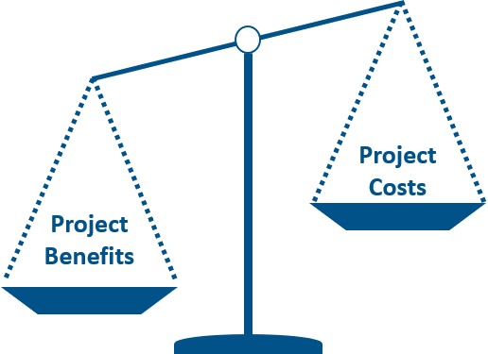
What is a Benefit Cost Analysis (BCA) ?
Benefit-Cost Analysis (BCA) is a method that quantifies the benefits (avoided losses) of a mitigation project compared to its costs
Establishes the project's Cost Effectiveness (requirement is a BCR > 1)
BCAs involve technical studies that require heavy data collection, supporting documentation development, and in many cases, engineering expertise
BCAs are required for project subapplications (note additional considerations in FEMA NOFOs)

Slide 19

What you need to know about FEMA Hazard Mitigation Grants:
MEMA is the conduit for applications and funding to and from FEMA. MEMA manages the State Contracts/Grant Awards.
The process from grant application to grant award can take several months to a year (or longer) - please be prepared.
It is the sub-applicant’s responsibility to maintain, and keep current, their local hazard mitigation plan for eligibility.
It is the subrecipient’s responsibility to ensure that proper procurement is undertaken for projects which use federal funds.

Slide 20

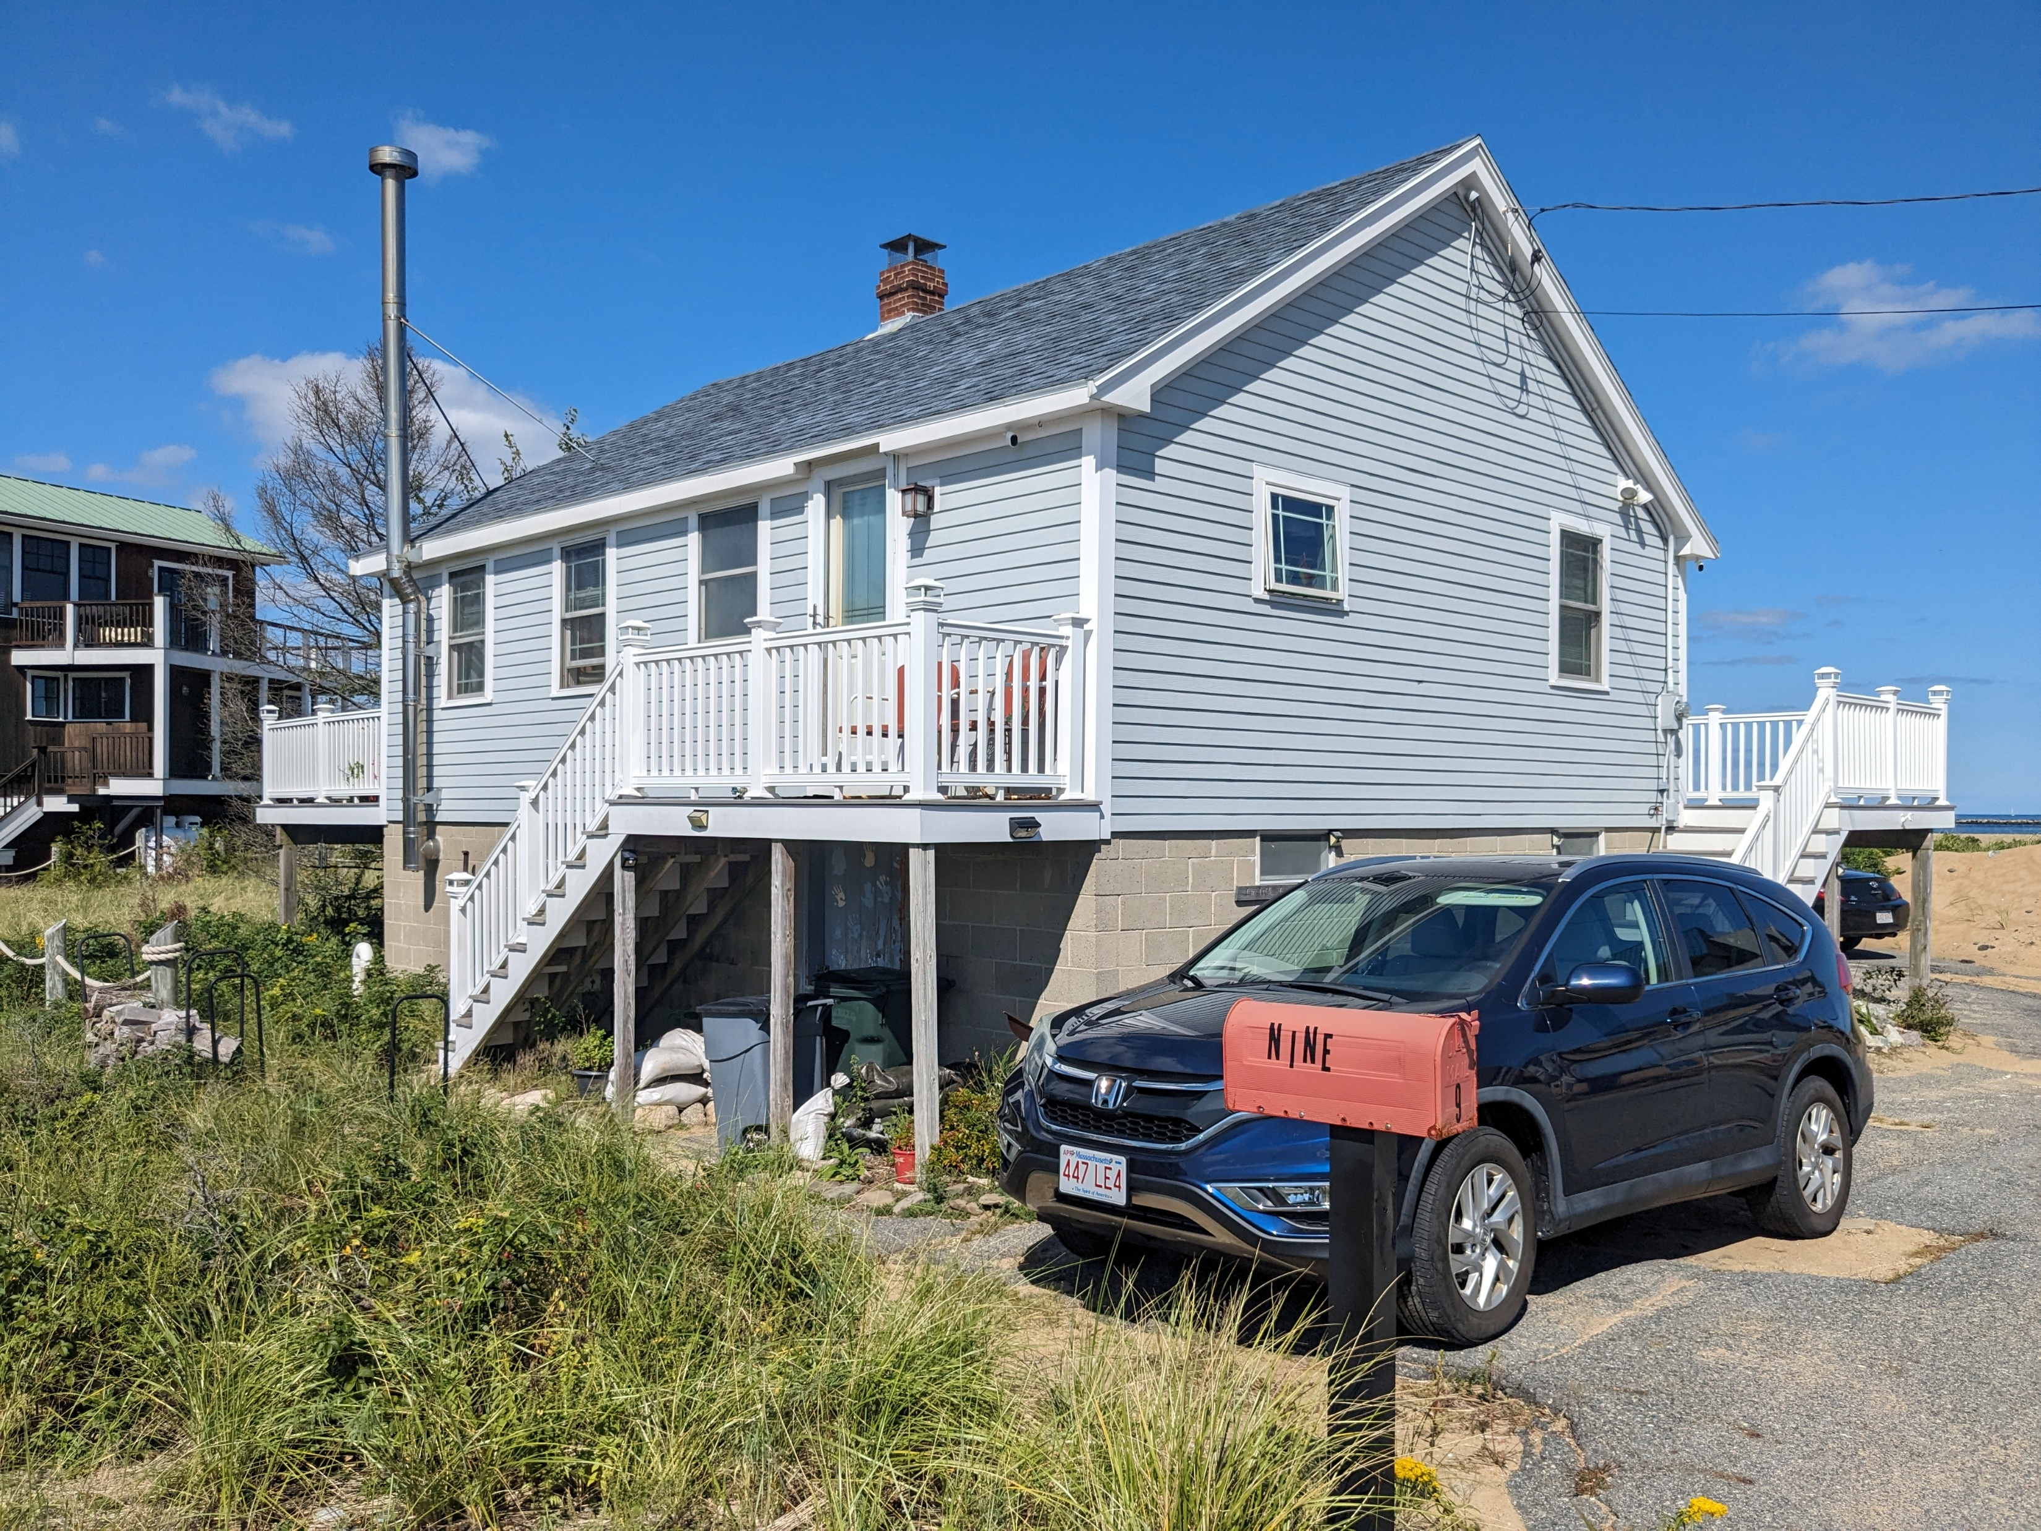
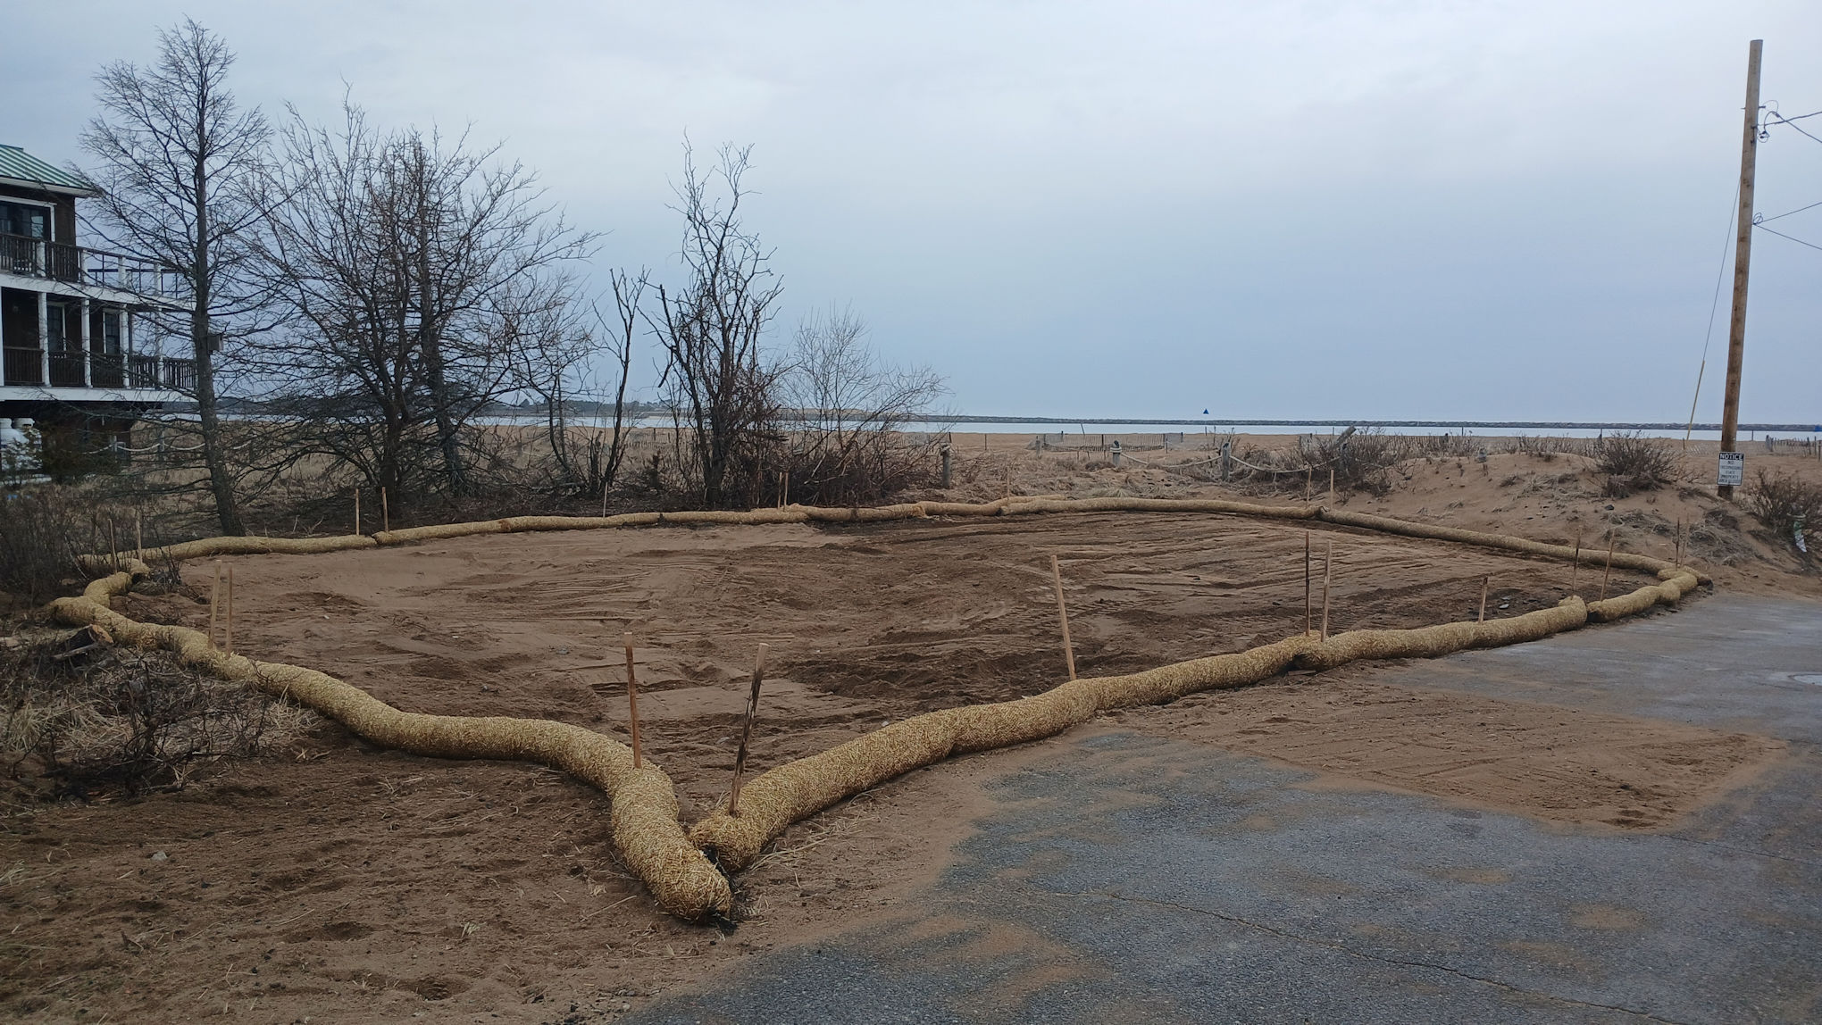
Structure Acquisition: Newburyport
Before
Structure acquisition is a voluntary program where local governments purchase flood-prone properties.
Property is demolished and converted to permanent open space to reduce future flood risk.
These projects are designed to break the cycle of disaster damage.
Funded through HMGP.
After

Slide 21
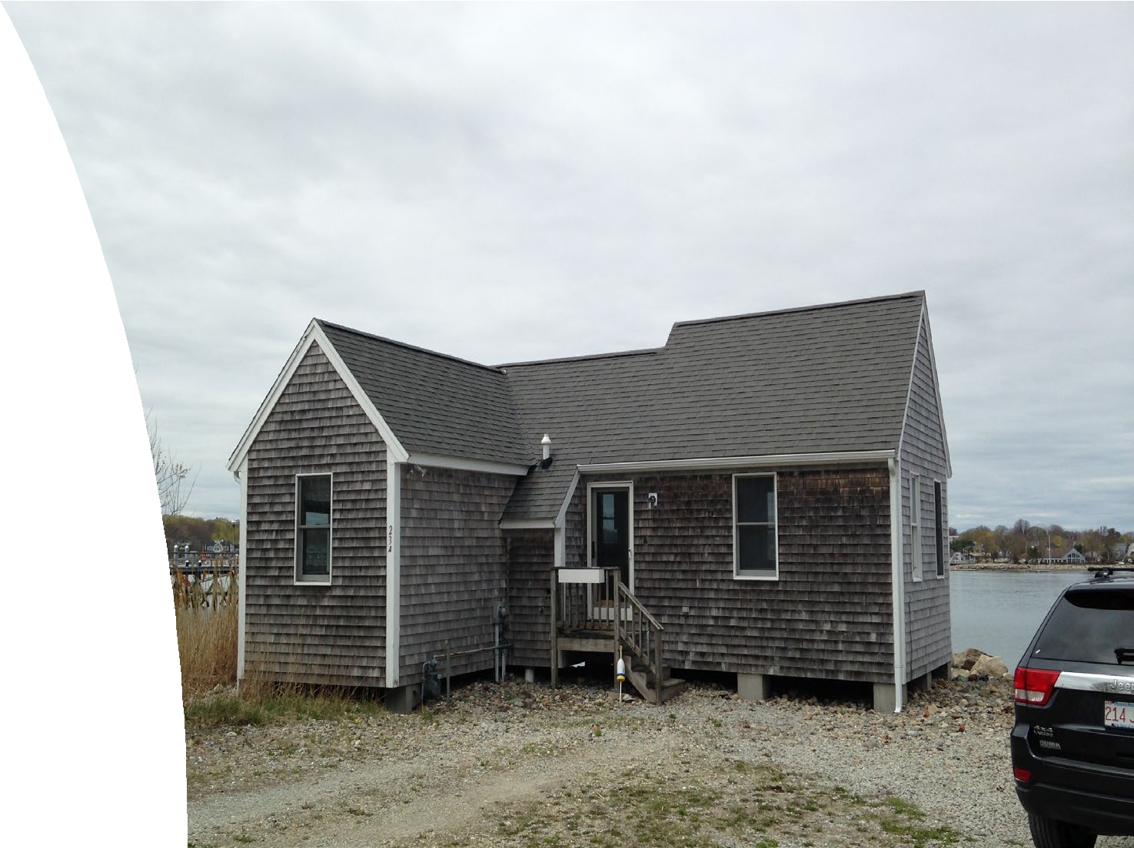
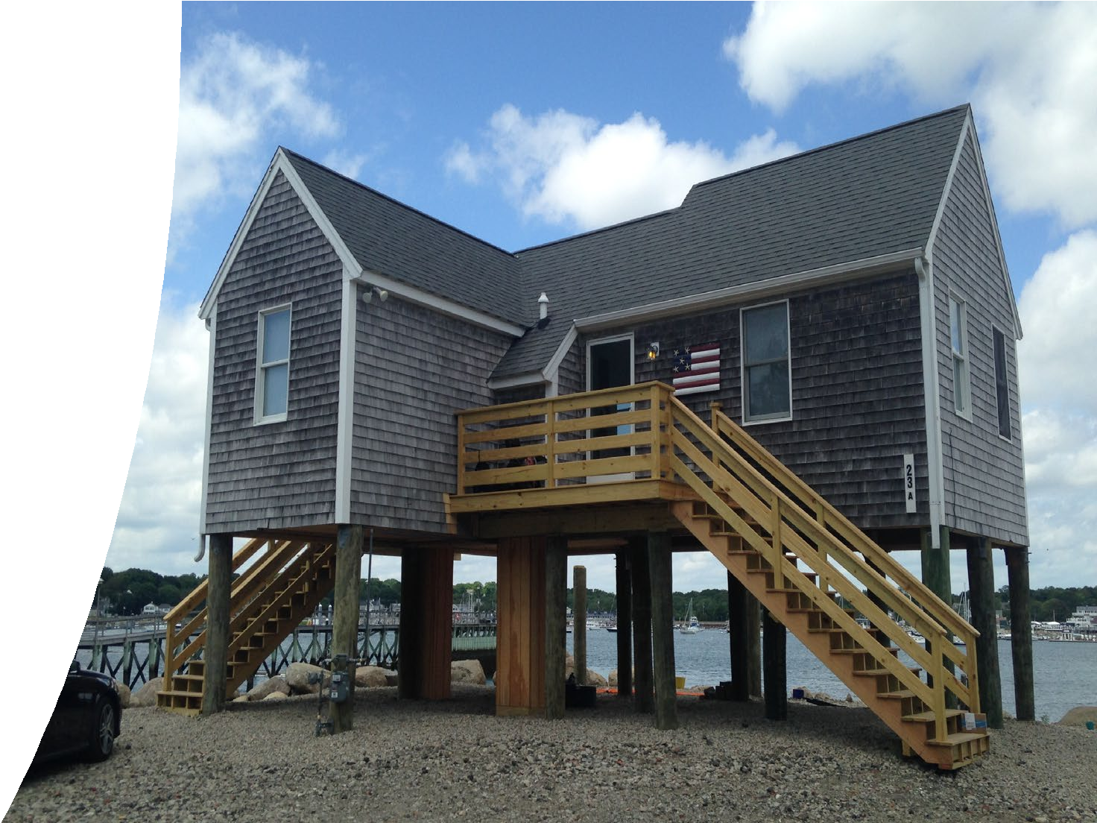
Structure Elevation: Scituate
Before
Structure elevation is identified as a hazard mitigation strategy.
Homes must be structurally sound in order to elevate.
Must meet NFIP, MSBC & ASCE 24-24
standards.
Funded through FMA.
After

Slide 22
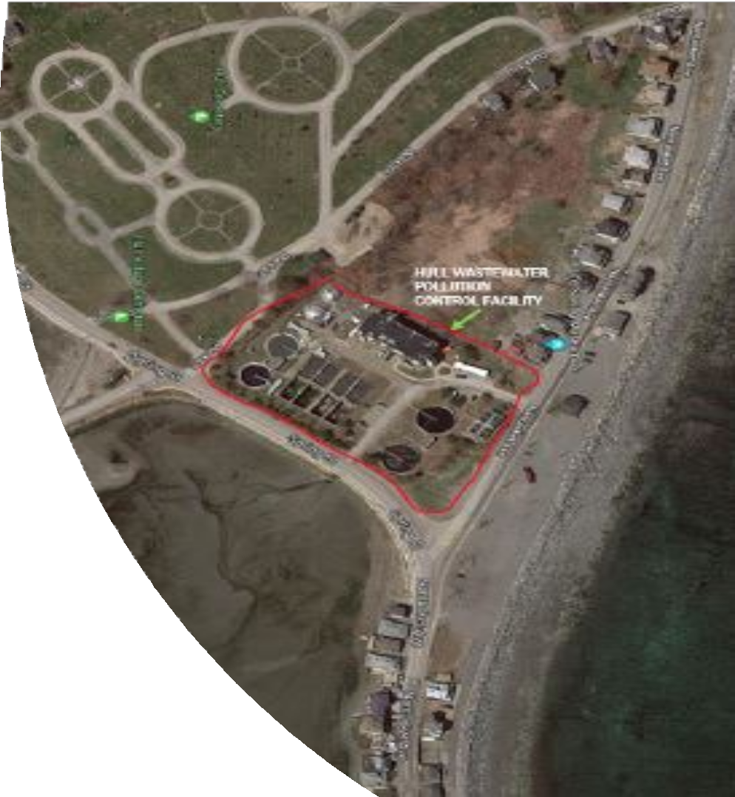
Flood Resiliency Retrofit:
Hull
This project will elevate critical electrical assets at the Hull Wastewater Pollution Control Facility to an elevation above current flood levels and taking future-conditions into account.
Project is underway and being funded through the HMGP program.

Slide 23

Non-Federal Cost Share
Cost share is typically 25% of the total project for cost.
Individual Flood Mitigation Projects may have increased Federal funding (depending on RL/SRL status).
Non-Federal cost share may include:
  Local, state, or private cash payments (MVP Funding, Culvert Replacement Municipal Assistance Funding, etc.)
  For private homes, if there is a cost share, it would come from the homeowner
  In-Kind Contributions (labor, equipment, materials, etc.)

Slide 24
FMA FY24 Amendment
Application Timeline
Statement of Interest (SOI) Deadline | May 29, 2026
Sub-applicant Register with FEMA GO Deadline | May 29, 2026
Federal Grant Application Period Opens | April 30, 2026
BCA Deadline (if applicable) | June 15, 2026
Sub-application State Deadline | July 7, 2026
State Review Committee | July 2026
Submittal to FEMA for National Competitive Review | July 31, 2026
Award Notification for FY24 FMA Cycle | TBD
Project Initiation | TBD

Slide 25
Technical Assistance Available
Technical Assistance
Submit a Statement of Interest (SOI)
on MEMA's Website

Slide 26

Helpful Links:
MEMA Hazard Mitigation Website
Statement of Interest
FMA State Notice of Funding Opportunity
Benefit-Cost Analysis (BCA) Download
2025 HMA Program & Policy Guide
FEMA GO Portal
Sam.gov Registration / Information
Federal Procurement Information

Slide 27

MEMA Hazard Mitigation Website
Contact MEMA
Shelly O'Toole
MEMA State Hazard Mitigation Officer
michelle.otoole@mass.gov
508-820-1443
Elena Kilduff
MEMA Regions 1 & 3
elena.kilduff@mass.gov
508-820-1436
David Woodbury
MEMA Regions 2 & 4
david.woodbury@mass.gov
508-820-2034
Michael Enko, CFM
MEMA Civil Engineer
michael.enko@mass.gov
508-820-1440
Patrick Limerick
Mitigation and Recovery Grants Support Coordinator
patrick.limerick@mass.gov
508-404-4369
Jeff Zukowski
State Hazard Mitigation Planner
jeffrey.zukowski@mass.gov
508-820-1422
Marybeth Groff, CFM
Hazard Mitigation & Climate Adaptation Coordinator
marybeth.groff@mass.gov
508-820-1435

Slide 28
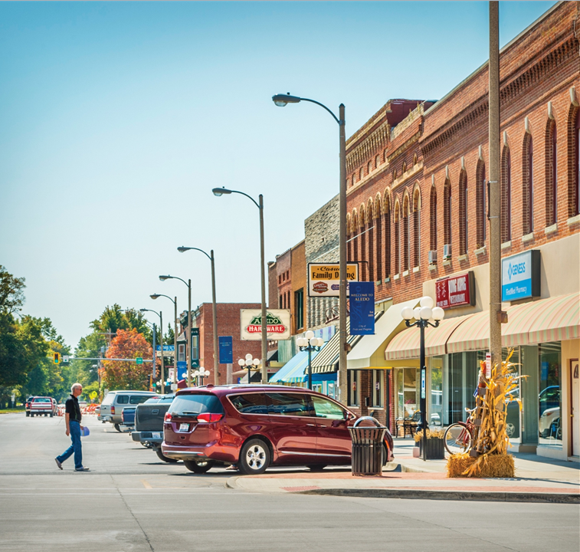

2026 Distance Learning & Telemedicine Grant Program
Presented by: Robert Fry
General Field Representative NY/PA/NJ

Slide 29
Distance Learning & Telemedicine Grant Program
Webinar Roadmap
The Basics
Eligibility
Matching
Scoring
Applying
Assistance

Slide 30
Distance Learning & Telemedicine Grant Program – The Basics
Distance Learning
Distance Learning means the real-time, interactive delivery of curriculum via telecommunications and promotes the connection of students and teachers at remote sites.
  Provide educational programs, instruction, or information originating in one area, whether rural or not, to students and teachers who are located in rural areas; or
  Connect teachers and students, located in one rural area with teachers and students who are located in a different rural area.

Slide 31
Distance Learning & Telemedicine Grant Program – The Basics
Telemedicine
Telemedicine is a real-time, interactive, telecommunications link to an end user from medical professionals at separate sites in order to exchange health care information for the purpose of providing improved health care services to residents of rural areas.
  Benefits rural residents both in reduced travel and improved access to service

Slide 32
Distance Learning & Telemedicine Grant Program - Eligibility
Applicant Eligibility
The following entity types are eligible to apply:
  Incorporated organization;
  Indian tribe or tribal organization, as defined in 25 U.S.C. 5304;
  State or local unit of government;
  Consortium as defined in 1734.3; or
  Other legal entity, including a private corporation organized on a for-profit or not-for-profit basis.
  Almost every entity except individuals & partnerships

Slide 33
Distance Learning & Telemedicine Grant Program - Eligibility
Eligible Grant Purposes (See DLT Application Guide for details)
Acquiring, by lease or purchase eligible equipment.
  If leased, the cost of the lease during the 3-year life of the grant is eligible.
  Broadband facilities must be applicant owned & are limited to 20% of grant
Acquiring instructional programming that is a capital asset (including the purchase or lease of instructional programming already on the market)
Providing technical assistance and instruction for using eligible equipment. (category limited to 10% of grant)

Slide 34
Distance Learning & Telemedicine Grant Program - Applying
Completing the Grant Application
  Standard Form 424 w/Site Worksheet
  An Executive Summary of the Project
  Scoring Criteria Documentation
  Matching Requirements
  Scope of Work
  Financial Information and Sustainability
  Statement of Experience
  Telecommunications Systems Plan
  Compliance with other Federal Statutes
  Evidence of Legal Authority and Existence
  Environmental Impact & Historic Preservation
  Consultation w/ USDA State Director & State Strategic Plan Conformity
  Supplemental Information

Slide 35
Questions?

Slide 36
Rural Development | Telecommunications Program
Rural Utilities Service | U.S. Department of Agriculture
1400 Independence Ave., S.W. | Washington, D.C. 20250
www.rd.usda.gov

Slide 37

End Slide
USDA is an equal opportunity provider, employer, and lender.

Slide 38
Q&A
Place your questions in the chat!

Slide 39
Federal Funds Partnership Meeting Schedule
Future meeting dates:
  Tuesday, June 23rd 2-3 pm
  Tuesday, July (date TBA) 2-3 pm

