Slide 1
Massachusetts Commission on Falls Prevention
Robin Lipson, Executive Office of Elder Affairs
7 May 2018

Slide 2
Governor’s Council to Address Aging in MA
2

Slide 3
Governor’s Council to Address Aging in MA Plan and Process
Year One
Held 5 in-person meetings including 4 expert panels
Reviewed documents and data from thought leaders
Held 4 listening sessions across the state
Invited input and recommendations via web portal
Heard from over 500 individuals across the Commonwealth
Year Two
Establish working groups to research, develop and explore potential initiatives
Provide recommendations to Governor Baker
Drafted initial blueprint
Establish a plan for communications of the Council’s work and reports
Develop metrics to evaluate outcomes and measure success
3

Slide 4
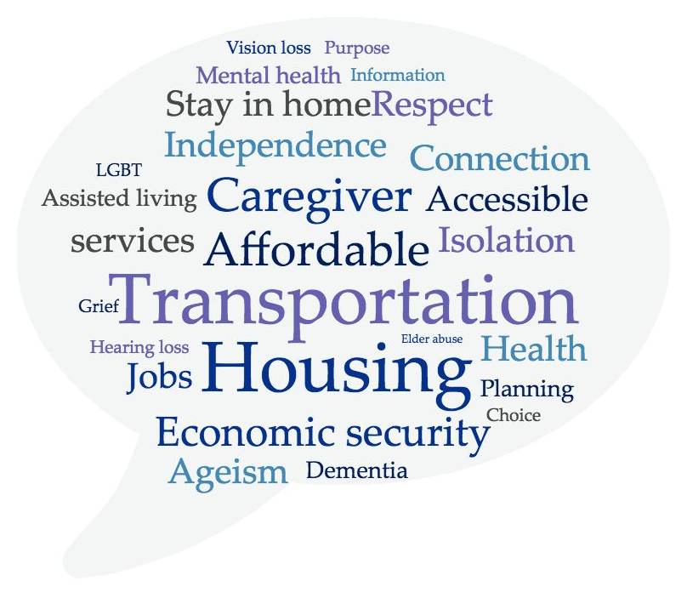
Overview What the Council Heard
Over nine months the Council held five working meetings and convened four listening sessions throughout the state in addition to collecting public comment online. The result was input from more than 500 Massachusetts residents.
4

Slide 5
Governor’s Council to Address Aging in MA Create an Age-Friendly Commonwealth
Access, Equity, Inclusion
Ensure Access & Affordability of Services
Promote Age-Friendly Communities
Facilitate Connection & Engagement
Improve Economic Security
Innovation and Technology
Community
Community
5

Slide 6
Blueprint Initial Priorities
Declare Massachusetts as an age-friendly state
Include age-friendly best practices in community compact program (new business, economic development, innovation and technology)
Promote the designation of age-friendly employers and practices that support mature workers and workers who are caregivers
Increase participation in employer sponsored retirement plans and explore options for those without access to employer sponsored plans
Support caregivers through increased information and awareness efforts
Promote and update property tax deferral programs
Consider options, including new sources of capital, for increasing production of accessible, affordable, service enriched housing
Quickly scale and replicate successful age-friendly pilots, such as ride-sharing
Become the Silicon Valley for innovative technology, products and services related to aging
Begin changing perceptions and address ageism with specific trainings and communication tools
6

Slide 7
Workgroups
Members from the Governor’s Council to Address Aging in Massachusetts, along with topics experts are working on specific proposals in the following areas:
Caregiving
Employment
Housing
Innovation and Technology
Transportation
The workgroups will present proposals to the full Governor’s Council to Address Aging in October 2018.
7

Slide 8
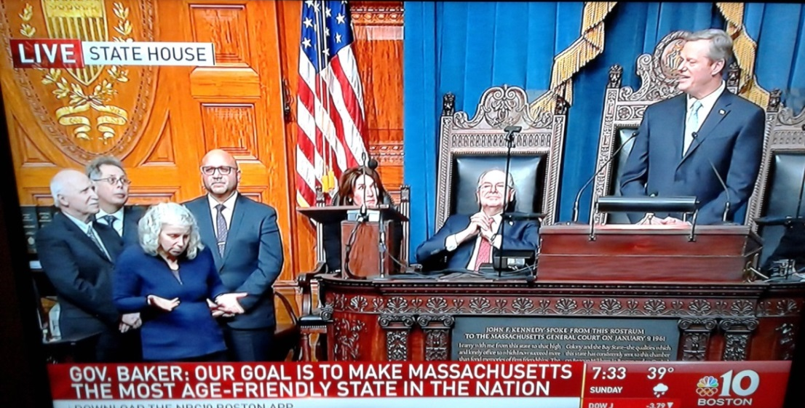
Age-Friendly State
The Governor announced that Massachusetts has been designated by AARP as only the second state in the country to join the organization’s Age-Friendly Network.
This designation commits us to making Massachusetts more livable and welcoming for older adults and people of all ages through a diverse network of partners and communities.
8

Slide 9
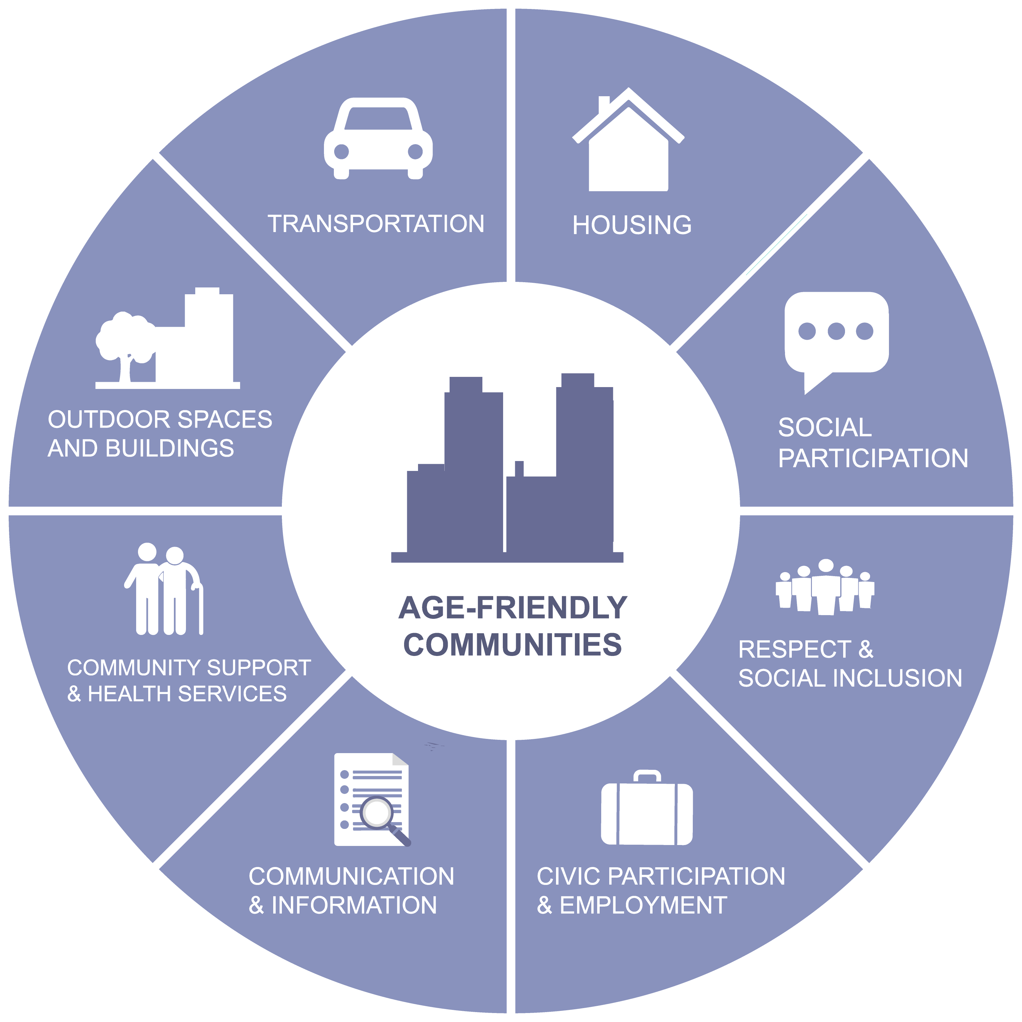
What Does Age Friendly Mean?
Age-Friendly describes a movement to make communities more welcoming and livable for older residents and people of all ages. It describes efforts we can take together to create places where people can grow up and grow old together. AARP has identified eight areas for communities throughout the country to focus on improving:
Outdoor Spaces & Buildings
Transportation
Housing
Social Participation
Respect & Social Inclusion
Civic Participation & Employment
Communication & Information
Community & Health Services
9

Slide 10
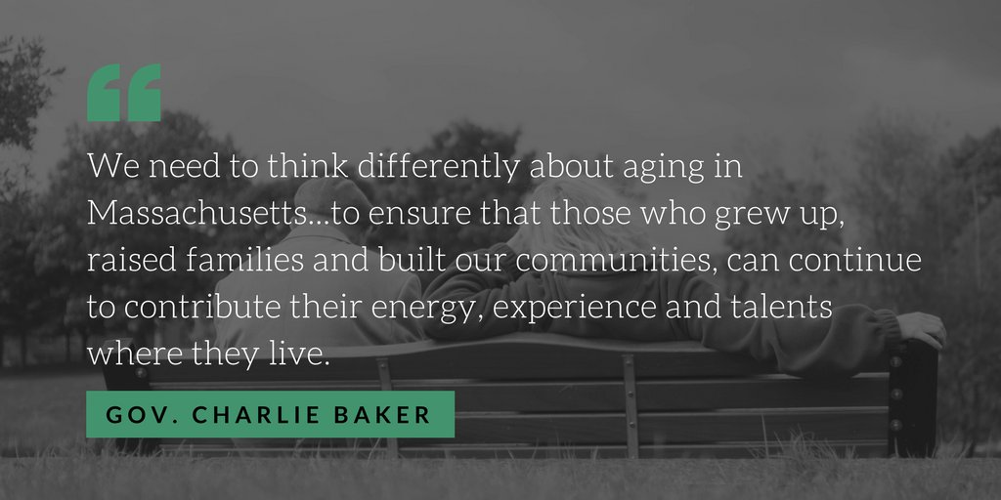
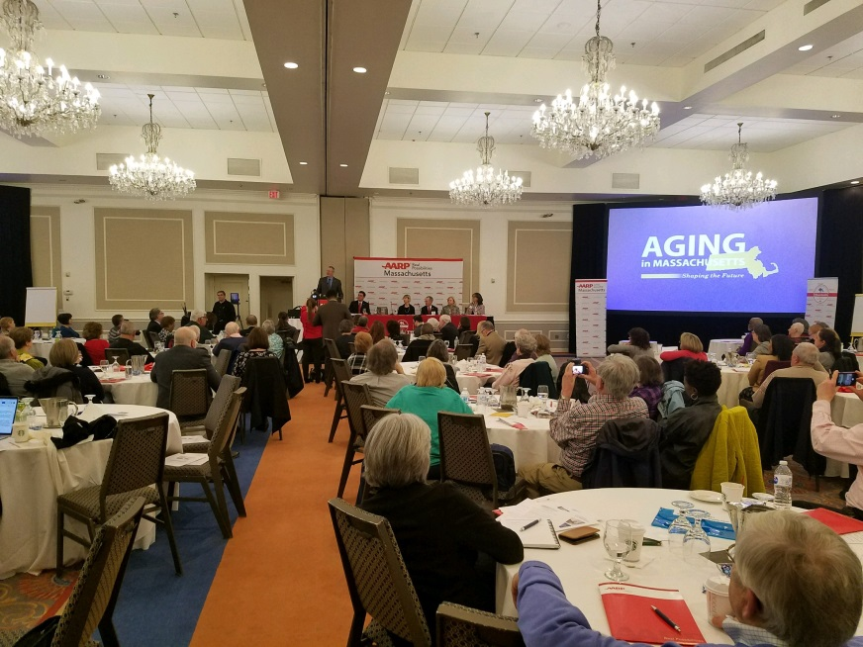
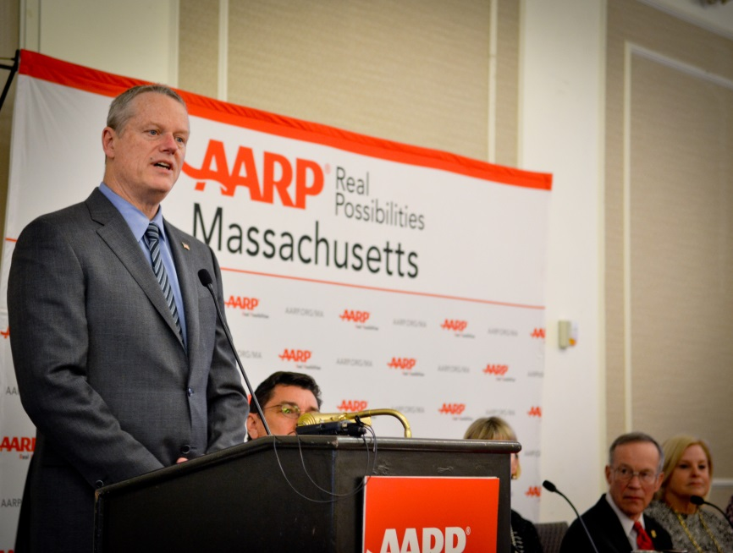
Age-Friendly State Designation April 11th Celebration Event
10

