Slide 1
Commission on Falls Prevention
James Fuccione – Senior Director
May 2018
The work of the Massachusetts Healthy Aging Collaborative is supported in part by:

Slide 2
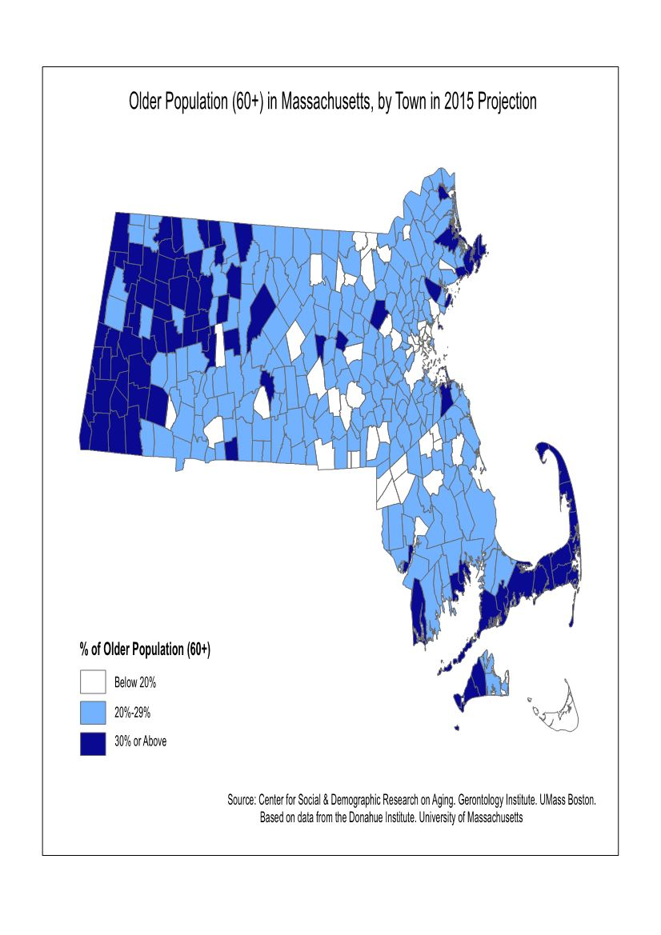
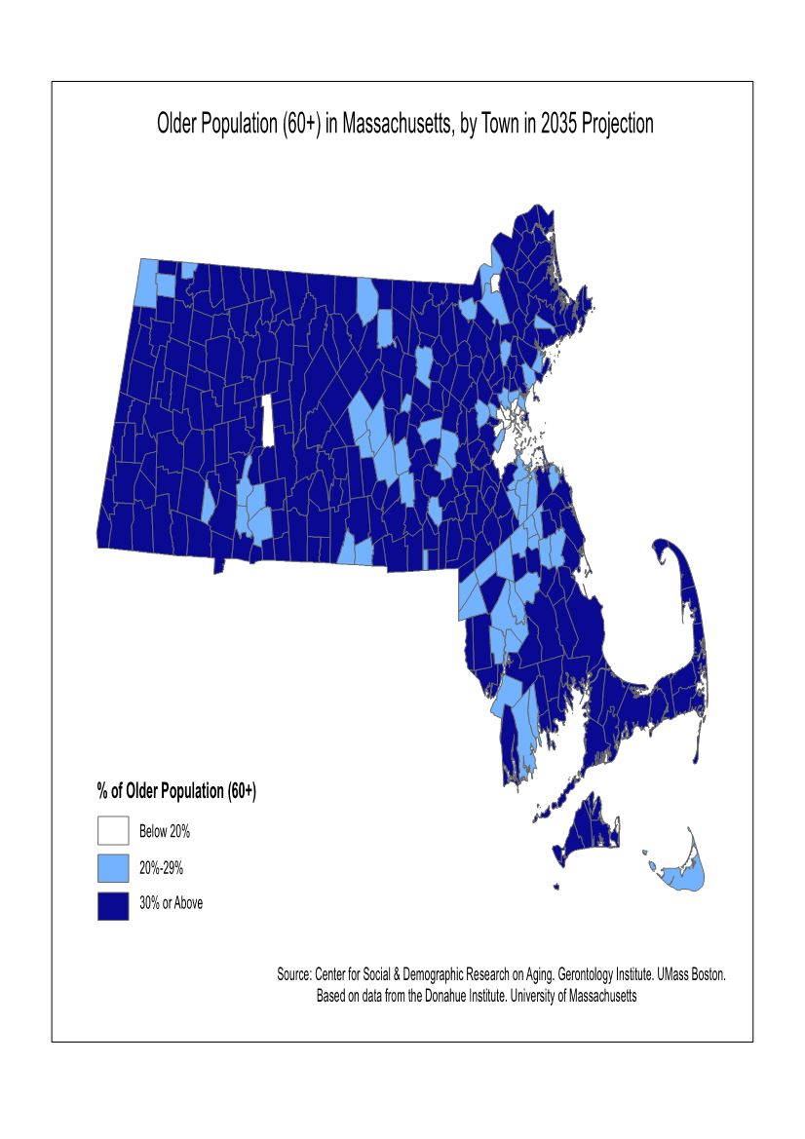
Aging Population in MA (60+)
2015
20-year projection

Slide 3
How we got here: Age/Dementia Friendly
International/National:
Announced at WH Conference on Aging
becomes USA affiliate for WHO
2005 to Today
Massachusetts:
+ Healthy Aging
+ Dementia Friendly
MA
Convener/Steering Committee
Action Oriented

Slide 4
About MHAC
The Massachusetts Healthy Aging Collaborative is a network of leaders in community, health and wellness, government, advocacy, research, business, education, and philanthropy who have come together to advance healthy aging.
Building the Age-Friendly Movement
Deepen Capacity-Building at Community Level
Embed Access, Equity and Inclusion within the Age-Friendly Movement
Develop and Promote a Policy and Advocacy Platform for Healthy Aging

Slide 5
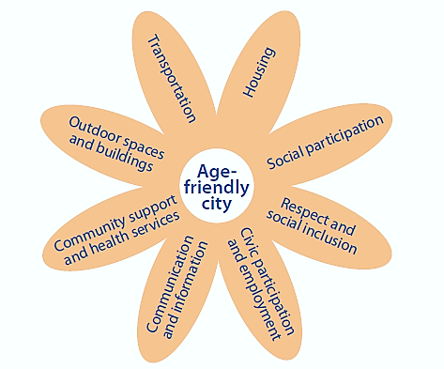
Age-Friendly Communities
A continuous improvement process (assessment, action planning, implementation) focusing on improving communities in three areas:
Physical environment
Social Environment
Community and health services
Physical Environment
Social Environment
Community and Health Services

Slide 6
Alignment with Dementia Friendly
Build capacity of local communities to embark on the Age/Dementia Friendly designation journey
Age-Friendly Community efforts…
Include people living with Dementia, caregivers, and service/support providers on task force
A Dementia Friendly advisory group that can focus on raising awareness and working through sectors in coordination with Age-Friendly

Slide 7
Age-Friendly Communities in MA

Slide 8
Where to Begin…
It all starts with CONVENING: Active Age- and Dementia Friendly models
Age-Friendly Berkshires (AARP – Municipal Resolution):
Countywide effort began with regional planning agency and private-pay home care company that lead “planning” and “people” sides of the work, respectively.
All volunteers and volunteer organizations
Age-Friendly Yarmouth (WHO):
Director of Senior Services dedicates time to Age-Friendly work.
Age-Friendly Boston (AARP):
City’s Elderly Commission have dedicated staff to convene groups, liaise between city departments and carry out action plan.
Support came from THPF and UMass Boston
Salem for All Ages (AARP):
Volunteer, retired professor leads “people” side of the work with support from Mayor’s office and local volunteers/volunteer orgs
Support from UMass Boston

Slide 9
Age-Friendly Lens: Municipal Gov’t
Accounting
Animal Control
Assessing Department & Board of Assessors
Board of Selectmen
Capital Projects & Facilities Management
Conservation Commission
Community & Economic Development
Council on Aging
Cultural Council
Finance Division
Fire
Health Department
Human Resources
Human Services
Inspectional Services
Library
Licensing
Parks, Recreation & Cultural Affairs
Planning Board
Police
Public Schools
Public Works
Purchasing
Retirement Board
Technology Services
Town Clerk
Town Manager
Treasurer / Collector
Veterans Services
Zoning Board of Appeals

Slide 10
Age-Friendly Lens: Stakeholder Orgs
Focus on linking Social Determinants of Health

Slide 11
What Determines Population Health?
Source: Countyhealthrankings.org

Slide 12
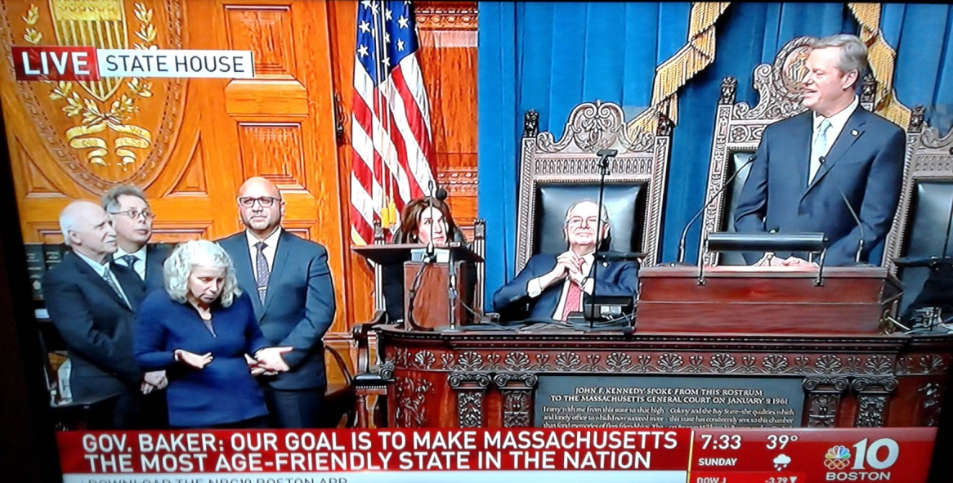
Age-Friendly State
Governor announced that Massachusetts has been designated by the AARP as only the second state in the country to join that organization’s Age-Friendly Network.
This designation commits our state to a continued path of progress in making Massachusetts more livable and welcoming for older adults and people of all ages.

Slide 13
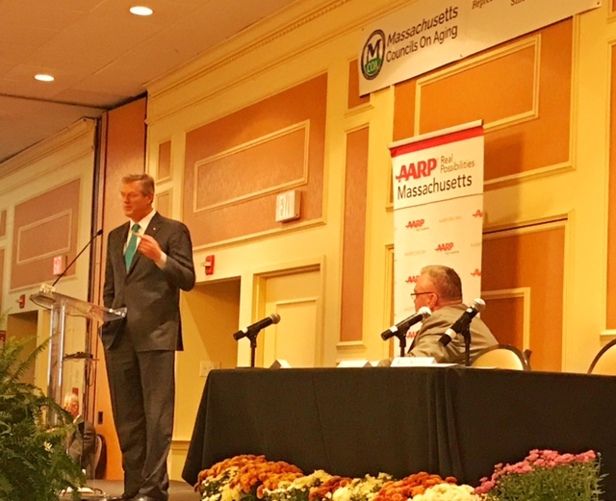
Age-Friendly State

Slide 14
Data Gathering

Slide 15
Data Gathering

Slide 16
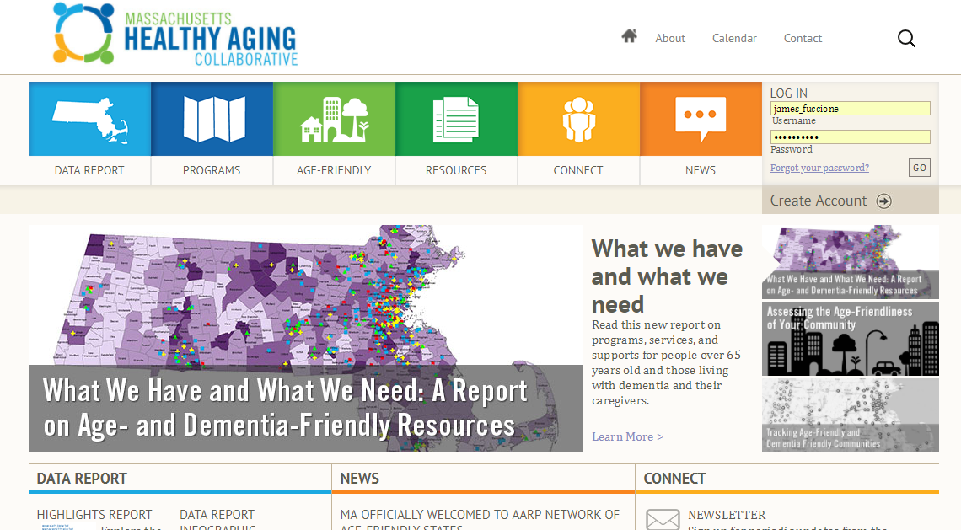
Visit Us

Slide 17
Thank You!
James Fuccione: James.Fuccione@mahealthyaging.org
617-717-9493

