Slide 1
Transforming Public Transportation for People With Disabilities
Town Hall
Massachusetts Commission for the Blind & MBTA
Thursday October 7, 2021 12 pm - 1:30 pm

Slide 2
Updates from System Wide Accessibility: Laura Brelsford
New Orange & Red Line Vehicles:
Two Orange Line train sets are currently in service
Improved color contrast throughout
Enhanced PA/VMS systems
Door locator tones
Tactile/braille card numbers at each doorway
New priority seating signage

Slide 3
New Bus & Subway Trainings
Full day trainings, completely refreshed
Changes based on feedback from Bus Operators, Subway Motorpersons & Riders with disabilities
Classroom and hands-on learning
New module dedicated to responding to emergencies

Slide 4
Internal Accessibility Monitoring Program
Recently relaunched after Covid –related hiatus
~20 part-time monitors
Evaluate all aspects of Operations compliance with accessibility policies
Bus, Subway, Commuter Rail, Ferry and Stations covered
Current focus on Subway stop announcements

Slide 5
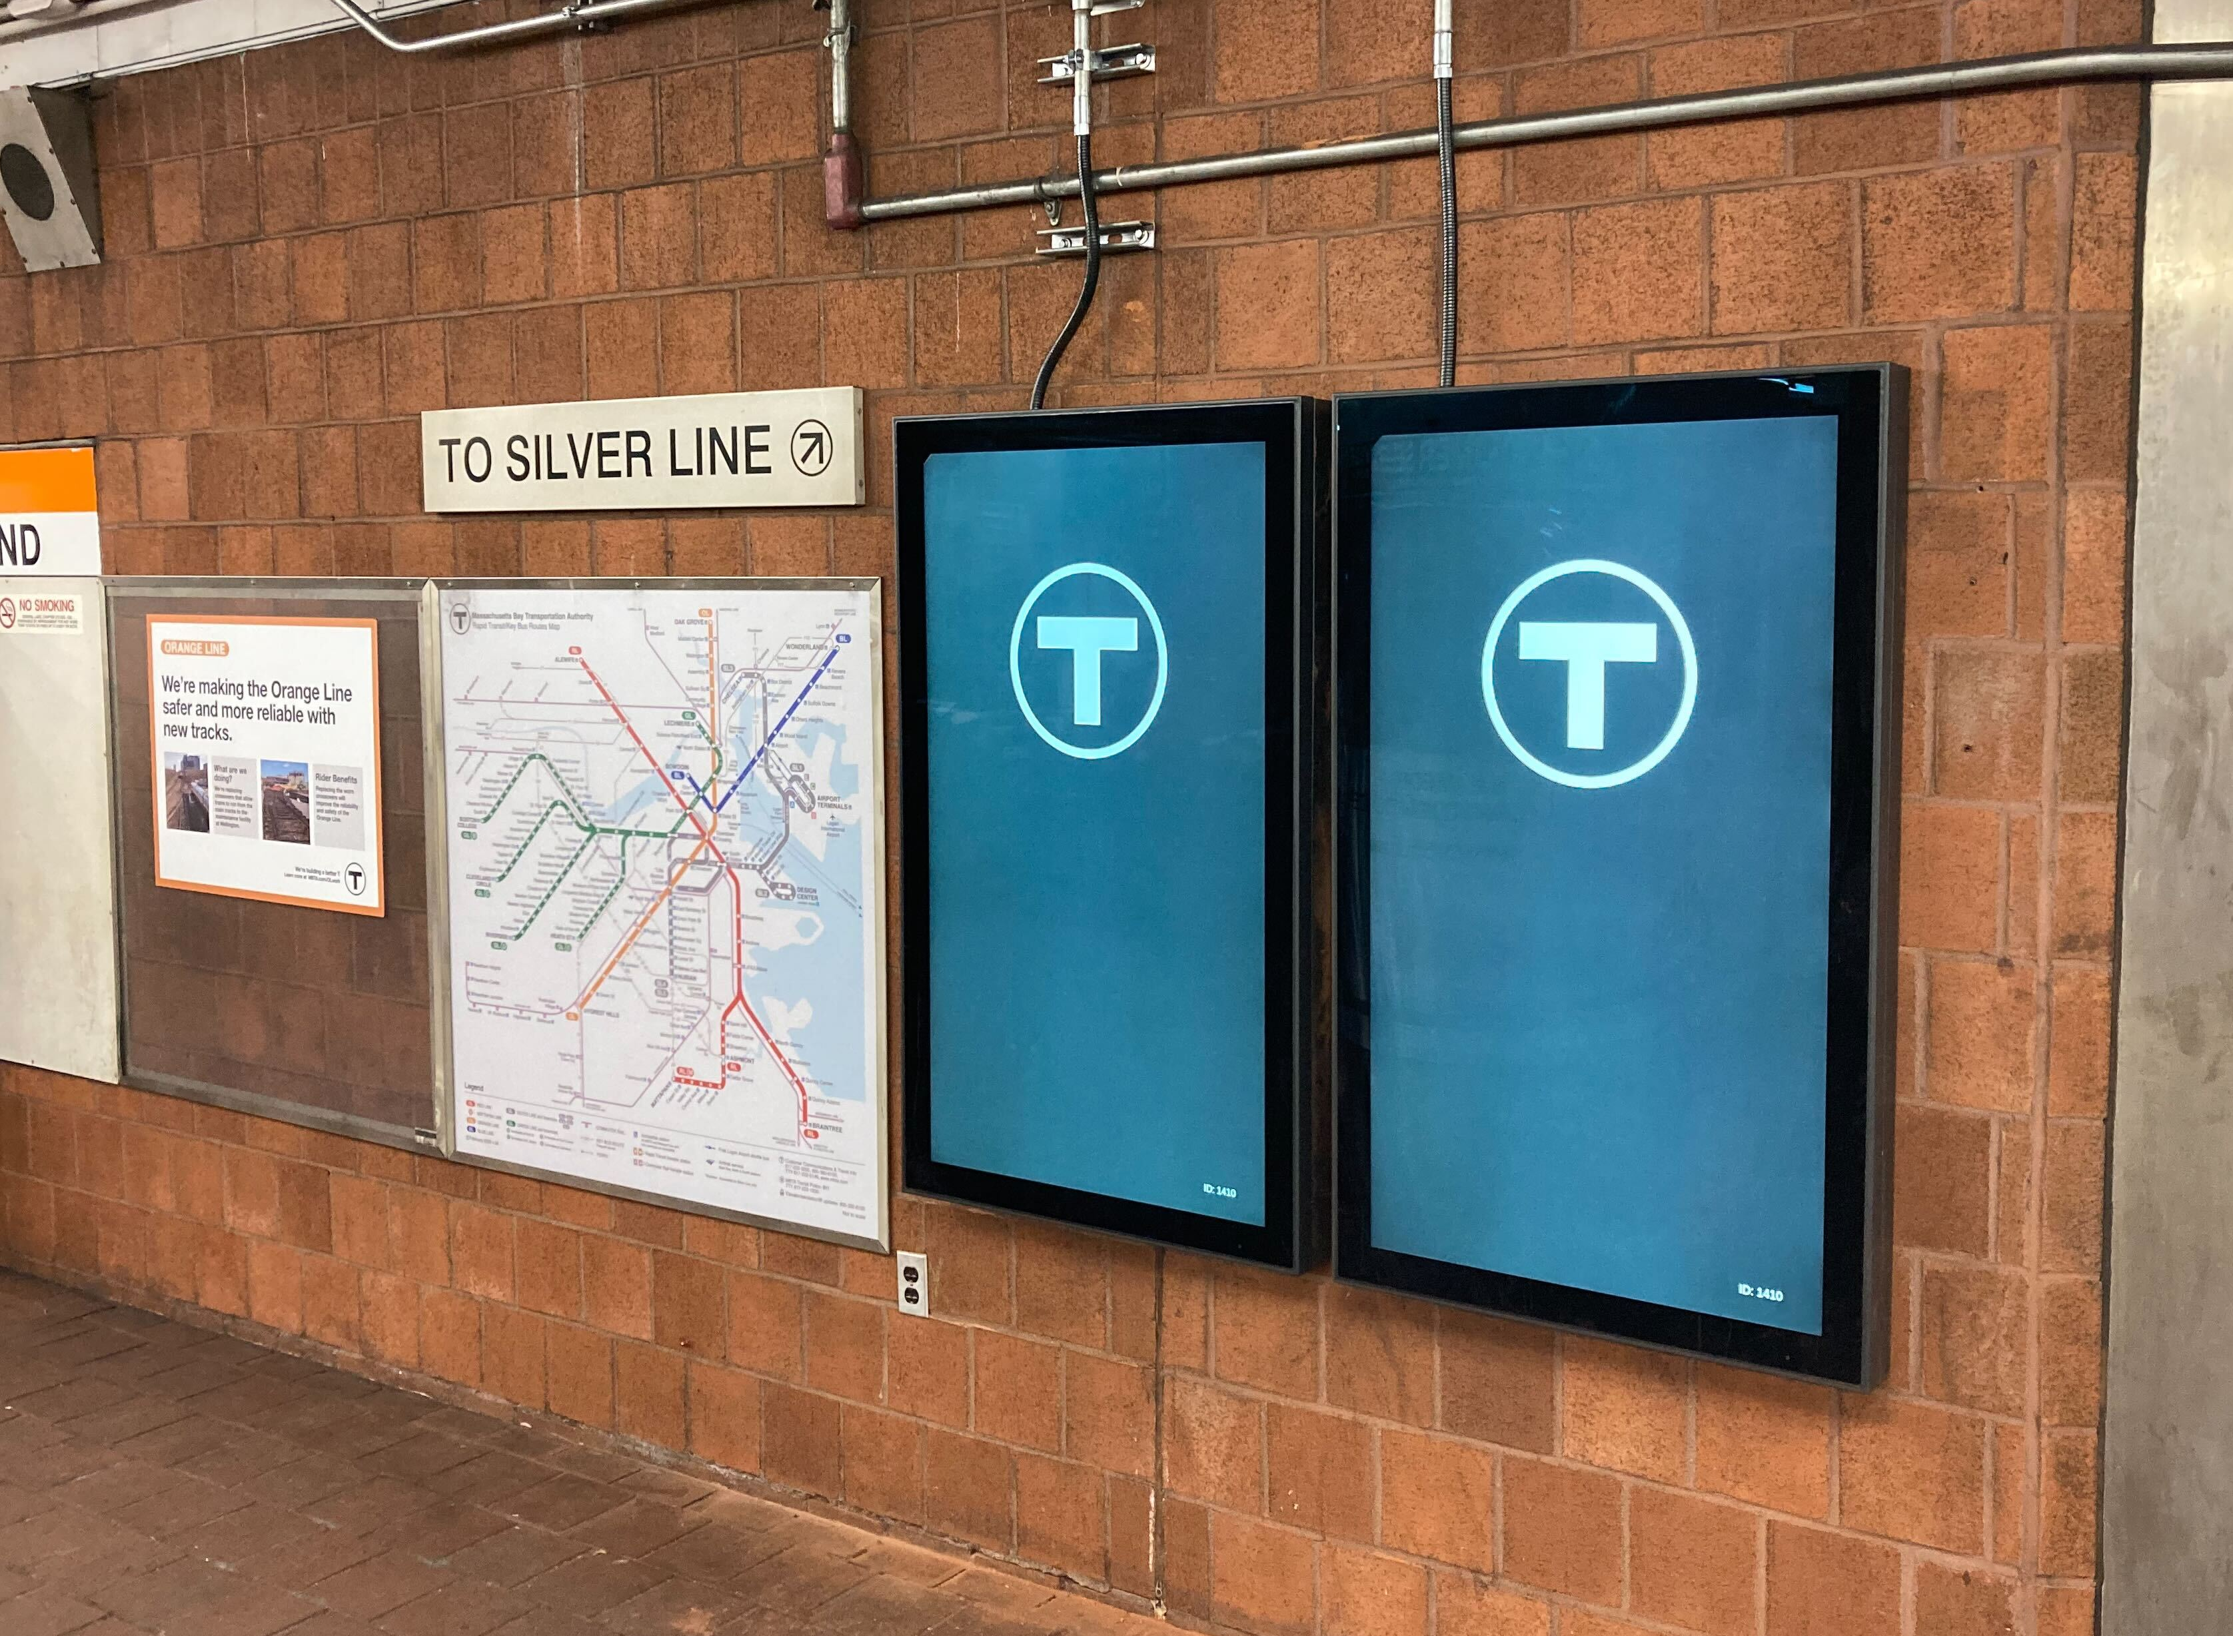
Karti Subramanian: New Digital Signage Project
Pre-fare Screens
Riders want more information about the status of the system & service before they pay their fare.
These screens will:
Go live in eight (8) stations in November
Be in all rapid-transit stations in the next 2-3 years
Contain several new types of information—including a real-time snapshot of elevator outages
Include a button to generate an audio message
✋🏽 Get Involved
Subscribe to SWA's updates to hear when this new information is available. Email us to tell us what information would best support your trips on the T. And sign-up to help us craft the audio experience.
Photo of the first two, side-by-side 55-inch screens installed at Tufts Medical Center that will display new kinds of real-time information.

Slide 6
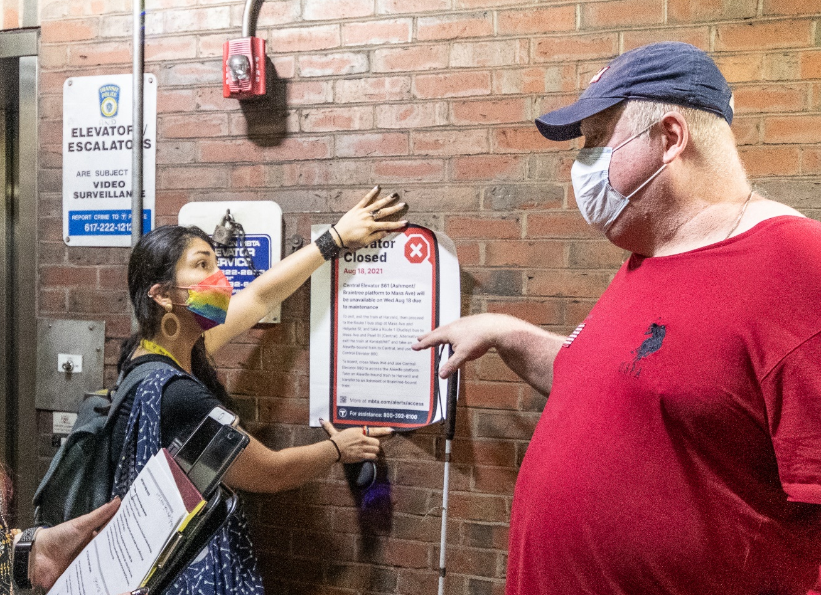
New Digital Signage Project
Elevator Screens
Riders who depend on elevators need better ways to plan their trips & navigate outages.
These screens will:
Go live in two (2) stations in November
Be scaled-up based on pilot feedback
Be dedicated entirely to elevator out-of-service information
Include a short audio message
✋🏽 Get Involved
Subscribe to SWA's updates to hear when this new information is available. Give us feedback when you come across a screen during the pilot. And sign-up to help us craft the audio experience.
A rider giving feedback to a Customer Technology employee on a mockup of what a 19-inch screen at elevator entrances might display.

Slide 7
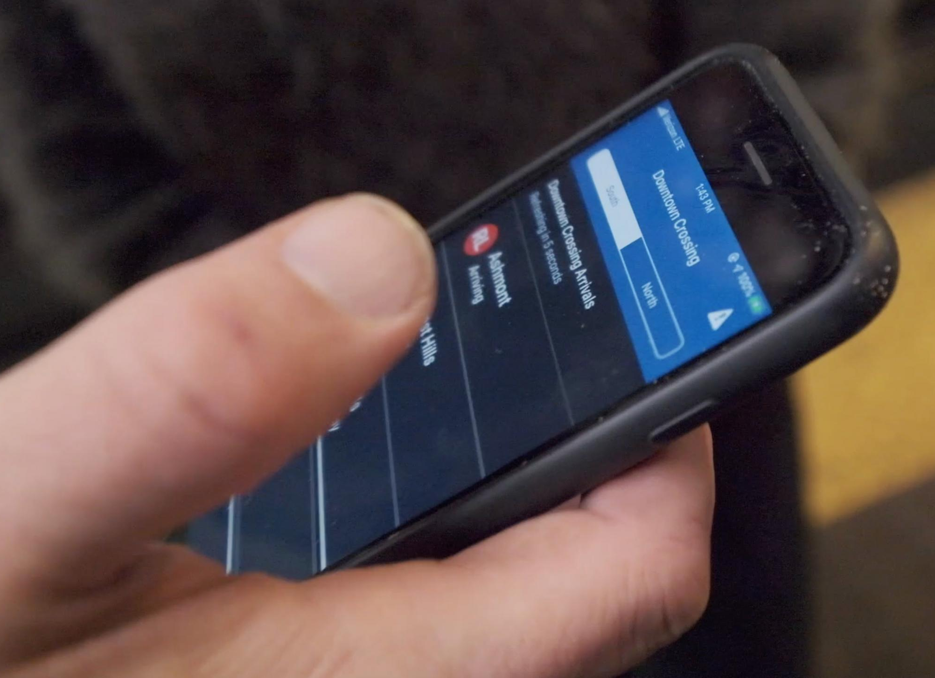
New Technology Policy
Audio & Visual Equivalence
As digital signage proliferates, we want to hold ourselves to a standard of two-way, audio- and visual-equivalence that supports all riders.
We've drafted a policy, based on what we know about digital signage technology, research with peer transit agencies, and feedback from riders. When ready, that policy will be available at mbta.com/accessibletech.
✋🏽 Get Involved
Subscribe to SWA's updates to hear when this draft policy is available. Send us your feedback.
Photo of a rider using a Bluetooth-beacon based iPhone application.

Slide 8
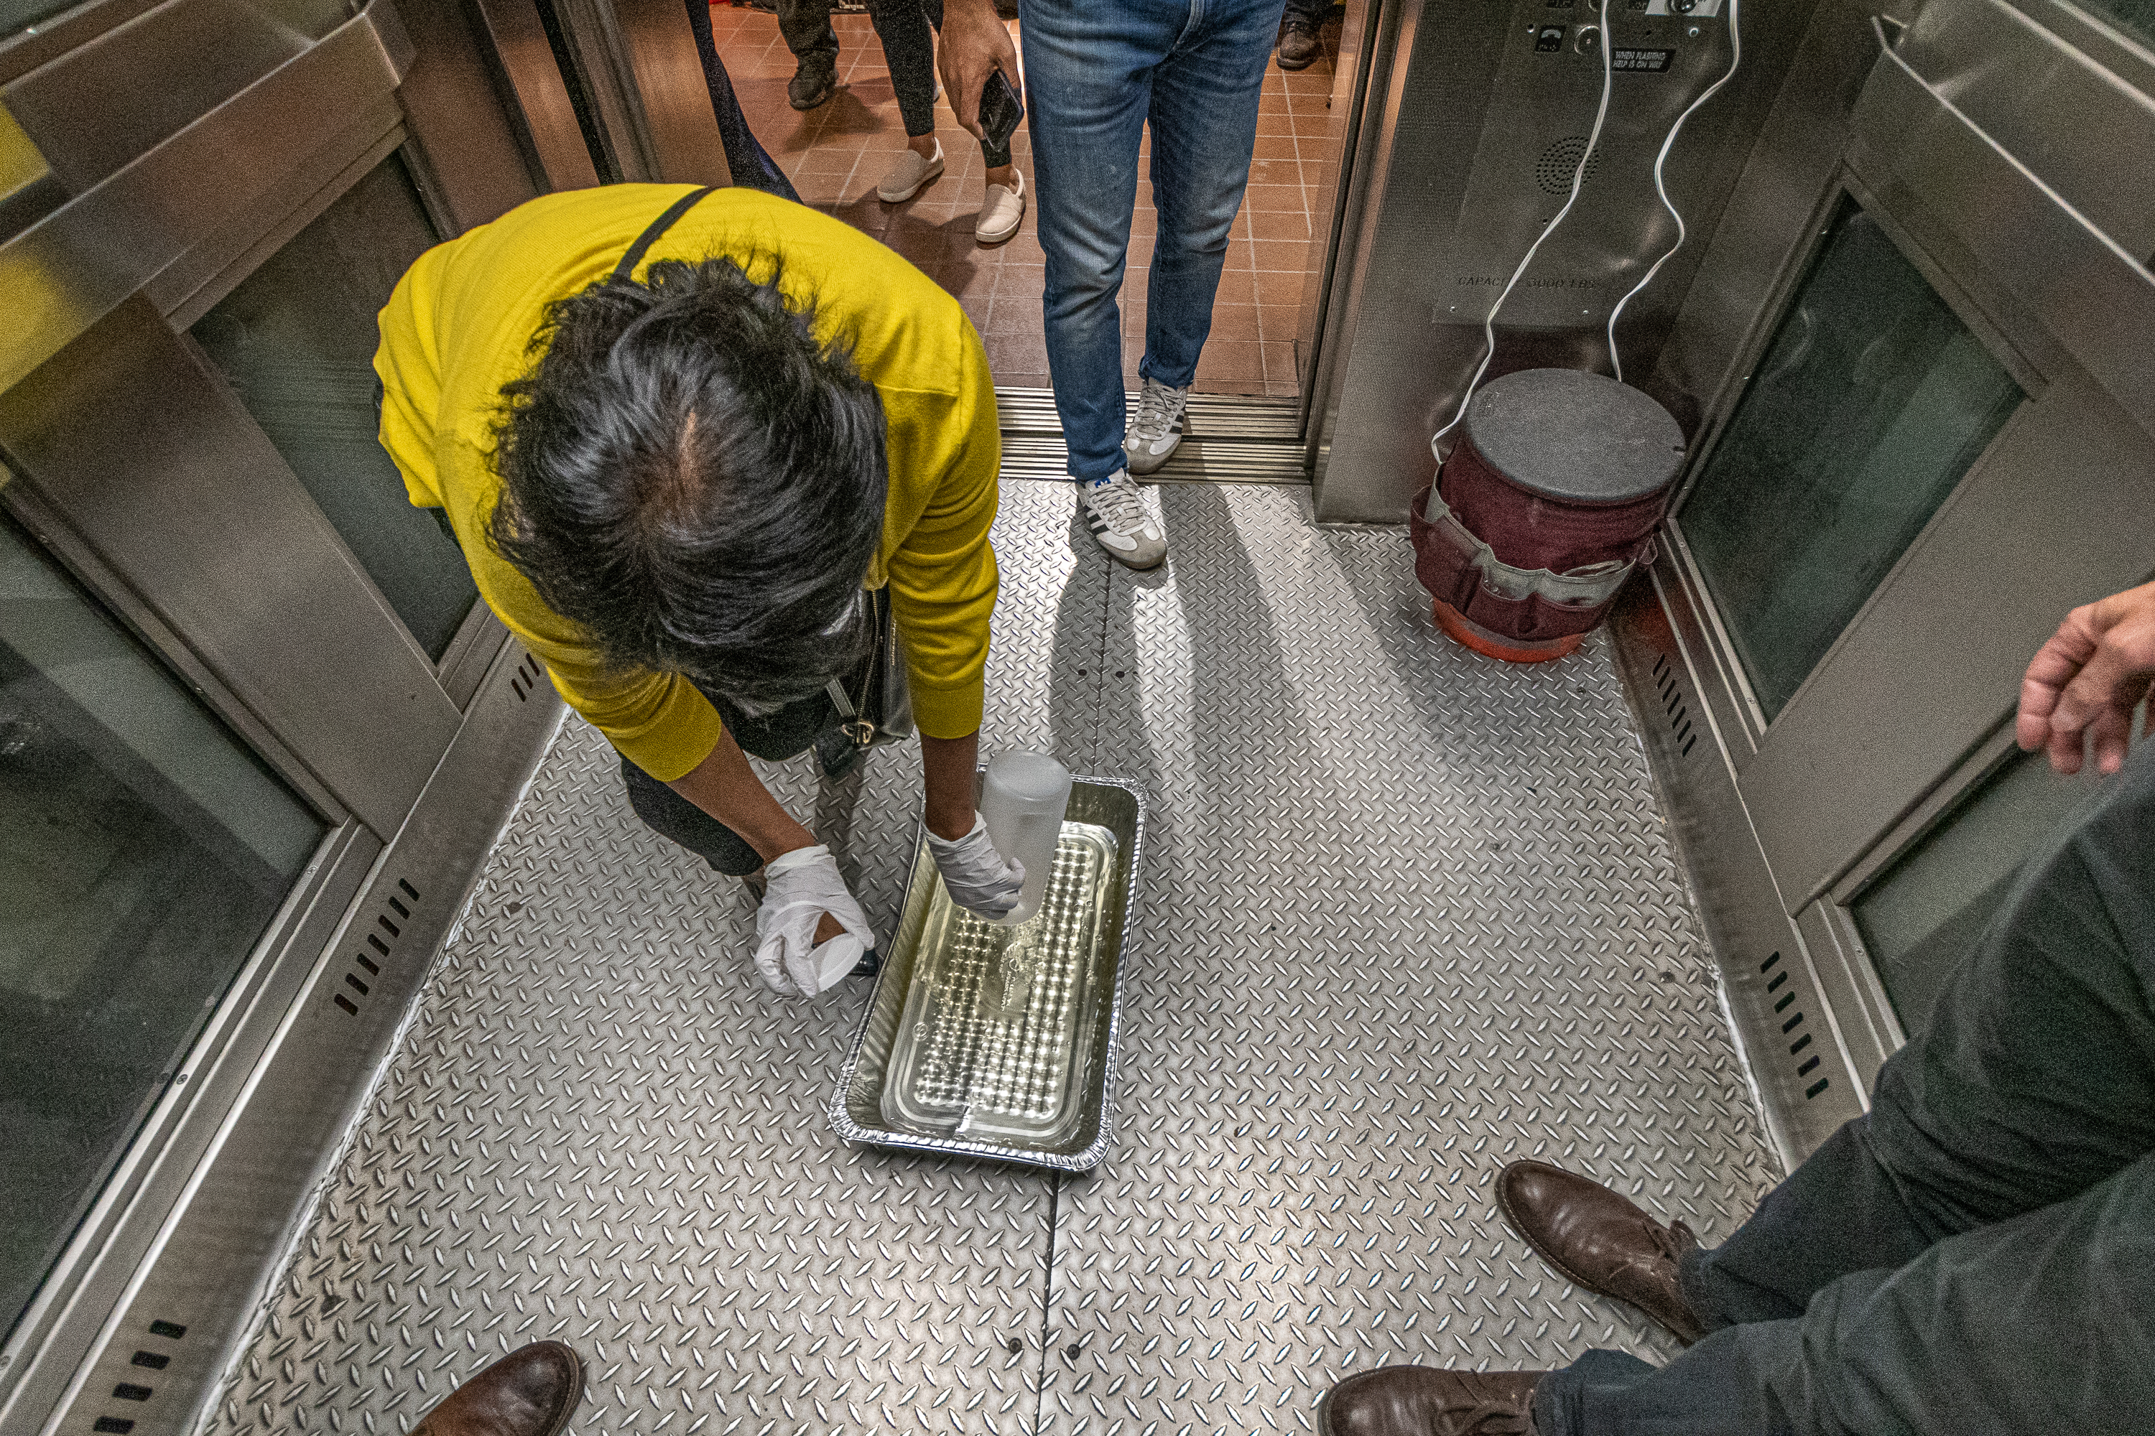
New Technology Pilot
Urine-Detecting Sensors
Dirty elevators are a long-standing rider frustration. We have many ways of addressing this & now have a promising new technology to try, too.
We'll soon launch a pilot:
To evaluate a sensor that detects the presence of urine & notifies our cleaning crews
In three (3) elevators in downtown stations
✋🏽 Get Involved
Subscribe to SWA's updates to hear when this pilot begins.
Urine is placed in a container inside an elevator at South Station, during an initial proof-of-concept of the urine-detection sensor.

Slide 9
Proposed Investigation
Blindways 2.0
In 2016, the Perkins School for the Blind launched an app to help blind riders solve the “last 30 feet” problem. We think that new technology might support a better way of solving this problem.
We’re in the early stages of investigating this new technology, in the hopes of raising money & support to develop a proof-of-concept.
✋🏽 Get Involved
Sign-up to be a research participant with Customer Technology.
Photo of a rider using the Blindways app to navigate to a bus stop.

Slide 10
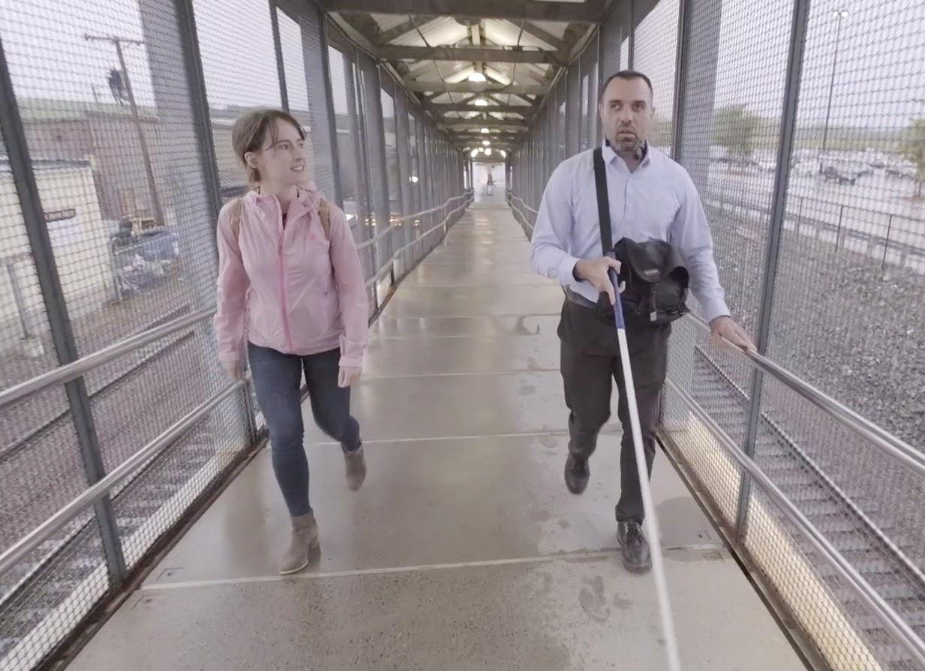
Proposed Technology Pilot
Indoor Wayfinding
In 2019, blind & low-vision riders told us that navigating unfamiliar stations was the biggest barrier to taking non-routine trips on the T.
We are hiring a project manager to help launch a pilot, to learn from the blind community about whether any of the existing technology solutions stands out above all others.
✋🏽 Get Involved
Subscribe to SWA's updates to hear when this pilot begins. Email us if there is a technology that you use that you think we should know about. Sign-up to be a research participant with Customer Technology.
A Customer Technology employee walks with a rider during a user research study for blind and low-vision riders.

Slide 11
Get Involved
📧 Email us
If you have questions or ideas about any of the topics mentioned above, you can email:
SWA at swa@mbta.com
Customer Technology at customertech@mbta.com
📋 Sign up
Help us improve the tools and technology you use when you ride the MBTA. Sign-up at mbta.com/techfeedback.

Slide 12
Reduced Fare Tech Team: Katie Kalugin & Emily Balkam

Slide 13
What is the Reduced Fares System (RFS)?
Purpose is to create one source of truth for the intake and administration of the MBTA's free and reduced fare programs for our senior, disability, blind, and youth riders.
The Reduced Fares System will:
Centralize, and securely store data and documents.
Utilize data and reporting to support decision-making.
Include API/data connections to other systems.
Be used through the completion of Fare Transformation.
For Riders: Accessible and intuitive digital application with self-service options, as well as application submission and status notifications.
For Program Administrators (internal and external): An intuitive and efficient dashboard/workflow to review and process applications for eligibility and fulfillment.
Launch Order | Program
1 | Youth Pass
2 | Senior
3 | Blind Access
4 | TAP
Notes:
Katie

Slide 14
Accessibility, Research, & Security
3rd party vendor for accessibility audit
3rd party vendor for security penetration testing
User interviews + user testing:
What are the motivations, expectations, and challenges faced by people applying for reduced fare programs?
What challenges do riders face as they complete the application?
What questions do riders have?
How can we better support riders throughout the online application process?
Notes:
Katie

Slide 15
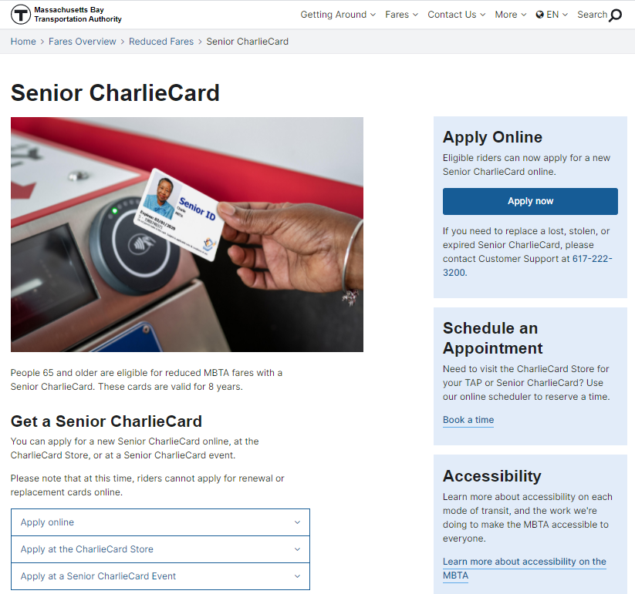
Easier to Apply for Reduced Fares
Developing secure, online reduced fare applications for the MBTA's free and reduced fare programs:
Senior
TAP
Blind Access
Youth Pass
LINK TO SENIOR CHARLIECARD ONLINE APPLICATION
Seniors and riders w/disabilities can now schedule a time to visit the CharlieCard Store to either apply in-person or renew their reduced fare CharlieCard
Notes:
Katie

Slide 16
Blind Access CharlieCard
Example online application instructions:
Upload an image of a valid, government-issued photo ID, such as a driver’s license, passport, or state ID.
Upload a picture of yourself from the neck up and in front of a solid background. Hats, face coverings, and sunglasses are not permitted.
Upload an image of one of the following:
Massachusetts Commission for the Blind ID Card
Certificate of Blindness (or other blindness certification)
Notes:
Katie

Slide 17
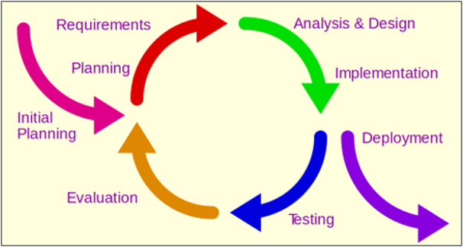
Where Are We Now and What's Next?
Completed design and feedback for Youth Pass; launched the Youth Pass online October 4th, including providing our external admins access to the system
Beginning design and feedback for Senior next, followed by Blind Access
Stakeholder involvement throughout
Form for external stakeholder ideas, feedback, and questions
Notes:
Katie

Slide 18
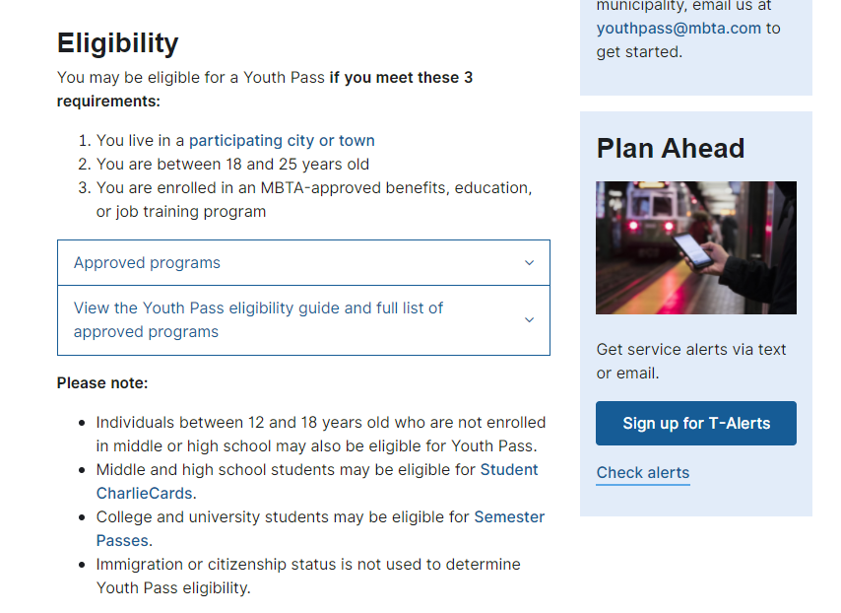
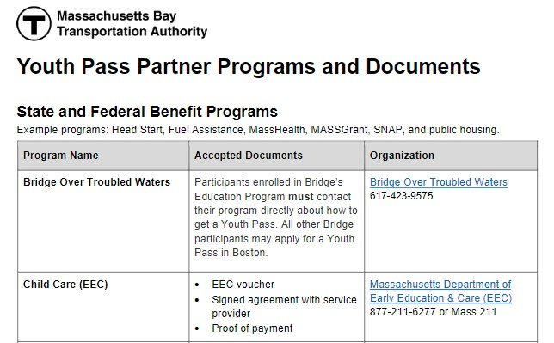
Youth Pass Online Application – Step One
Step 1
Instructions
Notes:
Emily

Slide 19
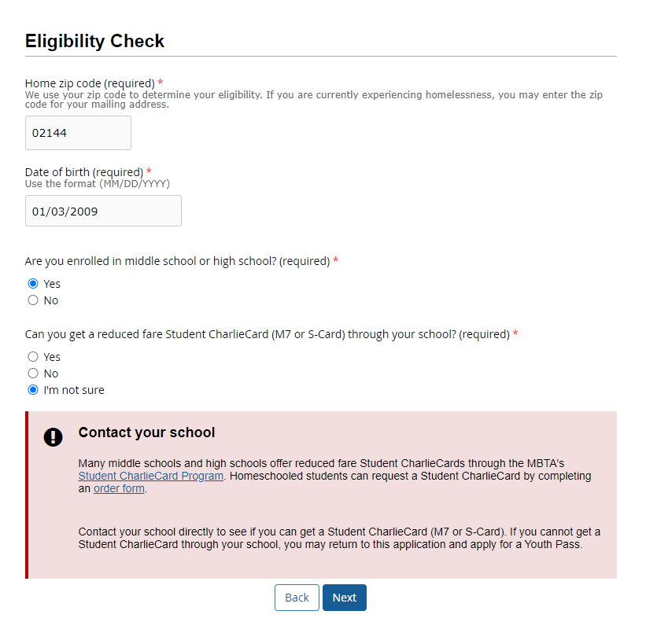
Youth Pass Online Application – Step Two
Step 2
Eligibility Checker
The application immediately stops applicants who
Entered a zip code not covered by the Youth Pass Program
Are not enrolled in a partner program (if 18-25)
Say that they can get a Student Charlie Card
Are younger than 12
Are older than 25
Whose birthdate is in the future
There are error messages to prevent typos
Birthdate is in the future
Invalid email or phone number
Required fields must be completed
Notes:
Emily

Slide 20
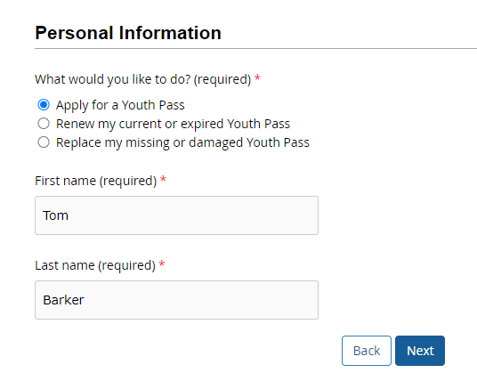
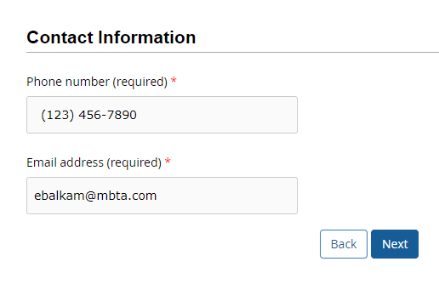
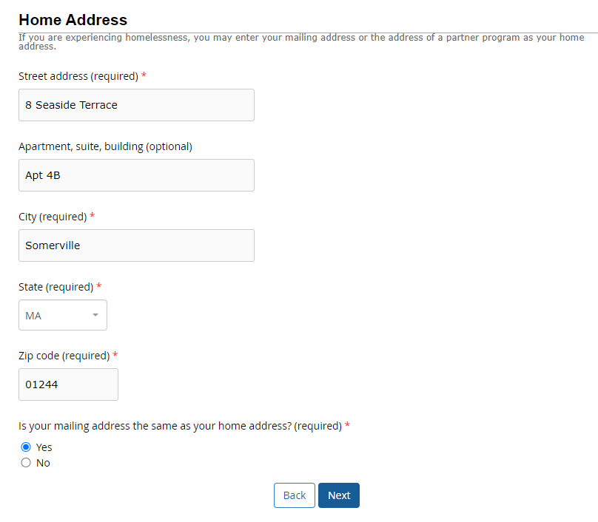
Youth Pass Online Application – Step Three
Step 3
Address and contact info
Applicant provides name, email, and phone number​
Applicant enters home address and mailing address (if different)
Notes:
Emily

Slide 21
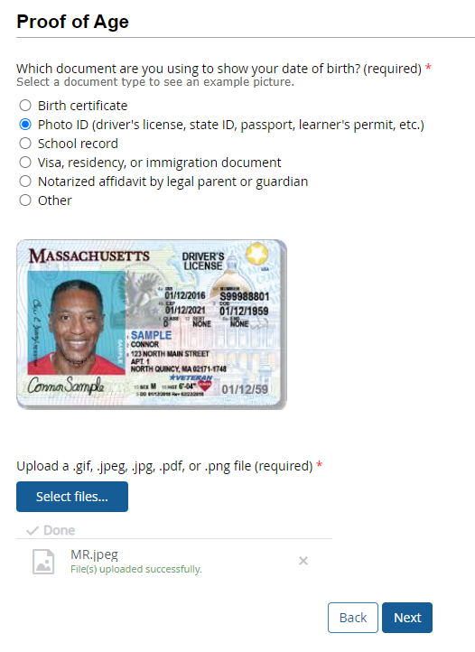
Youth Pass Online Application – Step Four
Step 4
Applicant uploads documents
Example photos associated with each option appear to help illustrate accepted documentation
Applicant can upload from desktop or phone with "Select files"
They can remove the file and add another one if needed
Notes:
Emily

Slide 22
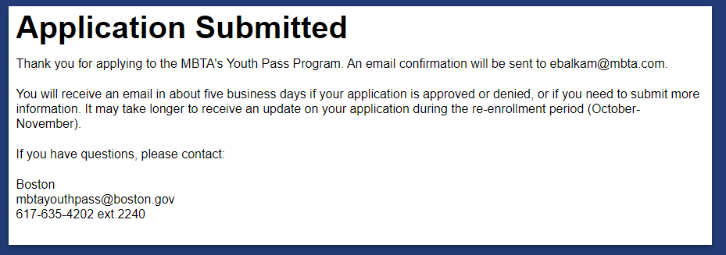
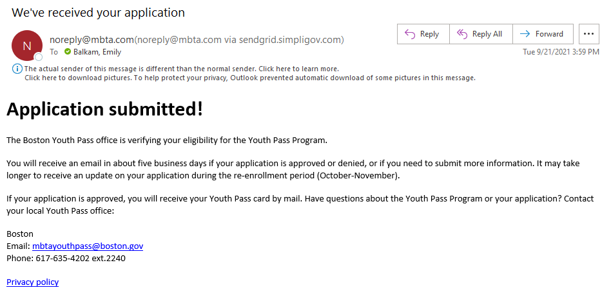
Youth Pass Online Application – Step Five
After submitting
Applicant notifications
Confirmation on screen​
Email confirmation​
Status notifications throughout the process to set expectations and get input when required
Notes:
Emily

Slide 23
Opportunities to Streamline the Application Process
API/data connection between MCB and MBTA to:
Share client information and photo
Confirm eligibility
Onsite support by MCB staff to help rider complete online application
Notes:
Katie

Slide 24
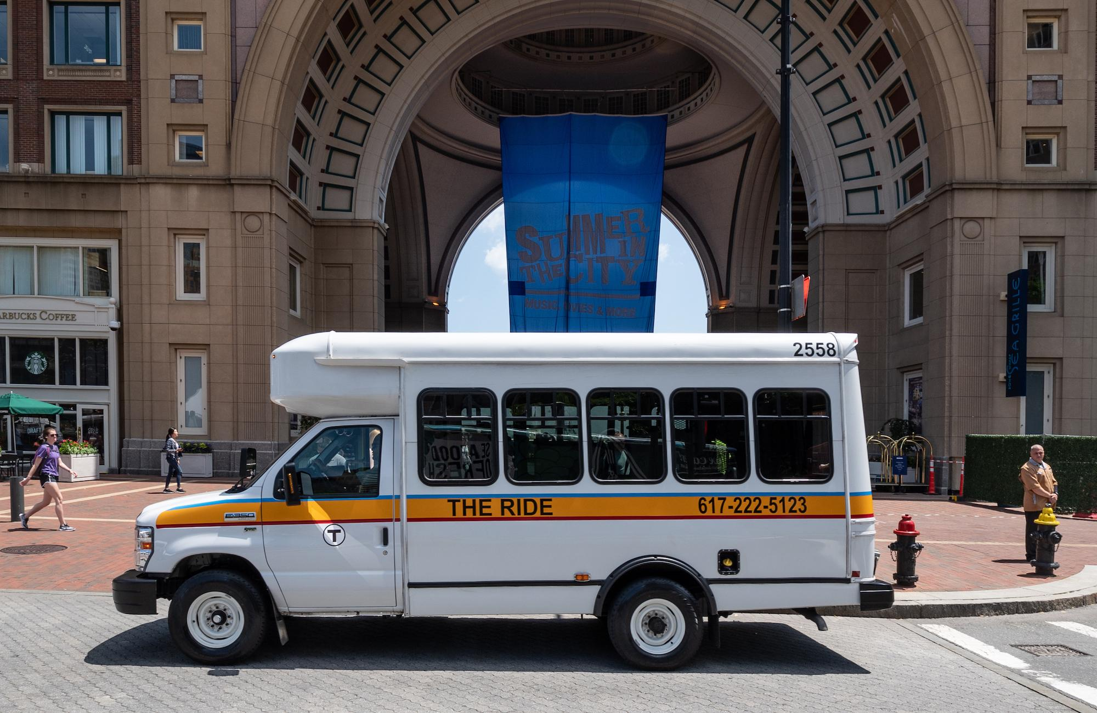
The RIDE: Mahour Rahimi
Image Description: Photo of a vehicle from The Ride parked along a street in Boston.

Slide 25
RTAG – Eri Solomon
How to get involved: join the Riders’ Transportation Access Group
RTAG is a customer organization with a mission to advise the MBTA on transportation issues that affect people with disabilities and seniors. Membership is open to the general public.
More information can be found here: https://www.mbta.com/accessibility/get-involved/rtag
Next meeting: Tuesday, November 23 at 2:00pm
All meetings will be held over Zoom with dates and times subject to change.
Image Description: Photo of the RTAG logo. There are colored circles around each letter, Red for R, Orange for T, Green for A, and Blue for G. There is also a grey train track separating R and T as well as on the bottom of the logo.

Slide 26
How To File A Customer Complaint: Jennifer Ross
Accessibility complaints require a full investigation, which may take up to 30 days.
If you have a complaint for either fixed route or the RIDE:
Monday - Friday: 6:30 AM - 8 PM Saturday - Sunday: 8 AM - 4 PM
Main Hotline: 617-222-3200
Toll Free: 800-392-6100
TTY: 617-222-5146
Elevator/Escalator Hotline: 617-222-2828
https://www.mbta.com/customer-support

Slide 27
Q & A

