Slide 1
Massachusetts Commission for the Blind Virtual Town Hall – May 1, 2020

Slide 2
Opening Music
MCB Consumer
Barry Spiro

Slide 3
Welcome
Commissioner
David D’Arcangelo

Slide 4
AGENDA
Programs & Services: John Oliveira
Orientation & Mobility: Meg Robertson
Assistive Technology: Alexander Pooler
Employment Services: Joe Buizon
Children’s Services: Susan Lavin
Older Independent Blind: Karen Hatcher
Questions & Answers

Slide 5
OVERVIEW
MCB provides social and vocational rehabilitation services to almost 26,000 consumers.
We aim to provide quality services that enhance the lives of our consumers by promoting independence, dignity and self-determination.
We achieve this by partnering with community agencies, healthcare providers, employers and, most importantly, our consumers and their families.

Slide 6
AGENCY OVERVIEW
1 of 15 agencies in the Executive Office of Health and Human Services (EOHHS)
Almost 150 Employees
4 Offices
Boston (Regions 3, 4 & 6)
New Bedford (Region 5)
Worcester (Region 2)
Springfield (Region 1)

Slide 7
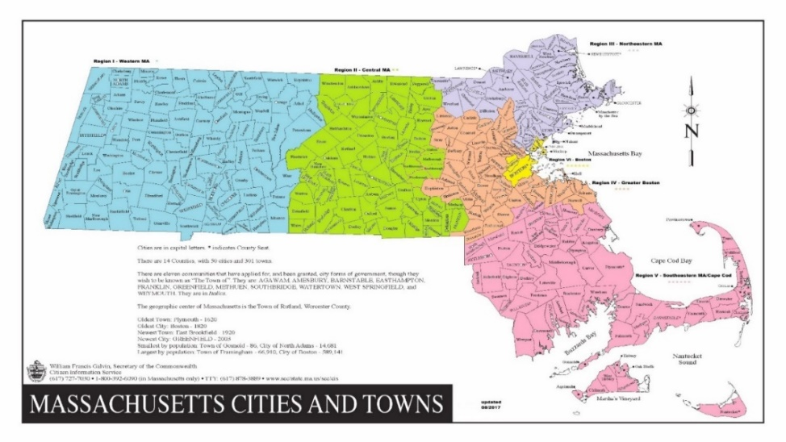
SIX REGIONS OF MCB

Slide 8
Programs & Services
Update
Deputy Commissioner
John Oliveira

Slide 9
VOCATIONAL REHABILITATION (VR)
VR services assist older students and adults to prepare for, achieve, retain, or regain employment. The VR program is federally funded with a State match. (950 consumers actively receiving services)

Slide 10
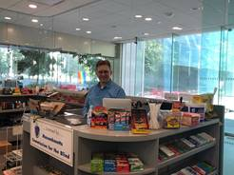
VOCATIONAL REHABILITATION (VR)
Part of our VR program, the Randolph Sheppard program prepares individuals who are legally blind for a career in concession management. (There are approximately 29 vending stands operating across the Commonwealth).

Slide 11
SOCIAL REHABILITATION (SR)
Social Rehabilitation (SR) services assist in the adjustment to blindness and support maximum personal independence and living in community. SR services are targeted to children 0-13, seniors and anyone not served by VR including consumers in the Deaf-blind extended supports unit. The SR program is state funded. (2,200 seniors and other non-vocational adults actively receiving services)

Slide 12
VISION REHABILITATION THERAPY (VRT)
MCB’s Rehabilitation Teaching (RT) services prepare individuals who are blind to perform daily living skills safely and independently at home, in the community, and at work. Specialized teaching services include training in activities of daily living such as cooking, kitchen organization, safety and appliance use and self-care (grooming, clothing organization and care).

Slide 13
COVID-19
Response
MCB’s Continuity of Services

Slide 14
MCB Working Through COVID-19
MCB left our physical offices on Friday, March 13 and were open for business on Monday, March 16.
MCB’s typical Counseling process has Counselors equipped with laptops that have mobile internet access (MiFi), which enables use of email & webmail, access to the web (teleconferencing & video conferencing WebEx & Zoom)

Slide 15
MCB Working Through COVID-19
Counselors have access to our Cloud-based off premises Client Management System (AWARE)
MCB’s Central Registration has registered 55 new registrants, processed ~200 travel cards, Identification cards, Massachusetts Equipment Distribution Program applications, Disability Placard applications and Certificates of Blindness.

Slide 16
MCB Working Through COVID-19
More than 70% of MCB staff have been newly trained on Zoom for remote service calls and internal meetings, including a virtual meeting with almost 60 MCB Stakeholders on March 20th and a virtual all-staff call on March 27th with 129 participants that followed several other all-staff calls since March 10th.

Slide 17
MCB Working Through COVID-19
Working with TIC and affiliates to share MCB messaging on the hour, every hour since the March 10th MA State of Emergency declaration. Our Social Media has gotten the message out and our Social Media metrics have increased exponentially.

Slide 18
MCB Working Through COVID-19
Our Assistive Technology (AT) unit continues making AT deliveries in PPE to ensure safety for staff and consumers, along with continuing to provide remote AT assistance and training.

Slide 19
MCB VR Success Stories During COVID-19
A VR Consumer was working remotely as a software engineer for three years with a starting salary of $83,000. During the stay-at-home order, he was offered and accepted a new position as a full-time software engineer for an educational technology and publishing company. He started April 6, 2020 at a base salary of $110,000 plus bonus.
A VR Consumer has been hired by a theatre company on a full-time basis as a ticket agent and customer service representative. He is working remotely and has been employed over 90 days and has been retained despite COVID-19 lay-offs.

Slide 20
Orientation &
Mobility
Meg Robertson
Director O & M

Slide 21
ORIENTATION & MOBILITY SERVICES
Direct O&M training on hold
Phone interviews for new referrals
Trouble shooting O&M issues
Encouraging practice of long cane skills
Encouraging the learning of GPS apps, in familiar environments
Sending out replacement O&M equipment
Review of street crossings & environments for future instruction
On-Line O&M Training Continuing Ed. Courses

Slide 22
ORIENTATION & MOBILITY SERVICES
Check-in with current and past O&M students
Access to food options
Boredom & social isolation
Verbal review of routes using safe O&M techniques related to social distancing guidelines
Review different ways to sanitize guide dog harness & long cane
Resources for face masks
Face mask causing disorientation
Future planning: additional O&M techniques/routes

Slide 23
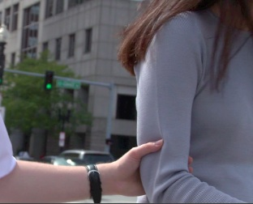
SOCIAL DISTANCING
Adaptive Guiding
Voice Guide
Hand on guide back
Use of extra cane between guide and self
Shopping carriage
Options for not going out
Use of long cane for ID

Slide 24
Assistive
Technology
Alexander Pooler
Assistive Technology Director

Slide 25
Assistive Technology
Assistive Technology is working with our consumers remotely on their technology issues:
Deployment and training on Low Vision Devices
Help in downloading software to develop touch typing skills like Talking Typer
Assistance in configuring ZoomText:
How to change magnification?
How to change mouse pointer?
How to change contrast?
Questions related to free access to VFO software JAWS, Fusion, and ZoomText until June 30, 2020
https://portal.freedomscientific.com/SponsoredSoftware

Slide 26
Assistive Technology
Distance Problem Solving:
JAWS Tandem - A JAWS Tandem connection serves as an online meeting between two JAWS users. A meeting can be conducted over the Internet, which is known as a Tandem Center session, or over a private network, known as a Tandem Direct session. The primary connection method is through Tandem Center, a gateway server responsible for creating meeting IDs, verifying proper use of JAWS Tandem, and providing a path between the two systems. After the session is established, the controller can manage and run the target system's desktop.

Slide 27
Assistive Technology
Remote Working and Learning for our Consumers:
Many schools and businesses are using work/learn from home software such as:
Jamboard
EdPuzzle
Blackboard
Moodle
Canvas
Google Classroom
Zoom, WebEx
Microsoft Teams

Slide 28
Employment
Services
Joe Buizon
Employment Services Supervisor

Slide 29
Employment Services
What does Employment Services do?
Work with consumers in conjunction with the VR counselors to assist individuals to prepare and eventually obtain gainful employment
How has our work changed during this historic time?
Helping any number of consumers apply for unemployment benefits

Slide 30
Employment Services
JOB DRIVEN PROGRAMS
Aid Consumers with Job Applications
Summer Internship Program
Virtual Mentoring Program

Slide 31
Employment Services
JOB DRIVEN PROGRAMS
Mock Interviews
Moving October Job Fair to a Virtual Job Fair
Employment Now initiative – CHA and MEE
Continue to Reach out and Engage with Employers

Slide 32
Children’s
Services
Susan Lavin
Director of Programs

Slide 33
Children’s Services - Overview
Children’s Social Workers (CSW’s) promote the
education and wellness of legally blind children and
their families by providing:
Case management
Educational advocacy and parental support through the special education process
Socialization and recreational* opportunities,
Information and referral for a variety of services and benefits

Slide 34
Children’s Services - Overview
Information and referral for a variety of services and benefits
Assistance and advocacy in accessing public benefits and in-home support services
Respite* and flexible family supports*
Certifications for the Talking Book Library
*Title XX/income eligibility applies. These are promulgated yearly based on 200% of the Federal Poverty Guidelines.

Slide 35
Children’s Services - Overview
MCB Registry: Age 0 - 14
REGION | # OF INDIVIDUALS
WESTERN MA - 1 | 180
CENTRAL MA - 2 | 205
NORTHEAST - 3 | 231
GREATER BOSTON - 4 | 229
SOUTHEAST - 5 | 188
BOSTON - 6 | 187
TOTAL | 1220

Slide 36
Older Independent
Blind (OIB)
Karen Hatcher
Director OIB

Slide 37
Program Details
FEDERAL GRANT FUNDING SUPPORTS THE OIB PROGRAM (TITLE VII – CHAPTER 2 VR ACT OF 1973 AS AMENDED)
GOAL: TO PROVIDE INDEPENDENT LIVING SERVICES AND SUPPORT OLDER INDIVIDUALS WHO ARE BLIND. MCB ENCOURAGES ALL CONSUMERS TO MAINTAIN THEIR INDEPENDENCE AT HOME AND IN THEIR COMMUNITY.
ELIGIBILITY: MA RESIDENT, LEGALLY BLIND AND OVER AGE 55

Slide 38
Before/After COVID-19
NEW CONSUMER INTAKE / HOME VISITS REMOTELY BY PHONE
LOW VISION AIDS / DEVICES HAND DELIVERED MAILED TO CLIENT
REHABILITATION TEACHING / TRAINING “LIVE” REMOTELY BY PHONE
LOW VISION PEER SUPPORT GROUPS “LIVE” REMOTELY BY PHONE
OIB PRESENTATIONS AT SENIOR CENTERS REMOTELY PEER GROUPS
DIABETIC MANAGEMENT AND SUPPORT GROUP PILOT REMOTE TRAINING
PERKINS TALKING BOOKS MAILED BARD DOWNLOADS

Slide 39
Questions?

Slide 40
Our offices are closed.
But our services continue.
1-800-392-6450
MCBinfo@mass.gov

Slide 41
Connect With MCB
Website: www.mass.gov/mcb
Twitter/Instagram: @massblind
Facebook: @masscommblind
LinkedIn: Massachusetts Commission for the Blind

Slide 42
Closing Music
MCB Consumer
Barry Spiro

