Slide 1
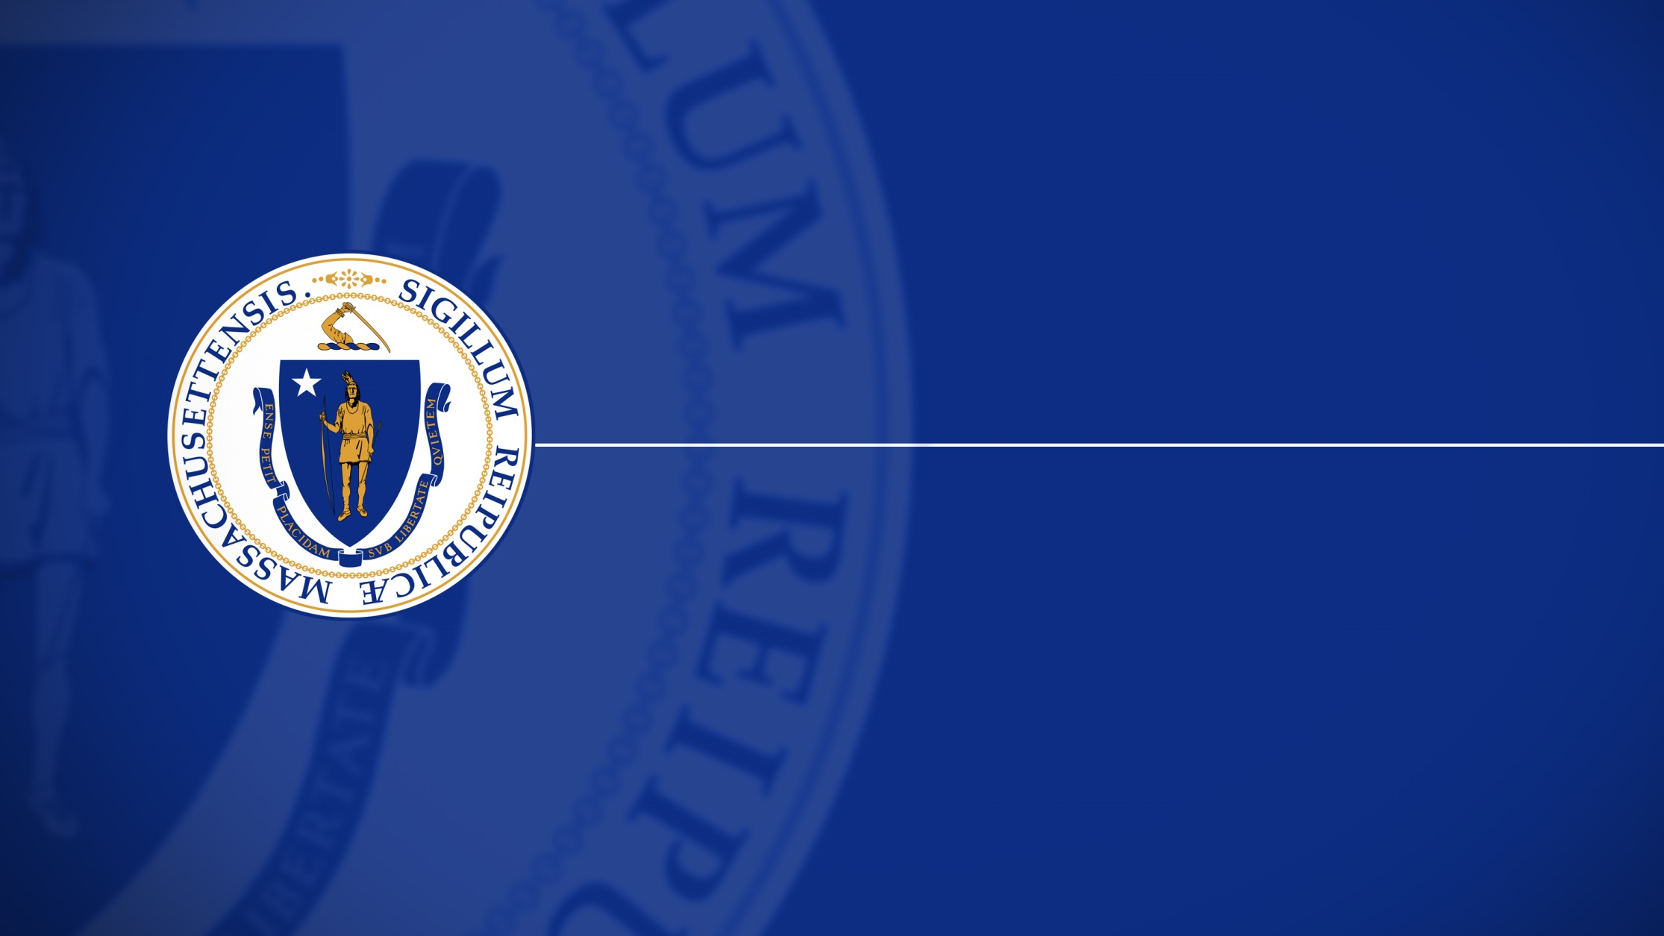
Massachusetts Commission for the Blind MCB Virtual Town Hall: MBTA Mobility Center March 10, 2023

Slide 2
Welcome
MCB Virtual Town Hall: MBTA Mobility Center Allyson Bull, M.Ed., COMS, TVI
Kara Peters, M.Ed., COMS

Slide 3
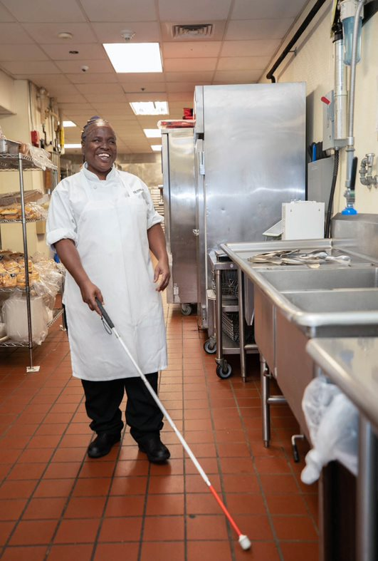
What is Orientation and Mobility?
Orientation and Mobility (O&M)
“The ability to move independently, safely, and purposefully through the environment,” (Blasch & Welsh, 1987)
Cover skills including:
Orientation to the environment
Non-visual
Auditory
Long cane techniques
Technology/GPS/app training
Notes:
Citation:
Blasch, B., & Welsh, R., (1987). Foundations of Orientation and Mobility. American Foundation for the Blind.

Slide 4
MCB Orientation and Mobility Services
Orientation and Mobility (O&M) services through MCB are provided by Certified Orientation and Mobility Specialists (COMS)
MCB provides community O&M services
Take place at home, work, and community locations (nursing homes, prisons, colleges, day program settings, etc.)
Lessons will be structured differently depending on the consumer’s goals and abilities
1:1 service model
Notes:
Services are free

Slide 5
Who is eligible for MCB O&M services?
Individuals registered with MCB are eligible for O&M community services
Students should receive O&M services through their IEP; they become eligible just before graduation
Individuals on both the social rehabilitation (SR) and vocational rehabilitation (VR) track
DeafBlind Extended Supports (DBES)
Adults with legal blindness

Slide 6
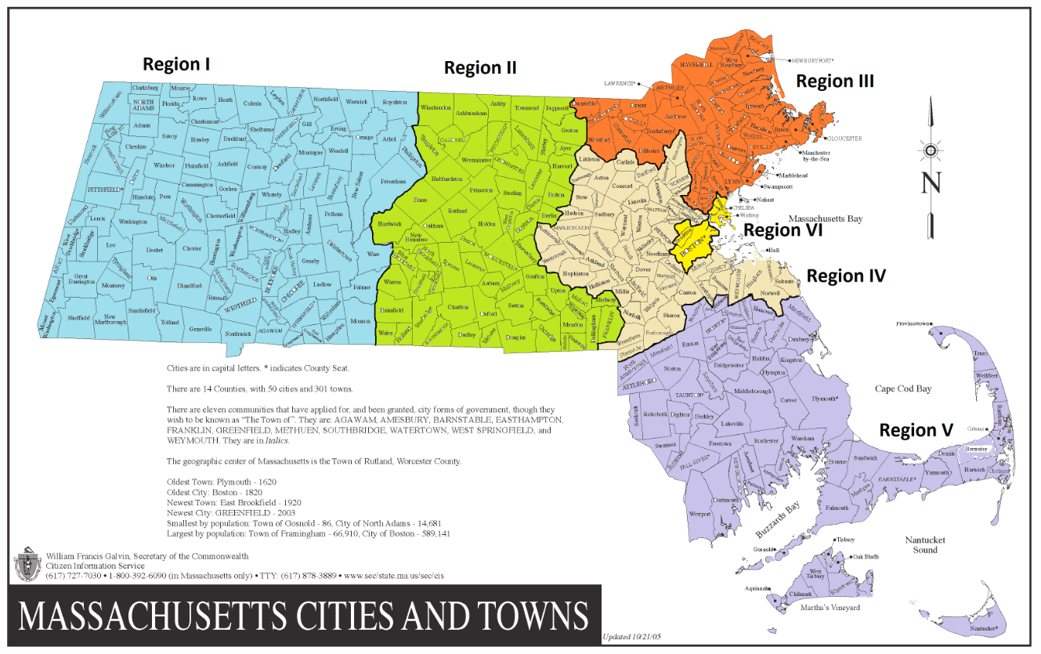
Where does MCB O&M Take Place?
MCB COMS
Region 1 (Western MA)
Mike Dionne
Region 3 (Northeast)
Matt Edwards
Region 4 (Metro-west)
Kara Peters
Region 5 (Southeast)
Karin Barrows
MCB also receives supplementary O&M support from our community partners at the Carroll Center for the Blind.
Notes:
Pre-submitted question: What is the typical weekly schedule for the COMS? Remote vs field days.

Slide 7
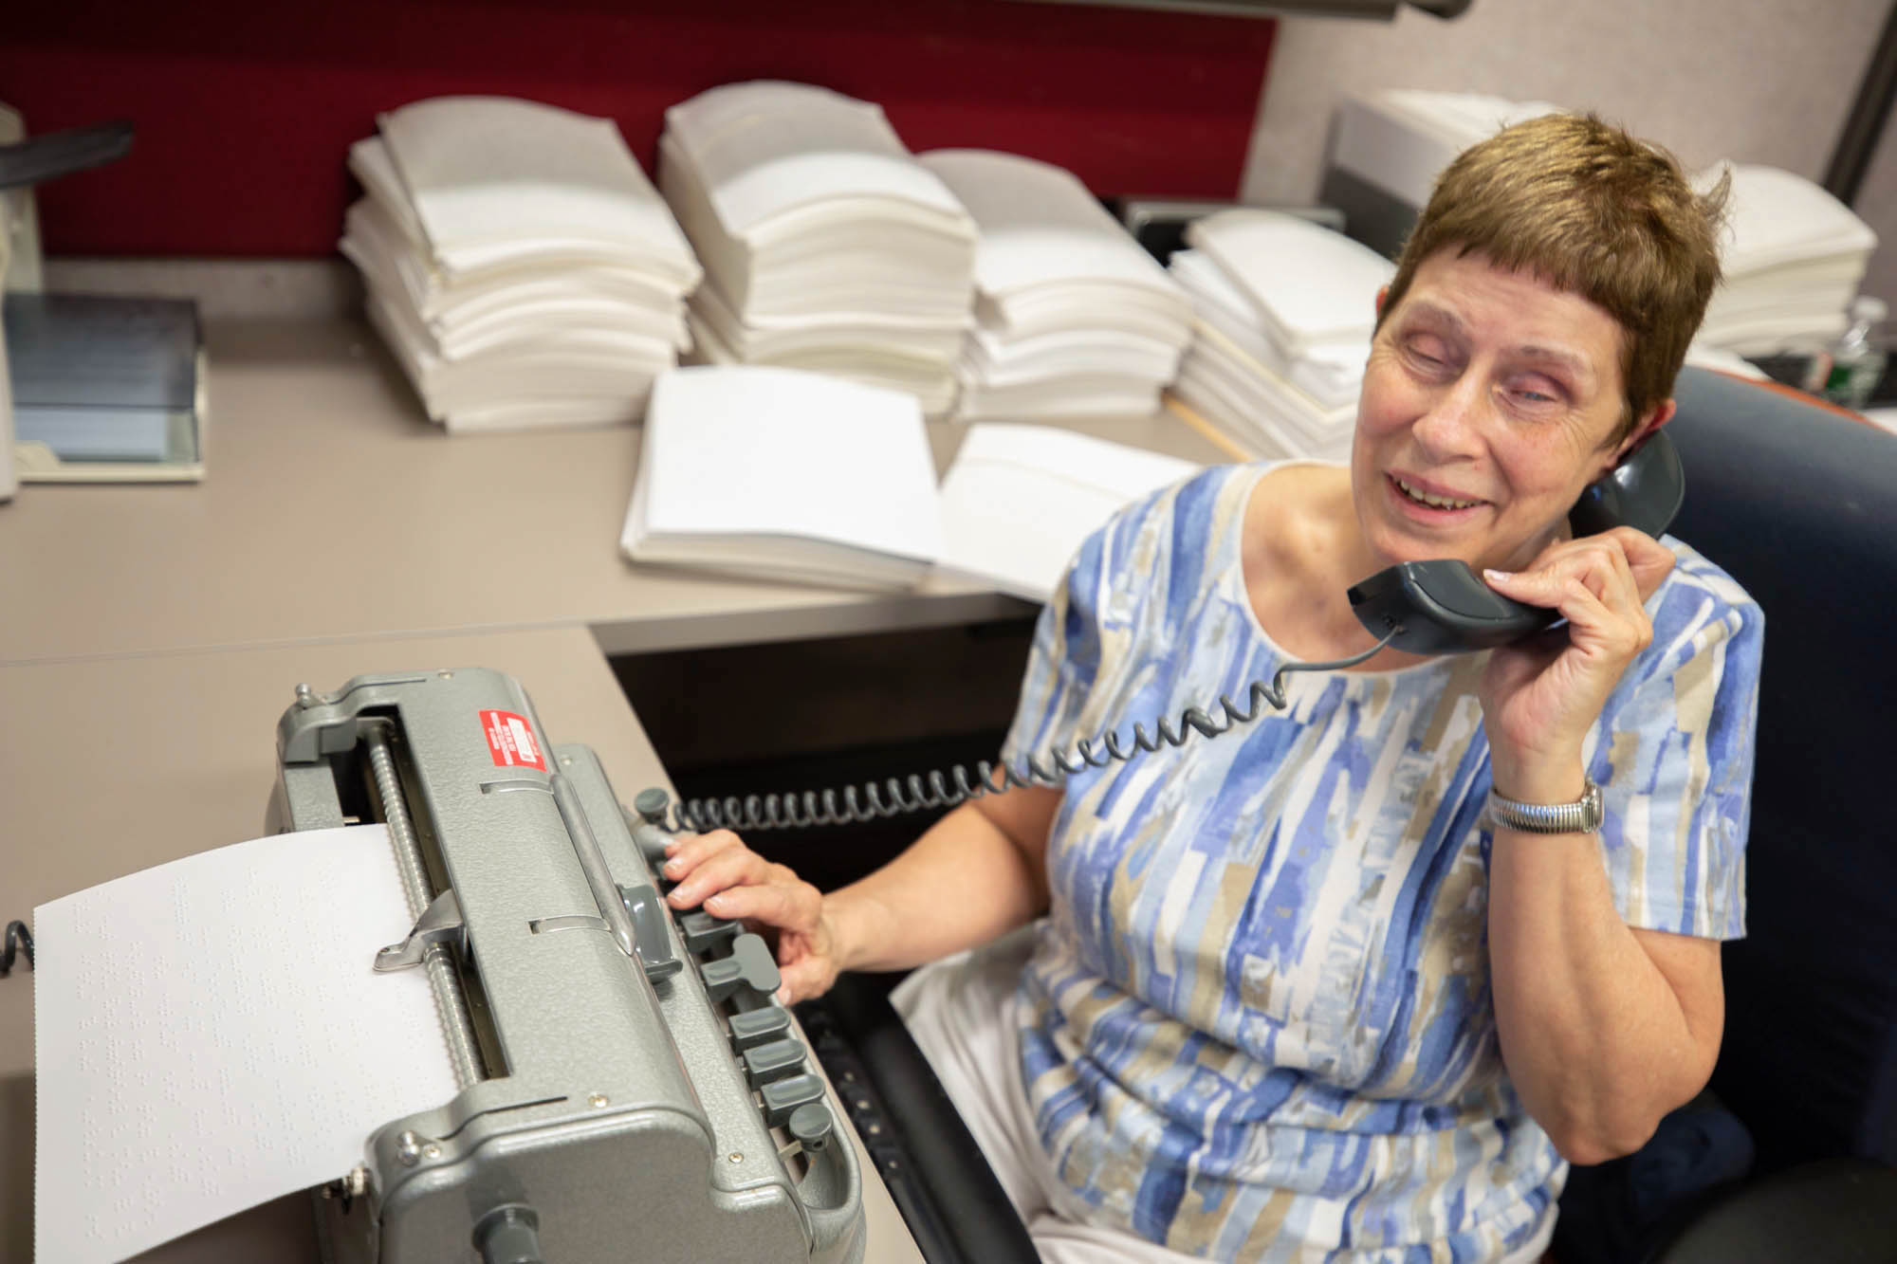
How to Request O&M with MCB
You can request MCB O&M services by contacting your case manager. If you do not know who your case manager is, you can contact the main MCB line:
(617) 727-5550
Toll free: 800-392-6450
MCBInfo@mass.gov
Notes:
- Pre-submitted question: Does your case have to be open to receive services? Yes.

Slide 8
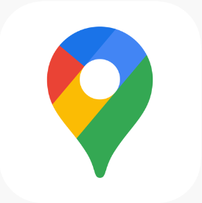
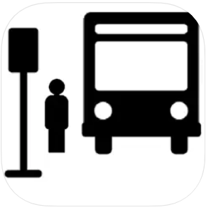
O&M Apps
The following apps can be helpful for trip planning and navigation:
These are apps for navigation, will not assist with crossing the street
BlindSquare
Apple Maps/Google Maps (with narration/Screen reader)
Transit (not an official MBTA app)
All Aboard (MEE)
Aira
Be My Eyes
Lazarillo

Slide 9
CONNECT WITH MCB
1-800-392-6450
600 Washington Street, Boston, MA 02111
www.mass.gov/mcb
MCBinfo@mass.gov
Follow us:
Twitter: @massblind
Facebook: @masscommblind
Instagram: @massblind
LinkedIn: Massachusetts Commission for the Blind

Slide 10
MBTA Mobility Center
MCB Town Hall
03/10/2023

Slide 11
What is the MBTA Mobility Center?
The MBTA Mobility Center serves as a "one stop shop" to empower the community on how to navigate the MBTA’s extensive accessible public transit services and other community resources while navigating through Boston and the Greater Boston Region
Notes:
One stop shop where we assist with teaching the community how to travel through the region using various modes of transportation.

Slide 12
Mobility Center Services
Services include
1:1 Individualized Travel Training for people who are 65+ and individuals with a disability
Group trainings for riders and agency staff in the community
Transit Access 101 group trainings at the emergency training center
Trip planning assistance
Technology training
Reduced fare application support
Notes:
Creating a toolbox of resources and tools that can be used to help people navigate.

Slide 13
1:1 Travel Training Process
Intake through referral
Pre-training assessment and goal setting
Travel training tips
Trip training at a frequency and time agreed upon by the trainer and trainee
Monitoring and evaluation of goal achievement
Notes:
Add map of RIDE service area?
Customized training
Intake PTA
Tips while traveling
Setting goals- monitoring and evaluation goal achievement.

Slide 14
Who is a Candidate for 1:1 Travel Training?
For individualized Travel Training with the MBTA Mobility Center those who are legally blind should meet the following criteria:
Must have already completed Orientation & Mobility training
Able to safely navigate in the community
Want to learn a route or explore stations within the MBTA bus and subway service area, or zones 1a though 3 on the Commuter Rail
Self-identify as having a disability or as someone who would benefit from travel training

Slide 15
Training on The Commuter Rail
Notes:
MCB will travel train on the entire system but MBTA will travel train within the MBTA’s service area.

Slide 16
Group Trainings
Transit Access 101 One hour classroom instruction at MBTA Emergency Training Center on the basics of using the MBTA system Explore an out-of-service Blue Line subway car and Green Line trolley Explore and ride an out-of-service MBTA bus and ride the Red Line Live demonstration on using fare vending machines and fare gates | On-site Group Trainings One hour classroom instruction held at community-based organizations (e.g. senior center) Explore an out of service MBTA bus to learn more about bus features

Slide 17
Trip Planning
The Mobility Center’s Travel Trainers and Transit Coordinators provide trip planning assistance:
Providing guidance to individuals and groups covering tools such as maps, schedules, MBTA trip planning tools, and phone apps
Exploring alternative modes of transportation, as well (for example: ridesharing, micro-transit, MassRideMatch.org)

Slide 18
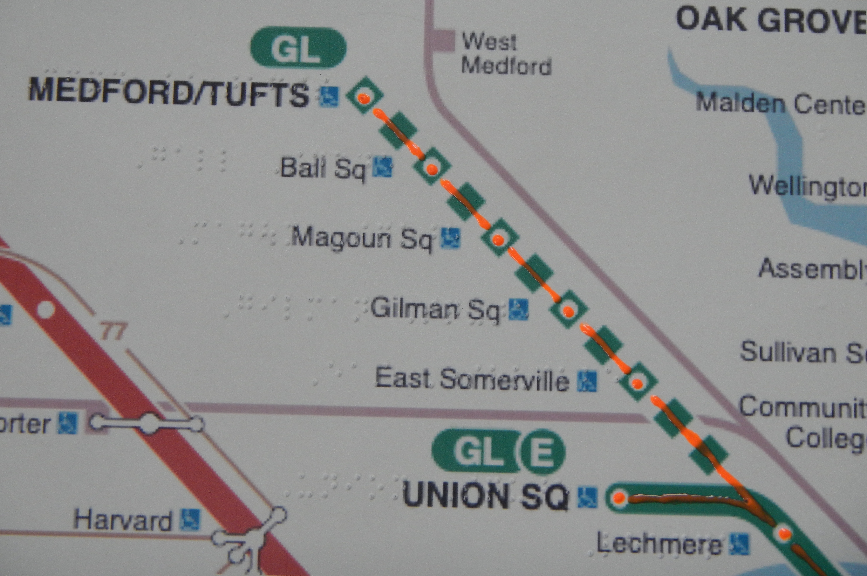
Tactile Tools
Notes:
Sighted Guide techniques. Knowing closet parallel traffic. Knowing how to use other senses as weather affects one's ability to hear traffic patterns and other environmental changes. Knowing changes in surfaces when ambulating. Using technology to receive audible and vibration notifications.

Slide 19
Technology Training
Mobility Center customers can receive training focused on skill-building in:
Using online resources, such as the T-alert tool for service alerts and the MBTA Trip Planner, to understand schedules and navigate the fixed-route and manage their reduced-fare account
Using mobile apps to order private transportation from taxi companies and ridesharing, such as Uber and Lyft
Using online tools to accomplish tasks or attend appointments virtually, such as online grocery delivery and telehealth
Signing up for and/or booking trips on RIDE Flex
Notes:
Many stations will have a screen with auditory announcements

Slide 20
How to Apply for the Blind Access Card
Online at mbta.com/blindaccess/apply Card will be mailed to you
Your Travel Trainer can help complete the process online or in person at the CharlieCard Store
Located at the Downtown Crossing Concourse
By appointment on Mondays or walk-in Tuesday-Friday
Mobility Center staff are trained to assist in completing the online version via phone. A Navigator, who answers the phone, can direct you to where to apply online or in-person. They can help book an appointment for you, if preferred
Notes:
Emily is going to dive into what the process of applying for the Reduced Fare card looks like in a few minutes, but this is how the Mobility Center can help you do that

Slide 21
Contact the Mobility Center
In-person: 1000 Mass. Ave, Suite 201, Boston, MA 02118
Monday – Friday 8:30AM – 5PM
Phone: 617-337-2727 or 617-337-2756 (711 for Relay)
Website: www.mbta.com/accessibility/mbta-mobility-center
E-mail: howtotravel@mbta.com or
mbtamobilitycenter@mtm-inc.net
Facebook: MBTA Mobility Center

Slide 22
Reduced Fare Programs
Emily Balkam
Sr. Technical Product Manager for Reduced Fares
Massachusetts Bay Transportation Authority (MBTA)

Slide 23
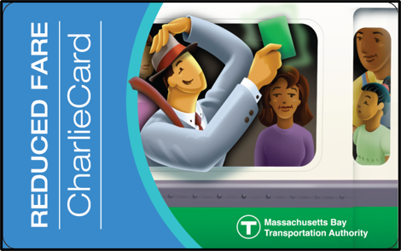
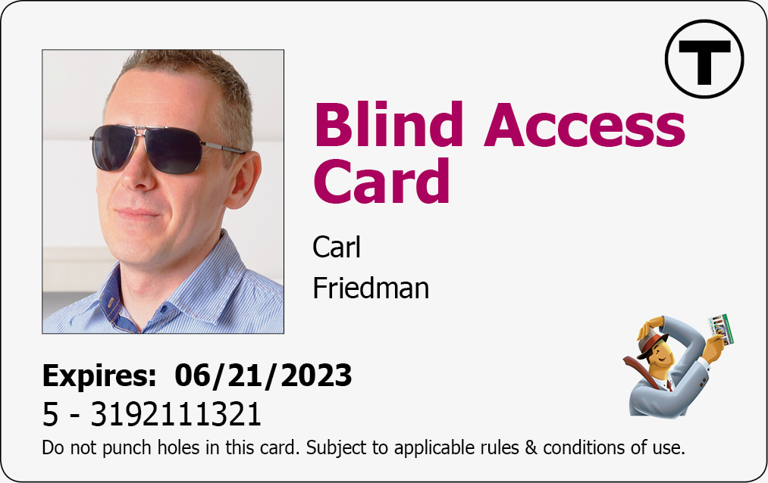
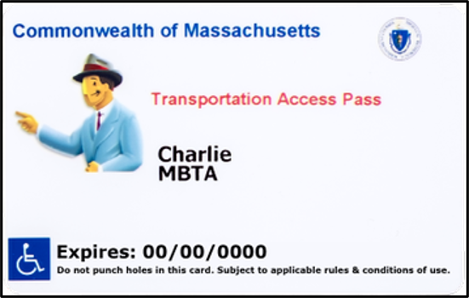
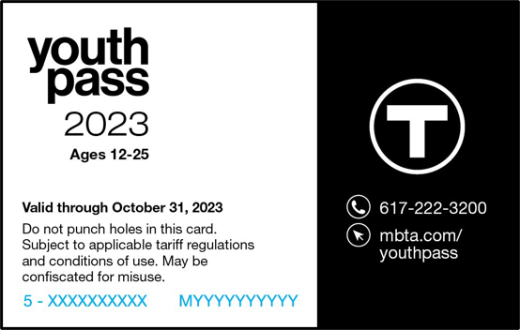
Reduced Fare Media
Senior
50% reduced one-way fares
$10 7-Day LinkPasses
$30 monthly LinkPasses
Age 65+
Blind Access
Free travel for cardholders and a sighted guide
Transportation Access Pass
50% reduced one-way fares
$10 7-Day LinkPasses
$30 monthly LinkPasses
Youth Pass
50% reduced one-way fares
$10 7-Day LinkPasses
$30 monthly LinkPasses
Ages 12-25

Slide 24
Apply for Reduced Fare Programs
In Person for Senior, Blind and TAP:
CharlieCard Store: 7 Chauncy St, Boston, MA 02111
Mobility Center: 1000 Massachusetts Ave, Boston, MA 20118
In Person for Youth Pass:
Visit mbta.com/fares/reduced/youth-pass for participating city or towns.
On-Line (fully accessible):
Senior: mbta.com/senior/apply
Blind: mbta.com/blindaccess/apply
TAP: mbta.com/tap/apply
Youth: mbta.com/youthpass/apply

Slide 25
Selecting a Language
Select a language, and all copy will translate automatically.
Supported languages:
English
Spanish
Portuguese
Simplified Chinese
Traditional Chinese

Slide 26
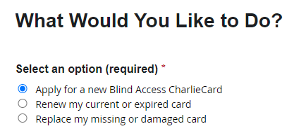
Starting the Application
The instructions will show what documents you will need to upload in the application.
This form can be used for new, renewal or replacement card requests.

Slide 27
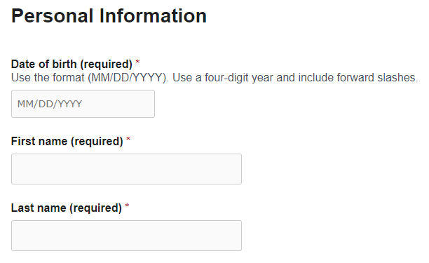
Required Personal Information
All required fields must be completed including:
Date of birth
First name
Last name

Slide 28
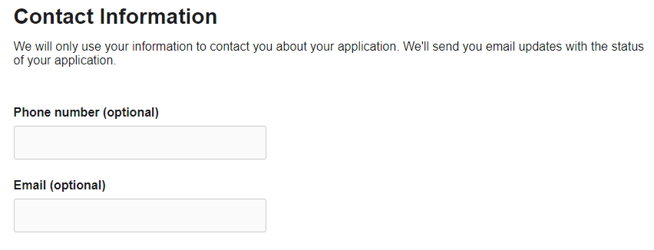
Optional Contact Information
Adding an email and phone number are optional.
If you provide an email address, you will receive status updates as your application is processed.

Slide 29
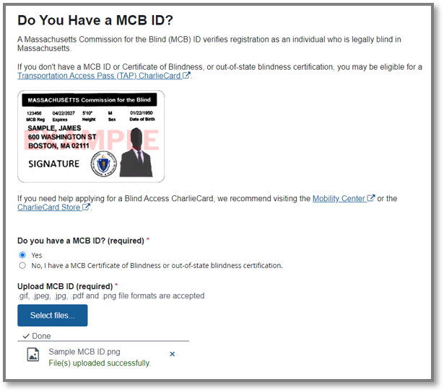
Proof of Blindness
If you have an MCB ID, you can upload it as both proof of blindness and proof of identity.
If you don't have an MCB ID, you can upload a MCB or out-of state blindness certification instead. You will also be asked to upload a photo ID.

Slide 30
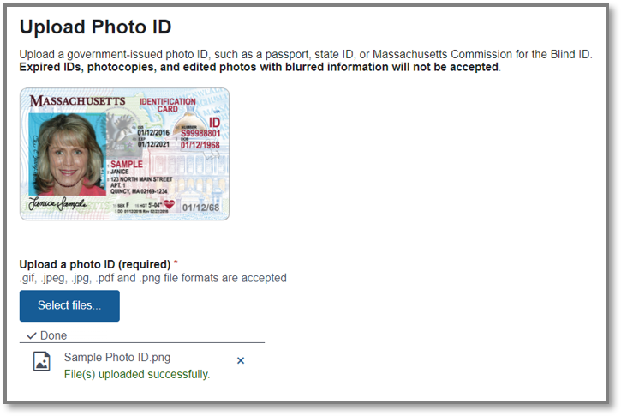
Upload a Photo ID
If you do not have an MCB ID, you are required to upload a photo ID to verify your identify.
Click on the blue Select files button to upload from a desktop or phone
You only need to upload the front of your card

Slide 31
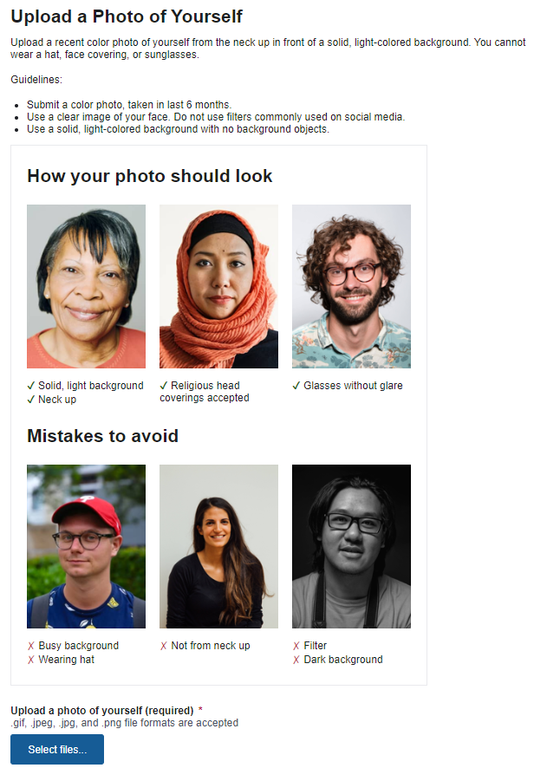
Upload a Photo of Yourself
You are required to upload a photo for fraud prevention purposes.
Your picture must be a recent color photo of yourself from the neck up in front of a solid, light-colored background. You cannot wear a hat, face covering, or sunglasses.

Slide 32
Getting Your Card
You can choose to have your card mailed to you, or you can pick up your card at the CharlieCard Store.
You will receive email or mailed notifications in your preferred language as your application is processed.

Slide 33
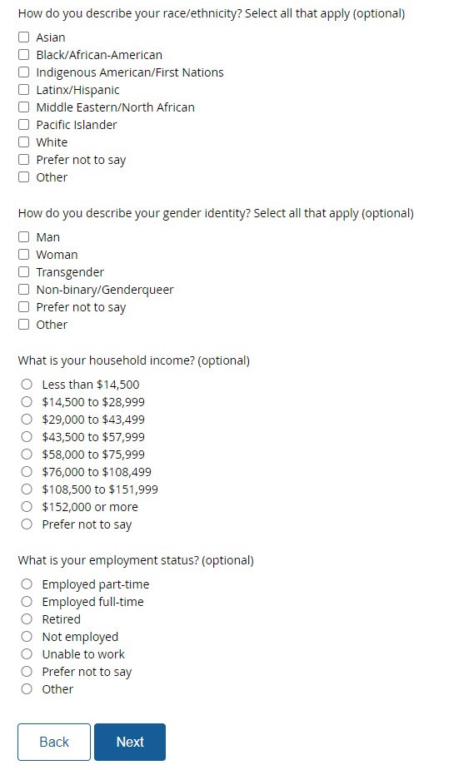
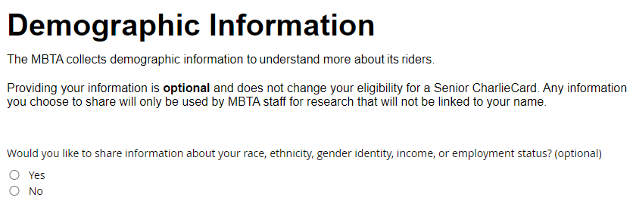
Optional Demographic Information
These questions are optional and are not required to apply.

Slide 34
Required Rules and Conditions
You must check off the agreement statement to finish submitting your application.

Slide 35
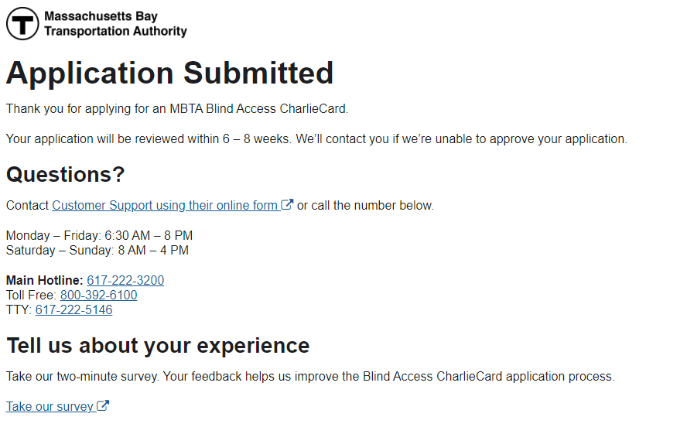
Notifications After Submission
After Submission:
On screen confirmation
If you provided an email address, status notices are sent as application is processed
If you did not provide an email, printed letters and phone calls will be used when needed

