Slide 1
MCDHH
Dr. Opeoluwa Sotonwa
Commissioner

Slide 2
OVERVIEW
MCDHH
Staffing
Programs

Slide 3
MCDHH
Agency

Slide 4
Established in 1985 by Massachusetts General Law to function as the lead agency representing the issues and needs of Deaf, hard of hearing and late deafened citizens in the Commonwealth.
Executive Office of Health and Human Services: MCDHH is one of the 11 Agencies that make up the EHS.
MCDHH Website: www.mass.gov/mcdhh

Slide 5
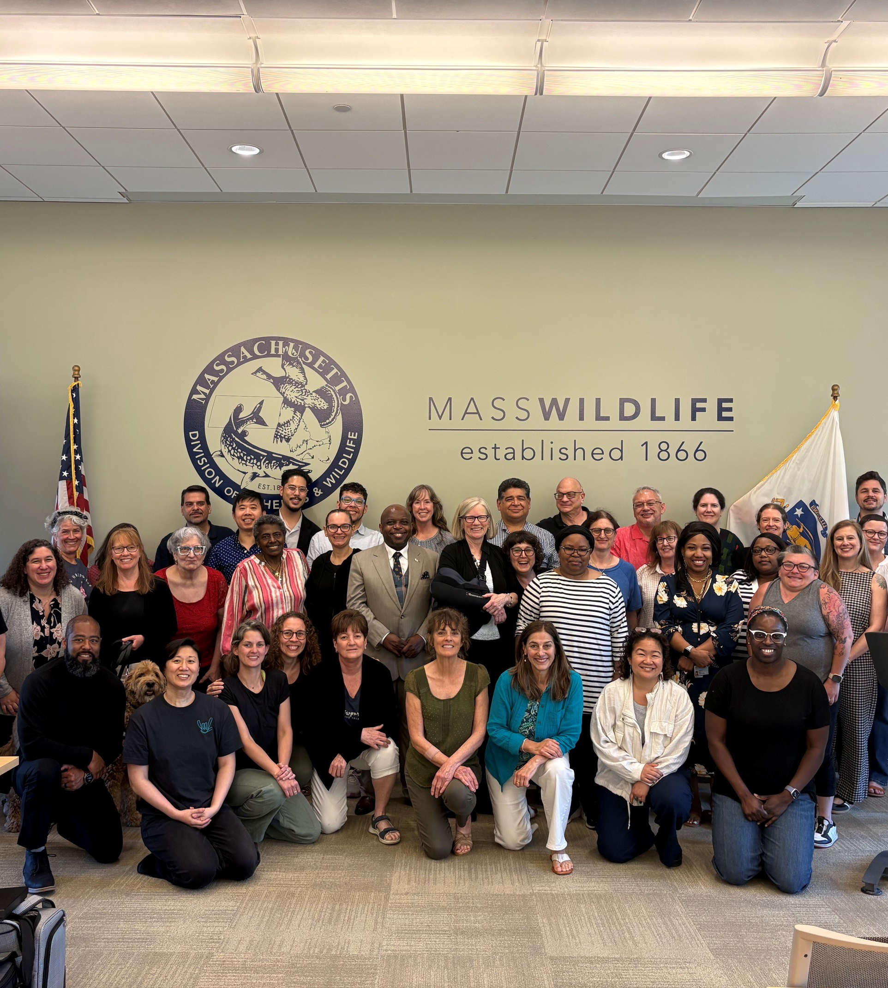
MCDHH
Staffing

Slide 6
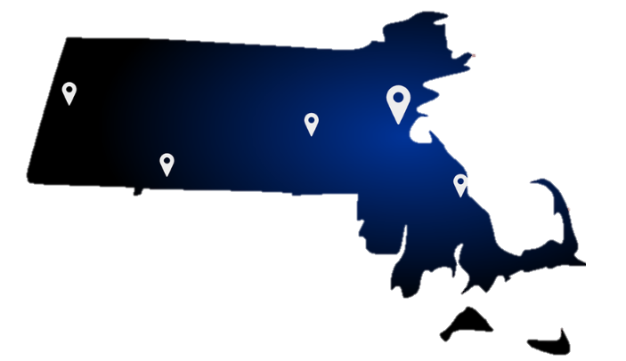
Offices
Staff: Currently 59 staff state-wide
Boston (40 Broad St, Boston, MA 02109)
Plymouth (38 Industrial Park Road, Plymouth, MA 02360)
Westborough (167 Lyman Street, Westborough, MA 01581)
Springfield (436 Dwight Street, Suite #204, Springfield, MA, 01103)
Pittsfield (160 North Street, Suite #201, Pittsfield, MA, 01201)
6

Slide 7



PROGRAMS
7

Slide 8
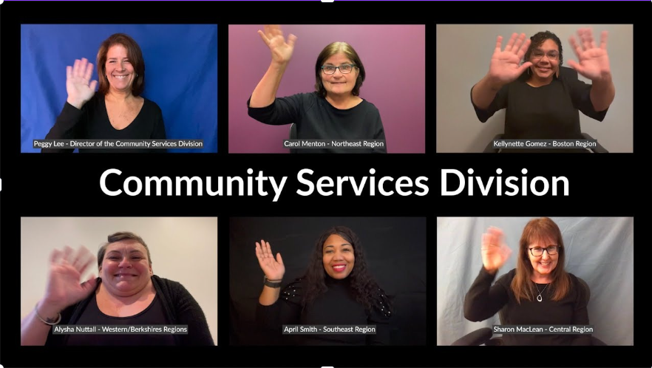

Slide 9
The Social Services Department has officially changed its name to the Community Services Division.
The Adult Case Managers are now Service Navigators. The Children’s Specialist kept their title.
9

Slide 10
FY25 - CSD
Served 2,321 clients with 4,055 advocacy hours and 173 hours of community guidance.
Expanded team to five Service Navigators and five Children’s Specialists, adding a new Boston specialist to reach underserved communities.
Strengthened partnerships with DCF, DMH, DDS, housing, and independent living centers.
10

Slide 11
Communication Access
Services (CAS) Division

Slide 12



Interpreter and CART referral Services
Workforce Development
Screening and Evaluation
After-Hours Emergency Service pilot program

Slide 13
FY25 - CAS
Referral & Workforce Development: Managed more than 25,000 service requests with a 64% fulfillment rate.
Launched a Sign Language Interpreter Mentorship Pilot and began CART training planning.

Slide 14
Communication Access,
Training and Technology Services (CATTs)

Slide 15
Public Education, Information and Training
Responds to General Inquiries
Communication Products: COVID Card, Visor Card, Emergency Services Card
Technical Support
Website Management
Accessible Video Creation
Provide guidance for State Agencies on Communication Access.
Work with community to identify areas where we can provide solutions.
15

Slide 16
FY25 - CATTs
Delivered over 24,000 trainings to police, EMTs, and hospitals.
Produced 120 ASL-accessible contract videos and expanded outreach statewide.

Slide 17
Contact the Commissioner
To reach Commissioner Sotonwa or the MCDHH, please use the online contact form provided by the official MCDHH website.
Access the contact form at: https://www.mass.gov/forms/contact-mcdhh-online.
Fill out the required fields with your information and message.
Click "Submit" to send your message directly to the Commissioner and the MCDHH team.

Slide 18
Thank you
Dr. Opeoluwa Sotonwa
Massachusetts Commission for the Deaf and Hard of Hearing | Mass.gov

