Slide 1
MDAR – Plant Industries Nursery Forms EEA ePLACE Portal Instructions
Below forms are part of Plant Industries-Nursery Program
Nursery Grower License
Nursery Agent License
Change of Company Information Form
EEA ePLACE Portal
1
Notes:
1
Bill Oates

Slide 2
Instructions for EEA ePLACE Portal
Finding your Registration/License Application
Adding Contact Information
Adding Application Information
Uploading attachments
Review and submit your Application
Make a Payment

Slide 3


General Navigation
Click button to move to the next page.
Any field with a red asterisk (*)is required before you continue to the page.
Click button to save your work and resume later.
Click on the tool tips where applicable to get more details.
Suggested preferred browsers are Chrome and Microsoft Edge

Slide 4
Finding your Registration/License Application in EEA ePLACE Portal
EEA ePLACE Instructions
Back to home
1
Notes:
4
Bill Oates

Slide 5
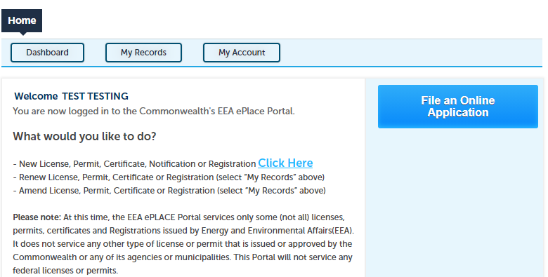
File an Online Registration/License Application
After logging in to the EEA ePLACE Portal, click here to start

Slide 6
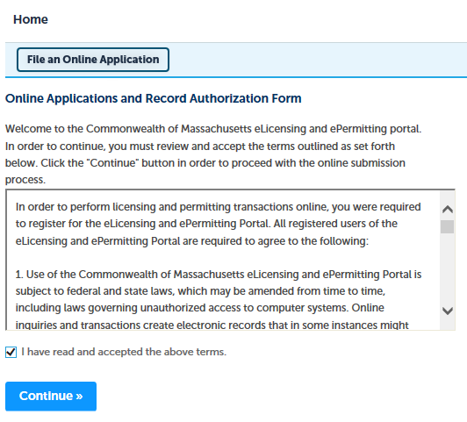
File an Online Registration/License Application
Read and accept the “Terms and Conditions”
Click the checkbox and click “Continue”

Slide 7
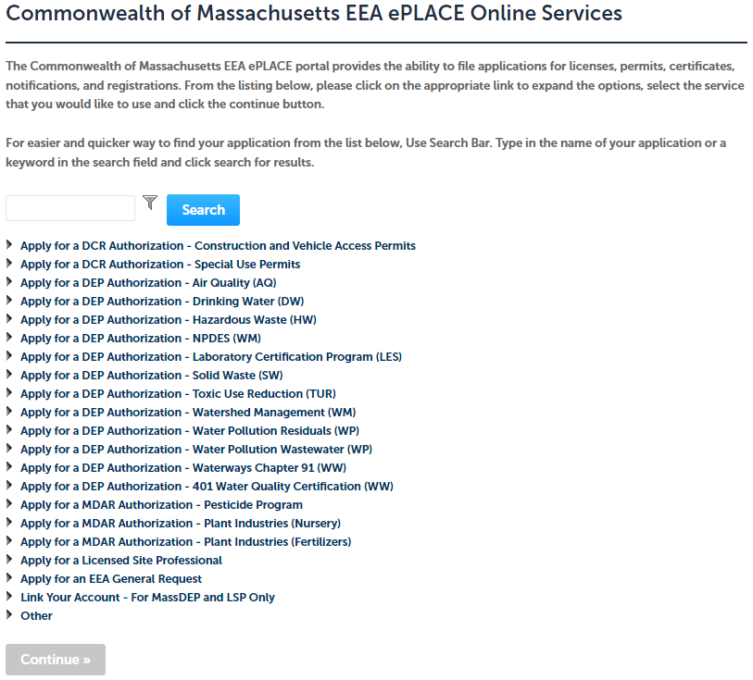
Select the MDAR- Plant Industries Program
Click on “Apply for a MDAR Authorization – Plant Industries (Nursery) from the list of options
You can also search for the application on the search bar field

Slide 8
Plant Industries – Registration/License Process
Apply for New Registration/License
Adding new Outlet(s) to your current Registration/License
Renew your Registration/License
Modify/Amend your Registration/License
Update your Company/Nursery Information
Back to home

Slide 9
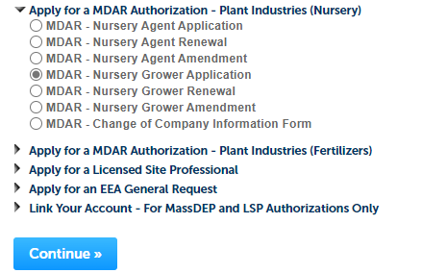
Apply for New Registration/License
Select MDAR – Plant Industries (Nursery) program a list of applicable record types will be displayed.
Choose the appropriate application for a new registration/license, then click "Continue" at the bottom of the page to begin your application.

Slide 10
Adding new Outlet(s) to your License
Select MDAR – Plant Industries(Nursery) program, a list of applicable record types will be displayed.
To add Outlet(s), select “Nursery Agent Application”
Click "Continue" button.
Important: Before beginning the application process to add new Outlet(s) ensure you have your Company Reference Number and Current Registration/ License Number. If you do not have this information, please contact the agency.

Slide 11
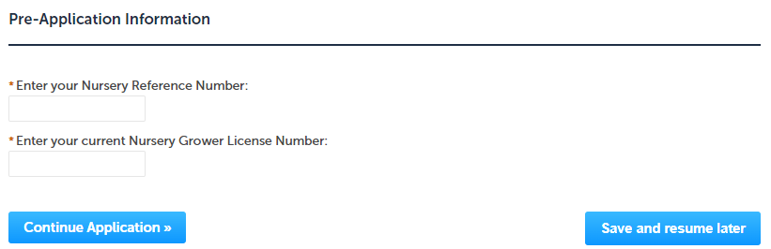
Renew your Registration/License
Select MDAR – Plant Industries (Nursery) program, a list of applicable record types will be displayed.
Choose the appropriate renewal for your registration/license, then click "Continue“ to begin your application.
Important: Before beginning the renewal process, ensure you have your Company Reference Number and Current Registration/ License Number. If you do not have this information, please contact the agency.

Slide 12
Modify/Amend your Registration/License
Select MDAR – Plant Industries (Nursery) program, a list of applicable record types will be displayed.
Choose the appropriate amendment your Registration/ License, then click "Continue“ to begin your application.
Important: Before beginning the amendment process, ensure you have your Company Reference Number and Current Registration/ License Number. If you do not have this information, please contact the agency.

Slide 13
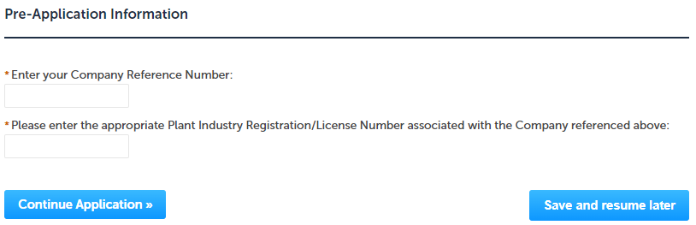
Update your Company/Nursery Information
Select MDAR – Plant Industries (Nursery) program, a list of applicable record types will be displayed.
Choose the “MDAR – Change of Company Information Form” to update your Company or Nursery Information, click "Continue“ to begin your application.
Important: Before beginning the Company Information form, ensure you have your Company Reference Number, and any Current Registration/ License Number associated with the Company. If you do not have this information, please contact the agency.

Slide 14
Adding Contact Information
EEA ePLACE Instructions
Back to home
1
Notes:
14
Bill Oates

Slide 15
Contact Types
Note: Please read the instructions under each contact section to add the information accordingly.
Company Information – Look Up
Company Information – Add New
Authorized Representative Company
Back to home

Slide 16
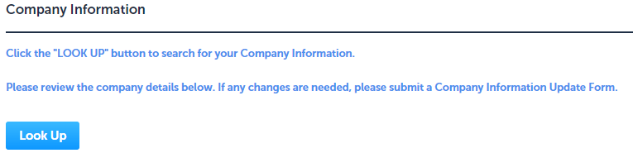
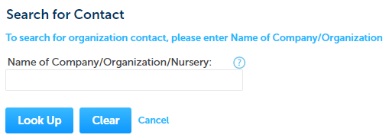
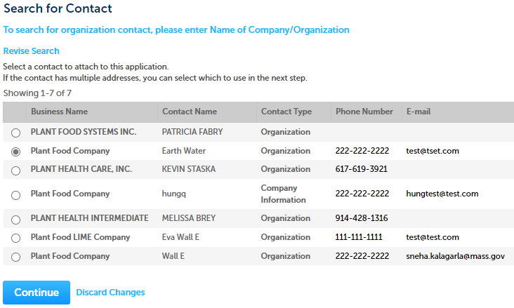
Contact Type – Company Information – Look Up
Company Information will be the company information of the Registrant company.
Depending on your application, the system will provide you option
To “Look Up” the Company Information
Click the “Look Up” button
Search portlet will open. Enter the Company name information and click “Look Up”.
Select the contact and click “Continue”.

Slide 17
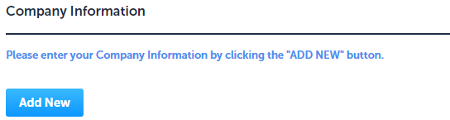
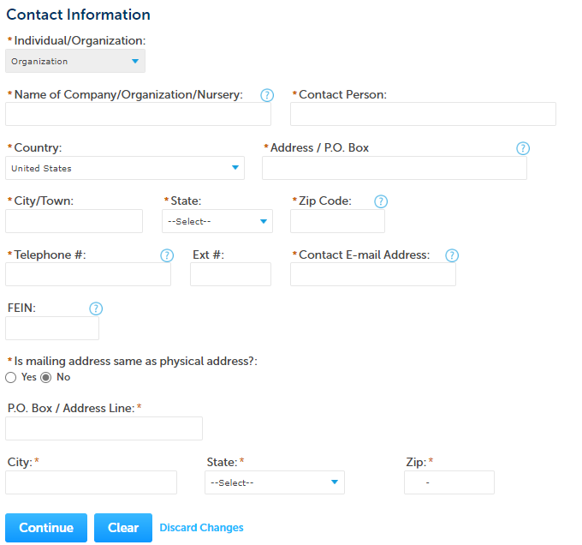
Contact Type – Company Information – Add New
Company Information will be the company information of the Registrant company.
This information will be required. To add this information
Click “Add New”
Enter the information and click “Continue”

Slide 18
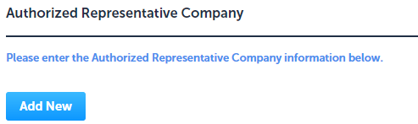
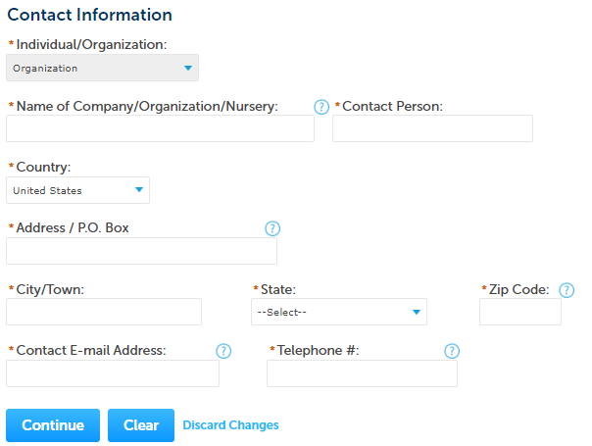
Contact Type – Authorized Representative Company
Authorized Representative Company will be the company information of the 3rd party company hired by the registrant company.
This information will be required. To add this information
Click “Add New”
Enter the information and click “Continue”

Slide 19
Adding Application Information
EEA ePLACE Instructions
Back to home
1
Notes:
19
Bill Oates

Slide 20
Adding Application Information
Adding Application Information – Table
Adding Application Information – Yes/No
Adding Application Information – Text box
Adding Application Information – Description box
Adding Application Information – Checkboxes
Adding Application Information – Dropdowns
Back to home

Slide 21
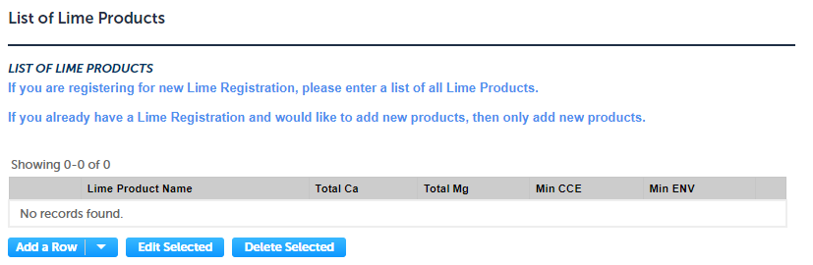
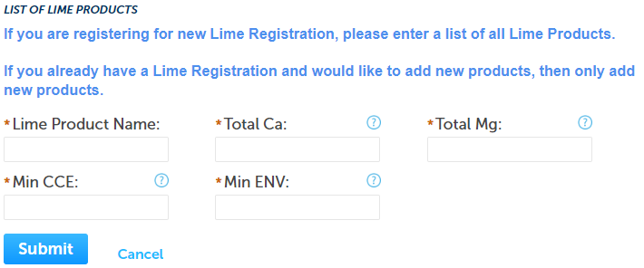
Adding Application information - Table
Please read the instructions under the section, if available
To add information into the table,
Click “Add a Row”
Enter information accordingly and click “Submit”
Repeat the steps above to add multiple rows
Click "Continue Application" to proceed to the next page of the application

Slide 22
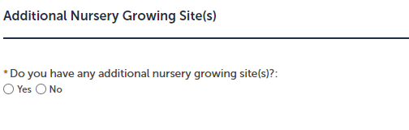
Adding Application information – Yes/No
Please read the instructions under the section, if available
To answer the questions, select either “Yes” or “No” as applicable
Click "Continue Application" to proceed to the next page of the application

Slide 23
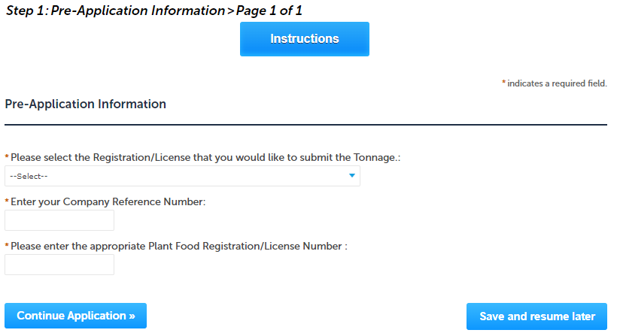
Adding Application information – Text box
Please read the instructions under the section, if available
Enter the information accordingly in the Text boxes
Click "Continue Application" to proceed to the next page of the application accordingly

Slide 24
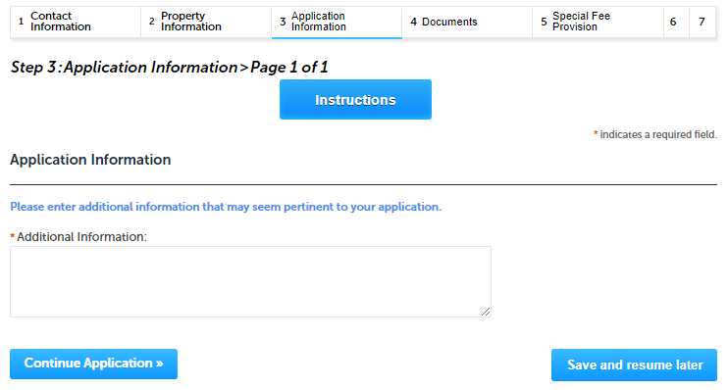
Adding Application information – Description box
Please read the instructions under the section, if available.
Enter the information accordingly in the Description box.
Note – You can enter up to 4000 characters in the description box.
Click "Continue Application" to proceed to the next page of the application.

Slide 25
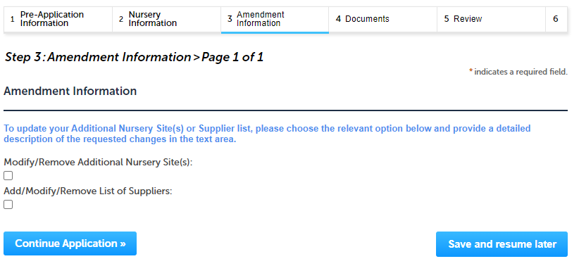
Adding Application information – Checkboxes
Please read the instructions under the section, if available
Select the checkbox(es) accordingly.
Note – You can select multiple or only one check box depending on the business rule.
Click "Continue Application" to proceed to the next page of the application accordingly.

Slide 26
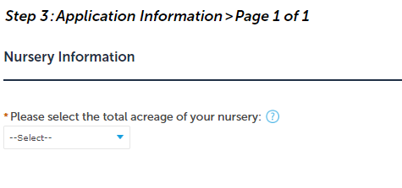
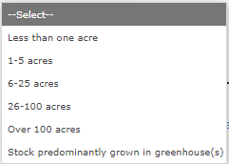
Adding Application information – Dropdowns
Please read the instructions under the section, if available
Select a value from the dropdown list which is applicable to the application section.
Click "Continue Application" to proceed to the next page of the application accordingly

Slide 27
Uploading attachments in the Document Section
EEA ePLACE Instructions
Back to home
1
Notes:
27
Bill Oates

Slide 28
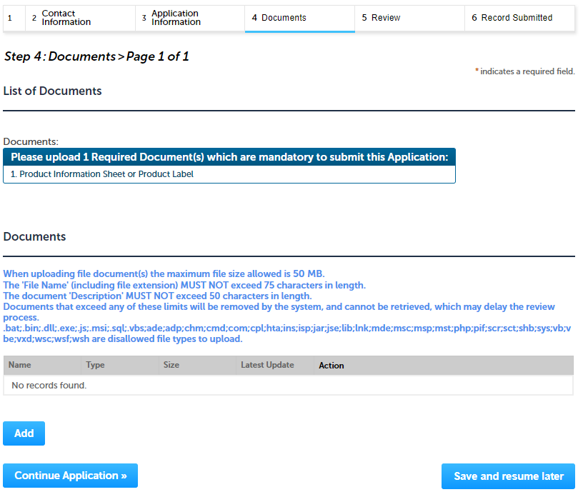
Uploading Documents
A list of all required documents will be displayed on the Documents page, if applicable
Note: It is mandatory step to upload the documents to submit the application
To upload the attachments, click “Browse” button

Slide 29
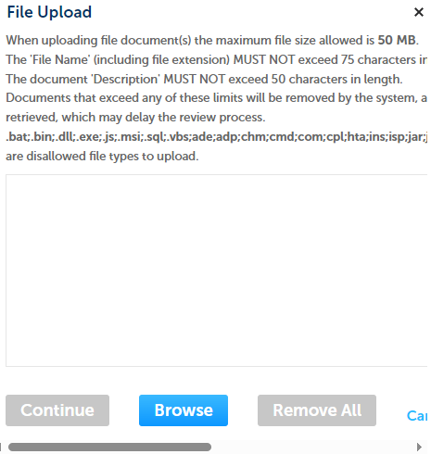
Uploading Documents (Attaching)
A “File Upload” window opens
Click “Browse”
A pop-up will open and choose the file(s) you want to attach.
Note : Ensure the name of attachment
Has less than 75 characters.
Does not contain any special characters such as commas, dashes etc.,
When all files reach 100%, click “Continue”

Slide 30
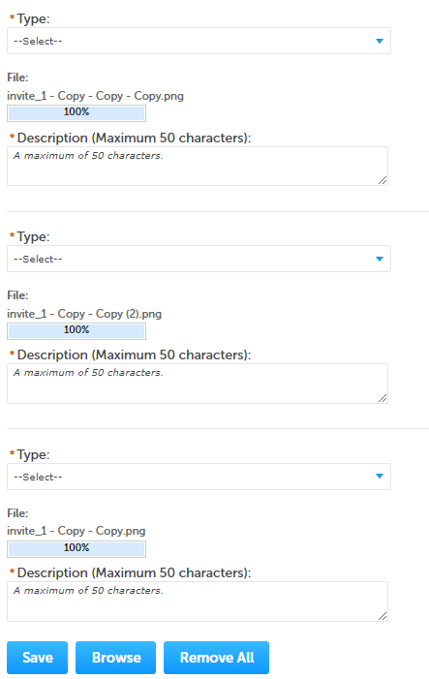
Uploading Documents (Attaching)
Select the document type
Provide a description of each document that you uploaded
Click “Browse” to add more documents
When all documents are uploaded and described, click “Save”

Slide 31
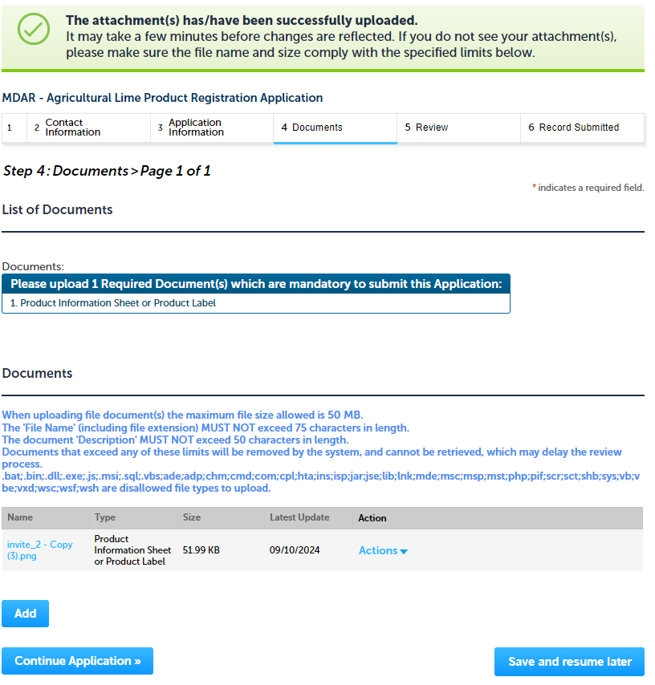
Uploading Documents (Attaching)
You should see a message that you have successfully attached documents
Review the list of attached documents
When ready, click on “Continue Application” to proceed to the next page of the application.

Slide 32
Review and submit your Application
EEA ePLACE Instructions
Back to home
1
Notes:
32
Bill Oates

Slide 33
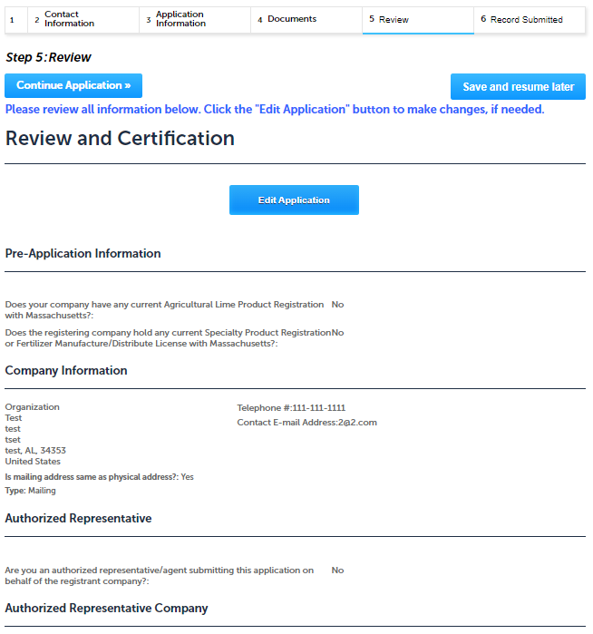
Review of your application
The entire application information is shown on a summary page for your review
If you need to make any changes, select “Edit Application” button. This will take you to the first page of your application
Continue to the bottom of the page

Slide 34
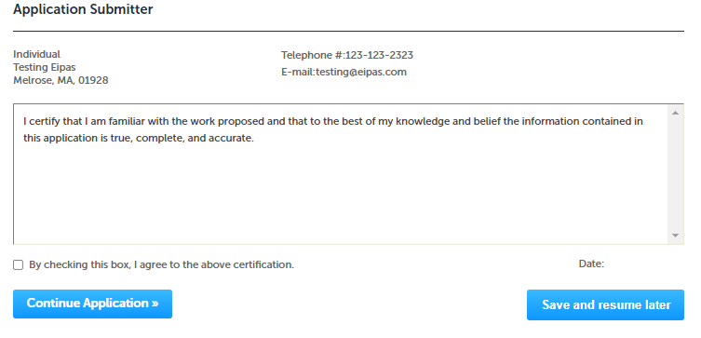
Certifying the application
Read the Certification Statement
Select the check the box to complete your certification
Click “Continue Application” to proceed with the submittal of the application
Please note that some applications require specific certification steps; please check system email notifications. The notifications will provide instructions on how to complete the next steps.

Slide 35
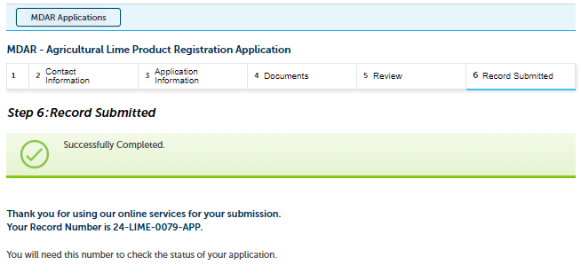
Application Submission Successful!
When you submit your application, you will receive a Record ID so you can track the status of your application online
Upon submission of your application please make sure to check your email for system notifications
Note: A copy of your Application i.e., Proof of Record (POR) will be emailed

Slide 36
Make a Payment for an Application
EEA ePLACE Instructions
Back to home
1
Notes:
36
Bill Oates

Slide 37
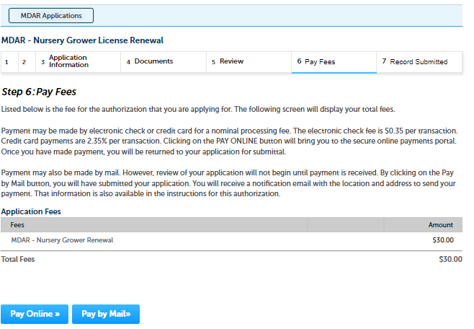
Selecting the Payment Option
As a part of application submission, the system will take you to the fee page, both online payment and pay by mail options are available
Note - Online payment will require a service charge
Click the appropriate box to continue

Slide 38
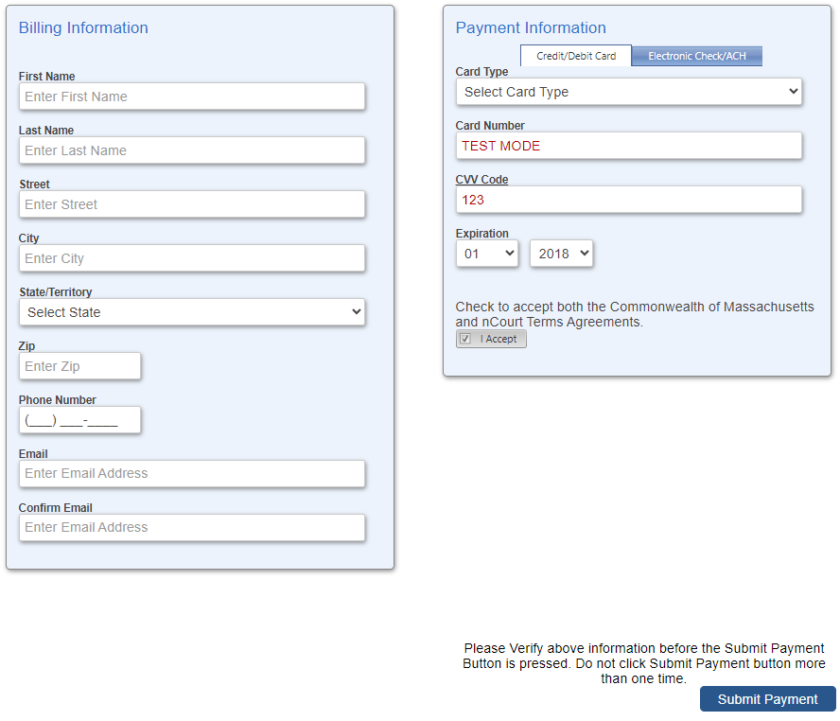
Pay Online
If you choose “Pay Online”, you will be brought to this screen
Provide all payment and billing information
Accept the terms and conditions and click submit
You will be e-mailed a receipt.
The application will be submitted to the Agency

Slide 39
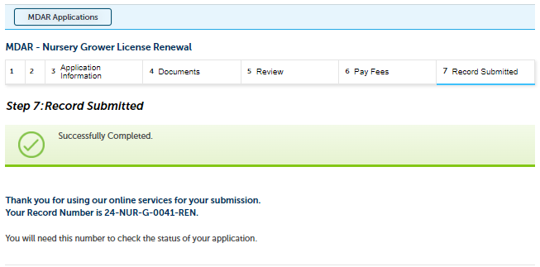
Application Submission Successful!
When the online payment is completed successfully, the Record ID page will be displayed
Note: Use this number to track the status of your application online
Upon submission of your application please make sure to check your email for system notifications

Slide 40
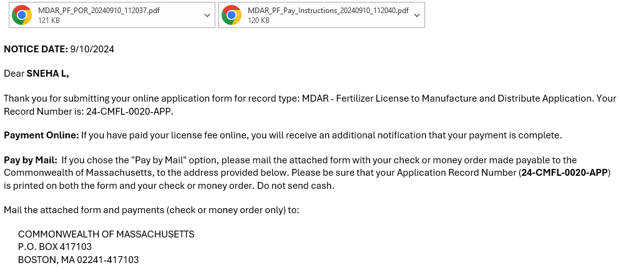
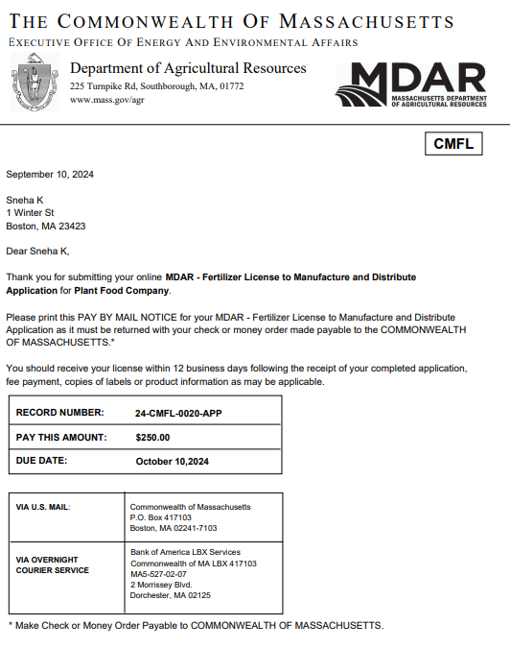
Pay by Mail
If you choose “Pay by mail”
Check your email for instructions
Note – A payment instructions will be attached to your notification
Please note – If you decide to pay online, you can access the payment link. Go to Slide 7 for instructions

Slide 41
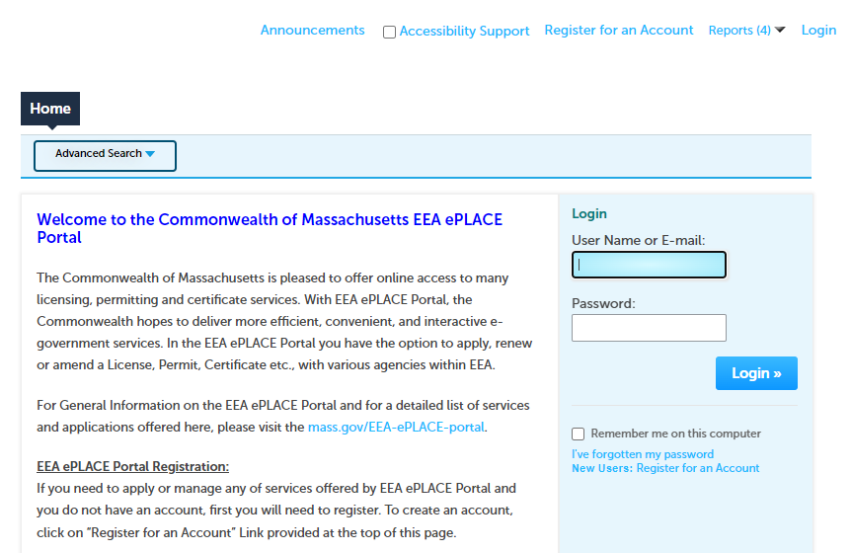
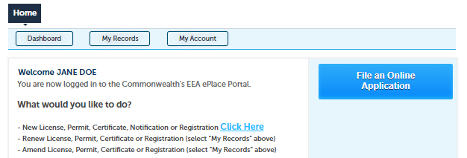
How to make a payment via PAY FEES DUE link
If your application is assessed with additional fees, you can pay online by logging into your account in EEA ePLACE using your username/ password - Mass.gov Licensing and Permitting Portal
Click on the “My Records” tab
Notes:
https://eplace.eea.mass.gov/citizenaccess/

Slide 42
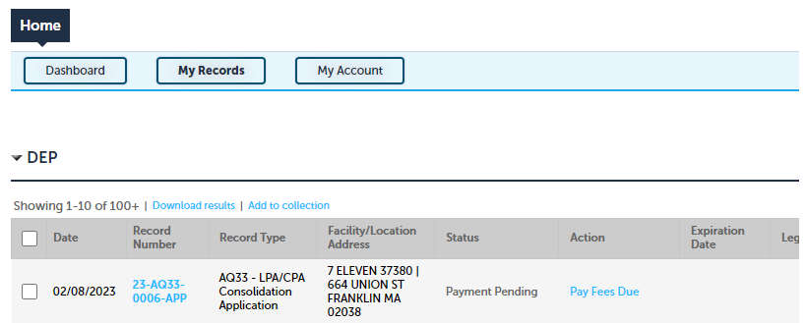
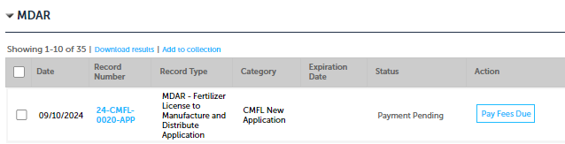
Accessing Payment Link on the Application Record
The Application Record will be listed
Select “Pay Fees Due” link
The system will take you to the Fee Page, where you can select the payment option
Follow instructions from page 3 – 6 to complete your payment accordingly
Notes:
https://eplace.eea.mass.gov/citizenaccess/

Slide 43
Questions?
For technical assistance:
Contact the ePlace Help Desk Team at (844) 733-7522
Or send an email to: ePLACE_helpdesk@state.ma.us
For assistance with MDAR – Plant Industries Agency
Nursery and Plant Inspections
https://www.mass.gov/nursery-and-plant-inspections

