Slide 1

Additional Benefits Under the Trade Program
Charlie Baker, Governor
Karyn Polito, Lieutenant Governor
Rosalin Acosta, Secretary
Alice Sweeney, Director, MassHire DCS
MassHire Program & Services are funded in part by US Department of Labor (USDOL) Employment and Training Administration grants as well as non-federal funded grants

Slide 2


Slide 3
Reemployment Trade Adjustment Assistance (RTAA)
Reemployment Trade Adjustment Assistance (RTAA) provides wage subsidies to individuals 50 years of age or older who return to work paying less than their trade-impacted employment.
Notes:
Workers participating on the ATAA need a Certification from the USDOL

Slide 4

Reemployment Trade Adjustment Assistance (RTAA)
The following rules apply:
Available to customers age 50 or older at application
Must apply for RTAA Two years from the date customer exhausts UI (and any EUC) or two years from the date of reemployment, whichever is earlier
Must earn less than they did from the certified company and cannot earn more than $50,000 annually in gross wages
customers may receive up to $10,000 over the course of the 2 year eligibility period
Not be with the same division/facility from which he/she
was separated
Notes:
Workers participating on the ATAA need a Certification from the USDOL

Slide 5
Reemployment Trade Adjustment Assistance (RTAA)
The following rules - continued:
Can include multiple jobs
If a customer decides to pursue training after collecting RTAA, they will not be eligible for TRA, the receipt of RTAA negates the receipt of TRA
RTAA participants may participate in training full-time or part-time and reemployed at least 20 hours per week
If a customer is employed part-time (at least 20 hours per week) and in TAA approved training, the State must verify participation in training on a monthly basis
Notes:
Workers participating on the ATAA need a Certification from the USDOL

Slide 6

Reemployment Trade Adjustment Assistance (RTAA)
NOTE: If an individual has already received Trade Readjustment Allowances (TRA), the RTAA eligibility period will begin with the date of qualifying reemployment and will be reduced by the number of weeks of TRA received.
Prior TRA receipt will also reduce the maximum amount of RTAA potentially payable.
Notes:
Workers participating on the ATAA need a Certification from the USDOL

Slide 7
RTAA Eligibility Period
No TRA = 104 weeks beginning the earlier of:
The date of UI exhaustion based on the qualifying separation
  With multiple qualifying separations, the last separation is used
Date on which the worker first begins qualifying reemployment

Slide 8
RTAA Eligibility Period
With TRA = 104 weeks beginning on:
Date on which the worker first begins qualifying reemployment reduced by the total number of weeks for which the worker received TRA

Slide 9

Alternative Trade Adjustment Assistance (ATAA)
Following the Sunset Provisions for Reversion 2021, RTAA is replaced by ATAA
The following rules apply:
DOL will issue a determination for ATAA Eligibility at time of Petition Certification
Must be at least age 50 at time of application
Cannot earn more than $50,000 annually in gross wages new job
Workers may receive up to $10,000 over the course of the 2 year eligibility period
Notes:
Workers participating on the ATAA need a Certification from the USDOL

Slide 10
Alternative Trade Adjustment Assistance (ATAA)
Customer must obtain reemployment within 26 weeks from date of separation to be eligible
New employment cannot be with the same division/facility from which he/she was separated.
Workers must choose between TRA or ATAA
ATAA participants are not eligible for any other benefits other than relocation allowances and HCTC. Receipt of ATAA prohibits eligibility for other benefits.
Notes:
Workers participating on the ATAA need a Certification from the USDOL

Slide 11
Age Requirement
A customer may obtain employment before turning 50 years old and receive A/RTAA benefits after turning 50 years old
  IF the A/RTAA eligibility period established after obtaining such employment has not expired when the individual turned 50 years old.

Slide 12
Continuing Eligibility
A customer can change employment
Can hold multiple jobs
  all jobs must be submitted on application
  If an additional job is obtained after initial ATAA eligibility is established, it must be included.
Can experience a period of unemployment and return to A/RTAA

Slide 13

A/RTAA - Reminders
A/RTAA - If there is a change in employer a redetermination is required. In order to do so all the paystubs must be entered from the old employer before TAA can close the current A/RTAA Application. Once the Application is closed then a NEW A/RTAA Application will be submitted for new employment. TAA will review and make a determination.

Slide 14
A/RTAA Weekly Certifications
When submitting weekly certifications, the following wages must be included:
Regular pay
Overtime
Commission
Bonus pay
Shift differential
Paid sick or vacation time
Total hours for the week must also be included.

Slide 15
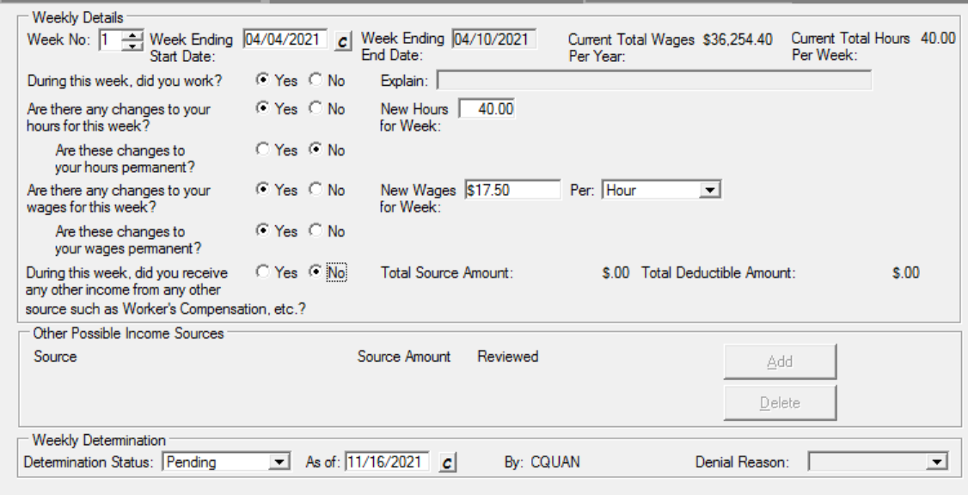
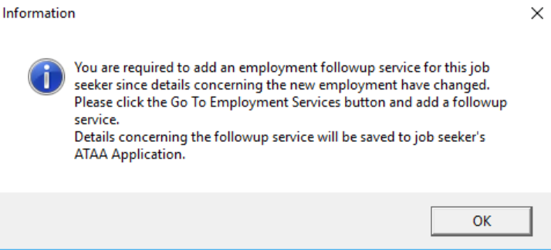
Changes in Wages
If there is a permanent change in wages, make sure to select the option in the weekly certification and post the service update on the employment tab under Services. *Employment Follow-Up

Slide 16
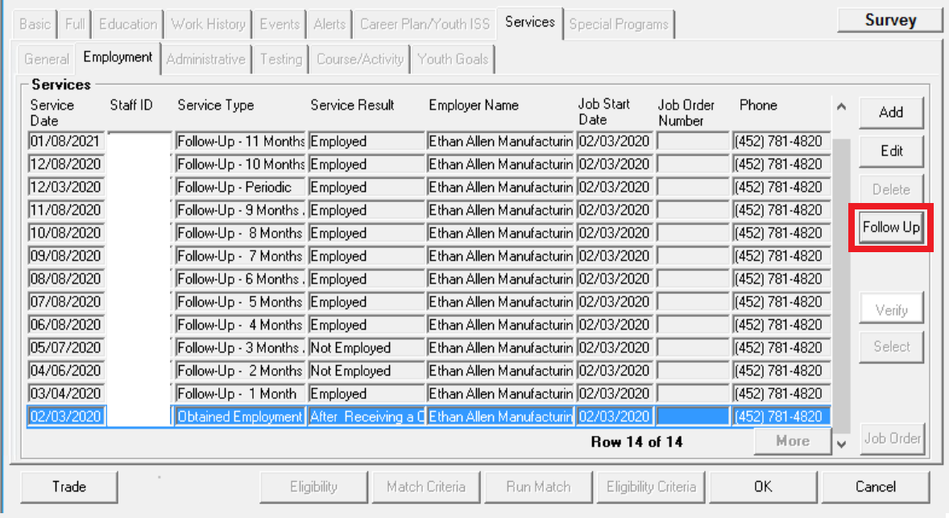

Slide 17
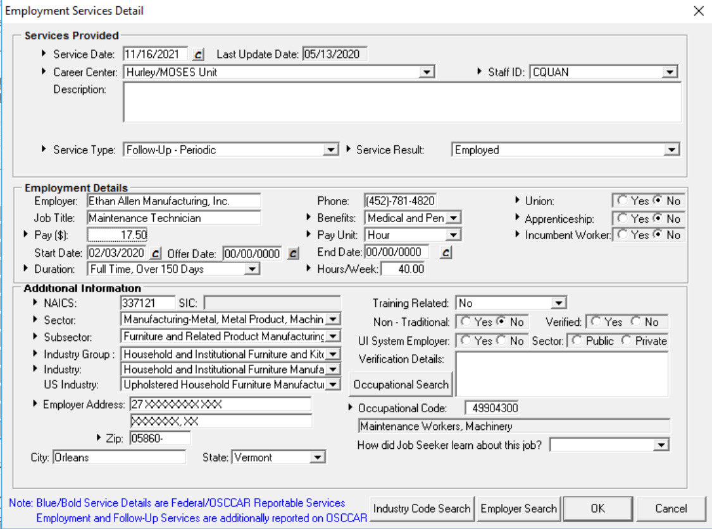

Slide 18
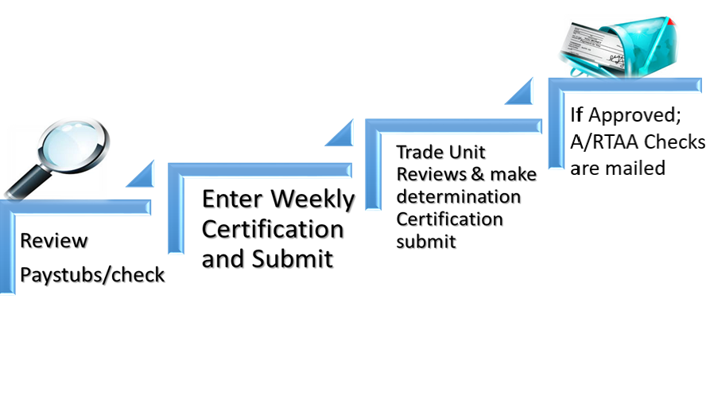
A/RTAA - Reminders

Slide 19


Slide 20
Health Coverage Tax Credit (HCTC)
The Health Coverage Tax Credit has been extended through December 31, 2021
Forms may be submitted by one of the following:
Mail to: Internal Revenue Service
Stop 6098 AUSC
Austin, TX 78741
Fax: 855-250-1731
Email: wi.hctc.stakehldr.en@irs.gov
Allow up to six weeks from receipt of the form.
Notes:
Emphasize that the new 65% coverage for HCTC is for customers under BOTH the new and old Acts.

Slide 21
Health Coverage Tax Credit (HCTC)
HCTC is only available to the following:
An eligible trade adjustment assistance (TAA) recipient (Customer must be receiving TRA or would be but has not yet exhausted UI (as of the first day of the month or any day within that month), reemployment (RTAA) recipient. Or
55-64 years old whose defined-benefit pension plans were taken over by the Pension Benefit Guaranty Corp (PBGC). Or
The family member of a TAA recipient, RTAA recipient, or PBGC pension payee who is deceased or who finalized a divorce with the customer.
Have a qualifying health plan.
For more information, please visit
https://www.irs.gov/credits-deductions/individuals/hctc
https://wdr.doleta.gov/directives/corr_doc.cfm?DOCN=4983

Slide 22
Not Eligible for HCTC
The customer is not eligible for HCTC if they:
Can be claimed as a dependent on another person’s federal income tax return; or
Are enrolled in Medicare, Medicaid, the Children’s Health Insurance Program, or the Federal Employees Health Benefits Program or are eligible to receive benefits under the U.S. military health system (TRICARE); or
Are enrolled in an Affordable Care Act Marketplace insurance.

Slide 23
Claiming HCTC
Daily, the Trade Unit sends a list of potentially eligible customers to the HCTC Program
Customer should ensure that they meet all the HCTC Eligibility Requirements and has a Qualified Health Plan
Must register for Advance Monthly Payments for HCTC
Customer should complete the form and send in all required documents
Once enrolled customer must submit payment for 27.5%. HCTC will take the 27.5%, pay the remaining 72.5%, and send 100% payment to the health plan
Customer should continue to pay health insurance bills in full directly to the health plan until the customer receives enrollment confirmation.

Slide 24


Claiming HCTC Monthly
Daily, Trade Unit sends list of potential eligibles to HCTC program
HCTC sends Program Kit and Registration Form to customer
HCTC Program sends monthly invoices to customer
Customer completes form and sends it back to HCTC
HCTC pays remaining 72.5% and sends 100% payment to the health plan
Customer submits payment for 27.5% of health insurance premium to HCTC Program

Slide 25


Slide 26
Job Search Allowances
Granted to assist an customers in obtaining suitable employment outside of their local travel area.
(31 or more miles roundtrip.)
A petition certification is required before filing a job search application

Slide 27
Job Search Allowances
Travel to and attendance at job fairs and interviews
Travel to and attendance at prevocational workshops
Making an in-person visit with a potential employer who may reasonably be expected to have openings for suitable employment
Completing a job application in person with a potential employer who may reasonably be expected to have openings for suitable employment
Going to a local one-stop, copy shop, post office, or similar entity to print, copy, mail, email, or fax a job application, cover letter, and/or a resume
Going to a local one-stop, public library, community center, or similar entity to use online job matching systems, to search for job matches, request referrals, submit applications/resumes, attend workshops, and/or apply for jobs
Attending a professional association meeting for networking purposes

Slide 28
Job Search Allowance Eligibility
An customer totally separated from the job covered under the certification when beginning the job search
Cannot reasonably expect to secure suitable employment in the commuting area
Can reasonably expect to obtain either suitable employment or employment that pays a wage of at least the 75th percentile of national wages, as determined by the National Occupational Employment Wage Estimates
Meets the suitable employment requirements in the area of the job search
Notes:
Jesse - Section 618.415 Eligibility for a job search allowance. sets forth the eligibility requirements for job search allowances. Section 237(a)(2)(B) of the Act requires, as a condition for receipt of a job search allowance, that “the worker cannot reasonably be expected to secure suitable employment in the commuting area in which the worker resides.” In implementing this provision, the Department used the same definition of the term “suitable employment” as is used in subpart F and defined in Subpart A, section 618.110. This departs from 20 CFR 617.32(a)(4) and 617.42(a)(6), which used “suitable work,” applying the State UI law definition of suitable work, as the threshold for approval of job search and relocation allowances.
Section 618.415, paragraph (a) has several changes. Paragraph (a) excludes language on registration for work with the State agency because Section 618.310 already requires States to provide employment and case management services, and the Act does not contain this particular registration requirement for job search allowance eligibility.
Paragraph (a)(3) substitutes the term “suitable employment” for “suitable work” and eliminates the reference to long-term duration. Suitable employment may exclude some work—i.e., some lower-skilled and lower-paying work—that would qualify as suitable work under a State law. Suitable employment is work at a substantially equal or higher skill level paying at least 80 percent of the AAW’s previous wage. Suitable employment differs from suitable work because, in most States, suitable work includes jobs with wages, skills requirements, or both, that are lower than those in jobs that would qualify as suitable employment under the Act. Paragraph (a)(3) also adds “employment that pays a wage of at least the 75th percentile of national wages, as determined by the National Occupational Employment Wage Estimates.” This alternative ensures that AAWs who can reasonably expect to find a job that otherwise meets the suitable employment definition except that it pays a wage of at least the 75th percentile of national wages, rather than paying at least 80 percent of the AAW’s previous wage, would still be eligible for job search allowances.
The changes will make it easier for workers to qualify for a job search allowance, because fewer local jobs would qualify as suitable employment. The change, however, might make it harder for workers to qualify for a relocation allowance, because, similarly, fewer jobs requiring relocation would qualify as suitable employment. This difficulty should be mitigated by the fact that workers who find suitable employment with the help of a job search allowance would also be eligible for a moving allowance to relocate to that same suitable employment. The unique economic circumstances of workers adversely affected by international trade is why the Department made this change. This change also would provide administrative consistency and uniformity of interpretation and application of Federal law.
The next few slides will walk you through finding the 75th percentile, and the State would use the percentile for the occupation of the job in question. If there are multiple jobs available that might be suitable, the percentile for that specific occupation would apply.

Slide 29
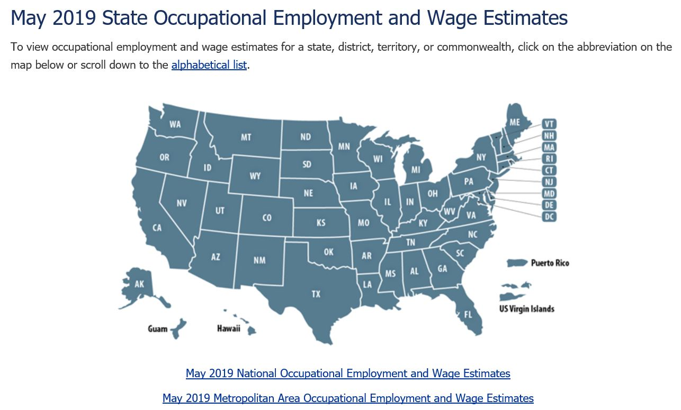
75th Percentile
Can reasonably expect to obtain either suitable employment or employment that pays a wage of at least the 75th percentile of national wages, as determined by the National Occupational Employment Wage Estimates
Visit BLS web page: https://www.bls.gov/oes/current/oessrcst.htm
Notes:
Jesse -
To find the 75th percentile of national wages, as determined by the National Occupational Employment Wage Estimates, visit the U.S. Bureau of Labor Statistics (BLS) web page, select the appropriate State and occupation for the worker, view percentile wage estimates, and locate the 75th percentile.

Slide 30
Job Search Allowance Eligibility
Cannot reasonably expect to secure suitable employment by alternatives to being physically present in the area of the job search;
Not previously have received a relocation allowance under the same certification; and
Complete a state-approved job search within 30 calendar days after the worker leaves the commuting area to begin the job search
Notes:
Jesse - Section 618.415 Paragraph (a)(4) establishes that the State determines whether an AAW could reasonably expect to find suitable employment through alternatives to a job search allowance, such as by having an AAW search and interview for jobs through electronic means. The Department added this provision to reflect the cost-saving technological advances of the modern era. There are now countless websites, apps, and online services that connect employers with workers, and many communication technologies make face-to-face discussion via video conferencing simple and inexpensive. By this change, the Department is encouraging States and AAWs to use these cost-saving, and possibly equally effective, measures.
Paragraph (a)(5) clarifies that a State may not approve job search allowances if the AAW received a relocation allowance under the same certification since an AAW must have already obtained work to qualify for the relocation allowance.
Paragraph (a)(6) gives an AAW 30 calendar days to complete a job search.
Paragraph (b) describes when a job search is complete. A job search is not complete until the AAW has received a bona fide (i.e., good faith) offer of employment, or has contacted each employer the AAW either planned to contact or to whom the AAW was referred by the State agency or other one-stop partner.

Slide 31
Job Search Allowance Findings Required
Before approving the final payment of a job search allowances states must:
  Find that the customer meets the eligibility requirements for a job search allowance specified
  Verify that the worker contacted each employer the state certified, or to whom the state or one-stop center referred the worker as part of the job search
  Must find that the worker completed the job search within the established time limits
  Must have the Job Search Allowance Interview Verification Form signed by Interviewing Company
  Submit all original receipts during the job search
Notes:
Jesse - Section 618.420 Findings required for a job search allowance. explains what a State must find before approving a job search allowance, and further delineates the responsibilities between a liable State and an agent State, when a job search occurs in a different State from the liable State. Subpart H, Administration by Applicable State Agencies, establishes the responsibilities of the liable State and an agent State. Specifically, Section 618.824 establishes that the liable State makes all determinations on each claim for program benefits, and the agent State pays the costs for job search and relocation allowances.
Paragraph (a) adds the employer contact verification requirement. The Department has determined that this requirement, which requires a liable State to verify the AAW’s contacts with employers certified by the AAW in the worker’s own job search plan or through referrals, more logically fits under the section on required findings.

Slide 32
Job Search Allowance Amount
90% of allowable costs up to a maximum benefit of $1,250
May included multiple job searches for up to 30 days from 1st interview
Participant may use other forms of transportation but reimbursement will be limited to the mileage calculation
Notes:
Jesse - Section 618.425 Amount of a job search allowance. explains how to calculate the amount of a job search allowance and updates the maximum amount available for allowances to the statutory limit of $1,250. It also simplifies requirements by basing allowable travel, lodging, and meal costs on the Federal Travel Regulations (or FTR), which in the Department’s judgment are reasonable and necessary in amount. The lodging and meal allowance is set, by statute, at 90 percent of the lower of actual meal and lodging costs or one-half the applicable prevailing per diem rates in the FTR. Section 618.425 reflects the statutory limit. Section 618.425 also replaces the term “public transportation” with the term “mode of transportation.” The reference to public transportation has been unduly limiting, so the Department is using this more expansive term.

Slide 33
Job Search Allowance Deadline
Deadline for application (before):
  The later of the 365th day after either the date of the certification under which they are covered, or the 365th day after their last total separation; or
  The 182nd day after the date of concluding approved training
  Must be filed prior to leaving on Job Search.
Notes:
Jesse - Section 618.415(a)(1) provides the time limits within which an AAW must request a job search allowance. It contains minor rewording for readability, but the requirements are unchanged.

Slide 34


Slide 35
Relocation Allowance
Available to a customer with a total separation
Must be approved by the state prior to relocation
Relocate to suitable employment within the United States
Outside of their local travel area. (31 or more miles roundtrip.)
Verify employer is not offering relocation to the customer
Submit all itemized receipts to TRADE in order to receive reimbursement
Notes:
Julie - Section 618.440 Applying for a relocation allowance. describes the application process for a relocation allowance but differs from 20 CFR 617.41 on when to file an application. While paragraph (a) is essentially unchanged, paragraph (b) allows an AAW to apply for a relocation allowance only after the Department issues a certification covering that worker. This is consistent with sec. 238(a)(1) of the Act. This is the same change for job search allowances reflected in Section 618.410, which also does not permit applications until after the Department issues a certification. A State may not issue a relocation allowance or a reimbursement to anyone not covered by a certified petition for any reason. Permitting precertification applications can raise workers’ expectations of payments that may not become available.
Paragraph (b) also contains the requirement that the State may approve the relocation only after an AAW files an application and before such worker undertakes the relocation.

Slide 36
Relocation Allowance Eligibility
No previous relocation allowance under the same certification
Relocate within the U.S., but outside the worker’s commuting area
No reasonable expectation of securing suitable employment in the commuting area
Obtained either suitable employment or employment that pays a wage of at least the 75th percentile of national wages, as determined by the National Occupational Employment Wage Estimates, and otherwise meets the suitable employment requirements, or a bona fide offer of such employment, in the area of intended relocation
Notes:
Julie –
First, Section 618.445 removes the requirement regarding registration with the State agency from the job search eligibility requirements because the Act does not contain a registration requirement for relocation allowance eligibility and because Section 618.310 of subpart C, absent from 20 CFR part 617, already requires that States make available employment and case management services to all trade-affected workers. Further, paragraph (a)(5) departs from 20 CFR 617.42(a)(6) in three respects.
Paragraph (a)(5) substitutes a Federal law definition of “suitable employment” for “suitable work” under State law and eliminates the reference to “affording a reasonable expectation of employment of long-term duration” because the concept of long-term employment is substantially included in the definition of “suitable employment.” Paragraph (a)(5) also adds “employment that pays a wage of at least the 75th percentile for national wages, as determined by the National Occupational Employment Wage Estimates.” This alternative ensures that AAWs who obtain or receive a bona fide offer of a job that otherwise meets the suitable employment definition except that it pays a wage of at least the 75th percentile of national wages, rather than paying at least 80 percent of the AAW’s previous wage, would still be eligible for relocation allowances.
Therefore, before granting a relocation allowance, the State must determine that an AAW has no reasonable expectation of securing suitable employment in the commuting area. This is consistent with the treatment of job search allowances, and, as explained earlier, is in many States likely to be a higher standard than the suitable work standard used in 20 CFR part 617. Using suitable employment in the eligibility criteria for relocation allowances limits the jobs for which a State may pay a relocation allowance. However, the Department has concluded this change would increase workers’ options. The change would permit more AAWs to use a relocation allowance to secure suitable employment or other high-paying employment outside the commuting area, rather than settle for suitable work within the commuting area. And AAWs who are eligible for the job search allowance, and thereby find suitable employment or other high-paying employment, will similarly be eligible to relocate to that same suitable employment by using a relocation allowance.

Slide 37
Relocation Allowance Timing
Begin the relocation no later than:
  182 days after the worker files the application
  182 days after the conclusion of an approved training program, if the worker entered a training program that received supplemental assistance approved under 20 CFR 618.640(c) (subsistence payments) and (d) (transportation payments)
Complete the relocation within a reasonable time
Notes:
Julie –- Two other significant differences involve the timing of relocations. First, paragraph (a)(6) simply states the two statutory 182-day time limits for beginning a relocation, instead of stating that an AAW must begin a relocation “within a reasonable period” and later elaborating on what is a reasonable period merely by providing the same deadlines as in paragraph (a)(6). Section 618.445 omits references to reasonable period to begin a relocation because the firm deadlines provided for an AAW beginning a relocation are sufficient, and render moot the references to a reasonable period.
Paragraph (a)(7) requires an AAW to complete the relocation within a “reasonable time” under the FTR, while retaining the required factors in 20 CFR 617.43(a) that a State must consider in determining whether a worker has completed the relocation within a reasonable time.
The second significant difference involves the statutory 182-day time limit in which the relocation must occur. The 2002 Program amended sec. 238(c)(2) of the Act, which requires the AAW’s relocation to occur within 182 days after the conclusion of an approved training program, by adding at the end of the provision the alternative condition “if the worker entered a training program approved by the Secretary under [sec.] 236(b)(1) and (2)” (which govern supplemental assistance for workers in training outside the commuting area). All workers who conclude TAA approved training must apply for a relocation allowance no later than the 182nd day after concluding such training, in accordance with sec. 238(a)(2)(E)(ii) the Act and § 618.445(a)(1)(ii). However, the Department interprets sec. 238(c)(2) of the Act to mean that an AAW approved by the State, under § 618.640(c) and (d), to receive subsistence and transportation payments (supplemental assistance) for training at facilities outside the worker’s commuting area, must also begin the relocation within 182 days after completing training, the same as the relocation allowance application deadline. In contrast, AAWs who are not approved by the State to receive subsistence and transportation payments, because they receive training within their commuting area, may begin relocation within 182 days after applying for a relocation allowance, which effectively permits these workers to begin relocation much later than workers who receive supplemental assistance in training.

Slide 38
Relocation Allowances Amount
Travel
  Mileage for POV at the relocation rate, per GSA
Lodging / Meals
  90% of lodging and meals, lessor of:
    Actual costs; or,
    50% of per diem allowance
Lump Sum Payment
  3x average weekly wage
  Up to $1,250
Notes:
Julie - Section 618.455 Determining the amount of a relocation allowance. consolidates, reorganizes, and updates the requirements. A relocation allowance includes, with specified qualifications, 90 percent of the travel and subsistence costs of the AAW and their family to reach their new home, 90 percent of the cost of moving household effects, and a lump sum equal to three times the worker’s average weekly wage, not to exceed $1,250. The lump sum maximum reflects the statutory limit.
Section 618.455 requires States to follow the Federal Travel Regulations. Paragraph (a)(1) refers to 41 CFR chapter 301 (travel) and paragraph (a)(3) refers to 41 CFR chapter 302 (movement of household goods).
Paragraph (a)(2) sets reimbursement amounts for the family’s meals and lodging at 90 percent of the lower of their actual meals and lodging costs or one-half the applicable prevailing per diem rates in the FTR. The current per diem rates can be found at: gsa.gov.
Paragraph (a)(4) Lump sum. As part of the relocation allowance, the worker will receive a lump sum equivalent to three times the worker’s average weekly wage, not to exceed $1,250.
Paragraph (b) Reduction. Is not new. If the AAW is eligible to receive or has received moving expenses from any other source for the same relocation, the State must deduct the amount received from the amount of the relocation allowance as determined in paragraphs (a)(1) through (3) of this section.
Paragraph (c) Limitation. Is also not new. In no case may the State pay a travel allowance for the AAW or a family member more than once for a single relocation.

Slide 39
Household Goods
Movement of household goods
  Commercial carrier, rental trailer/truck, etc.
  Can include up to $40,000 of insurance
Temporary storage of up to 60 days
Subject to Federal Travel Regulations
  Currently set at 18,000 lbs.
Notes:
Julie – Section 618.455, Paragraph (a)(3)(ii) increases the allowable amount of insurance coverage of such household goods and effects to $40,000 from $10,000. The Department determined that $10,000 was no longer an appropriate level of insurance coverage as households’ accumulated goods and effects have increased in value due to inflation and rising household incomes since 1987.
Section 618.455 omits the more detailed provisions for trailers, rental trucks, house trailers, and temporary storage. These detailed requirements are unnecessary and better addressed by the Federal Travel Regulations (or FTR). The Department notes that moving a house trailer or mobile home, as permitted under paragraph (a)(3)(i), has special requirements under the FTR, at 41 CFR part 302-10, of which the worker must be notified before planning such a move.

Slide 40
Relocation Allowance Deadlines
File an application before either:
  The later of the 425th day after the date of the certification under which the worker is covered, or the 425th day after the date of the worker’s last total separation; or
  The 182nd day after the date the worker concluded training
  Must be filed before relocation.
Notes:
Julie - Section 618.445 Eligibility for a relocation allowance. Paragraph (a)(1)
(a) Conditions. To be eligible for a relocation allowance, the AAW must:
(1) File an application before either:
(i) The later of the 425th day after the date of the certification under which the worker is covered, or the 425th day after the date of the worker’s last total separation; or
(ii) The 182nd day after the date the worker concluded training;

Slide 41
Travel Allowance
Travel allowance is a reimbursement paid to eligible Trade customers whose travel to the training provider will be 31 miles or more round trip compared to travel from home to the Trade certified employer *Always make sure to double check if the customer could be eligible for Travel allowances and submit it with the training package.
Daily travel allowance may not exceed 50% of the federal per diem rate established for the area the client will travel
Travel allowance cannot exceed the reasonable costs total
For more information, please review Policy 100 DCS 13.101

Slide 42
Contacts
Maynor Acevedo
Maynor.Acevedo@Detma.org
Christopher Quan
Christopher.Quan@Detma.org

