Slide 1

欢迎来到MassHire
Notes:
SCRIPT
Welcome to Masshire – our mission is to connect businesses and job seekers through a statewide network of employment experts. It’s our job to help people find meaningful employment, and to help businesses find qualified candidates.

Slide 2



MASSHIRE 职业中心
帮助消除寻找工作的恐惧和忧虑!
MassHire 支持您并帮助您恢复工作
Notes:
SCRIPT
Our career counselors at MassHire are here for you and understand searching for a job can feel confusing, frightening, lonely, and frustrating. We’ll help you get through this process and help you get back to work as soon as possible.
Please pay close attention to the information given throughout this presentation, as we walk you through what you can expect in terms of career support.

Slide 3
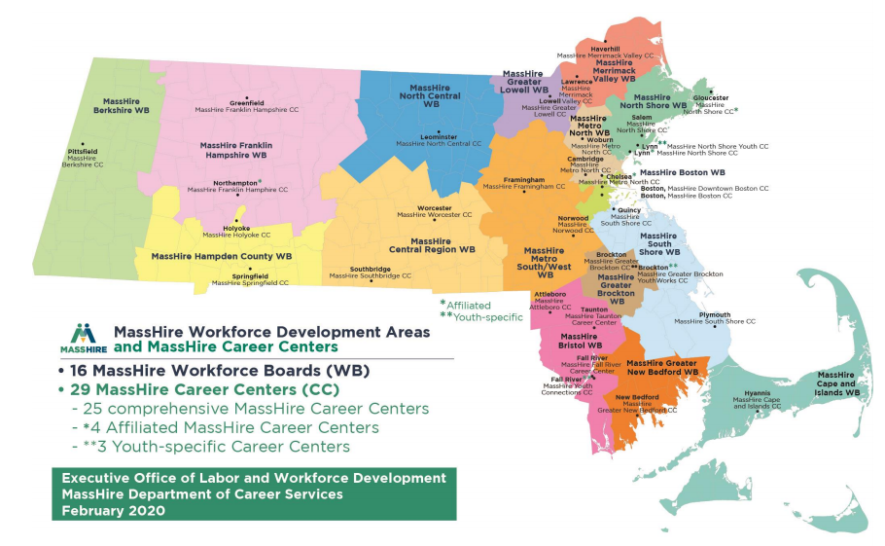
MassHire 办公室地点
https://www.mass.gov/how-to/find-a-masshire-career-center
查找职业中心
Notes:
SCRIPT
There are several MassHire Career Centers across Massachusetts that are working to strengthen our online services. The services described in this presentation will be accessible online, with the opportunity to work with career counselors remotely.
Please call your nearest career center to learn more about these services.
Go to www mass gov how to find a masshire career center to find the MassHire Career Center closest to you.
If you have questions about any of the content in this slide deck, please visit the link and contact your local career center over the telephone.

Slide 4






MassHire 合作伙伴
Department of Unemployment
Assistance (DUA)
www.mass.gov/DUA
Department of Transitional Assistance (DTA)
www.mass.gov/DTA
Mass Rehabilitation Commission (MRC)
www.mass.gov/MRC
Mass Commission for the Blind (MCB)
www.mass.gov/MCB
Senior Community Service Employment Program (SCSEP)
https://www.mass.gov/senior-community-service-employment-program-scsep
Notes:
SCRIPT
MassHire partners with other government agencies to help connect you with social services and support needs while you are looking for employment.

Slide 5
MassHire 如何帮助你?
专业计划和服务
求职途径
训练途径
失业保险
Notes:
SCRIPT
How can MassHire help you?
A career counselor can help you learn about job search, training opportunities and to evaluate your barriers and goals. You’ll receive customized job search counseling to find immediate next steps and plan for the future.
Explore your training options. Learn about HiSET (also known as GED) and certificate training programs. You may be eligible to get paid while learning skills on the job!
MassHire Career Centers can even assist with helping you meet your unemployment insurance requirements.
But, first, we want to begin with showing you the many specialized programs and services that MassHire Career Centers have to offer!

Slide 6

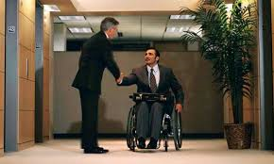

专业计划和服务
Notes:
SCRIPT
MassHire offers many specialized services and programs to assist job seekers on their pathway to employment.

Slide 7

退伍军人服务
退伍军人客户和符合条件的配偶
  我们自豪地为那些自豪地为我们的国家服务的人服务!
Notes:
SCRIPT
Veteran Services include veteran job seekers and eligible spouses who are entitled to priority of service.
Each MassHire Career Center has a Veterans’ representative on site to provide information and referrals to access other services and Benefits.

Slide 8

残障客户
客户可以自我识别
并获得个人帮助如果您有残障
安排可根据合理要求提供
Notes:
SCRIPT
If you are a person who has a disability, please know that you can self-identify, and receive individual assistance at any MassHire Career Center.
Adaptive equipment and reasonable accommodations are available upon request, along with
Referrals to relevant agencies, such as
Massachusetts Commission for the Blind; and
Massachusetts Rehabilitation Commission

Slide 9

年轻人
资格要求应用
Notes:
SCRIPT
Our young adults program which ranges from ages 14 – 24 provides work readiness workshops, financial literacy programs, Career Pathway Programs including HiSET (also known as the GED), job training and higher education.
We also work with youth for year-round and summer jobs as well as individual job search assistance and placement.

Slide 10


多语种服务
要获得翻译的出版物和文件,请拜访我们的多语言网址 :
https://www.mass.gov/orgs/office-of-multilingual-services
Notes:
SCRIPT
Should you need assistance with translation or interpretation services for multiple languages including American Sign Language, MassHire Career Centers can help.
Please contact the Multilingual Unit at 1-888-822-3422.

Slide 11


贸易调整援助 (TAA),
贸易调整津贴 (TRA)
如果您的工作已转移到海外或受到外国竞争的影响, 您可能有资格获得福利, 包括 :
  职业培训的财政援助
  现金利益
截止日期适用
Notes:
SCRIPT
If your job has been adversely affected by foreign competition or the service you provided moved overseas, you may be eligible for benefits which include financial assistance for job training and/or an extension of unemployment benefits.
Strict deadlines apply – contact your nearest MassHire Career Center to find out if you are Trade eligible.

Slide 12



全国性流离失所工人补助金(NDWGs)
全国性流离失所工人补助金
协助因意外经济事件而大规模裁员的客户.
Notes:
SCRIPT
MassHire career centers have federal grants available, such as National Dislocated Worker Grants or NDWGs.
This grant offers assistance to customers who have been affected by large scale layoffs caused by an unexpected economic event. These grants may also assist by providing funding assistance for training, career development and job placement

Slide 13

季节性农民工人(MSFWs)和农业雇主提供的服务
员工协助服务和推荐支持服务.
Notes:
SCRIPT
If you are a person who has been employed in temporary agricultural work and travels to different farms there are services available for you!
Migrant Seasonal Farm Workers or MSFWs may receive staff assistance such as job referrals and placement, skills development training and career guidance.

Slide 14
我从哪里开始？ 求职或培训
你的新工作!
评定
制定职业行动计划– 求职或/和培训?
研究目前的市场
申请工作或开始培训
Notes:
SCRIPT
Career Centers work with you in a variety of ways, including job search and training.
The first step is an assessment of your skills and experience which can help you figure out if you need to upgrade your skills through training to get a job in your desired field. Assessments answer your the job search-related questions throughout the process.
Researching the job market can help you find answers to your job search and training questions such as: do I have the skills? Are there jobs for me and what are they paying? Where are the schools located and how much does training cost? Labor market research keeps you informed about what skills are most in demand and which employers are hiring.
Together with your career counselor, you will develop a Career Action Plan. Your eligibility for training programs and other special services will be determined during this process. You can update your resume, practice interviewing skills, work on your goals and determine barriers.
The job search process and labor market research prepares you to apply for jobs or begin a training program with the ultimate goal of becoming employed.

Slide 15
评估 :
求职或培训?
评估如何帮助您找到工作或培训?
  确定优势，挑战和障碍
  确定目标和机会
  促进决策
评估实施可以衡量什么?
  知识，技能和能力 (KSAs)
  才智/能力
  工作和个人价值观
  人格特质
  职业兴趣
marketing tools
job searching
market Analysis
skill building
Training Research
Assessment
Notes:
SCRIPT
MassHire Career Centers can help you with Assessments.
Effective job search and training begins with assessment – of yourself and the job market.
Career assessments are tools that are designed to help customers understand how a variety of personal attributes (values, preferences, motivations, aptitudes and skills), impact your potential success and satisfaction with different career and training options and work environments.
What Assessments can do:
Determine if you have marketable skills or need training or enhance your skill set
Identify gaps in your skills to make an informed decision about your need for training and what the training looks like

Slide 16
市场信息：
求职或培训?
确定培训计划
找出技能差距
和工资信息
知道是什么工作
增长或下降
了解哪些工作需要证书
寻找正在感兴趣填补工作的雇主
缩小求职范围
做出明智的决定
解答你的求职
或培训途径问题
找到合适的工作
Notes:
SCRIPT
How can labor market information help me with my job search or training?
It can help answer job search or training questions such as:
Can I get a job with my current skills?
Which employers are hiring?
What are employers paying?
Where are the schools located?
How long is the training program?
How much does training cost?
Answers these questions to help you make informed decisions for your job search or training needs

Slide 17
网上求职或培训实施
为什么使用网上实施探索求职或培训?
做出更好,更明智的决策
了解如何评估您的知识,技能,能力,价值和兴趣涉及到培训和求职过程
这些网上实施可以协助评估,培训,就业和更多
www.Onetonline.org
www.masscis.intocareers.org
www.careerinfonet.org
www.torqworks.com
WorkKeys
Notes:
SCRIPT
These online tools offer many types of assessments, as well as answering questions related to jump-starting your job search, training, employment needs, and much more.
Please contact your nearest career center for detail and assistance with your job search and training questions.

Slide 18
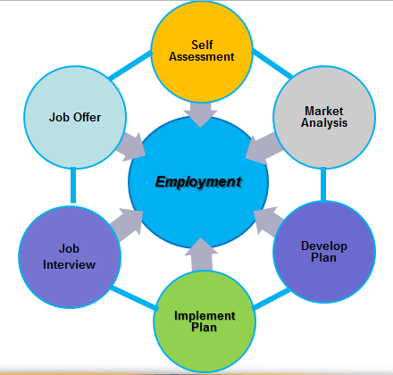
求职途径
求职过程
LMI
LMI
LMI
LMI
LMI
LMI
Notes:
Mass Hire Career centers can help demystify the job search process.
There are six major steps:
First is conducting a Self Assessment to answer some critical questions such as:
What do you want to do? What skills do you have or may be missing?
(Arrow pointing to Market Analysis)
Script: Next, take a look at the job market to understand what industries are in-demand and where are they located.
(Arrow pointing to Develop Plan)
Script: Once you obtained this information you can begin to develop a plan that includes a cover letter and a resume. Remember you want to highlight those skills so don’t be shy about your achievements!
(Arrow pointing to Implement Plan)
Script: Now it’s time to put that plan in to action! Research specific organizations you may be interested in; talk to friends, family, former coworkers and managers. You never know who knows who!
(Arrow pointing to Job Interview)
Script: Implementing your plan, prepares you for the job interview. It’s important to dress appropriately, practice in the mirror or with someone on how to answer common questions and don’t forget to follow up with thank you notes!
(Arrow pointing to Job Offer)
Script: By gathering research, understanding the job market, developing and implementing a plan, and being prepared for the job interview will likely lead to a job offer where you may want to negotiate salary.
These steps often don’t occur in this specific order and may have to be repeated a few times. Just keep in mind the ultimate goal is Employment.

Slide 19

训练途径
自我评估
完成培训或
认证计划
目前市场信息
雇用
制定职业行动计划
设定培训目标
Notes:
SCRIPT
Deciding if you need training is a process, and MassHire Career Centers can help. These steps can help you make informed decisions about if you need training or certification to become reemployed.
Self-assessment:
Helps you determine your strengths and weaknesses
Helps you to create a plan to meet your training and employment goals; and
Helps you determine what is possible and to set realistic goals
Labor Market Information:
What skills are needed for today‘s changing job market?
What types of jobs are available once I complete training?
Can I afford training or do I need to work while attending a training program?
Setting Goals:
Setting goals is important to give you direction to get to your desired employment
Goals help you prioritize, plan, and get organized
Developing a Career Action Plan:
Once you complete self-assessments, research the labor market, and set goals, you are ready to develop a career action plan.
Your plan may include training options, skills that you want to develop, or the types of jobs that you want to apply for after training.
Once you have successfully completed your training program, you are ready for the ultimate goal of your career action plan using your newly acquired knowledge and skills to get the job that you want!

Slide 20
工作的学习
注册学徒
传统 (建筑施工与基于技能的工作)
非传统 (技术,工厂职位和医疗保健)
在职培训(OJT)
定制设计培训
退伍军人福利
Notes:
SCRIPT
Work-based learning are models that provide the opportunity to learn while you earn, and include, Registered Apprenticeships and On-the-Job Training (OJT)
Benefits of a Registered Apprenticeship include:
Being hired as permanent, full-time employee, including wages and benefits
Attending part-time , classroom training (4-5 weeks); and
Mentored training while on the job
Similar, is the OJT Program that enables employers to hire new employees and train them at their place of business. These benefits include:
Being hired as permanent, full-time employee, including wages and benefits
A training program created based on the job description and any missing skills; and
Job coaching during the period of training
Call your local career center to speak with a career counselor for additional details regarding work-based learning.

Slide 21
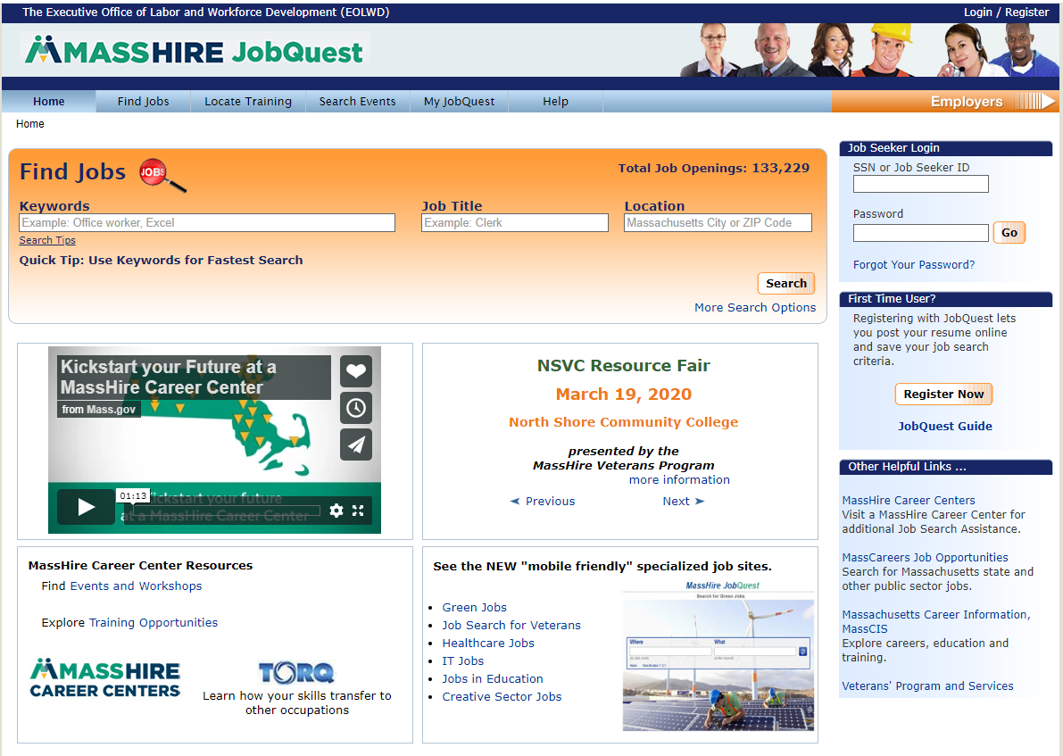
MassHire JobQuest 求职
搜索：
职位
培训学校
活动
进入:
我的 Job Quest
登录
第一次使用者
注册
活动公告榜
www.mass.gov/jobquest
Notes:
SCRIPT
JobQuest is Massahusetts’ online database of job openings, and available job training programs with information on schools, cost and location. You can also learn about MassHire events where you might have the opportunity to network and meet with employers.
You’ll create a JobQuest profile which allows you to upload your resume, and job match based on your skill set.

Slide 22
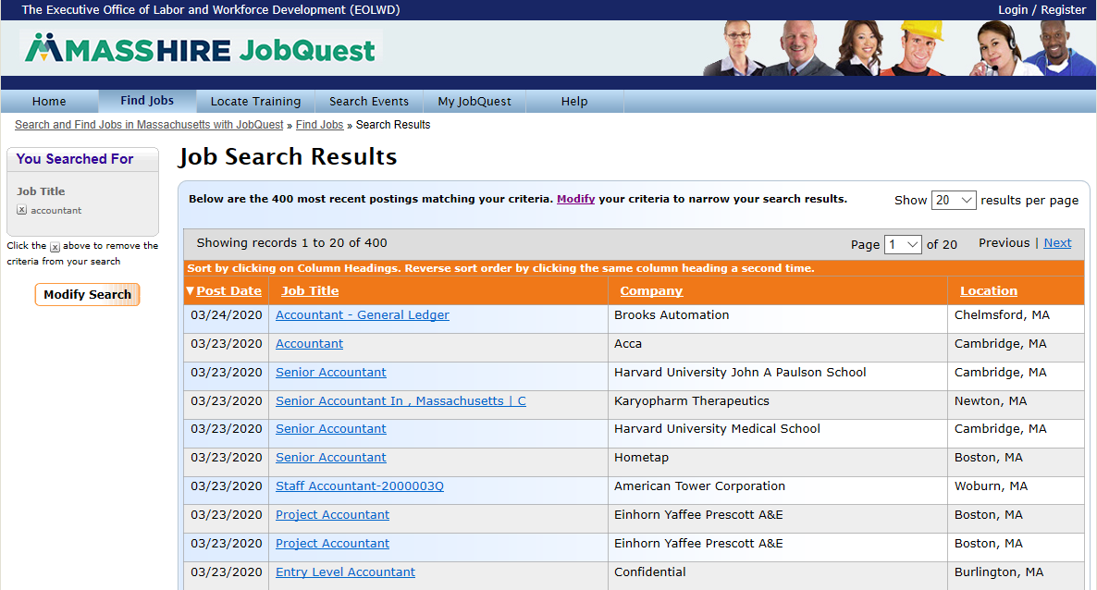
JobQuest – 职位匹配
22
Notes:
SCRIPT
Job matching can help focus your job search by matching your skills to many jobs that have been posted by employers
JobQuest can also
Find training and certification programs; and
Locate employment related events all over the state; and
Link to Labor market information tools such as TORQ

Slide 23
讨论活动的会议
评估
识别技能
WorkKeys
TORQ
Myers-Briggs Type Indicator
简历
创建, 修改简历
求职信
网上申请
联网
网络连接
LinkedIn
求职
安排你的求职
申请人追踪系统
创建你的自我营销策
成熟工人
面试
杰出面试
电话面试
工资谈判
Notes:
SCRIPT
Workshops
Participate in our workshops to assist in making informed decisions about your Career Path
Take a look at your interests, skills and abilities and assess your next step
Questions that attending Masshire career center workshops can answer:
How can I update my resume?
What are my skills?
What are my transferrable skills?
Do I need training or certification to get a job?

Slide 24

讨论活动的会议
财政知识
个人预算
储蓄计划
信用,债务
财务决策
身份盗窃
基本技能培训
技能准备
工作准备技能
个人内在社交技能
这些培训是针对再入学的，
TANF /公共援助，以及长期失业的人
Notes:
SCRIPT
These Additional Workshops can help jobseekers with specialized topics needed to get into the workforce.

Slide 25

培训机会计划(TOP)
Section 30
    在经过批准的培训中，您可能有资格获得最多26周的失业金
    参加经批准的全日制培训时，您的工作搜索要求可能会被免除
    在领取第20周福利,提交申请表给失业援助部
    了解更多信息 :
      请参阅您的UIOnline申请人收件箱请求TOP申请; 或者
      联系您当地的职业中心;或者
      联系TOP部门 : (617)-626-5521或者http://www.mass.gov/dua/top
Notes:
Script:
The Training Opportunities Program (TOP, for short) allows you to collect unemployment benefits while you attend full-time training for new job skills. If you qualify,
All remaining info on the slide and voice over does not change except for this addition at the beginning

Slide 26
失业金
失业金 (UI)提供暂时的部分工资.
  您必须能够, 准备好并积极找工作当领取失业金时
有关失业保险的问题，请联系失业保险部 :
致电访问下面的网站 877-626-6800或拜访下面的网站.
拜访 mass.gov/dua
Notes:
SCRIPT
MassHire helps to make sure you are meeting your unemployment benefit requirements.
For questions about Unemployment Insurance, contact the Department of Insurance at 877-626-6800 or visit mass.gov/dua.

Slide 27
再就业服务和资格评估(RESEA)
RESEA 是联邦补助计划为接受失业金的客户筹备.
如果您被选为RESEA计划的成员，请密切注意DUA通知信，其中包含重要信息和截止日期.
这RESEA通知将被发送到 :
您的UIOnline收件箱; 和
美国邮件
你必须采取行动
并在信函中规定的截止日期之前答复.
如果您有任何问题或疑虑，请联系您当地的MassHire职业中心.
27
Notes:
Script is the slide.

Slide 28
问题?
联系您当地的MassHire职业中心
https://www.mass.gov/how-to/find-a-masshire-career-center
Notes:
SCRIPT
These are some of the many resources and job search guidance that MassHire has to offer. We look forward to assisting you at a MassHire career center near you!
If you have any questions regarding your job search, training or next steps, please use the link on the screen to contact your local career center.

