Slide 1
COVID-19 Disaster Recovery NDWG – OJT Operational Guidance Training
February 1, 2022

Slide 2
Today’s webinar training will be recorded.
Please use the chat box to introduce yourself.
Please use the chat box to ask a question.
Remember to mute your computers and phones to minimize background noise.
Local area technical assistance is available if you feel a “deeper dive” into this information would be beneficial mscibelli@masshirehcwb.com

Slide 3
Presenter’s
Melissa Scibelli
Director of Workforce Development Programs
MassHire Hampden County Workforce Board
Andrea Kingman
Business Services Manager
MassHire Greater Brockton Career Center

Slide 4
COVID-19 NDWG Project/Grant Overview
Grant Partners:
Grantee: EOLWD/MassHire Department of Career Services/Primary Operator: MassHire Hampden County Workforce Board/Other Partners: MassHire Career Centers (16 total across MA)
The MassHire Hampden County Workforce Board (MHHCWB) has been identified as the statewide operator for this project. Funds for Career Services will be accessible through the NDWG Vouchering model. In this model, $2,400 per-Eligible enrollee is available to be accessed by local WIOA Fiscal Agents for the provision of Career Services. Period of Performance: April 10, 2020 – March 31, 2022 (applying for NCE through 2023).
MASTER AGREEMENT
Executed between the MassHire Hampden County Workforce Board, Inc. and all 16 local area WIOA Fiscal Agents. Master Agreement Consists of:
Work Statement:
Scope of Work-Roles and Responsibilities
Participant Eligibility and Enrollment Criteria
Training and Support Services procedures
Vouchering Procedures
SPoC Designation

Slide 5
Overview of Training Topics
OJT Model Overview and Benefits
Eligibility: Employer and Employee
OJT Process: Working with the Employer and Customer
OJT Documents/Paperwork Review
MOSES Data Entry (guidance slides in separate packet)
Technical Assistance/Resources

Slide 6
Workforce Trends - Opportunities for OJT’s
Reinvention – disruptive change creating opportunities for job seekers and employers
50% of all employees will need reskilling by 2025, as adoption of technology increases, according to the World Economic Forum's Future of Jobs Report
Newly emerging this year are skills in self-management such as active learning, resilience, stress tolerance and flexibility
Respondents to the Future of Jobs Survey estimate that around 40% of workers will require reskilling of six months or less
World Economic Forum
https://www.weforum.org/agenda/2020/10/top-10-work-skills-of-tomorrow-how-long-it-takes-to-learn-them/

Slide 7
On-the-Job Training (OJT) Background
On-the-Job Training (OJT) provides WIOA eligible participants occupational skills and training essential to the performance of a specific job. OJT is an “earn and learn” employment model where participants may upgrade, retool, and increase employability skills. OJT addresses local employers’ workforce needs, enhances the skills of the participants and aids employers in attaining qualified, skilled workforce with the competencies that are needed.

Slide 8
On-the-Job (OJT) Training
Earn While You Learn Model
Hands on training that the employer designs
A payment to offset training costs
An opportunity to train employees and provide knowledge or skills essential to the full and adequate performance of a job
An investment in the company and the employee
An opportunity to train an individual to learn new skills (COVID-19 impact on jobs)

Slide 9
How Does It Work?
Qualified (eligible) applicants are matched with approved job openings with eligible employers
A training plan is developed that meets the needs of the employer and participant
A contract is developed and executed
The employer gets reimbursed for the costs of training during the OJT period (formula is based on the hourly pay of the OJT employee)
It is often used to learn how to use particular tools or equipment in a live-work practice, simulated, or training environment.

Slide 10
Eligible Participant(s) (Specific to COVID-19 DWG)
To be eligible to participate in the MA Disaster COVID-19 DWG project,
individuals must meet all of the following eligibility requirements:
WIOA Title I Eligibility including:
•A citizen or national of the United States, lawfully admitted permanent resident alien, refugee, asylee, parolee, or other immigrant authorized by the Attorney General to work in the United States.
•In compliance with the Military Selective Service Act. (WIOA Sec. 189(h)). (This applies to males 18 or older who were born on or after January 1, 1960).
COVID-19 NDWG Eligibility (one must apply):
Temporarily or permanently laid off as a consequence of the COVID-19 pandemic;
A dislocated worker as defined at 29 U.S.C. 3102(3)(15);
A long-term unemployed worker; or (27 weeks or more during prior 24 months)
A self-employed individual who became unemployed or significantly underemployed as a result of the COVID-19 pandemic.
Veterans’ preference applies within these eligible groups.

Slide 11
OJT Provisions
MassWorkforce WIOA OJT (On the Job Training) policy issuances – Documents located here
https://www.mass.gov/service-details/massworkforce-wioa-ojt-on-the-job-training-policy-issuances
On-the-Job (OJT) Wage Caps and Reimbursement Rate Waivers for Job Driven, Dislocated Worker Training, and Sector Partnership National Emergency Grants(NEGs)
https://www.mass.gov/doc/on-the-job-ojt-wage-caps-and-reimbursement-rate-waivers-for-job-driven-dislocated-worker
Eligibility (Funding source specific)
Reimbursement: 50% unless Local Workforce Development Board has established criteria to reimburse up to 75% of wages
Max contract hours: 1040
Must be a full-time and permanent position and new employee
Employer Eligibility: EEC checklist and Confirm that this employer is compliant with DUA taxes (email leslie.seifried@state.ma.us) and Certificate of Good Standing

Slide 12
On the Job Training (OJT) Process “Guidance”
☐Step 1: Meet with the Employer – Employer Eligibility Checklist / DUA Compliance
☐Step 2: DRAFT of the OJT Training Plan
☐Step 3: Identify OJT Participant(s)
☐Step 4: OJT Pre-Contract
☐Step 5: OJT Contract and OJT Training Plan Design / Certificate of Good Standing
☐Step 6: OJT Contract Start-Up
☐Step 7: Invoice and Progress Report
☐Step 8: Monitoring
☐Step 9: Follow Up

Slide 13
Marketing to Employers
Discussing OJT benefits during company meeting
Ability to train new hire without specific skill sets (skill gap); can give company opportunity to gain a larger pool of eligible applicants
Reimbursement assists in making up for loss productivity for training
Training plan is a useful tool for new hire; benefit by company organizing and creating schedule for new hire to keep on track
Relatively low extra work for company; career center handles most of paperwork
Great way to build workforce
New hire training is always needed no matter the position; going to hire someone anyway why not utilize the OJT, even for 4 weeks?

Slide 14
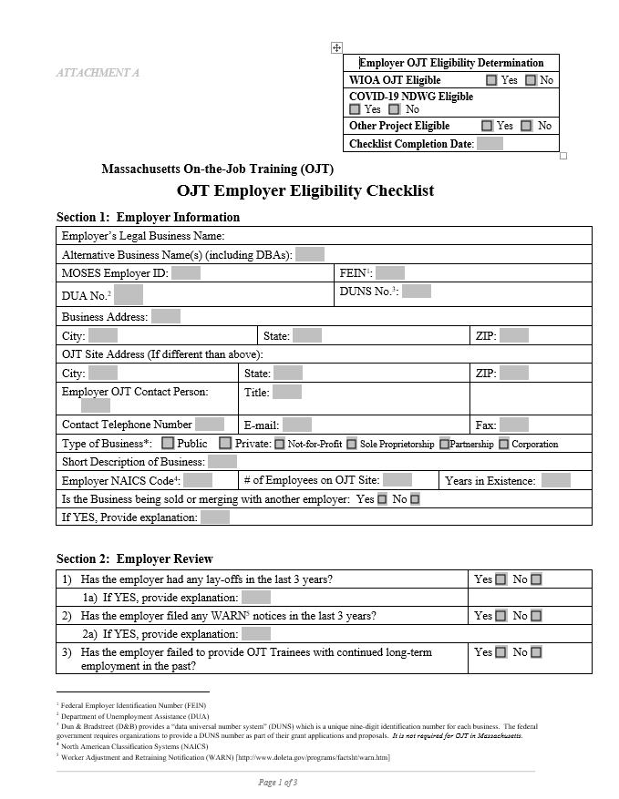
Employer Eligibility Checklist

Slide 15
DUA Compliance Verification (submit with EEC)
Email to Leslie
Dear Leslie (leslie.seifried@state.ma.us)
Please check the DUA Status of the following company:
Company FEIN#
Street
City, State, ZIP
Thank you,
[Your name]
When Leslie receives a response she will respond to your request via email.
Requests made by 3pm will typically have a response within 48 business hours. The response will indicate whether the Employer is “compliant”, or “out of compliance” with the designated program (no information about the nature of the non-compliance will be shared).
Leslie’s email response will be forwarded to the primary operator MHHCWB with the EEC form.

Slide 16
Certificate of Good Standing
Request from Employer at the time of EEC Completion.
Employer must provide a Certificate of Good Standing dated within the last 3 months
Submit a copy with the OJT Contract to MHHCWB

Slide 17
OJT Training Plan… What’s that?
Training Plan
Utilized for OJT Matching process
Identify potential OJT candidates skill gaps
Connection to OJT Contract & Monthly Progress Report
Training Plan is embedded into the OJT Contract and Monthly Progress Report
Resources:
https://www.onetonline.org/
MHHCWB (mscibelli@masshirehcwb.com) for examples

Slide 18
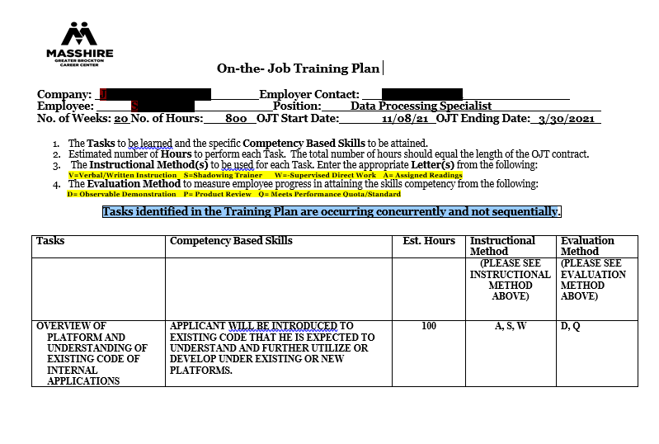
Training Plan Example

Slide 19
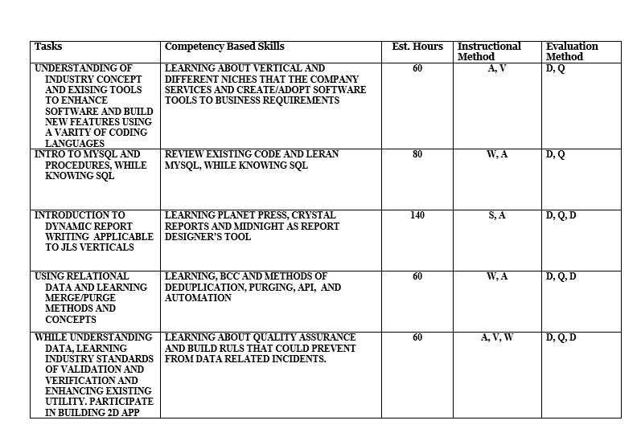
Training Plan Example

Slide 20
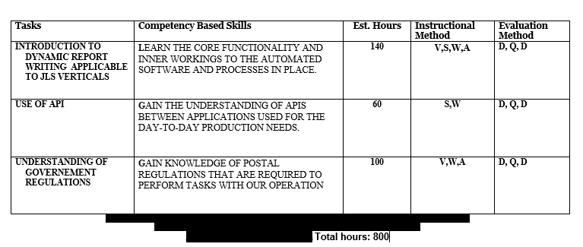
Training Plan Example

Slide 21
Identify Eligible OJT Participant(s)
Referral Options and Eligibility
The participant must meet eligibility criteria for the COVID-19 NDWG. The DRAFT OJT training plan will guide the match process based on competencies outlined for the OJT position.
Internal and Reverse Referrals
Career Center Staff
WIOA Title I , VET, TRADE, NDWG and other potential customers
Search applicant pool for potential OJT candidates
Employers – Reverse referrals

Slide 22
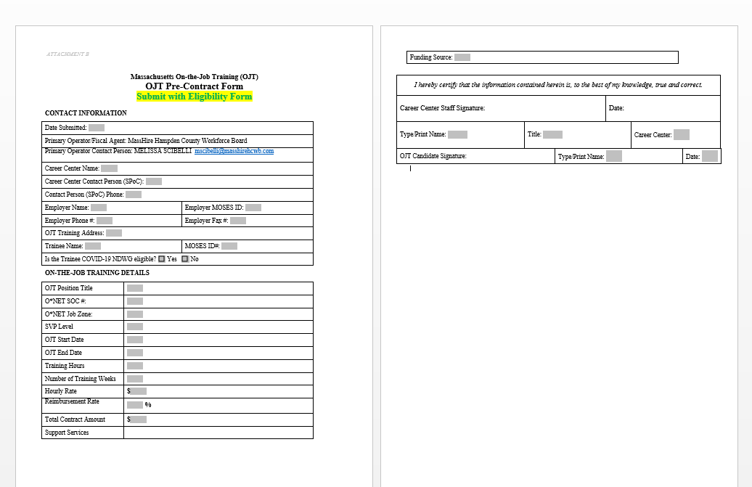
OJT Pre-Contract Form

Slide 23
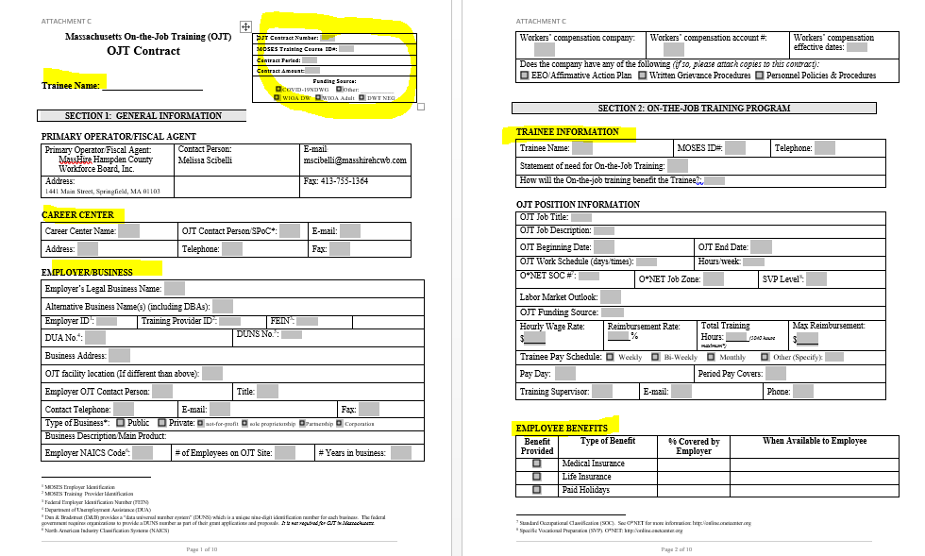
OJT Contract Template

Slide 24
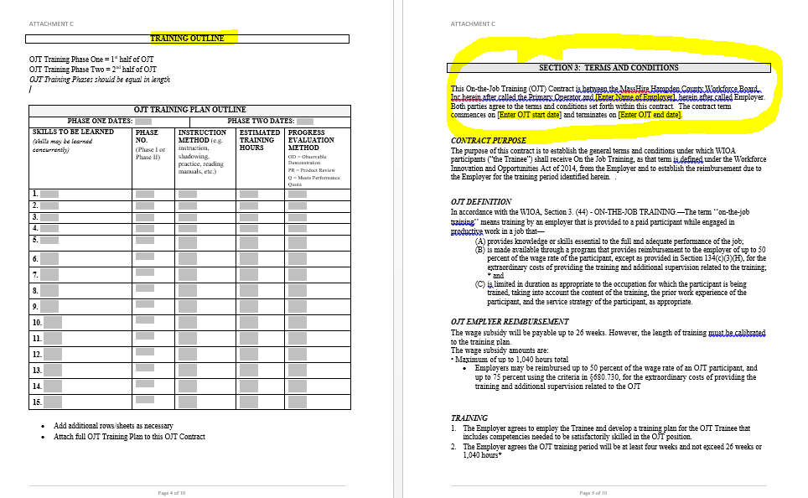
OJT Contract Template

Slide 25
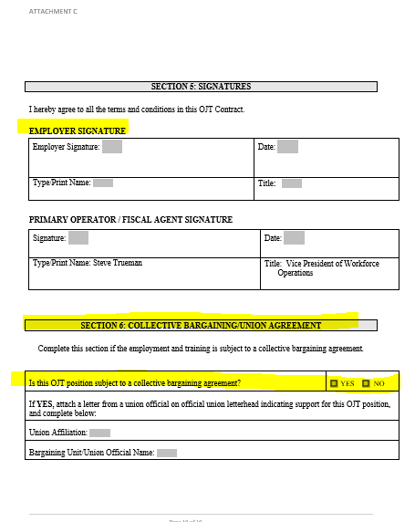
OJT Contract Template

Slide 26
Contract Execution
SPoC prepares OJT Contract and completes all applicable information
SPoC gets the employers’ signatory name and email address
SPoC sends contract and signatory information to MHHCWB for OJT Contract Review, Approval & Signature Execution Process:
MHHCWB will:
Review and Approve
Send to Employer for e-signature
Send a fully executed copy to SPoC

Slide 27
Contract Start-Up
At time of contract signing or prior to; the SPoC reviews the following with employer:
Invoicing Process
Monthly Progress Report
Local Monitoring and Primary Operator Monitoring

Slide 28
Invoice and Progress Report
Invoice – Monthly Process
The Employer submits Invoice with backup documentation to SPOC with the OJT Monthly Progress Report – signatures must be on both
The SPoC verifies for accuracy and gets official signature
The SPoC submits to MHHCWB and will process payment directly to the employer within 30-days of receipt of the invoice
*See OJT invoice template and monthly progress report template forms in Policy attachments

Slide 29
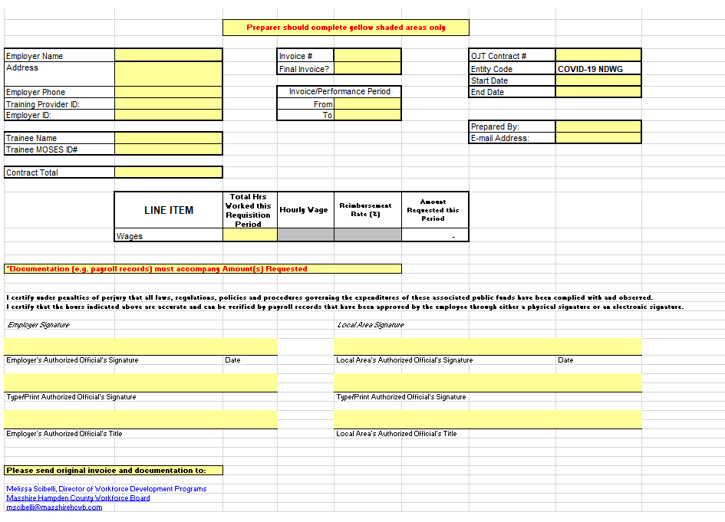
Employer Invoice Template

Slide 30
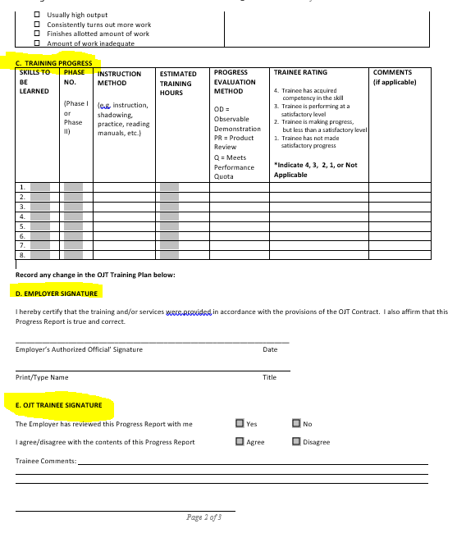
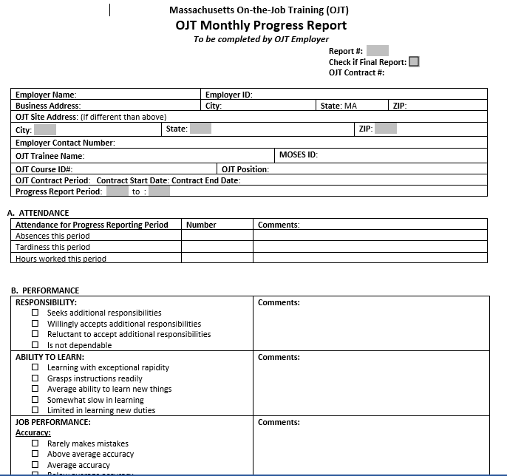
Monthly Progress Report

Slide 31
MOSES Guidance
MOSES Guide is available to address data entry and Course and Training Provider information
See Primary Operator OJT MOSES Guidance Review Packet

Slide 32
OJT Worksite Monitoring
MassHire staff will monitor OJT at least once in person or virtually. A monitoring form is included in the policy
Primary Operator will also conduct 1 monitoring during the OJT contract time period (can be done in conjunction with local area monitoring)
*See OJT monitoring form template in Policy attachments

Slide 33
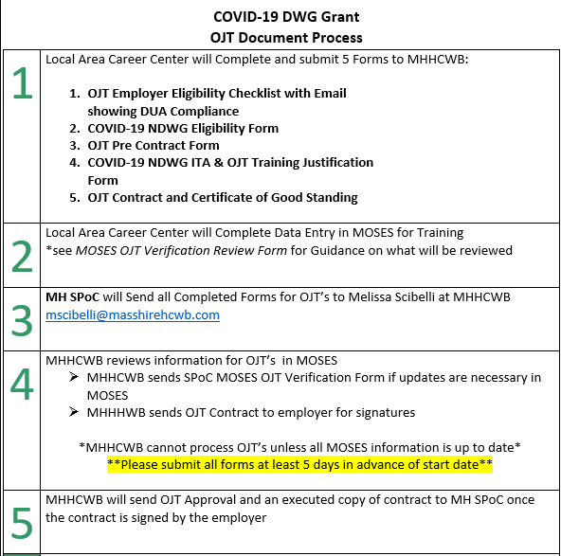
MHHCWB Statewide OJT Document Process

Slide 34
Resources
Commonwealth of MA Website
https://www.mass.gov/on-the-job-training-ojt
U.S. Department of Labor
https://www.dol.gov/general/topic/training
The Balance Careers - article
https://www.thebalancecareers.com/how-on-the-job-training-brings-you-value-1917941
O*NET OnLine
https://www.onetonline.org/

Slide 35
Contact Information:
Melissa Scibelli
Director of Workforce Development Programs
MassHire Hampden County Workforce Board
mscibelli@masshirehcwb.com
Andrea Kingman
Business Services Manager
MassHire Greater Brockton Career Center
akingman@masshiregbcc.org

Slide 36
Additional Questions or Comments?

