Slide 1

Trade Readjustment Allowance (TRA)
Reversion 2021
Department of Unemployment Assistance
DUA/DSC Integration Unit 2021

Slide 2
Trade Readjustment Allowances
Trade Readjustment Allowance (TRA) under the Trade Act of 1974 (as amended by the Trade Adjustment Assistance Reauthorization Act of 2015 (TAARA 2015)), and the Trade Adjustment Assistance for Workers Reversion 2021 are federal funds appropriated by Congress.
The Department of Labor (DOL) allots appropriated funds to The Department of Unemployment Assistance (DUA) – TRA Unit for the administrating the Trade Readjustment Allowance (TRA) benefits.
TRA provides financial support to eligible participants while enrolled in or participating in training or conducting work search. TRA is not available until all eligibility for unemployment insurance (UI) benefits and applicable extensions are exhausted.

Slide 3
Background
Section 406 of TAARA 2015 included “reversion” and “sunset” provisions;
These materials only address reversion;
On July 1, 2021, TAA for Workers will revert to a modified version of the 2002 Program;
Program will be known as “Reversion 2021”
The TAA Program does not expire on July 1, 2021
TEGL 24-20 is the Operational Guidance for Reversion 2021
20 CFR 618 applies unless impacted by Reversion 2021

Slide 4
Trade Readjustment Allowances
There are three types of TRA:
Basic TRA
Payable if the participant is either enrolled in TAA approved training, has obtained
a waiver of the training requirement or has completed their TAA approved
training.
Additional TRA
After basic TRA has been exhausted, workers who are enrolled in a TAA-approved training program are eligible for an additional 65 weeks of income support, within a 78-week eligibility period.
Completion TRA
Payable only if the participant is attending TAA approved training, has exhausted
all rights to Additional TRA and has met specific training benchmarks. Completion
TRA cannot be paid for any week the participant isn’t attending training or not
within the 20th week of completing their TAA approved training.

Slide 5
Qualifying Requirements for Trade (TAA)
To be eligible for TAA benefits, an adversely affected worker must meet all the following requirements:
Petition numbers For Reversion 2021 will begin with 98000. The petition number corresponds with the law governing the TAA Program.
Certification - Must be an adversely affected worker covered by a certification and be laid off because of lack of work.
Dates are determined by Department of Labor (DOL) and will be listed on the certification
Separation – Must have a qualifying layoff. The first qualifying layoff must have occurred on or after the impact date of the certification; and on or before the expiration date of the certification.
.
Notes:
NOTE: Eligibility for TAA and TRA are not the same. There is no earnings requirement for general TAA eligibility (training, employment and case management services, job search, relocation, etc.).
Note: Customers are provided a written determination of their eligibility for TAA services and deadline date to be in approve TAA training or have received an approved waiver from training.

Slide 6
Qualifying Requirements for Trade (TAA)
Apply to participate in the Trade program. One 1666 form per certification i.e., petition number.
Nightly, UIO will received a file of individual Applications to Participate in the Trade Adjustment Assistance (TAA) Program Form 1666 from MOSES.
TRA staff will determine if an individual is eligible for TAA services.
The TAA Form 1666 determination will be either uploaded to the individuals UIO Inbox or sent by U.S. Mail.

Slide 7
Notification
Electronic Notification
If the claimant chooses "electronic" as their preferred correspondence method, they will receive an email from the agency alerting they have important, time sensitive correspondence.
U.S. Mail
If the claimant chooses “U.S. Mail” as their preferred correspondence method, their determination will be mail. Determination is uploaded to the claimant’s UIO Inbox.
It is important they check their UIO Inbox daily and do not discard any correspondence they receive from the agency.
It is important they read their determination as it has the TRA deadline date and the 210-day deadline date.

Slide 8
Qualifying Requirements for Basic TRA
Basic” TRA benefits are determined based on an individual’s initial separation from the Trade-certified company (i.e., their first qualifying separation after the company’s impact date).
Wages and employment - Must have had at least 26 weeks of employment with the certified employer at wages of at least $30 or more per week during the 52-week period ending with the week of their first qualifying separation, or any subsequent qualifying layoff under the same certification.
Entitlement to UI - Must be monetarily eligible for unemployment insurance (UI) benefits at the time of the first qualifying layoff, on or after the impact date;
Exhaustion of UI - Must have exhausted all rights to unemployment insurance benefits or federal extensions. BYE of the current claim can not be expired;
The weekly Basic TRA payment begins the week after a worker’s UC eligibility expires.

Slide 9
Qualifying Requirements for Basic TRA
Must meet the 8/16-week eligibility deadline;
Must be enrolled in or participating in TAA approved training or have received a waiver from the TAA training requirements (only Basic TRA) or have the deadline extended due to extenuating circumstances by the enrollment in training deadline.
8 weeks from the date of the certification; OR 16 weeks from the customer’s most
recent total separation from adversely affected employment.
Basic TRA can not be paid if customer has a break in training of 30 days or more (excludes weekends and holidays);
The total amount of Basic TRA benefits available to a worker is equal to 52 times the weekly TRA benefit minus the total amount of UC benefits and Federal Extensions.
For example, assuming a, a worker who received 30 weeks of UC benefits would be eligible for 22 weeks of basic TRA.
TRA can only be requested through UI Online weekly.

Slide 10
Qualifying Requirements for Basic TRA
Workers must be enrolled or participating in TAA-approved training, have completed such training, or have obtained a waiver from the training requirement.
Can continue to collect Basic TRA after training ends as long as the customer is conducting an active work search. Must meet stricter work search requirements (EB work test) to receive Basic TRA, accept suitable work, actively seek work, be referred to suitable work (for Basic TRA Only).
Duration of Basic TRA: Participants may use Basic TRA during the 104-week eligibility period following layoff from adversely affected employment.
If participants return to the Trade-affected employer and are subsequently laid off, their 104-week eligibility period starts over.
After the 104-week Basic Eligibility period, participants are no longer able to receive any remaining Basic TRA.

Slide 11
Qualifying Requirements for Additional TRA
Eligibility deadlines for “Additional” TRA benefits
To be eligible for Additional TRA, a worker must make a bona fide application for training within 210 days of the later of the worker’s
Most recent qualifying separation or
The first certification of eligibility to apply for adjustment assistance that covers the workers.
When an individual’s 1666 is approved, UIO will automatically display the link to Apply for TRA Benefits on their Home Page.
The claimant should not delay in applying for TRA. Delays can result with missing the deadline date and not receiving “Additional” TRA.
Once the application has been submitted, UIO will store the submittal date and send it over to update the MOSES Trade Application Details TRA screen.

Slide 12
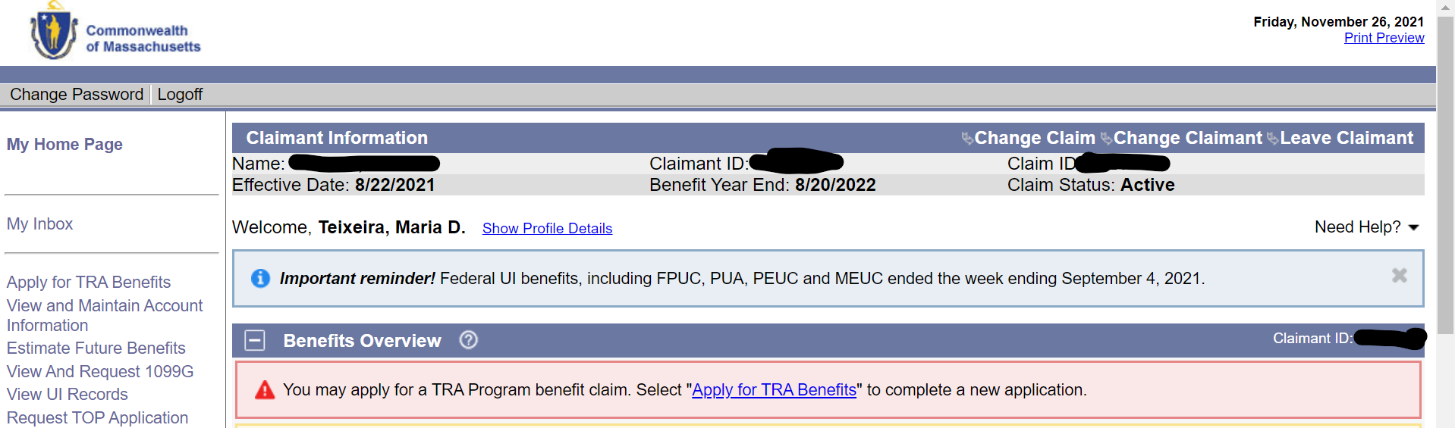
Qualifying Requirements for Additional TRA
When the claimant signs into UIO, their Home Page will display the link to Apply for TRA Benefits. The link can be found under Benefits Overview and on the left side of the claim.

Slide 13
Qualifying Requirements for Additional TRA
Additional TRA is limited to workers who are enrolled in a training program;
Workers who have received a training waiver are not eligible for additional TRA.
TAA participants may only collect additional TRA so long as they remain enrolled in
a qualified training program.
Benchmarks are up to date
No Additional TRA can be paid during breaks in training longer than 30 days, or breaks during transition from remedial to vocational training
Unlike “Basic” TRA, no “Additional” TRA benefits can not be paid beyond the completion of the approved TAA Training Program

Slide 14
Qualifying Requirements for Additional TRA
Or after the 78-week eligibility period has ended even if there is a remaining balance of benefits
This 78-week eligibility period follows the last week of entitlement to Basic TRA or begins with the first week of TAA-approved training.
Benchmarks: The purpose of training benchmarks is to allow early and ongoing assessment of the performance of a training participant to determine whether the original training program is a good fit.
Benchmarks also function as a protection of the appropriate expenditure of TAA Program funds.

Slide 15
Completion TRA
“Completion” TRA benefits are available to individuals who have exhausted all “Basic” & “Additional” TRA, including federal extensions, are still attending TAA approved training.
provides participants with up to 13 additional weeks of income support while in full time training
must be applied for via UIO within the last 20 weeks of training
Conditions of Completion TRA:
The requested weeks are necessary for the customer to complete a training program that leads to a degree or industry recognized credential; AND
The customer is participating in full time training each week; AND
The customer has met the performance benchmarks established in the approved training plan; AND
The customer is expected to continue to make progress toward the completion of the approved training; AND
Complete the training during the period authorized for receipt of Completion TRA.

Slide 16
Completion TRA Eligibility Period
While there are 13 weeks of Completion TRA payable to eligible TAA participants, these 13 weeks can only be collected if the customer will complete the training* and is within the last 20 weeks of training. The 13 weeks are payable anytime during the 20-week period.
*Just Cause can be approved to extend the 20-week period
This 20-week time frame will begin with the first week in which a TAA participant files a claim for Completion TRA and not automatically at the end of Additional TRA.
If a participant has exhausted all other UI and TRA benefits but will not be able to complete approved training within the allowable 20-week period, none of the 13 weeks of Completion TRA are able to be paid.
Completion TRA benefits cannot be paid during scheduled school breaks greater than 30 days.
Completion TRA benefits cannot be paid beyond the completion of the approved TAA Training Program.
Completion TRA benefits cannot be paid beyond the 20-week time frame -

Slide 17
Breaks in training
Eligibility for Basic and Additional TRA continues during scheduled breaks in training, but only if a scheduled break is no longer than 30 days (not counting weekends and holidays, unless these are included on the academic schedule) and all of the following additional conditions are met:
1. Participant were in TAA-approved training immediately before the beginning of the break,
2. The break is pre-approved in the published academic schedule, or the previously established schedule of training issued by the training provider, or is indicated in the training program approved for participants; and
3. Participants resume training immediately after break
The break begins on the day following the last day of scheduled training and up to the last day of the break preceding the next scheduled day of training. Weekend days are not counted unless they are normally scheduled for training. Official state and federal holidays are also not counted.

Slide 18
Summary: Maximum TRA Under TAARA 2015
UI/Basic TRA (30 weeks of UI + 22 weeks of TRA) = 52 weeks
Additional TRA (if in training) = 65 weeks max
(within the 78-week eligibility period) Note: Once training ends, Additional ends.
_______________________________________________________________
Maximum of = 117 weeks
_______________________________________________________________
Completion TRA
(If benchmarks and other criteria are met, payable within the last 20 weeks of training)
= 13 weeks max
_____________________________________________________
Maximum of = 130 weeks

Slide 19
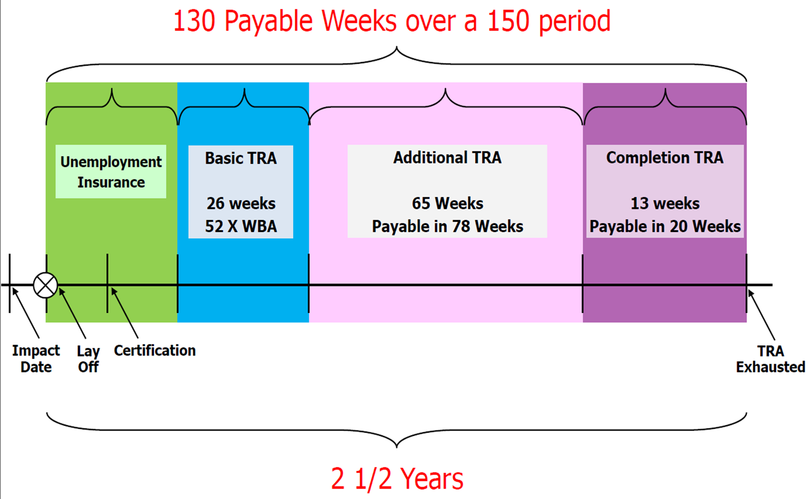
TAARA 2015 Program Benefits: TRA Timeline

Slide 20
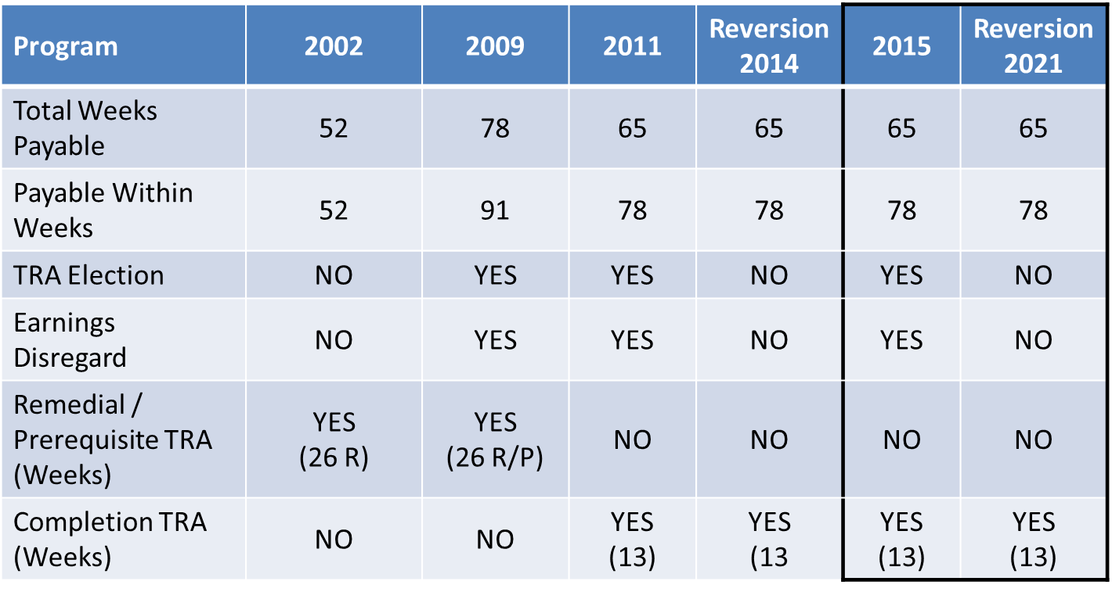

Additional TRA Matrix

Slide 21
Earnings Disregard & Election Provisions
No Earnings Exclusion
Workers employed while in training will no longer be allowed to earn wages without an impact on their TRA Weekly Benefit Amount (WBA).
Any wages earned weekly above their UI earnings exclusion amount during the benefit year are deducted dollar for dollar from their WBA.
Claimant’s must report total gross earnings on their weekly certification.
The claimant’s earnings exclusion $ amt can be found on the initial UI Monetary Determination they received.

Slide 22
Earnings Disregard & Election Provision
Earnings Over the Benefit Rate (EOBR)
Partial income reported during the weekly benefit certification by the claimant that is over the benefit rate plus earnings disregard.
The claimant is required to report all wages.
Benefits will not be paid if the reported wage is greater than the WBA.
Election between TRA and UI
If they qualify for subsequent UI claim, TAA participants will no longer be allowed to elect to receive TRA instead of the new UI claim filed.
Claimant must exhaust the new UI claim before they return to the TRA claim.

Slide 23

THANK YOU

