Slide 1

Trade Adjustment Assistance Program Reversion 2021
Charlie Baker, Governor Karyn Polito, Lieutenant Governor Rosalin Acosta, Secretary Alice Sweeney, Director, MassHire DCS
MassHire Program & Services are funded in part by US Department of Labor (USDOL) Employment and Training Administration grants as well as non-federal funded grants

Slide 2

Trade’s Purpose
The TAA Program has and will continue to help customers who have lost their jobs as a result of foreign trade to quickly rejoin the workforce by providing them with the means to attain competitive and marketable skills for today’s increasingly competitive work environment.
Notes:
Mention that despite the multiple amendments, the purpose of the program has remains the same.

Slide 3
Some History…
The Trade Expansion Act of 1962 first implemented the Trade Readjustment Allowance program. Training benefits were not available with this Act.
The Trade Act of 1974 establishes training benefits for workers affected by Trade. This act has been amended several times.

Slide 4

Amendments
After the Trade Act of 1974, there were several Amendments
It was amended in 2002 through the Trade Adjustment Assistance Reform Act of 2002.
In 2009 it was amended through the Trade and Globalization Adjustment Assistance Act of 2009.
In 2011 it was amended through the Trade Adjustment Assistance Extension Act of 2011 (TAAEA expired on December 31, 2013. Reversion 2014 took place until a new Act was signed into law)
On June 29, 2015, the Trade Adjustment Assistance Reauthorization Act of 2015 was signed into law (TAARA 2015 covers petitions approved on or after Jan 1, 2014)

Slide 5
Reversion 2021
TAARA 2015 established sunset provisions called “Reversion 2021” to begin July 1, 2021 and expire June 30, 2022.
Any new petitions filed on or after July 1, 2021 will start with 98,000 and will fall under Reversion 2021 requirements.

Slide 6
Petitions v. Rules to Follow
2002 Act applies to… | Customers who are covered by petitions filed before May 18, 2009. Petition numbers are 69,999 and lower and customers who are covered by petitions filed on or after February 15, 2011. Petition numbers 80,000 through 80,999
2009 Act applies to… | Customers who are covered by petitions filed on or after May 18, 2009. Petition numbers are 70,000 through 79,999
2011 Act applies to… | Customers who are covered by petitions filed on or after October 21, 2011. Petition numbers 81,000 through 84,999
2015 Act applies to… | Customers who are covered by petitions filed on or after January 1, 2014. Petition numbers are 85,000 and higher
Notes:
Stress that it is important to know both the 2002 Act and the 2009 Act as we will be providing benefits under two different sets of rules for customers covered by petitions filed before AND on or after May 18, 2009.
Mention that we are now going to go over some of the major differences between the two Acts. For current counselors, this will highlight the changes. For new counselors, this will give an overview of the services under the Trade program.

Slide 7
Petitions v. Rules to Follow
Reversion 2021 applies to… | Customers who are covered by petitions filed on or after July 1, 2021. Petition numbers are 98,000 and higher
Notes:
Stress that it is important to know both the 2002 Act and the 2009 Act as we will be providing benefits under two different sets of rules for customers covered by petitions filed before AND on or after May 18, 2009.
Mention that we are now going to go over some of the major differences between the two Acts. For current counselors, this will highlight the changes. For new counselors, this will give an overview of the services under the Trade program.

Slide 8
Key Changes of Reversion 2021
Deadline - Training must be approved by the latter of 8 weeks from date of petition certification; or 16 weeks from worker’s most recent total separation
Affected Workers - Workers responsible for manufacturing. Service sector workers no longer covered. (still file for a 1666 in case service sector workers are later found eligible)
Incumbent worker training - Adversely affected incumbent workers are not eligible for TAA benefits and services (workers must be fully separated)

Slide 9
Key Changes of Reversion 2021
Federal Good Cause – no longer available, but states may apply Equitable Tolling of deadlines to extend deadlines in egregious circumstances. (In order to apply for Equitable Tolling, one must have an approved Extenuating Circumstances extension)
Justifiable Cause – No longer available. Can no longer extend the period in which TRA can be paid
Health Coverage Tax Credit (HCTC) – Expires December 31, 2021.

Slide 10
Key Changes of Reversion 2021
TRA While in Training – Full or Part-Time training is allowable
Training Benchmarks – Must still be completed
210 day Rule – In order to be eligible for Additional TRA, Customer must file an application for training within the later of 210 days from petition certification or layoff

Slide 11
Key Changes of Reversion 2021
Earnings UP TO TRA WBA – No longer allowed to earn up to 100% of your WBA
Revert to the 1/3 rule-can earn up to 1/3 of your WBA before benefits are affected.
Election of TRA or UI – No option available for filing for TRA or UI subsequent benefits. All TRA requires the exhaustion of all UI entitlement.
Upon BYE, a new UI claim MUST be filed, and if eligible, that new UI claim must be collected before going back on TRA. In some cases, customers will requalify due to PT wages and therefore, the new UI claim could be at a much lower rate than what they were collecting on TRA.

Slide 12
Key Changes of Reversion 2021
ATAA - Wage subsidies for older workers under RTAA are no longer available, ATAA is restored.
Special Rule for Military - Military Service Deadline Extension is no longer available (returning members of the Armed Forces and National Guard units could be determined ineligible for benefits if, for example, they missed the enrollment in training deadlines as a condition of TRA eligibility, or if the plant at which they worked closed while they were away on active duty)
Employment and Case Management - Funds are not provided; States are required to “make every reasonable effort,” to provide case management services through co-enrollment. NDWG, WIOA, Wagner Peyser, etc.

Slide 13
Training Under Reversion 2021
Training programs are approvable for up to 130 weeks
Incumbent training is NOT allowable-customer must be totally separated to start training
Participant can attend Full Time or Part Time training and be eligible for TRA, if otherwise eligible
Reasonable Costs:
Remedial Training: $10,000
Occupational Training: $20,000
Degree Programs: $28,000
MAX (including travel, subsistence, etc.): $35,000
These costs are for ALL TAA Participants, regardless of petition number
Notes:
No Retroactive Approval – after training is complete no requests for travel and subsistence allowances will be approved/backdated

Slide 14
Training Waivers Allowed under Reversion 2021
Health – The customer is unable to participate in training due to the health of the customer, except that this basis for a waiver does not exempt a customer from the availability for work, active search for work, or refusal to accept work requirements under Federal or State unemployment compensation laws.
Enrollment Unavailable – The first available enrollment date for the customer’s approved training is within 60 days after the date of the training determination, or, if later, there are extenuating circumstances for the delay in enrollment, as determined under guidance issued by the Secretary.
Training Not Available – Training approved by the Secretary is not reasonably available to the customer from either governmental agencies or private sources (which may include area vocational schools as defined in section 3 of the Carl D. Perkins Vocational and Technical Education Act of 1998 (20 USC 2302) and employers), no suitable training for the customer is available at reasonable cost.
For more information, please review Policy 100 DCS 13.103

Slide 15

Return of Alternative Trade Adjustment Assistance (ATAA)
Following the Sunset Provisions for Reversion 2021, RTAA is replaced by ATAA
The following rules apply:
DOL will issue a determination for ATAA Eligibility at time of Petition Certification
Must be at least age 50 at time of application
Cannot earn more than $50,000 annually in gross wages new job
Workers may receive up to $10,000 over the course of the 2 year eligibility period
Notes:
Workers participating on the ATAA need a Certification from the USDOL

Slide 16
Return of Alternative Trade Adjustment Assistance (ATAA)
Customer must obtain reemployment within 26 weeks from date of separation to be eligible
New employment cannot be with the same division/facility from which he/she was separated.
Workers must choose between TRA or ATAA
ATAA participants are not eligible for any other benefits other than relocation allowances and HCTC. Receipt of ATAA prohibits eligibility for other benefits.
Notes:
Workers participating on the ATAA need a Certification from the USDOL

Slide 17
Job Search Allowance Amount
90% of allowable costs up to a maximum benefit of $1,250
May included multiple job searches for up to 30 days from 1st interview
Participant may use other forms of transportation but reimbursement will be limited to the mileage calculation
Notes:
Jesse - Section 618.425 Amount of a job search allowance. explains how to calculate the amount of a job search allowance and updates the maximum amount available for allowances to the statutory limit of $1,250. It also simplifies requirements by basing allowable travel, lodging, and meal costs on the Federal Travel Regulations (or FTR), which in the Department’s judgment are reasonable and necessary in amount. The lodging and meal allowance is set, by statute, at 90 percent of the lower of actual meal and lodging costs or one-half the applicable prevailing per diem rates in the FTR. Section 618.425 reflects the statutory limit. Section 618.425 also replaces the term “public transportation” with the term “mode of transportation.” The reference to public transportation has been unduly limiting, so the Department is using this more expansive term.

Slide 18
Relocation Allowances Amount
Travel
Mileage for POV at the relocation rate, per GSA
Lodging / Meals
90% of lodging and meals, lessor of:
Actual costs; or,
50% of per diem allowance
Lump Sum Payment
3x average weekly wage
Up to $1,250
Notes:
Julie - Section 618.455 Determining the amount of a relocation allowance. consolidates, reorganizes, and updates the requirements. A relocation allowance includes, with specified qualifications, 90 percent of the travel and subsistence costs of the AAW and their family to reach their new home, 90 percent of the cost of moving household effects, and a lump sum equal to three times the worker’s average weekly wage, not to exceed $1,250. The lump sum maximum reflects the statutory limit.
Section 618.455 requires States to follow the Federal Travel Regulations. Paragraph (a)(1) refers to 41 CFR chapter 301 (travel) and paragraph (a)(3) refers to 41 CFR chapter 302 (movement of household goods).
Paragraph (a)(2) sets reimbursement amounts for the family’s meals and lodging at 90 percent of the lower of their actual meals and lodging costs or one-half the applicable prevailing per diem rates in the FTR. The current per diem rates can be found at: gsa.gov.
Paragraph (a)(4) Lump sum. As part of the relocation allowance, the worker will receive a lump sum equivalent to three times the worker’s average weekly wage, not to exceed $1,250.
Paragraph (b) Reduction. Is not new. If the AAW is eligible to receive or has received moving expenses from any other source for the same relocation, the State must deduct the amount received from the amount of the relocation allowance as determined in paragraphs (a)(1) through (3) of this section.
Paragraph (c) Limitation. Is also not new. In no case may the State pay a travel allowance for the AAW or a family member more than once for a single relocation.

Slide 19
Trade Readjustment Allowances
Reversion 2021 continues three types of TRA:
Basic TRA
Additional TRA
Completion TRA

Slide 20
TRA Eligibility Requirements
An individual must…
Meet the 8/16 week deadline
8 weeks from the date of the petition certification; OR
16 weeks from the customer’s most recent total separation from adversely affected employment
Have at least 26 weeks of employment at the Trade-certified company earning $30 or more
Be eligible for UI based on separation from Trade-certified company
Have exhausted all UI (on all claims)
Be enrolled in TAA-approved training or have an approved waiver from training
Accept suitable work, actively seek work, be referred to suitable work
Notes:
Mention that ALL of these criteria must be met in order to receive any TRA

Slide 21
Basic TRA
UI/Extensions and Basic TRA | = 52 weeks max
Available after customer has exhausted UI and any Extensions
Any extensions of UI (e.g., EUC and EB) may reduce either the number of weeks one may be paid TRA benefits and/or the dollar amount of potential TRA benefits one may be entitled to
Customer must be in TAA-approved training or have an approved waiver from training
No Basic TRA can be paid if customer has a break in training of 30 days or more (excludes weekends and holidays)
Can continue to collect Basic TRA after training ends as long as customer is conducting job search

Slide 22
Additional TRA
Additional TRA | = up to 65 weeks max
(Only if in training)
Customer must have exhausted all Basic TRA
Customer must file an application for training within the later of 210 days from petition certification or layoff
Customer must be in approved training full-time or part-time (cannot be on a waiver from training)
Customers have 78 weeks to collect 65 weeks of Additional TRA
No Additional TRA can be paid during breaks in training longer than 30 days, or breaks during transition from remedial to vocational training
Once training ends, Additional TRA ends
Notes:
Wait for animation.
Talk about the 91 weeks (extra 13 weeks to allow for breaks, etc) Stress that customer must be in training (cannot be on a waiver).

Slide 23
Completion TRA
Completion TRA aligns with the Department’s larger aim to increase the completion of recognized credentials
Provides participants with up to 13 additional weeks of income support while in full time training
Must be applied for via UIO within the last 20 weeks of training (Link will appear once the customer is within the last 20 weeks of training and it meets the other criteria)
Conditions of Completion TRA:
The requested weeks are necessary for the customer to complete a training program that leads to a degree or industry recognized credential; AND
The customer is participating in full time or part time training each week; AND
The customer has met the performance benchmarks established in the approved training plan; AND
The customer is expected to continue to make progress toward the completion of the approved training; AND
The customer will be able to complete the training during the period authorized for receipt of Completion TRA

Slide 24
Completion TRA Eligibility Period
While there are 13 weeks of Completion TRA payable to eligible TAA participants, these 13 weeks can only be collected if the customer will complete the training* and is within the last 20 weeks of training. The 13 weeks are payable anytime during the 20 week period. *Just Cause can be approved to extend the 20 week period
This 20 week time frame will begin with the first week in which a TAA participant files a claim for Completion TRA and not automatically at the end of Additional TRA.
If a participant has exhausted all other UI and TRA benefits, but will not be able to complete approved training within the allowable 20 week period, none of the 13 weeks of Completion TRA are able to be paid.

Slide 25
Summary: Maximum TRA
UI/(Extensions) and Basic TRA | = 52 weeks
Additional TRA (if in training) (Payable within 78 weeks) | = 65 weeks max
Maximum of | = 117 weeks
Completion TRA (If benchmarks and other criteria are met, payable within the last 20 weeks of training) | = 13 weeks max
Maximum of | = 130 weeks

Slide 26
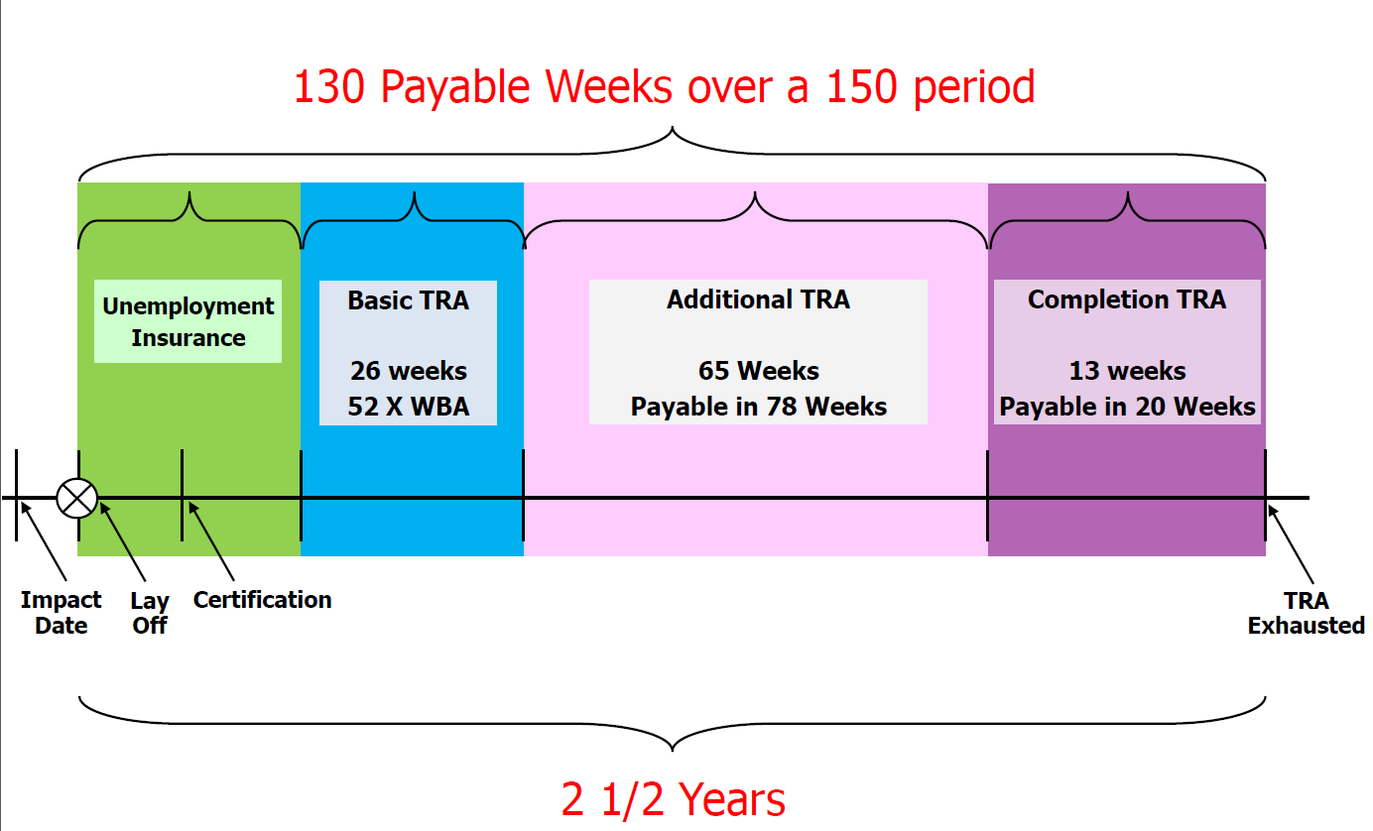
TRA Program Benefits: TRA Timeline
There may be a gap in payments based on when Additional TRA is exhausted

Slide 27
Contacts
Maynor Acevedo
Maynor.Acevedo@Detma.org
Christopher Quan
Christopher.Quan@Detma.org

