Slide 1

Trade Readjustment Allowance (TRA)
Department of Unemployment Assistance
DUA/DSC Integration Unit 2021

Slide 2

Trade Readjustment Allowances
There are three types of TRA:
Basic TRA
Additional TRA
Completion TRA
Trade Readjustment Allowance (TRA) under the Trade Act of 1974 (as amended by the Trade Adjustment Assistance Reauthorization Act of 2015 (TAARA 2015)), is federal money appropriated by Congress that has been requested by the Department of Labor (DOL) and distributed by the Department of Unemployment Assistance (DUA) – TRA Unit for workers that have been approved and meet the requirements of the TAA Program for retraining and employment.

Slide 3
Qualifying Requirements for Trade (TAA)
Apply to participate in the Trade program. One 1666 form per certification i.e., petition number.
Company must be Trade Certified
Member of Certified Worker Group
Qualifying Separation from Adversely Affected Employment – must be for a lack of work
NOTE: Eligibility for TAA and TRA are not the same. There is no earnings requirement for general TAA eligibility (training, employment and case management services, job search, relocation, etc.)
Note: Customers are provided a written determination of their eligibility for TAA services and deadline date to be in approve TAA training or have received an approved waiver from training.

Slide 4
Qualifying Requirements for Basic TRA
“Basic” TRA benefits are determined based on an individual’s initial separation from the Trade-certified company (i.e., their first qualifying separation after the company’s impact date.
Individual must meet wages & employment:
26 weeks of employment at wages of $30 or more within the 52-week period prior to separation
An individual must meet the 26/26-week deadline:
26 weeks from the date of the petition certification; OR
26 weeks from the customer’s most recent total separation from adversely affected employment.
Be eligible for Unemployment Insurance (UI) and exhausted all UI benefits (including Federal Extensions, Extended Benefits (EB)) and have a claim with a current Benefit Year (BYE).
Note: An individual’s potential eligibility for “Basic” TRA is 52 weeks however, this can change (be reduced) depending on the number of weeks they collect Unemployment Insurance (including Pandemic Emergency Unemployment Compensation (PEUC)Program and Extended Benefits (EB).

Slide 5
Qualifying Requirements for Basic TRA
Be enrolled in a full-time TAA-approved training or have an approved waiver from training or have completed an TAA-approved training
No Basic TRA can be paid if customer has a break in training of 30 days or more (excludes weekends and holidays)
Part Time training can be approved, but customer will not be eligible for TRA benefits.
Can continue to collect Basic TRA after training ends as long as the customer is conducting an active job search.
Accept suitable work, actively seek work, be referred to suitable work (for Basic TRA Only)
Basic cannot be paid after the 104-week eligibility period has ended even if there is a remaining balance of benefits.
Note: The 104-week eligibility period begins with the first week following the most recent qualifying separation from the certified company.

Slide 6
Qualifying Requirements for Additional TRA
“Additional” TRA benefits are available to individuals who are still attending an approved TAA training program. A maximum of 65 weeks of “Additional” TRA benefits are payable over a 78-week eligibility period.
Exhausted all Basic TRA (including Federal Extensions, Extended Benefits (EB))
Have a claim with a current Benefit Year (BYE).
Must be in approved training full-time
Waivers are not allowed for “Additional” TRA
Attending all scheduled classes, making satisfactory academic progress, and following the approve TAA training plan
Note: If at any time the training plan has been changed, TRA and TAA needs to be notified immediately. Modifications to training contracts must be done prior to the end date or it may affect their benefits.

Slide 7
Qualifying Requirements for Additional TRA
Benchmarks are up to date
No Additional TRA can be paid during breaks in training longer than 30 days, or breaks during transition from remedial to vocational training
Unlike “Basic” TRA, no “Additional” TRA benefits can be paid beyond the completion of the approved TAA Training Program
Or after the 78-week eligibility period has ended even if there is a remaining balance of benefits
This 78-week eligibility period follows the last week of entitlement to Basic TRA or begins with the first week of TAA-approved training.
Benchmarks: The purpose of training benchmarks is to allow early and ongoing assessment of the performance of a training participant to determine whether the original training program is a good fit. Benchmarks also function as a protection of the appropriate expenditure of TAA Program funds.

Slide 8
Completion TRA
“Completion” TRA benefits are available to individuals who have exhausted all “Basic” & “Additional” TRA, including federal extensions, are still attending TAA approved training.
provides participants with up to 13 additional weeks of income support while in full time training
must be applied for via UIO within the last 20 weeks of training
Conditions of Completion TRA:
The requested weeks are necessary for the customer to complete a training program that leads to a degree or industry recognized credential; AND
The customer is participating in full time training each week; AND
The customer has met the performance benchmarks established in the approved training plan; AND
The customer is expected to continue to make progress toward the completion of the approved training; AND
The customer will be able to complete the training during the period authorized for receipt of Completion TRA

Slide 9
Completion TRA Eligibility Period
While there are 13 weeks of Completion TRA payable to eligible TAA participants, these 13 weeks can only be collected if the customer will complete the training* and is within the last 20 weeks of training. The 13 weeks are payable anytime during the 20-week period. *Just Cause can be approved to extend the 20-week period
This 20-week time frame will begin with the first week in which a TAA participant files a claim for Completion TRA and not automatically at the end of Additional TRA.
If a participant has exhausted all other UI and TRA benefits but will not be able to complete approved training within the allowable 20-week period, none of the 13 weeks of Completion TRA are able to be paid.
Completion TRA benefits cannot be paid during scheduled school breaks greater than 30 days.
Completion TRA benefits cannot be paid beyond the completion of the approved TAA Training Program.
Completion TRA benefits cannot be paid beyond the 20-week time frame.

Slide 10
Summary: Maximum TRA Under TAARA 2015
UI/Basic TRA (26 weeks of UI + 26 weeks of TRA) = 52 weeks
Additional TRA (if in training) = 65 weeks max
(within the 78-week eligibility period) Note: Once training ends, Additional ends.
____________________________________________________
Maximum of = 117 weeks
_____________________________________________________
Completion TRA
(If benchmarks and other criteria are met, payable within the last 20 weeks of training)
= 13 weeks max
_____________________________________________________
Maximum of = 130 weeks

Slide 11
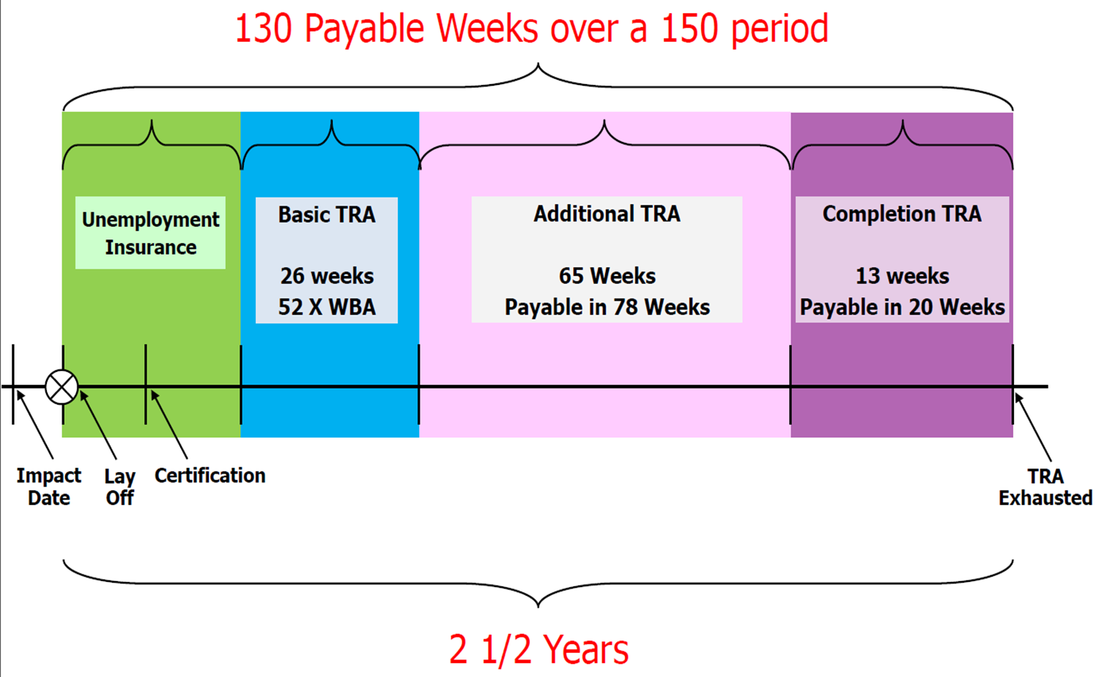
TAARA 2015 Program Benefits: TRA Timeline

Slide 12
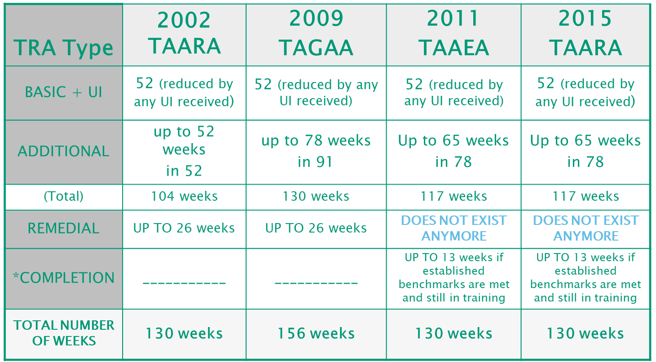

TRA Benefits Matrix

Slide 13
Earnings UP TO TRA WBA
A worker may work part-time while attending training full-time.
A customer may earn up to 133% of their WBA while working and in full-time training before deductions are made.
Report all gross wages earned for work perform during the week claimed, regardless of when the wages will be received.
TRA earnings disregard does not apply to R-UI, PEUC and EB benefits.

Slide 14
TRA Election Provision
Allows adversely affected workers to elect TRA instead of UI where:
The worker is entitled to receive UI as a result of a new benefit year based in whole or in part upon part-time or short-term employment in which the worker engaged after the worker’s most recent total separation from adversely affected employment
The worker is otherwise entitled to TRA except need not have exhausted all rights to UI in the new benefit year
UI Online will send out the TRA/UI ELECTION OPTION Form
Once an election is made, it cannot be changed
Payments cannot be processed until the election option has been completed and processed by DUA

Slide 15

We would like to thank you for your time!
Are there any questions?
www.mass.gov/dcs/trade

Slide 16
Contacts
Susan Zebrak
Susan.A.Zebrak@DETMA.ORG
Christopher Quan
Christopher.Quan@Detma.org

