Slide 1

TrainingPro Enhancements
MassHire Programs & Services are funded in full by US Department of Labor (USDOL) Employment and Training Administration grants. (Additional details furnished upon request.)
Sharing Student Data with MassHire
October 22, 2021

Slide 2





Housekeeping
Please stay muted so all participants can hear the presenters
We will answer questions in the chat as we stop at various points throughout the presentation and at the end.
The Session will be recorded and shared.
This training deck will be posted on or after October 25th: https://www.mass.gov/training-provider-information
Closed caption is located at the bottom, left corner of your screen, and you can change to your language of choice

Slide 3
About Today
What is today’s training about?
What is today’s training not about?
How to use a few new screens in TrainingPro to submit student data to the Commonwealth
  Rules and logic for the data submittals
Ongoing benefits of submitting student data
General use of the TrainingPro application
Training Provider eligibility or eligibility processes
Goals & Objectives
Submission Timeline
Communicate:
  What’s changing
  Why things are changing
  Future expectations & requirements
Provide:
  Opportunity for questions & answers
  Contact information for follow-up questions
Make sure that you supply required data to the Commonwealth by June 30th of each year (e.g., before 6/30/22, 6/30/23, etc.)

Slide 4


What’s Changing?
Until this year Massachusetts as well as several other states, had a waiver from the USDOL to report only on their WIOA participants in training. That waiver ended on June 30, 2021, so now we must report on all (WIOA and non WIOA) students in approved training courses.

Slide 5

Eligible Training Provider Approval Process
Federal workforce grants provide funds for program participants receiving training from approved training providers.
Training providers register and submit their programs of study for approval through the TrainingPro application and data are stored in MOSES.
MassHire Department of Career Services (MDCS) is responsible for approving the training providers.
MassHire Workforce Boards (ITA), the Trade Unit, and DUA Section 30 are responsible for approving the courses.
Once training providers and courses have been approved, they are available to the public on the Eligible Training Provider List (ETPL) on MassHIre JobQuest.

Slide 6
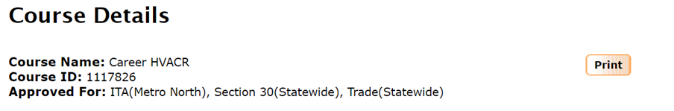
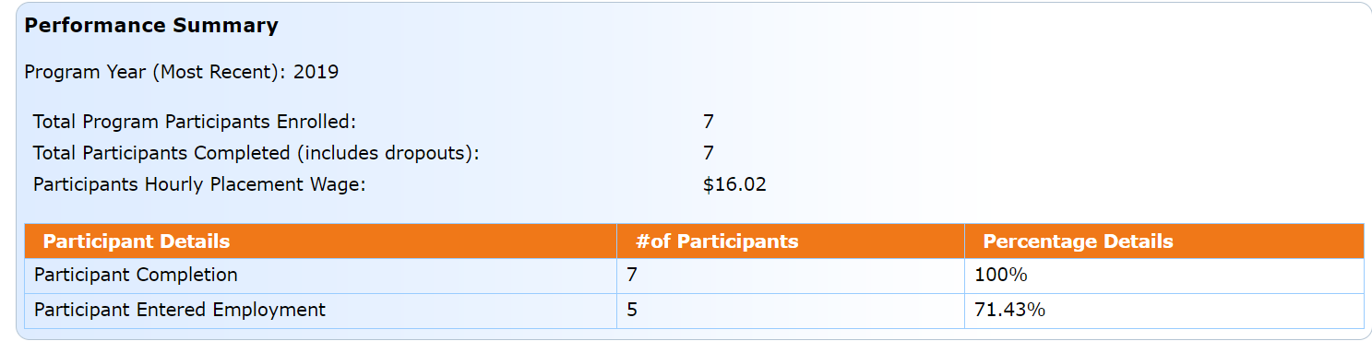
Training Provider Performance Reporting
Currently course performance information is reported in aggregate for all students by the training providers through TrainingPro.
MDCS displays course information and performance data on MassHire JobQuest.
Asking training providers to continue providing data for approx. 2 years as MDCS is collecting and compiling the new data so we can accumulate enough data to do appropriate performance outcomes.

Slide 7

New Performance Reporting Requirements
MDCS must now develop course performance data based on DUA wage matching for use in ETP approvals and for display to consumers on the MassHire JobQuest ETPL
MDCS currently reports annual performance data to DOL only for students receiving MassHire services whose training was paid with federal funds
MDCS will begin to report performance data on ALL ETP students for the FY2022 Federal report due in October 2022
MDCS has developed a new secure portal to TrainingPro through which training providers will submit the student data that MDCS needs in order to develop the required performance data.

Slide 8

Student Data to be Collected
Student SSN – to allow wage match for earnings data
Student contact information
  Name, Student ID
Dates of training program enrollment and completion
Credential awarded
Training Provider organizational information and programs of study information will continue to be collected through TrainingPro through the normal process.

Slide 9

Data Security
Personally Identifiable Information (“PII”)
  Stored behind secure firewall
  Restricted access to any PII
  Only used for federal reporting
  Only aggregate data will be displayed for the public
  Uploaded data are not stored in the application infrastructure (data is stored directly in a secure database)
  SSNs are visible for editing and viewing until “Submit” is clicked, then only the last 4 digits will show

Slide 10

How will the new data be used?
The data you share will enable MDCS to share aggregate performance data with:
  U.S. Department of Labor (“DOL”)
  General public
Performance Metrics (using DUA wage data where possible):
  Employment rate after exit (% rate)
    % of student who gain employment after exit
  Credential attainment (% rate)
    % of student who gain a credential up to a year after exit
  Completion Rate (% rate)
    % percent of students who completed the course
  Median Earnings (aggregate)
    Of those students who have entered employment

Slide 11
Benefits
Sharing the required student data will help ensure that programs are renewed and funding continues
Opportunity to showcase your courses, remain on the ETPL, and provide much needed skills to customers across the Commonwealth
Be a part of closing the skills gap, addressing the needs of customers and businesses
Access to summarized data analytics (by provider and by course) enabling better decision making for stakeholders

Slide 12


Slide 13

Uploading Data
There are two options for uploading student data;
  In bulk, via a comma separated value (CSV or TXT) file
  By data entering individual student records

Slide 14
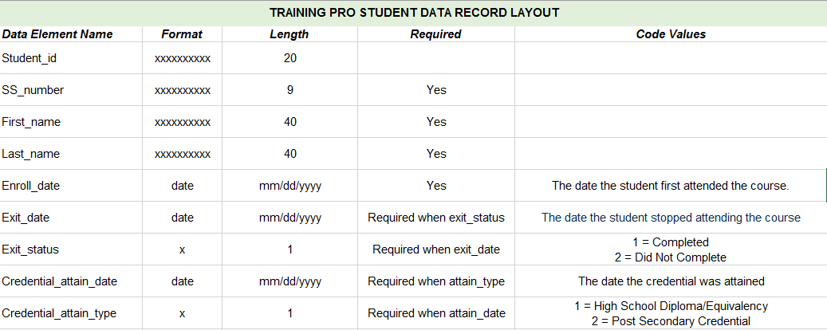
Adding student data: Record Layout
Used to match UI wage records

Slide 15
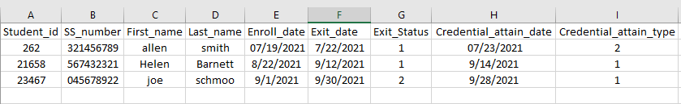
Adding student data: Record Layout
Some very important stuff: Column header names are required Column header names must be exact matches to above Be sure to format the SSN column to Text to retain leading zeros ("0").

Slide 16
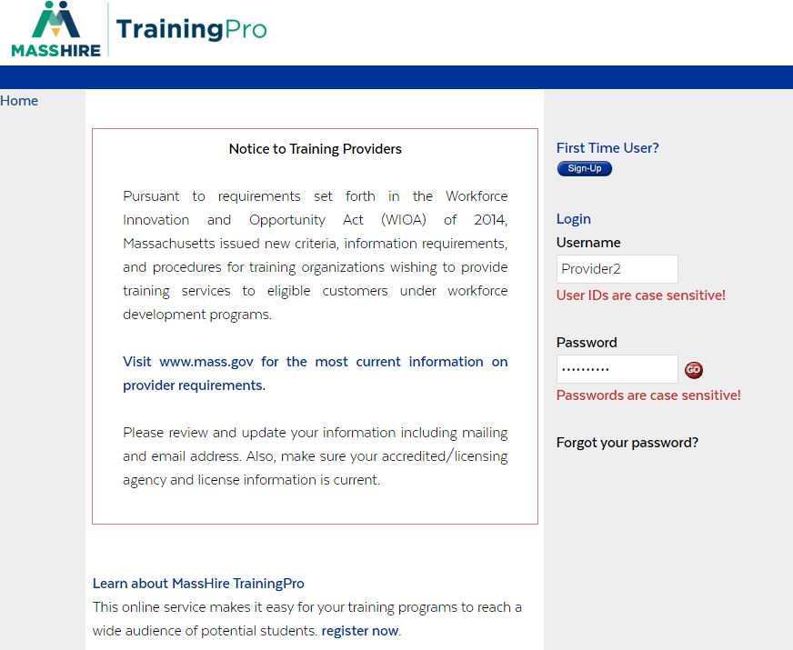
Adding student data by .csv upload
1) Login into your MassHire TrainingPro account

Slide 17
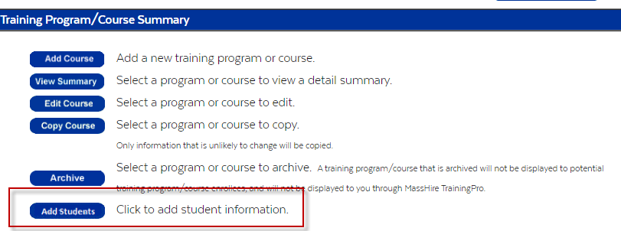
Adding student data by .csv upload
2) Click Add Students on the Welcome page
  The Add Students button will be available if you have an approved ITA course with an approval date greater than or equal to June 30, 2022

Slide 18
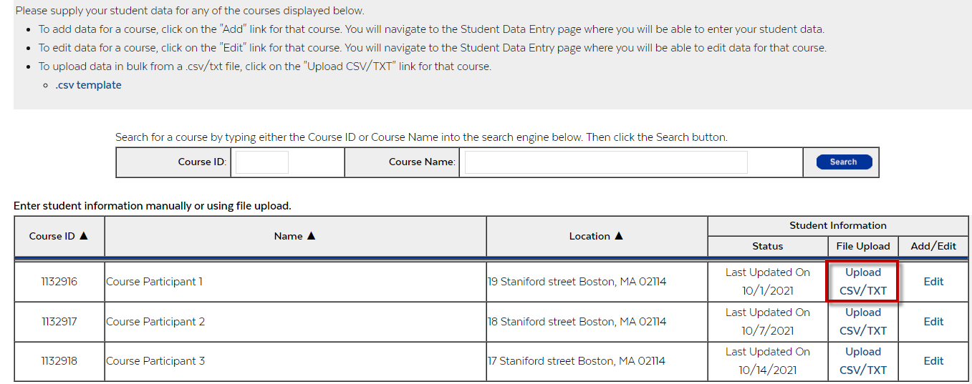
Adding student data by .csv upload
2) On the Course Selector page, click "Upload CSV" for the course that you want to upload data to

Slide 19
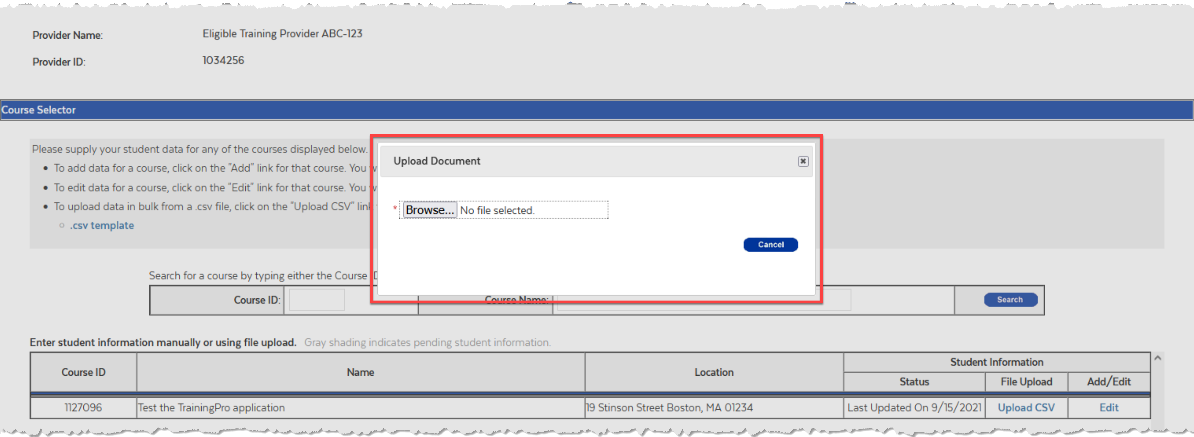
Adding student data by .csv upload
3) Browse for the file that you'd like to upload
This is a link to a downloadable csv template

Slide 20
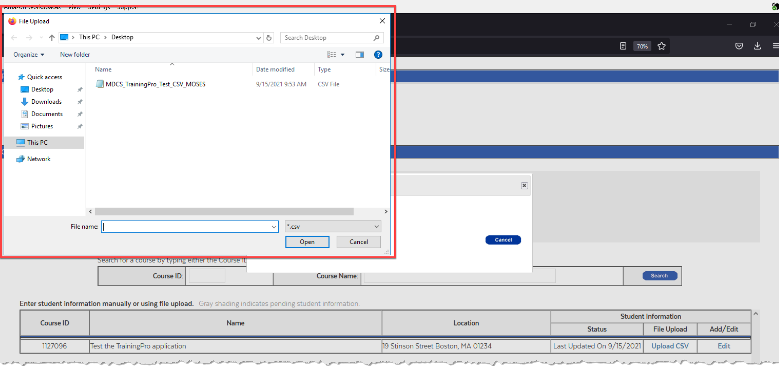
Adding student data by .csv upload
4) Upload your .csv file

Slide 21
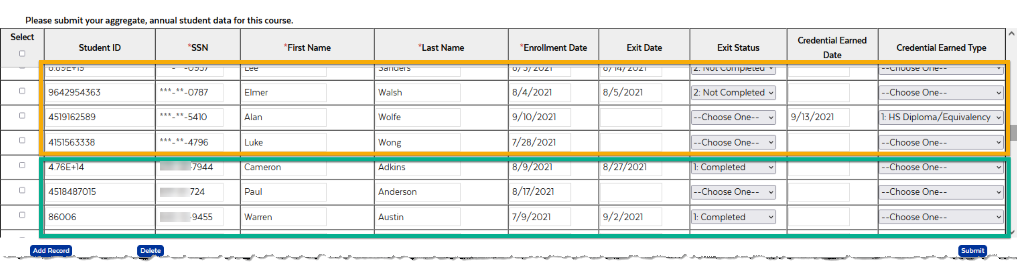

Adding student data by .csv upload
Once successfully uploaded, your CSV data will automatically be appended to the table on the Student Data Entry page. Review or edit data directly in the table if needed.
Previously entered rows
(Spoiler Alert: You can tell because SSNs are h***en once submitted)
Newly uploaded rows are always appended to the end of the known list for this course
Since new data is just added to the bottom of any pre-existing list, there is no “sort” feature on the table so that records stay in order

Slide 22
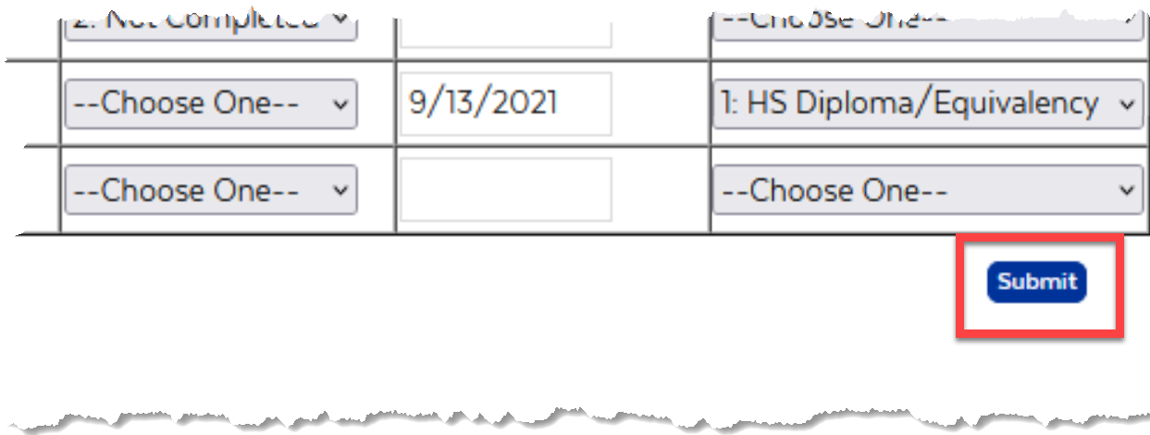
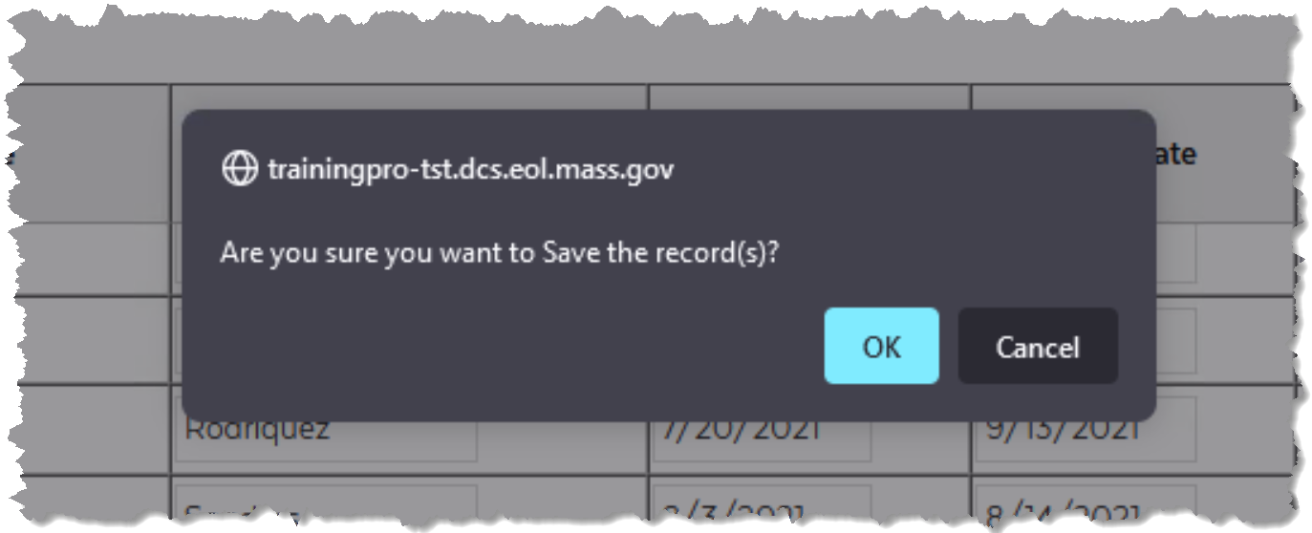
Adding student data by .csv upload
5) Once satisfied with your data, click "Submit" in the lower right-hand corner of the screen

Slide 23
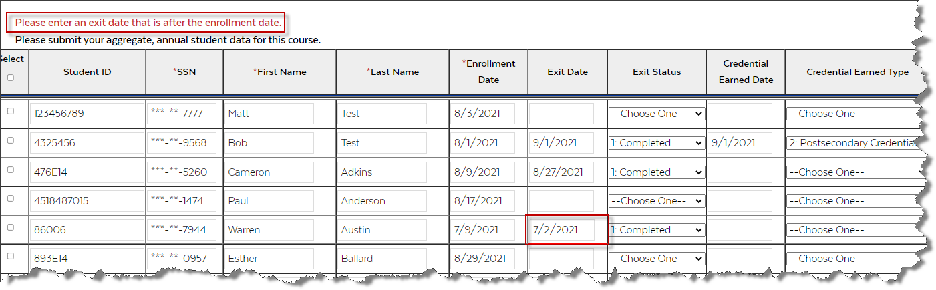
Adding student data by .csv upload
Any errors in the file (e.g. wrong codes, logical date errors) will be highlighted on the screen
Please Note: Upon “Submit” the application will: Check for all field validations (see “Field Logic & Details” for specifics)

Slide 24
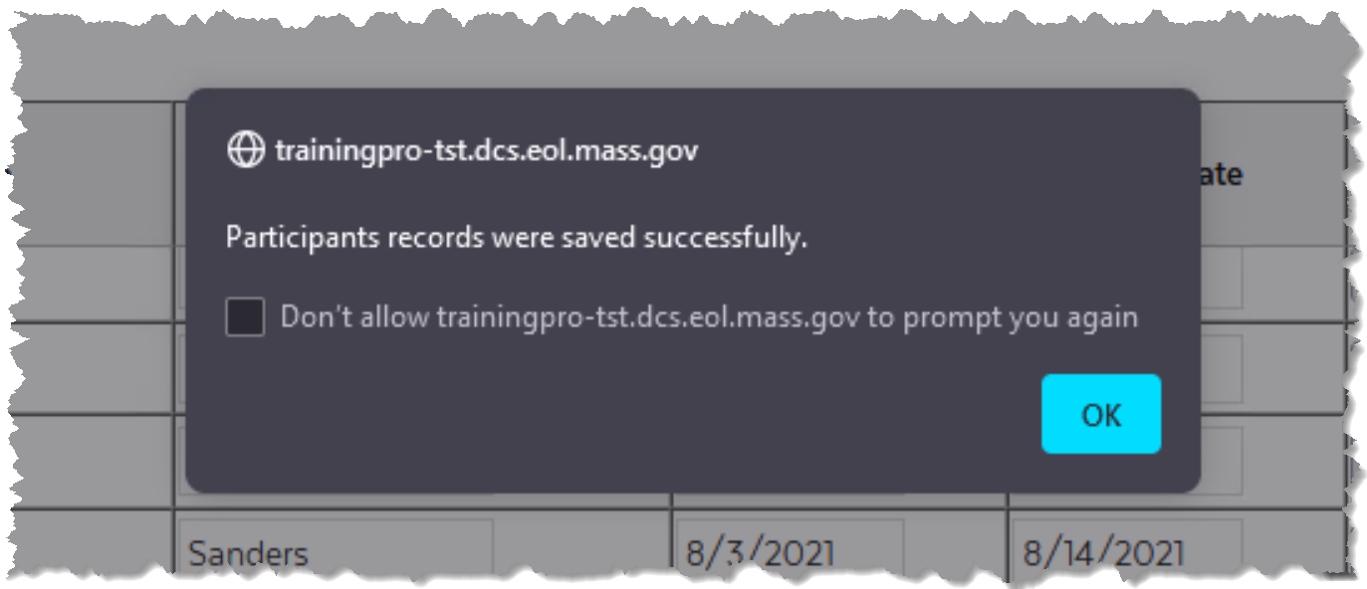

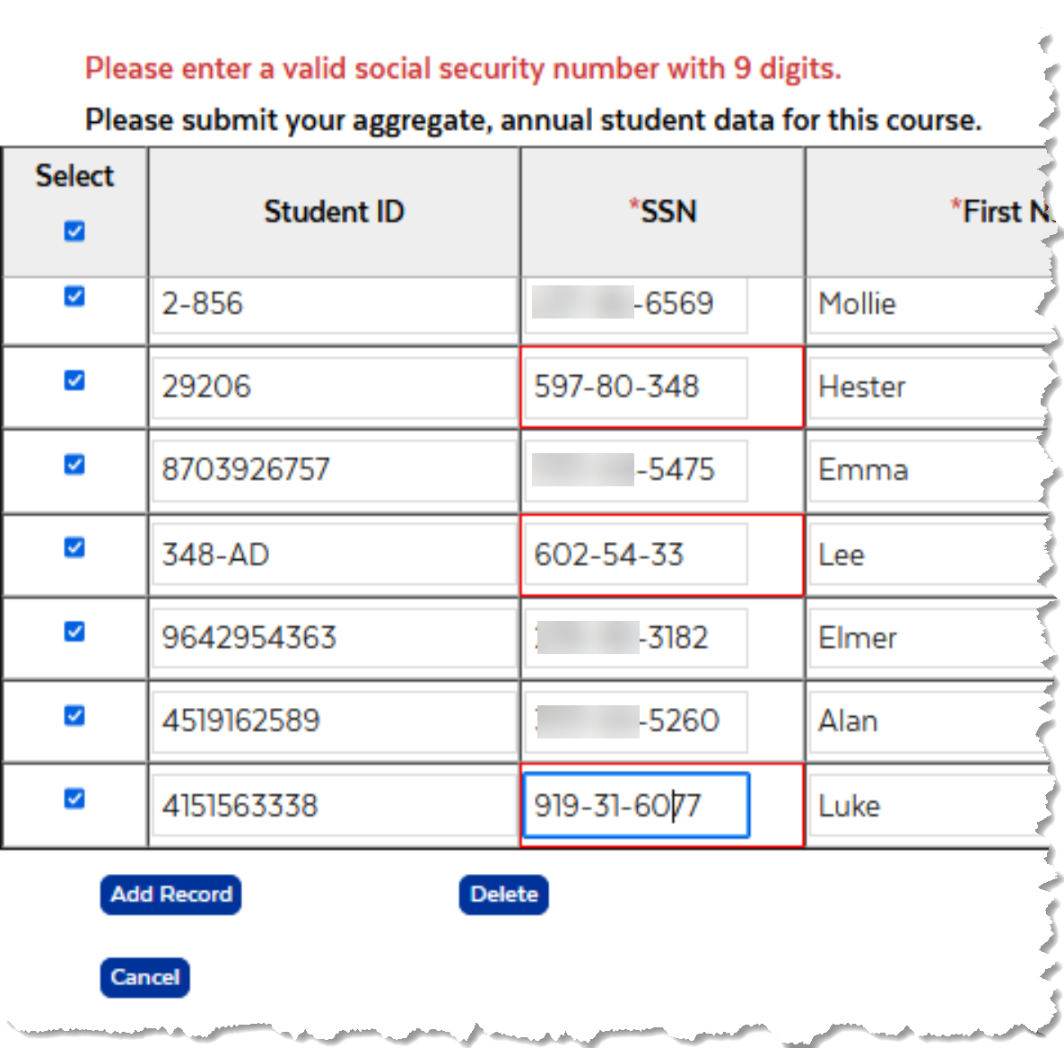

Adding student data by .csv upload
Success message will display, and you will be navigated back to the "Course Selection Page"
Error messages will be indicated at the top of the screen

Slide 25
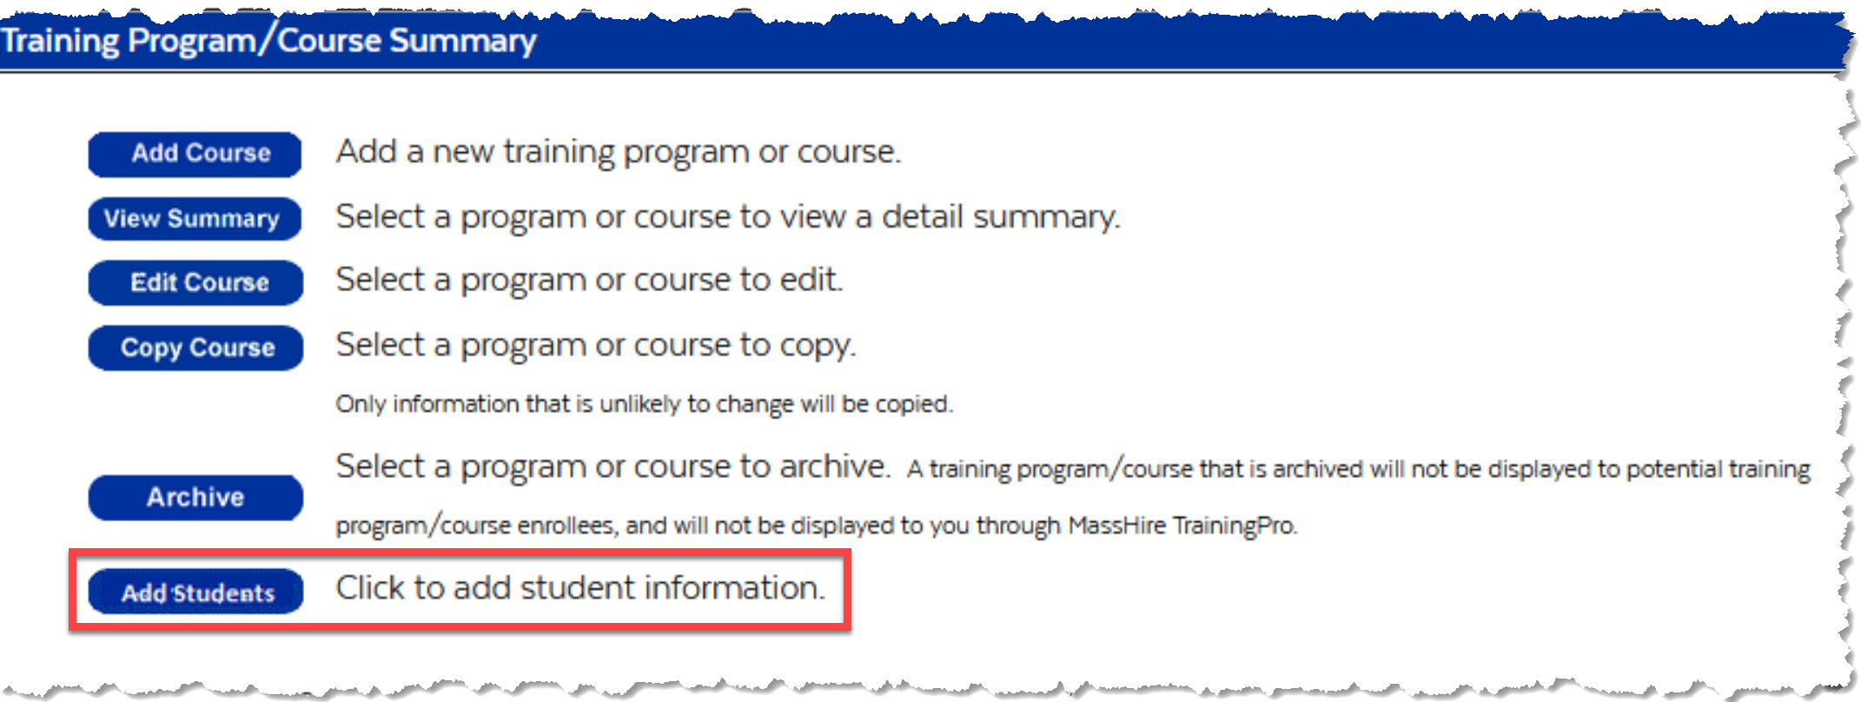
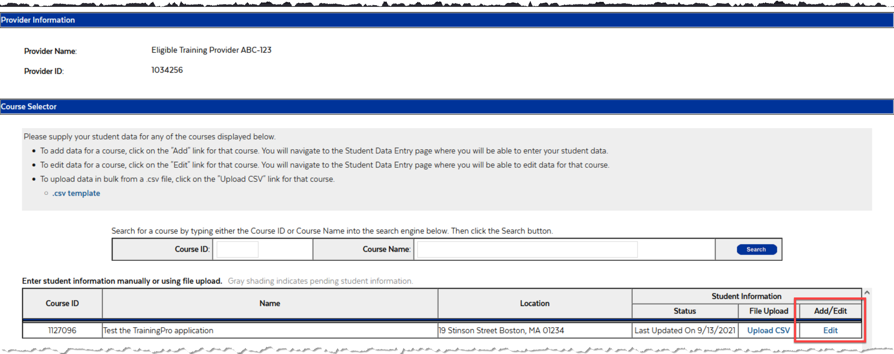
Adding student data individually
1) Click "Add Students" on the Welcome page
2) Click "Add" for the course that you'd like to add student data to
Please Note: You may see "Edit" for courses where data has already been entered. Clicking "Edit" will lead you through the same process flow

Slide 26
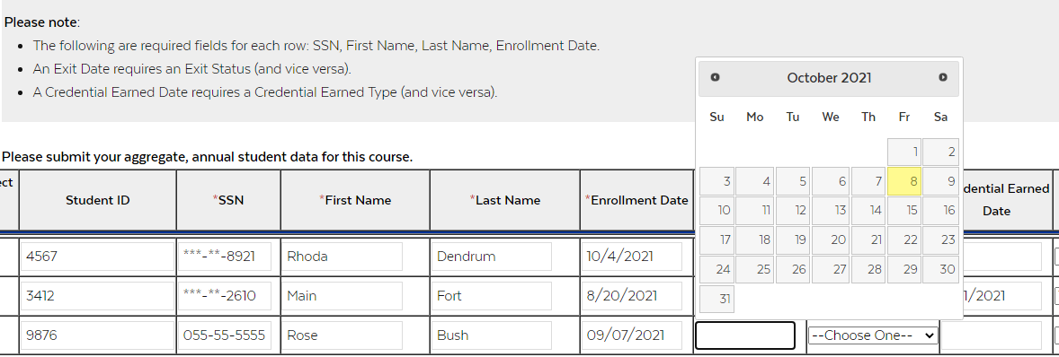
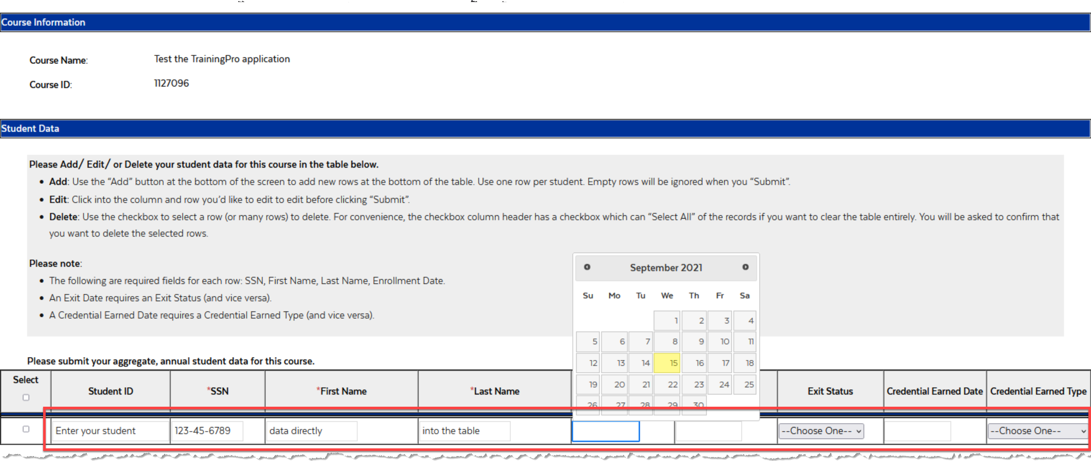
Adding student data individually
3) Enter your student data directly into the table

Slide 27
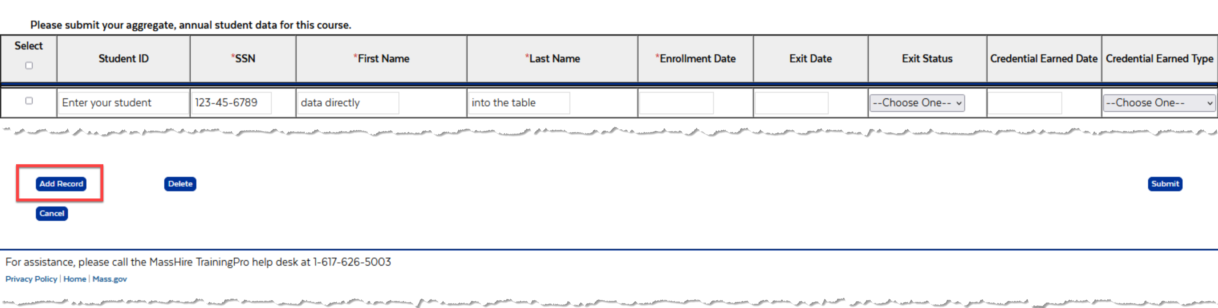
Adding student data individually
4) Click the "Add Record" button if you need more rows

Slide 28
Adding student data individually
5) Once satisfied with your data, click "Submit" in the lower right-hand corner of the screen
Please Note: Upon “Submit” the application will: Check for all field validations (see “Field Logic & Details” for specifics)
Any errors in the file (e.g.; wrong codes, logical date errors) will be highlighted on the screen

Slide 29
Adding student data manually
Success message will display, and you will be navigated back to the "Course Selection Page"
Error messages will be indicated at the top of the screen

Slide 30
Review or Edit existing student data
1) Click "Add Students" on the Welcome page
2) Click "Edit" for the course that you'd like to edit

Slide 31
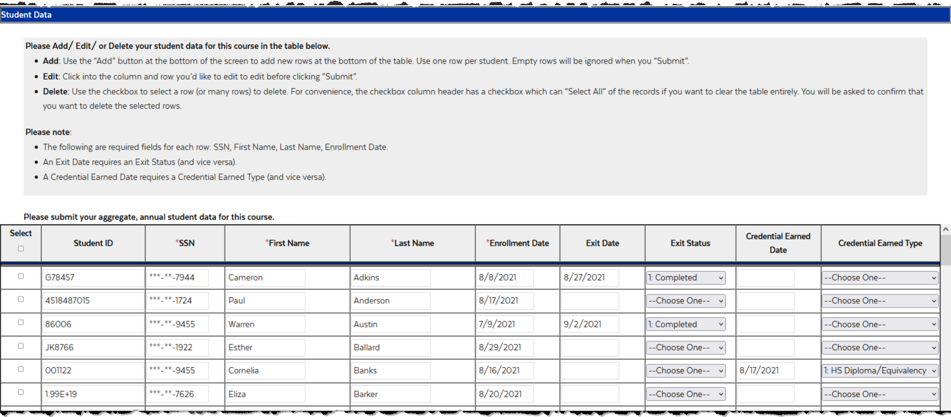
Review or Edit existing student data
3) Edit your data directly in the table
At most, only the past 2 years' worth of data will display,
older records are removed from editing or viewing

Slide 32
Review or Edit existing student data
4) If you have made any changes click "Submit" in the lower right-hand corner of the screen
Please Note: Upon “Submit” the application will: Check for all field validations (see “Field Logic & Details” for specifics)
Any errors in the file (e.g. wrong codes, logical date errors) will be highlighted on the screen

Slide 33
Editing student data
Success message will display, and you will be navigated back to the "Course Selection Page"
Error messages will be indicated at the top of the screen

Slide 34
Deleting student data
1) Click "Add Students" on the Welcome page
2) Click "Edit" for the course that you'd like to edit/ delete records for

Slide 35
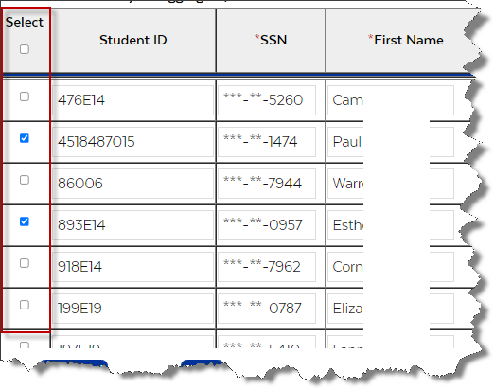
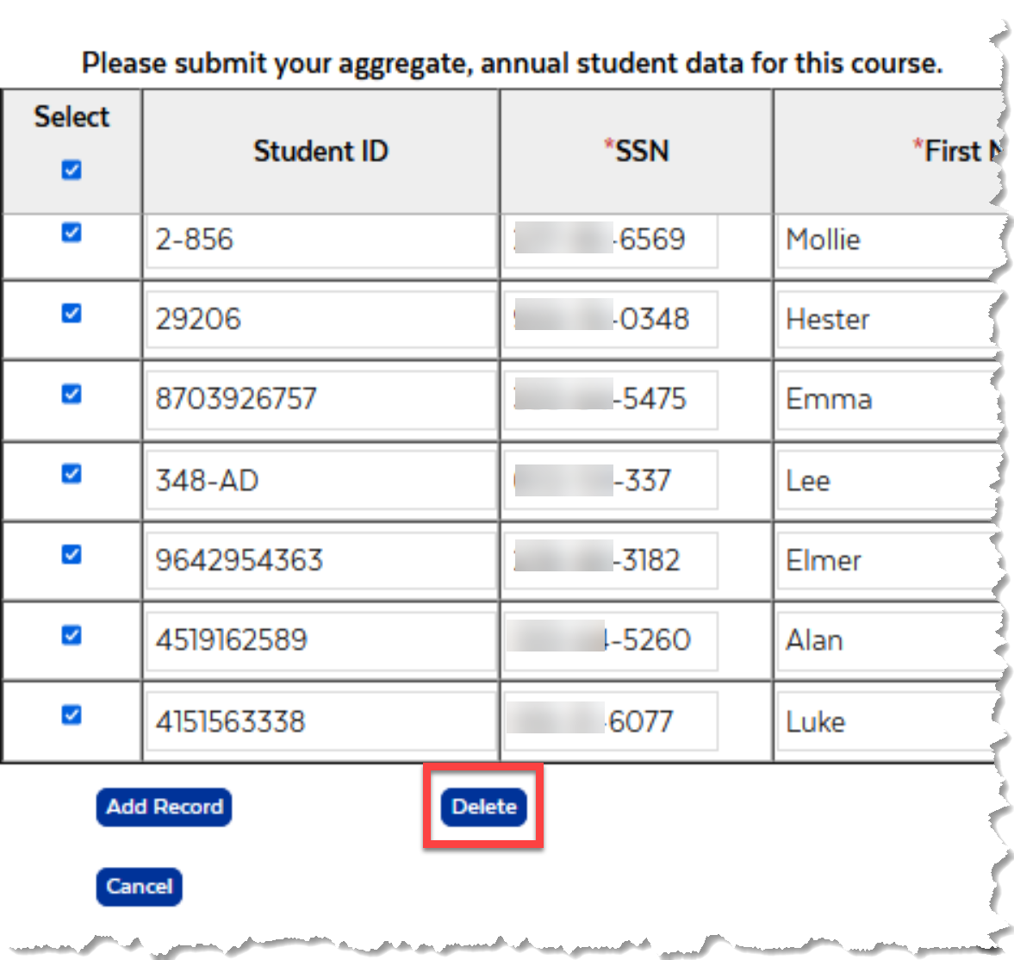
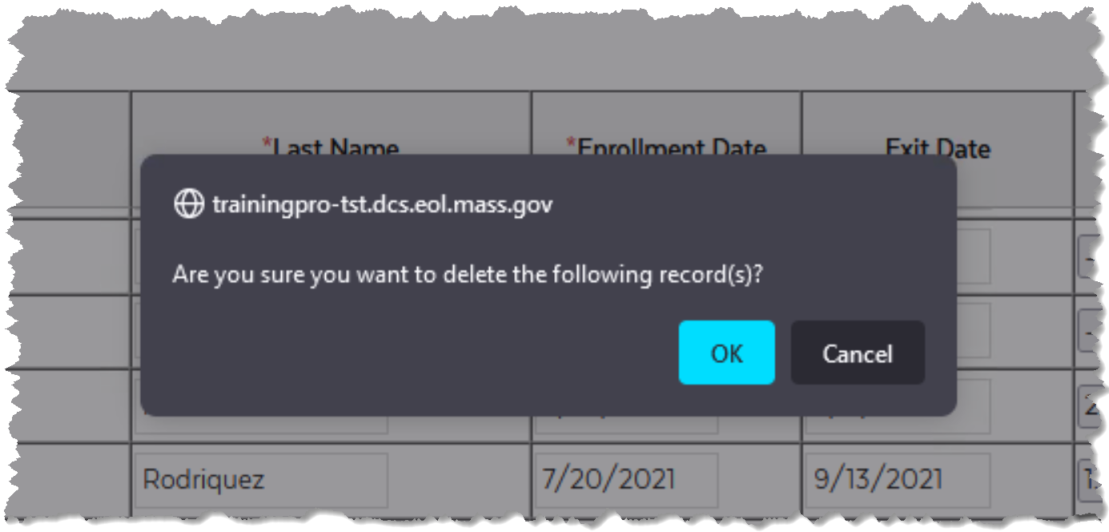
Deleting student data
3) Use the checkboxes in the left-most column to select the rows you'd like to delete or click on Select at the top to select all records. [Be careful!]
4) Click "Delete" in the lower left-hand corner of the screen
4a) You will be prompted to verify you'd like to delete the selected rows

Slide 37
Live Demonstration
Brian and the live demo

Slide 38
Frequently Asked Questions (FAQ)
Can I submit data whenever I’d like to?
  Yes, we report on the data annually (so it’s important to submit data at least once a year). However, you can submit data with whatever frequency you’d like. Just keep piling it on and we’ll handle the rest!
I made a mistake with some data I uploaded, can I edit it?
  Yes, just click into the column and row you’d like to edit, edit it, and click “Submit” when done. See “Editing Student Data” section of the deck.

Slide 39
Frequently Asked Questions (FAQ)
Why can’t I see SSNs after I’ve submitted them?
  For security reasons we mask the SSN once submitted. You can retype the SSN and resubmit if needed.
What is the importance of the 6/30/2021 cut-off date? (i.e., no data may be entered prior to this date)
  The portal data only applies to students who enroll on or after July 1, 2021 into ETPL approved courses.

Slide 40
Frequently Asked Questions (FAQ)
Can I get individual student wage data?
  No, but you can view aggregate performance data by provider and by course, based on wage data
What student data do I upload?
  Upload student data for all students who are enrolled in an approved ETPL course for which you have an approval through June. For example:
    You can upload student data between today and June 30, 2022 for all students who are either currently enrolled in an approved course, or will be enrolled in an approved course on or before June 30, 2022.

Slide 41
Appendix
Additional Reference Material

Slide 42
TRAINING AND EMPLOYMENT GUIDANCE LETTER No. 08-19
https://wdr.doleta.gov/directives/corr_doc.cfm?DOCN=5389 (Top of Page 9)
Accompanying information must not reveal personally identifiable information about an individual participant. In addition, disclosure of personally identifiable information from an education record must be carried out in accordance with the Family Educational Rights and Privacy Act (FERPA) (20 U.S.C. § 1232g; 34 CFR Part 99) including the circumstances relating to prior written consent.

Slide 43
Family Educational Rights and Privacy Act (FERPA)
(20 U.S.C. § 1232g; 34 CFR Part 99)
34 CFR § 99.35 - What conditions apply to disclosure of information for Federal or State program purposes?
(1) Authorized representatives of the officials or agencies headed by officials listed in § 99.31(a)(3) may have access to education records in connection with an audit or evaluation of Federal or State supported education programs, or for the enforcement of or compliance with Federal legal requirements that relate to those programs.

Slide 44
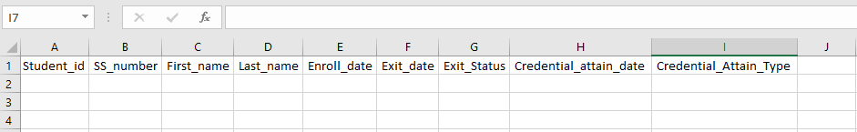
Adding student data: The Template
Note that the header row is required for the csv upload and the column names must match exactly to the list below!
Please Note: CSV files must be <50MB The following 4 fields are required for each row you try to upload: SSN First Name Last Name Enrollment Date An Exit Date requires an Exit Status (and vice versa) Use "1" for Completed Use "2" for Not Completed A Credential Earned Date requires a Credential Earned Type (and vice versa) Use "1" for a High School Diploma or Equivalency Use "2" for a Postsecondary Credential |  | Column names and order must be: Student_id SS_number First_name Last_name Enroll_date Exit_date Exit_Status Credential_attain_date Credential_Attain_Type This is the default for the template so please do not change column order or names

Slide 45
Adding student data: Helpful Definitions
Enrollment Date: The date the student first attended the course.
Exit Date: The date the student stopped attending the course; they either completed the course or did not complete the course.
Exit Status: The student either
  Completed (Use the value of “1” for the .csv upload), or
  Did not complete the course at the point they stopped attending (Use the value of “2” for the .csv upload)
Credential Date: The date that the student earned a credential (i.e., the date on the credential document)
Credential Earned Type: Can be either
  A high school diploma or equivalent (HiSET, GED) (Use the value of “1” for the .csv upload), or
  A postsecondary level credential (Use the value of “2” for the .csv upload)
    From TEGL 10-16: A recognized postsecondary is a credential consisting of an industry-recognized certificate or certification, a certificate of completion of an apprenticeship, license recognized by the State involved or Federal Government, or an associate or bachelor degree.
    Examples of post-secondary level credentials include Microsoft Certified Professional (MCITP), National Institute for Automotive Service Excellence Certification, Certificate from Massachusetts Division of Apprenticeship Standards, State Licensed Asbestos Inspector, Federal Aviation Administration Aviation Mechanic License, Associate or Bachelor degree.

Slide 46
Adding student data by .csv upload
Upon upload the application will scan your .csv file for several requirements:
File must be a .csv and <50MB
SSN field cannot be empty, must be numeric and 9 digits
Enrollment Date field cannot be empty and must contain a date value without any other characters
Exit Date field (if populated) must contain a date value without any other characters
Exit Status field (if populated) must contain either a “1” or a “2”
Credential Date field (if populated) must contain a date value without any other characters
Credential Type field (if populated) must contain either a “1” or a “2”

Slide 47
Using the .CSV template

Slide 48
Adding student data by .csv upload

Slide 49
Adding student data manually

Slide 50
Reviewing student data already entered

Slide 51
Editing student data

Slide 52
Deleting student data

Slide 53
Student Data Entry Table
Student ID, First & Last Name Fields
Student ID:
  An optional field for your own use and reference
  Maximum of 20 characters (all characters are allowed)
First & Last Name Fields
  Separate, required fields allowing up to 40 characters
  Double quotes (“) are not allowed

Slide 54
Student Data Entry Table
SSN Field
Required field that can only be 9 numeric characters
  First 3 digits cannot be "000“, "666”, or anywhere in the 900 series
  Second group of two digits cannot be "00"
  Third group of four digits cannot be "0000"
Visible for editing and viewing until “Submit” is clicked
Once submitted, only the last 4 digits will show
  Clicking into the SSN field will not reveal the SSN
  Type over the prior SSN to edit and re-submit if unsure

Slide 55
Student Data Entry Table
Enrollment Date Field
Required date field
  Cannot be in the future
  Cannot be before 6/30/2021
For CSV Uploads | For Manual Entry/ Editing
Must be a valid date entry (numeric) | Date picker available

Slide 56
Student Data Entry Table
Exit Date Field
Optional date field
  Required when an Exit Status is present
  Cannot be in the future
  Cannot be before 6/30/2021 or the Enrollment Date
For CSV Uploads | For Manual Entry/ Editing
Must be a valid date entry (numeric) | Date picker available
When entering your data in the current month of…
Jan | Feb | Mar | Apr | May | Jun | Jul | Aug | Sept | Oct | Nov | Dec
You can enter up to Jan 1st two years back |  |  |  |  |  | You can enter up to Jan 1st one year back

Slide 57
Student Data Entry Table
Exit Status Field
Optional field
  Required when an Exit Date is present
For CSV Uploads | For Manual Entry/ Editing
Cell value must be either a “1” or a “2” 1 = Completed 2 = Not Completed | Drop down list of values available

Slide 58
Student Data Entry Table
Credential Date Field
Optional date field
  Required when a Credential Earned Type is present
  Can not be in the future
  Can not be before 6/30/2021 or the Enrollment Date
  Must be no more than one year after the Exit Date
For CSV Uploads | For Manual Entry/ Editing
Must be a valid date entry (numeric) | Date picker available

Slide 59
Student Data Entry Table
Credential Earned Type Field
Optional field
  Required when a Credential Date is present
For CSV Uploads | For Manual Entry/ Editing
Cell value must be either a “1” or a “2” 1 = HS Diploma/ Equivalency 2 = Postsecondary Credential | Drop down list of values available

Slide 60
Training Deck
This training deck will be posted after the set of trainings are completed (by October 25th) to:
https://www.mass.gov/training-provider-information

