Slide 1
EMERGENCY MEDICAL
CARE ADVISORY BOARD
Bureau of Health Care Safety and Quality
Department of Public Health
Wednesday, November 15, 2017

Slide 2
Agenda
Routine Items
Overview of Conflict of Interest, Training, and Open Meeting Law Requirements
Overview of OEMS
Overview of EMCAB
Medical Services Committee Report
Next Steps

Slide 3
Conflict of Interest, Training, & Open Meeting Law Requirements
Conflict of Interest
Sondra Korman, Deputy General Counsel
Performance and Care Enhancement (PACE) Learning Management System Training
Mark Miller, Director, Office of Emergency
Medical Services
Open Meeting Law
Sondra Korman, Deputy General Counsel

Slide 4
Conflict of Interest Law
The Conflict of Interest (COI) law, M.G.L. c. 268A, is meant to prevent conflicts (and appearances of conflict) between a state employee’s private interests and his or her public duties.
As statutory public body members, you are considered to be “special state employees” subject to the COI law.
  The COI law is complex; State Ethics Commission attorneys are available, through the “Attorney of the Day” program, to provide confidential advice/guidance on how the COI law applies to you in a particular situation.
    Contact Attorney of the Day @ (617) 371-9500

Slide 5
Conflict of Interest Law-Training Requirements
All state employees subject to the COI law are required to:
  Certify they received and reviewed the annual Summary of Conflict of Interest Law, and
  Complete the biannual online training program through DPH’s PACE (Performance and Care Enhancement Learning Management System).

Slide 6
Training Requirements
Required Conflict of Interest Law PACE Online Trainings
Conflict of Interest Law Online Training Program:
https://www.pace.state.ma.us/kc/ilc/course_launch_router.asp?strBuildingID=5&strFunctionID=37&crs_ident=C27172&return_loc=course%5Finfo%5Fenroll%5Ffrm%2Easp%3FstrBuildingID%3D5%26strFunctionID%3D37%26strSearchType%3DAND%26intSearchID%3D%26blnReturn%3DTrue%26table%3Dcrs%26function%3Dcourse%5Finfo%5Fenroll%26crs%5Fident%3DC27172%26keywords%3Dconflict%26topic%3DT00011&strReturnLocString=Return+to+Course+Catalog
Conflict of Interest Law Summary:
https://www.pace.state.ma.us/kc/ilc/course_launch_router.asp?strBuildingID=5&strFunctionID=37&crs_ident=C27172&return_loc=course%5Finfo%5Fenroll%5Ffrm%2Easp%3FstrBuildingID%3D5%26strFunctionID%3D37%26strSearchType%3DAND%26intSearchID%3D%26blnReturn%3DTrue%26table%3Dcrs%26function%3Dcourse%5Finfo%5Fenroll%26crs%5Fident%3DC27172%26keywords%3Dconflict%26topic%3DT00011&strReturnLocString=Return+to+Course+Catalog
PACE Contact:
Kathy Creed, Kathy.creed@state.ma.us
State Ethics Commission
For information regarding the Education & Training requirements, refer to the State Ethics Commission website: http://www.mass.gov/ethics/revised-implementation-procedures.html
Phone: (617) 371-9500

Slide 7
PACE Trainings
  An account has been created for each EMCAB member in PACE.
  You must complete the training within 30 days.
  You should have received an automated email from the PACE system.
    If not, please email Kathy Creed.
  If you discover that you may have a conflict, contact the State Ethics Commission’s Attorney of the Day @ (617) 371-9500.

Slide 8
Open Meeting Law (OML)
The OML is designed to ensure transparency in the deliberations of public bodies.
A deliberation is:
  an oral or written communication, through any medium, including electronic mail,
  between or among a quorum of a public body,
  on any public business within its jurisdiction.
If a quorum of a public body wants to discuss public business within that body’s jurisdiction, they must do so during a properly posted meeting.

Slide 9
Deliberation
A deliberation does not include:
distribution of a meeting agenda, scheduling or procedural information, or
reports or documents that may be discussed at a meeting, provided that no member of the public body expresses an opinion on matters within the body’s jurisdiction.
  NOTE: If a public body member sends an email to a quorum of the public body expressing an opinion on any matter that could come before that body, the communication violates the OML, even if no recipient responds.

Slide 10
What is a Quorum?
A Quorum is defined as:
  a simple majority of the members of a public body, unless otherwise provided in a general or special law, executive order, or other authorizing provision. G.L. c. 30A, § 18.
  As applied to EMCAB—a quorum equals 21 members (½ of 41 members + 1 )
Notes:
10

Slide 11
Avoiding OML Violation-Best Practice Recommendations
Public body members must not engage in “serial deliberations”—a series of separate, independent conversations outside of a meeting among a quorum of the members regarding a topic within its jurisdiction.
In order to avoid even the appearance of a potential OML violation, the AGO advises public body members to refrain from communications over email except for distributing meeting agenda, scheduling meetings and distributing documents created by nonmembers.

Slide 12
Remote Participation
The Attorney General’s Regulations, 940 CMR 29.10, permit members to participate remotely in future public meetings if the public body specifically votes to allow remote participation.
  On September 24, 2013, EMCAB voted to allow its members (and members of its standing committees) to participate remotely.
The AGO strongly encourages all members to be physically present at public meetings, when possible.

Slide 13
Reasons/Minimum Requirements for Remote Participation
Public body members may participate remotely in a meeting “only if physical attendance would be unreasonably difficult.”
  A quorum of the body, including the chair, must be physically present at the meeting location.
  Members of a public body who participate remotely and all persons present must be clearly audible to each other.
All votes taken during a meeting in which a member participates remotely must be by roll call vote.

Slide 14
Procedures for Remote Participation
  A member who wishes to participate remotely should notify the chair (or, in the chair’s absence, the person chairing the meeting) of his/her desire to do so, with the reason and factual support for the request.
  At the start of the meeting, the chair must announce members participating remotely; the meeting minutes must contain this information as well. (No detail as to the reason is required).
  Members participating remotely may vote; roll call vote is required.

Slide 15
Additional References
Conflict of Interest Law:
https://www.mass.gov/laws-regulations-rulings-opinions-and-advisories
https://www.mass.gov/learn-more-about-conflicts-of-interest
Office of Attorney General, Open Meeting Law Website and Guide:
https://www.mass.gov/files/documents/2017/09/25/2017%20Guide%20only.pdf
http://www.mass.gov/ago/government-resources/open-meeting-law/

Slide 16
Overview of the Office of Emergency
Medical Services (OEMS)

Slide 17
OEMS Overview
Mission statement:
“To promote a statewide community-based emergency medical services (EMS) system that reduces premature death and disability from acute illness and injury through the coordination of local and regional EMS resources.”
Under the EMS statute, DPH is the lead agency for statewide oversight and coordination of EMS, including:
  Ambulance service and vehicle standards,
  Certification and education of EMS personnel,
  Setting standards of clinical care in the pre-hospital environment, and
  Investigating and enforcing regulatory and Protocol violations.

Slide 18
Areas of Oversight
EMS Personnel Certification & Training
Initial certification
Recertification
EMS Education (initial & continuing)
Accreditation of EMT Training Institutions
Approval of Instructor/Coordinators and Examiners and Chief Examiners
Ambulance Licensure & Inspection
Ambulance service licensure (initial & renewal)
Ambulance service inspections
Ambulance vehicle inspections and certification
Service Zone Planning Review
Policy & Regulatory Development
Regulations, Administrative Requirements,
Advisories, Memoranda review and update
Service Zone Planning Review, Approval, Tracking
Legal, Legislative, and Policy questions
Compliance & Investigations
Complaint Investigations
Serious Incident Report Review
Data Analysis
EMS Data Systems (MATRIS)
Trauma Data System
Clinical Coordination
Statewide Treatment Protocols
Special Project Review, Approval, Tracking

Slide 19
EMS Delivery
In Massachusetts, EMS is delivered on the local, community level by:
  24,000 EMTs: Basic, Advanced, and Paramedics
  2,000+ Vehicles certified as ambulances: transporting, non-transporting, and air
  55 Accredited Training Institutions: provide initial training to EMS personnel
  320 Ambulance Services: private for profit, private nonprofit, municipal agency, and volunteer
OEMS has oversight over all of these components of EMS delivery in the Commonwealth.

Slide 20
Compliance and Investigations
The goal of compliance is to protect the public from harm and bring about long-lasting improvements in EMS care and service delivery.
The Department handles approximately 130-145 EMS-related compliance cases each year. These involve ambulance services, EMS personnel, accredited EMT training institutions, Instructor/Coordinators and Examiners.
These cases include:
  Serious incident reporting (self-reporting by ambulance services);
  Complaint investigations; and
  Follow up on criminal matters involved certified EMS personnel.
Serious incident reporting and compliance investigations gives licensees an opportunity to reform policies or practices and improve patient safety.

Slide 21
Data Analysis
Trauma System Registry
  Collects data from hospitals
  Provides mechanism to review the landscape of Trauma on the state level
  Allows for outcomes data to be collected and analyzed
Massachusetts Ambulance Trip Record Information System (MATRIS)
  Collects 1.5 million records each year
  There are 140 different data elements
  Data is used to identify areas of improvement or research, such as protocol changes or tracking pre-hospital opioid use

Slide 22
OEMS Updates
Updated OEMS Regulations:
  Regulations now allow for electronic verification of EMS personnel credentials and current CPR training standards.
Improved Data Quality:
  Improved MATRIS data has helped OEMS to maximize the use of data for a number of important projects, both with the Department and the US CDC, including the identification of opioid overdose cases for both Chapter 55 and the Department’s quarterly reports on the Stop Addiction webpage, http://www.mass.gov/eohhs/gov/departments/dph/stop-addiction/current-statistics.html.
  In response to stakeholder feedback, OEMS has improved the data submission process for the Trauma Registry Database.
Implemented New Policies to Improve Patient Safety:
  Changes to the Statewide Treatment Protocols have given paramedics new medication options, such as ketamine, ketorolac, and alternative pain relief interventions, including acetaminophen and ibuprofen.
Enhanced Recertification Processes
  OEMS efforts to improve the Recertification Process led to 109% of the EMTs anticipated to renew, based on historical data, renewing in 2017 recertification cycle.

Slide 23
OEMS Updates
  Opioid Crisis
    Working with EMS and other key stakeholders to combat the opioid crisis and focusing on ways to develop comprehensive pain control policies.
    Tools to combat the crisis include:
      Training and education on the Voluntary Non-Opioid Directive
      Naloxone to BLS and First Responders
      MATRIS data analysis
Mobile Integrated Health (MIH)
  Will implement a MIH program once operational start-up costs are appropriated.
  The Department received stakeholder feedback on the development of the program through the Mobile Integrated Health Advisory Council (MIHAC).
FirstNet and CMED Update
  Prioritization of radio bandwidth on new frequencies for EMS, law enforcement, fire, and public utilities.
  Upgrade of CMED equipment to fiber-optic cables in a number of cities and the rewiring of CMED connection in hospitals in those cities.

Slide 24
Overview of the Emergency Medical Care
Advisory Board (EMCAB)

Slide 25
EMCAB Overview
EMCAB is established as an advisory board to the Department of Public Health under the EMS statute, MGL c. 111C, §13(a).
In accordance with the EMS statute, EMCAB advises the Department by reviewing and making recommendations on specified matters as assigned, draft regulations, and significant sub-regulatory policies, such as Administrative Requirements and the Statewide Treatment Protocols.
EMCAB last met on June 23, 2015, and will meet semiannually.

Slide 26
Standing Committees
In accordance with the EMCAB provisions of the EMS statute, under MGL c. 111C, §13(b), the Department has established “committees advisory to the board [meaning EMCAB], including, without limitation, a trauma systems committee.”
There are six other EMCAB standing committees (as established in the EMCAB Operating Rules):
  Medical Services Committee
  Workforce Training Committee
  Operations Committee
  Mass Casualty Incident (MCI) Response Committee
  Communications Committee
  Community Care and Education Committee
All standing committees must adhere to Open Meeting Law.

Slide 27
Standing Committees
The Medical Services Committee has met regularly.
New members have been appointed to the Trauma Systems Committee and planning for the next meeting is underway.
The Department will be reengaging with the five standing committees that have not recently met.

Slide 28
Committee Membership
  Members of the standing committees do not need to be EMCAB members.
  Each committee may have no more than 15 members and has:
      One member designated by DPH’s EMS for Children program;
      Two members representing the Regional EMS Councils (with the exception of MSC); and
      Equal membership distribution reflecting the geographic areas of the Commonwealth and the sectors of the EMS industry and community.
  The EMCAB chair and the committee chair together put together a proposed membership for each committee. Individuals can self-nominate, be nominated by an EMCAB member, or by the Department.
  Nominations must be submitted to EMCAB Chair Mark Miller
  by Friday, December 15, 2017.

Slide 29
Committee Chairs
All Committee Chairs must be EMCAB members.
For two of the Committees, EMCAB does not vote for the chair:
  Trauma Systems Committee – chair as set by the statute is the Commissioner or her designee
  Medical Services Committee – chair as set by the EMCAB Operating Rules is the State EMS Medical Director

Slide 30
Appointment of Sitting Chairs (VOTE)
Under the EMCAB Operating Rules, EMCAB votes on the chairs of the other five standing committees.
Chairs serve for two-year terms. They are then eligible to be re-elected for additional two-year terms.
The following individuals are the current chairs of three of these committees:
  Operations Committee – David Faunce
  Communications Committee – Ed McNamara
  Community Care and Education Committee – Derrick Congdon

Slide 31
Recommendations for
Vacant Chair Seats
The chair position is open for the following committees:
  Workforce Training Committee
  Mass Casualty Incident (MCI) Response Committee
Members interested in consideration for chairs of these two committees must submit their request to EMCAB chair Mark Miller by Friday, December 15, 2017.
At the next EMCAB meeting, members will vote to confirm:
  The memberships of the five standing committees, and
  The Chairs for the two committees.

Slide 32
Medical Services Committee (MSC)
Report to EMCAB
Jon Burstein, MD, FACEP, FAEMS
State EMS Medical Director

Slide 33
MSC Actions
Emergency Protocol Changes
Proposed Protocol Changes
Reconsideration by MSC

Slide 34
Emergency Protocol Changes
TXA for trauma (MDO)
Non-opioid pain meds (Required and optional)
  Acetaminophen PO
  Ibuprofen PO
  Ketorolac IM or IV
  Acetaminophen IV
Pediatric IFT language (Required)

Slide 35
Proposed Protocol Changes for EMCAB Consideration
CPR methods
  “CCR,” is currently an option, to be mandatory
Medication Safety Improvements
BLS use of epinephrine
  “Check and inject” method
Stroke scale enhancement

Slide 36
Proposed Change: CPR
“Cardiocerebral” resuscitation to be standard
  AHA/ILCOR recommendation
  Increased survival
Currently a “Medical Director Option;” would be mandated

Slide 37
Proposed Change:
Medication Safety Improvements
Review of three benzodiazepine medications that are currently carried on paramedic-level ALS ambulances and are used for anticonvulsant, or seizure, purposes: diazepam, lorazepam and midazolam.
Found that midazolam is the most effective pre-hospital drug to use as an anticonvulsant for adult and pediatric cases.
  It is noted to have the fewest side effects, few storage issues, and the highest effectiveness of the current choices that ambulances typically carry.
  The other two benzodiazepines (diazepam and lorazepam), were found to have greater issues in the pre-hospital realm that make them less ideal than midazolam

Slide 38
Proposed Change:
BLS Check & Inject for Epinephrine
Autoinjectors can cause harm
  Administration problems (dose or site)
  Soft tissue and bone injury
Specific kit to reduce errors
ALS currently allowed to do this in MA
  Would be an “MDO” for BLS
    Specific training and equipment
    Verified by ambulance inspectors
Some BLS services currently do this
  Special Projects in Massachusetts
  Seattle
  New York State

Slide 39
Proposed Change:
Stroke Scale
Currently EMS uses 3-item scale
  Stroke-likely or no-stroke-likely
Change to FAST-ED 5-item scale
  Stroke-likely, LVO-stroke-likely, no-stroke-likely
Receiving hospital can assess early for transfer
Minimal extra effort, saves time and brain
No change in current stroke point of entry
  Enables for future as science progresses

Slide 40
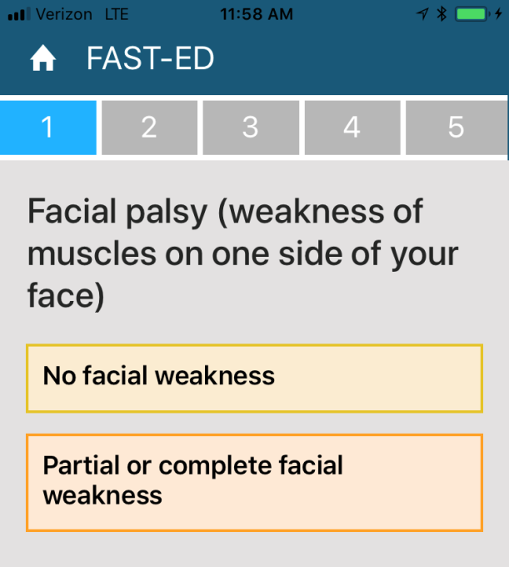
FAST-ED Stroke Scale

Slide 41
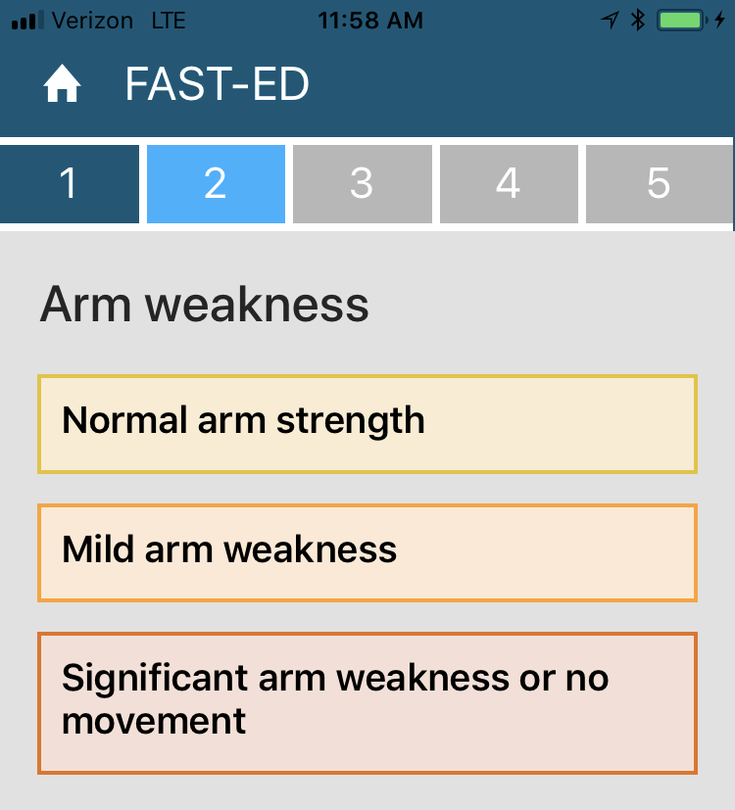
FAST-ED Stroke Scale

Slide 42
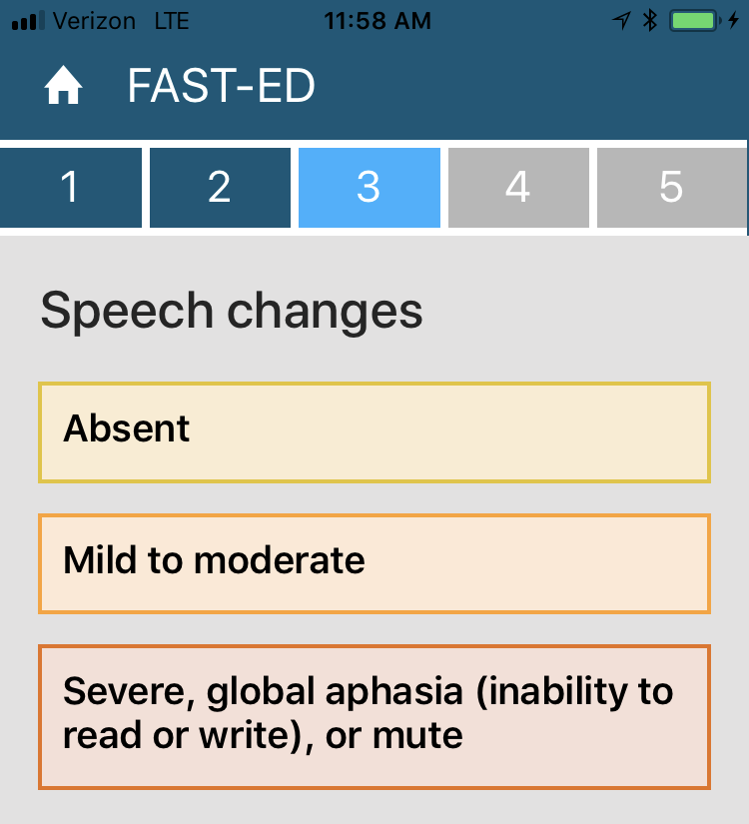
FAST-ED Stroke Scale

Slide 43
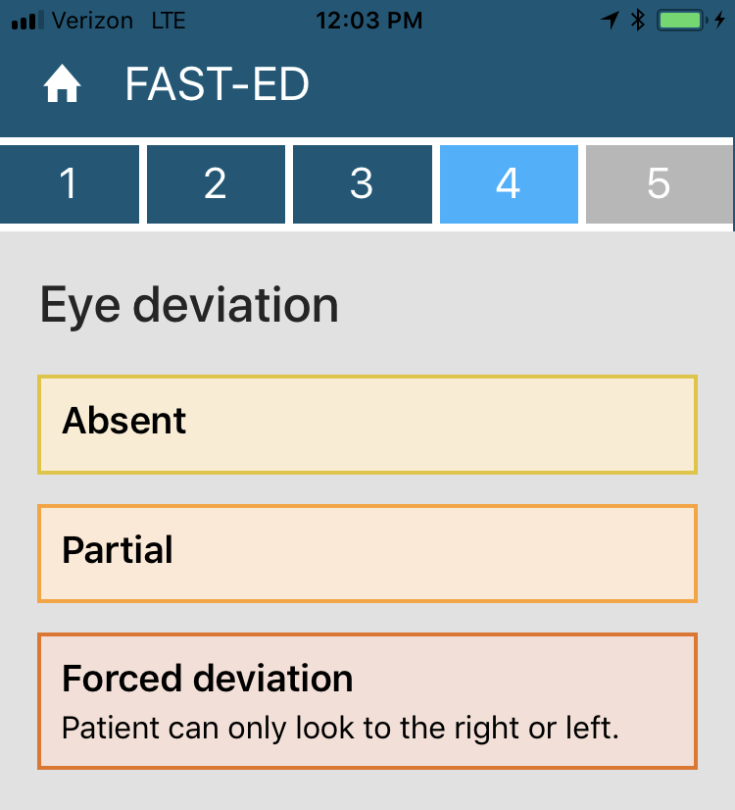
FAST-ED Stroke Scale

Slide 44
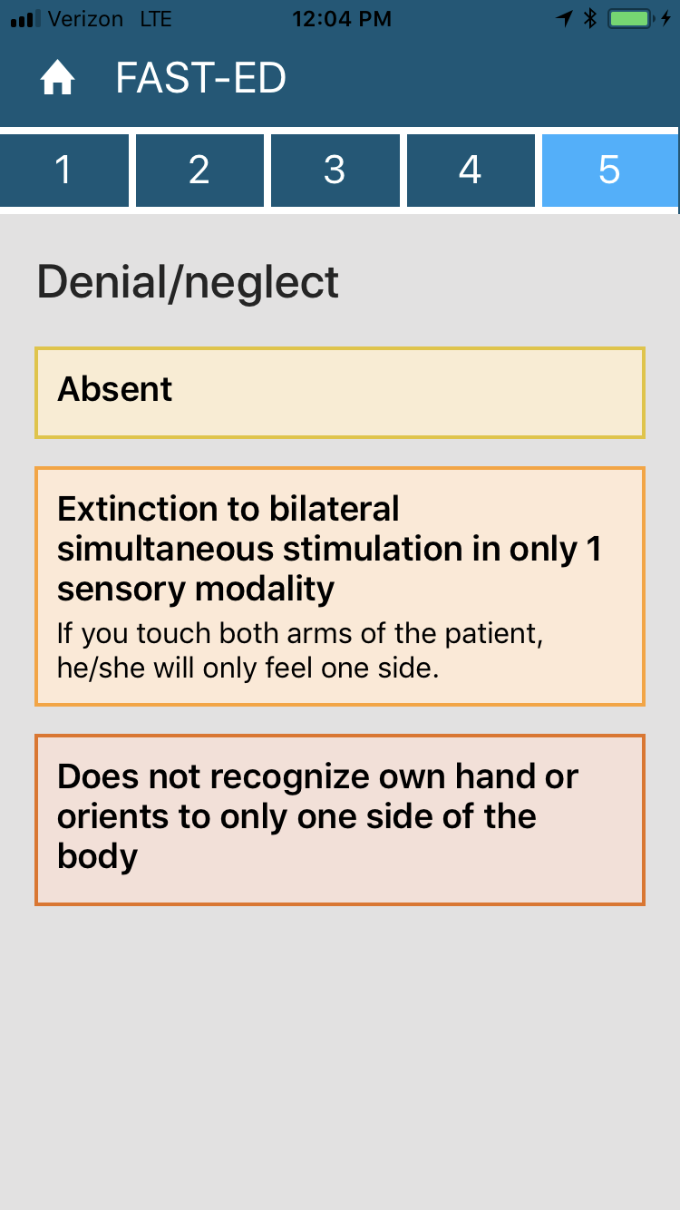
FAST-ED Stroke Scale

Slide 45
Statewide Treatment Protocols
Statewide Treatment Protocols 2017 (VOTE)
  EMCAB is voting to recommend that the Department adopt the updated 2017 Statewide Treatment Protocols, with the updates as proposed by its Medical Services Committee.
Next Steps
  Department reviews the Protocols.
  Upon approval, Protocols are issued to all ambulance services, which includes a 60-day period for training of EMS personnel and the deadline for final implementation.
  Once issuance occurs, ambulance services can begin to implement the new Protocols prior to final implementation date, once personnel are trained.

Slide 46
Back to MSC, Under Reconsideration
IV Pumps
  Required ALS Equipment, under AR 5-402
  Approved MSC 12/14, EMCAB 6/15
  Proposed AR 5-402 went out to ambulance services for comment period, 5/16. Comment period closed 8/16.
  Updated AR 5-402 with pump requirement and other changes issued 9/23/16, with 12/31/17 effective date of pump requirement (and 12/15/16 effective date for all other items).
  Safety in low-frequency use
    Syringe pumps
    Training
Pain management optimization
  Narcotic simplification
    Patient safety
    Effective and safe pain control

Slide 47
Next Steps
Meeting Schedule:
  April 25, 2018, 10:00am-12:00pm
  October 17, 2018 , 10:00am-12:00pm
  April 24, 2019, 10:00am-12:00pm
  October 16, 2019, 10:00am-12:00pm
  All Meetings will be held at MEMA.

Slide 48
Additional Information
For more information, please visit:
https://www.mass.gov/service-details/emergency-medical-care-advisory-board-emcab
http://www.mass.gov/eohhs/gov/departments/dph/programs/hcq/oems/

