Slide 1
Acute Care Advisory Committee
Alzheimer’s Association – State of the State
Wednesday, December 7, 2016
1:30PM-5:30PM
One Ashburton Place, Manning Conference Room, 5th Floor

Slide 2
Problem Statement
The acute care setting can be a very challenging environment for individuals with Alzheimer’s or related dementia. Cognitive functioning often declines after hospitalization. Adoption of dementia-capable care in hospitals can result in improved health care outcomes and reduce unnecessary utilization of hospital care.

Slide 3
What’s Going On?
About one fourth of older hospital patients (65 and older) have dementia.
Their dementia may never have been formally diagnosed, and even if it has been diagnosed, the diagnosis may not be noted in their hospital record.
Some older patients show symptoms of dementia for the first time in the hospital because of stress caused by acute illness and being in an unfamiliar setting.
Source: Alzheimer’s Association

Slide 4

What’s Going On? (Con’t)
Older hospital patients with dementia are at much higher risk for delirium, falls, dehydration, inadequate nutrition, untreated pain, and medication-related problems.
They are more likely to wander, to exhibit agitated and aggressive behaviors, to be physically restrained, and to experience functional decline that does not resolve following discharge.
Source: Alzheimer’s Association

Slide 5
Cost Implications & Analysis
In the United States alone, the number of adults over 65 is expected to reach 79 million by 2030, making up 19% of the population.
Hospitalizations will be more numerous, and cost effective risk management will be even more crucial.
Source: National Institutes of Health

Slide 6
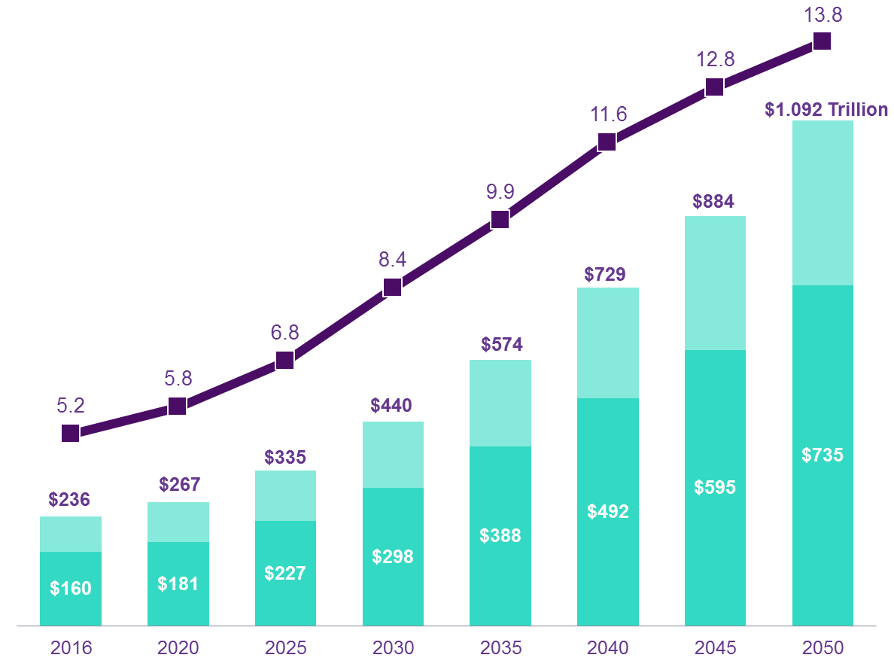
Alzheimer’s Prevalence and Costs
In Millions of People; In Billions of 2016 Dollars

Slide 7
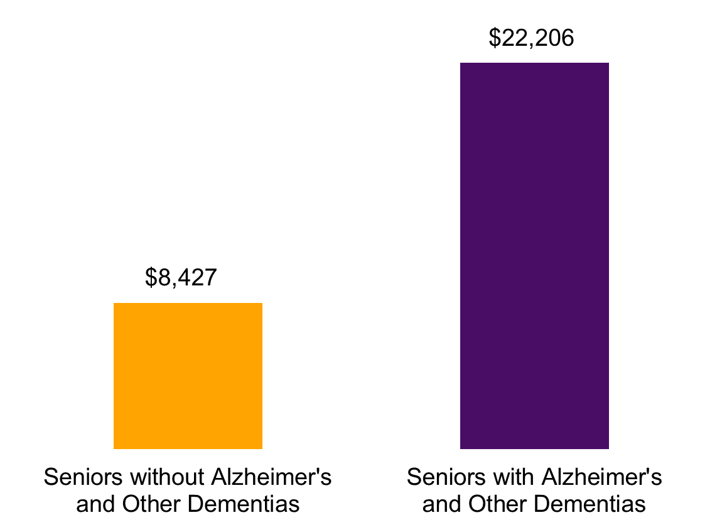
Costs to Medicare
Average Per Person Medicare Payments 2008 (Inflated to 2015 Dollars)

Slide 8
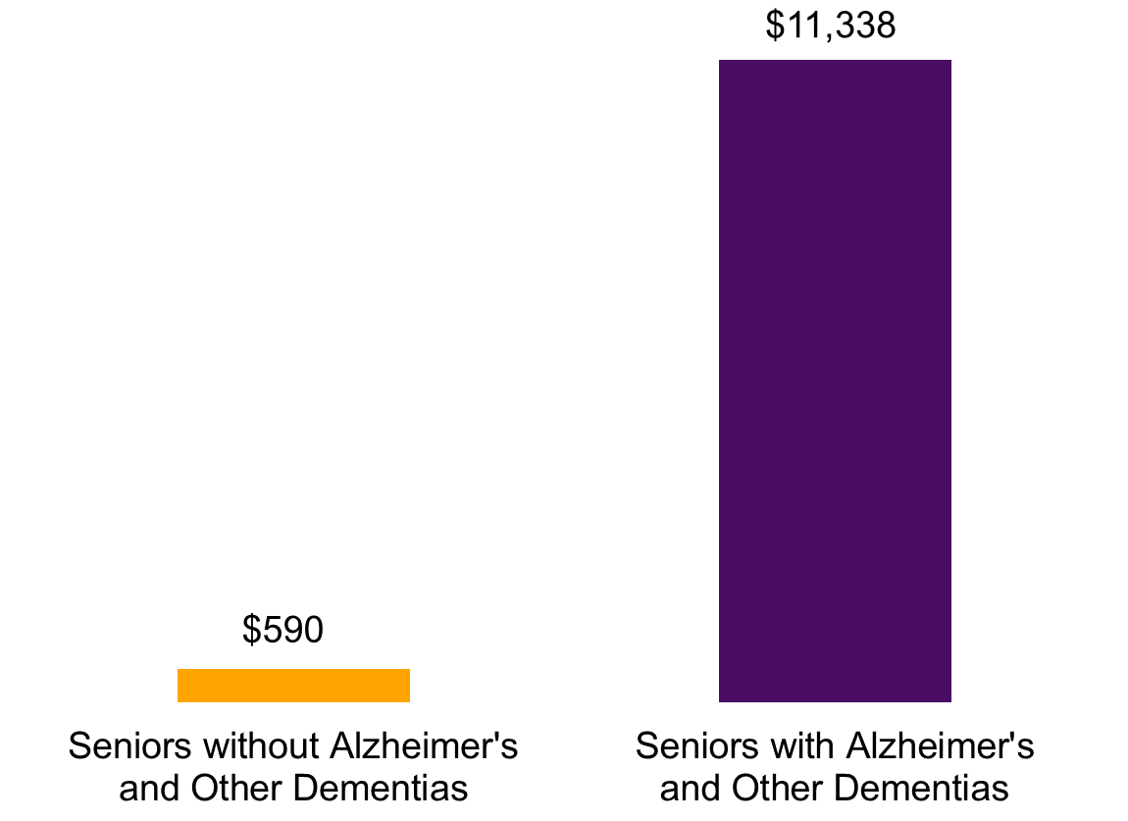
Costs to Medicaid
Average Per Senior Medicaid Payments 2008 (Inflated to 2015 Dollars)

Slide 9
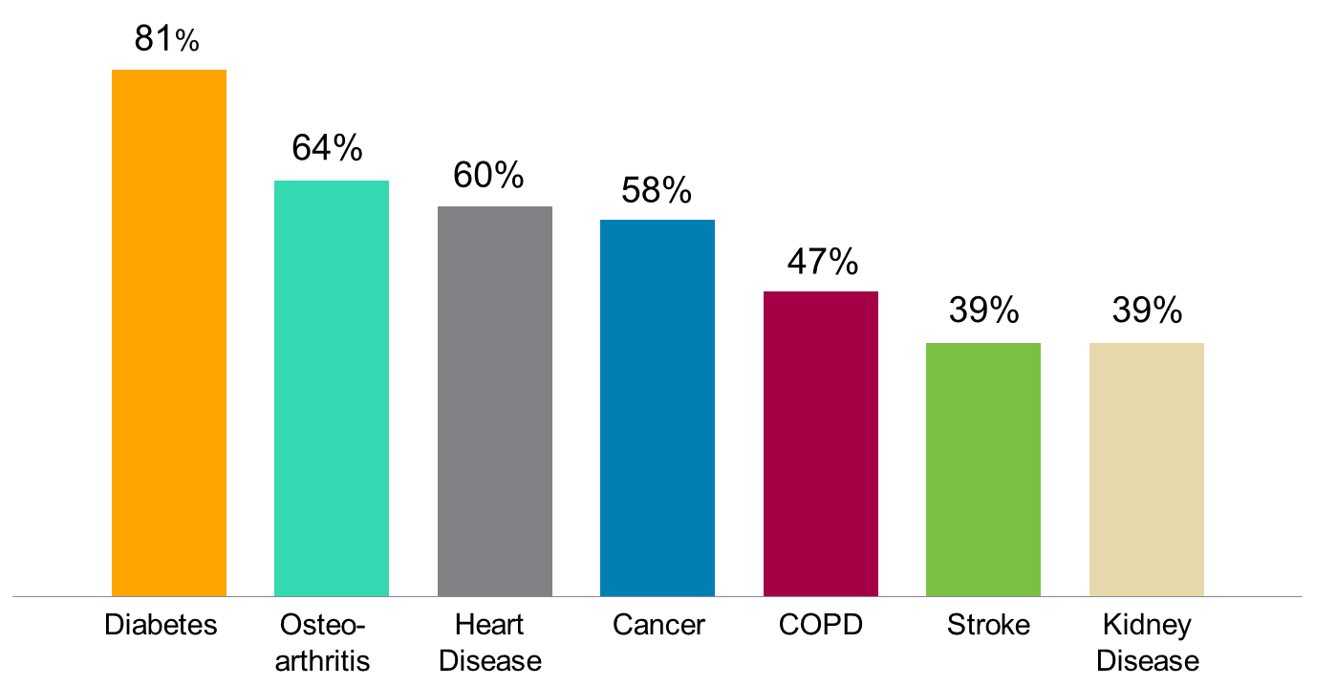
Higher Medicare Costs Due to Alzheimer’s: Average Increase in Costs for Senior with Alzheimer’s and Another Condition Compared with Senior with Other Condition Only

Slide 10
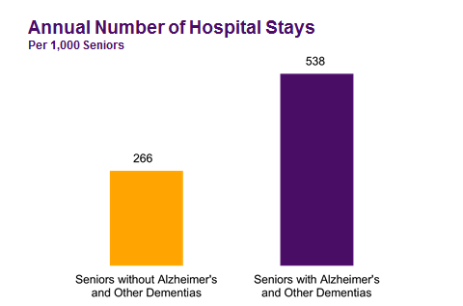
PWD’s -- 1.33 Increase Preventable Hospitalizations

Slide 11
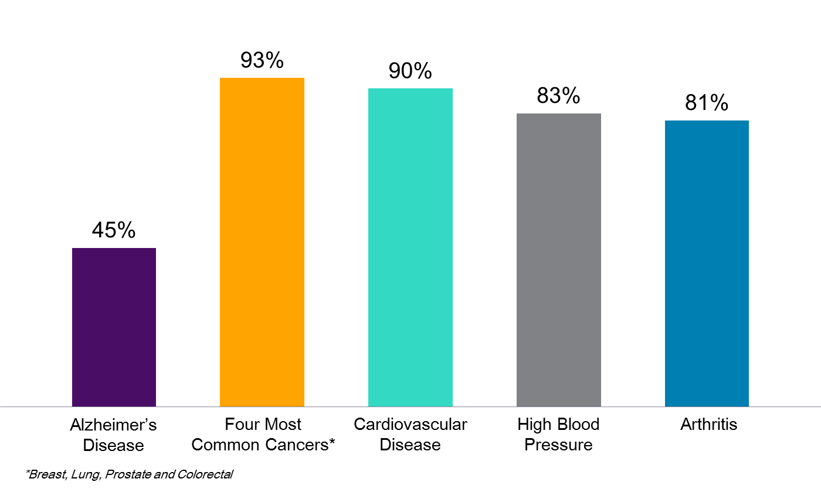
Disclosure of Diagnoses
Percentage of Seniors Diagnosed with Specified Condition or Their Caregivers Who Are Aware of the Diagnosis

Slide 12
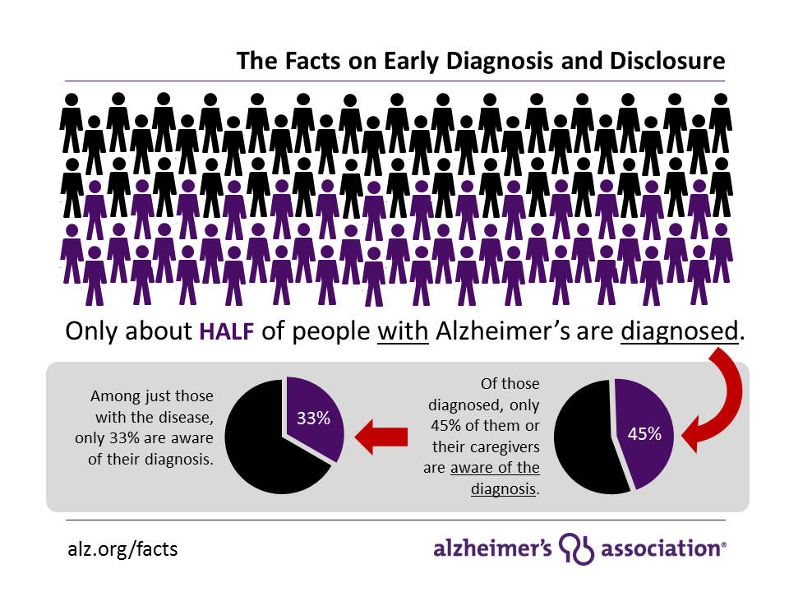

Slide 13
Partners in Dementia Care – VA & Alz Assn. Boston and Houston: Treatment Sites
Telephone care consultation service.
PDC effective in decreasing the number of hospitalizations and ER visits.
But, not in likelihood of initial hospitalization
Positive impact on re-hospitalizations and return ER visits.
Most effective when caregivers reported more difficulties with cognitive symptoms.

Slide 14
Initiatives of Alzheimer’s Association
Risk Management CME program (approved by MMS).
The Dementia Care Coordination Initiative
Currently 8+ partners:
  2 insurers and 6 clinical/hospitals
Adapt acute care settings via the Acute Care Advisory Committee.

Slide 15
Dementia Care Coordination: Transforming Dementia Care
Premise: Supported and capable family caregivers = improved health status for PWD.
Coordinating care between: Clinician, patient/family and Alz. Assn.
Training clinicians in diagnosis, treatment and family support.
Diagnosing early and informing patient/family.

Slide 16
DCC: Expected Outcomes
Decrease in hospital readmissions, decrease in unnecessary ER visits and improved medication management.
Reduction in premature nursing home placement (28% -- Mary Mittelman; NYU).
Improved patient and caregiver health metrics.
Improved AD management strategies.
Improved patient and caregiver satisfaction.

Slide 17
Current Partners
Tufts Health Plan (Medicare Preferred)
McLean Hospital Memory Diagnostic Unit
Partners HealthCare (iCMP)
Blue Cross Blue Shield of Massachusetts (Medicare Preferred)
Boston Medical Center (Depts of Neurology and Geriatrics)
Beth Israel Deaconess Medical Center (Division of Gerontology)
UMass Memorial Health Care (Accountable Care Organization)
NaviCare (Fallon)

Slide 18
Acute Care Setting: The Last Frontier
The Association has worked on addressing the quality of dementia care in various care settings.
  Nursing Homes
    Legislative approach mandated dementia Care standards including training.
    Assisted Living Facilities
    Regulatory approach to improve care standards, as well as physical environment.
  Home Health Care
        Partnership with EOEA: training for Supportive Home Care Aide service.

Slide 19

Not New Problems…New Solutions
Identify core standards of care.
Ensure a collaborative approach in implementing pilot programs.
Present a strategy to the state legislature and state agencies to ensure that acute care settings are dementia-capable.

Slide 20
Key Opportunities to Improve Acute Care
Screening/identifying patients with cognitive impairment
Dementia capable ER protocols
Inpatient care: Developing and implement dementia standards of care
Training and support for direct care hospital workforce
Engaging PWD and family caregivers at all points of inpatient care
Supporting family caregivers as PWD returns home
Implement Dementia Care Coordination initiative
Care transitions to other care settings
Measuring results

Slide 21
References
Bass, David. (2015). Impact of care coordination program “Partners in Dementia Care: on veterans’ hospital admissions and emergency department visits. Alzheimer’s and Dementia, (pp 13-22)
Maslow, K. (2006). How Many People with Dementia are Hospitalized?” In N.M.Silverstein, & K. Maslow (Eds.). Improving hospital care for persons with dementia (pp 3-21). NY: Springer Publishing Co, Inc.
Matthews, S. B., Arnold, S. E., & Epperson, C. N. (2014). Hospitalization and Cognitive Decline: Can the Nature of the Relationship Be Deciphered? The American Journal of Geriatric Psychiatry, 22(5), 465-480.
http://dol.org/10.1016/j.jagp.2012.08.012
Mittleman, Mary, PhD, Neurology. 2006 Nov 14;67(9):1592-9.

