Slide 1
EMERGENCY MEDICAL CARE ADVISORY BOARD (EMCAB)
Wednesday, October 17, 2018
10:00AM-12:00PM

Slide 2
Agenda
Welcome
EMCAB Standing Committees
Medical Services Committee Report to EMCAB
Informational Presentation: Trauma Registry
Next Steps

Slide 3
Welcome: Reminders
Quorum: A Quorum is defined as:
  a simple majority of the members of a public body, unless otherwise provided in a general or special law, executive order, or other authorizing provision. G.L. c. 30A, § 18.
  As applied to EMCAB—a quorum equals 21 members (½ of 41 members + 1 )
Notes:
3

Slide 4
OEMS Updates
Department Update
  Office relocation to be announced
  Certification Season
MIH update
  Community EMS began accepting applications on October 1.
  MIH and MIH with an EDA component will begin accepting applications in late November.

Slide 5
EMCAB Standing Committees

Slide 6
Standing Committees:
Appointment of Chairs
At the November 15, 2017 meeting, EMCAB voted on the chairs of three standing committees.
  Communications: Ed McNamara
  Operations: David Faunce
  Community Care and Education: Derrick Congdon
Today, EMCAB will vote on the chairs of the two remaining committees.
  Workforce Training
    Nominee: Deborah Clapp
  Mass Casualty Incident (MCI) Response
    Nominee: Jonathan Brickett

Slide 7
Standing Committees: Membership Slates
Today, we will vote on the proposed Standing Committee Membership Slates for three Committees:
  Communications
  Operations
  Community Care and Education

Slide 8
Communications Committee
Slate (Vote)
Name | Representation
Ed McNamara | Standing Committee Chair, Central Mass EMS, Region 2
Elliot Derdak | CMED Boston EMS, Region 4
Tina Dixson | CMED – CMEMSC, Region 2
David Faunce | SEMAEMS, Region 5
Kathy Haniffy | CMED – AMR, Region 1
Michael Kass | Armstrong Ambulance, Region 3
Rich Patterson | NEEMS- CMED, Region 3
Marc Restuccia | UMass Memorial Hospital, ED Physician/EMS for Children Designee
Ralph Swenson | CMED Barnstable County Sheriff's Office, Region 5
Derrick Congdon | MBEMSC- CMED, Region 4
Deborah Clapp | WMEMS- CMED, Region 1

Slide 9
Operations Committee
Slate (Vote)
Name | Representation
David Faunce | Standing Committee Chair, SEMAEMS, Region 5
Ron Audette | Hospital (non-EMS), St. Anne’s Hospital
Jeff Begin | ALS Service, Brewster Ambulance
Coleman Bushnell | Service Administrator, Norfolk FD
Andrew Farkas | Aeromedical/Critical Care, Boston Med Flight
Tom Henderson | Fire Based EMS, Rockland FD
Michael Hunter | Hospital Based EMS, UMass/WEMS
Gary Huntress | Volunteer Service
Sean Kukauskas | IFT Service, Spaulding Rehab Amb
Joseph O’Hare | Third Service Municipal, Boston EMS
Yolanda Marrow | EMSC, Baystate MC Pediatric ER
Kevin Mont | Private Ambulance, Fallon Ambulance
Joshua Mullen | Rural Fire Dept, Wilbraham Fire Dept
Jeff Scafidi | Private Ambulance, Armstrong
Ben Turnberg | BLS Service, Chicopee FD

Slide 10
Community Care and Education Committee Slate (Vote)
Name | Representation
Derrick Congdon | Standing Committee Chair, Region 4
Brian Andrews | County Ambulance/ Region 1
Wook Beltran, MD | DO/AHMD/Educator/R1 Medical Director Baystate Health/UMMS
John Broach | Physician/ Region2/ Cadet program/Swat
Timothy Choate | DFS Represenative
Deborah Clapp | Region 1 / EMSC/ Rural rep
Bill Mergendahl | Private ambulance/ Pro EMS
Kevin Mont | Fallon Ambulance
Angela Mulkerin | EMCAB member
Nathan Stanaway | Baystate
Rachel Taradasch | Private ambulance/ Pro EMS
Lisa Trusas | Milford Police Dispatcher

Slide 11
Standing Committee Topics
Operations
  Update AR 5-401 (BLS) and AR 5-402 (ALS) equipment lists.
  Create Class V ambulance equipment list AR
Communications
  Copper Fiber
  FirstNet
  Triage and Transportation Apps
Community Care and Education
  Public access to EMS: Next Generation 911/911 Texting

Slide 12
Medical Services Committee (MSC) Report to EMCAB

Slide 13
Protocol Changes
2019 Statewide Treatment Protocols:
Surgical Cric as MDO
Ketamine for Pain
CPAP for AEMTs

Slide 14
  Trauma Registry

Slide 15
Trauma Registry Background
The Trauma Registry data system (Trauma Registry) is comprised of reported hospital data, as submitted by hospital trauma registrars.
The Trauma Registry collects information in accordance with the National Trauma Data Bank as well as some minimal state specific data points that allow linkages with other State systems.
The data element categories are organization and personal identifiers, demographics, clinical information, injury information, pre-hospital information, emergency department information, diagnosis information, injury severity information, and quality assurance information.

Slide 16
Trauma Registry Reporting Requirements
As required by 105 CMR 130.851 (C): a hospital providing trauma services as a designated trauma center must provide:
to the Center for Health Information Analysis (CHIA) the designated trauma center data set specified in Department guidelines;
As required by 105 CMR 130.852 (A), a hospital that is not a designated trauma center may be licensed to provide Emergency Services only if the hospital provides to CHIA the trauma service hospital data set to be specified in 105 CMR 130.851(C).

Slide 17
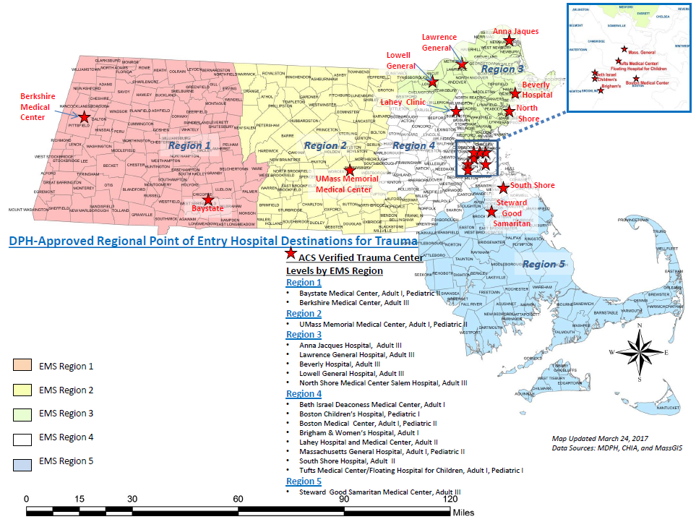
Massachusetts Emergency Medical Service Regions (EMS) and American College of Surgeons (ACS) Verified Trauma Centers

Slide 18
Legacy Data: Injury Type-Terrorism
Data Source: MA Trauma Registry

Slide 19
Legacy Data: All Cause Trauma Incidents by Age
Data Source: MA Trauma Registry

Slide 20
Legacy Data: Trauma Incidents by Age and Gender
Data Source: MA Trauma Registry

Slide 21
Legacy Data: Diving Accidents by Age
Data Source: MA Trauma Registry

Slide 22
Unintentional Trauma by Type-Unintentional Bite
Data Source: MA Trauma Registry
N= 1,346
Notes:
Reported unintentional bites were predominantly dog bites, at over 900 from 2011-2015, other bites and stings were also common, with unintentional human bites were quite rare.

Slide 23
Unintentional Trauma by Type
Data Source: MA Trauma Registry
N= 1,295
Notes:
Community hospitals and non designated trauma centers received the majority of dog bite patients, particularly dog bites and bites that fell into the other category.
Over 1,000 bites meeting registry requirements, including hospitalization, were treated by community hospitals, vs just under three hundred in teaching hospitals.

Slide 24
Legacy Data: Dog Bites by Age
Data Source: MA Trauma Registry

Slide 25
Legacy Data: Suicide and Self-Injury by Age
Data Source: MA Trauma Registry

Slide 26
Legacy Data: Suicide and Self-Injury by Age and Gender
Data Source: MA Trauma Registry

Slide 27
Unintentional Trauma by Type-Vehicle and Pedestrian Related

Slide 28
Unintentional Trauma by Type
Data Source: MA Trauma Registry
N= 53,818

Slide 29
Unintentional Trauma by Type
Data Source: MA Trauma Registry
N= 53,818
Notes:
Nearly 54,000 vehicle or pedestrian related traumas were reported from 2011-2015

Slide 30
Legacy Data: Trauma Incidents by Region and Age
Data Source: MA Trauma Registry

Slide 31
Out of State Transfers
Massachusetts Ambulance Trip Record Information System (MATRIS) is the tool used to collect and maintain standardized EMS patient data and information from licensed EMS services, based on the trip records their EMS personnel complete for each call to which they respond.
These data elements and MATRIS are fully compliant with the National EMS Information System (NEMSIS).
EMS Regions
  Number of Active Services : 339
  Percentage of Services Reporting: 98.2%
  Total Runs Collected: 10,501,124

Slide 32
Out of State Transfers
Massachusetts Ambulance Trip Record Information System (MATRIS)
Trauma Runs 10/1/2014 - 9/30/2015
Destination State | Frequency | Percent
MA facilities | 76,134 | 96.66%
OUT OF STATE - UNK | 1 | 0.00%
OUT OF STATE - CT | 6 | 0.01%
OUT OF STATE - ME | - | 0.00%
OUT OF STATE - NH | 130 | 0.17%
OUT OF STATE - NY | 1 | 0.00%
OUT OF STATE - RI | 504 | 0.64%
OUT OF STATE - VT | 3 | 0.00%
Can't Identify/Missing | 1,985 | 2.52%
Total | 78,764
Destination Names of RI Destinations | Frequency
Hasbro Children's Hospital | 77
Rhode Island Hospital | 492
Total | 569
Total number of ambulance trips: 710,645
Data includes emergency runs only (no Interfacility transfers)
Data includes transported runs only (no cancelled, refusals, treated and released)
Destinations state is based on cleaning of destination name
Trauma Runs are where Primary impression = Traumatic Injury or Cause of Injury is populated
Data abstracted on June

Slide 33
Hospital Level All Cause Trauma Counts
Median = 1885
Data Source: MA Trauma Registry
Median= 1,885
N=143,576 traumas
Notes:
We summed all reported traumas for each hospital from 2011 to 2015 in the Legacy data. This includes designated trauma centers and community hospitals and demonstrates the wide range of traumas reported by participating Massachusetts facilities
Names have been removed to maintain anonymity
These are preliminary data, include 64 reporting facilities and one outlier was removed. This figure may change after additional data cleaning and analysis.
Counts by hospital ranged from 21 to 8,431 traumas, the preliminary count for 2011-2015 is 143,576 traumas. When hospital counts are sorted by volume you can see the counts gradually increase and the spike at the high end of the spectrum.

Slide 34
Additional Information
For more information, please visit:
https://www.mass.gov/service-details/trauma-systems-committee

Slide 35
Future Meetings
Meeting Schedule:
  Wednesday, April 24, 2019
  Wednesday, October 16, 2019
  All meetings will be held from 10:00am-12:00pm and are expected to be held at MEMA.

Slide 36
Additional Information
For more information, please visit:
https://www.mass.gov/service-details/emergency-medical-care-advisory-board-emcab
http://www.mass.gov/eohhs/gov/departments/dph/programs/hcq/oems/
Thank you.

