Slide 1
Health Information Technology Council Meeting
August 5, 2019

Slide 2
Agenda
Welcome
Undersecretary Lauren Peters
Connection requirement/attestation update
Chris Stuck-Girard
HIway 2.0 migration and HIway 1.0 shutdown
David Whitham
Market-based ENS Initiative — Regulatory update
Undersecretary Lauren Peters and Bert Ng
HIway success story
Phill Argyris, Tufts Medical Center
Conclusion
Undersecretary Lauren Peters

Slide 3
Welcome
Undersecretary Lauren Peters

Slide 4
Vote: Approve minutes
MOTION: That the Health Information Technology Council hereby approves the minutes of the council meeting held on May 6, 2019 as presented/amended

Slide 5
Connection requirement/attestation update
Chris Stuck-Girard

Slide 6
HIway connection requirement phased in over four years
The four year phase-in progressively encourages providers to use the HIway for provider-to-provider communications via bi-directional exchange of health information
Progressive HIway connection requirements
Year 1 Send or receive HIway Direct messages for at least one use case ○ Can be from any use case category listed below
Year 2 Send or receive HIway Direct messages for at least one use case ○ Must be a provider-to-provider communications use case
Year 3 Send HIway Direct messages for at least one use case, and Receive HIway Direct messages for at least one use case ○ Both must be provider-to-provider communications use cases
Year 4 Meet Year 3 requirement or be subject to penalties if requirement is not met ○ Penalties go into effect in the applicable Year 4 (e.g., January 2020 for acute care hospitals)
Additional ENS requirement for acute care hospitals only
Send admission, discharge, and transfer notifications (ADTs) to ENS framework
2019
Future
Use case categories
Public health reporting
Provider-to-provider communications
Quality reporting
Payer case management

Slide 7
HIway connection and attestation requirement
The HIway connection requirement requires providers to connect to the Mass HIway
as set forth in M.G.L. Chapter 118I, Section 7, and as detailed in the Mass HIway Regulations (101 CMR 20.00)
The table below shows the year by which organizations must connect to the HIway
The organizations must subsequently attest to their connection between June 1 and July 31 of each year
Provider organization | First year requirement applies | Submit by July 31, 2019
Acute care hospitals | 2017 | Year 3 attestation form
Large and medium medical ambulatory practices | 2018 | Year 2 attestation form
Large community health centers
Small community health centers | 2019 | Year 1 attestation form

Slide 8
Improvements to attestation process
For the 2019 attestation cycle, the HIway updated forms, added a save and continue function to the online webforms, and enabled webform submission of HIE Requirement Exception Forms
Last fall, the HIway analyzed how the attestation forms could be improved:
Ease of use/convenience for provider organizations
Quality of submitted data
Supplemental instructions were fleshed out, confusing questions were clarified, and new questions were added
A save and continue function was added to the online webform, providing convenience for submitters
New this year: POs may not submit PDF forms

Slide 9
2019 Attestation Update
As of August 1, submissions of Attestation Forms (95 submissions) and HIE Exception Forms (38 submissions) were coming in at a steady pace.
The HIway continues to reach out to provider organizations to maximize submissions.
Status update (as of August 1, 2019):
26 Acute Care Hospitals submitted Year 3 forms, and 23 submitted exception forms regarding HIway connection plans (73%; 49 out of 67 expected).
24 Community Health Centers submitted Year 2 forms; 2 provided exception forms (65%; 26 out of 40 expected).
45 Medium/Large Medical Ambulatory Practices submitted Year 2 forms, and 13 provided exception forms. A total of 340 entities (including organizations, sub-organizations, and practice locations) were accounted for by these forms. There are approximately 553 practices that meet the regulatory definition of a Medium/Large Medical Ambulatory Practice.
Notes:
Note: Karishma to update

Slide 10
August/September attestation outreach
Attestation Goals:
All ACHs/CHCs submitting forms
Increased submissions from practices, especially the 47 large practices with 50+ providers
In early August, send mass and individual emails with deadline, links, and instructions. Sources of email contacts:
POs that have started forms
2018 attestation/exception forms
HIway/MeHI contacts database
Webinar attendees
Hold one more attestation/connection requirement webinar (Aug. 20)
After webinar and emails, send postal mail advisory to ACHs, CHCs, and large practices that have not submitted form (early September)
Notes:
Note: Karishma to update

Slide 11
Estimating universe of medium & large medical ambulatory practices
Issue
HIway defines medium medical ambulatory practices as 10 registered providers or more
HIway defines large medical ambulatory practices as 50 registered providers or more
No external source of truth that counts registered providers
Why this matters
HIway needs, but currently lacks, an accurate count to measure progress
HIway can begin fining medium and large practices for failure to attest in CY2021
Recommended solution
HPC RPO data and MeHI Salesforce data count physicians
Peer-reviewed research estimates that practices with 8 physicians have at least 10 registered providers*
Using that ratio, HIway/MeHI developed a list of the estimated universe of 553 medium/large practices
*Peikes, Deborah N., et al. “Staffing patterns of primary care practices in the comprehensive primary care initiative.” The Annals of Family Medicine 12.2 (2014): 142-149. (Estimating 8 physicians will have at least 2 providers [PAs + NPs] on staff to exceed the 10 registered provider threshold)

Slide 12
Universe of medium/large medical ambulatory practices
Questions and Comments
Is this approach to developing a universe of medium/large medical ambulatory practices reasonable?
Does our methodology make sense?
Next steps: Review with stakeholders

Slide 13
HIway 2.0 migration and HIway 1.0 shutdown
David Whitham

Slide 14
HIway 2.0 migration status
Participant Migration Completed 6/13/2019
As of 6/13/2019 a total of 252 participants completed migrating their 316 connections to HIway 2.0.
A few HIway 1.0 participants were not ready to migrate. Each implemented individual plans to establish new HIway 2.0 connections at a later date, when their organization’s testing is complete and their forms are approved.
HIway 1.0 Shut Down on 6/14/2019
On 6/14/2019, access to HIway 1.0 was shut down, following an extensive communications and awareness campaign. To date, no reports have been received of HIway Participants inadvertently left behind.
On 6/28/2019 the HIway approved work orders to decommission the HIway 1.0 infrastructure.

Slide 15
HIway 2.0 achievement graph by quarter
HIway 2.0 Migrations WAVES 0-1
Early Adopters & Pilots
WAVE 2
WAVES 2-3
Initiation and Planning Infrastructure setup/testing
9 CG nodes Migrated
Project Management Plans are in place
Pilot Participants are engaged
Early Adopter migrations in progress
Completed a total of 7 Participant migrations
Q1-Q2 2018
Q2 2018
Q3 2018
Q4 2018
Q1 2019
Q2 2019
WAVES 4-6
WAVES 7-9
WAVES 10-11 & SUNSET HIway 1.0
Completed a total of 71 Participant migrations
Completed a total of 161 Participant migrations
Completed a total of 252 Participant migrations

Slide 16
HIway 2.0 transaction volume growth and progression of participant migrations

Slide 17
HIway 2.0 client engagements
Project Kick-Off
Planning &
Testing
Outreach
Process Awareness &
Training
Migration Engagement
Production
Cutovers
Typical HIway 2.0 Migration Cycle is 4-8 Weeks
HIway 2.0 migration was a collaborative process including the Participant’s business and IT teams as well as EOHHS and Orion Health members of the Mass HIway team
A few migrations exceeded 8 weeks due to high volumes, extensive testing requirements, or long turnaround times for forms. The following were key areas of focus during the life cycle:
Process, documentation, and training in completion of the DOID and HCO forms
Outreach to all participating teams and trading partners throughout the migration cycles
Migration schedule development, including weekly status planning and support discussions, with large organizations including:
Atrius Health, BIDMC, Boston Children’s Hospital, Partners HealthCare, Tufts Medical Center
Walkthrough of production cutover plans and execution of the cutovers

Slide 18
Process and support for new HIway onboarding
Discovery
Week 1-2
Account Manager will work with New Orgs to select the best connection options and direct address
Execute
Week 3-5
Account Manager will assist the New Orgs with the identity verification process (DOID and HCO Forms)
Test
Week 6-8
HIway Services Team will configure and test the solution prior to Go Live
Go Live
Week 9
After going live, Account Manager will provide training and workflow support
* Timeline indicates typical time spent by the Mass HIway team from the time all completed requirements are obtained from the participant. Actual times vary by connection type and EHR vendor.

Slide 19
Market-based ENS Initiative – Regulatory update
Undersecretary Lauren Peters and Bert Ng

Slide 20
ENS initiative: History
EOHHS ENS Initiative goal:
Supporting timely statewide Event Notification Services (ENS) across the Commonwealth in order to improve health care delivery, quality, and coordination
EOHHS process:
Feb 2018: RFR issued - Developing a state-operated repository of Admission, Discharge, and Transfer (ADT) data with the potential for ENS services in the future
Oct 2018: RFR cancelled - Creating a state-operated ADT repository would be duplicative of existing market capabilities
Oct 2018: RFI issued - Leveraging the existing ENS marketplace to achieve universal provider access to ENS more quickly
Jul 2019: Proposed regulations - Defining certification process for ENS vendors
EOHHS guiding principles:
Universal access - Promoting data sharing within an ENS framework to increase accessibility to ENS by providers of all sizes
Streamline provider experience - Crafting ENS framework to allow single submission and single reception of data
Improve notification timing - Working with industry to improve data flow timing

Slide 21
ENS initiative: Framework
Data submitters – acute care hospitals
Boston Hospital
Pittsfield Hospital
Cape Hospital
ENS
Framework*
Share Data
ENS 1
Contracts:
Boston PCP
Boston BH
ENS 2
Contract:
Boston CP
ENS 3
Contract:
Cape PCP
Boston PCP
Boston BH
Boston CP
Cape PCP
ENS recipients
*ENS framework will include regulations and a state certification process that will govern the ENS initiative. Number of vendors still to be determined; three used for simplified illustrative purposes.

Slide 22
ENS initiative: Regulatory and certification process
Objectives:
Implement a regulatory framework that:
Supports initiatives the HIway would facilitate to improve health care delivery, quality, and coordination
Promotes robust privacy and security standards that protect patient data
Regulation:
Establish a HIway-facilitated framework, including ENS certification process
Require providers to submit ADT feeds to certified ENS vendor(s)
Certification:
EOHHS to develop detailed objective criteria to determine certification eligibility
Define ENS “rules of the road” through vendor certification (e.g., limit use cases, require vendor reflection, security requirements, etc.)

Slide 23
ENS regulation and certification timeline
Q3 2019
6/28 – Proposed regulation published
7/19 – Proposed regulation public hearing & written testimony
Finalize regulation
Listening session on certification criteria
Q4 2019
Post certification criteria
Vendors chosen and certified
Q1 2020
ENS framework live

Slide 24
Certification: Process
Vendors will be certified for a 2-year term, with the option to recertify. Future certification criteria will account for evolving HIT landscape and new technologies.
Initial certification
Future certification
(Re-certification)
Term
2-year term
(’20 – ’22)
2-year terms (’22 – ’24, ’24 – ’26, etc.)
Objective
Create framework for vendor to vendor ADT sharing
Adapt with changing/new technologies and ENS services
Criteria
Some flexibility on interoperability standards
(menu of options)
Move toward uniform interoperability standards

Slide 25
ENS Initiative discussion
Questions and Comments

Slide 26
HIway success story
Phill Argyris, Tufts Medical Center

Slide 27
Tufts Medical Center – External Provider Communications and the Mass HIway
Presenter:
Phill Argyris
Manager of Software Development, Information Services
Rob Troller, Aaron Tatko, Binh Phan, Eric Lominac, Graeme Townrow
August 5, 2019

Slide 28
Tufts MC began Automated External Provider Communication with AutoFax & Secure Email
Started in 2007
200 NEQCA Physicians with Communication Preferences for AutoFax
Secure Email Pilot – April 2012

Slide 29
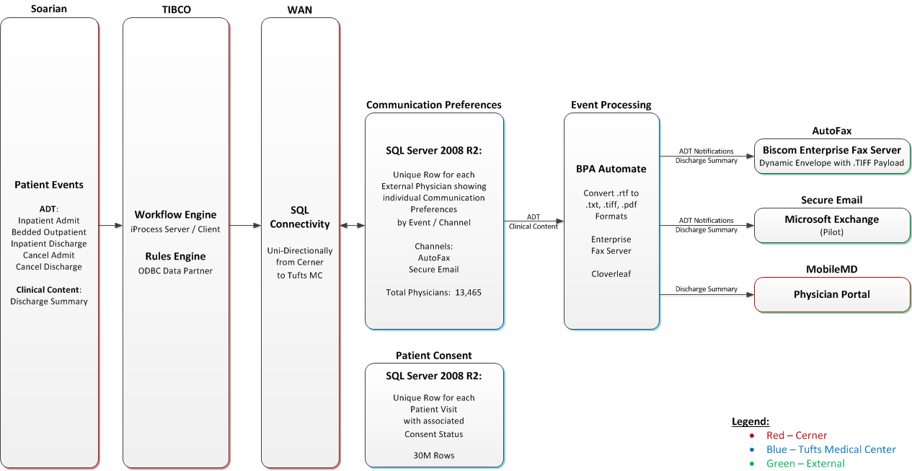
Tufts MC External Provider Communication Technical Architecture – 2012

Slide 30
Tufts MC Internal Provider Directory

Slide 31
Tufts MC External Provider Communication by the numbers…
AutoFax:
Total: 339,488
Timeframe: 10/17/2011 – 6/25/2019
Secure Email:
Total: 4,635
Timeframe: 3/19/2014 – 6/25/2019
Post-Acute:
Total: 5,230
Timeframe: 12/10/2014 – 6/25/2019

Slide 32
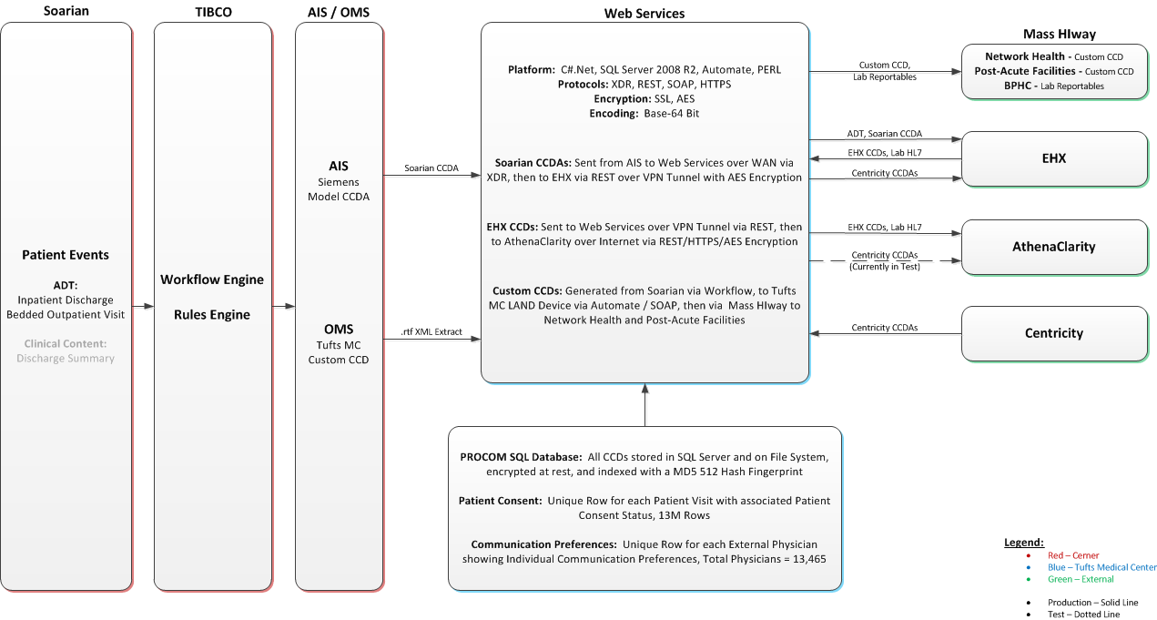
Tufts MC External Provider Communication Technical Architecture – 2016

Slide 33
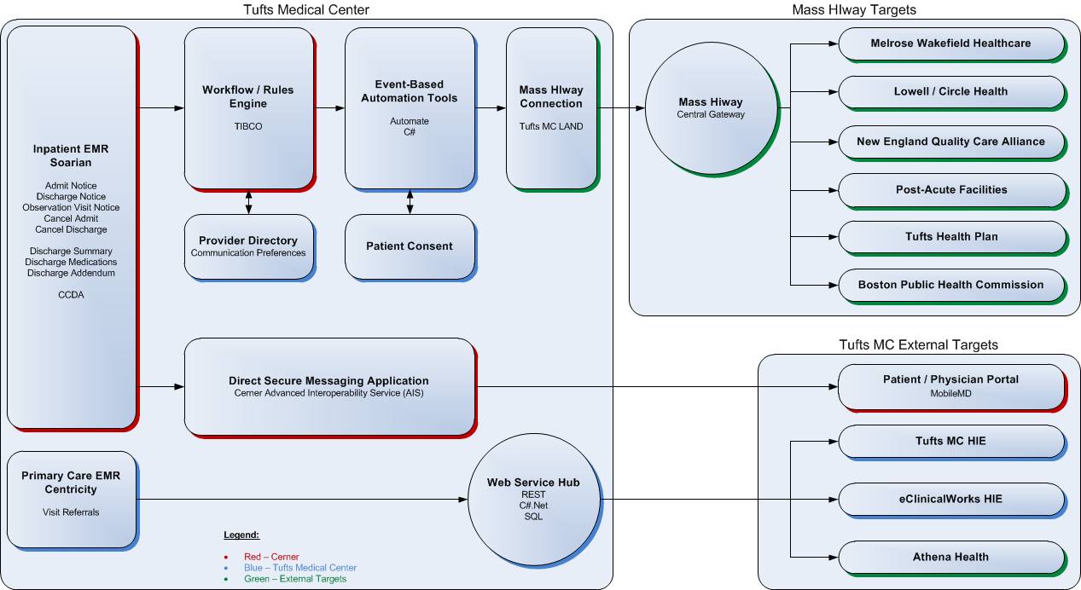
Tufts MC External Provider Communication Updated Architecture with Mass HIway

Slide 34
Tufts MC Mass HIway – External Provider Communications by the numbers…
Summary of Tufts Medical Center Outbound Mass HIway Messages – as of 6/25/2019
Hospital Affiliation | EMR | Practice | Domain | Physicians | Live Date | ADT Notifications | Discharge Summaries | CCDs | Total
Melrose-Wakefield | Centricity | Hallmark Health | Cerner | 120 | 7/26/2017 | 5,899 | 2,373 |  | 8,272
Lowell General | Millennium | LGH Woman Health, Inc. | womanhealth.circlehealthdirect.org | 7 | 2/1/2018 | 20 | 14 | 1 | 35
Lowell General | Millennium | Cancer Care Associates | cancercareassociates.circlehealthdirect.org | 5 | 4/5/2018 | 18 | 8 | 2 | 28
Lowell General | Millennium | OBGYN Associates | obgynassociatesmv.circlehealthdirect.org | 4 | 2/1/2018 | 17 | 3 |  | 20
Lowell General | Millennium | Lata Mundkur | latamundkur.cernerdirect.com | 1 | 1/21/2018 | 6 | 1 | 5 | 12
Lowell General | Powerworks | Chelmsford Pediatrics | chelmsfordpediatrics.cernerdirect.com | 4 | 6/22/2017 | 206 | 93 | 184 | 483
Lowell General | Powerworks | Riverside Medical | riversidemed.cernerdirect.com | 6 | 12/14/2017 | 187 | 79 | 154 | 420
Lowell General | Powerworks | Drumhill Pediatrics | drumhillpediatrics.cernerdirect.com | 3 | 9/29/2017 | 139 | 57 |  | 196
Lowell General | Powerworks | Office of Deirdre Connolly | officeofdeirdreconnolly.cernerdirect.com | 2 | 12/13/2017 | 93 | 33 | 70 | 196
Lowell General | Powerworks | Chelmsford Internal Medicine | chelmsfordinternalmedicine.circlehealthdirect.org | 1 | 12/18/2017 | 16 | 7 | 11 | 34
Lowell General | Powerworks | Sepulveda Associates | sepulvedaassociatespc.cernerdirect.com | 2 | 5/17/2018 | 15 | 5 | 2 | 22
Lowell General | Powerworks | Lowell Surgical Associates | lowellsurgassociates.cernerdirect.com | 2 | 4/4/2018 | 6 | 2 |  | 8
Lowell General | Powerworks | Merrimack Valley Ortho | merrimackvalleyortho.cernerdirect.com | 4 | 8/15/2018 | 3 | 1 | 1 | 5
Lowell General | eCW | Lowell General | eclinicaldirectplus.com | 42 | 11/28/2018 |  | 196 |  | 196
NEQCA | Custom | Blue Hills Medical Center | bluehillsmedicalcenter.masshiway.net | 2 | 7/26/2016 | 136 | 51 | 106 | 293
 |  |  |  | 205 |  | 6,761 | 2,923 | 535 | 10,220

Slide 35
Tufts MC Mass HIway – External Provider Communications by the numbers – Post-Acute…
Summary of Tufts Medical Center Outbound Mass HIway Post-Acute Messages – as of 7/8/2019
Hospital Affiliation | EMR | Domain | Live Date | ADT Notifications | Discharge Summaries | Custom CCDs | Total
Marian Manor (So.Boston) | PointClickCare | marianmanor@marianmanor.pccdm.com | 12/4/2014 |  | 43 | 164 | 207
VNA Care Network | Mass HIway Webmail | vna.care@direct.vnacare.masshiway.net | 12/16/2014 |  |  | 3,957 | 3,957
South Shore VNA | Mass HIway Webmail | south.shore@direct.sshvna.masshiway.net | 6/4/2015 |  |  | 1,028 | 1,028
Kindred Hospital | N / A | hospital.kindreddirect.com | 6/5/2015 |  |  | 75 | 75
 |  |  |  |  | 43 | 5,224 | 5,267

Slide 36
Mass HIway Use Case 1: Tufts MC to Provider on eClinicalWorks
Upon discharge of the patient, Tufts automatically sends the Discharge Summary to the PCP at Circle Health
The Discharge Summary is sent as a Direct Message with a PDF attachment over the Mass HIway, and is received in the PCP’s eClinicalWorks EHR

Slide 37
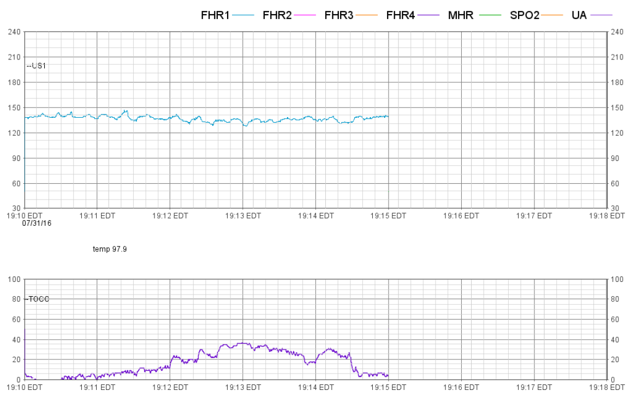
Mass HIway Use Case 1: Tufts MC to Provider on eClinicalWorks
LGH provider requires a consult for a patient, or transfers care to Tufts MC, and sends a PDF of Fetal Link Report from their Cerner Millennium EHR to ldrcoverage@direct.tuftsmedicalcenter.masshiway.net via Direct Message
This Direct Message is received by Tufts Mass HIway Connect Device, and is forwarded as an encrypted email to LDR Coverage account for review
Provider reviews report at LDR Coverage; can reply via encrypted email in Outlook, and Mass HIway Connect Device sends a Direct Message to LGH provider, which is received by LGH provider in Cerner Millennium EHR

Slide 38
Conclusion
Undersecretary Lauren Peters

Slide 39
Appendix: HIway operations update

Slide 40
HIway participation April 21, 2019 – July 20, 2019
7
New participation agreements
4D Healthware Capital Blue Cross Care Alliance of Western Massachusetts Daybrook Skilled Nursing Hospice of Franklin County Merrimack Valley Child & Adolescent Health Riverside Pediatrics

Slide 41
HIway connections April 21, 2019 – July 20, 2019
20
New connections
4D Healthware* Anna Jaques Hospital Boston Children’s Hospital Capital Blue Cross* Cambridge Health Alliance Care Alliance of Western Massachusetts* Daybrook Skilled Nursing* East Boston Neighborhood Health Center Elder Services of Berkshire County, Inc. Hospice of Franklin County* Hunt Nursing & Retirement Home MelroseWakefield Healthcare, Inc.**
Mount Greylock Extended Care Netsmart Pioneer Valley Information Exchange Tri-County Pediatric Associates Tufts Health Plan WestMass ElderCare Windsor Nursing Home
* Participants that were enrolled and
connected in the same period
** Received two new connections
All other participants received new connections during 2.0 migration

Slide 42
HIway transactions
HIway transaction reporting update
The mechanisms for counting transactions changed with the migration from HIway 1.0 to HIway 2.0 To avoid potential confusion caused by combining counts from two differing systems, reporting of transaction data was suspended The HIway team continues to monitor transaction levels for operational purposes Now that HIway 2.0 transaction data is being collected, we can see that transaction levels have continued to exceed 10 million per month Public Health Reporting continues to represent about 87% of transactions, while over 140,000 Provider to Provider transactions are processed each month Incidentally, a much higher capacity was demonstrated as the system accommodated a significant temporary increase spanning May and June due to a provider system error The HIway team will prepare updated graphs and data that provide additional insight into trends and progress when we have more history with HIway 2.0

Slide 43
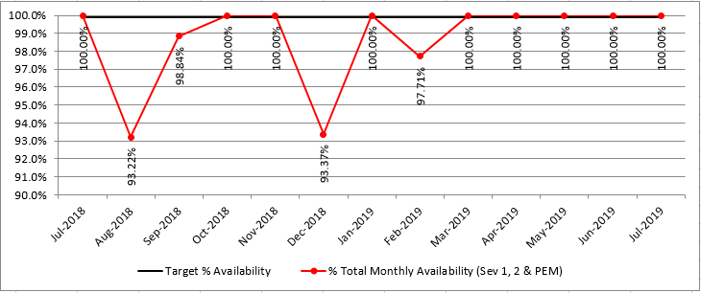
13 month HIway availability review
Target: “Total monthly availability” – no lower than 99.9% (downtime no more than ~44 minutes/month)

Slide 44
Thank you!

