Slide 1
V
Health Information Technology Council Meeting
November 4, 2019

Slide 2
Agenda
Welcome
Undersecretary Lauren Peters
Market-based ENS Initiative — Regulation/certification update
Bert Ng
HIway connection requirement/attestation update
Chris Stuck-Girard
HIway education, outreach, and provider consulting services update
Laurance Stuntz & Julie Creamer
Governor’s healthcare bill & HIway strategic plan
Undersecretary Lauren Peters & Bert Ng
Conclusion
Undersecretary Lauren Peters

Slide 3
Welcome
Undersecretary Lauren Peters

Slide 4
Vote: Approve minutes
MOTION: That the Health Information Technology Council hereby approves the minutes of the council meeting held on August 5, 2019 as presented/amended

Slide 5
Market-based ENS Initiative — Regulation/certification update
Bert Ng

Slide 6
ENS Initiative history
EOHHS ENS Initiative goal:
Supporting timely statewide Event Notification Services (ENS) across the Commonwealth in order to improve health care delivery, quality, and coordination
EOHHS process:
Feb 2018: RFR issued - Developing a state-operated repository of Admission, Discharge, and Transfer (ADT) data with the potential for ENS services in the future
Oct 2018: RFR cancelled - Creating a state-operated ADT repository would be duplicative of existing market capabilities
Oct 2018: RFI issued - Leveraging the gains of existing ENS marketplace to achieve universal provider access to ENS more quickly
Oct 2019: Regulation finalized - Formalizing certification process for ENS vendors
EOHHS guiding principles:
Universal access - Promoting data sharing within an ENS framework to increase accessibility to ENS for providers of all sizes
Streamline provider experience - Crafting ENS framework to allow single point of submission and single point of reception of data
Improve notification timing - Improving timing for flow of data (real/near-real time)

Slide 7
ENS certification: Process
Vendors will be certified for a 2-year term, with the option to recertify. Future certification criteria will account for evolving HIT landscape and new technologies.
Objective
Create framework for vendor-to-vendor ADT sharing
Term
Initial fixed 2-year term
(’20 – ’22)
Future rolling 2-year terms
Criteria
EOHHS will evaluate ENS vendors’ ability to meet certification criteria
Standard MA terms
ENS vendors agree to and comply with standard terms and conditions of the Commonwealth
Obligations
The terms that ENS vendors will be held to for participating in the ENS framework

Slide 8
ENS certification: Criteria
EOHHS will evaluate all ENS vendors based on business requirements, functional capabilities, and security capabilities to determine whether to grant certification
Business requirements
Functional capabilities
Security
Do business in MA
Minimum operating threshold
20 practices or
700k patients
Full status
Threshold in MA
Provisional status
Demonstrate MA success potential
Add’l business info
Adverse events
Data breaches
Send and receive HL7 ADTs
Patient matching algorithm
Generating notifications to ENS recipients
Secure destruction of ADTs
Reporting to the state (see “Reporting requirement,” next slide)
HITRUST Certified
Encrypt data at rest
Use secured channel to transmit data
Use endpoint security measures like antivirus, security training, and secure destruction of ADTs

Slide 9
ENS certification: Obligations
EOHHS will hold all Certified ENS Vendors to the ENS framework obligations during the certification term in areas including data security, data reflection, and reporting
Data security
Data reflection
Reporting requirement
Maintain HITRUST Certification
Maintain certification criteria standards
Encryption
Secure channel
WISP
Must treat ADT appropriately under data reflection
Certified ENS Vendors must share ADTs with one another
Certified ENS Vendors must handle and delete ADTs appropriately
Immediate deletion of Raw ADTs, non-match Processed ADTs
Report quarterly transaction data
Report Client list quarterly for program management (submitters + receivers)
Report adverse events or changes in certification condition

Slide 10
ENS mechanics: ADT processing
Submitting vendor processes
Recipient vendor processes
Acute Care Hospital
Submits ADT
Send
Raw
ADT
Certified ENS
Vendor 1
Send
Raw
ADT
Certified ENS
Vendor 2
Process ADT to canonical format for matching
Keep
Raw
ADT
Keep
Processed ADT
Delete
Raw
ADT
Keep
Processed ADT
(matching purposes only)
Patient match
Delete
Raw
ADT
Keep
Processed ADT
(CE2/BA2 BAA)
No patient match
Delete
Raw
ADT
Delete
Processed ADT
Note: Required deletions must be done immediately at end of automated process step

Slide 11
ENS Initiative: ENS regulation and certification timeline
Q3 2019
6/28 – Proposed regulation published
7/19 – Proposed regulation public hearing & written testimony
Q4 2019
10/4 Final regulation in effect
10/4 Listening session on certification criteria
Post finalized certification criteria on COMMBUYS
Qualifying vendors certified
Q1 2020
ENS framework creation
Q2 2020
ENS framework live – Hospital ADTs requirement delay

Slide 12
HIway connection requirement/attestation update
Chris Stuck-Girard

Slide 13
2019 attestation update
As of Oct. 30, the HIway received 137 Attestation Forms and 55 HIE Exception Forms.
With submissions trailing off, the HIway plans shut down the attestation webform imminently.
Status update (as of Oct. 30):
43 Acute Care Hospitals submitted Year 3 forms, and 24 submitted exception forms regarding HIway connection plans (100%; 67 out of 67 expected).
34 Community Health Centers submitted Year 2 forms; 3 provided exception forms (93%; 37 out of 40 expected).
60 Medium/Large Medical Ambulatory Practices submitted Year 2 forms, and 28 provided exception forms.
A total of 557 entities were accounted for by these forms (including organizations, sub-organizations, and practice locations). An estimated 553 practice entities meet the regulatory definition of a Medium/Large Medical Ambulatory Practice.
Notes:
Note: Karishma to update

Slide 14
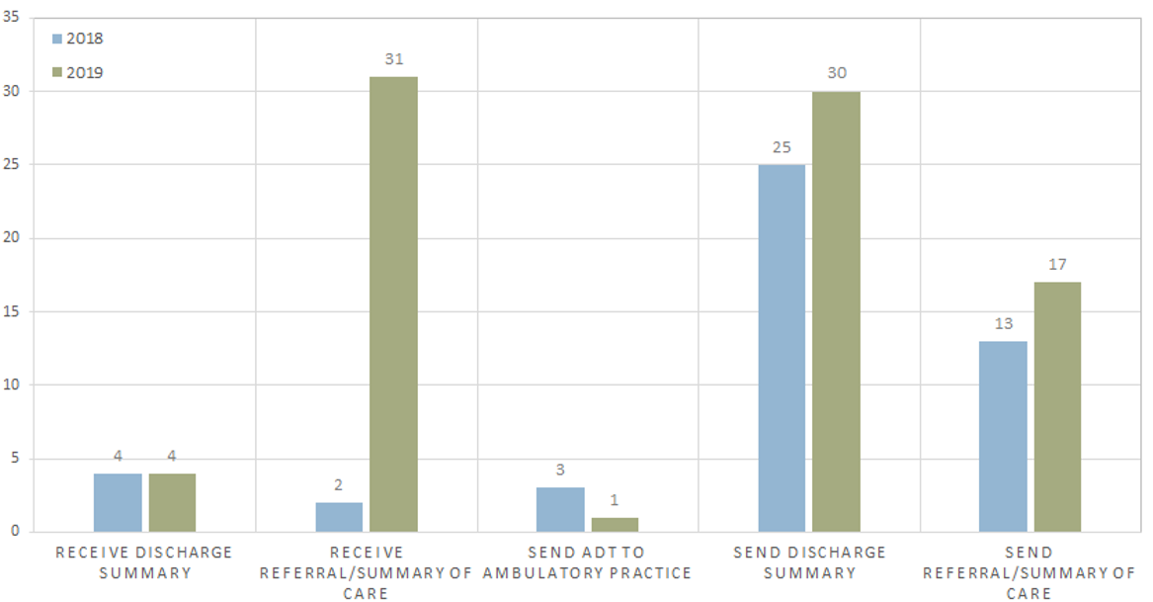
Attestation use cases: Provider-to-provider transmissions
Acute care hospitals
*See Appendix B for detailed use case statistics
Notes:
Shows Provider to Provider use cases that were submitted during the 2018 and 2019 attestation periods.
The blue bar represents 2018 submissions and the green bars are for 2019.

Slide 15
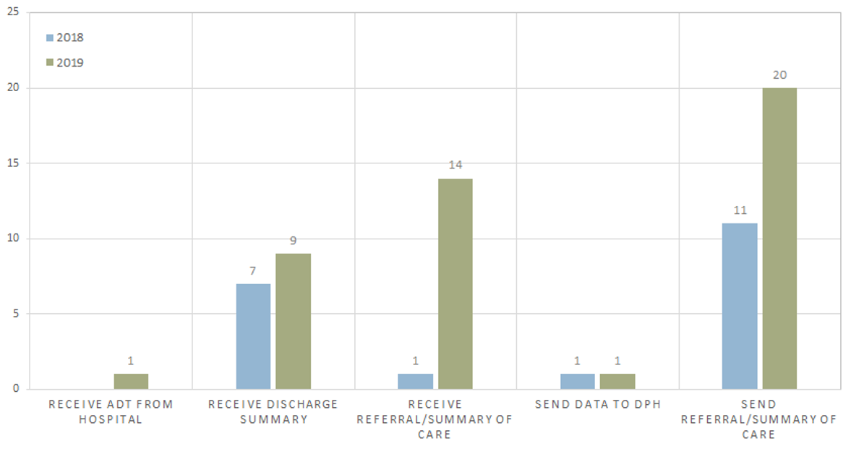
Attestation use cases: Provider-to-provider transmissions
Community health centers
*See Appendix B for detailed use case statistics
Notes:
Shows Provider to Provider use cases that were submitted during the 2018 and 2019 attestation periods.
The blue bar represents 2018 submissions and the green bars are for 2019.

Slide 16
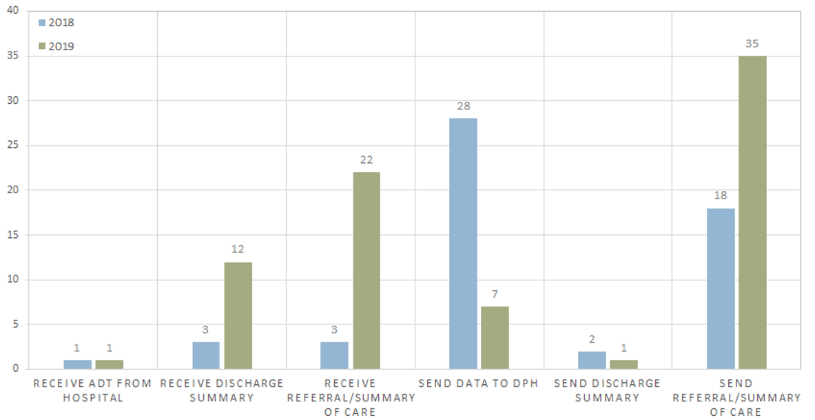
Attestation use cases: Provider-to-provider transmissions
Medium/large medical ambulatory practices
*See Appendix B for detailed use case statistics
Notes:
Shows Provider to Provider use cases that were submitted during the 2018 and 2019 attestation periods.
The blue bar represents 2018 submissions and the green bars are for 2019.

Slide 17
Future attestation
Currently, to meet the Connection Requirement, one party must send/receive messages via the HIway
HIE has evolved in recent years: Many provider organizations now exchange without messages “touching” the HIway
The HIway strives to advocate for the adoption of HIE, not to impose limitations or be a competitor
Accordingly, we are considering broadening the Connection Requirement to recognize alternative approaches to meeting the connection requirements (e.g., Query HIE or HISP Direct Messages)

Slide 18
Discussion: Future attestation
Questions and comments?
Is this the correct way to accommodate the shifting HIE landscape?
Should we require Direct messages or allow Query HIE use cases as well?
Does this approach give provider organizations appropriate flexibility?
Should other changes be made to the Connection Requirement?

Slide 19
HIway education, outreach, and provider consulting services update
Laurance Stuntz & Julie Creamer

Slide 20
Mission statement
“The mission of this team is to move health information exchange beyond baseline technical connectivity and ensure adoption and meaningful utilization of HIE by providers contributing to improved quality of care, improved patient outcomes, and reduced costs.”
Mass HIway Adoption and Outreach Operational Plan, 7/12/2018

Slide 21
Support for HIway 2.0 migration
Account Management and Outreach & Education teams:
Worked together to ensure that all providers required to transition to HIway 2.0 were informed of the necessary migration steps in a timely fashion.
Results:
In 2019, the transition to 2.0 was completed on time and on schedule, and there was little feedback from providers regarding lack of awareness or lack of preparedness related to the transition.
252 participants completed migrating their 316 connections to HIway 2.0.
Support provided:
Live and recorded webinars to explain the migration process.
Monthly newsletter reminders, targeted email blasts, personalized emails, phone calls.
Hard copy final notices sent to all providers notifying them their HIway access would be terminated.
Account Management support to complete Healthcare Organization (HCO) and Declaration of Identify (DOID) forms

Slide 22
Support for attestation requirement
Account Management and Outreach & Education teams:
Worked together to ensure that all providers required to attest in 2018 and 2019 were made aware of this requirement.
Results:
In 2019, attestation numbers were very high: 100% of hospitals, 93% of CHCs, and a strong majority of medium and large ambulatory practices.
Support Provided:
Live and recorded webinars to explain the requirements and the attestation process.
Monthly newsletter reminders, targeted email blasts, personalized emails, phone calls.
Hard copy final notices sent to all providers instructing them they are required to attest.
Used MeHI’s Salesforce data and the most recent RPO data to ensure the Mass HIway has a comprehensive universe of providers.

Slide 23
Provider Directory 2.0 (PD 2.0)
Account Management and Outreach & Education teams:
Worked together to execute the Provider Directory 2.0 implementation project. The Account Management Team led the PD 2.0 implementation project on behalf of the Mass HIway.
Results:
Launched new process to gather updated provider data. Improved PD 2.0 Maintenance Template. Drafted new process. Conducted test pilots. Implemented outreach campaign to obtain PD files from all Mass HIway participants.
Support Provided:
Analyzed PD 1.0 template and developed crosswalk showing changes from PD 1.0 to PD 2.0 and incorporating Direct Trust v2.5 format.
Added instructions to all fields on the template, as well as instructions for completion.
A pilot of the PD 2.0 template has been completed and PD outreach to additional provider organizations is underway with high utilizers (provider-to-provider use cases) being prioritized.
Testing of PD 2.0 with inclusion of all Massachusetts Direct Trust providers is underway.
A new process for collecting and updating Provider Directory information from all providers is underway and will be finalized by the end of the calendar year.

Slide 24
HAUS Services Initiative
Account Management and Outreach & Education teams:
Worked together to promote HAUS Services. The Account Management team worked with providers to explain the services, obtain signed agreements, and deliver the services.
Results:
Completed 2 HAUS engagements with 9 signed Terms of Participation Agreements and actively engaged with 11 organizations, exceeding the goal of 8 enrolled organizations.
Support Provided:
AM team partnered closely with ACO/CP team and had monthly meetings with the CP Leadership Team. HAUS Services have been promoted via CP weekly digests.
AM team also partnered closely with the HIway Policy team and offered HAUS services to all organizations that have not yet attested or who completed an exception form.
Promoted HAUS via monthly newsletter, targeted email blasts, personalized emails, and calls.
Extensive website materials were developed to promote the value of HAUS Services.
Live and recorded webinars to explain the HAUS Services (9 total with 2 dedicated to HAUS).
Hosted 5 Process Improvement Learning Collaboratives/Workshops to advance active use of HIE.

Slide 25
HAUS engagements
Provider Organization | Use Case | Status
North Shore Community Health | Referrals to orthopedic specialist | Complete
Hallmark PHO Phase 1 | Referrals to specialists | Complete
Women’s Health Care | Receiving discharge summaries with Beth Israel Deaconess Medical Center | Complete
BayPath Elder Services | Electronically exchanging information with rehab facilities | In process
Jewish Healthcare Center | Receiving discharge summaries and CCDs from hospitals | In process
Merrimack Valley ACO | Exchanging care plans with Community Partners | In process
South Boston Community Health Center | Receiving ADTs and discharge summaries from Tufts Medical Center | In process
Broad Reach Liberty Commons | Use case pending | Exploratory
Natick Walpole VNA | Sending authorizations to insurance companies | Exploratory

Slide 26
Priorities for SFY 2020
Support new initiatives:
Support the launch of ENS and Query HIE (including Carequality / CommonWell) and promote and educate providers on these initiatives.
Drive the implementation of Provider Directory 2.0 and ensure all providers confirm provider listings in the directory.
Establish a quarterly update process to ensure PD accuracy.
Work closely with DirectTrust to become a significant contributor in the National Provider Directory movement by working with providers to ensure high-quality data.
Expand HAUS Services to include ongoing Provider Directory work and promotion of Certified ENS Vendors.

Slide 27
Priorities for SFY 2020
Continued support of ongoing initiatives:
Promote and support 2020 attestation requirement and continue to increase the number of provider organizations that attest.
Promote HAUS Services for ACOs and CPs and other organizations that must meet the connection requirement and/or need to otherwise augment HIE capacity.
Expand learning collaboratives, workshops, toolkits, webinars, and HIway/MeHI websites to promote, and support providers in, HIE implementation.
Expand identification and documentation of use cases and provider health information exchange patterns and relationships.

Slide 28
Governor’s healthcare bill & HIway strategic plan
Undersecretary Lauren Peters & Bert Ng

Slide 29
Governor’s legislation – HIE provisions
On October 18, 2019, Governor Baker filed H.4134, An Act to improve health care by investing in VALUE. The legislation proposes several key changes related to health information exchange and the HIT Council.
HIT Council
Modifies the membership of the HIT Council to include a more diverse set of perspectives
Includes representatives from the life sciences and digital health industries
Statutory definition of HIE
Conforms statutory language to align with the HIway goal of promoting health information exchange initiatives more broadly rather than a specific HIE delivery system or infrastructure
Aligning HIE consent with HIPAA
Aligns patient consent requirements with HIPAA and standards used by private HISPs in the state

Slide 30
HIway strategic plan: Overview
Current State?
SWOT analysis to assess current state functionality and identify future opportunities
Where do we go?
The HIway conducted a multistate scan to see what services other state HIEs are offering to inform the Council’s consideration of future initiatives and strategy
How do we get there?
Prioritize services and initiatives to pursue and the best approach to implementation (state-run services/infrastructure vs. leveraging market-based functions)

Slide 31
HIway SWOT analysis
Strengths
Weaknesses
Internal
Connection requirement
Direct Message – Webmail
Consulting services for providers to adopt – HAUS
Clinical gateway – Public health uniform submission
No repository to enable pull technology through the HIway
Lengthy procurement processes (state procurement plus CMS approval for federal match)
Regulation limits HIE requirement to hospitals, CHCs, physician practices
Opportunities
Threats
External
Increased FHIR API adoption by providers and payers
CMS/ONC Interoperability activities
Medicaid Enterprise Systems funding
USCDI v1.0 data requirements
Increased data exchange for specified use cases (e.g. Distributed Data Network (DDN) model)
42 CFR Part 2 – SUD data policies
HITECH funding ending 10/1/21 requiring modified funding strategy
TEFCA focus on pull technology
EHRs increasingly building Direct Messaging natively into systems
Disparate data: garbage in → garbage out

Slide 32
Results of multistate scan on services
Jurisdictions reviewed: CA, DC, ME, MD, MI, NY, OK, OR, RI, VT
Governance for HIEs are a mix of public, private, and public-private partnerships
In all states reviewed, participation is voluntary
Patient consent policies vary from state to state
Prescription Drug Monitoring Program Integration
(OK,* OR)
Event Notification
(CA, DC, MD, ME, MI, NY, OR, RI, VT)
Referral Loop Management
(CA, OR*)
Record Locator Service#
(CA, MI, NY, OK)
eCQM
(CA, DC, MD, MI)
Web portal
(RI, VT)
Facilitating disclosure of Part 2 data
(RI)
Patient access via mobile apps
(MD, MI)
*Proposed service
# Prior HIway service – shut down due to low adoption rate

Slide 33
Discussion
Current State?
SWOT analysis to assess current state functionality and identify future opportunities
Where do we go?
The HIway conducted a multistate scan to see what services other state HIEs are offering to inform the Council’s consideration of future initiatives and strategy
How do we get there?
Prioritize services and initiatives to pursue and the best approach to implementation (state-run services/infrastructure vs. leveraging market-based functions)

Slide 34
HIway 3-year plan strawman
2020 goals
ENS framework up and running
Determine next set of provider groups to begin attestation requirements
Amend regulations to add participant groups and require data standards (API + FHIR)
Design/develop one new HIway service
2021 goals
Implement new HIway service
Set data standards for key health data points
Pursue enhancements to the ENS framework as necessary
2022 goals
Require payers and providers to meet API + FHIR by 1/1/2022 and meet state-based data standards as necessary

Slide 35
Conclusion
Undersecretary Lauren Peters

Slide 36
Next HITC meeting
Winter HITC meeting
February 3rd, 2020
3:30 – 5 p.m.
One Ashburton Place (21st floor), Boston

Slide 37
Appendix A: HIway operations update

Slide 38
HIway participation July 21, 2019 – October 20, 2019
4
New participation agreements
DermCare Physicians & Surgeons North Shore Physicians Group Oncolens Philip Leung

Slide 39
HIway participation July 21, 2019 – October 20, 2019
6
New connections
Bureau of Public Health Facilities Dialysis Clinic, Inc. East Boston Neighborhood Health Center Merrimack Valley Child & Adolescent Health Oncolens* Philip Leung*
* Participants that were enrolled and connected in the same period

Slide 40
HIway transactions
HIway transaction volume update
HIway 2.0 processed a total of 17.3 million transactions during the October reporting period (September 21—October 20, 2019) In October, Public Health Reporting accounted for over 14.9 million transactions, or 87% of the total. This included 8.5 million Syndromic Surveillance transactions and 6.3 million immunization transactions. Increased volume for immunization transactions reflects the implementation of the new Immunization Query functionality. Provider-to-provider transactions totaled 174,729 for October. The Mass HIway team will continue to monitor transaction levels, both to support operations and to identify data that provide additional insight into HIway trends and progress.

Slide 41
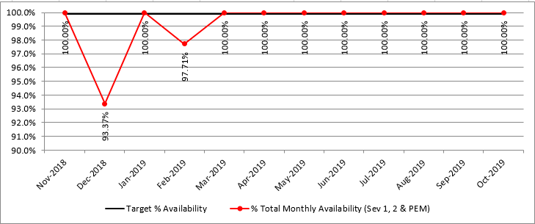
HIway availability review
Target: “Total monthly availability” – no lower than 99.9% (downtime no more than ~44 minutes/month)

Slide 42
Appendix B: Provider-to-provider use case statistics

Slide 43
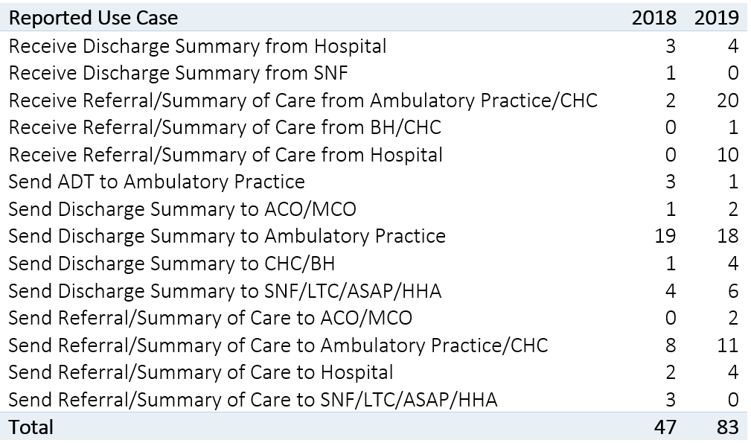
Provider-to-provider use case statistics
Acute care hospitals

Slide 44
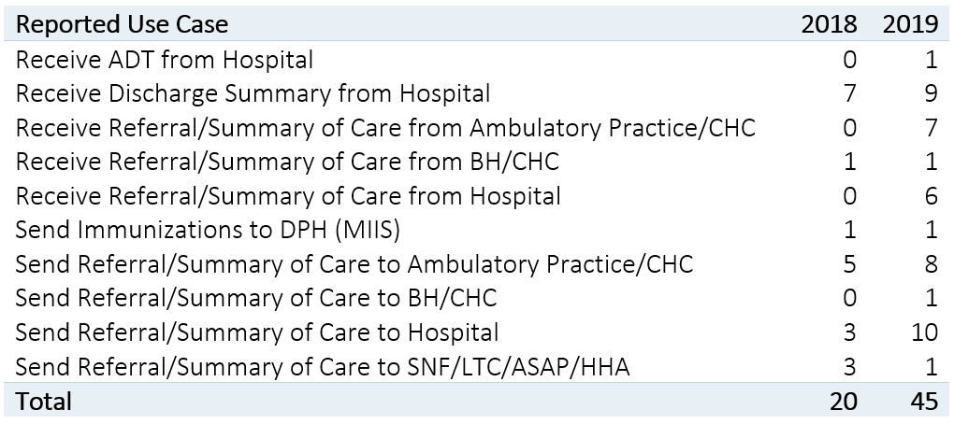
Provider-to-provider use case statistics
Community health centers

Slide 45
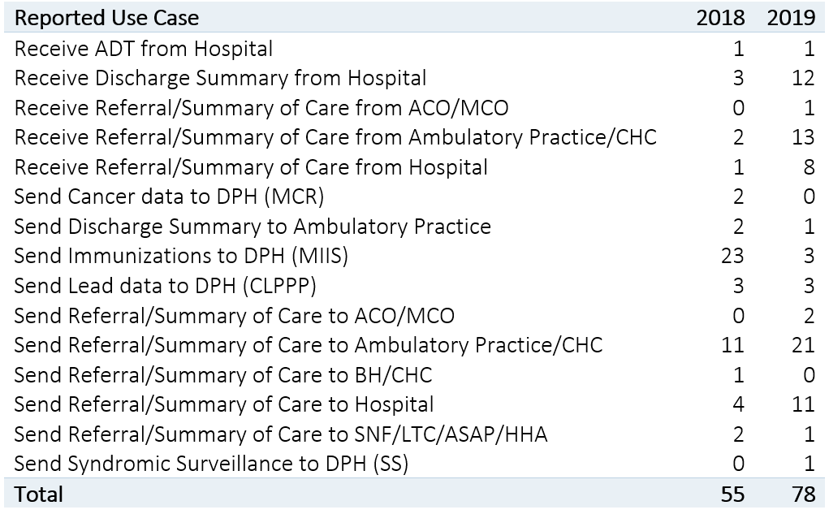
Provider-to-provider use case statistics
Medium/large medical ambulatory practices

Slide 46
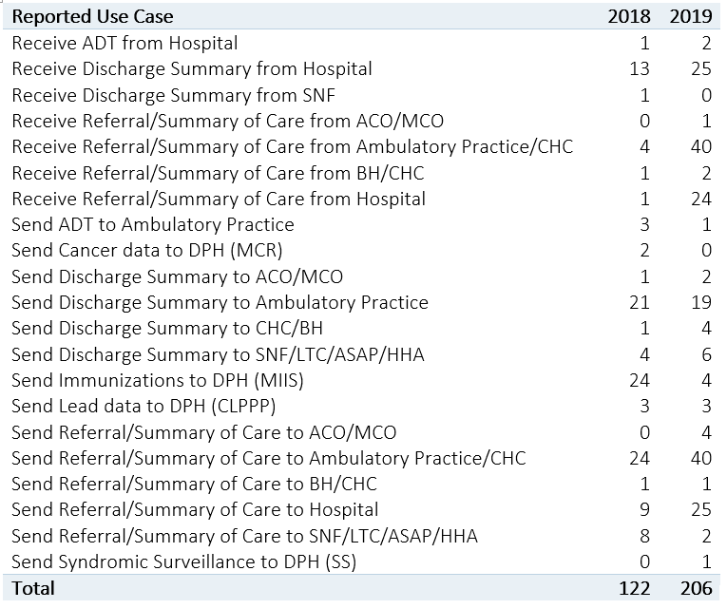
Provider-to-provider use case statistics
Total (hospitals, health centers, and ambulatory)

Slide 47
Thank you!

