Slide 1
V
Health Information Technology Council Meeting
November 6, 2023
Draft Policy in Review

Slide 2
Agenda
Welcome
Statewide Event Notification Services (ENS) Framework Update
  ENS Framework Quarterly Report
  ENS Challenges & Opportunities
ADT Landscape Improvements
ADT Workflow Improvement Project
  Lynn Community Health Center
Conclusion
er for any MassHealth Updates – David Whitham /

Slide 3
Welcome
Welcome
Karen Tseng / Kevin Mullen

Slide 4
Statewide ENS Framework
Q2 ENS Vendor Report
Angela Miller
November 2023

Slide 5
Statewide ENS Framework: Network view
Data Submitters – Acute Care Hospitals
Boston Hospital
Pittsfield Hospital
Cape Hospital
Statewide
ENS
Framework*
Share Data
Certified ENS 1
Subscriptions
Boston Hospital
Boston PCP
Boston BH
Certified ENS 2
Subscriptions
Pittsfield Hospital
Boston CP
Certified ENS 3
Subscriptions
Cape Hospital
Cape PCP
Boston PCP
Boston BH
Boston CP
Cape PCP
ENS Recipients
*Statewide ENS Framework includes regulations and a vendor certification process that govern an Interoperable ENS Network.
3 Certified ENS Vendors shown in illustration. Actual number will be based on ENS vendors that meet ENS certification criteria.

Slide 6
Statewide ENS Framework: Detail view
Boston Hospital sends ADT to ENS 1
ENS 1 runs own matching algorithm, positive match for client, notification sent to Boston PCP (Boston CP does not yet know that their patient was seen at Boston Hospital)
Boston Hospital
ENS 1 also sends ADT copy to ENS 2 and ENS 3
ENS 2 runs own matching algorithm, there is a positive patient match ☑, notification sent to Boston CP
1
ENS 3 runs own matching algorithm, there is no positive patient match ☒, ADT data deleted, retaining only audit data
Certified ENS 1
Subscriptions
Boston Hospital
Boston PCP
3
Certified ENS 2
Subscriptions
Boston CP
Certified ENS 3
Subscriptions
Cape PCP
3
2
4
☑
5
☒
Boston PCP
Boston CP
ADT deleted
Governance: BAA (CE1/BA1)
Governance: BAA (CE2/BA2)
Governance: State
Federal obligations: HIPAA and 42 CFR Part 2 | State obligations: HIV and genetic testing

Slide 7
Types of ENS Alerts Provider Organizations are Receiving
Type of Notification | Type of Messages | Method of Receipt | Patients Included | Things to Consider
ADT Feeds (Subscribed) | ADT Alerts | Certified ENS Vendor Portal, Direct message in EHR, Population Health Management Tool | Dependent on roster being sent to certified ENS Vendor (ACO patients, high risk patients, etc.) | Does your organization have more than 1 ADT feed based on different patient rosters?
CMS Conditions of Participation Messages (Unsolicited) | ADT Alerts | Direct message in EHR | Patients who identify their PCP during their hospital or ED encounter | These alerts will go directly to the provider named as the patient’s PCP (therefore not all inclusive)
Directly from Hospital (Organization specific) | ADT alerts, ED and Discharge Reports | Fax, EHR, or portal login | Most likely will only receive from hospitals that your organization has an existing relationship with, and for patients who identify their PCP during their encounter. | These reports will contain all pertinent clinical information, including medication information and discharge instructions

Slide 8
Q2 ENS Vendor Reporting
Certified ENS Vendor reporting for Quarter 2 (4/1/23 – 6/30/23) was due on 7/31/23
This was the second submission using the new ENS Vendor Quarterly Reporting Template, which was updated during the amendment process
Both certified ENS vendors, Bamboo Health and Collective Medical Technologies, submitted their reporting on time

Slide 9
Q2 ENS Vendor Reporting
The new ENS Vendor Quarterly Reporting Template revealed unforeseen complexities in metric calculations.
The Mass HIway Team has collaborated with the Certified ENS Vendors to refine reporting definitions and methodologies.
This partnership has:
  Enhanced Mass HIway's understanding of the ENS/ADT landscape.
  Strengthened ties with ENS Vendors.
  Unearthed issues in the Statewide ENS Framework.
In September, Mass HIway convened both ENS Vendors to address reporting discrepancies, ensuring unified reporting methodologies.
Both vendors identified and will implement updates to their reporting methods by Q3.

Slide 10
2023-Q2 ENS Vendor Reporting
2023-Q2 ADT Message Volume
 | Vendor A | Vendor B
Number of ADTs received from Massachusetts Acute Care Hospitals | 29,973,476* | 33,488,282
Number of Reflected ADTs received from other ENS Vendor | 2,840,449 | 3,196,340**
Number of Notifications sent using Reflected ADTs | 303,203 | 128,609
* Vendor A's reported ADT volume is post-processing. They aim to report raw ADT numbers from acute care hospitals in Q3.
** Vendor B's data excludes certain ADTs from Vendor A. Changes to include these will be made in Q3.

Slide 11
Q2 ENS Vendor Reporting: ADT Quality
Quality of Demographic Information | Vendor A | Vendor B
% including Date of Birth | 100% | 100%
% including Sex | 100% | 100%
% including Address Line 1 | 99% | 99%
% including City/Town | 99% | 99%
% including Zip Code | 99% | 99%
% including Phone Number | 96% | 91%
% including SSN | 80% | 68%
Quality of Clinical Information | Vendor A | Vendor B
% of A01 messages with Chief Complaint | 53% | 0%*
% of A03 messages with Diagnosis Code | 47% | 51%
% of A03 messages with Diagnosis Description | 47% | 51%
Quality of Clinical Information Table Notes:
A01 Message: Admit Message
A03 Message: Discharge Message
* Vendor B does not currently process Chief Complaint information.

Slide 12
Q2 ENS Vendor Reporting: Organizations Receiving Alerts
Note: Many organizations represent multiple facilities, which were not included in these counts.

Slide 13
Statewide ENS Framework Challenges and Opportunities
Angela Miller & Liz Reardon
November 2023

Slide 14


Challenges and Opportunities
Challenges within the Statewide ENS Framework
Issues identified with;
Acute Care Hospital ADT Feeds
Certified ENS Vendor Processes
Understanding by Provider Organizations
Participation of Free-Standing Psychiatric Hospitals

Slide 15
Challenges with Acute Care Hospital Feeds & ENS Vendors
Acute Care Hospital ADT Feeds Challenges:
  Variations in direct ADT feeds to ENS vendors.
  Incomplete ADT feeds to vendors despite regulations.
  Common data quality issues hinder ADT alert utility.
  Hospitals filter out specific health information due to regulatory interpretations.
Certified ENS Vendors Challenges:
  Reflection based on facility level, leading to incomplete ADT reflections.
  Varying data quality requirements complicate reflected feed processing.
  No post-go-live data quality monitoring; hospitals bear the responsibility.
  Difficulties in ENS Vendor Quarterly Reporting.

Slide 16
Provider Specific Challenges
Understanding by Provider Organizations Challenges:
  Multiple ENS alert sources lead to confusion and can overwhelm clinical workflows
Participation of Free-Standing Psychiatric Hospitals Challenges:
  Despite technical capabilities, psychiatric hospitals aren't sharing ADTs with ENS Vendors, likely due to Behavioral Health privacy regulation concerns.

Slide 17
Next Steps
The Mass HIway will continue partnership with the Certified ENS Vendors and collaboration with ENS participants and stakeholders to identify and address issues and improvement opportunities.
Improvement opportunities and focus areas include;
  Optimizing ENS vendor processes
  Standardizing ADT feed protocols and data quality controls
  Clarifying regulatory guidelines for participants
  Educating providers on ENS alert integration
  Addressing psychiatric hospitals' privacy concerns
  Forming a collaborative forum for continuous improvement

Slide 18
ADT Landscape Improvements
Angela Miller & Liz Reardon
November 2023

Slide 19


ADT Landscape Improvement
ADT Landscape Surveys
Psychiatric Facility Survey
FQHC Survey
ADT Landscape Webinar

Slide 20
Introduction
Introduction
Introduction
The Mass HIway conducted two surveys to understand capabilities and challenges in the ADT landscape for freestanding psychiatric hospitals, hospital psychiatric units, and Federally Qualified Health Centers (FQHCs).
Findings will help EOHHS identify support areas and improvement opportunities.

Slide 21
Survey Distribution
Psychiatric Facility Survey Distribution
Survey Distribution
Psychiatric Hospital Survey was sent to all freestanding psychiatric hospitals and inpatient psychiatric units within the state.
Partnerships with the Massachusetts Department of Mental Health and the MassHealth Office of Behavioral Health were used to distribute the survey.

Slide 22
Psychiatric Facility Survey Results
Psychiatric Facility Survey Results
Survey Results
100% response rate from 55 psychiatric facilities (16 freestanding psychiatric facilities and 39 hospital psychiatric units).
96% of all facilities have or are in the process of implementing an EHR.
EHR systems used by freestanding psych. facilities: Epic, HCS, Medsphere CareVue, Avenues-Angel Systems, Netsmart, Cerner, and IRIS (built on Salesforce).
EHR systems used by hospital psych. units: Meditech, Epic, Cerner, Meditech transitioning to Epic, Online Medical Record transitioning to Epic.
Two freestanding facilities without EHRs cited cost and implementation/training as top reasons for not using an EHR.

Slide 23
ADT Capabilities
Psychiatric Facility ADT Capabilities
ADT Capabilities
Responses indicate 69% of freestanding psychiatric facilities and 79% of hospital psych. units are confident they can send ADTs.
Adjusting for confirmed-certified EHRs and/or electronic Patient Registration Systems, the potential ability to send ADTs improves to near 100% for both groups.

Slide 24
Opportunities & Challenges
Opportunities
Opportunities
Widespread EHR adoption among surveyed organizations.
Sufficient ADT capabilities for most organizations.
Potential to increase ADT exchange levels from these groups.
High interest in participating in workgroups to address barriers (41/55 facilities willing to participate).
Challenges
Activating ADT interfaces presents financial and operational challenges for some organizations.
Barriers remain with ADT data consistency and quality, inclusion of clinical details, privacy consent issues, and organizational limitations.
Challenges

Slide 25
FQHC Survey Results
FQHC Survey Distribution
Survey Distribution
The FQHC Survey was distributed to all state FQHCs, excluding those based in hospitals.
Partnership with the Massachusetts League of Community Health Centers was established to distribute the survey. The ADT Questions were included in the Mass League’s annual IT survey, which goes out to IT leaders from each of the FQHC sites.

Slide 26
FQHC Survey Results
FQHC Survey Results
61% response rate from 38 FQHCs IT Leads.
74% of respondents reported receiving ADT alerts, while 13% reported not receiving ADT alerts, and 13% were unsure.
Of those FQHCs receiving ADT alerts, 53% reported receiving them via >1 method.
The most common methods of receipt reported were through an EMR or a certified ENS Vendor Portal.

Slide 27
FQHC Survey Results
FQHC ADT Follow-up Workflows
Of the FQHCs receiving ADT alerts:
82% review and act on their ADT alerts daily.
47% use criteria to prioritize which ADT alerts they follow-up on, the most common criteria being clinical information like diagnosis and risk score.
88% cited staffing capacity as a barrier that impacts their ADT alert utilization. Other common barriers include ADT format and method of receipt.
From comments submitted by respondents, lack of clinical information within ADT alerts is a major pain point in many FQHCs’ follow-up workflows.

Slide 28
FQHC Survey Results
FQHCs’ confidence in their follow-up workflows: Respondents were asked to rate their confidence in their ADT follow-up workflow from a scale of 1 – 5 (1 being not confident at all and 5 being very confident).
IT Lead Response
QI/Nurse Manager Response*
*Data from April 2023 Mass League QI Forum Zoom poll

Slide 29
ADT Webinar Update
Angela Miller & Liz Reardon
November 2023

Slide 30
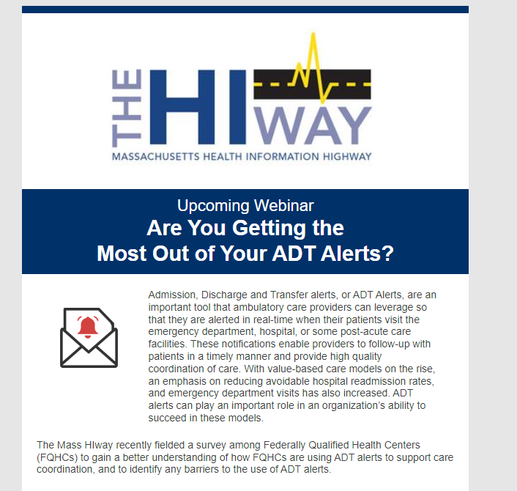
ADT Webinar
The Mass HIway hosted an ADT Webinar on Tuesday, June 20th
Webinar content was developed based on results from the ADT Landscape surveys
Promotion for the event was done via the Mass HIway and MeHI newsletters and the Mass League of Community Health Center communication channels

Slide 31
ADT Webinar: Registrants & Attendees
58 webinar registrants, 39 (67%) attended
During registration, participants were invited to suggest topics for the webinar.
Topics included:
EHR integration methods
Workflow integration of ADTs across organizations
Efforts to align more Mass HIway participants with the Direct Standard for Event Notifications
Statewide developments in ENS
Benefits of ENS for practices and providers.

Slide 32
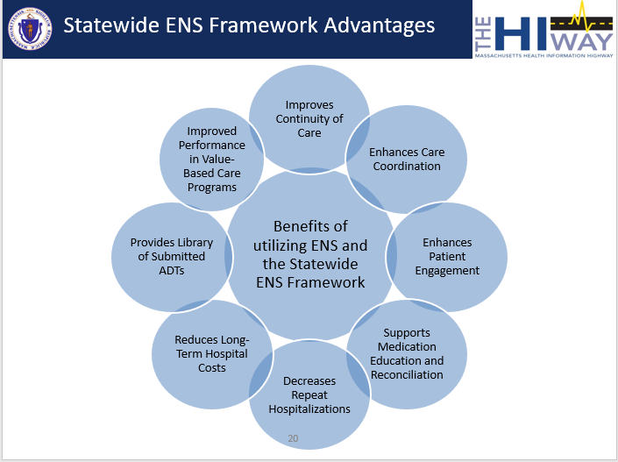
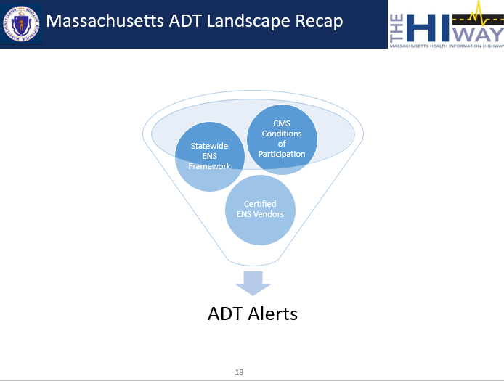
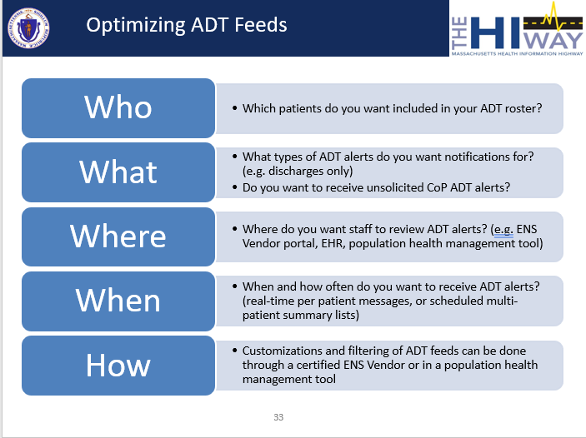
ADT Webinar Agenda
Mass HIway Overview
What are ADT Alerts?
Understanding the Massachusetts ENS Landscape
Statewide ENS Advantages
Common ADT Alert Utilization Barriers
Making the Most of ADT Alerts
Provider Organization Spotlight: Manet Community Health Center
Q&A
A recording of the webinar is available here

Slide 33
ADT Webinar Feedback

Slide 34
Next Steps
Partnering with 3 FQHCs to follow their ADT workflow improvement journeys and consult as needed
Develop best practice documentation for provider organizations to optimize their ADT workflows
Outreach to hospitals with low ADT Data Quality rates per ENS Vendor Reporting
Working closely with the DirectTrust, as well as EHR and ENS Vendors to understand the gaps leading to non-conformance to the DirectTrust Event Notification Standard

Slide 35
Lynn Community Health Center
Hospital and ED Discharge Follow-up Work
Heather Shipp, Quality Improvement Manager
November 2023

Slide 36
Lynn Community Health Center

Slide 37
Lynn CHC Hospital and ED Follow-up Background
Lynn CHC is working to revamp their Hospital and ED Discharge Follow-up workflow
  Improvement of this workflow aligns with Lynn CHC’s core value of providing high quality health care to the Lynn community
  Lynn CHC participates in the Mass Health ACO and is looking to improve performance on the Mass Health ACO quality measures
    Hospitalization for Mental Illness
    Emergency Department Visit for Mental Illness, which require timely follow-up after an event
After a QI review, 3 Key Problem Contributors were identified in their current workflow. Subscription to an ENS Vendor with portal access has been identified as a countermeasure that can help to improve these problem areas

Slide 38
Problem Contributor 1: Reactive Process
Key Problem Contributor | Effect | Countermeasures
Process is reactive – notification of patient discharge comes to LCHC from acute care setting sometime after discharge (ranging from day of to weeks after or never) | Sitting and waiting for patients to be presented to LCHC has resulted in regularly missing the 7-day ED/Hospital follow-up criteria. | Short-term: Use ADT list provided by C3 to proactively find ACO patients and redesign staff workflow Long-term: Subscribe to ENS Vendor to receive ADT alerts for all patients, as well as ENS Vendor Portal features

Slide 39
Problem Contributor 2:
High No-Show Rate
Key Problem Contributor | Effect | Countermeasure
High no show rate for hospital/ED follow-up appointments (Reasons include: Patient didn’t know about visit Contact info. wrong/disconnected/do not pick up Transportation issues Elements of paranoia, depression and low motivation after ED/Hospital visit for Behavioral Health dx | Patients don’t receive essential care Hospital/ED follow-up appt. slots severely under utilized | ENS Subscription to ensure timely notification of events and most up to date patient contact information Scheduling patients within 3 days of discharge so there’s another opportunity if they miss appt. Follow-up outreach with patient when appt. missed Patient appt. reminder calls a head of scheduled visit

Slide 40
Problem Contributor 3:
Lack of Discharge Summary
Key Problem Contributor | Effect | Countermeasure
Discharge summary not present at follow up | Discharge summary needed for provider to complete follow-up visit | ENS Subscription: Discharge summaries available in ENS portal if shared by hospital (CCDA) and real time notification of event gives LCHC staff more time to request discharge summaries from hospitals HIPPA clause accessible for LCHC staff to cite when hospitals push back on discharge records request

Slide 41
Recap of ENS Subscription Benefits to Lynn CHC
Control over roster of patients
  Will be able to receive ADTs for all patients vs. just ACO patients
Control over which event types they want to review and ability to filter ADT feed as needed
ENS Vendor Portal Offerings:
  Most recently provided patient contact information
  Tracking of sub-groups of specific patient populations (ex. Chronic disease patients)
  Hospital discharge summary information (CCDA) available if included by hospital
  Ability to add case manager contact information to specific patients for hospital staff

Slide 42
Mass HIway Support
Presentation on ENS and FQHC ADT Survey Results at the Mass League Quality Improvement Coordinator and Nurse Manager Forum
Sharing of “ADT Alerts: Understanding the Massachusetts ENS Landscape and Making the Most of ADT Alerts” June webinar
Monthly meetings with Mass HIway Account Manager to answer ENS and ADT questions including:
  Clarifying types of ENS Alerts and different aspects of the Statewide ENS Framework
  Review of the Lynn CHC ENS Alert Current State and discussion of current barriers
  Overview of different ENS Alert options
  Sharing of tips on how to leverage historical ADT data to inform health center operations and scheduling

Slide 43
Next HITC meeting
Next HITC meeting
Monday, February 5th, 2024
3:30 p.m. - 5 p.m.
W

Slide 44
Appendix A: HIway operations update

Slide 45
Mass HIway Participation
April 21, 2023 – October 20, 2023
13
New connections
Wildflower Health* Talkiatry* Orthopedic Surgical Center of the North Shore Fairview Hospital (ePOLST Pilot)* Fairview Commons (ePOLST Pilot)* Nest Health* Medical Associates Pediatrics* Reading Pediatric Associates* Kitman Labs, Inc.* Cochrane Dental Associates* Absolute Home Health Agency, LLC* Emerson Hospital (changed connection type) Pediatric Associates of Brockton (Canton)
* Participants that were enrolled and connected in the same period.

Slide 46
Mass HIway Participation
April 21, 2023 – October 20, 2023
1
New participation agreements
Mass General Brigham Community Physicians - Burlington

Slide 47
Mass HIway Transactions
Mass HIway Transactions
Mass HIway transaction volume update
The Mass HIway processed over 107.6 million production transactions between 7/21/2023 – 10/20/2023. During the 7/21/2023 – 10/20/2023 time period, Public Health Reporting accounted for ~105.6 million transactions, or 98% of total production volume. This included 39.7 million Syndromic Surveillance transactions and 65.6 million Immunization transactions. Note: Immunization queries from commercial insurance companies for COVID-19 vaccination updates that processed through the “MIIS QBP” Clinical Gateway node are included in the Immunization total. Provider –to-provider transactions supporting several use cases accounted for 1% (1,422,749 transactions) of total production volume for the 7/21/2023 – 10/20/2023 time period. Quality Reporting volume was 540,422 for the 7/21/2023 – 10/20/2023 time period. The Mass HIway team continuously monitors transaction levels, both to support operations and to identify data that provide additional insight into HIway trends and progress.

Slide 48
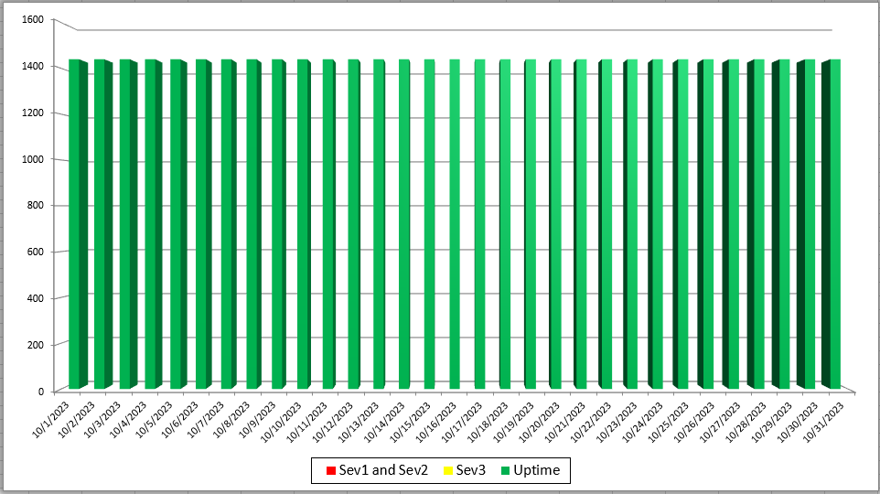
Mass HIway Incident Summary Dashboard
October 2023
Sev 1 - All / Most Mass HIway components impacted as a result of outage. For example: LAND, Webmail, Direct XDR, and DPH nodes are all down
Sev 2 - Multiple Mass HIway components impacted as a result of outage in one of the shared service. For example: LAND and Webmail are down but Direct XDR and DPH nodes are up.
Sev3 – One Mass HIway component impacted as a result of outage. For example: Webmail is down but all other services are up and running.

Slide 49
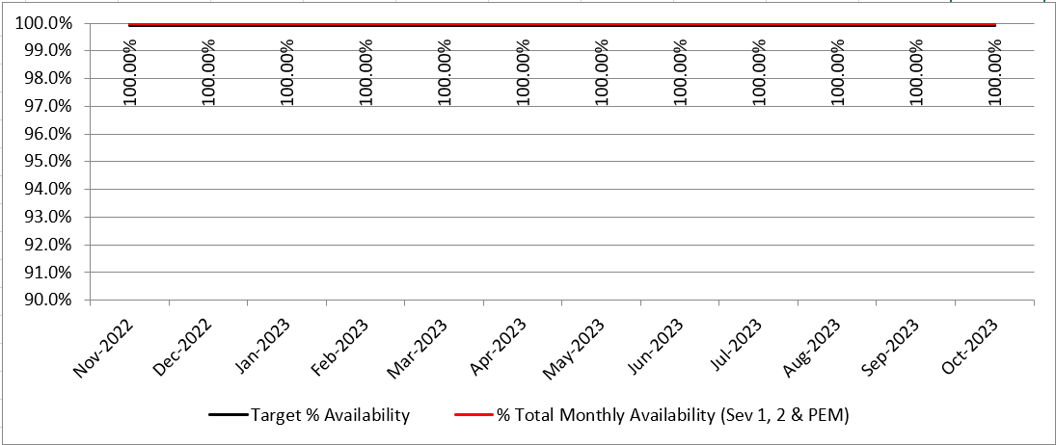
HIway Availability Trends – October 2023
Metric Targets:
“Total Monthly Availability” – no lower than 99.9% (downtime no more than ~44 minutes/month)

Slide 50
Thank you!

