Slide 1
Drug Formulary Commission
Bureau of Health Care Safety and Quality
Department of Public Health
November 5, 2015

Slide 2
Opening Remarks
Drug Formulary Commission Statutory Mission
Schedule II and III Opioid Universe
Component 1: Drugs Of Heightened Public Health Risk
Component 2: Drug Formulary Therapeutic Substitutes With Abuse Deterrent Properties
Component 3: “Cross Walk”
Draft Formulary

Slide 3
Presentation Agenda
Review of October 15 Meeting
Discussion of Evaluation Criteria
Therapeutically Equivalent Substitution Criteria
Inclusion of Drug Products with FDA Approved Labeling
Update on Data Requests

Slide 4
Development of Draft Formulary

Slide 5
Development of the Draft Formulary
Draft Formulary:
Guidance document for the prescribing and dispensing community.
Consists of 3 components:
Component 1: Drugs considered as having a heightened public health risk.
Component 2: Drugs considered to be a therapeutically equivalent substitute.
Component 3: Crosswalk of Components 1 and 2.

Slide 6
Drug Formulary: Mandatory or Voluntary
The Formulary is voluntary for physicians.
Insurance must pay equally for a Formulary substitute.
A pharmacy must dispense a Formulary substitute unless “no substitutions” appears on the prescription.

Slide 7
Component 1: Heightened Public Health Risk
Component 1:
Vote on October 15, 2015, to include all Schedule II and III opioids on the Formulary as having a heightened public health risk as these drug groups have been determined by the DEA as having a higher likelihood of being addictive, able to be tampered with, and misused.

Slide 8
Component 2: Therapeutically Equivalent Substitutes
Component 2:
At the October 15, 2015 meeting:
Final discussion on the criteria to use in the development of the evaluation of drugs to determine if they should be placed on the formulary as therapeutically equivalent substitutes.
Introduction of a draft monograph to apply the criteria in the evaluation tool.
The monograph will be used to standardize the process and ensure a transparent review.

Slide 9
Therapeutically Equivalent Substitutes: Criteria
Monograph

Slide 10
Therapeutically Equivalent Substitutes: Draft Monograph
Overview of the Draft Monograph:
Transparent and standardized process.
Will begin with review of all Schedule II and III opioids:
All 28 drug groups that have been designated as having a heightened public health risk.
381 individual drug products that compose the 28 drug groups.
338 individual drug products in Schedule II.
43 individual drug products in Schedule III.

Slide 11
Therapeutically Equivalent Substitutes: Draft Monograph
Filtering Question:
Proposed filtering question
“Does the drug have FDA abuse deterrent labeling or an abuse deterrent property?”
Goal of filtering question
To enable the Commission to prioritize review of individual drug products that are most likely to be considered therapeutically equivalent substitutes based on specific criteria, including:
FDA approved ADF labeling
ADF properties

Slide 12
Therapeutically Equivalent Substitutes: Draft Monograph
Sample Monograph:
Oxycontin CR ADF

Slide 13
Draft Formulary
Inclusion of Drug Products
with FDA Approved Labeling

Slide 14
Draft Formulary FDA Approved ADF Labeling
The US Food and Drug Administration (FDA) has a comprehensive review process for manufacturers to comply with in order to be approved by the FDA to label their products as abuse deterrent formulation (ADF).
Some elements of this review process include:
Laboratory Manipulation and Extraction Studies
Pharmacokinetic Studies
Clinical Abuse Potential Studies
Post Market Studies

Slide 15
Draft Formulary FDA Approved ADF Labeling
List of Medications with Abuse-Deterrent Claims in FDA-Approved Labeling
Product Name | Manufacturer | Ingredient(s) | Dose Form | Method of Abuse Deterrence
Targiniq ER | Purdue | Oxycodone ER and Naloxone | Tablet | Antagonist
OxyContin | Purdue | Oxycodone ER | Tablet | Crush-resistant Formulation
Hysingla ER | Purdue | Hydrocodone ER | Tablet | Crush-resistant Formulation
Embeda | Pfizer | Morphine ER and Naltrexone | Capsule | Antagonist

Slide 16
Draft Formulary FDA Approved ADF Labeling
Does the Drug Formulary Commission want to place all Schedule II and III drug products with FDA approved ADF labeling on the drug formulary as therapeutically equivalent substitutes?

Slide 17
Drug Formulary Commission: Data Requests
Update on Data Requests

Slide 18
Update on Data Requests: Introduction
The Commission has made requests for data to assist the development of its work.
Some of the data is collected and analyzed by agencies outside of DPH.
The Department is working to compile the requested data.
We will begin by providing data on the Massachusetts Prescription Monitoring Program (MA PMP.)

Slide 19
Update on Data Requests: Introduction
Data overview of MA PMP data, including:
The annual number of prescriptions;
The geographic location of those prescriptions;
An analysis of high utilizers; and
An analysis of high prescribers.
Notes:
Mike reads and then introduces Jon.

Slide 20
Points for Consideration
In CY 2011, the MA Online PMP began requiring pharmacies to submit Schedules III-V controlled substance prescriptions in addition to Schedule II controlled substance prescriptions.
Automatic enrollment of prescribers began in 2013.
Automatic enrollment of mid-level prescribers began in 2015.
Automatically enrolled prescribers now include physicians, dentist, podiatrists, physicians assistants and advance practice nurses, including nurse anesthetists.
Based on surveys on the audits, prescribers find electronic prescriber alerts very helpful.

Slide 21
Number of Prescriptions Annually
Since CY 2012, there has been a 3.1 percent decrease in the number of Schedule II and III opioid prescriptions dispensed and reported to the MA Online PMP. The total solid quantity has decreased by 5.4 percent since CY 2012.
Please note that this Table includes all Schedule II and III opioid prescriptions dispensed and reported to the MA Online PMP, for both in- and out-of-state residents.
Notes:
Volume is reported annually
Before 2011, this volume was only reported for Schedule II drug products.
2011 was the first year of the MA Online PMP, and the first year that reporting expanded to Schedules III, IV and V.
This Table includes Schedules II and III only

Slide 22
Geographic Location of Prescriptions
Geographic location of prescriptions, an analysis was completed on the zip codes of patients who received Schedule II and III opioids.
The following Table sets out that information by county, in which the patient resides.
The total number of prescriptions in the following Table includes only those prescribed to Massachusetts residents and excludes those prescriptions for individuals who have an out-of-state address.
The Map compares the county percentages to the state total.
The percentages range from 16.8% in Middlesex County (i.e., individuals residing in Middlesex County account for 16.8 percent of all the Schedule II and III opioid prescriptions reported to the MA PMP) to 0.2% in Nantucket County.
Notes:
Skip this slide and go directly to geographic table and map.
Use this slide as talking points.

Slide 23
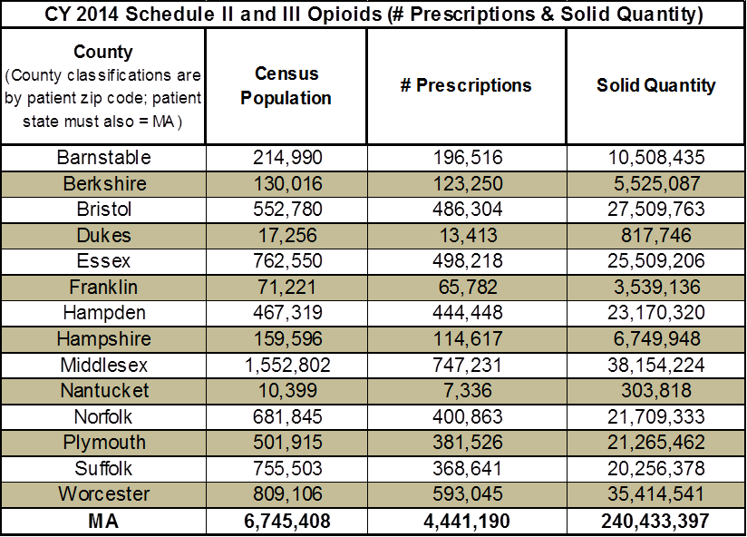
Geographic Location of Prescriptions
Notes:
This Table is a summary of the most current annual data for schedule II and III opioids. It is CY 2014 data.
This data has been published before in a different format.
Annual county level data report.
Quarterly county level data reports.
This data tells us the aggregate county level data, without regard to population.

Slide 24
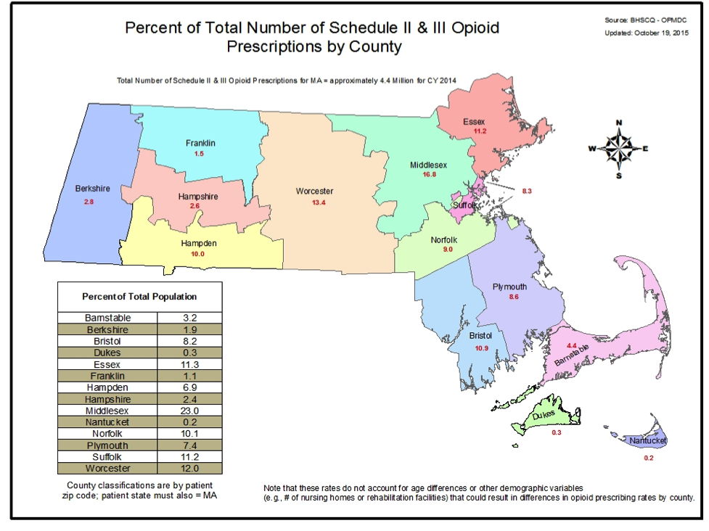
Geographic Location of Prescriptions
Notes:
This map represents the county share of prescriptions.
Note that this data is based solely on where the patient receiving the prescription resides.
REDIRECT: These percentages do not account for demographic variables (e.g. number of nursing homes or rehabilitation facilities) that could result in differences in opioid prescribing by county.
The total county population has not been taken into account to scale these results; however the county percentage of total Massachusetts population is inset.
Total number of Schedule II and III Opioid prescriptions for Massachusetts equals approximately 4.4 million for CY 2014.

Slide 25
Analysis of High Utilizers
The following Figure provides an example of Multiple Provider Episode (MPE) trends among high utilizers, and displays the MPE rates (per 100,000) for three prescriber/pharmacy thresholds between CY 2009 and CY 2014.
Six prescriptions and six pharmacies;
Eight prescriptions and eight pharmacies; and
Ten prescriptions and ten pharmacies.
As shown, the rates for each of the three thresholds have been cut nearly in half over this five year period.
Notes:
Skip this slide and go directly to high utilizers and prescribers.
Use this slide as talking points.
To meet the specified threshold, an individual must have been prescribed one or more schedule II opioid and dispensed one or more schedule II opioid.

Slide 26
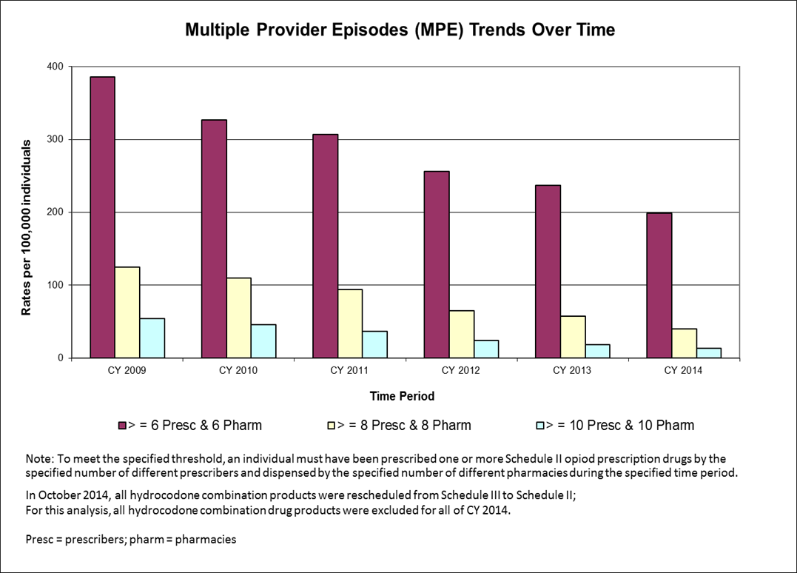
Analysis of High Utilizers
Notes:
This data was reported in our annual legislative report.
In October, 2014, all hydrocodone combination products were rescheduled from Schedule III to Schedule II;
For this analysis, all hydrocodone combination products were excluded for all of CY2014.
REDIRECT questions to these bullets:
The MA Online PMP is one tool in the effort to combat the growing epidemic of opioid addiction and overdose.
Its effectiveness as a data source for prescribers and dispensers continues to grow and improve.
ANSWER ONLY IF ASKED Only prescribers get Multiple Provider Episode (MPE) Alerts
Dispensers do not have access to EHR and may not have the necessary information to use the alerts appropriately.
Could be a barrier to access for patients who really need the medication.
New PMP will address improvements to Alert system.

Slide 27
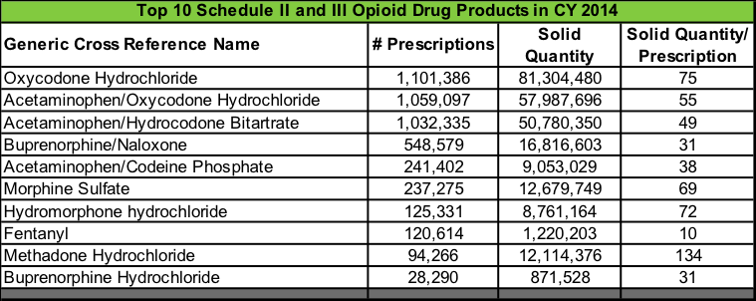
Analysis of High Prescribers
The Department identified the top 10 Schedule II and III opioid drug products as reported to the PMP in CY 2014.
The data presented represents the top 10 Schedule II and III opioid drug products prescribed by number of prescriptions, solid quantity, and solid quantity per prescription.
Notes:
This data has not been previously reported.
These are the top 10 Schedule II and III Opioids based on number of prescription, solid quantity, and the average solid quantity per prescription.
Methadone (addiction medications) – DON’T WAIT FOR QUESTION
Only those prescribed for pain are on the PMP
Federal confidentiality law does not allow the sharing of information from recovery centers.

Slide 28
Summary
This data provides a snapshot to assist the Commission in the understanding and identification of the annual number of prescriptions; the geographic location of those prescriptions; an analysis of high utilizers; and an analysis of high prescribers.
The MA Online PMP is one tool in the effort to combat the growing epidemic of opioid addiction and overdose.
Its effectiveness as a data source for prescribers and dispensers continues to grow and improve.
Notes:
STICK TO YOUR ISLANDS ON THIS PAGE FOR ANSWERING MANY QUESTIONS.

Slide 29
Drug Formulary Commission:
Data Requests
Data Requests | Date of Request | Expected Presentation to DFC
High Prescriber Utilizers | 08/06/15 | Today
Abuse Deterrent or Near Abuse Deterrent Products | 08/06/15 | December
High Multiple Provider Episodes Utilizers | 08/06/15 | December
Opioid Prescriptions - # of Prescriptions, Solid Quantity, and Solid Quantity per Prescription | 09/08/15 | December
Patient-Specific Overdose Death Data Linked to PMP | 08/06/15 | TBD
MA All payer Claims Database | 08/06/15 | TBD
Pharmacies with High Number of Individuals who exceed MPE Threshold | 09/08/15 | TBD
Frequency of Schedule II and III Drug Products that are also Prescribed with Potentiating Controlled Substance Drugs (Tramadol, Benzodiazepines) | 09/08/15 | TBD
Opioid Drugs Associated with Emergency Department Visits for Opioid Overdose | 09/08/15 | TBD
Notes:
In other words, the drug does contains some drug deterrent properties but is not an exact match

Slide 30
Meeting Summary
Meeting Recap
Review of takeaways
Next steps

