Slide 1
Executive Office of Elder Affairs
RESPECT INDEPENDENCE INCLUSION
Home Care Licensing Commission
ASAP and Home Care Agency Overview
2 June 2021

Slide 2
Three Ways to Work in “Home Care”
Home Health Agency
Home Care Agency
Consumer Direct Hire
Agency is the employer for person providing services in the home
Generally skilled services via medical order – injections, wound care, rehabilitative therapy
Largely paid by health insurers
Agencies may also provide supportive home care services – groceries, meal prep, dressing, bathing, toileting
Agency is the employer for person providing supportive care services in the home. No skilled services; medical order not needed.
Consumer may contract directly with an Agency for supportive home care services.
Individual or long-term care insurance is payer
Consumer may contract with professional care managers, such as an EOEA regional aging services access points (ASAPs), which then contract with Agencies for supportive home care services for ASAP consumers
Multiple Payers: EOEA, MassHealth, Health Insurers, Individual or long-term care insurer
Consumer is the employer and is responsible for background checks, W-2, liability insurance, etc.
Supportive care services
Consumers find employees via: (1) MassHealth Personal Care Attendant Program, (2) Job Boards (Craigslist, Care.com, HelpAroundTown.com, etc.), (3) Friends, neighbors, etc.,
Payors: Mass Health, EOEA, VA, LTC insurance and private pay

Slide 3
EOEA Home Care Service Network
Executive Office of Elder Affairs (EOEA)
Approximately 65,000+ consumers $363+ million budget (FY’20)
25 Aging Services Access Points (ASAP)
Regional geographic based non-profit organizations designated by EOEA (MGL 19A) with statewide home care coverage
Care Management
Assessment
Care Planning
Advocacy
Contracting with Direct Service Providers
Provider Relations (Procurement, Contracting, Monitoring, Complaints)
Provider management of Critical Incidents
Adult Protective Services Program
Direct Service Providers
Home Care Agencies
(HM/PC Providers)
Home Health Agencies
(Certified Providers)
Other Service Providers
(Trans, DME, ADH, SDC, etc.)

Slide 4
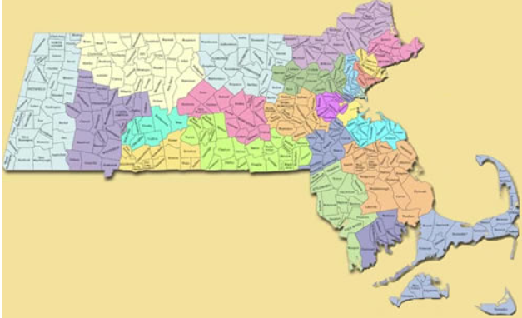
What is an Aging Services Access Point (ASAP)?
“Designated” by the Executive Office of Elder Affairs (MGL 19A, Sec. 4B) to “provide a coordinated system of care…to assist elders in maintaining their residences in the community”
25 ASAPs in Massachusetts
Every zip code has an ASAP
EOEA monitors performance by program contracted with ASAPs, including supportive home care, adult protective services, ombudsman, senior nutrition, supportive and congregate housing

Slide 5
ASAPs contract with approximately 134 agencies to serve 65,000 consumers at home
Home Care Agencies
77 providers
Home Health Agencies (Certified)
57 providers
Services:
Companion
Homemaking: meal prep, laundry, cleaning, grocery shopping
Chore Services: heavy cleaning
Personal Care: bathing, dressing, toileting

Slide 6
Process and Obligations of Home Care Agencies Contracting with ASAPs
Procurement
Contracting
Provider Monitoring
MassHealth FEW Provider Enrollment
Critical Incident Management
Minimum of three years
Standardized RFP process
Public advertisement
Review of all submitted procurement applications
Decision to contract issued based off standardized review process
Approved by ASAP Board of Directors
EOEA established standardized Provider agreement
Outlines programmatic, invoicing, compliance requirements
Consistent standards that all home care agencies must follow
Executed for specific service, unit type & rates
Service descriptions & provider qualifications adhere to EOEA requirements
Every two years
Ad hoc Incident based
Onsite, Consumer record review, provider performance, time/attendance, worker qualifications, records, complaints, compliments
CAP issued when performance concerns identified
Annual Quality Data reported to EOEA and CMS
All Home Care Agencies required to enroll
Re-credentialing every 3 years
Required to update Home Care agency record with changes on ad hoc basis
EOEA oversight to ensure enrollment
Adheres to CMS requirements
ASAPs sends complaints of abuse, neglect, exploitation or theft against any Direct Service Provider/worker to appropriate investigative agency
Unpaid Caregiver Complaints investigated by Adult Protective Services
Paid Caregiver Complaints investigated by DPH
ASAP reports complaints to EOEA for oversight
Annual reporting of FEW related complaints to CMS

Slide 7
Two Levels of Oversight
EOEA over ASAP
Designation review (every 3 years)
Procurement process
Onboarding and termination of providers
Ensure processes in place to respond to consumer complaints
Quality monitoring
Review critical incidents (real time)
Administrative oversight of corrective action
ASAP over Agency
Audit of services and billing
Resolution of consumer and family complaints
Staff and consumers surveys to ensure service provision
Quality
Review critical incident reports
Point of service delivery review (onsite at time of service)
Vet compliance w personnel practices (CORI/SORI) and employee suitability requirements (Office of Inspector General list)

Slide 8
Where are the gaps?
Private agencies that do not contract with ASAPs → no oversight at all
No protection for consumers who hire services on their own (not through ASAP, MassHealth, or managed care organizations)
No guarantee of service standards
May be called a home care agency, but there no way of knowing if workers have completed standard training or what competencies that they have
No financial guarantees for workers or consumers

Slide 9
Questions and Discussion

