Slide 1
Emergency Medical Services Advisory Committee
Bureau of Health Care Safety and Quality Department of Public Health February 24, 2021

Slide 2
Agenda
Welcome and Routine Items
Vote on Minutes from April 2019
Department Update
OEMS Update
MIH Program updates
Reports
Medical Services Committee Report (Dr. Jon Burstein)
Workforce (Deb Clapp)
OEMS Response to COVID-19
2

Slide 3
Open Meeting Law: G.L. c. 30A, §§18-25
The purpose of open meeting law (OML) is to ensure transparency in the deliberations on which public policy is based.
This requires that meetings of public bodies be open to the public.
All meetings of a public body must be open to the public.
A meeting is any deliberation by a public body with respect to any matter within the body’s jurisdiction.
A deliberation is a communication between members among members of a public body.
A public body is any multi-member board, commission, committee or subcommittee within the executive or legislative branches (except the Legislature) of state government
This includes any body created to advise or make recommendations
Under OML the public is permitted to attend meetings.
Individuals in meetings may not address the public body without the permission of the chair.
Public participation is allowed at the discretion of the chair.
For more information on Open Meeting Law, please visit:
https://www.mass.gov/the-open-meeting-law
3

Slide 4
What is a Quorum?
A Quorum is defined as:
A simple majority of the members of a public body, unless otherwise provided in a general or special law, executive order, or other authorizing provision. G.L. c. 30A, § 18.
Massachusetts Department of Public Health http://www.mass.gov/dph/oems
Notes:
4

Slide 5
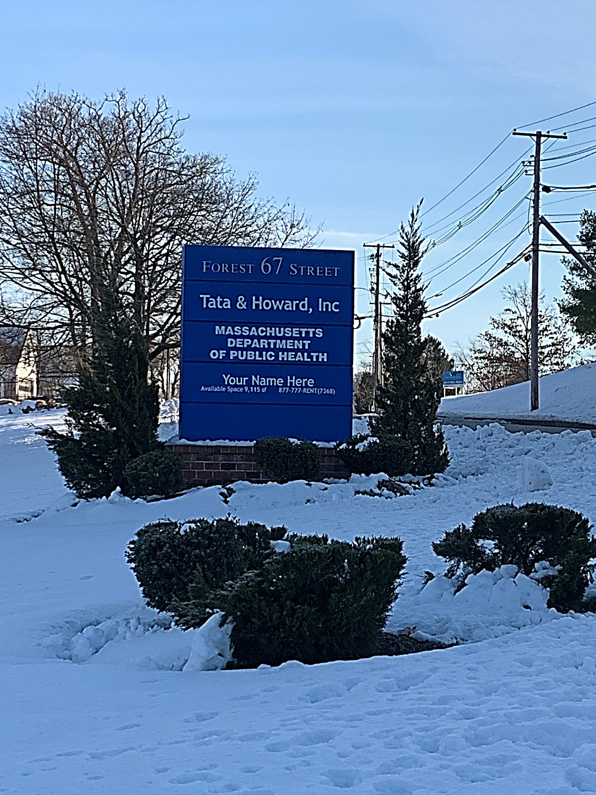
Department Update
OEMS Update
BHCSQ move to 67 Forest Street in Marlborough
COVID-19 impact on office and staff
Staffing
Staffing Moves
Retirements

Slide 6
OEMS Update
Community EMS Programs
114 programs currently operating across 33 communities

Slide 7
OEMS Update
MIH Updates
At this time, there are seven MIH programs operating across the Commonwealth
In response to the COVID-19 Public Health Emergency, MIH approved eight additional programs on a temporary basis
Massachusetts Department of Public Health http://www.mass.gov/dph/oems

Slide 8
Reports
Medical Services Committee Update
MSC continues to meet virtually on a regular basis
Protocol changes for 2021
Med Director Options
Use of U/S, use of transport vents
Inter-Facility Transfer care criteria clarified
Code Black status clarified in Routine Patient Care
COVID protocols remain in effect
As emergency protocols so not added to STP document
Will be added as generic “when ordered” High-Risk ID in 2022

Slide 9
Reports
Workforce Training Committee
Reviewed AR 2-305: “Minimum Skill Requirements for Paramedic EMT Training”
Identified conflicts between existing AR and current national accrediting standards
Recommended aligning AR wording to be consistent with national accrediting standards. (updated by OEMS per recommendation 4/20)
Reviewed AR-2-307 “Minimum Skill Requirements for Advanced EMT Training”
Due to low/no volume of AEMT training programs and lack of national accreditation standards, deferred any recommendations at this time

Slide 10
Reports
Workforce Training Committee
Topics for future meetings
BLS Psychomotor Exam
Examiner trainings/updates/new examiners
Instructor-Coordinator requirements/updates
Defining Local Continued Competency Requirements (LCCR)

Slide 11
OEMS Response to COVID
Summary of OEMS Actions and Updates
Staffing/Workforce:
Waiver of requirements of 170.305 (Allow minimum staffing at one EMT/Medic and one first responder)
Governor’s Order – Certification of temporary EMTs/Paramedics (recently expired)
Operational Considerations:
Dispatching/PSAP information sharing
Workplace Screening, Mask Order, PPE supply management
Clinical Guidance:
COVID STPs 1.2 & 1.3 (with waiver)
Scene Management, Risk of Aerosolizing Procedures, other considerations
EMS role in testing

Slide 12
OEMS Response to COVID (cont.)
EMS Education/Certification/Recertification:
Temporary Certification of EMTs/Paramedics
Certification Expiration Extensions
Use of VILT and increase in allowance of Distributive Education
Changes to Initial Training Requirements/Testing & Con-Ed
Vaccination Involvement
Direct Supply of Vaccine to ambulance services (MIIS and MCVP)
Utilization of EMS through LBOH and Mass Vaccination Site
Changing Needs – EMS Adapts to Changing Roles/Responsibilities

Slide 13
Future Meetings
The next meeting of EMCAB will be in September 2021.

