Slide 1
Welcome Family Statewide Expansion Advisory Committee
May 2026 Convening

Slide 2





Welcome and DPH BFHN Team Introductions
Stephanie Doyle, MS
Deputy Director of Strategy & Implementation
Bureau of Family Health & Nutrition
Christine Silva, MPH
Director, Massachusetts Home Visiting Initiative
Division of Pregnancy, Infancy, & Early Childhood
Danielle Biggins, MS
Home Visiting Implementation Specialist
Division of Pregnancy, Infancy, & Early Childhood
Project Support Team

Slide 3

Advisory Committee Group Agreements
Source: JustLead Washington

Slide 4

May 2026 Agenda
# | Topic
1 | Welcome remarks
2 | Welcome Family model and program expansion update
3 | Member introductions
4 | Orientation to expectations and operations
5 | Prep for July 2026 meeting

Slide 5
Active participation today!
Click this to open the chat function

Slide 6
Active participation today! (continued)
Click ‘Raise Hand’ and unmute ‘Mic’ to ask questions and make comments

Slide 7
Welcome Family
Where it’s been and where it’s going

Slide 8
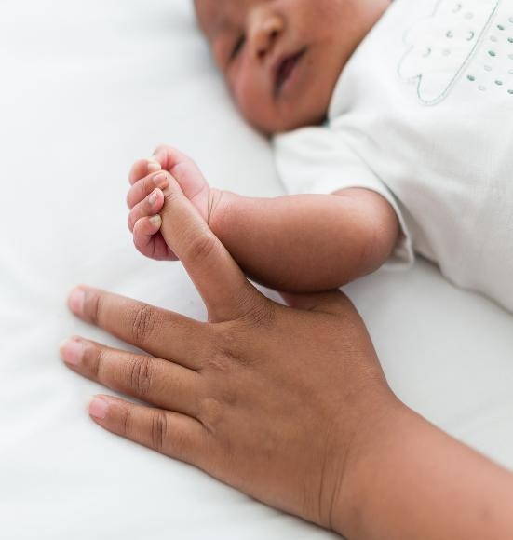
Family testimonial
“It is so hard and lonely those first few weeks with a new baby and [the nurse] was so supportive, helpful and genuinely cared for how I was doing, not just the baby.
This was exactly what I needed; someone to talk to, with experience who would give me immense amounts of advice and tips to cope with a new baby.”​

Slide 9
Alignment with health policy
Evolution of Welcome Family
Reduce Inequities
Year | Milestone
2011 | Welcome Family conceptualized
2011- 2013 | Planning Committee modeled Welcome Family after evidence-based Family Connects program
2013- 2022 | Welcome Family launched in Fall River & Boston, then Lowell, Lawrence, Holyoke, Springfield and New Bedford.
2022 | Welcome Family elevated in the Special Commission on Racial Inequities on Maternal Health
2023 | Health Care For All identified universal postpartum home visiting as a legislative priority
2024 | Governor Healey signed into law an act promoting access to midwifery, birth centers, and doulas, including universal postpartum home visiting
2026 | Allocation to launch included in MA State H2 2026 Budget
Racial Inequities in Maternal Health Commission Report
Maternal Health Services Report – Exec. Office of Health and Human Services (EOHHS) to promote provider and payer participation
Reduce fragmentation
MA Maternal, Infant, and Early Childhood Home Visiting (MIECHV) 2020 Needs Assessment
Driven by statute
2024 “An Act promoting access to midwifery care and out-of-hospital birth options”
G.L. Chapter 111, Section 248

Slide 10
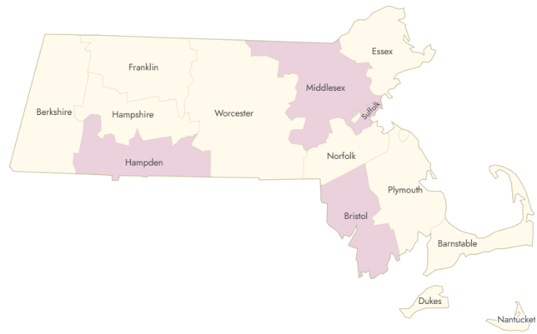
Current Welcome Family programs
Welcome Family Lowell
Eligibility: Residents of Lowell or people giving birth at Lowell General Hospital
Welcome Family Boston
Eligibility: Residents of Boston
Welcome Family Holyoke/Springfield
Eligibility: Residents of Holyoke or Springfield or people giving birth at Baystate Medical Center
Welcome Family Fall River
Eligibility: Residents of Fall River or people giving birth at Charlton Memorial Hospital
Welcome Family New Bedford
Eligibility: Residents of New Bedford or people giving birth at St. Luke’s Hospital

Slide 11
Milestones planned for this year
Current Welcome Family Programs are procured until 2027
Budget sustainability to procure programs
Additional goals and milestones for 2026-2027:
  Prepare for procurement of Welcome Family agencies
  Rate setting processes (not under this Committee’s purview)
  Promulgation of regulations (not under this Committee’s purview)
  Strategy for effective statewide launch and implementation (This Committee’s mission!)
  DPH will keep this Committee informed of parallel public comment opportunities that emerge.

Slide 12
Core components of the evidence-based program
Established process with birth hospital/centers to ensure universal access.
Nurse home visits conducted by an RN w/ maternal and pediatric experience.
Nurse home visits include a clinical assessment and use of validated screening tools for depression, domestic violence, and substance use.
Follow-up phone call and feedback loop with providers to promote continuity of care and coordination with the medical home.
Nurses receive regular reflective supervision (clinical and administrative) by a nurse supervisor
Robust data collection and reporting system ensure high quality implementation and system integration.

Slide 13

Welcome Family Goal
Promote optimal maternal and infant physical and mental well-being and provide an entry point into a system of care for families with newborns in Massachusetts.

Slide 14
Program flow
Introduction
  Identify new caregiver
  Introduce the program
Referral
  Complete Referral Form
  Send to Welcome Family Agency
Schedule Visit
  Call/text to schedule visit
  Complete Scheduling Contact Form
Nurse Visit (90-minutes)
  Informed Participant Notice
  Complete WF Assessment
  Facilitate warm handoff to referral (as needed)
  Provider Feedback Forms
2-3 Week Follow-up Call
  Call participant 2-3 weeks after the home visit
  Complete Follow-up Phone Call and Referral Outcomes Forms
  Offer additional resources and support (as needed)
Key:
Dark blue: Referral Source (e.g., birth hospital)
Orange: Welcome Family agency

Slide 15
Referral process
Introduce Welcome Family to new caregiver
Send referral information to Welcome Family program
Typically occurs at birth hospital
Build awareness of Welcome Family
Information about Welcome Family can be shared prenatally
Referring provider from the hospital can vary (e.g., nurse, nurse educator, lactation support)
In some settings, the Welcome Family nurse conducts rounds to introduce the program
Online referral forms with basic information (e.g., caregiver name, infant date of birth, contact information)
If the Welcome Family nurse is making the referral, they are able to schedule the visit at that time

Slide 16
Welcome Family Visit structure
The Welcome Family visit includes an assessment of six core areas:
  Clinical assessment of caregiver and infant (e.g., infant weight, caregiver blood pressure)
  Unmet health needs, including access to medical care and reproductive health services
  Maternal and infant nutrition, including breastfeeding support and WIC/SNAP needs
  Emotional health, including depression and social connectedness
  Substance use, including tobacco
  Domestic violence

Slide 17
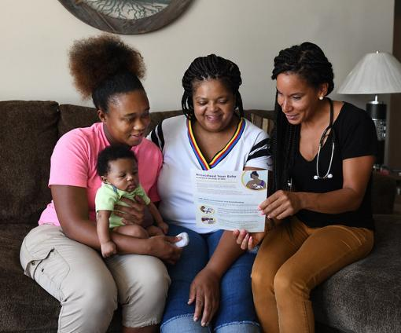
Welcome Family Visit structure (continued)
During the visit, the nurse identifies and addresses family needs through screening, brief intervention, education and support, and referrals to community resources.
There is ample time in the visit to answer questions and address concerns related to parenting and support early relational health.

Slide 18
Follow-up phone call
All caregivers are contacted 2-3 weeks after their home visit.
The goals of the follow-up phone call are to:
  Check-in with the caregiver on any questions or concerns.
  Document outcomes of any referrals made during the home visit.
  Offer additional information or referrals as needed
    (e.g., if a new concern has emerged since home visit or if a concern identified during visit has persisted or worsened).

Slide 19
Data collection, quality, and oversight
Data collection | Quality and performance | Program oversight
Data system uses Oracle Apex online platform Only required to have access to internet Designed for ease of use in the field for real time completion of forms and screenings | System-built reports support: Timely workflow steps (i.e., scheduling and follow-up phone calls) Ability for WF Program to review data from forms Quality dashboard monitors: All WF performance measures disaggregated by demographics and by live vs virtual visits DPH-run Learning Collaborative supports data driven continuous quality improvement | Annual programmatic site visit Annual fiscal site visits Individual monthly check-ins by supervisor for nurses

Slide 20

Outcomes: Family experience
19,181 visits completed to date. 900 respondents indicate families are very satisfied.
99%
would recommend Welcome Family to other families with newborns.
97%
reported that the visit helped them feel very connected to the services and supports within their community.
4.94
satisfaction score when asked “How satisfied were you with the Welcome Family visit?”
(5= very satisfied)

Slide 21
Outcomes: Utilization and public health impacts
Utilization rates across programs vary, with a current rate of 10% of eligible births served across active programs.
DPH would like to see utilization increase, and Welcome Family visits established as a cultural norm statewide.
Infants of Welcome Family participants were more likely than comparison group to be connected to EI: ​
Children who received Welcome Family were less likely to use emergency medical care for injuries 1-2 years after birth (10.6% vs. 12.5%).
13.1% | more likely to be referred by age 3
21.0% | more likely to be evaluated by age 3
25.4% | more likely to be enrolled by age 3 ​
Kotake C, Fauth RC, Stetler K, Goldberg JL, Silva CF, Manning SE. Improving connections to early childhood systems of care via a universal home visiting program in Massachusetts. Children and Youth Services Review 2023; https://doi.org/10.1016/j.childyouth.2023.106995.

Slide 22
Outcomes: Utilization and public health impacts (continued)
Utilization rates across programs vary, with a current rate of 10% of eligible births served across active programs.
DPH would like to see utilization increase, and Welcome Family visits established as a cultural norm statewide.
Infants of Welcome Family participants were more likely than comparison group to be connected to EI: ​
Children who received Welcome Family were less likely to use emergency medical care for injuries 1-2 years after birth (10.6% vs. 12.5%).
13.1% | more likely to be referred by age 3
21.0% | more likely to be evaluated by age 3
25.4% | more likely to be enrolled by age 3 ​
Kotake C, Fauth RC, Stetler K, Goldberg JL, Silva CF, Manning SE. Improving connections to early childhood systems of care via a universal home visiting program in Massachusetts. Children and Youth Services Review 2023; https://doi.org/10.1016/j.childyouth.2023.106995.

Slide 23
Chat waterfall! (Success)
What does success look like for the statewide expansion of Welcome Family?

Slide 24

Who we are—Member introductions
A powerful mix of lived experience, community leadership, and maternal health expertise
Parents & family leaders
Former and current program participants and parent leaders
Community‑based leaders
Organizations rooted in equity, culture, and community trust
Healthcare & home visiting professionals
Welcome Family nurses, public health nurses, lactation consultants, midwives, doulas, and pediatric and perinatal providers

Slide 25


Where we’re from and what we bring
Geographic, cultural, and lived experience diversity across Massachusetts
Members represent communities across Massachusetts:​
Western MA​
Central MA​
Metro Boston
Merrimack Valley​
Southeast MA​
Cape Cod​
Languages, beside English, spoken across the group:​
Spanish​
Portuguese​
Luganda​
Japanese​
Arabic​
Russian​
Lived experience in this room includes:​
Parents who have received home visiting and postpartum support.
Parents navigating postpartum now or in the past
Families impacted by high‑risk or preterm births.
Immigrant and refugee experiences
Clinicians and leaders shaped by personal parenting journeys

Slide 26
What brings us together
Different backgrounds. Shared commitment to families thriving.
Shared Priorities | Shared Contribution
Community engagement & system coordination Equity and culturally responsive care Workforce training, recruitment & retention Awareness and access to services Responding to emerging family needs Quality monitoring & evaluation | Centering parent voice in program design Strengthen the postpartum workforce Bridging hospitals and community‑based support Making Welcome Family accessible, trusted, and statewide

Slide 27
Breakout room introductions
Get to know your fellow members in small breakout groups!
Share your name and role or experience
Briefly share what brings you to this committee’s work and a question you're carrying as Welcome Family expands statewide.
After the breakout groups, each group can briefly share a question or curiosity that emerged.

Slide 28
Orientation to the
Welcome Family
Advisory Committee

Slide 29


Advisory Committee aim
Supporting a successful statewide expansion
The Welcome Family Advisory Committee (AC) will advise DPH on designing strategies to achieve a high-quality, highly utilized, and accessible Welcome Family universal nurse-led postpartum home visiting statewide system of programs.
The AC will provide input on DPH’s approach to community outreach and awareness building, workforce development, data-driven quality monitoring, and equitable access to the Welcome Family service.
The goal is to ensure all families with newborns are aware of Welcome Family prenatally, offered a visit, and experience high-quality, culturally responsive, community-based postpartum services in the 8-week postpartum period.

Slide 30
Level of influence and transparency
Advisory Committee members advise the state.
State is decision maker.
The state will strive for transparency, communicating how it considered Advisory Committee input in decision making with rationale.
State proposes strategy concept to Advisory Committee
Advisory Committee provides input
State considers input and makes strategy or policy decision
State presents decision with rationale back to Advisory Committee
Members can provide ongoing feedback on decision-making to state team at any time

Slide 31
Advisory Committee areas of focus
Objective | Build awareness | Community engagement in services and system coordination | Workforce training and capacity | Workforce recruitment and retention | Quality monitoring and program evaluation strategy | Equity in utilization and experience | Timely response to community need and emerging acute issues
Intended Outcome | Broader reach and higher referral and utilization rates across regions. | Better coordination of community services and referrals. | Consistent, high-quality, family-centered service delivery. | Achieve adequate staffing to support service expansion. Improved staff stability and workforce diversity. | Data-driven program decisions and improved family outcomes. | More equitable participation and outcomes across all families and regions. | Welcome Family becomes a trusted source of accurate public health information which can be leveraged to connect with families directly aligning with public health priorities.
See your Membership Expectation Document for more detail on each objective

Slide 32
Chat waterfall! (Objectives)
What additional objectives should the Advisory Committee inform?

Slide 33
Advisory Committee expectations and operations
Expectations
Operations
Frequency: Monthly
Format: Virtual
Tenure: Spanning Design Phase
Meeting materials will be shared in advance to help prepare you for active engagement
Meetings will encourage active participation
Meeting minutes, slides, and resources will be posted online within 2 weeks of meetings
Members can email DPH at any time

Slide 34

Preparing for June’s meeting
Strategies to Build Awareness of Welcome Family to achieve broader reach and higher referral and utilization rates across regions.
Meeting dates and times:
Mondays at 2pm EST
June 8, 2026
July 13, 2026
August 10, 2026
September 14, 2026
October 19, 2026***
November 9, 2026
December 14, 2026
January 11, 2027
February 8, 2027
March 8, 2027
April 12, 2027
May 10, 2027

Slide 35
Thank you!
Welcome Family Statewide Expansion Advisory Committee

Slide 36
Evaluation Poll
Scale for all questions: 1–5, with 5 = Strongly Agree
This meeting provided sufficient opportunities for members to share input and perspectives.
Participating in this meeting was engaging and satisfying.
Meeting facilitation encouraged respectful, inclusive participation from all members.
I had the information I needed to feel prepared to participate in this meeting.

