Slide 1
DPH PANDAS/PANS Advisory Council
May 14, 2025
4:00 – 6:00 PM
Please stand by. The meeting will begin shortly.

Slide 2
Agenda
Welcome: Roll Call & Vote to Approve 3/12/2025 Minutes
Announcements: General & Housekeeping
Guest Speaker: Laney Bruner-Canhoto, Assistant Commissioner, Department of Developmental Services
Discussion: Reflection of DDS
Discussion: Website Update
Update: DPH
Discussion: 2024 Annual Report Next Steps
Wrap Up: Next Steps
Next Meeting: Wednesday, July 9th, 2025, 4-6PM
Vote: Adjourn
EG

Slide 3
Opening Roll Call & Vote
Attendance roll call
Vote to approve Meeting Minutes (March 12, 2025)
EG

Slide 4
Meeting Rules
Open Meeting Law applies:
  Chat function disabled
  Texting, emails, etc. are public records
  Council member attendance taken to establish quorum
Agenda pre-planned
Cameras on during the meetings
Mute your mic unless you are speaking
Meeting not recorded
“Raise your Hand” option to speak
EG

Slide 5
Statutory Authority
Section 26 of Chapter 260 of the Acts of 2020, or the Health Care Omnibus bill establishes a special advisory council, chaired by the Commissioner of the Department of Public Health, or his designee, to advise the commissioner on research, diagnosis, treatment and education relating to pediatric autoimmune neuropsychiatric disorder associated with streptococcal infections and pediatric acute neuropsychiatric syndrome (PANDAS/PANS).
EG

Slide 6
Aim statement
The DPH PANDAS/PANS Advisory Council aims to advise the DPH Commissioner on research, diagnosis, treatment, and education relating to pediatric autoimmune neuropsychiatric discovered associated with streptococcal infections and pediatric acute neuropsychiatric syndrome (PANDAS/PANS).
The Advisory Council will issue a report to the general court annually with recommendations concerning:
Practice guidelines for the diagnosis and treatment of the disorder and syndrome;
Development of screening protocols;
Mechanisms to increase clinical awareness and education regarding the disorder and syndrome among physicians, including pediatricians, school-based health centers and providers of mental health services;
Outreach to educators and parents to increase awareness of the disorder and syndrome; and
Development of a network of volunteer experts on the diagnosis and treatment of the disorder and syndrome. (From Section 26 of Chapter 260 of the Acts of 2020).
EG

Slide 7
General Announcements
Does anyone have any announcements?
JV/SG

Slide 8
Department of Developmental Services, DDS
Laney Bruner-Canhoto, Assistant Commissioner, Department of Developmental Services
Discussion Format
  15 minutes: DDS presentation
  30 minutes: Questions & Answers
Update your name and role in Zoom for our speakers
Raise hand
Presentation and Q&A will end promptly by 5 pm
Be mindful of the space and time you are taking
Foster an open discussion focused on group learning and problem solving
JV/SG

Slide 9
Discussion: Reflection on DDS
Related to the 2023 & 2024 reports, did the speaker share anything:
  That supports it?​
  That contradicts it?​
Do you have follow-up questions for DDS? ​
Do you have any recommendations for the next report yet?

Slide 10
Discussion: Website Update
Please review your information under "PANDAS/PANS Advisory Council Members" tab on the website
  If any information is incorrect or outdated, please email all changes to madelyn.m.goskoski@mass.gov

Slide 11
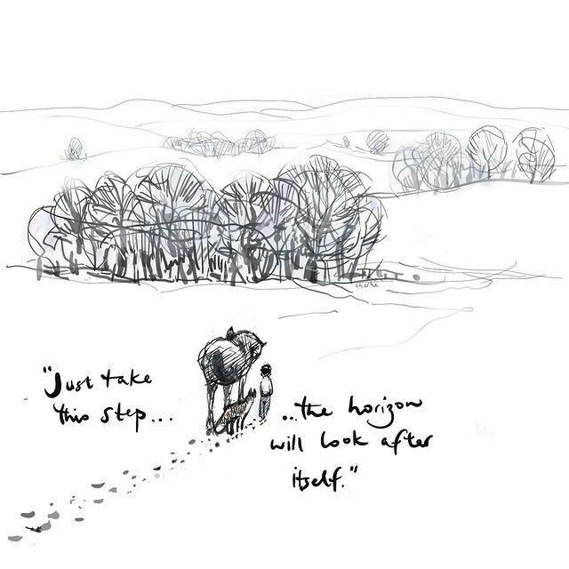

DPH Update
Thank You!

Slide 12
Vote on 2024 Annual Report
Next Steps
  Are there any updates from the writing group?

Slide 13
Next Steps
Fourth Meeting of 2025!
  Wednesday, July 9th, 2025, 4-6 PM
  Future meetings via Zoom
    If you need help, please email Maddy Goskoski at madelyn.m.goskoski@mass.gov in advance who will find assistance.
Next steps:
  Email madelyn.m.goskoski@mass.gov to get on the July agenda
  Anything else?
  Vote to Adjourn
EG

Slide 14
Motion to Adjourn
Thank You!

