Slide 1
Public assistance overview covid-19
MEMA
MASSACHUSETTS EMERGENCY MANAGEMENT AGENCY
DISASTER RECOVERY UNIT

Slide 2
Major declaration FEMA-4496-DR-MA
DECLARATION DATE: March 27, 2020
INCIDENT DATE: January 20, 2020 and continuing
DECLARED COUNTIES: All Massachusetts Counties
AUTHORIZED DISASTER ASSISTANCE: FEMA Public Assistance Program
Category B - FEMA Public Assistance Program

Slide 3
AGENDA
FEMA PUBLIC ASSISTANCE PROGRAM
ELIGIBLE ACTIVITIES AND COSTS
REQUIRED DOCUMENTATION
HOW TO APPLY FOR PUBLIC ASSISTANCE

Slide 4
FEMA PUBLIC ASSISTANCE (PA) PROGRAM
FEMA provides supplemental financial assistance to state, local and tribal governments, and certain private non-profit organizations for emergency protective measures that may be eligible under FEMA’s Public Assistance Program in accordance with the COVID-19 Emergency Declaration in order to ensure that resource constraints do not inhibit efforts to respond to this unprecedented disaster.
The assistance FEMA provides through its PA Program is subject to a cost share. The Federal share is 100% of the eligible costs.
FEMA will not duplicate assistance provided by the Department of Health and Human Services (HHS), including the Centers for Disease Control and Prevention, or other federal agencies. Additionally, this emergency declaration does not make direct financial assistance available to private businesses or individuals.

Slide 5
Category b – emergency protective measures
DEFINITION:
An emergency protective measure is an activity undertaken to eliminate or lessen an immediate threat to lives, public health, or safety.

Slide 6
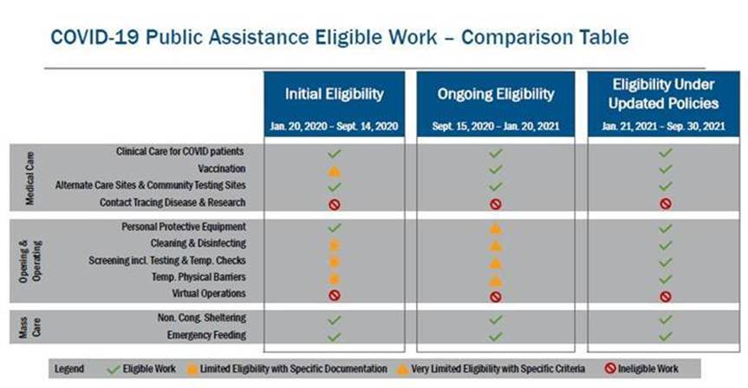
Eligibility Periods
Links to Guidance:
Initial Eligibility
Ongoing Eligibility
Eligibility Under Updated Policies

Slide 7
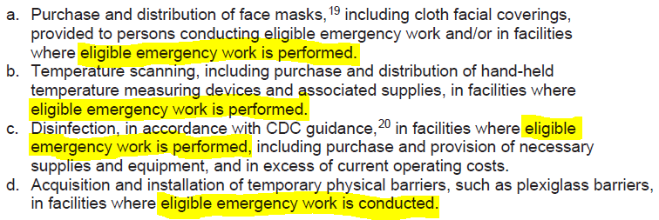
Eligibility: September 15, 2020 – January 20, 2021
Eligible Emergency Work: emergency actions taken to directly respond to COVID-19.
Does not include school re-opening or operation costs
Click HERE for FEMA guidance.

Slide 8
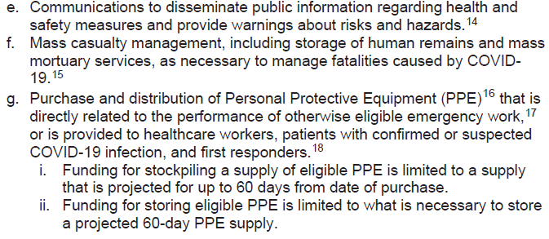
Ongoing guidance: September 15, 2020 – January 20, 2021
Activities are eligible for reimbursement ONLY if the entity has the legal responsibility!

Slide 9
Eligibility: January 21, 2021 – September 30, 2021
FEMA may provide assistance to all eligible PA Applicants, including SLTTs and eligible PNPs, for the following measures implemented to facilitate the safe opening and operation of all eligible facilities in response to COVID-19 declared events:
Purchase and distribution of face masks, including cloth face coverings, and Personal Protective Equipment (PPE).
Cleaning and disinfection, in accordance with CDC guidance or that of an appropriate Public Health official available at the time the work was completed, including the purchase and provision of necessary supplies and equipment in excess of the Applicant’s regularly budgeted costs.
COVID-19 diagnostic testing.
Screening and temperature scanning, including, but not limited to, the purchase and distribution of hand-held temperature measuring devices or temperature screening equipment.
Acquisition and installation of temporary physical barriers, such as plexiglass barriers and screens/dividers, and signage to support social distancing, such as floor decals.
Purchase and storage of PPE and other supplies listed in this section based on projected needs.
Supplemental to September 1st 2020 policy
Eligible Public Facilities
Click HERE for FEMA guidance.

Slide 10
Documentation Requirements Small PROJECTS VS LARGE PROJECTS
SMALL PROJECT DOCUMENTATION
from $3,300 - $131,100
LARGE PROJECT DOCUMENTATION
equal to or exceed $131,100
Electronic Streamlined Project Application
MEMA Workbook (Summary Log)
Subrecipient Small Project Certification Form
Procurement Policy
Pay Policy & Applicable Union Contracts
Electronic Streamlined Project Application
MEMA Workbook (Summary Log)
Procurement Policy
Pay Policy & Applicable Union Contracts
Force Account Labor
Time Sheets
Proof of Payment
Force Account Equipment
Proof of Ownership
Operator Time Sheets & Logs
Materials & Supplies
Invoices/Receipts
Proof of Payment
Procurement Documentation
Contracts
Contract Agreements
Invoices/Receipts
Proof of Payment
Procurement Documentation

Slide 11
HOW TO APPLY FOR PUBLIC ASSISTANCE
Request an Organization Profile
Only if you are a first time applicant in Grants Portal, if you have received PA from a disaster in 2018 or more recently in MA, go to next section.
Local Government
Directly request portal account/request public assistance for DR 4496 at https://grantee.fema.gov
Nonprofit with 501(c)3 IRS Status
Must go through MEMA for portal registration
1) Fill out Portal Registration Form, located here
2) Email Portal Registration Form to disaster.recovery@mass.gov
Submit a Request for Public Assistance (RPA)
Once you have requested and created an organization profile in Grants Portal, you should receive an automatically generated email confirming an organization profile has been created. In order to request PA for DR 4496, you must complete the following:
1) Log into account on Grants Portal at https://grantee.fema.gov
2) Navigate to the “Request Public Assistance” button on the upper right side of your screen.
3) Complete and submit the RPA Form.

Slide 12
State Public assistance contacts
MA Public Assistance Officer
Erica.Heidelberg@mass.gov
MA Public Assistance Program Coordinator – Complex Lane Projects
Lorraine.Eddy@mass.gov
MA Public Assistance Program Coordinator – Standard Lane Projects
Amanda.Campen@mass.gov
Questions?
https://www.mass.gov/info-details/covid-19-federal-disaster-declaration#questions-
Disaster.Recovery@mass.gov

