Slide 1
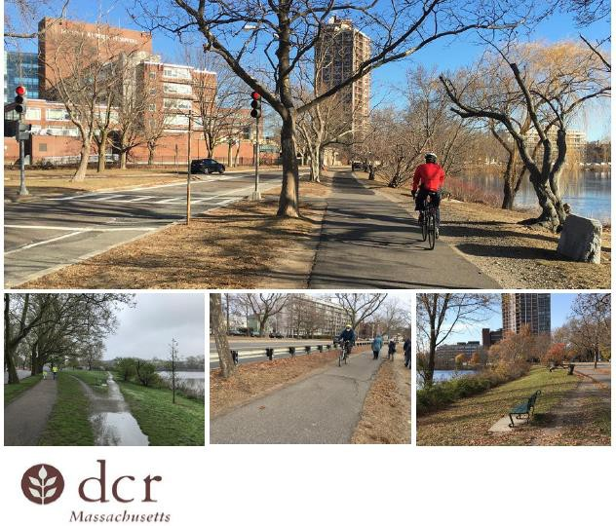

Riverbend Park and Landscape Maintenance: Construction Briefing
Massachusetts Department of Conservation and Recreation
Memorial Drive Phase III Project Update
February 5, 2026
Memorial Drive Phase III Construction Project
Charles River Reservation
Cambridge, Massachusetts
/ Brown, Richardson + Rowe

Slide 2

Commonwealth of Massachusetts

Slide 3

DCR Mission

Slide 4

DCR Core Principles

Slide 5
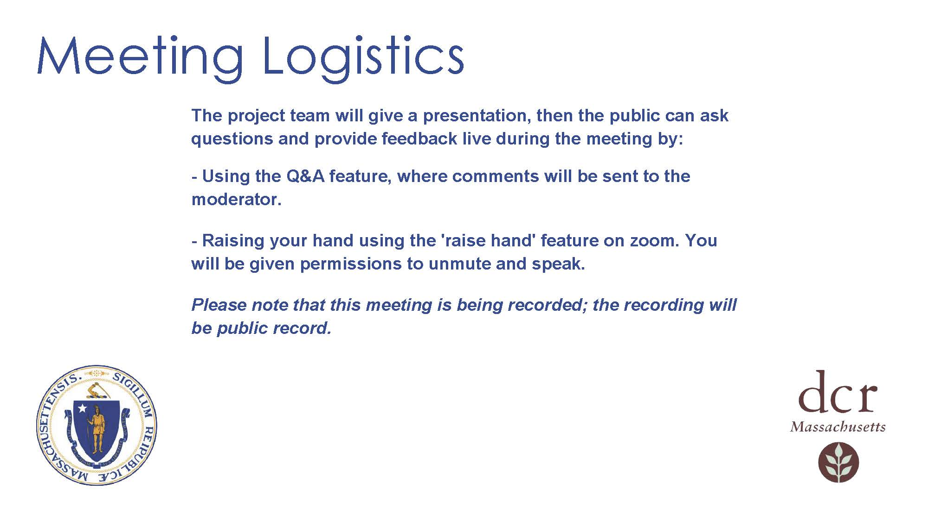
Meeting Logistics

Slide 6
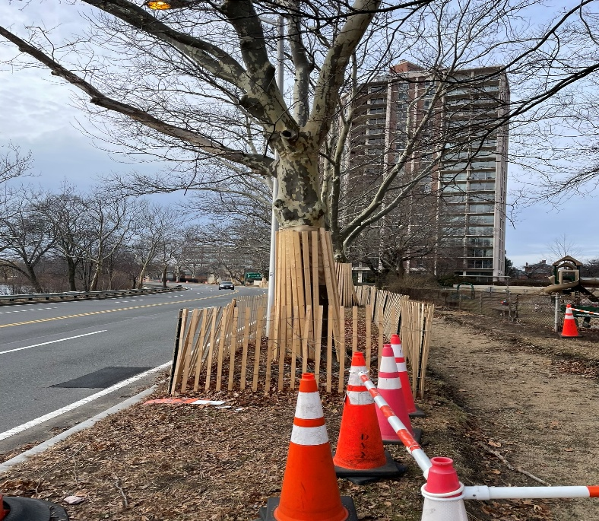
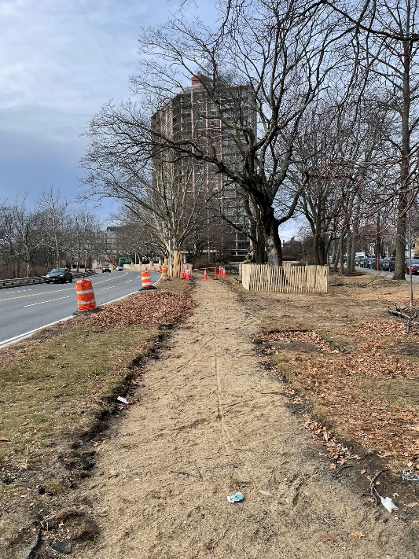
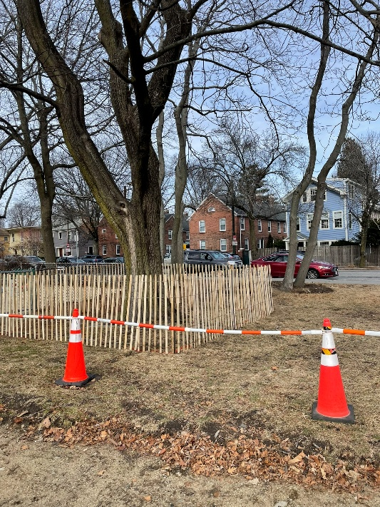
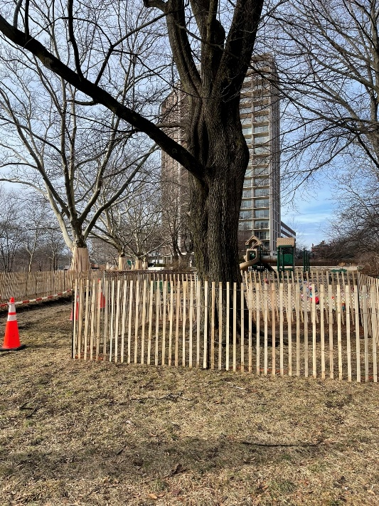
Agenda Items
Riverbend Park Closure
Trees: Construction Update
Questions and Comments
Memorial Drive, Cambridge, MA

Slide 7
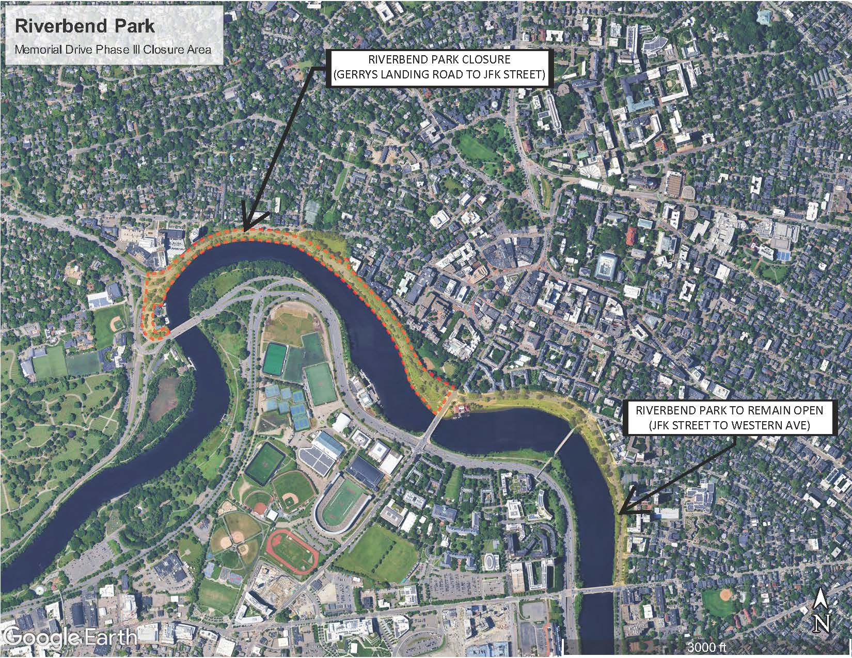
Riverbend Park Closure Limits

Slide 8
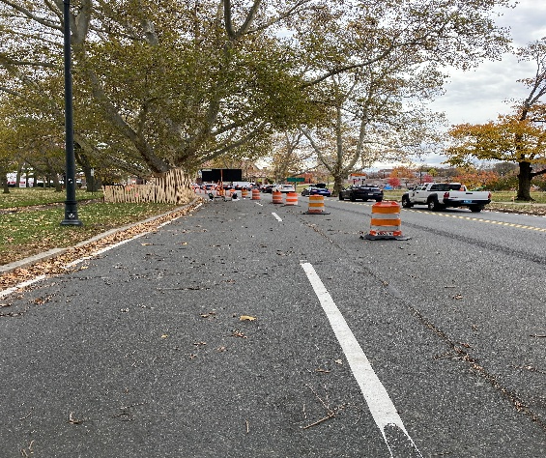
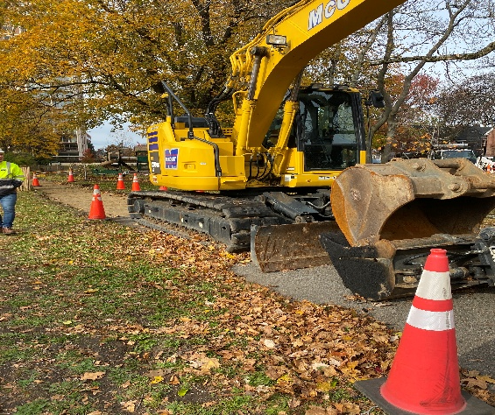
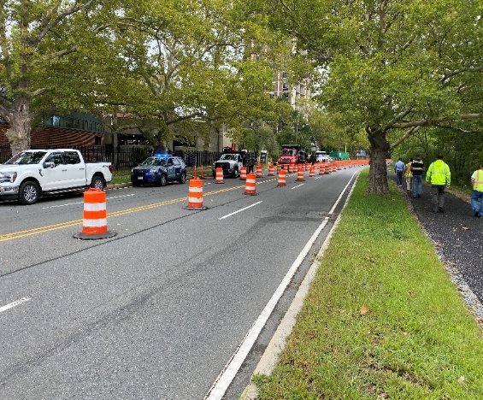
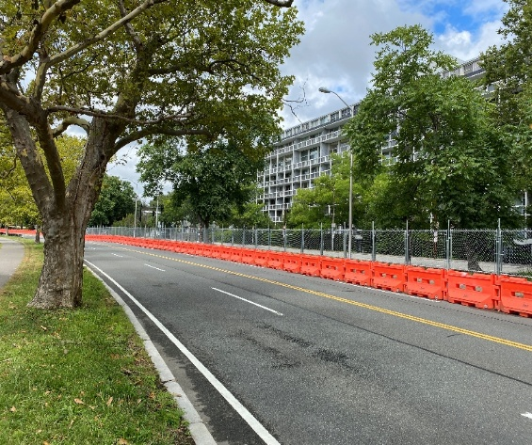
Riverbend Park – West End Closure
Gerrys Landing Road to JFK Street
ONGOING AND UPCOMING CONSTRUCTION ACTIVITIES RESTRICT PUBLIC ACCESS
REQUIRED SAFETY BARRIERS WILL RESTRICT ACCESS TO PARKLAND AND TRAVEL LANES
CONTRACTOR LIABILITY AND INABILITY TO GUARANTEE SAFE PUBLIC ACCESS
221 MOUNT AUBURN STREET DEMOLITION IMPACTING TRAFFIC AND SAFETY

Slide 9
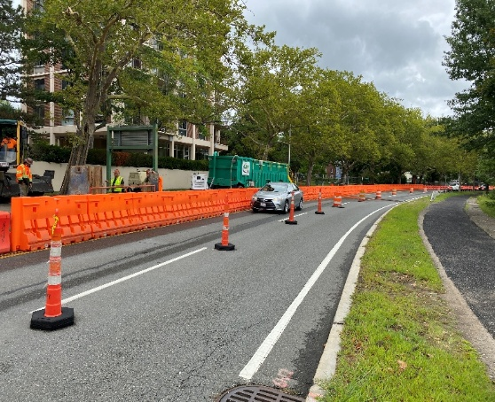
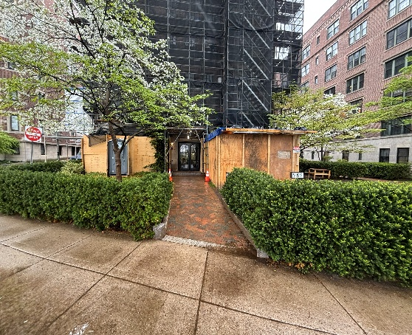
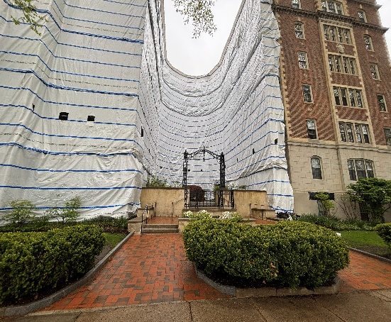
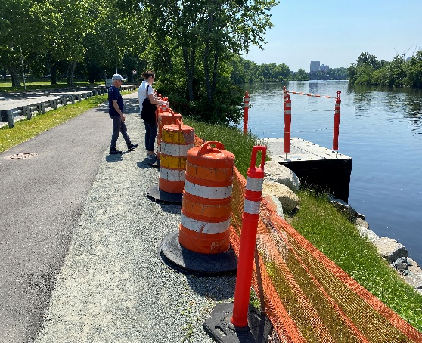
Riverbend Park – West End Closure (continued)
Gerrys Landing Road to JFK Street
ADDITIONAL ADJACENT CONSTRUCTION ACTIVITIES (# 980 - # 992 MEMORIAL DRIVE)
MASSDOT’S ELIOT BRIDGE RECONSTRUCTION FURTHER CONSTRAINS MOVEMENT
CITY OF CAMBRIDGE PROJECTS CAM 005 AND CAM 007 INSIDE PROJECT LIMITS
2026 FIFA WORLD CUP WILL BRING SIGNIFICANTLY INCREASED REGIONAL TRAFFIC

Slide 10
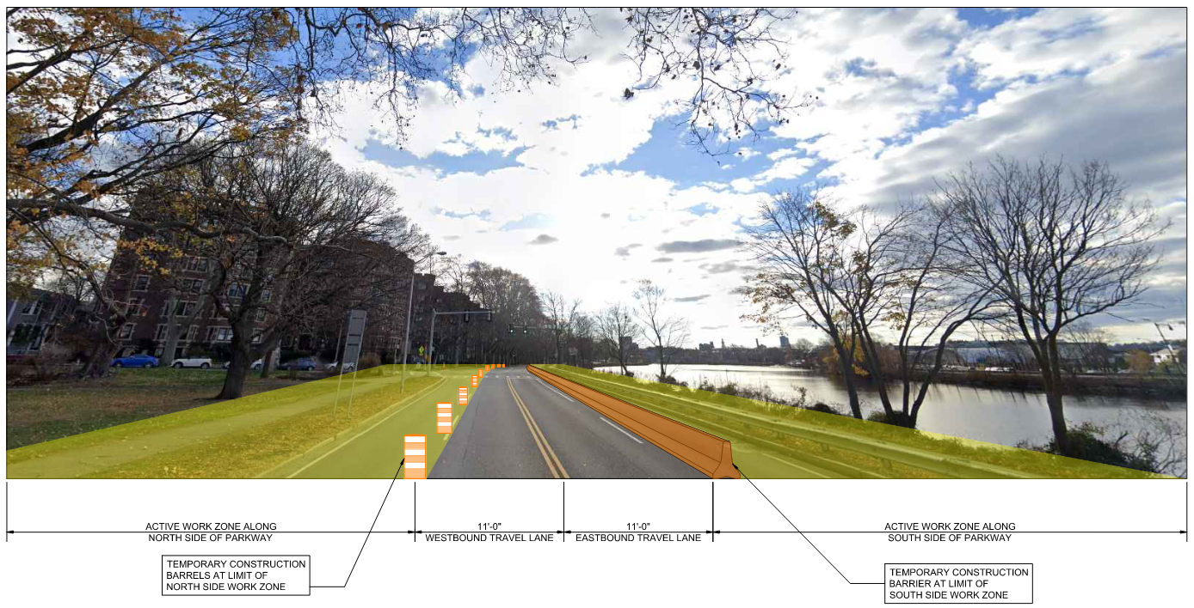
Riverbend Park – West End Closure
Potential Construction Staging Summer 2026
ACTIVE WORK ZONES PRESENT ON BOTH SIDES OF PARKWAY
NORTHERN SIDEWALK FINAL CONSTRUCTION UNDERWAY
SOUTHERN CURBLINE RELOCATED AND PATHWAY GRADING IN PROGRESS
TRAFFIC PATTERNS AND ACCESS MAINTAINED

Slide 11
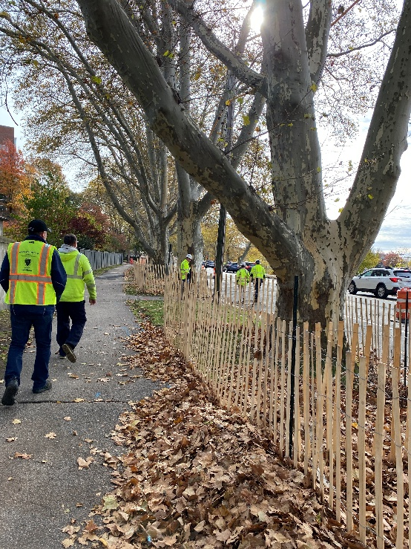
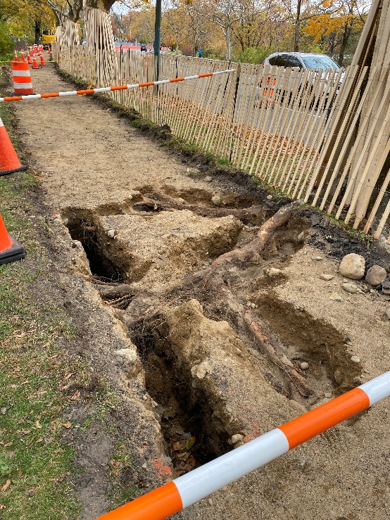
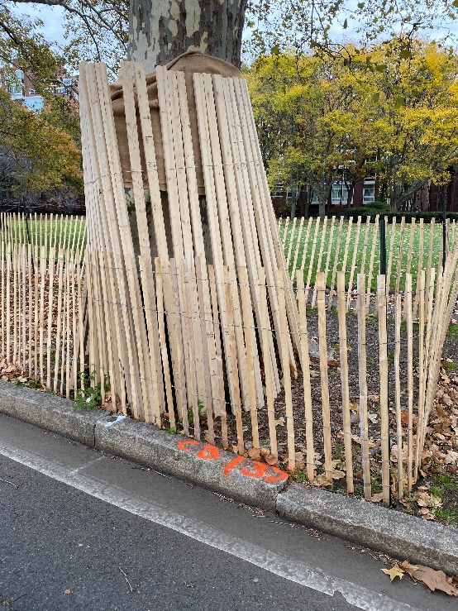
Trees: Construction Update
PROTECTION MEASURES:
Tree protection fencing and cladding installed
Deep root fertilization to occur in Spring
Herbicide and Fungicide applications as needed to address disease
Air excavation and root pruning (under 2-inch diameter)

Slide 12
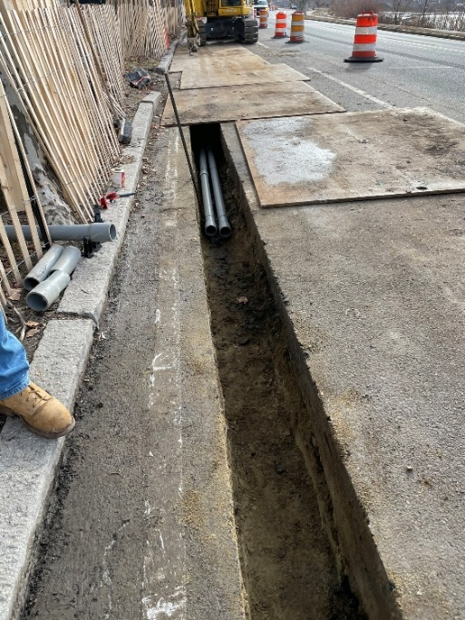
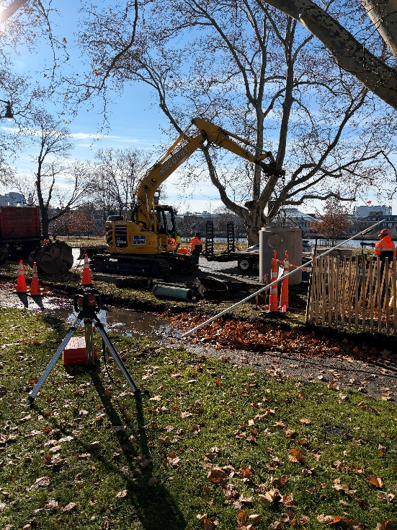
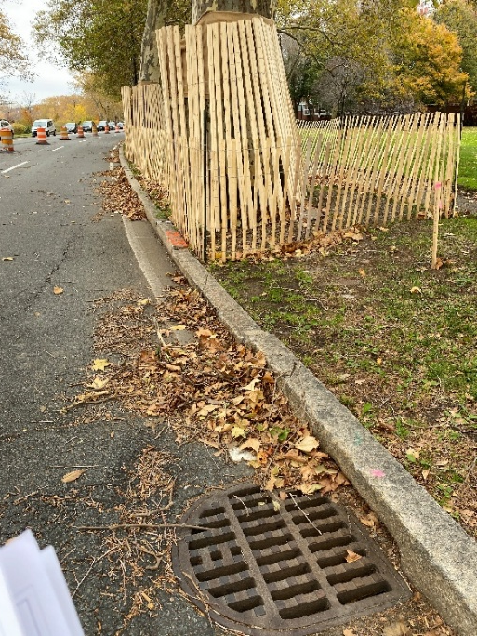
Trees: Construction Update
AVOIDANCE MEASURES:
Electrical trenching relocated into the street to minimize impacts to existing tree roots
Reduced size and changed location of all 45 electric hand holes
Proposed catch basin locations revised to minimize impacts to existing tree roots

Slide 13
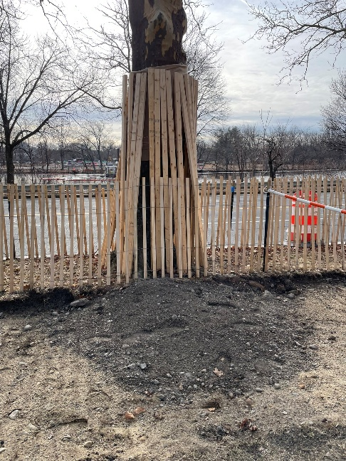
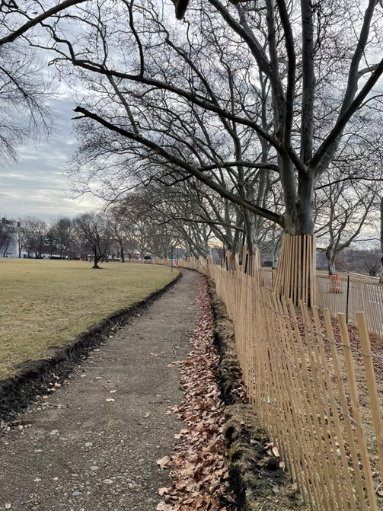

Trees: Construction Update
AVOIDANCE MEASURES:
Adjustments to proposed porous flexible pavement sidewalk grade profile made to minimize impact to tree roots
Porous flexible pavement detail revised to utilize structural soil above existing base material to provide greater rooting area for existing tree roots
Reuse of existing base material at porous flexible pavement sidewalk to minimize excavation and prevent damage to tree roots

Slide 14
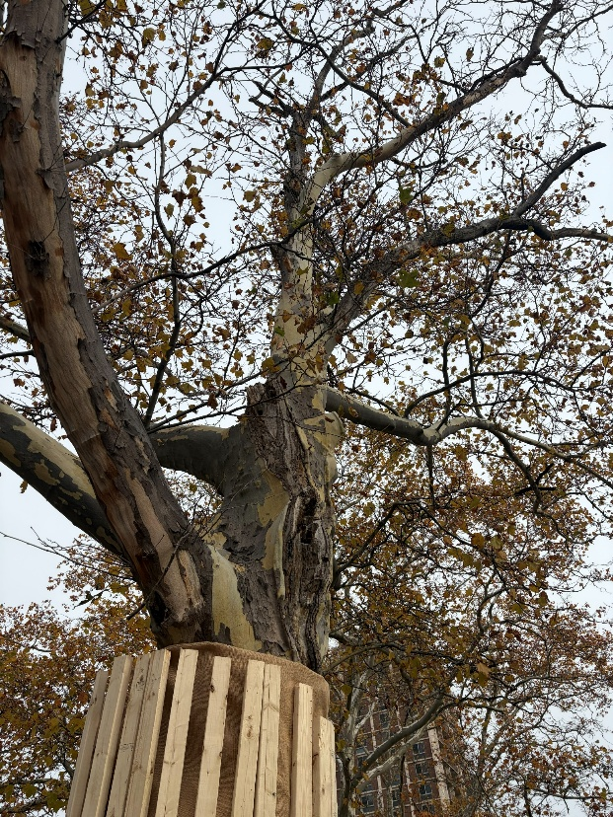
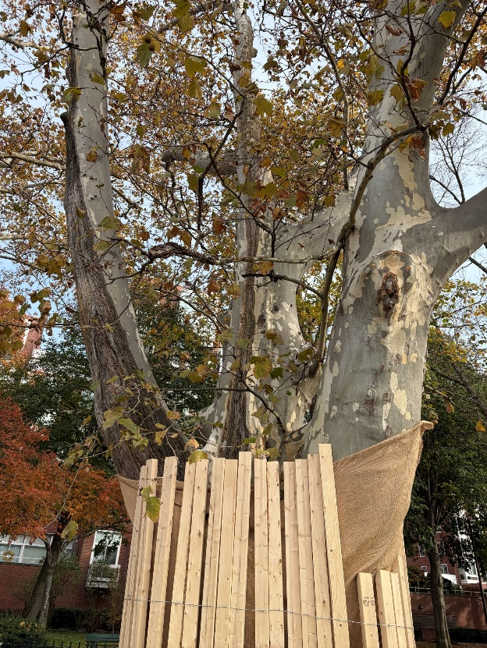
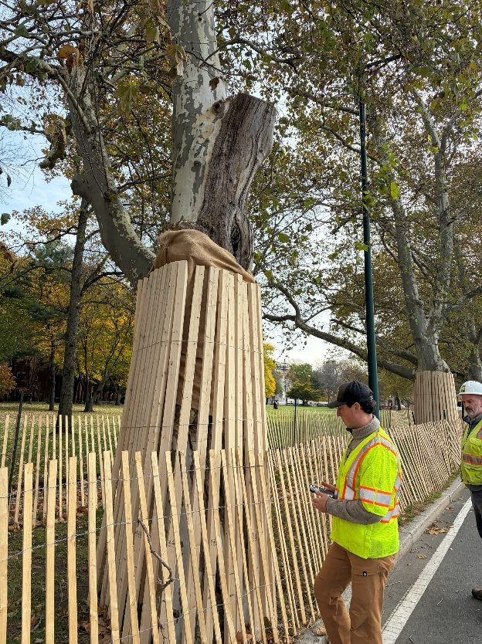
Trees Construction Update
ADDITIONAL LONDON PLANE TREE REMOVALS RECOMMENDED BY ARBORISTS:
Tree #6456
(Adjacent to # 330 Mt. Auburn Street) Mt. Auburn Hospital
Tree #6499
(Adjacent to JFK Memorial Park)
Westerly End
Tree #6500
(Adjacent to JFK Memorial Park)
Westerly End

Slide 15
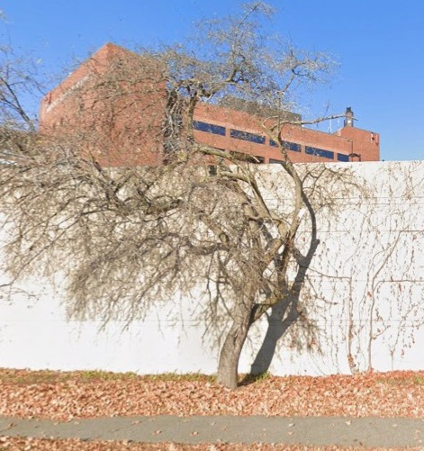
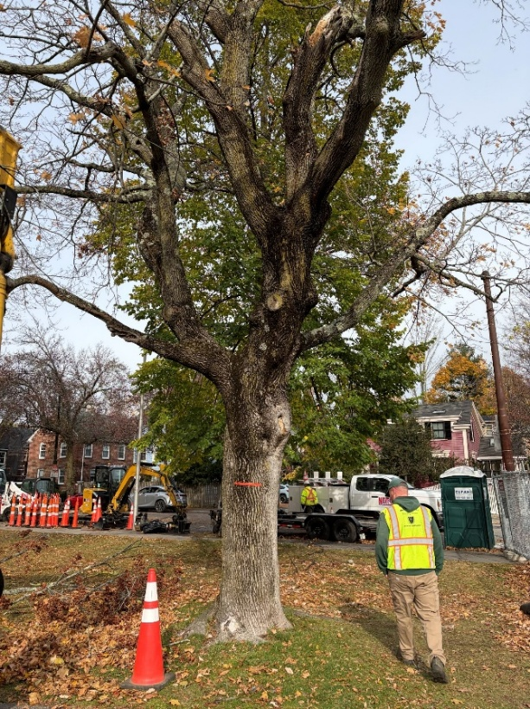
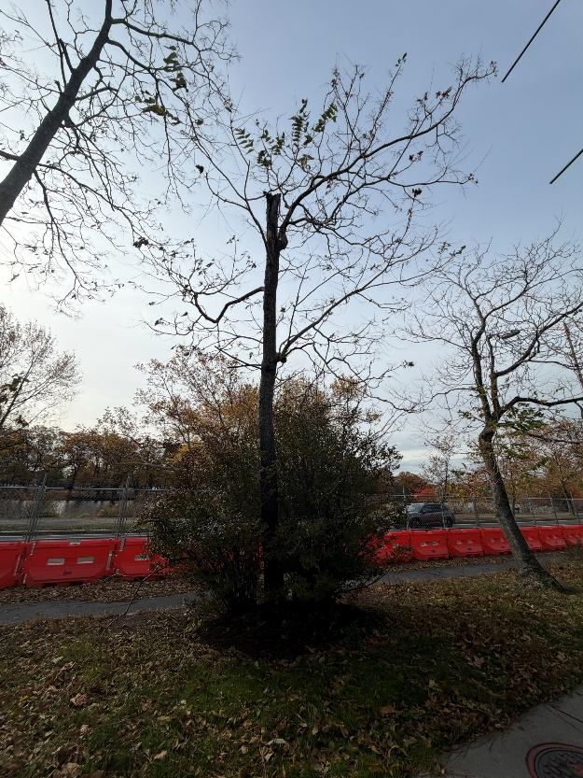
Tree Construction Update
ADDITIONAL TREE REMOVALS RECOMMENDED BY ARBORISTS (OTHER SPECIES):
Crab Apple
(At Mt. Auburn Hospital East Garage
Norway Maple
(Inside Riverbend Park)
Tree of Heaven
(Across from #199 Mt. Auburn Street

Slide 16
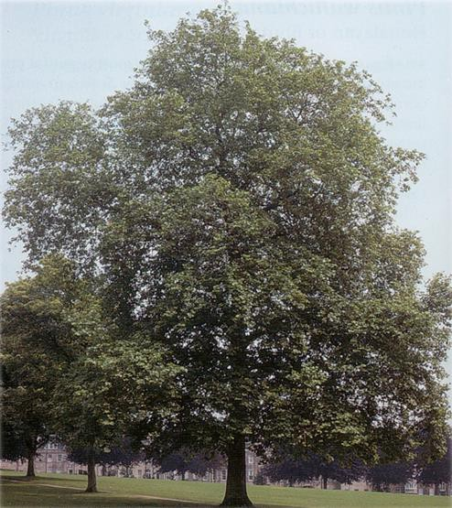
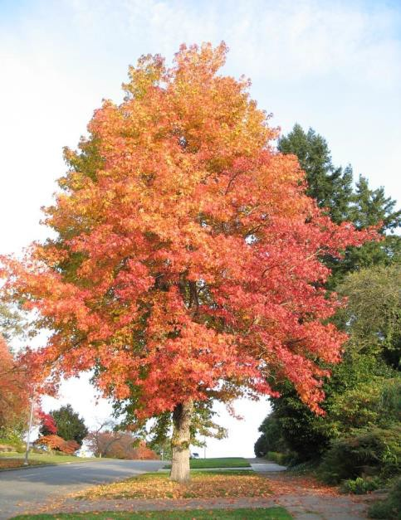
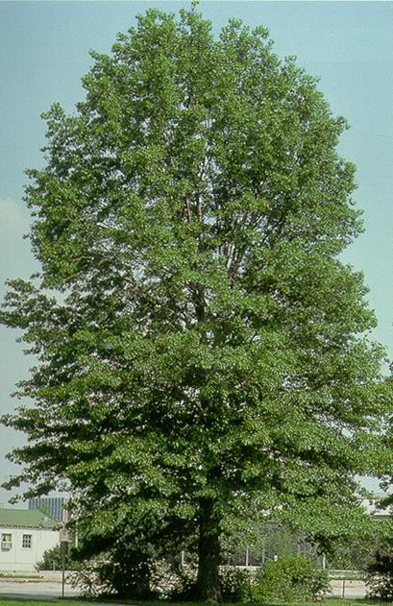
Planting Palette includes Native Species and London Plane Trees
Plant 85 new trees (55 native, 30 LPT’s) in accordance with DCR’s 2018 Charles Riverbank Vegetation Management Plan, Cambridge Urban Forest Master Plan, and Master Plan for the Charles River Basin. Plant native shrubs and perennials on the riverbank.
London Plane Tree
Sweetgum
Tulip Tree

Slide 17
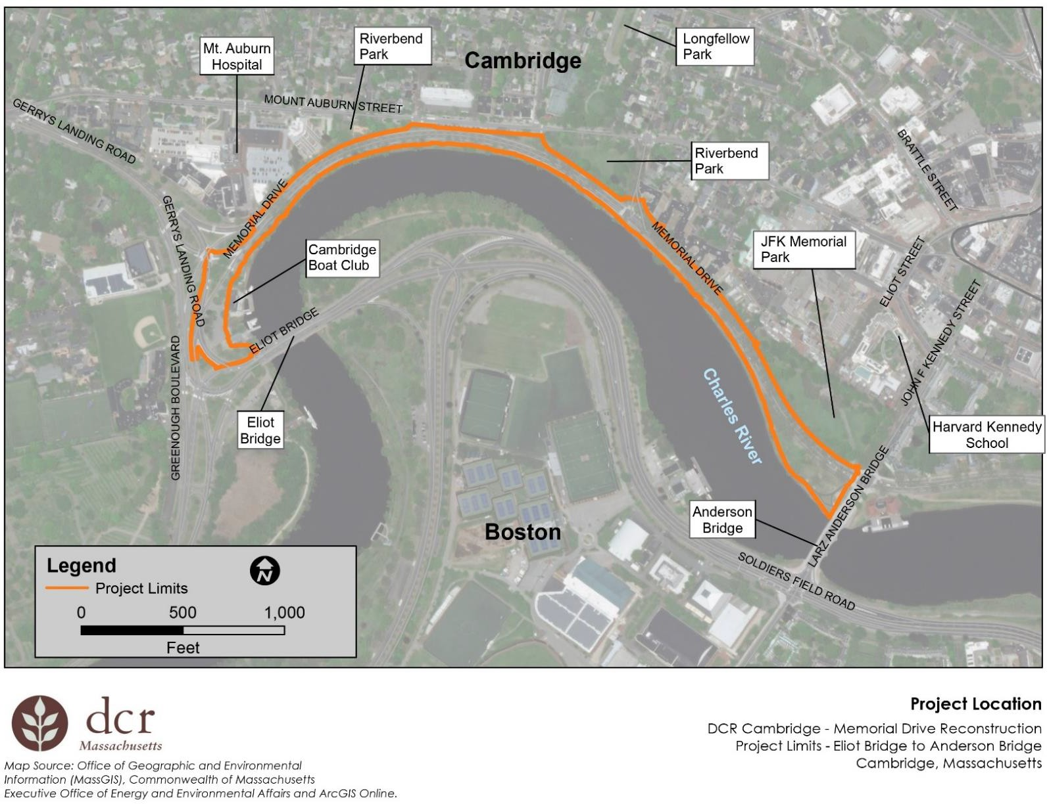
QUESTIONS

