Slide 1
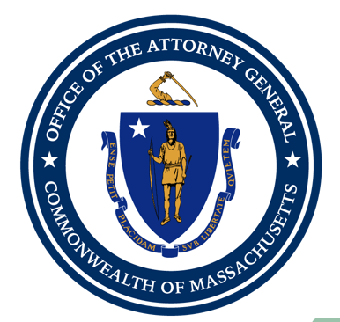
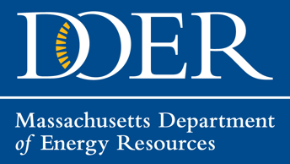
Merrimack Valley Stakeholder Feedback Summary—Residential Survey Results
__________________________
May 11, 2021

Slide 2
Summary Statistics
3f) Have you used Mass Save to improve your property’s energy efficiency?
Yes | No
67 | 57
205 Responses
Community:
  55% Lawrence, 15% North Andover, 19% Andover
Ownership:
  109 – owner (including 95 landlords)
  74 - renter
3g) If you answered no on the previous question, please answer why below:
I am not aware of Mass Save. | The process was difficult. | The Mass Save incentive wasn’t high enough. | Improvements would have benefited my tenants, not me. | My property needed upgrades before EE improvements could be made.
19 | 11 | 3 | 2 | 19
3h) If you answered that your property needed upgrades on the previous question, please check the type of upgrade(s) that was needed.
Testing/removal of knob and tube wiring | Asbestos removal | Vermiculite removal | Roof replacement | Electrical upgrade | Building code compliance issues | Other
3 | 5 | 2 | 7 | 7 | 1 | 3

Slide 3
Program Goals Ranked for $21 million LMI Programs

Slide 4
Additional Program Goals Offered (open-ended question)
Program Goal | Votes
Solar | 12
Education and awareness campaign | 4
Restrict funds to those affected | 4
Repair street | 3
Victim compensation | 3
Door and window replacement | 2
Generator/resiliency | 1
Income qualification | 1
No income qualification | 1
Open eligibility | 1
Eliminate utility debt | 1
Climate needs | 1
Workforce training | 1
Home repairs | 1

Slide 5
Program Outreach and Support

Slide 6
Ranking Outreach Methods

Slide 7
Recommendations for Local Contractors
Juba North Andover
Richard Bowman. Plumber
Angel Martinez -Electrical Services
MDJ Incorporated
Bradford Plumbing
Greater Lawrence Technical School
Maclellan
Bill Brogan plumber. Andover MA
Tortora Electric
Alcantara Contractor Inc.
Plumber Paul Michel in Haverhill
Sleeping Dog Properties (General Contractor), Andover
Rivers Plumbing Andover
Drinkwater Electric Lawrence
Work with local inspectional Services to provide contractors list
Edwin Perez electricians
A&D construction
3rd generation plumbing
R. W. White Contracting.
Service Dept South
Prestige Heating And Cooling
Greater Lawrence Voc-Tec
Notes:
THIS RESPONSE BELOW WAS ADDITIONAL FEEDBACK
no this should occur by a third party making a list of all legally licensed and INSURED contractors and this should be verified to ensure all remain that way during the term of any work they do. Also Lawrence, Andover and North Andover shoud have inspectors who all follow the same rules and requirements and can fill in as needed or train others and ALL be on the same page.

Slide 8
Recommendations for local community partners and organizations
Bread and Roses
YWCA
Girl and Boys Club
Rotary Club
Chamber of Commerce
Real Estate Companies
Community Action
Elder Services
Greater Lawrence Technical School
Andover Community Trust
The Dream Network
ABCA
Greater Lawrence Community Action Council (GLCAC)
Low Income Home Energy Assistance Program (LIHEAP)
Mass Save
Licensing bureau
Maria Moeller at The Community Group
Local radio stations
Mail ins
Craft Unions
Massachusetts Building Trades Council
Lawrence Community College NECC

