Slide 1
Middlesex County Restoration Center
March 2022

Slide 2
The Problem
People with behavioral health (BH) conditions are disproportionately represented among those interacting with law enforcement and emergency departments.
Police chiefs report that up to 75% of officer time may be spent on calls related to behavioral health conditions
Among individuals in jail/prison in Middlesex County:
50% have a mental health condition
75% have co-occurring conditions
80% have a substance use condition
Though people presenting with behavioral health emergencies only accounted for 14% of ED visits in 2015, they accounted for 71% of all ED visits that boarded (spent 12+ hours in an ED waiting for a hospital bed)
Not only are the above outcomes bad for individuals, they are expensive to government, health insurers, and individuals:
The average arrest costs $2,500
An average mental health ED visit costs $4,200
63% of these visits are by MassHealth members
Notes:
CATIA

Slide 3
Restoration Center Commission
An Act Relative to Criminal Justice Reform passed in 2018, containing a provision creating the Middlesex County Restoration Center Commission.
Purpose is to investigate how to prevent arrest and unnecessary hospitalization of individuals with BH conditions
Co-chairs:
Middlesex Sheriff Peter J. Koutoujian
Danna Mauch, PhD, President and CEO of the Massachusetts Association for Mental Health
Comprised of stakeholders from:
The State Legislature
Criminal legal system entities (Trial Court and police)
BH providers and advocates
Representatives of state administrative agencies
Notes:
CATIA

Slide 4
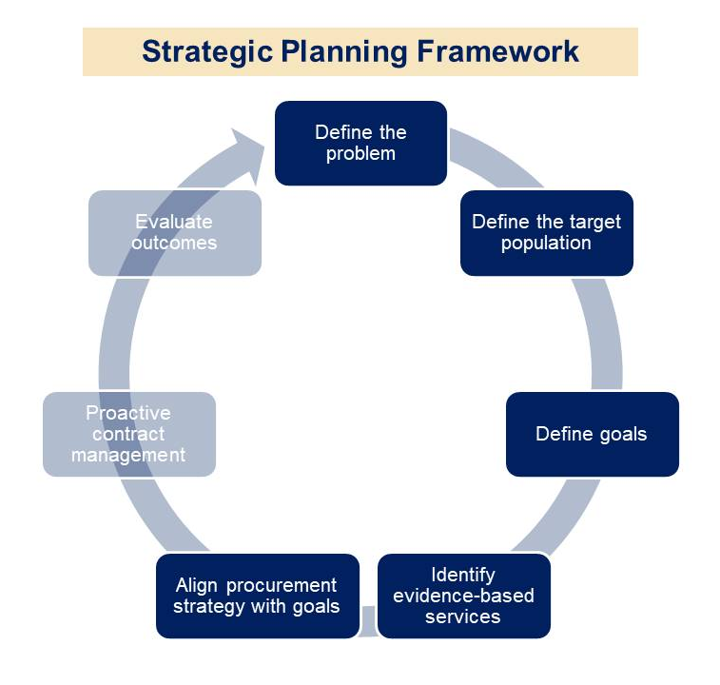
Commission Planning Process
Year One
Analysis of gaps and needs for BH and diversionary services in Middlesex County
Review of national best practices and exemplary programs
Year Two
Development of a model Restoration Center
Year Three
Refinement of Model
Year Four
Procurement of a provider for a pilot project
Future
Evaluation and outcome measurement with an eye toward replication and scale
Notes:
CATIA

Slide 5
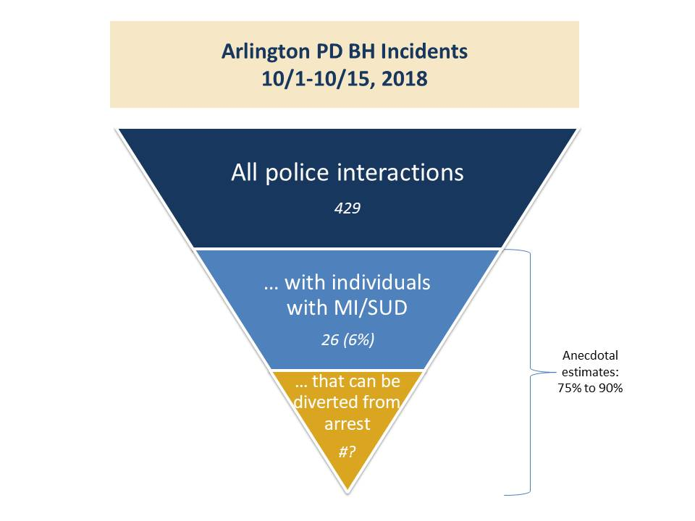
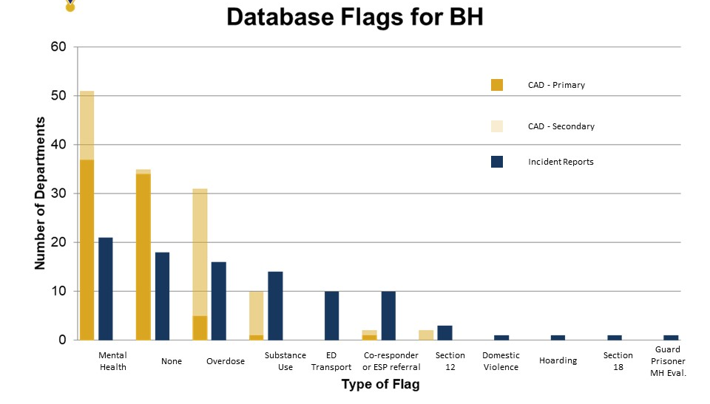
Defining the Target Population
While anecdotal estimates of officer time spent on these calls is 75%, actual data we reviewed shows less than 10% of 911 calls coded as BH.
Many departments do not flag such calls; those that do only capture those calls that have no co-occurring non-BH call codes.
Source: Middlesex County Restoration Center Commission Survey of Police Departments, 2019.

Slide 6
Defining the Target Population
Restoration Center Estimated Daily Intakes
Source: Middlesex County Restoration Center Commission Year Two Findings and Recommendations. Data from multiple locations.

Slide 7
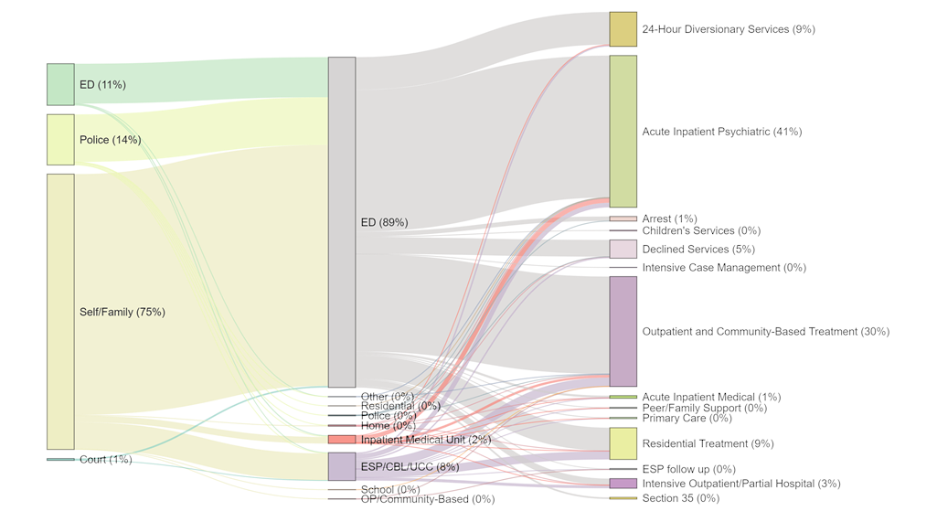
Preventing Unnecessary Hospitalization
Most mobile crisis intervention calls are being triaged in an ED, even though most calls are from home and most crisis assessments don’t result in acute inpatient hospitalization.
Location of crisis caller Location of assessment Disposition of crisis episode
Source: Massachusetts Behavioral Health Partnership data on Emergency Services Programs in Middlesex County. Analysis by Catia Sharp.

Slide 8
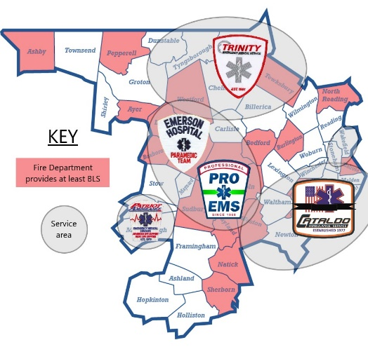
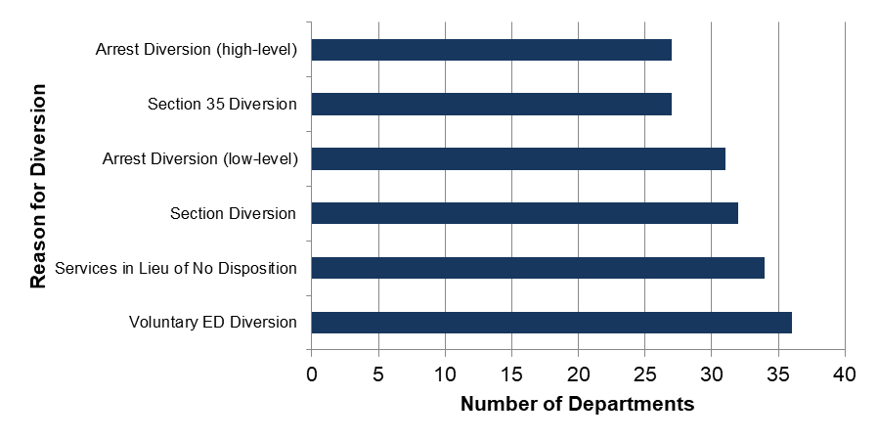
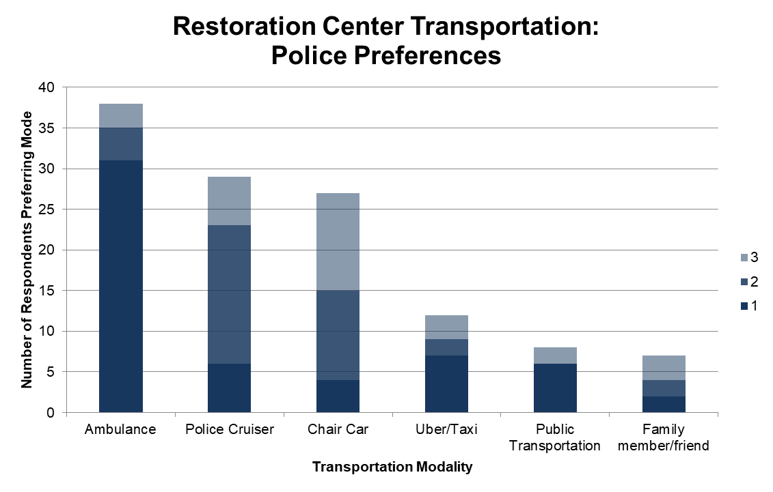
Preventing Arrest
We surveyed all Middlesex County police departments to review their appetite and readiness for diversion.
Departments said they would use a Restoration Center to divert from the ED, divert from arrest (even high-level offenses), and from leaving a person in the community without support.
Departments prefer secure modes of transportation to a Restoration Center. These modes may present challenges due to many jurisdictions and ambulance providers.
Legend indicates first, second, and third preferences from police.

Slide 9
Restoration Center Goals and Policies
POLICIES
GOALS
No client turned away due to payer and coverage issues, complexity of need, or behavioral concerns
Allow police and ambulance drop-off as well as walk-ins
Co-location of MH and SUD services; assume most clients will have co-occurring needs
Emphasis on warm hand-offs to the next level of care
Collaborate with the Administration’s Roadmap to Behavioral Health Reform, including by aligning with CBHCs
Reduce ED Boarding
Increase use of community-based behavioral health care
Increase use of services supporting social determinants of health in the community
Strengthen police co-responder program and Crisis Intervention Training
Reduce arraignment and forensic commitments
Reduce recidivism
Reduce involuntary treatment petitions
Notes:
CATIA

Slide 10
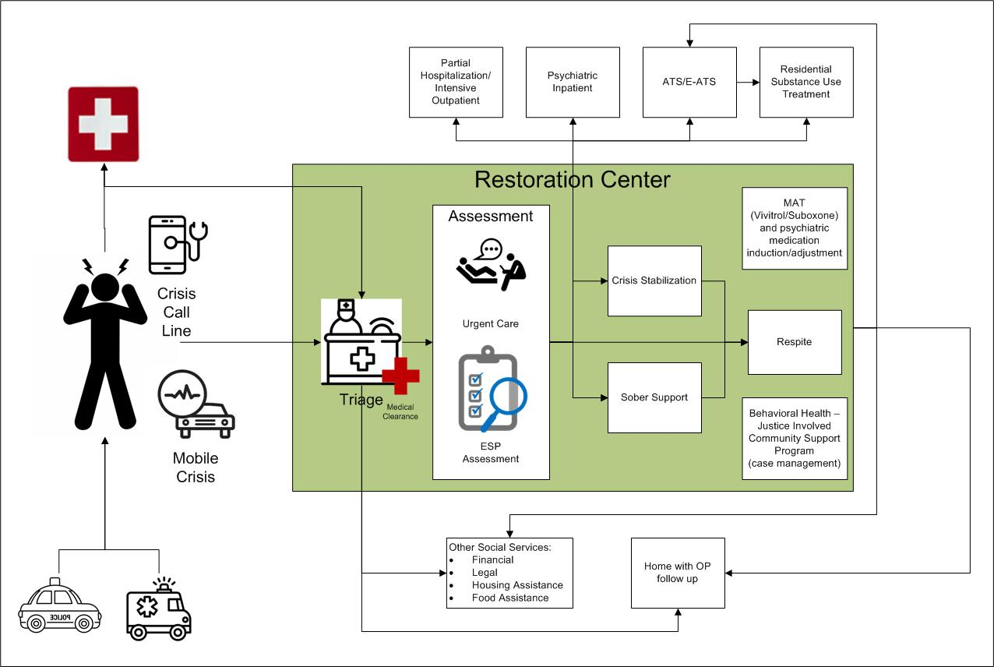
The Model

