Slide 1

Mobile Integrated Health Care and
Community EMS Programs
MIH Overview for Medical Directors,
Hospitals, and Health Care Entities
September 5, 2018

Slide 2
Background
Chapter 111O of the General Laws of Massachusetts sets forth standards for the approval and oversight of Community EMS Programs and Mobile Integrated Health Programs, including those with ED Avoidance Components and ensures a high quality of care, and strong consumer protection in alternate health care settings.
The Public Health Council approved MIH Program regulations, 105 CMR 173.000, Mobile Integrated Health Care and Community EMS Programs, on August 8, 2018.

Slide 3
Underlying Inspiration for MIH:
The Quadruple Aim
Population Health
Improving the health
of populations
Right Care
Right Time
Right Place
Right Cost
Patient Experience
of Care
Per Capita Cost
Quadruple
Aim
Improving the patient experience of care (including quality
and satisfaction)
Reducing the per capita cost of
health care
Provider Experience
Improving the satisfaction, engagement, and retention
of providers
Source: Institute for Healthcare Improvement

Slide 4
Mobile Integrated Health Care: Redefining Care Delivery
Mobile Integrated Health Care (MIH) is an opportunity for enhanced partnerships between healthcare entities and healthcare providers to provide innovative healthcare models that use mobile resources, including EMS personnel, to deliver care and services to patients in an out-of-hospital environment.
Encourages partnerships between various healthcare providers as well as ACOs
Focuses on care coordination and managed care
Expands the setting of practitioners beyond the hospital environment with appropriate training and medical oversight
Programs may differ in goals and services provided based on the needs of the communities where they operate
Examples of services:
  Chronic disease management
  Behavioral health
  Preventative care
  Post-discharge follow-up visits
  Transport or referral to facilities other than hospital EDs
Examples of healthcare facilities and entities:
  Ambulance services
  Hospitals
  Accountable Care Organizations
  Visiting Nurse Associations
  Home Health Agencies
Examples of providers:
  EMS Personnel
  Community Paramedics
  Nurses
  Physician Assistants
  Emergency Service Providers (ESPs)
  Social Workers

Slide 5
Defining the MIH Spectrum
EMS Community EMS MIH MIH with ED Avoidance
Education
Stabilize, treat
and Transport
Scheduled and Acute Treatments, Transport & Refer
(e.g. readmission avoidance, post-discharge follow up)
Treat; Transport to
Alternate Destination within the MIH system
Preventive Services, Low Risk High Impact
(e.g. screenings, falls prevention)
HIGHER RISK

Slide 6
Background Comparison
 | EMS | CEMS | MIH | MIH with EDA
Authority | MGL 111C / 105 CMR 170 | MGL 111O / 105 CMR 173
Goal | Non-/Emergency EMS services | Prevention; high value/ low risk services | Address gaps; prevent over hospitalization | Appropriate Treatment
Staffing | Certified EMTs/ para. | Primary ambulance EMS | EMS/ Community Para. | Primary ambulance EMS
Training | Statewide Treatment Protocols (STP) | STP & Program-specific training | STP & Program-specific training | STP & Advanced EDA training
Operation | Juris. service zone plan | Muni; ambulance AMD | Healthcare partnerships | MIH Program
Oversight | Medical control/direction | Medical control/direction | Medical control/direction | Medical control/direction
Service | Licensed ambulance | Primary ambulance | No preference | Primary ambulance
Vehicle | Min. ambulance standards | Appropriate to encounter | Appropriate to encounter | Min. ambulance standards
Treatment | Assessment, treatment | DPH-approved services | Setting change but within Scope | Assessment, treatment
Transport | To emergency department | N/A | N/A | Alternative destination
911 | Respond to 911; dispatch | Activate 911 in emergency | Activate 911 in emergency | Respond to 911; dispatch
Primary Care Provider | N/A | PCP Referral | PCP coordination | PCP coordination

Slide 7
MIH Programs
1
2
3
COMMUNITY EMS |  | MIH |  | MIH w/ ED AVOIDANCE
EMS-based programs, in partnership with municipalities.
Focus on advancing illness or injury prevention through needed high value public health services with low risk potential.
Approved services defined by DPH, with option to petition to add new services.
Change to EMS care settings and patient access points, not the scope of care.
Utilizes EMS personnel (and other healthcare personnel) to deliver a coordinated continuum of care.
Addresses gaps in service delivery within a community.
Proactively prevents unnecessary hospitalizations or other harmful and wasteful resource delivery.
Care is provided outside of the hospital environment.
Component of an approved MIH Program that must be applied for separately, with a goal to prevent unnecessary hospitalizations.
Operated by an MIH Program and includes the community’s primary ambulance service.
Follows a primary ambulance service response, patient assessment, consultation with on-line medical direction, and patient consent to treatment at an alternate destination.

Slide 8
What is Community EMS?
A collaborative system that utilizes a primary ambulance service’s EMS Personnel in partnership with a local public health authority to address illness or injury prevention through high value public health services.
  Operated under the local public health authority
  Developed in coordination with the designated primary ambulance service
  Approved by the local jurisdiction and the ambulance service's affiliate hospital medical director (AHMD)
Community EMS services must fit in the scope of practice of the Emergency Medical Technician (EMT, AEMT or EMT-P) and should be high impact with low risk.
Approved services are defined in a DPH list, and Programs may petition to add new services to this list.

Slide 9
Community EMS Requirements
Applicants for Community EMS must meet the following requirements as part of their application:
Completed application form
Signature or letter of support from the authorized signatory of the local jurisdiction
Description of the program and proposed services from the Defined List of Community EMS Services
Attestation from the local public health authority and the primary ambulance service’s affiliate hospital medical director

Slide 10
What is MIH?
A system of pre- and post-hospital services that utilizes mobile resources, including EMS Personnel and community paramedics, to deliver a coordinated continuum of care that supports patients’ needs in the community.
Care is planned through collaborative and innovative program development to address gaps in service delivery and prevent unnecessary hospitalizations and other harmful or wasteful resource delivery.
An MIH Program may apply separately to include an ED Avoidance Component.

Slide 11
Examples of MIH Services, Partners & Providers
Services
  Chronic disease management
  Behavioral health
  Preventative care
  Post-discharge follow-up visits
  Transport or referral to facilities other than hospital EDs
Health Care Facilities or Entities
  Ambulance services
  Hospitals
  Accountable Care Organizations
  Visiting Nurse Associations
  Home Health Agencies
Providers
  EMS Personnel
  Community Paramedics
  Nurses
  Physician Assistants
  Emergency Service Providers (ESPs)
  Social Workers

Slide 12
MIH Requirements
Applicants for MIH must meet the following requirements as part of their application:
Completed application form
Gap in service delivery narrative
Proposed operational partnership documentation (e.g. MOU, LOI, MOA, contracts)
Organizational chart specific to applicant organization’s management and structure in the field
Designated Medical Director’s biography
Plan for medical oversight, including lines of authority and responsibility, development and review of clinical protocols, training and assessment of skills, communication systems, and continuous quality assurance and improvement
Completed MIH Compliance and Capacity Form

Slide 13
What is ED Avoidance?
A component of an approved MIH Program allowing for management of 911 patients in alternative settings, including outpatient clinics, psychiatric facilities, and the patient’s home.
DPH-approved MIH Programs may apply separately to operate an ED Avoidance Program in addition to the services provided through their MIH Program.
ED Avoidance utilizes the applicable jurisdiction’s designated primary ambulance service and paramedics with advanced training.
By treating at home or transporting the patient to an alternative destination, EDA may prevent crowding of hospital emergency departments as well as more appropriate care.

Slide 14





ED Avoidance Pathway
Transition to ED Avoidance follows a primary ambulance service response (911), patient assessment, consultation with on-line medical direction, and patient consent.
Contact Medical Direction for Permission to Avoid ED Transfer & Initiate Transition
to MIH
Treat in Home
Initiate Patient ED Refusal and Secure Patient Consent to Treat as MIH Patient
Treat and/or Refer or Transport to Appropriate Health Resource
Primary Ambulance Service Dispatch
Behavioral Health
911
Call
On-Scene, is Patient OK
Primary Care Provider
Subject to DPH ED Avoidance Protocol
Social Services
Substance Abuse Treatment

Slide 15
MIH with ED Avoidance Requirements
Applicants for MIH with ED Avoidance must meet the following requirements as part of their application:
Completed MIH with ED Avoidance application form
Either a completed MIH Program Application or a Certificate of Approval for an already approved MIH Program
Gap in service delivery narrative that is specific to the ED Avoidance Program
Contact information for each medical director
Program’s policies and procedures demonstrating the process for obtaining a patient’s informed consent
Clinical and triage protocols
Training curriculum

Slide 16
Required Data Submission
 | Frequency of Submission | Submission Method
Community EMS | Annual (optional) | DPH template with pre-defined fields
MIH | Quarterly | DPH template with pre-defined fields
MIH with ED Avoidance | Real-Time | Massachusetts Ambulance Trip Record Information System (MATRIS)
If an MIH Program also operates an ED Avoidance component, data must be submitted for both the MIH Program and the MIH with ED Avoidance Program.
Data submission instructions, defined data elements, submission templates for Community EMS and MIH will be available online at www.mass.gov/MIH.
Instructions for MATRIS access and use for MIH with ED Avoidance Programs will be available online at www.mass.gov/MIH.

Slide 17
Application Submission
All program and application information will be posted on the MIH website: www.mass.gov/MIH.
Application and Program guidance will also be posted online as available.
Application submission
  Community EMS, MIH, and MIH with ED Avoidance each have a unique application form, which will be available online as a fillable PDF.
  Applicants for all programs will submit completed applications by fax and additional required documents by email or mail to DPH.
  MIH and MIH with ED Avoidance applicants will remit payment for the initial application fee by mail.
  Once a complete Community EMS application is received, it will be reviewed and applicants will be notified within 30 days of program approval.
  MIH and MIH with ED Avoidance applications will be reviewed in the order that they are received, and applicants will have the opportunity to provide clarification on the information included in their application throughout the review process, as necessary.

Slide 18
MIH Program Fees
 | Application Fee (Due with Initial Program Application) | Biannual Registration Fee (Due following Program Approval and upon Registration Renewal)
Community EMS | -- | --
MIH | $1,000 | $30,000
MIH with ED Avoidance (EDA) | $2,000 | $40,000
If an applicant applies to operate both an MIH Program and an MIH with EDA Program, they must submit the application fee for each application ($1,000 for MIH; $2,000 for MIH with EDA).
If an applicant receives approval to operate both an MIH Program and an MIH with EDA Program, they must submit the registration fee for each program type ($30,000 for MIH; $40,000 for MIH with EDA).
MIH and MIH with ED Avoidance Programs are approved on a two-year basis, and
Programs may apply to renew their registration.

Slide 19
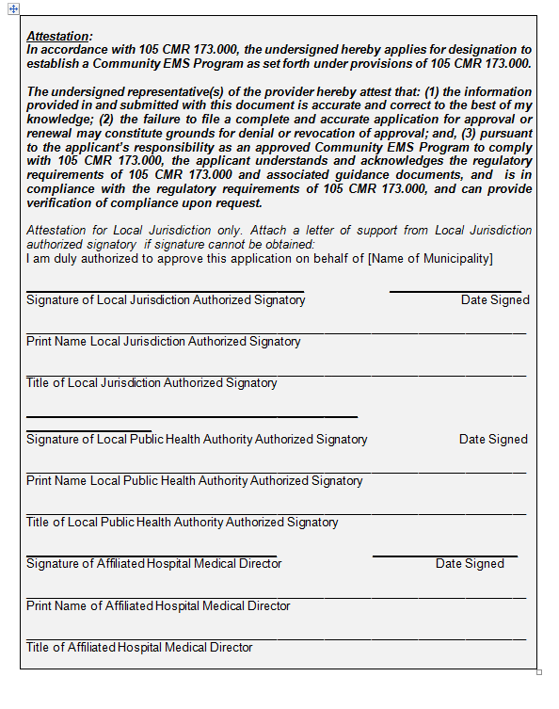
Community EMS Application
Attestation signatures needed:
Local Jurisdiction
Local Public Health Authority
Affiliate Hospital Medical Director
If cannot obtain local jurisdiction signature on the application, may attach a letter of support from the authorized signatory of the local jurisdiction

Slide 20
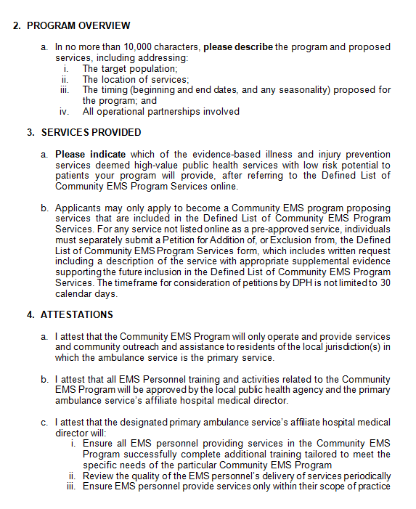
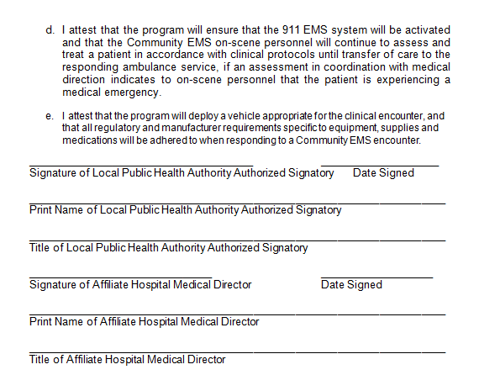
Community EMS
Application, cont’d
Description of program & proposed services
Services selected from Defined List of Community EMS Program Services that CEMS is applying to administer
Attestations

Slide 21
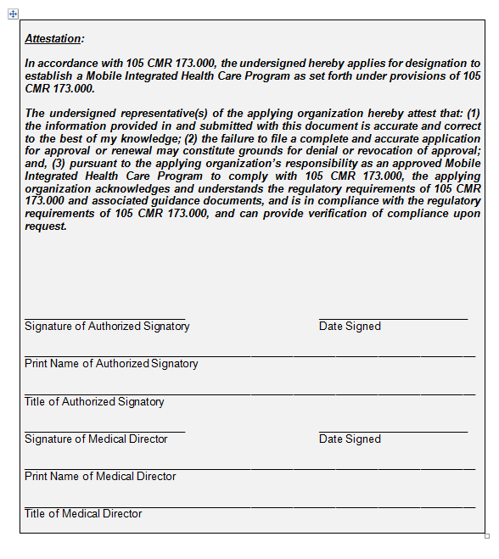
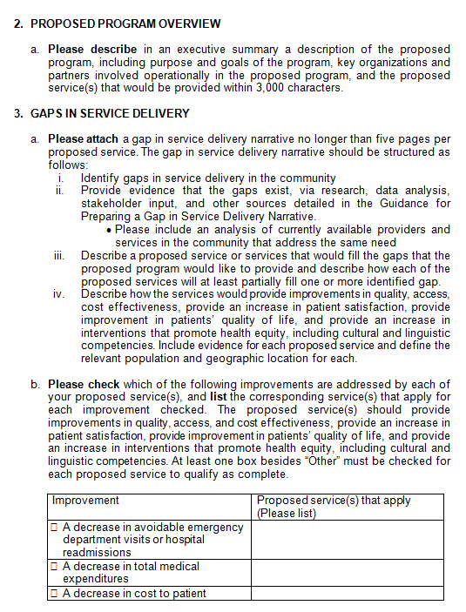
MIH Application
Attestation signatures needed:
Applicant authorized signatory
Program Medical Director
Executive summary of proposed program, including purpose and goals, organizational partners, and services.
Gaps in Service Delivery Narrative

Slide 22
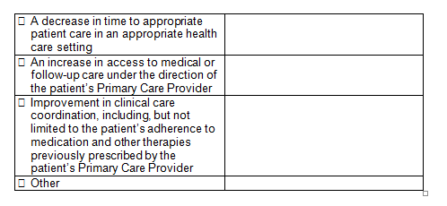
MIH Application, cont’d
Gaps in Service Delivery, cont’d
Identify how proposed services will address the improvements outlined in regulation:
Decrease in avoidable ED visits or hospital readmissions
Decrease in total medical expenditure
Decrease in cost to patient
Decrease in time to appropriate patient care in an appropriate healthcare setting
Increase in access to medical or follow-up care under direction of patient’s PCP
Improvement in clinical care coordination, including patient’s adherence to medication & other therapies previously prescribed by the patient’s PCP.

Slide 23
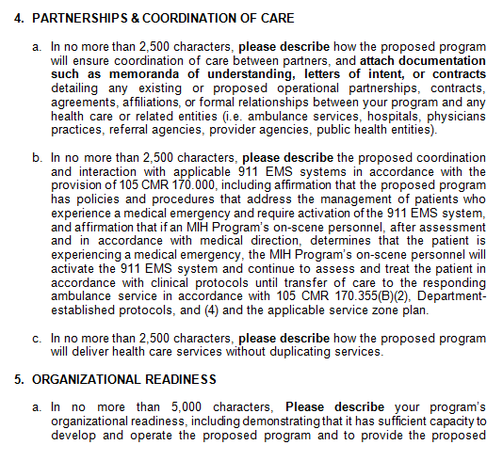
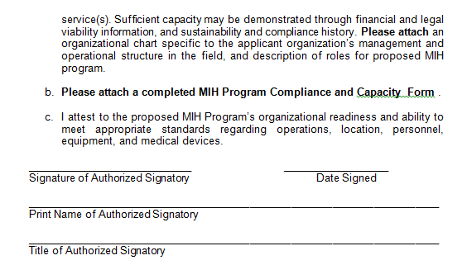
MIH Application, cont’d
Description about coordination of care and interaction with applicable EMS systems
Description of organizational readiness
MIH Program Compliance and Capacity Form

Slide 24
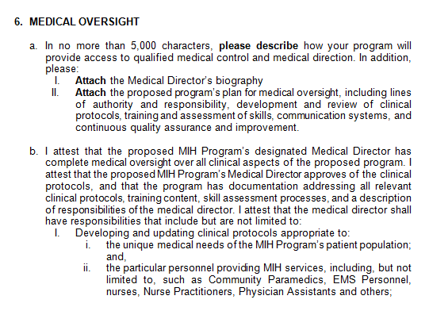
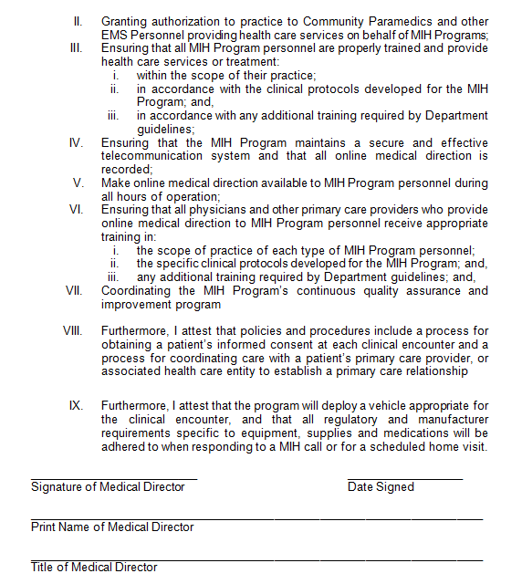
MIH Application, cont’d
Description of Program’s
Medical Oversight
Attestations

Slide 25
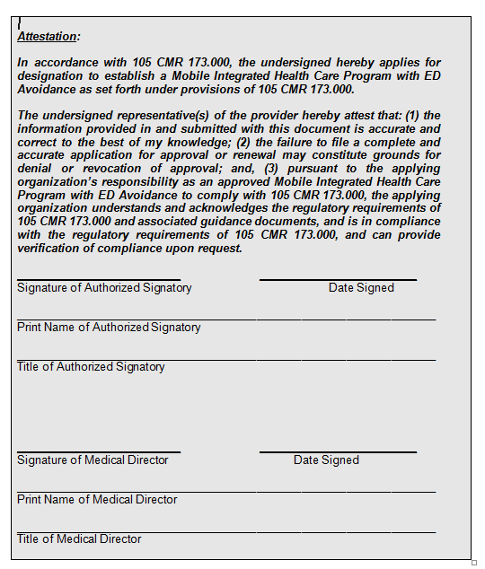
MIH with ED Avoidance Application
Attestation signatures needed:
Authorized Signatory of Program
Affiliate Hospital Medical Director

Slide 26
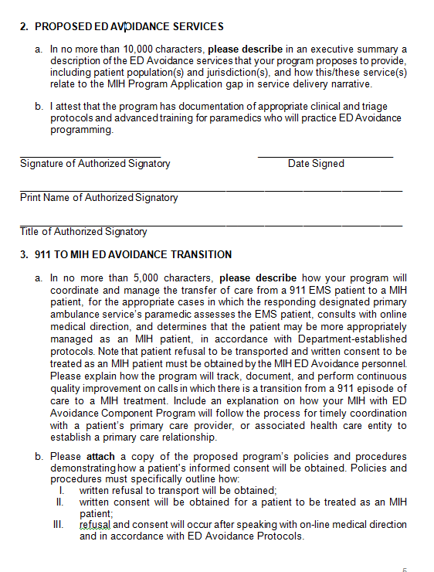
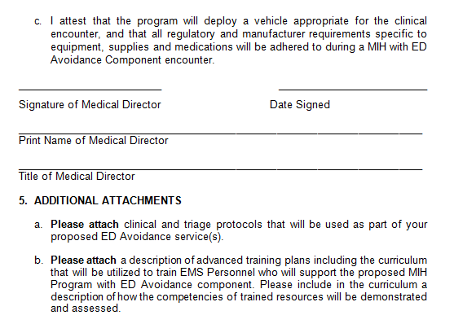
MIH with ED Avoidance Application, cont’d
Executive Summary of proposed ED Avoidance Services
Description of how Program will coordinate & manage transfer of care from a 911 EMS patient to an MIH patient
Policies, procedures, and attestation

Slide 27
Upcoming Educational Sessions
Topic | Date
MIH & Community EMS Overview for EMS | Tuesday, September 11 Tuesday, September 25
MIH Overview for Medical Directors, Hospitals, and Healthcare Entities | Tuesday, September 25
MIH Overview for Accountable Care Organizations (ACOs) | Thursday, September 13 Wednesday, September 26
Community EMS Application Overview | Friday, September 21
MIH Application Overview | Tuesday, October 16
MIH with ED Avoidance Application Overview | Friday, October 19
To be completed with upcoming webinars
Register online at:
https://www.mass.gov/service-details/mih-and-community-ems-educational-resources
Information about in-person informational sessions will be updated online and shared by the Office of Emergency Medical Services in the coming weeks

Slide 28
Online Resources
Information, application materials, and resources will be posted
online as they become available at:
www.mass.gov/MIH
Applicant Resources:
  Application forms and instructions for each program type
  MIH Regulations and Guidance
  Data submission information and resources for each program type
  Application resources, such as best practices for completing a gap in service delivery narrative
  Upcoming webinars in-person informational sessions
  Recorded DPH webinars and training materials
  Questions?
  Contact the Mobile Integrated Health Care Program by email at MIH@state.ma.us or by phone at 617-753-8000.

