Slide 1
Mobile Integrated Health
Advisory Council
Massachusetts Department of Public Health
December 14, 2015

Slide 2
Agenda
ROUTINE ITEMS:
Welcome and Introductions
Adoption of November 16, 2015 Meeting Minutes (VOTE)
OVERVIEW OF EXISTING PARAMEDIC PRACTICE AND SPECIAL PROJECTS:
Review of Paramedic Scope of Practice (PRESENTATION)
Cataldo SmartCare (PRESENTATION)
EasCare Mobile Health (PRESENTATION)
NEW BUSINESS:
Background and Need for 111O (PRESENTATION)
Defining Questions and Opportunities (DISCUSSION)
Upcoming Meeting Schedule

Slide 3
Themes From Last Meeting
Several key themes came out of MIHAC’s November meeting:
What is the role of MIHAC following passage of 111O? What roadblocks remain?
Questions regarding paramedic scope of practice
Importance of interdisciplinary partnerships and the cross-inclusion of all clinical scopes, including home health and community health workers
Need to embed MIH within a primary care continuum of care, including knowledge and training regarding triage and referral
And most importantly, “flexibility, flexibility, flexibility….” paired with minimum “guardrails” to ensure patient safety

Slide 4
Framing for Discussion
Pre-MIH statute: Limited MIH Special Projects Approved Under MGL 111C
LIMITATIONS: MGL 111C / EMS Statute
Solution to MGL 111C Limitations: Creation of MGL Chapter 111O / Mobile Integrated Health and Community EMS
Regulatory Need: If 111O resolved the limitations driven by 111C, what is the purpose of the MIHAC meetings and DPH regulations?
Market Opportunity: The market is able to build a new industry by creating new partnerships and program designs within the constructs of MGL 111O
Conclusion: DPH and MIHAC’s role is limited to determining the minimum “guardrails”

Slide 5
Exercise: Patient Safety
If your organization wished to create a new “MIH Program” with each organization represented by your fellow MIHAC members:
What obstacles still exist that would prevent an effective program (understanding that policy considerations such as payment and access are separate but needed conversation)?
What minimum guardrails do you believe are necessary to ensure quality care and patient safety?
Of these, are there any that should be determined by the applicant versus DPH?

Slide 6
Agenda
ROUTINE ITEMS:
Welcome and Introductions
Adoption of November 16, 2015 Meeting Minutes (VOTE)
OVERVIEW OF EXISTING PARAMEDIC PRACTICE AND SPECIAL PROJECTS:
Review of Paramedic Scope of Practice (PRESENTATION)
Cataldo SmartCare (PRESENTATION)
EasCare Mobile Health (PRESENTATION)
NEW BUSINESS:
Background and Need for 111O (PRESENTATION)
Defining Questions and Opportunities (DISCUSSION)
Upcoming Meeting Schedule

Slide 7
Adoption of Meeting
Minutes
Motion to adopt MIHAC November 16, 2015 meeting minutes (VOTE)

Slide 8
Agenda
ROUTINE ITEMS:
Welcome and Introductions
Adoption of November 16, 2015 Meeting Minutes (VOTE)
OVERVIEW OF EXISTING PARAMEDIC PRACTICE AND SPECIAL PROJECTS:
Review of Paramedic Scope of Practice (PRESENTATION)
Cataldo SmartCare (PRESENTATION)
EasCare Mobile Health (PRESENTATION)
NEW BUSINESS:
Background and Need for 111O (PRESENTATION)
Defining Questions and Opportunities (DISCUSSION)
Upcoming Meeting Schedule

Slide 9
Paramedic Scope of Practice
Highest level of state certification for EMS personnel, following 1-3 years of didactic and laboratory education, then clinical and field internship. Training is based on National EMS Educational Standards
State-defined scope of practice includes vascular/medication access (IV, IO, IM, etc.), airway management (simple adjuncts, endotracheal intubation, supraglottic airway placement) and electrical therapies
Affiliate Hospitals and their designated Affiliate Hospital Medical Directors (AHMD) provide medical oversight of ambulance service operation, including quality assurance, education and special project waiver development

Slide 10
Paramedic Scope of Practice
Additional procedures and medications may be utilized for inter-facility transfers, including mechanical ventilator monitoring
Over 40 medications may be administered under Statewide Treatment Protocols standing orders (off-line physician order), including analgesics, benzodiazepines, bronchodilators and vasoactive medications
Performance of full ACLS assessment and treatment, 12-lead ECGs and interpretation for STEMI (with activation of hospital PCI facilities)

Slide 11
Agenda
ROUTINE ITEMS:
Welcome and Introductions
Adoption of November 16, 2015 Meeting Minutes (VOTE)
OVERVIEW OF EXISTING PARAMEDIC PRACTICE AND SPECIAL PROJECTS:
Review of Paramedic Scope of Practice (PRESENTATION)
Cataldo SmartCare (PRESENTATION)
EasCare Mobile Health (PRESENTATION)
NEW BUSINESS:
Background and Need for 111O (PRESENTATION)
Defining Questions and Opportunities (DISCUSSION)
Upcoming Meeting Schedule

Slide 12
A review of Cataldo Ambulance Service’s experience with Community Paramedicine

Slide 13
SmartCare Timeline
12/2012 – Cataldo Ambulance Service senior management team start conceptual discussions on “home care” solutions after Pioneer ACOs are launched. After looking at national and international models, community paramedicine emerges as the leader in filling this “gap”. Work begins on SmartCare.
9/2013 – Partnership with BIDMC is formed to pilot a Community Paramedic Program
11/2013 – CAS presents Special Project Waiver to the Office of Emergency Medical Services
12/2013 – Decision made by MSC Community Care and Education Sub-Committee(formed by OEMS to specifically address MIH/CP projects) to use the HRSA tool to evaluate program effectiveness
2/19/2014 – CAS resubmitted SPW presentation to the Sub-Committee. Received recommendation for approval.

Slide 14
Patient
Population
Care Coordination
Patient Access and Interaction
PCP/Patient Connection
Quality Assurance and Reporting
Patient

Slide 15
Patient Population
Enrolled Patient
Urgent Patient
Isolated clinical incident requiring non emergent follow up care
Patient recently discharged with medical issue designated as lower risk
High Risk of Readmission – Chronic Disease
- CHF
- Pneumonia
- Myocardial Infarction
High Risk of Readmission – Post Operative
Other Identifiable High Risk Patients

Slide 16
Enrolled Patient
Example of Enrolled Patient
Patient Indentified as High Risk due to CHF
PCP and Case Coordinator Informed of Patient Enrollment into SmartCare program
Pre-Visit Action
SmartCare Paramedic reviews patient medical history via tablet PC and arrives on time via dedicated SmartCare Vehicle
On Scene Delivery
SmartCare Paramedic arrives at scene and evaluates home for any hazards and barriers to care
SmartCare Paramedic addresses specific medical concerns pertaining to nature of call
SmartCare Communications Division enters Patient information into Smart CAD
SmartCare Communications notifies both SmartCare Paramedic and Patient of scheduled Home Visit
SmartCare Paramedic enabled direct access to PCP via Phone or Telehealth Solution
SmartCare Paramedic and PCP identify most appropriate follow-up care including :
-Schedule of PCP Appointment
-Transport to Appropriate medical Facility
-Interventions at Scene
SmartCare Paramedic Documents Patient Interaction and shares updated history with PCP through secure Smart CAD connection

Slide 17
Urgent Patient Response
Example of Urgent Patient
Patient discharged from SmartCare Partner facility
Pre-Visit Action
On Scene Delivery
SmartCare Paramedic arrives at scene
SmartCare Paramedic addresses specific medical concerns pertaining to nature of call
Healthcare partner follows internal patient care program, ie: RN follow-up phone calls, pharmacist and PCP case review
Internal care coordinator identifies health related concern requiring in home patient evaluation best suited for SmartCare Paramedic
SmartCare Paramedic enables direct access to PCP via Phone or Telehealth Solution
SmartCare Paramedic and PCP identify most appropriate follow-up care including :
-Schedule PCP Appointment
-Transport to appropriate medical facility
-Interventions at scene
Care Coordinator activate SmartCare services.
SmartCare Paramedic documents patient interaction and shares updated history with PCP through secure Smart CAD connection
PCP and Case Coordinator Informed of Patient Enrollment in internal care transition program
In home SmartCare evaluation is scheduled within mutually agreed upon time

Slide 18
Key Features
24/7 access/call center
Layers of medical control
Extensive training
Expansive service area
Dedicated vehicle
Tele-health equipment
Quality assurance

Slide 19
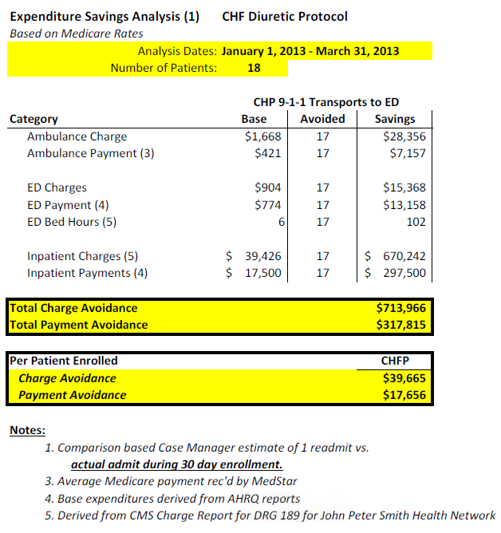
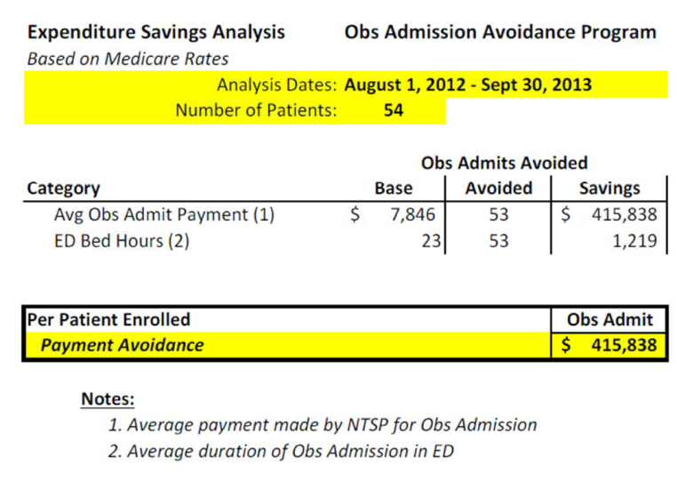
Statistics

Slide 20
Barriers to EMS Innovation
Financial
Culture
Legislative
Data
Education

Slide 21
SmartCare Timeline
4/11/2014 – SmartCare presented to full MSC Committee with unanimous vote of approval
4/2104 – Community Presentations done to introduce MIH/CP concepts to city and town partners
6/2014 – Meeting with DPH to discuss waiver. This was followed by several more meetings and presentations with various small groups from DPH to discuss statute and regulation obstacles
10/16/2015 – SmartCare receives approved SPW for one year to pilot Community Paramedic program

Slide 22
Patient Population
Enrolled Patient
Urgent
Patient
Isolated clinical incident requiring non emergent follow up care
Patient recently discharged with medical issue designated as lower risk
High Risk of Readmission – Chronic Disease
- CHF
- Pneumonia
- Myocardial Infarction
High Risk of Readmission – Post Operative
Other Identifiable High Risk Patients

Slide 23
SmartCare in Action

Slide 24
111O Gap Analysis
Vehicle should be registered/subject to inspection to ensure standards
Section 1: refers to “paramedic” – does this close the door for EMTs and other responders who may want to participate at some level?
Section 1: refers to “scope of practice” as it relates to current 911/IFT scope - these programs may require an expanded scope in certain areas
Section 2: refers to “appropriate training” - program specific?
Section 3: refers to programs operated by the “primary ambulance service” - no FD or other options?
Section 3: refers to vaccines under the directions of local public health – only option?

Slide 25
Key “Guardrail” Points
Programs must be patient centered to meet an identified gap/need not filled by current available resources
While treatment protocols will differ from 911/IFT and may differ from program to program, there should be clear standards/protocols by which to measure efficacy
Training is key, but will be tailored to meet the needs of each program built
Programs may include didactic, SIM, table-top scenarios, etc.

Slide 26
Key “Guardrail” Points
Record keeping/reporting/data analysis at the local and state levels are required to measure value. Standard reporting format should be considered
Response standards – program specific
Secure documentation system is a must
QA/QI process is necessary – incorporate the HRSA tool or something similar

Slide 27
For More Information
Visit the SmartCare Website: www.smartcarema.com

Slide 29
Agenda
ROUTINE ITEMS:
Welcome and Introductions
Adoption of November 16, 2015 Meeting Minutes (VOTE)
OVERVIEW OF EXISTING PARAMEDIC PRACTICE AND SPECIAL PROJECTS:
Review of Paramedic Scope of Practice (PRESENTATION)
Cataldo SmartCare (PRESENTATION)
EasCare Mobile Health (PRESENTATION)
NEW BUSINESS:
Background and Need for 111O (PRESENTATION)
Defining Questions and Opportunities (DISCUSSION)
Upcoming Meeting Schedule

Slide 30
Case Study
Saturday 22:34 Increasing Snow (10” predicted)
Private residence, family with pt, PCA due next day at 11 am
37 y/o F c/o Weak, Increased confusion, low grade fever, dark urine, productive cough
PMHx: TBI, Quadriplegia, Vent Dependant, HTN, Depression, Diabetes Type II, Sub-Pubic Cath
What are the Patient’s Options?

Slide 31
Mobile Integrated Health
Where can DPH help…

Slide 32
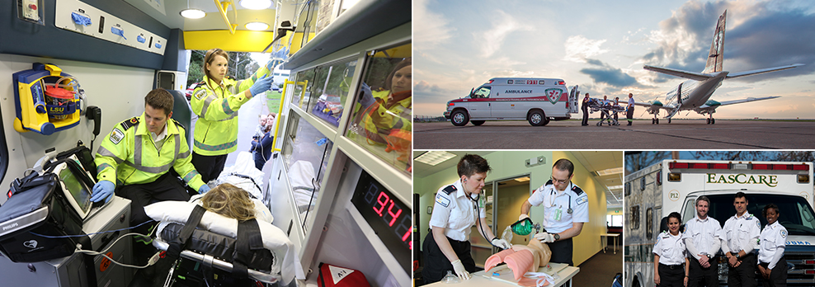
What is EMS?
EMT-Basics EMT-Advance
EMT-Paramedic EMT-Critical Care
Treat & Transport

Slide 33
Community Paramedicine & Mobile Integrated Health (MIH)

Slide 34
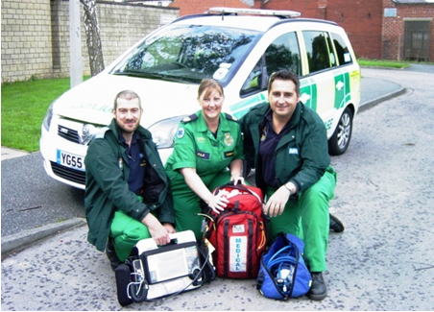
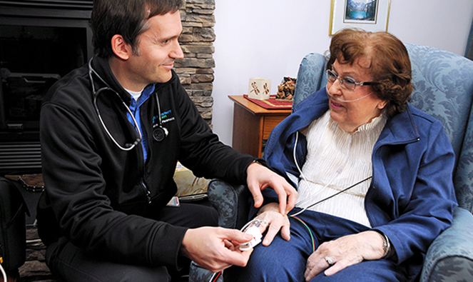
History of MIH
International & National
Nova Scotia, Canada
London, England
Alice Springs, Australia
Fort Worth, TX
Reno, NV
Minneapolis, MN
Meza, AZ

Slide 35
What is MIH?
Improving the patient experience of care
(including quality and satisfaction)
Improving the health of populations
Reducing the per capita cost of health care

Slide 36
Filling Gaps in Healthcare System
What is MIH?
Times of Service
Geographical Foot Prints
Weather
Clinical Services

Slide 37
Patient Centric
What is MIH?
Out of Hospital Care
Interactive Decision Making
Immediate Care
Closed Loop Communication

Slide 38
Collaboration

Slide 39
Gap Analysis
Supplementing existing CCA care model
Gap analysis and needs assessment
Many patients do NOT want to visit ED
They wait too long to call for help
Fear of admission to hospital
Long wait time in ED
Unnecessary care delivery
Eliminating potential for redundant resources
Additional resources for delivery of out of hospital care
18:00 to 06:00 daily

Slide 40
Program Construction
Project Manager
EMS Operations Director
EMS Logistics Director
EMS Clinical Director-Primary Investigator
EMS Medical Director
CCA Medical Director
Collaboration between partners

Slide 41
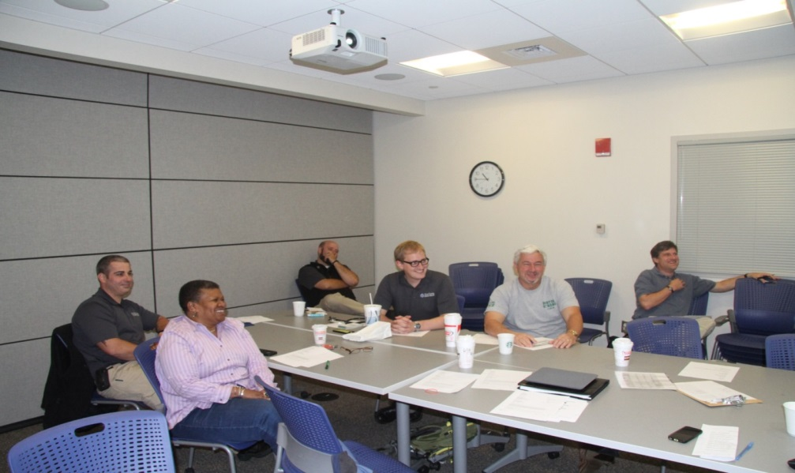
“One Size Does Not Fit All”
Existing training programs
Provide the fundamentals of Community Paramedicine
Do not provide the unique aspects to ensure patient centricity

Slide 42
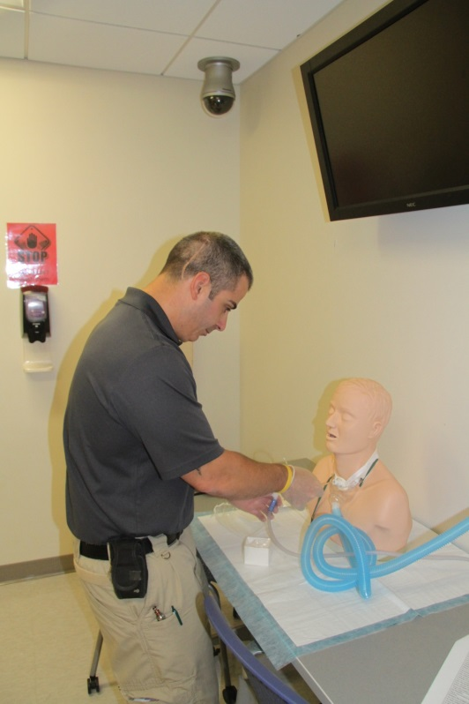
Training
EasCare-CCA program
325 hours
Curriculum was created through a collaborative process
50% Didactic 50% clinical practicum
The clinical component involved hospital and out of hospital pt visits
Competency: Simulation Lab

Slide 43
Expanding Roles
Expanded Formulary
Antibiotics
Pain Management
Point of Care Testing
Chem 8
U/A
Rapid Strep & Flu
Cultures
Behavioral Health
End of Life Care
Collaborative Care
Facilitated Transportation

Slide 44
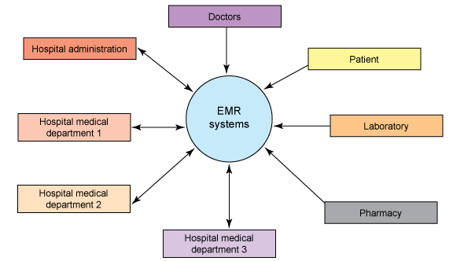
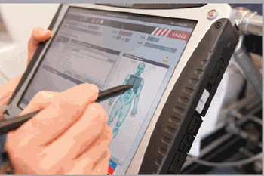
Expanding Processes
EMR + Closed Loop Communication = Better Decision Making

Slide 45
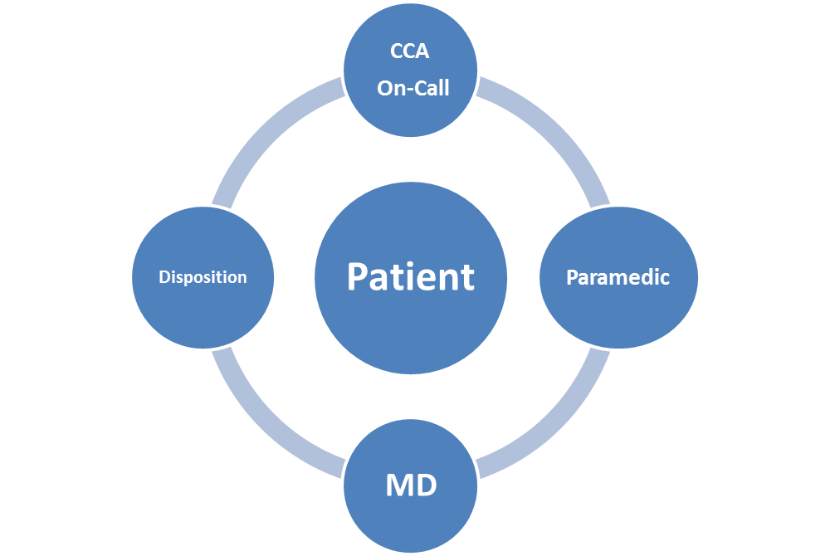
Program Call Flow

Slide 46
CQI - Oversight
Patient
EasCare Clinical Director
EasCare Medical Director
CCA Medical Director
CCA PCP
M&M Rounds
5-6 MDs
CCPs
Paramedic Log
Surveys
Patients
Staff
DPH Submission

Slide 47
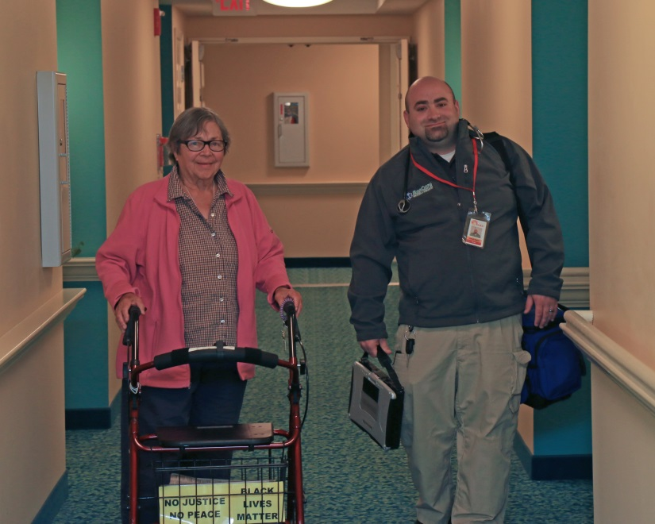
Improving the Health of Populations
DATA
424 Patient contacts (average 1.1 per night)
83 minutes of average patent contact time
Supplementing existing care model
Expenses Reduced
Savings Produced
Ambulance Transportation
ED Visit
Physician
Labs
Admission
OBs
Patient Experience
98 % of patients' Extremely Satisfied
2% of patient’s Satisfied
100% Staff Satisfied

Slide 48
How can DPH assist with MIH
& the IHI Triple Aim?
Streamlined Application
Process
Program Oversight
Sustainability
Program Requirements

Slide 49
Program Requirements
Gap Analysis
Program
Education
Data
Clinical Oversight
Integrated

Slide 50
Lessons Learned

Slide 51
MIH requires Flexibility

Slide 52
Case Study
Saturday 22:34 Increasing Snow (10” predicted)
Private residence, Family with pt, PCA due at 11:00
37 y/o F c/o Weak, Increased confusion, low grade fever, Urine (dark), Productive Cough
PMHx: TBI, Quadriplegia, Vent Dependant, HTN, Depression, Diabetes Type II, Sub-Pubic Cath
What are the MIH options??

Slide 53
Agenda
ROUTINE ITEMS:
Welcome and Introductions
Adoption of November 16, 2015 Meeting Minutes (VOTE)
OVERVIEW OF EXISTING PARAMEDIC PRACTICE AND SPECIAL PROJECTS:
Review of Paramedic Scope of Practice (PRESENTATION)
Cataldo SmartCare (PRESENTATION)
EasCare Mobile Health (PRESENTATION)
NEW BUSINESS:
Background and Need for 111O (PRESENTATION)
Defining Questions and Opportunities (DISCUSSION)
Upcoming Meeting Schedule

Slide 54
Background of 111O
This presentation will clarify Chapter 111O and address some critical questions raised at the first Council meeting (from a legal perspective):
Why is Chapter 111O necessary?
What barriers prevented MIH in MA?
What is not covered by Chapter 111O?

Slide 55
Evolution of Chapter 111O
Chapter 111O is tied to changing role of EMS providers in community health care delivery
Starting Point: M.G.L. c. 111C – Massachusetts Emergency Medical Services (EMS) System; authorizes DPH to act as lead agency in creating unified statewide EMS system;
Originated in 1973 and redrafted in 2000 as part of “EMS 2000”;
Statute defines/limits role of licensed ambulance services and EMTs;
Creates duty to dispatch emergency response; to provide potentially life-saving care to ill or injured patient; and to transport patient to ED;
Operative word throughout chapter 111C: “Emergency”.
Dilemma: Can licensed ambulance services partner with primary care providers to provide nonemergency medical services to patients in need?

Slide 56
111C Limitation: Definition of Emergency
Definition of “emergency” – a condition or situation in which an individual has a need for immediate medical attention, or where the potential for such need is perceived by the individual, a bystander or an emergency medical services provider
Take-away: emergency response excludes planned wellness check-ups, post-discharge visits

Slide 57
111C Limitation: Medical Control and Direction
EMS personnel required to function under medical direction and medical control through:
Off-line pre-hospital emergency treatment protocols (known as Statewide Treatment Protocols) – written medical instructions and standing orders governing care provided by EMS personnel
On-line medical direction – real time communication with medical control (ED) physician; deviations from protocols allowed only as authorized by hospital-based on-line medical control (ED) physician
Medical Control and Direction – Emergency Medical Services-based
Affiliate Hospital Medical Director (AHMD) is responsible for granting “authorization to practice” for EMS personnel; and
Ensuring that EMS personnel receive appropriate medical direction by qualified medical control ED physicians
Take-away: excludes medical control and direction by primary care practitioners

Slide 58
111C Limitation: Patient Transport
DPH’s authority governing nonemergency responses is limited to ensuring the provision of:
Timely inter-facility transportation of patients to hospitals, other facilities or programs which offer follow-up care and rehabilitation, in order to optimize utilization of available facilities
Take-away: excludes direct patient care in home

Slide 59
111C Limitation: Delivery System Integration
While DPH Commissioner has legal authority to waive EMS regulations, (i.e., transport to ED), she cannot waive statutory provisions
Fundamental principal of law: agencies have no authority to issue rules or create programs that exceed the statute
Take-away: Chapter 111C prevents full integration of EMS into community health care delivery systems

Slide 60
EMS Special Projects
Chapter 111C limited work-around for Special Project Approval Requests:
Definition of “emergency” provided sufficient flexibility to carve out a role for community paramedicine under 111C as follows:
Patient calls provider’s clinician (not 911) during special project hours;
Patient describes a condition that needs (or patient perceives need) for immediate medical attention;
Clinician determines that patient’s medical needs warrant community paramedicine response rather than 911;
Community paramedic’s clinical interventions adhere to Statewide Treatment Protocols (STP) and pre-approved STP deviations; and,
Other conditions/”guardrails” imposed on projects (e.g., training, AHMD oversight, med control delegations to PCP clinicians, 911 trigger, QC)

Slide 61
111O Flexibility: EMS in Nonemergency Services
Ch. 111O provides statutory framework for integrating EMS and other providers into community health care delivery systems
Affirmatively authorizes ambulance services to partner with other healthcare entities to provide MIH
By definition, MIH means nonemergency services or treatment, (preventative care, post-discharge follow-ups, chronic disease management, transport or referrals to facilities other than hospital emergency departments)

Slide 62
111O Flexibility: EMS in Nonemergency Services
Ch. 111O expands the settings and environments an EMS providers may encounter, but does not expand EMS provider’s scope of practice
Comparing Scope vs. Settings
Chapter 111C
Statewide Treatment Protocols
Emergency Care: Paramedic may administer furosemide as emergency pulmonary edema treatment, by on-line medical control approval if patient already on diuretics
Chapter 111O
Mobile Integrated Health Protocols
Preventive Care: Community Paramedic may administer furosemide for chronic congestive heart failure or fluid retention, before pulmonary edema or other emergency condition occurs
Provider Scope of
Practice
Remains Unchanged

Slide 63
111O Flexibility: Medical Control and Direction
Provides a more flexible definition of “medical control” and “medical direction” to allow primary care practitioner to provide off-line/on-line orders and direction to MIH providers
"Medical control'', the clinical oversight provided by a qualified physician or existing primary care provider to all components of the MIH program, including, but not limited to, medical direction, training, scope of practice and authorization to practice of a community paramedic provider, continuous quality assurance and improvement and clinical protocols
"Medical direction'', the authorization for treatment provided by a qualified physician or existing primary care provider in accordance with clinical protocols, whether on-line, through direct communication or telecommunication, or off-line through standing orders
Provides flexibility for determining use of mobile resources to meet the patient’s medical needs
Provides general guidance for approval of MIH programs; focus based on continuity of care

Slide 64
111O Flexibility
In Section 2(b), 111O establishes minimum statutory criteria or “guardrails” governing DPH approval of MIH programs
These minimum statutory guardrails mirror the Triple Aim goals of:
improving patient health;
improving patient experiences in the health care delivery system; and
decreasing health care costs.
MIHAC task: to assist in further defining/fine-tuning these guardrails for regulatory use

Slide 65
Not Specified in 111O
The types of contractual/business arrangements between MIH Providers that define roles, responsibilities, risk-sharing, etc.
Liability and immunity protections
Reimbursement and funding mechanisms

Slide 66
Agenda
ROUTINE ITEMS:
Welcome and Introductions
Adoption of November 16, 2015 Meeting Minutes (VOTE)
OVERVIEW OF EXISTING PARAMEDIC PRACTICE AND SPECIAL PROJECTS:
Review of Paramedic Scope of Practice (PRESENTATION)
Cataldo SmartCare (PRESENTATION)
EasCare Mobile Health (PRESENTATION)
NEW BUSINESS:
Background and Need for 111O (PRESENTATION)
Defining Questions and Opportunities (DISCUSSION)
Upcoming Meeting Schedule

Slide 67
Framing for Discussion
Pre-MIH statute: Limited MIH Special Projects Approved Under MGL 111C
LIMITATIONS: MGL 111C / EMS Statute
Solution to MGL 111C Limitations: Creation of MGL Chapter 111O / Mobile Integrated Health and Community EMS
Regulatory Need: If 111O resolved the limitations driven by 111C, what is the purpose of the MIHAC meetings and DPH regulations?
Market Opportunity: The market is able to build a new industry by creating new partnerships and program designs within the constructs of MGL 111O
Conclusion: DPH and MIHAC’s role is limited to determining the minimum “guardrails”

Slide 68
Exercise: Patient Safety
If your organization wished to create a new “MIH Program” with each organization represented by your fellow MIHAC members:
What obstacles still exist that would prevent an effective program (understanding that policy considerations such as payment and access are separate but needed conversation)?
What minimum guardrails do you believe are necessary to ensure quality care and patient safety?
Of these, are there any that should be determined by the applicant versus DPH?

Slide 69
Agenda Planning
Planning for MIHAC’s January meeting: DPH Staff will send you a table to complete in advance of our next meeting:
Please complete this exercise with your agency/organization
What obstacles exist that DPH can contemplate or solve for within the MIH regulations?
What guardrails are needed?
Are those guardrails spelled out in regulations or within the application?
What other information/presentations do you feel you need to complete this exercise?

Slide 70
Agenda
ROUTINE ITEMS:
Welcome and Introductions
Adoption of November 16, 2015 Meeting Minutes (VOTE)
OVERVIEW OF EXISTING PARAMEDIC PRACTICE AND SPECIAL PROJECTS:
Review of Paramedic Scope of Practice (PRESENTATION)
Cataldo SmartCare (PRESENTATION)
EasCare Mobile Health (PRESENTATION)
NEW BUSINESS:
Background and Need for 111O (PRESENTATION)
Defining Questions and Opportunities (DISCUSSION)
Upcoming Meeting Schedule

Slide 71
Upcoming Meeting Schedule
The Following dates/times are confirmed for future MIHAC meetings:
Wednesday, January 6 – 1:30 PM - 3:30 PM
Monday, February 1 – 9:30 AM - 11:30 AM
Friday, February 26 – 1:00 PM - 3:00 PM
Please note that DPH staff will be sending out another doodle poll to identify future meeting dates

