Slide 1
Mobility management in Massachusetts
A virtual forum
February 3, 2022
10am-noon

Slide 2
Welcome!
Zoom webinar
The session is being recorded
Share your thoughts!
Enter questions into the Q&A box at any time
Use the chat box to share thoughts with other attendees
Introduce yourself in the chat
Name, organization, region, why you’re interested in mobility management

Slide 3
Today’s agenda
Introduction
Examples of how agencies incorporate mobility management practices and strategies
An educator
An Aging Services Access Point/Area Agency on Aging
A Council on Aging
A transit authority
National Center for Mobility Management
Funding to support mobility management

Slide 4
What is mobility management?

Slide 5
The problem
It is confusing and difficult to find transportation options for older adults, people with disabilities, and others who lack access to transportation because transportation options are decentralized and fragmented

Slide 6
Mobility management
A set of tools & strategies to navigate and streamline community transportation options
Person-centered
Focusing on the consumer & how to meet their needs through a family of services

Slide 7
Who can do mobility management?
People whose title is “Mobility Manager”
People whose title is not “Mobility Manager”
Anyone who helps older adults, people with disabilities, and others figure out transportation
Urban
agencies
Suburban
agencies
Rural
agencies
YOU

Slide 8
Key tools and resources

Slide 9
Look for options with Ride Match
www.massridematch.org

Slide 10
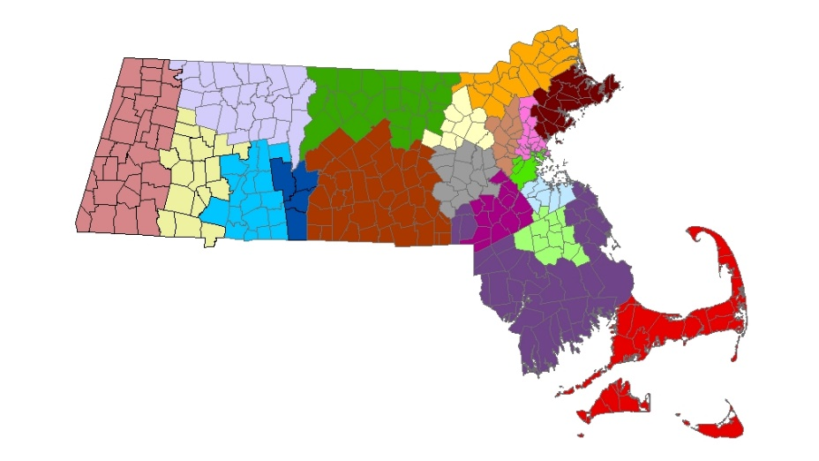
Connect with partners
Regional Coordinating Councils on Community Transportation
www.mass.gov/info-details/regional-coordinating-councils-for-community-transportation

Slide 11
More tools for agencies
www.mass.gov/mobility-management-and-transportation-coordination
www.mass.gov/human-service-agencies-and-community-transportation
Funding opportunities
Staff training
Guides on implementing transportation programs & services
Outreach & marketing
www.mass.gov/massmobility-newsletter
www.mass.gov/lists/massmobility-reports

Slide 12
Today’s speakers
Navigating community transportation options
Sherry Elander, Westfield Public Schools
Ruth Lindsay, SeniorCare
Maria Foster, Brookline Council on Aging
Coordinating transportation to streamline options
Angie Constantino, Greater Attleboro Taunton Regional Transit Authority
National perspectives
Judy Shanley, National Center for Mobility Management
Funding for mobility management
Jenna Henning, MassDOT

Slide 13
Mobility Management Not your Mother’s mobility…or is it?

Slide 14
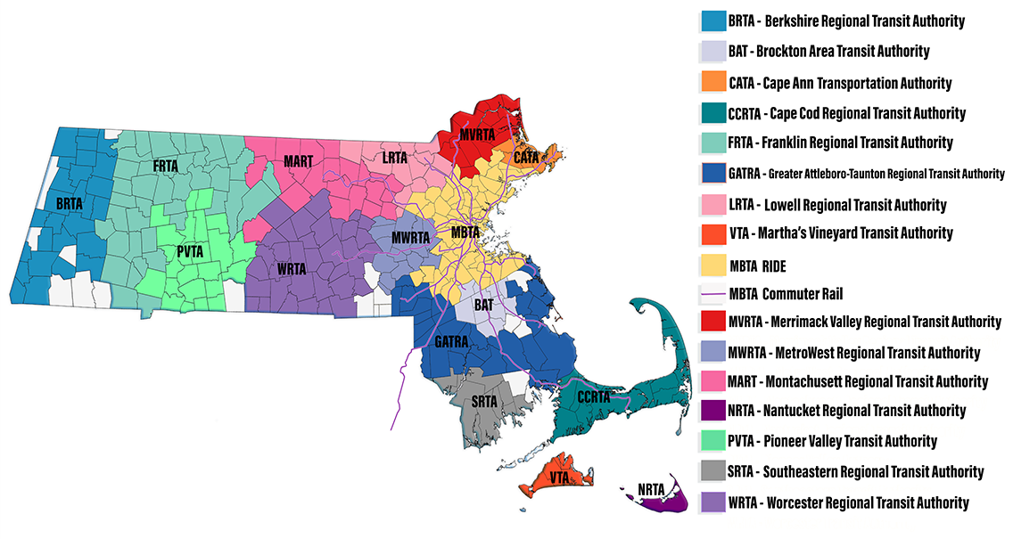
GATRA is 1 of 15 Regional Transit Authorities in Massachusetts
GATRA’s service area includes 29 communities in Southeastern MA
Mix of urban, suburban, and rural

Slide 15
GATRA services
29 communities means a diverse service area and results in the need for a diverse mix of service types
Fixed Route Fixed routes in 2 cities and systems in 2 smaller communities Intercity route Multiple in-town routes | GATRA GO Microtransit 4 individual microtransit systems | Paratransit/ Dial-a-Ride Dial-a-Ride service in all 29 communities Operated in some communities by Councils on Aging and regionally in others by private operators | Long Distance Medical Medwheels United Local & Long Distance Boston Hospital Bus

Slide 16
Regional Coordination – Example 1
Wareham - New Bedford Connection
NEED: Wareham services (DTA, Career Center, DMV, etc.) are located in New Bedford and there wasn’t an affordable transportation option to access them.
ACTIONS: The Regional Coordinating Council and GATRA convened stakeholder meetings to identify needs and timing
SOLUTION: GATRA obtained a Community Transit Grant to run the service and partnered with the Southeastern Regional Transit Authority to operate the service

Slide 17
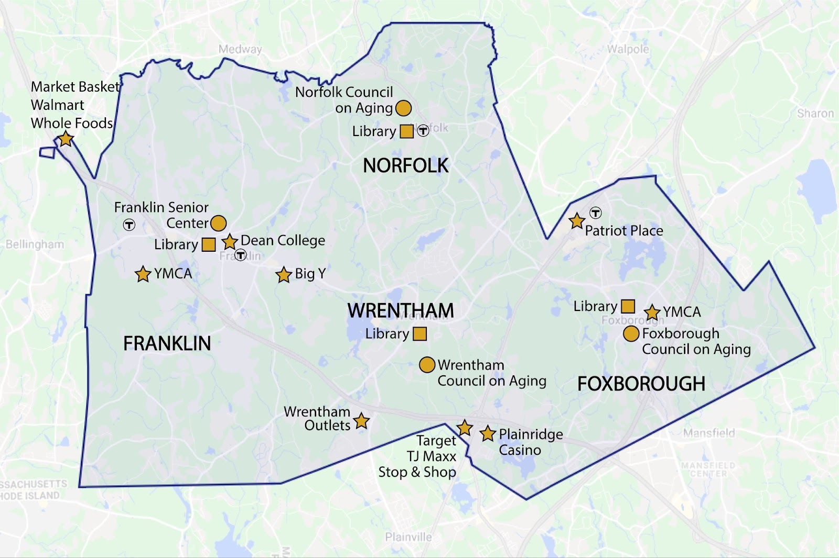
Regional Coordination – Example 2
GATRA GO United Service Area Foxborough | Franklin | Norfolk | Wrentham
Before microtransit
Fixed route connecting all communities
In-town fixed route
Regional Dial-a-Ride service
Local & Long distance medical transportation

Slide 18
Microtransit Service
Foxborough | Franklin | Norfolk | Wrentham
Current Service
Started December 2020
Monday - Friday 7:00AM – 6:00PM Saturday 9:00AM – 6:00PM
Can book using the app or call dispatch
Local/long distance medical transportation service for seniors and persons with a disability runs parallel with a shared fleet
3-4 vehicles
Highlights
Council on Aging paying for rides to/from the Center
Town paying for rides for their residents
College paying for students to ride
Download the App Today!

Slide 19
www.MassRideMatch.org
A one-stop searchable directory of public, private, and accessible transportation options in Massachusetts
Started at GATRA as a need to keep track of local and grant funded transportation options
Is now a statewide resource after partnering with MassDOT and other regional transit authorities to create a robust treasure trove of transportation options

Slide 20
History of RideMatch
2010
The Greater Attleboro Taunton Regional Transit Authority (GATRA) awarded a Mobility Management grant to design and implement services for older adults & people with disabilities
2011
Compiled first inventory of transportation providers in Southeastern Massachusetts
2012
Launches the first RideMatch website in December 2012

Slide 21
History, continued
2015
Received a Community Transit Grant (CTG) from MassDOT to expand database statewide – Berkshire Regional Transit Authority, Worcester Regional Transit Authority, Nantucket Regional Transit Authority, and Franklin Regional Transit Authority are the first RTAs to sign on
2017
RideMatch launches enhanced search feature utilizing Google Transit data that provides users with access to real-time transit schedules and step-by-step route information
2019
RideMatch adds a new home page search function that allows users to search for transportation options by city or town

Slide 22
Coordination and Mobility Management A National Picture
Judy L. Shanley, Ph.D.
Asst. VP, Education & Youth Transition
Easterseals Director, NCMM
MA Virtual Mobility Management Forum
February 2022

Slide 23
nc4mm.org
Who We Are
Our Mission
A national technical assistance center funded through a cooperative agreement with the Federal Transit Administration and operated through a consortium of three national organizations
To promote customer-centered mobility strategies that advance good health, economic vitality, self-sufficiency, and community.
We work to promote cross-sector partnerships and help communities create/improve transportation options – “mobility management”

Slide 24
Access NCMM Resources
Research products and tools
Our blog, Mobility Lines
Participate in our events
Share our online e-Learning modules
Take advantage of our grant programs
Encourage your MM colleagues to join MMC
Connect with your regional liaison

Slide 25
The Current Picture - Voices from the Massachusetts Field
We are siloed
Choppy service
Little replication
No one-way to know about services
Inconsistent means to access services
Fragmented service
Need a larger pool of services

Slide 26
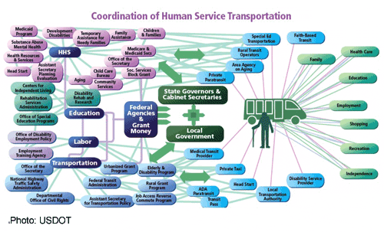
The Reality – Here and Nationally

Slide 27
An Obvious and Key Solution is Coordination!

Slide 28
The Solution is to Coordinate…Coordination can Work If…
The Right People / Organizations are at the Table (but, really its everyone’s business)
There is an Action Plan or Logic Model to Carryout the Work
Clear objectives and outcomes are articulated (performance measures)
Communication, governance, and decision-making processes in place
Align plans and accountability (HST plans, community health plans, complete streets, STIP, etc.)
Activities are based on environmental scans, needs assessment, and resource maps
Everyone shares the “spirit” to coordinate

Slide 29
Strategies to Make Coordination Actionable, Doable, Practical
Mobility Management Networks
CCAM at the State and Regional levels

Slide 30
CCAM Overview
Mission
History
The CCAM issues policy recommendations and implements activities that improve the availability, accessibility, and efficiency of transportation for the following targeted populations:
The CCAM is an interagency partnership established in 2004 by Executive Order 13330 to coordinate the efforts of the Federal agencies that fund human service transportation for CCAM targeted populations.
Organization
Individuals with Disabilities
DOT Secretary
Older Adults
HHS Secretary
ED Secretary
DOL Secretary
VA Secretary
USDA Secretary
Individuals of Low Income
HUD Secretary
DOI Secretary
Attorney General
SSA Comm’r
NCD Chair
Notes:
The CCAM Agencies: the Departments of Agriculture (USDA), Education (ED), Health and Human Services (HHS), Housing and Urban Affairs (HUD), Interior (DOI), Justice (DOJ), Labor (DOL), Transportation (DOT), Veterans Affairs (VA), National Council on Disability (NCD) and Social Security Administration (SSA).

Slide 31
“Good CCAM” Leads to Mobility Management: Putting the pieces together
> Efficiency, Quality – policy, practice
Results in Implementation – Mobility Management Networks
CCAM State Policies

Slide 32
Benefits of Coordinated Transportation & Mobility Management
Shared funding;
Extended service hours, services to new areas or new communities and to more people;
More trips made by persons needing transportation;
Services more responsive to schedules, points of origin, and destinations of customers;
Greater emphasis on safety and customer service;
Opportunity for multi-modal service;
Increased potential for innovation;
More flexible payment and service options; and
Enhanced relationships with non-traditional partners – unintended benefits.
Notes:
Here are more outcomes associated with mobility management and coordination….increased efficiency, reliability, and effectiveness of transportation. Minimizing the maze of services that we saw in the previous graphic.

Slide 33
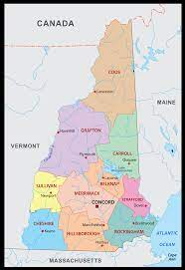
Moving Forward…State Example

Slide 34
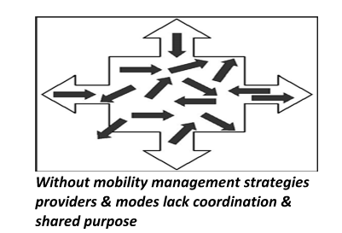
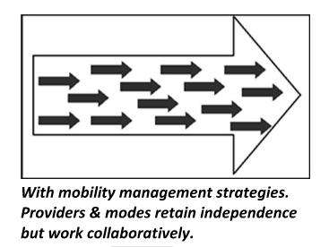
Vision
New Hampshire envisions an integrated system of safe, reliable, and sustainable transportation options that allow residents to maintain independence and participate in community life no matter their age or ability.
Ideal outcomes include:
Ease of use for customers
Eliminate confusion related to patchwork approach
Single call/click will get customers to best person
Braided State & Fed funds
Single distribution method for various sources of transportation-eligible programs
Ensure tax dollars are maximized
True coordination of services
Avoid redundancy
Economies of scale

Slide 35
Rural Example

Slide 36
Mixing Funds – A Grassroots Effort
Calhan Connection - Rural El Paso County Colorado – 2158 Square miles, 20 people per square mile. Envida – non-profit transit agency – organized and provides the service
First mile – last mile – becomes first 10 miles – last 10 miles
Developed a deviated fixed route – seven stops – along highway, ended at the transfer station for City of Colorado Springs Mountain Metro Transit
Ran two days a week – twice a day – expanded to Monday-Friday, three times a daily.
The U.S. Department of Transportation’s Rural Transportation Assistance Program and the county’s Community Development Block Grant Program (HUD) provided funding to launch the service. https://gazette.com/news/calhan-connectionhttps-bringing-public-transportation-to-rural-el-paso-county/article_beb02ac4-d316-11e8-9de4-bb19d09ad7c9.html

Slide 37
“If you always do what you have always done, you will always get what you always got”
--Susan Scott, Fierce Conversations

Slide 38
Recent CCAM Resources
Together, the CCAM agencies developed the following:
CCAM Report to the President, published September 2020
CCAM Cost-Sharing Policy Statement, published July 2020
Cost Allocation Technology for Non-Emergency Medical Transportation Final Report, published June 2020
CCAM Federal Fund Braiding Guide, published June 2020
CCAM Focus Group Report, published 2019
CCAM Program Inventory, which identifies 130 Federal programs that are eligible to provide funding for human services transportation for transportation-disadvantaged populations.
No single law or statute created these programs, therefore no uniform requirements on program administration or delivery exists, and each program maintains its own regulations, eligibility requirements, and operating procedures. Thus, there is duplication across Federal programs in services funded.

Slide 39
Technical Assistance (TA) Centers
National Center for Mobility Management
www.nc4mm.org 1-866-846-6400
info@nc4mm.org Annual Community Grants
National Aging and Disability Transportation Center
www.nadtc.org 1-866-983-3222
contact@nadtc.org Annual Community Grants
Rural Transit Assistance Program
www.nationalrtap.org 1-888-589-6821 info@nationalrtap.org
Shared-Use Mobility Center
www.sharedusemobilitycenter.org 1 312.448.8083
info@sharedusemobilitycenter.org
National Center for Applied Transit Technology
www.ctaa.org/about-n-catt/
Notes:
Here are the technical assistance centers that provide free support and resources to help improve mobility options for communities and individuals
National Rural Transit Assistance Program (RTAP) https://www.nationalrtap.org/ call for resources and info: 1-888-589-6821 or email: info@nationalrtap.org
This center supports the Grants for Rural Areas Program addresses the training and technical assistance needs of rural and tribal transit operators across the nation and supports state RTAP programs.
National Center for Mobility Management (NCMM) https://nationalcenterformobilitymanagement.org/ phone: 1-866-846-6400 email: info@nc4mm.org
This center supports mobility management, which means helping communities and individuals create and manage their mobility options
National Aging and Disability Transportation Center (NADTC) https://www.nadtc.org/ phone: 1-866-983-3222 email: contact@nadtc.org
This center supports the Grants for Enhanced Mobility for Seniors and Individuals with Disabilities Program. A person whose addiction to drugs poses a substantial limitation on one or more major life activities is a person with a disability and is eligible to receive transportation through the Section 5310 Enhanced Mobility of Seniors and Individuals with Disabilities Program, including to a drug treatment center.

Slide 40
TACL: The Transportation Technical Assistance Coordination Library
The Transportation Technical Assistance Coordination Library (TACL) provides a sustainable methodology and platform to access rural and tribal transportation coordination resources across a diverse range of transportation technical assistance centers and the Federal Transit Administration (FTA).
The FTA-funded technical assistance centers participating in this ongoing work with links to their coordination resources are:
National Aging and Disability Transportation Center (NADTC)
National Center for Applied Transit Technology (N-CATT)
National Center for Mobility Management (NCMM)
National Rural Transit Assistance Program (National RTAP)
Shared-Use Mobility Center (SUMC)
http://transportation-tacl.org

Slide 41
Parting Thoughts
Always think about the connections between coordination and mobility management.
1
Continuously examine what and how you are putting in place coordination and mobility management.
2
Measure, assess, and measure outcomes and impacts!
3

Slide 42
Thank You
Thank You
Judy Shanley, Ph.D.
Easterseals Director NCMM
Asst. VP for Education and Youth Transition at Easterseals
JShanley@easterseals.com

Slide 43
Funding for mobility management

Slide 44
Community Transit Grant Program
CTGP disperses Federal Transit Administration (FTA) Section 5310 and State Mobility Assistance Program (MAP) funding to provide and strengthen the transportation services available to meet the mobility needs of older adults and people with disabilities
www.mass.gov/community-transit-grant-program

Slide 45
Eligible Entities
Non-profit organizations
Municipalities
Councils on Aging
Regional Transit Authorities

Slide 46
Eligible Projects
Eligible Activities/Projects
Vehicle (Replacement or New)
Operating
Mobility Management
Must be covered in local Coordinated Public Transit-Human Services Transportation Plan
www.mass.gov/service-details/community-transportation-coordination

Slide 47
Local Match Requirements
Eligible sources: local government appropriations; local dedicated tax revenues; private or foundation donations; net income from advertising/concessions; agency contracts (such as human service program funding); non‐DOT Federal Funds; and in-kind (such as donated goods or volunteer services)

Slide 48
FY23 Approximate Timeline
May – June 2022:
Application Period
February 2022:
Program Announced
Oct – Nov 2022:
Executive Approval
April/May 2022:
Application Trainings Held
July – Sept 2022
Scoring, Review, and Project Selection
Jan – Mar 2023:
Federal Application/ Contracting Period
Jan 2023:
Effective Date for Operating/MM Contracts
Nov/Dec 2022:
Award
Announcements
May/June 2023:
Vehicle Deliveries
Jan/Feb 2023:
Post-Award Training

Slide 49
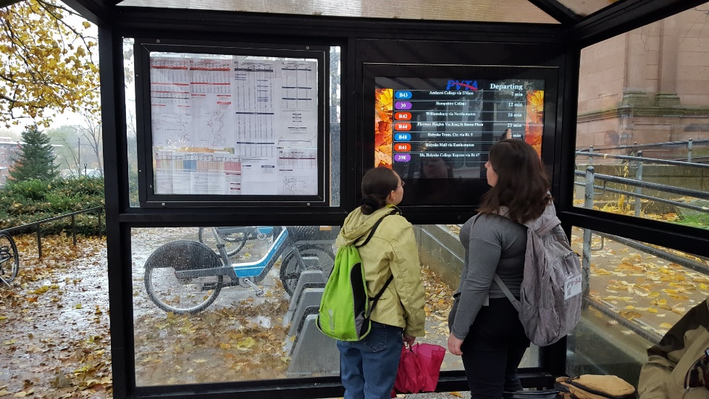
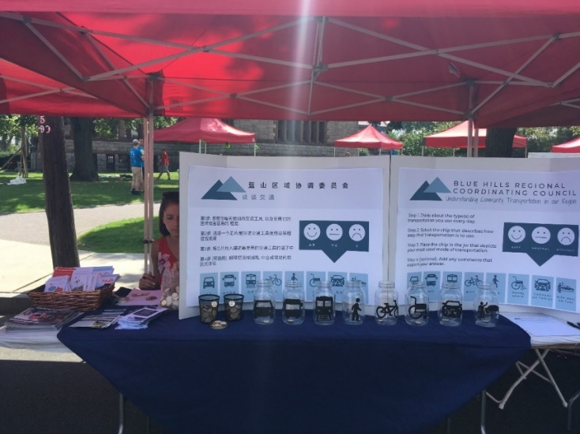
Mobility Management Project Examples
Travel training (salaries and materials)
Managing mobility option/resources
Short range planning and technology

Slide 50
Additional Funding Resources
National Center for Mobility Management
https://nationalcenterformobilitymanagement.org/external-grants/
Other Funding Opportunities
www.mass.gov/info-details/funding-for-community-transportation

Slide 51
Where do we go from here?

Slide 52
Coming soon…
The MBTA plans to incorporate Mobility Management into their new Mobility Center (coming July 2022)
Sign up to learn more: www.tinyurl.com/MBTA-MobilityCenter

Slide 53
Continue the conversation!
Massachusetts-based attendees are invited to sign up for an informal discussion on mobility management:
February 10, 1pm
February 11, 10am
February 17, 2pm
Connect with local partners through your Regional Coordinating Council
www.mass.gov/info-details/regional-coordinating-councils-for-community-transportation

Slide 54
Keep in touch!
Contact the co-hosts
Jenna Henning, jennifer.n.henning@dot.state.ma.us
Rachel Fichtenbaum, rachel.fichtenbaum@mass.gov
James Fuccione, james.fuccione@mahealthyaging.org
Contact the presenters
Sherry Elander, s.elander@schoolsofwestfield.org
Ruth Lindsay, ruth.lindsay@seniorcareinc.org
Maria Foster, mfoster@brooklinema.gov
Angie Constantino, aconstantino@gatra.org
Judy Shanley, jshanley@easterseals.com

Slide 55
Thank you!
Evaluate today’s forum
www.surveymonkey.com/r/MM-MA-eval
Thank you for everything you are doing to expand mobility in Massachusetts!

