Slide 1

Model Curriculum Units in Literacy and Humanities
2012 Curriculum Summit
November 13 and 14, 2012
Sarah Churchill Silberman and Judi Allen
Strengthening curriculum, instruction, and assessment

Slide 2
Research
Strong skills in English, mathematics, technology, and science, as well as literature, history, and the arts will be essential for many; beyond this, candidates will have to be comfortable with ideas and abstractions, good at both analysis and synthesis, creative and innovative, self-disciplined and well-organized, able to learn very quickly and work well as a member of a team and have the flexibility to adapt to frequent changes in the labor market as the shifts in the economy become ever faster and more dramatic. (NCEE,2007 p. xix)

Slide 3
Model Curriculum Units
Race to the Top initiative for ESE, which has previously concentrated on standards and assessments, not curriculum materials
100 PK-12 units in ELA/literacy, mathematics, science, and social studies by 2014
Exemplify the shifts in the 2011 Frameworks
Understanding By Design model with lesson plans and print/digital media resources
WGBH documenting the process

Slide 4
Model Units
The model units will provide districts and teachers with high quality and rigorous units they can choose to teach and/or use to advance their own curriculum development efforts. Part of the Teaching and Learning System (EDWIN)

Slide 5
Unit Components
Unit Plan (UbD Template)
Table of Contents
Lesson Plans (including lesson sequence)
Lesson Resources
CEPA – Curriculum Embedded Performance Assessment
CEPA Resources

Slide 6
Small Group Discussion
On a scale of 1-10 where does your district fall in terms of making the instructional shift to meet new standards?
Is your district/school developing units to align with the new MA Curriculum Frameworks?
What is your district’s criteria for these aligned units?
How do you know if the units will shift instruction?

Slide 7
Report Back

Slide 8
Understanding by Design
Stage 1 Desired Results
Goals
Transfer Goals
Understandings- Big Ideas
Essential Questions
Knowledge & Skills
Stage 2 Evidence
Performance Tasks
Formative Assessments
Stage 3 Learning Plan
Outline of learning experiences from which the lesson plans are developed

Slide 9
Understanding by Design

Slide 10
Instructional Shifts in ELA/Literacy
Building knowledge through content-rich nonfiction
Reading, writing, and speaking grounded in evidence from text, both literary and informational
Regular practice with complex text and academic language

Slide 11
Small Group Discussion
As you read Stages 1 and 2 of the unit, can you identify the shifts represented?

Slide 12
Report Back

Slide 13
Small Groups Discussion
Read Stage 3 and review the Lesson Plans. Think about where your teachers are in terms of instructional shifts:
If presented with this unit could the teachers in your district/school pick it up and teach it?
What professional development would they need to teach one of these model units?
Does this unit fit into your curriculum map?
Is there a purposeful place to use this unit as part of your larger instructional plan?

Slide 14
Report Back

Slide 15
One District’s Perspective
Process for Malden Public Schools
How they use the MCUs – create their own units
Supporting teachers with implementation
How have the MCUs helped Malden grow?

Slide 16
One District’s Perspective
The Malden Public Schools process:
5 Social Studies teachers (core group) participated in the DESE Model Curriculum
Core group shared their knowledge and model units with colleagues
http://historymalden.wikispaces.com/Understanding+by+Design
Professional Development was dedicated for teachers to collaboratively design units
Model units and process shared on-line
Implementation of model units & collection of student work to assess & revise units

Slide 17
One District’s Perspective
MCU’s have expanded Malden’s ability to change instruction to meet the new and different expectations in the 2011 standards.
Created space in the HSS curriculum for on going project-based work by identifying “big ideas”
Connected to new teacher evaluation tool
Expectations rigorous and transparent to all
http://historymalden.wikispaces.com/Curriculum+Map+USI

Slide 18
Quality Review Rubrics
The Tri-State Rubric was developed by MA, NY, and RI Educational Leaders to evaluate the quality of lessons and units intended to address the Common Core State Standards for ELA/Literacy and Mathematics.
Criterion-based rubrics in ELA & Mathematics
HSS and Science Content Leads have created rubrics for their respective content areas similar to the Tri-State Rubrics for ELA and Math.

Slide 19
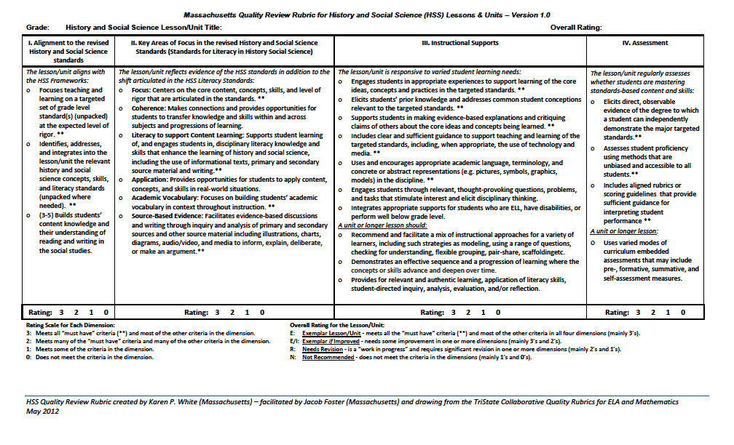
Quality Review Rubric for History and Social Science

Slide 20
In Small Groups Discuss the Quality Review Rubric
Through the lens of one of the four domains:
Review the unit
Make note of how the unit meets the criteria of that domain
Identify places within the unit that can easily be differentiated
Use the domain to measure the quality of the unit

Slide 21
MCU Tryouts
We released 29 Model Curriculum Units to districts who have been involved with the Model Curriculum Project.
Six more Model Curriculum Units will be released later this fall.
All RTTT districts may try out any released units

Slide 22
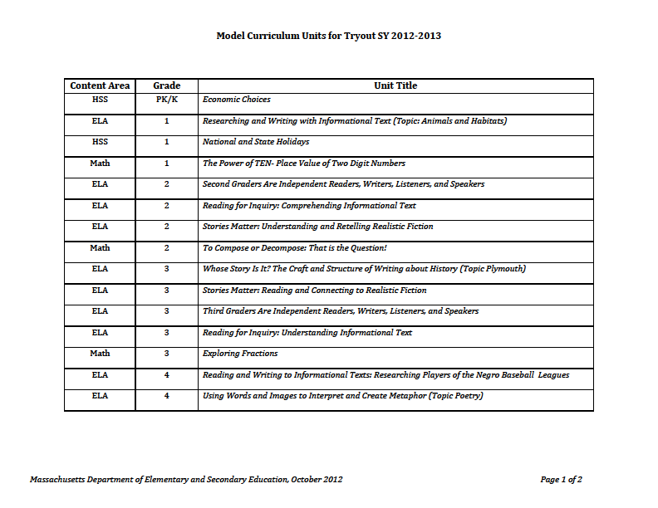
Tryout Units

Slide 23
Where to go from here?
Tryout Best Practices:
Teach the unit
Gather comments and student work
Feedback meeting
Consolidate feedback and make revisions
Release time stipend?
Update curriculum map

Slide 24
The Team
Julia Phelps
Anne Marie Condike
Sarah Churchill Silberman
schurchill@doe.mass.edu
Karen White
Jacob Foster
Susan Wheltle
Barbara Libby
Staff in the Center of Curriculum and
Instruction and Student Assessment Office

Slide 25


QUESTIONS?

